Slide 1
Computational Photography: Cameras + Optics
Connelly Barnes

Slide 2
Cameras + Optics
Today:
Camera obscura / pinhole camera
Cameras with lenses
Modeling camera projections

Slide 3
Art around UVA
Fralin Art Museum
Kluge-Ruhe Aboriginal Art Museum
McGuffey Art Center
Second Street Gallery

Slide 4
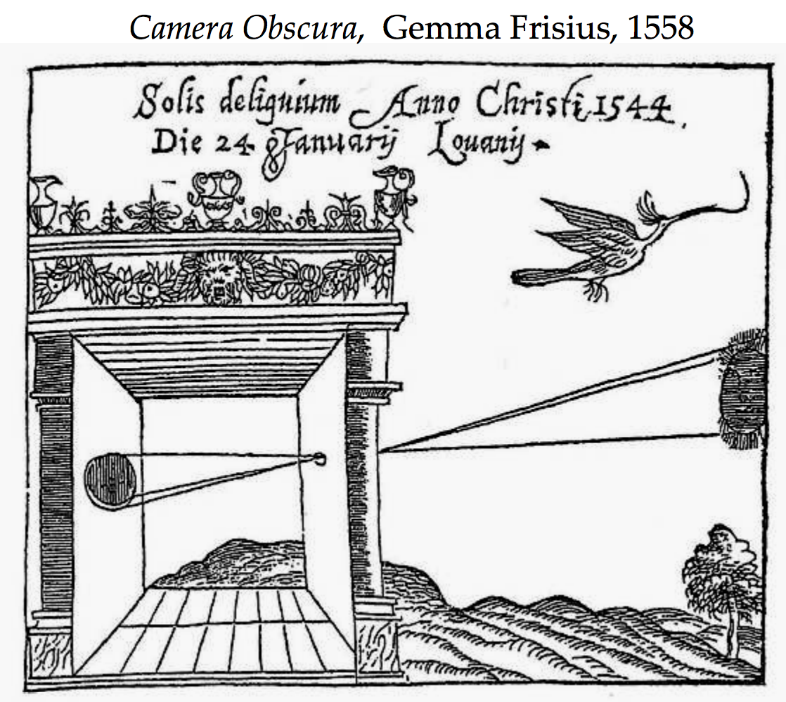
Camera Obscura
[Slide content from Efros]
Camera is Latin for chamber/room, obscura means dark

Slide 5
Camera Obscura
[Image from Efros]
Used by Euclid (300 B.C.) to show light travels in straight rays

Slide 6
Pinhole Camera
Illustration by Steve Seitz
- Blurry image results if all rays reach film

Slide 7
Pinhole Camera
Center of Projection
Illustration by Steve Seitz
- Pinhole camera has small aperture size.
- All objects are in focus – depth of field infinite

Slide 8
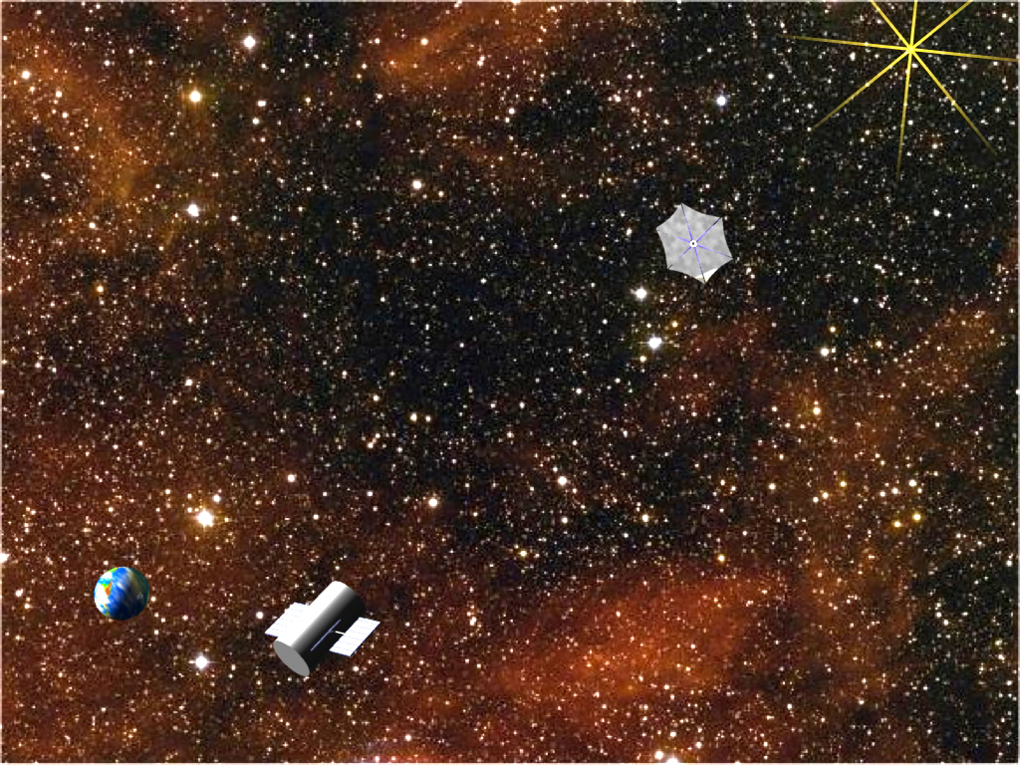
New Worlds Mission (NASA)

Slide 9
Pinhole Camera
Screen
Object
h_{o}
d_{i}
d_{o}
h_{i}
Image
h_{i}
d_{i}
=
Similar triangles gives optics law:
h_{o}
d_{o}

Slide 10
Pinhole Camera
h_{o}
d_{i}
d_{o}
h_{i}
1
Fix object size and imaging plane distance:
h_{i}
∝
d_{o}

Slide 11
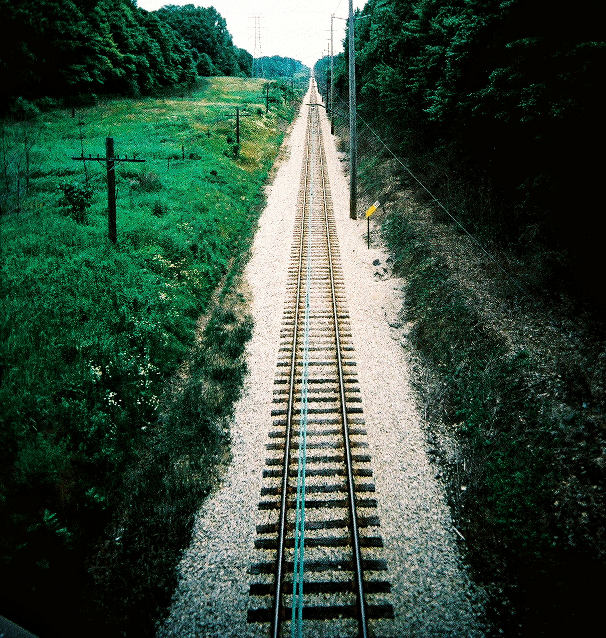
Perspective

Slide 12
Human Visual System
The human brain attempts to invert the 3D => 2D projective mapping.
Müller-Lyer Illusion

Slide 13
Limitations of Pinhole Camera
Pros:
Hard to detect (surveillance)
Infinite depth of field
Cons:
Not much light => higher noise
Diffraction for small aperture size

Slide 14
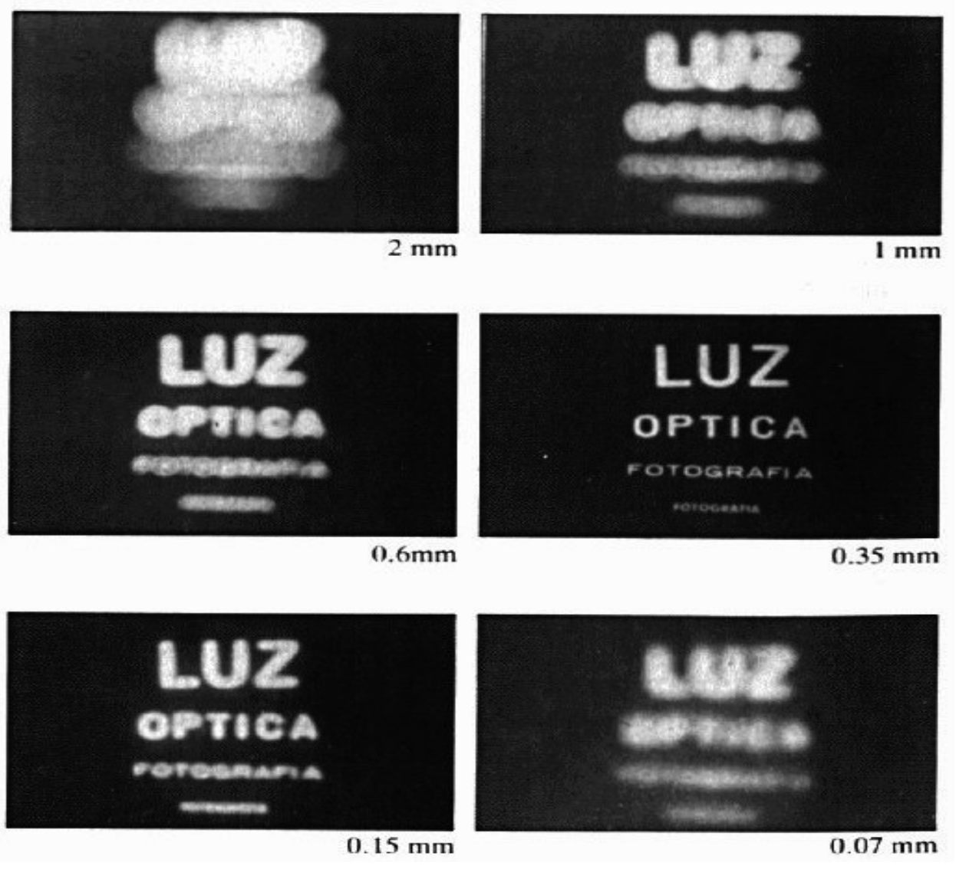
Limitations of Pinhole Camera

Slide 15
Lenses
Focal Length
f
Object
Focal Point
d_{o}
d_{i}
Image
Let in more light!

Slide 16
Lenses
f
d_{o}
d_{i}
1
1
1
=
+
Thin lens equation:
f
d_{o}
d_{i}

Slide 17
Focal Length
f
d_{o}
d_{i}
- Reported in mm, e.g. 50 mm lens.
- For zoom lenses, a range, e.g. 18-55 mm.

Slide 18
Angle of View (Field of View)
Focal Point
α
Sensor Dimension d
Focal length f
α = 2 tan⁻¹ [d/(2f)] ≈ d / f (radians)

Slide 19
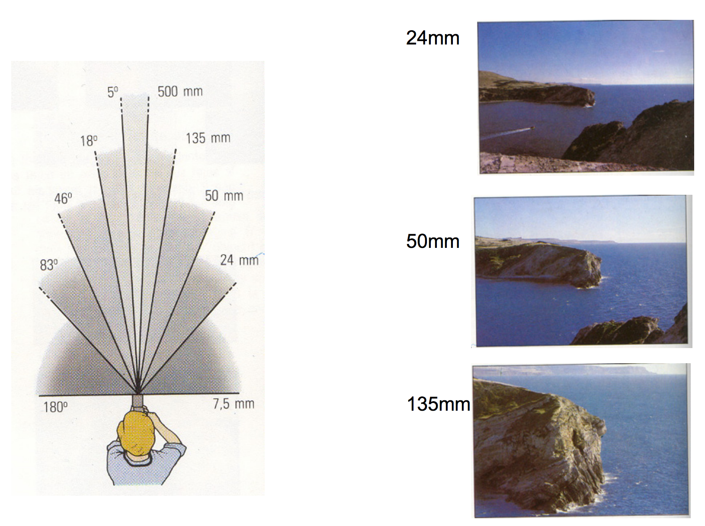
Angle of View (Field of View)
[Slide content from Fredo Durand]

Slide 20
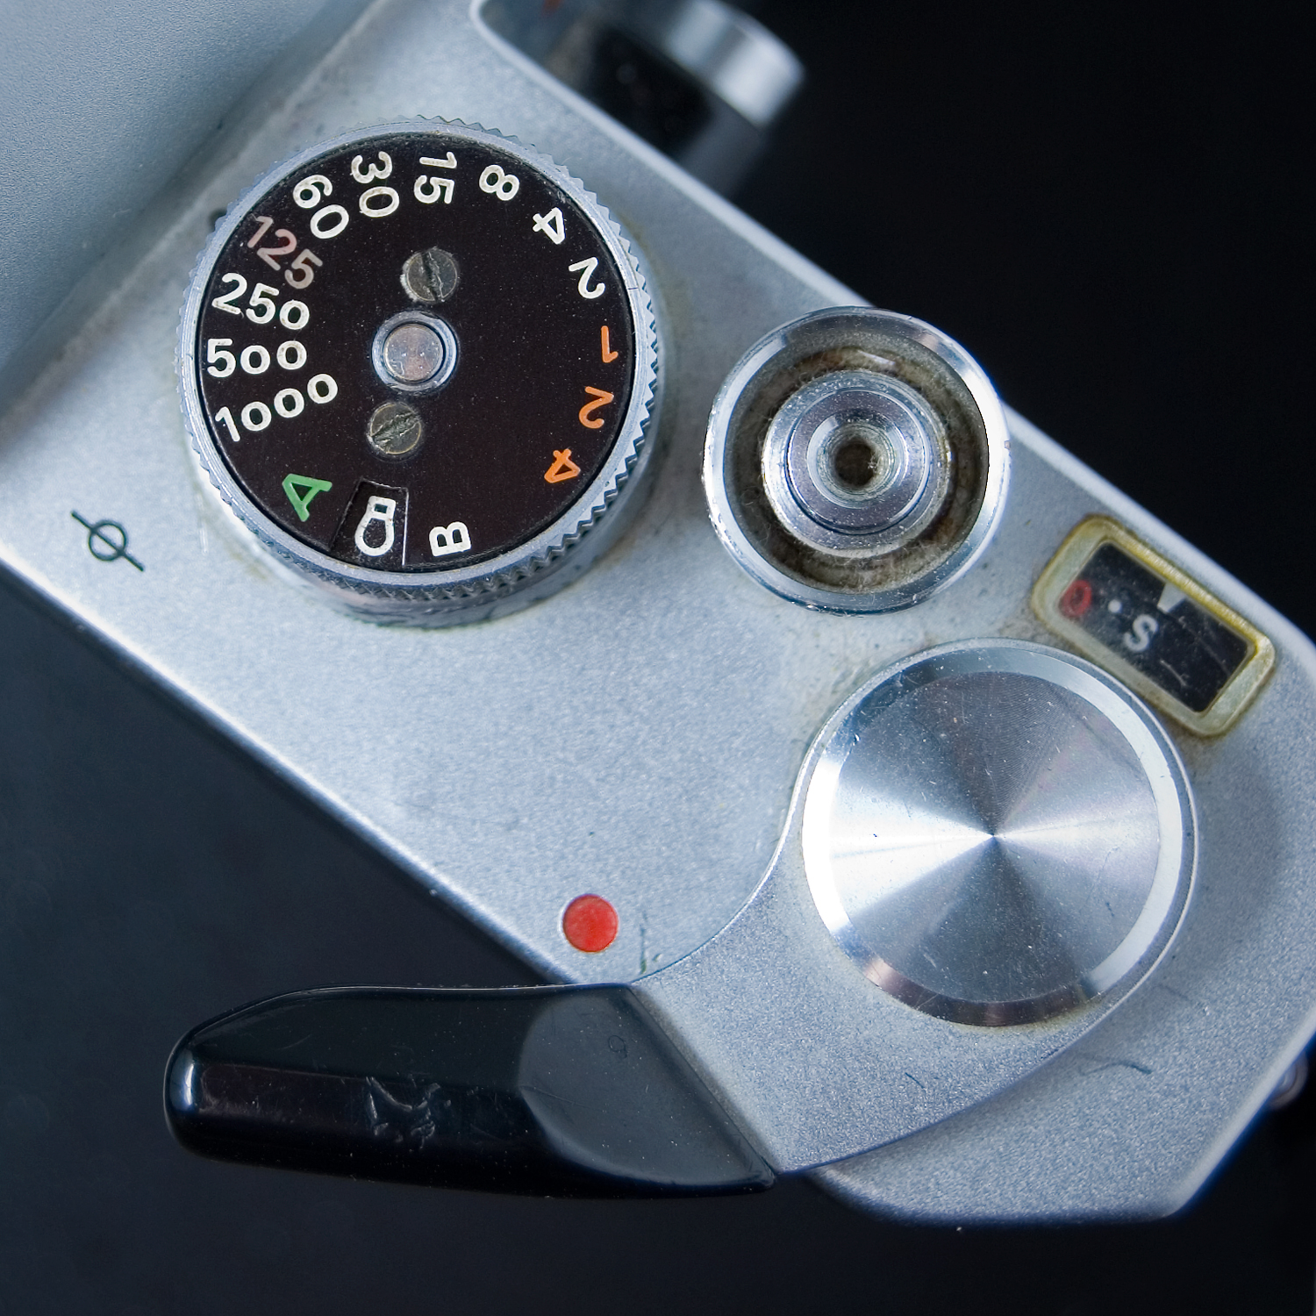
Shutter Speed
Expressed in fractions of a second, e.g. 1/100 sec
If shutter is open longer, integrates across time
If shutter open too short, can cause noise

Slide 21
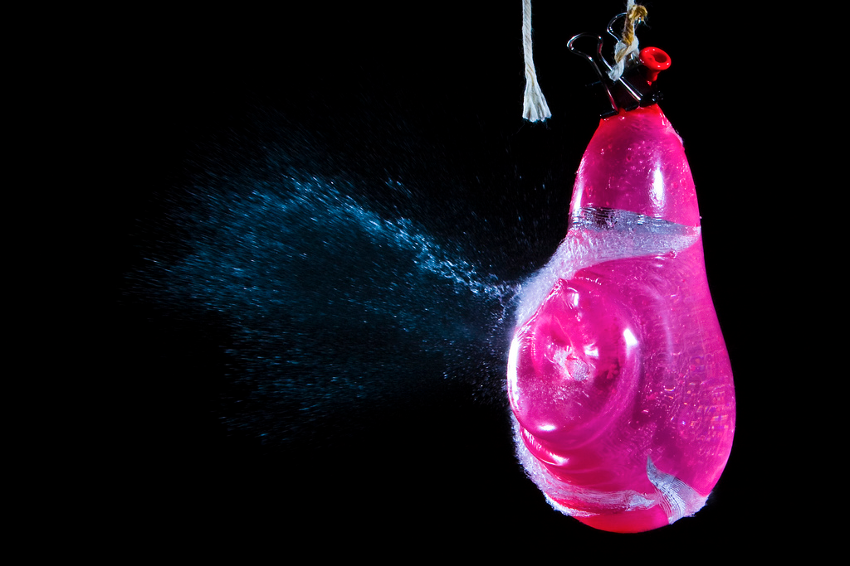
High Shutter Speed
[Photo by Terence Tam]

Slide 22
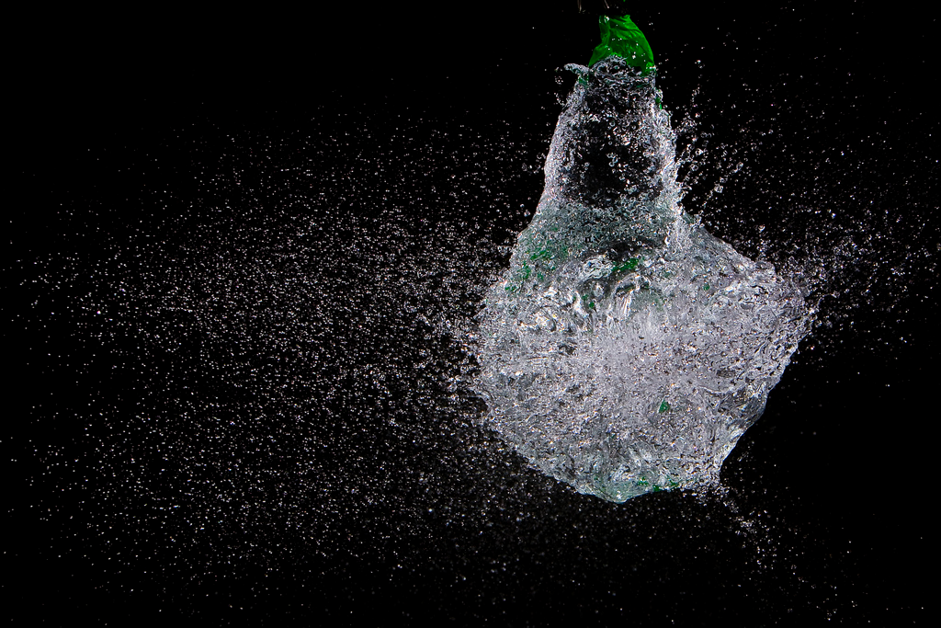
High Shutter Speed
[Photo by Terence Tam]

Slide 23
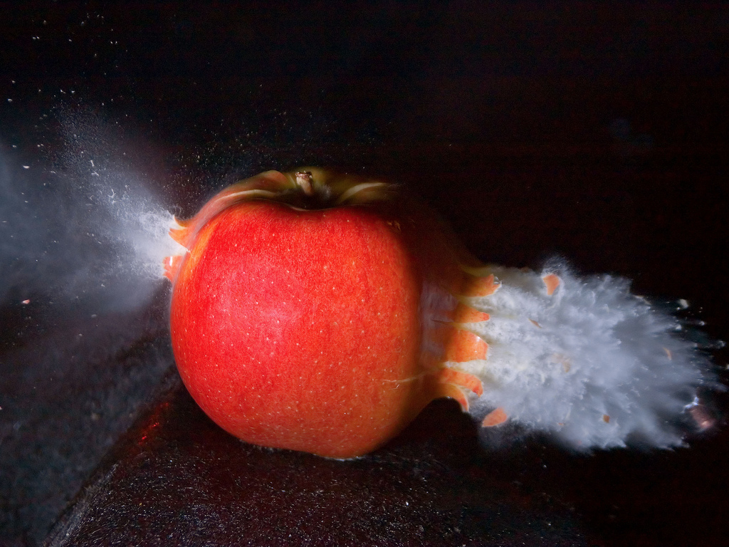
High Shutter Speed
[Photo by Jasper Nance]

Slide 24
Very High Shutter Speed
Trillion FPS Camera

Slide 25
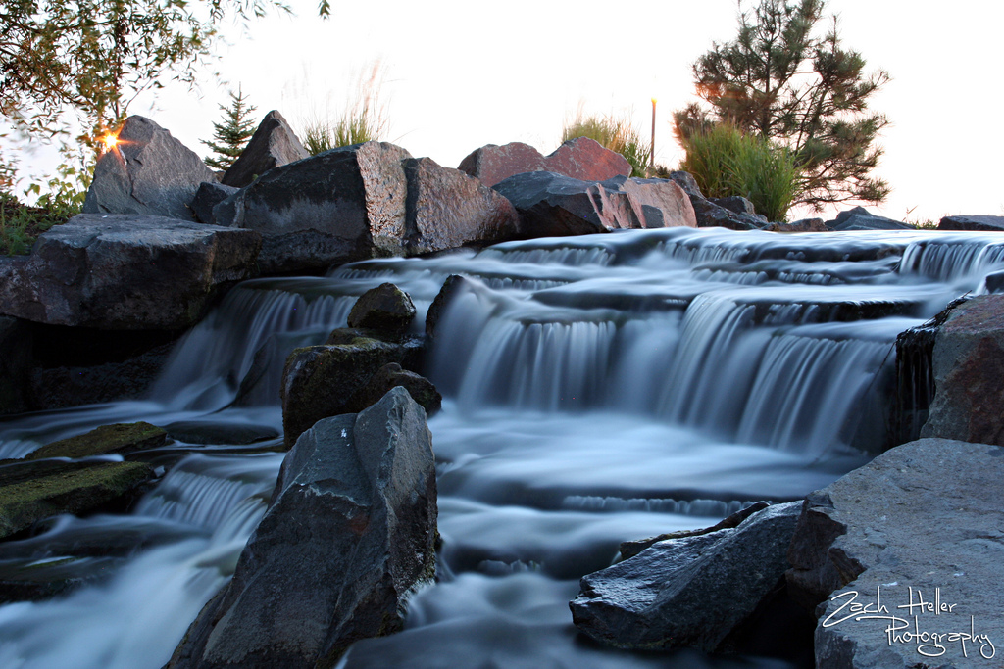
Low Shutter Speed
[Photo by Zach Heller]

Slide 26
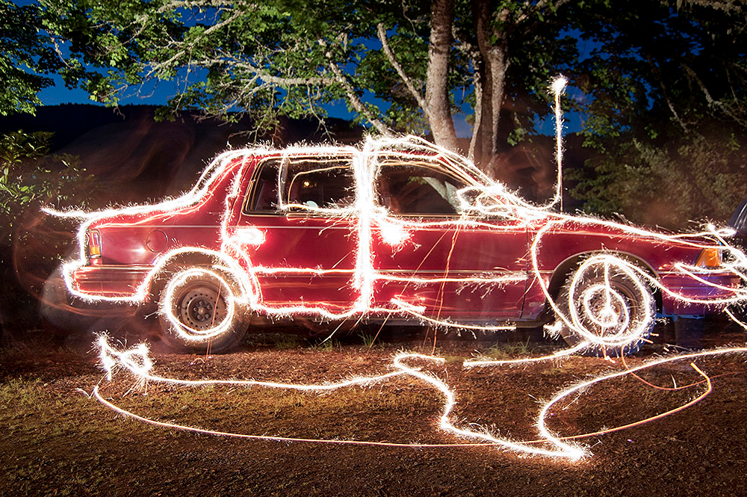
Low Shutter Speed
[Photo by Evan ‘thevlue’]

Slide 27
Low Shutter Speed
Star Trails

Slide 28
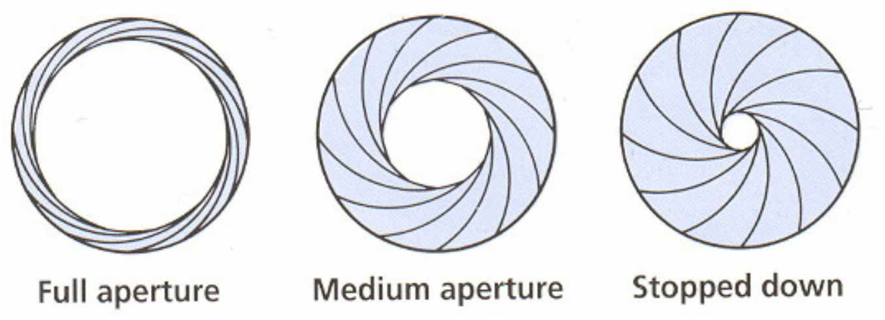
Aperture
[Slide content from Fredo Durand]
- Trades off more/less light.
- Controls depth of field

Slide 29
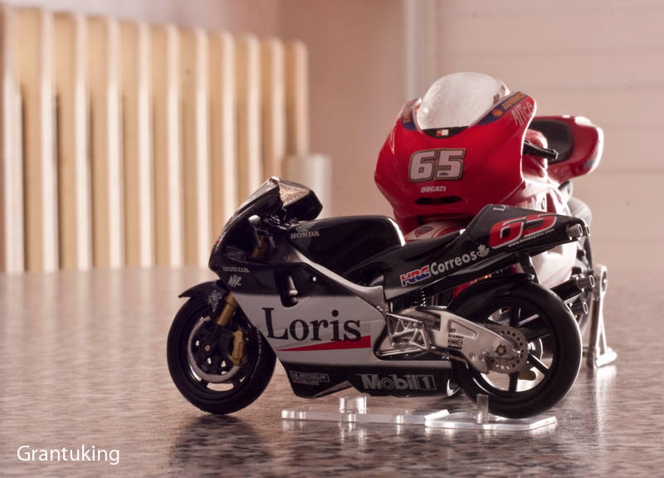
Depth of Field
[mmphotography.it]

Slide 30
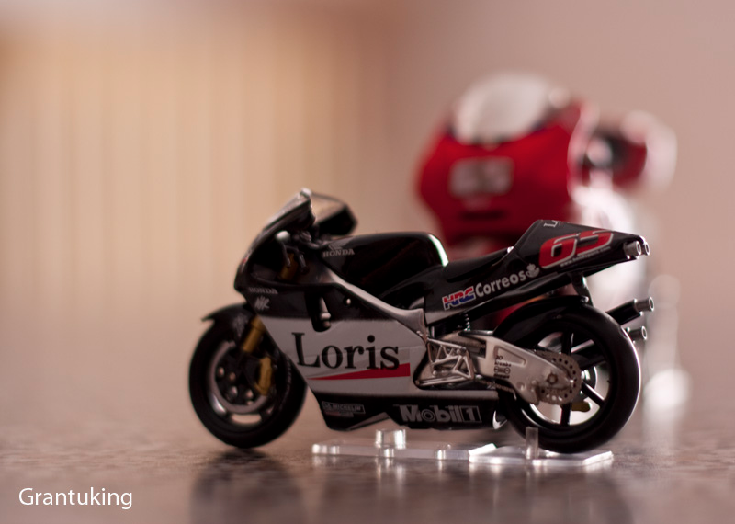
Depth of Field
[mmphotography.it]

Slide 31
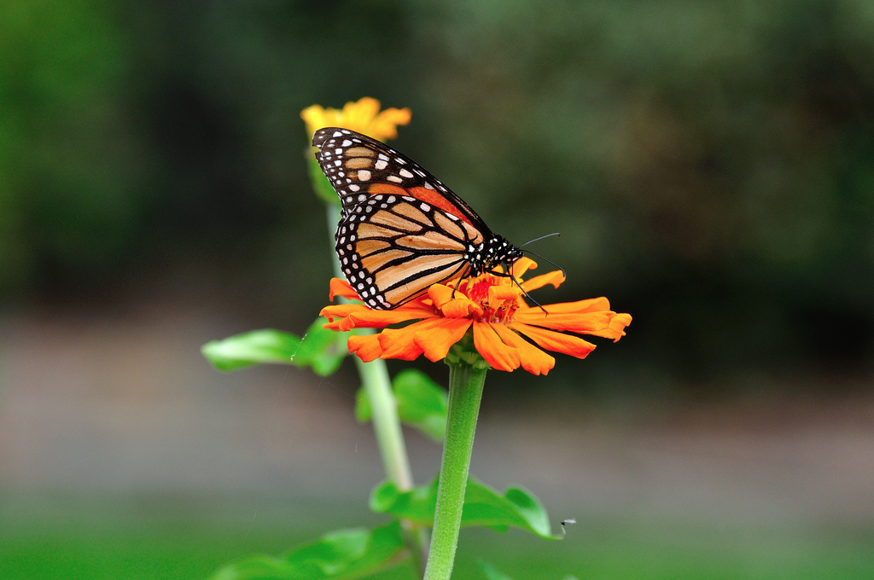
Depth of Field
[Photo by Neil Halin]

Slide 32
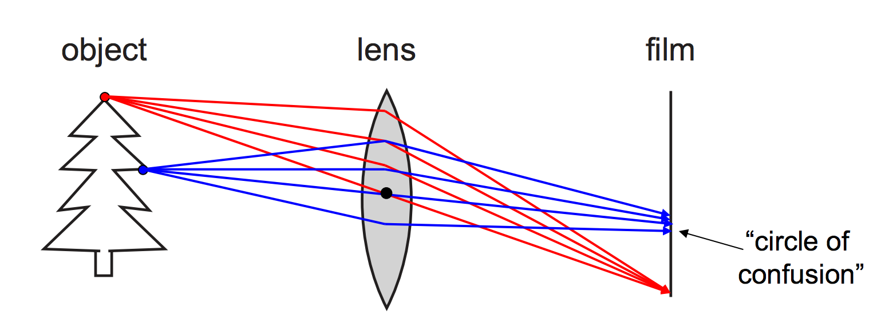
Aperture
Aperture controls depth of field
Illustration by Steve Seitz
- Only one depth where objects are exactly in focus
- Other depths project to a circle on the film

Slide 33
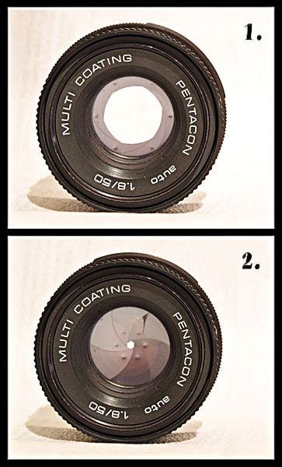
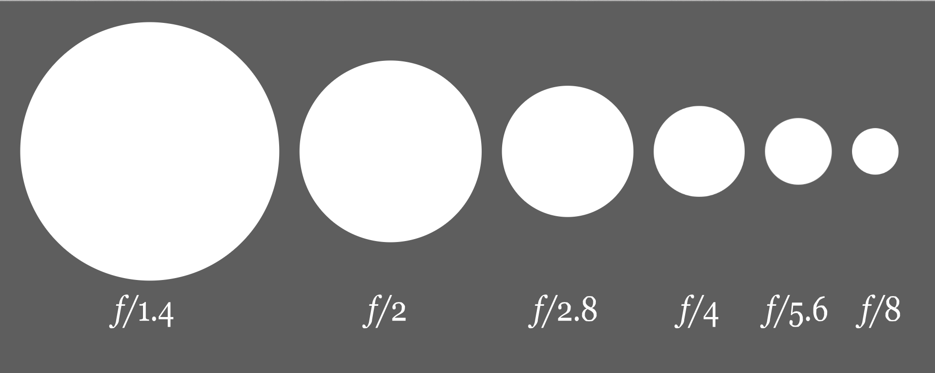
How to Adjust Focus?
Aperture controls depth of field
Denoted in f number (“f-stop”)

Slide 34
ISO
Analog gain factor
Normally 200-1600
Each time you double ISO the camera only needs half as much light
But, photon and sensor noise increases

Slide 35
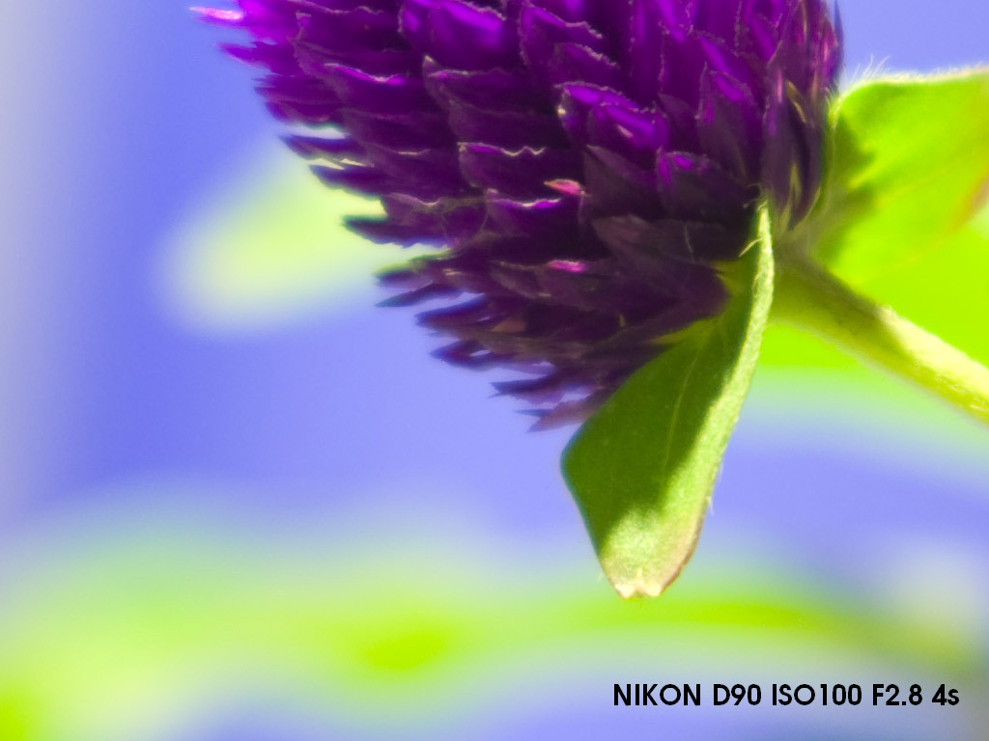
ISO
[Photo by FedEx]

Slide 36
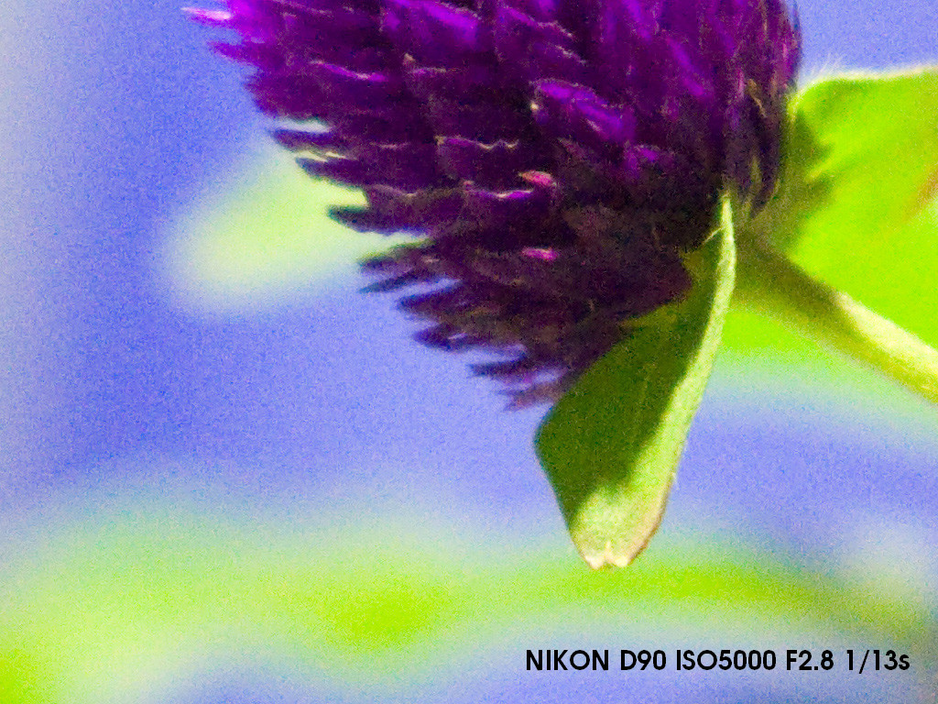
ISO
[Photo by FedEx]

Slide 37
How to Control Exposure
Trade off aperture, shutter speed, ISO to get desired exposure
Want signal to not overflow (overexposed)
Typically do not want noise
Use tripod!

Slide 38
How to Control Exposure
Aperture size decreased => less light let in.
What if we want more light?
Can keep shutter open longer.
For pro cameras:
Aperture priority – you set aperture, camera sets shutter speed
Shutter priority – you set shutter speed, camera sets aperture.

Slide 39
How to Adjust Focus?
Lytro

Slide 44
Homogeneous Coordinates
Used in graphics/vision when transforming geometry prior to projection on the screen.
e.g. to translate (T), scale (S), rotate (R), then perspective project (P) a point p:
q = PRSTp
PRST 4x4 matrices, pq 4x1 vectors

Slide 45
Homogeneous Coordinates
Transformation matrices found in OpenGL documentation:
glTranslate
glScale
glRotate
Derivation of Rotation Matrices in R3
Can look at some of these on the board

Slide 46
Conclusion
Discussed:
Camera obscura / pinhole camera
Cameras with lenses
Modeling camera projections
I should:
Get us DSLR and Lytro cameras to play with
Post the first assignment

