Slide 1
Computational
Photography:
Sampling + Reconstruction
Connelly Barnes
Slides from Alexei Efros and Steve Marschner

Slide 2
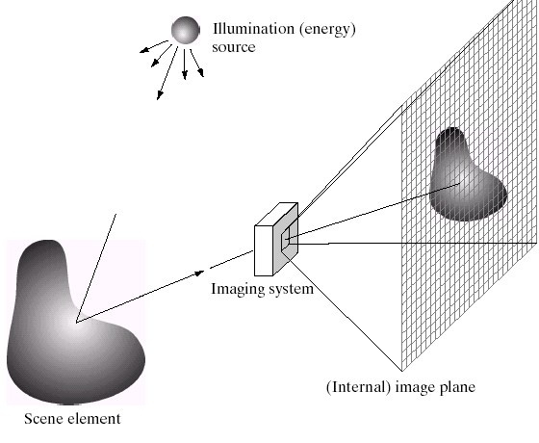
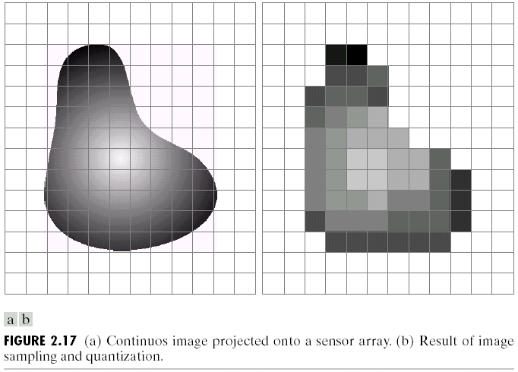
Sampling and Reconstruction

Slide 3
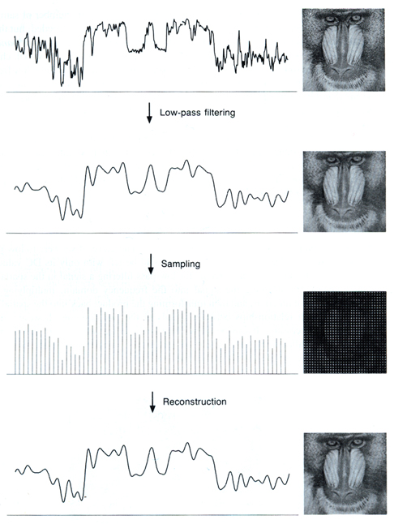
Sampled representations
How to store and compute with continuous functions?
Common scheme for representation: samples
  write down the function’s values at many points
[FvDFH fig.14.14b / Wolberg]

Slide 4
Reconstruction
Making samples back into a continuous function
  for output (need realizable method)
  for analysis or processing (need math method)
  amounts to “guessing” what the function did in between
[FvDFH fig.14.14b / Wolberg]

Slide 5
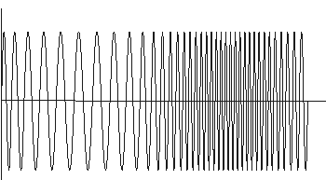
1D Example: Audio
low
high
frequencies

Slide 6
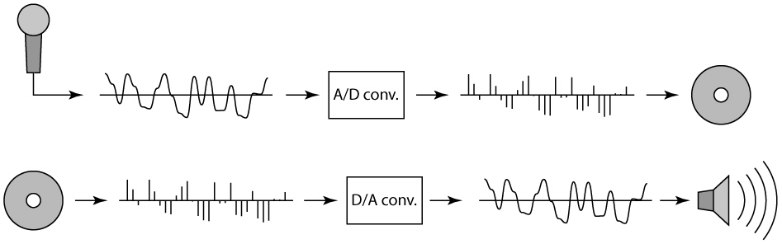
Sampling in digital audio
Recording: sound to analog to samples to disc
Playback: disc to samples to analog to sound again
  how can we be sure we are filling in the gaps correctly?

Slide 7
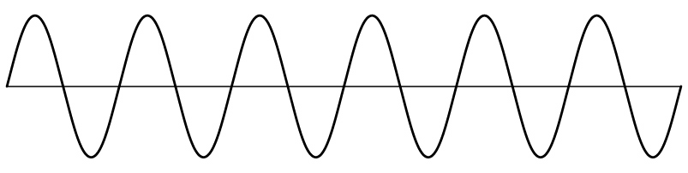
Sampling and Reconstruction
Simple example: a sine wave

Slide 8
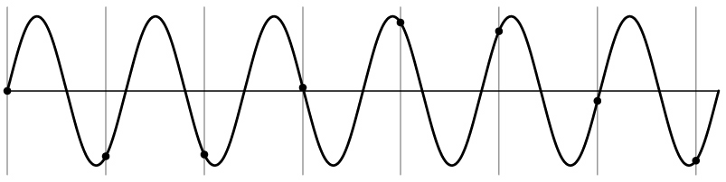
Undersampling
What if we “missed” things between the samples?
Simple example: undersampling a sine wave
  unsurprising result: information is lost

Slide 9
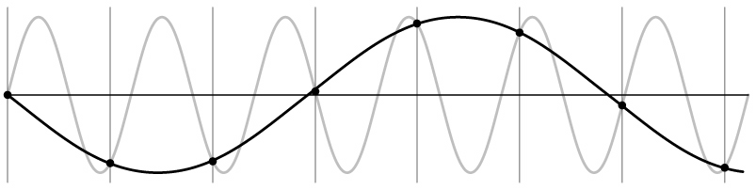
Undersampling
What if we “missed” things between the samples?
Simple example: undersampling a sine wave
  unsurprising result: information is lost
  surprising result: indistinguishable from lower frequency

Slide 10
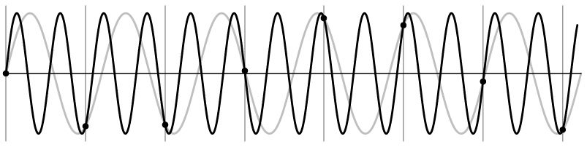
Undersampling
What if we “missed” things between the samples?
Simple example: undersampling a sine wave
  unsurprising result: information is lost
  surprising result: indistinguishable from lower frequency
  also was always indistinguishable from higher frequencies
  aliasing: signals “traveling in disguise” as other frequencies

Slide 11
Aliasing Examples
Airplane Propeller Video

Slide 12
Aliasing Examples
Time-lapse Watches Video

Slide 13
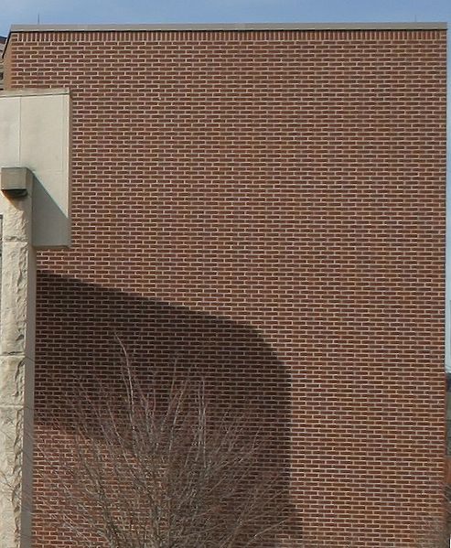
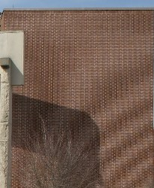
Aliasing
Properly sampled image
Moiré pattern (spatial aliasing)

Slide 14
Moiré Patterns
Moiré Patterns

Slide 15
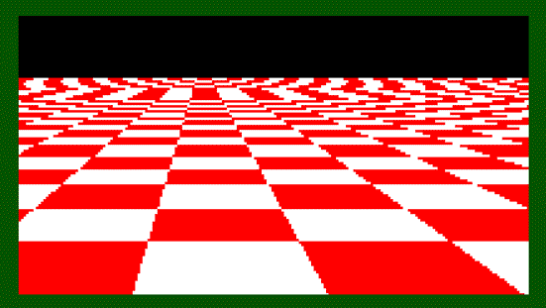
Aliasing in images

Slide 16
Antialiasing
What can we do about aliasing?
Sample more often
  Join the Megapixel craze of the photo industry
  But that only shifts the problem to higher frequencies
Blur / lowpass filter
  Get rid of some high frequencies
  Will lose information
  But better than aliasing

Slide 17
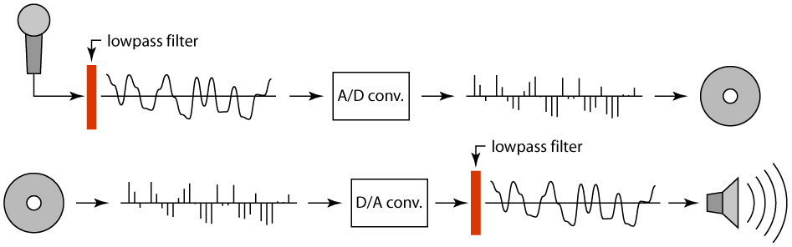
Preventing aliasing
Introduce lowpass filters:
  remove high frequencies leaving only safe, low frequencies
  choose lowest frequency in reconstruction (disambiguate)

Slide 18
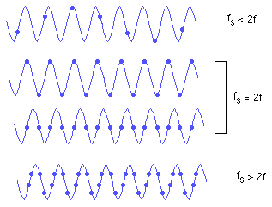
Nyquist-Shannon Sampling Theorem
A signal containing no frequencies higher than f
can be reconstructed exactly by sampling at > 2f.

Slide 19
Linear filtering: a key idea
Transformations on signals; e.g.:
  bass/treble controls on stereo
  blurring/sharpening operations in image editing
  smoothing/noise reduction in tracking
Key properties
  linearity: filter(f + g) = filter(f) + filter(g)
  shift invariance: behavior invariant to shifting the input
    delaying an audio signal
    sliding an image around
Can be modeled mathematically by convolution

Slide 20
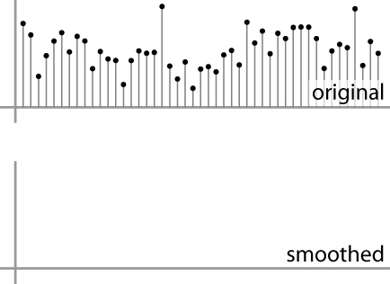
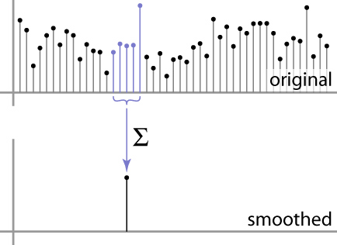
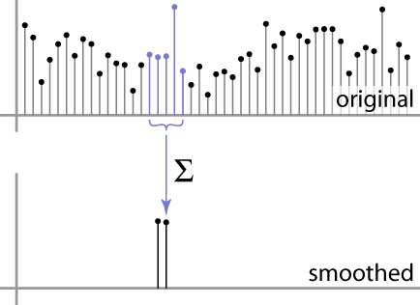
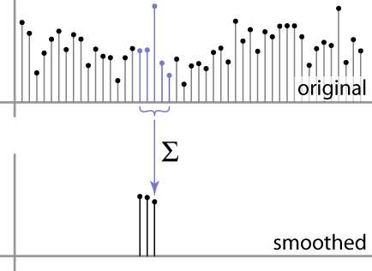
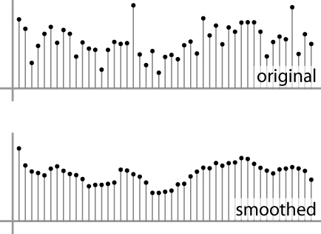
Moving Average
basic idea: define a new function by averaging over a sliding window
a simple example to start off: smoothing

Slide 21
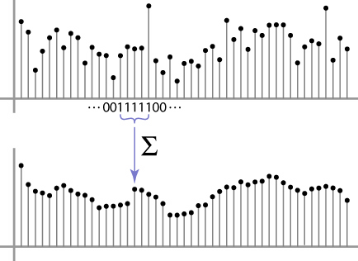
Weighted Moving Average
Can add weights to our moving average
Weights […, 0, 1, 1, 1, 1, 1, 0, …] / 5

Slide 22

Weighted Moving Average
bell curve (gaussian-like) weights […, 1, 4, 6, 4, 1, …]

Slide 23


Moving Average In 2D
What are the weights H?
0 | 0 | 0 | 0 | 0 | 0 | 0 | 0 | 0 | 0
0 | 0 | 0 | 0 | 0 | 0 | 0 | 0 | 0 | 0
0 | 0 | 0 | 90 | 90 | 90 | 90 | 90 | 0 | 0
0 | 0 | 0 | 90 | 90 | 90 | 90 | 90 | 0 | 0
0 | 0 | 0 | 90 | 90 | 90 | 90 | 90 | 0 | 0
0 | 0 | 0 | 90 | 0 | 90 | 90 | 90 | 0 | 0
0 | 0 | 0 | 90 | 90 | 90 | 90 | 90 | 0 | 0
0 | 0 | 0 | 0 | 0 | 0 | 0 | 0 | 0 | 0
0 | 0 | 90 | 0 | 0 | 0 | 0 | 0 | 0 | 0
0 | 0 | 0 | 0 | 0 | 0 | 0 | 0 | 0 | 0
Slide by Steve Seitz
Notes:
ones, divide by 9

Slide 24
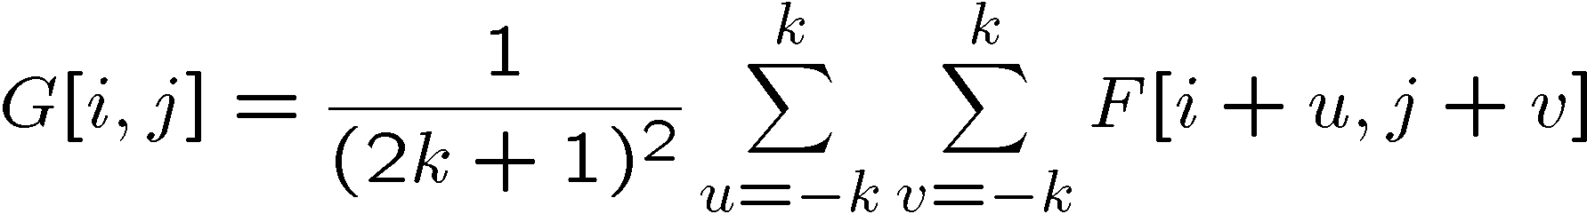
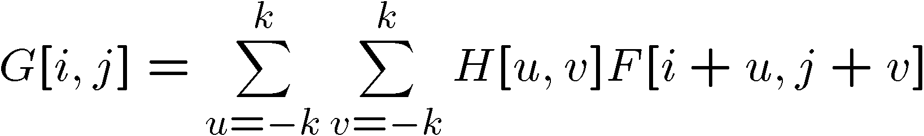

Cross-correlation filtering
Let’s write this down as an equation. Assume the averaging window is (2k+1)x(2k+1):
We can generalize this idea by allowing different weights for different neighboring pixels:
This is called a cross-correlation operation and
written:
H is called the “filter” or “kernel.”
Slide by Steve Seitz

Slide 25
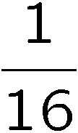
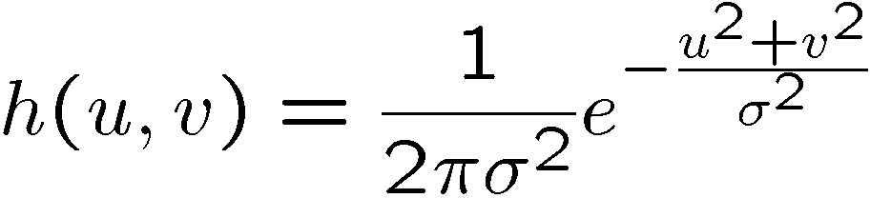
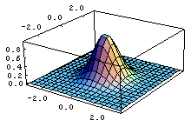
Gaussian filtering
A Gaussian kernel gives less weight to pixels further from the center of the window
0 | 0 | 0 | 0 | 0 | 0 | 0 | 0 | 0 | 0
0 | 0 | 0 | 0 | 0 | 0 | 0 | 0 | 0 | 0
0 | 0 | 0 | 90 | 90 | 90 | 90 | 90 | 0 | 0
0 | 0 | 0 | 90 | 90 | 90 | 90 | 90 | 0 | 0
0 | 0 | 0 | 90 | 90 | 90 | 90 | 90 | 0 | 0
0 | 0 | 0 | 90 | 0 | 90 | 90 | 90 | 0 | 0
0 | 0 | 0 | 90 | 90 | 90 | 90 | 90 | 0 | 0
0 | 0 | 0 | 0 | 0 | 0 | 0 | 0 | 0 | 0
0 | 0 | 90 | 0 | 0 | 0 | 0 | 0 | 0 | 0
0 | 0 | 0 | 0 | 0 | 0 | 0 | 0 | 0 | 0
1 | 2 | 1
2 | 4 | 2
1 | 2 | 1
Slide by Steve Seitz

Slide 26
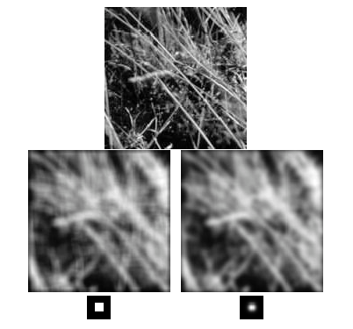
Box Filter vs. Gaussian Filter
Slide by Steve Seitz

Slide 27
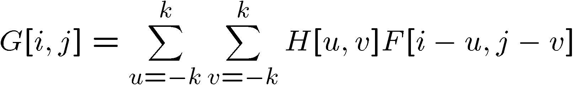

Convolution
Cross-correlation:
Convolution is similar to cross-correlation, but the filter is flipped horizontally and vertically before being applied:
It is written:
Suppose H is a Gaussian or mean kernel. How does convolution differ from cross-correlation?
Slide by Steve Seitz

Slide 28






Convolution is nice!
Notation:
Convolution is a multiplication-like operation
  commutative
  associative
  distributes over addition
  scalars factor out
  identity: unit impulse e = […, 0, 0, 1, 0, 0, …]
Conceptually no distinction between filter and signal
Usefulness of associativity
  often apply several filters one after another: (((a * b₁) * b₂) * b₃)
  this is equivalent to applying one filter: a * (b₁ * b₂ * b₃)

Slide 29
Separable Filters
Some kernels K can be written:
K = H ∗ V, H is horizontal, V is vertical
Filter first by H then V (or vice versa)
Why is this useful?

Slide 30
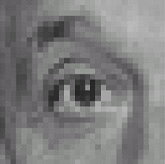
Practice with linear filters
0
0
0
?
0
1
0
0
0
0
Original
Source: D. Lowe
Notes:
30

Slide 31
Practice with linear filters
0
0
0
0
1
0
0
0
0
Original
Filtered
(no change)
Source: D. Lowe
Notes:
31

Slide 32
Practice with linear filters
0
0
0
?
0
0
1
0
0
0
Original
Source: D. Lowe
Notes:
32

Slide 33
Practice with linear filters
0
0
0
0
0
1
0
0
0
Original
Shifted left
By 1 pixel
Source: D. Lowe
Notes:
33

Slide 34
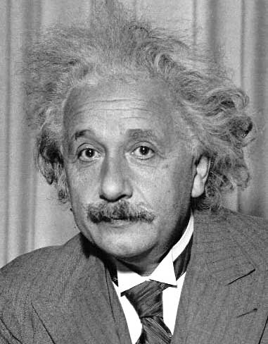
Other filters
?
1
0
-1
2
0
-2
1
0
-1
Sobel
Separable (show on board)

Slide 35
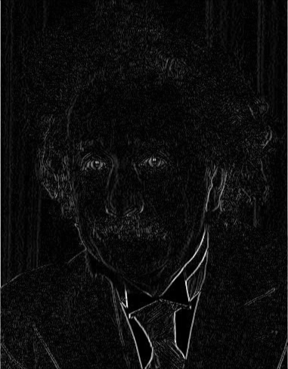
Other filters
1
0
-1
2
0
-2
1
0
-1
Sobel
Vertical Edge
(absolute value)

Slide 36
Other filters
?
1
2
1
0
0
0
-1
-2
-1
Sobel
Separable (show on board)
Notes:
Questions at this point?
36

Slide 37
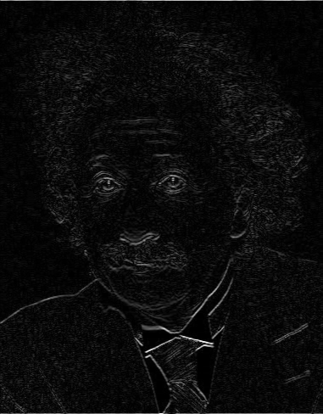
Other filters
1
2
1
0
0
0
-1
-2
-1
Sobel
Horizontal Edge
(absolute value)
Separable (show on board)
Notes:
Questions at this point?
37

Slide 38
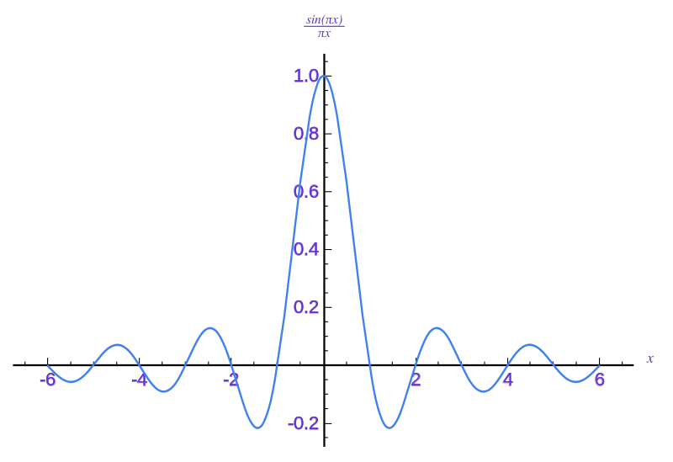
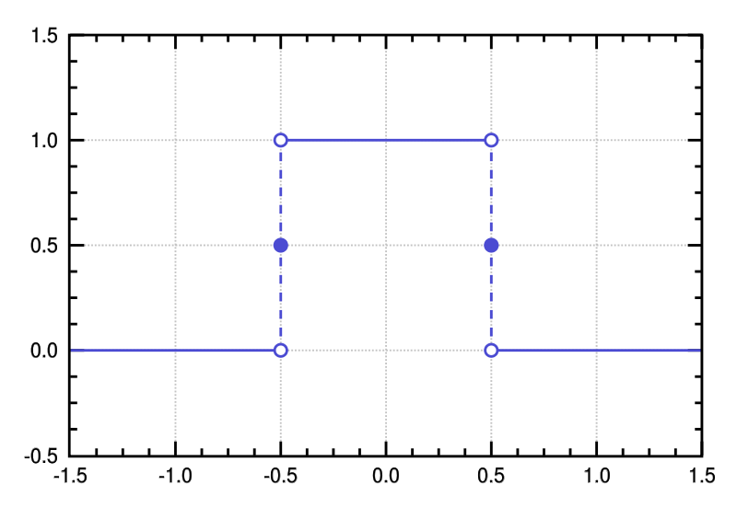
Sinc filter
Spatial Kernel
Frequency Response
Ideal for Nyquist-Shannon: removes high frequencies!
Often a bit higher quality than Gaussian
But can introduce ringing (oscillations) due to sine
Notes:
38
Linear vs. quadratic in mask size

Slide 39
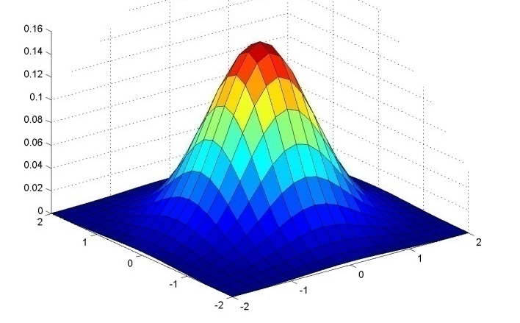
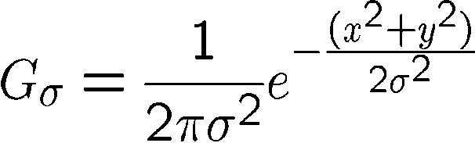
Important filter: Gaussian
Weight contributions of neighboring pixels by nearness
Same shape in spatial and frequency domain
(Fourier transform of Gaussian is Gaussian)
0.003 0.013 0.022 0.013 0.003
0.013 0.059 0.097 0.059 0.013
0.022 0.097 0.159 0.097 0.022
0.013 0.059 0.097 0.059 0.013
0.003 0.013 0.022 0.013 0.003
5 x 5, σ = 1
Slide credit: Christopher Rasmussen
Notes:
39

Slide 40
Gaussian filters
Remove “high-frequency” components from the image (low-pass filter)
  Images become more smooth
Convolution with self is another Gaussian
  So can smooth with small-width kernel, repeat, and get same result as larger-width kernel would have
  Convolving two times with Gaussian kernel of width σ is same as convolving once with kernel of width σ√2
Source: K. Grauman
Notes:
40
Linear vs. quadratic in mask size

Slide 41
Practical matters
How big should the filter be?
Values at edges should be near zero
Rule of thumb for Gaussian: set filter half-width to about 3 σ
Normalize truncated
kernel. Why?
Side by Derek Hoiem
Notes:
41

Slide 42
Size of Output?
MATLAB: conv2(g,f,shape)
Python: scipy.signal.convolve2d(g,f,shape)
  shape = ‘full’: output size is sum of sizes of f and g
  shape = ‘same’: output size is same as f
  shape = ‘valid’: output size is difference of sizes of f, g
full
same
valid
g
g
g
g
f
f
f
g
g
g
g
g
g
g
g
Source: S. Lazebnik
Notes:
42

Slide 43
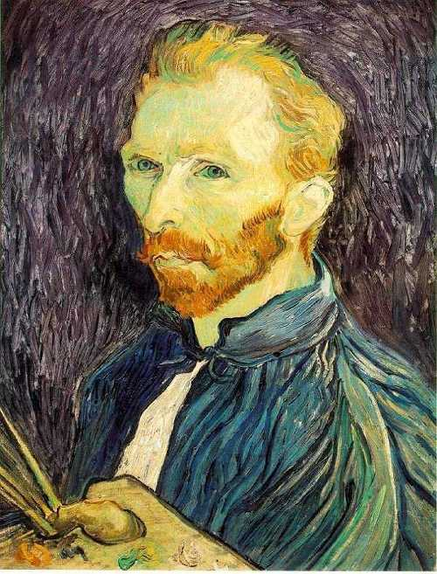
Image half-sizing
This image is too big to
fit on the screen. How
can we reduce it?
How to generate a half-
sized version?

Slide 44

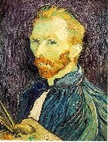

Image sub-sampling
1/8
1/4
Throw away every other row and column to create a 1/2 size image
  - called image sub-sampling
Slide by Steve Seitz

Slide 45
Image sub-sampling
1/2
1/4 (2x zoom)
1/8 (4x zoom)
Aliasing! What do we do?
Slide by Steve Seitz

Slide 46



Gaussian (lowpass) pre-filtering
G 1/8
G 1/4
Gaussian 1/2
Solution: filter the image, then subsample
  Filter size should double for each ½ size reduction. Why?
Slide by Steve Seitz

Slide 47
Subsampling with Gaussian pre-filtering
Gaussian 1/2
G 1/4
G 1/8
Slide by Steve Seitz

Slide 48
Compare with...
1/2
1/4 (2x zoom)
1/8 (4x zoom)
Slide by Steve Seitz

Slide 49
Gaussian (lowpass) pre-filtering
G 1/8
G 1/4
Gaussian 1/2
Solution: filter the image, then subsample
  Filter size should double for each ½ size reduction. Why?
  How can we speed this up?
Slide by Steve Seitz

Slide 50
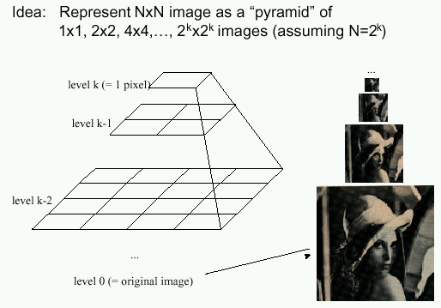
Image Pyramids
Known as a Gaussian Pyramid [Burt and Adelson, 1983]
  In computer graphics, a mip map [Williams, 1983]
  A precursor to wavelet transform
Slide by Steve Seitz

Slide 51
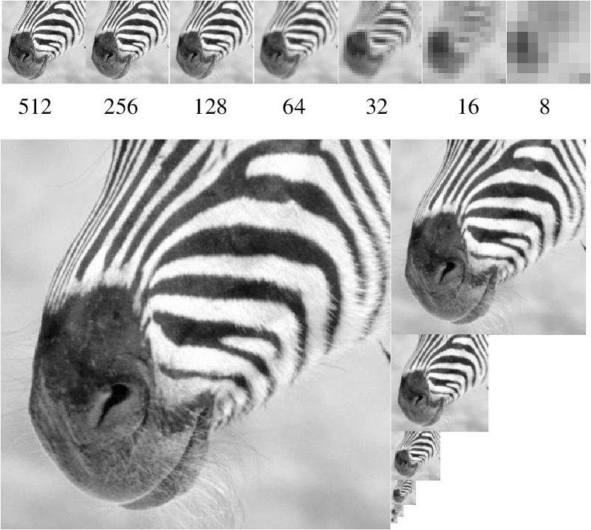
Figure from David Forsyth

Slide 52
What are they good for?
Improve Search
  Search over translations
    Classic coarse-to-fine strategy
  Search over scale
    Template matching
    E.g. find a face at different scales
Pre-computation
  Need to access image at different blur levels
  Useful for texture mapping at different resolutions (called mip-mapping)

Slide 53
Gaussian pyramid construction
filter mask
Repeat
  Filter
  Subsample
Until minimum resolution reached
  can specify desired number of levels (e.g., 3-level pyramid)
Whole pyramid is only 4/3 the size of the original image! (show)
Slide by Steve Seitz

