Slide 1
Computational
Photography:
Color perception, light spectra, contrast
Connelly Barnes

Slide 2
Color Perception, etc
Previously:
  Camera obscura / pinhole camera
  Cameras with lenses
  Modeling camera projections

Slide 3
Color Perception, etc
Today:
  Human / electronic eyes
  Electromagnetic spectrum
  Color spaces
Various slides by Alexei Efros, Fredo Durand, James Hays

Slide 4
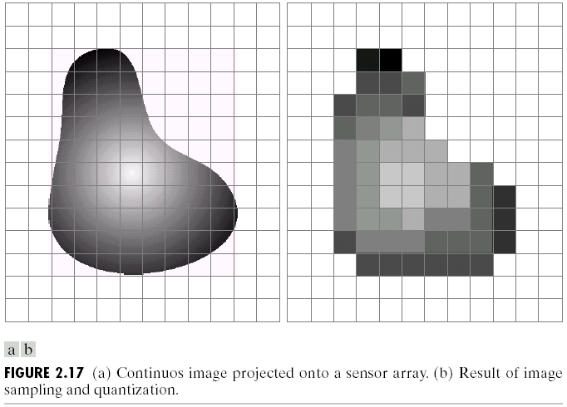
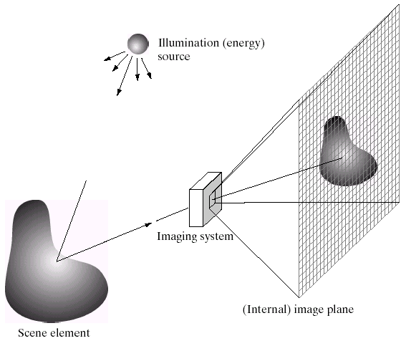
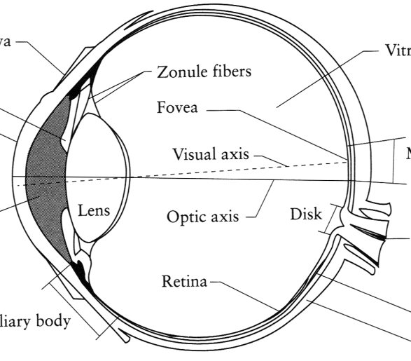
Image Formation
Digital Camera
Film
The Eye
Slide by Efros

Slide 5
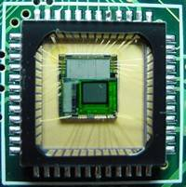
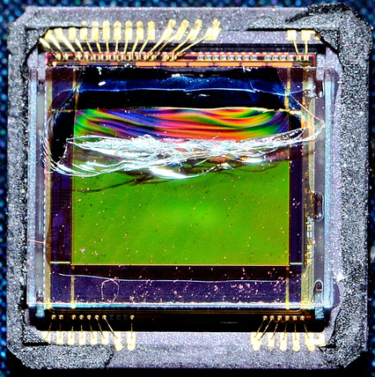
Sensor Array
CMOS sensor
CCD sensor
Slide by Efros

Slide 6
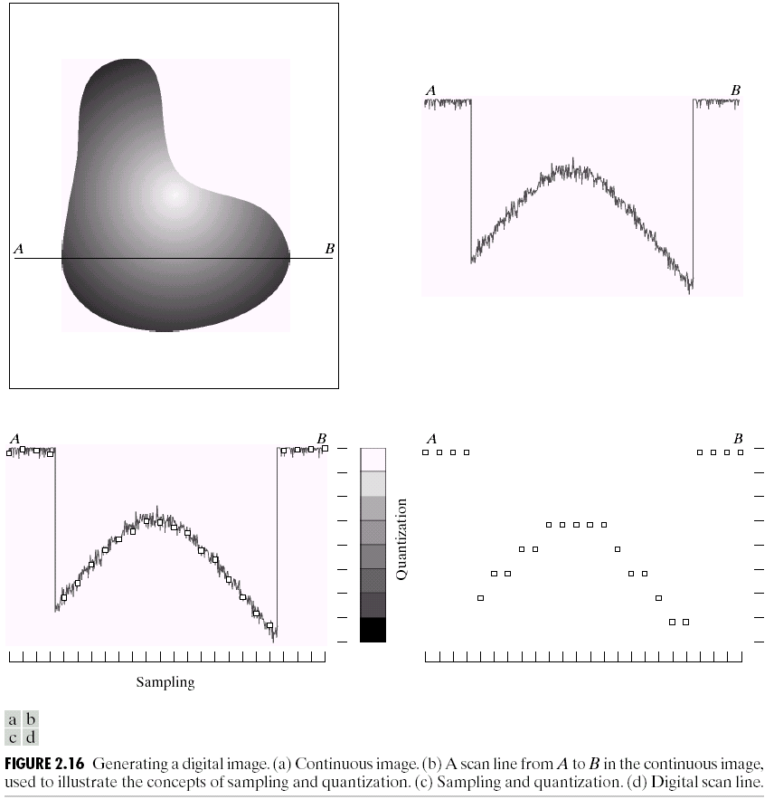
Sampling and Quantization

Slide 7
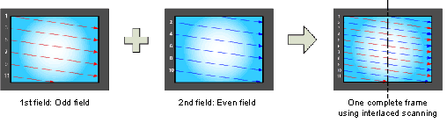
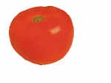
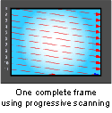
Interlace vs. progressive scan
http://www.axis.com/products/video/camera/progressive_scan.htm
Slide by Steve Seitz

Slide 8
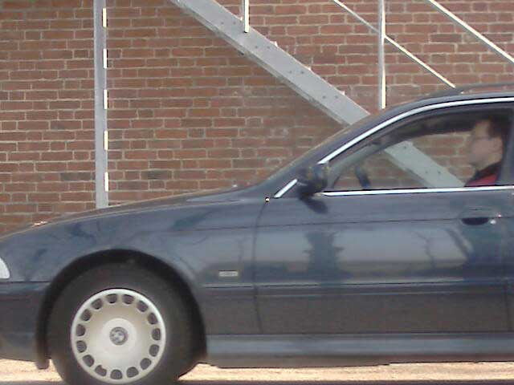
Progressive scan
http://www.axis.com/products/video/camera/progressive_scan.htm
Slide by Steve Seitz

Slide 9
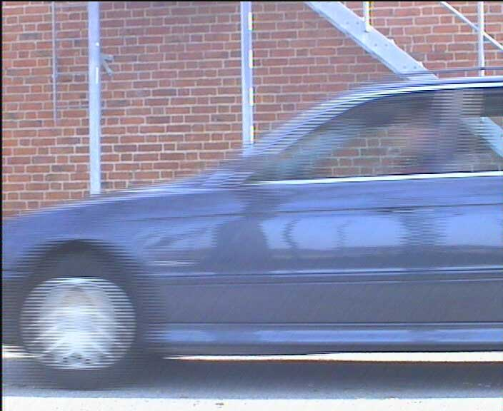
Interlace
http://www.axis.com/products/video/camera/progressive_scan.htm
Slide by Steve Seitz

Slide 10
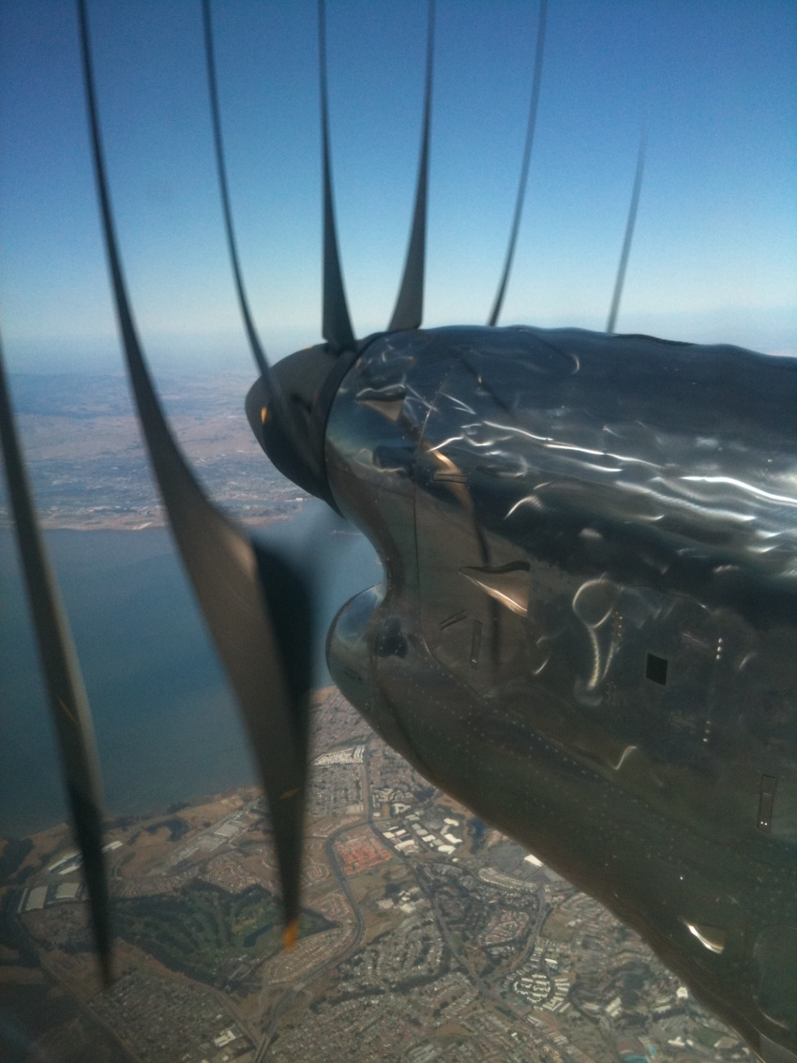
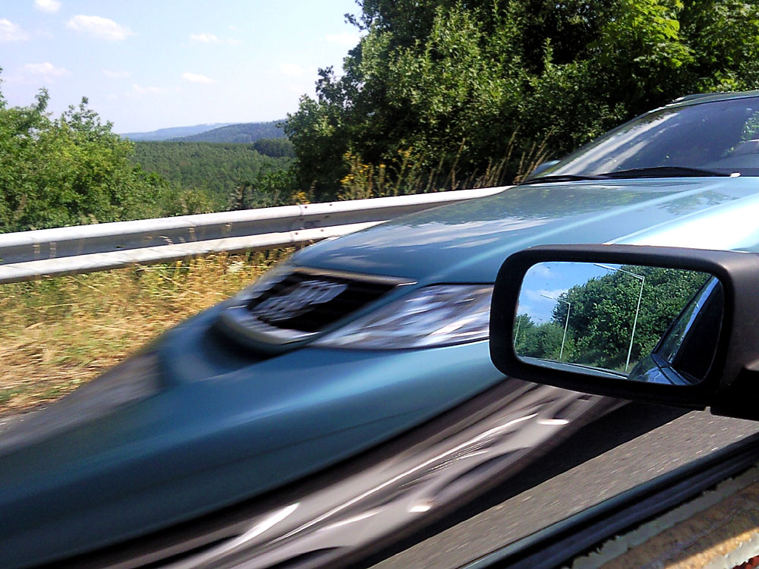
Rolling Shutter
SLR cameras at high shutter speed, most CMOS cameras
Notes:
http://en.wikipedia.org/wiki/Rolling_shutter
Even DSLRs have this problem.

Slide 11
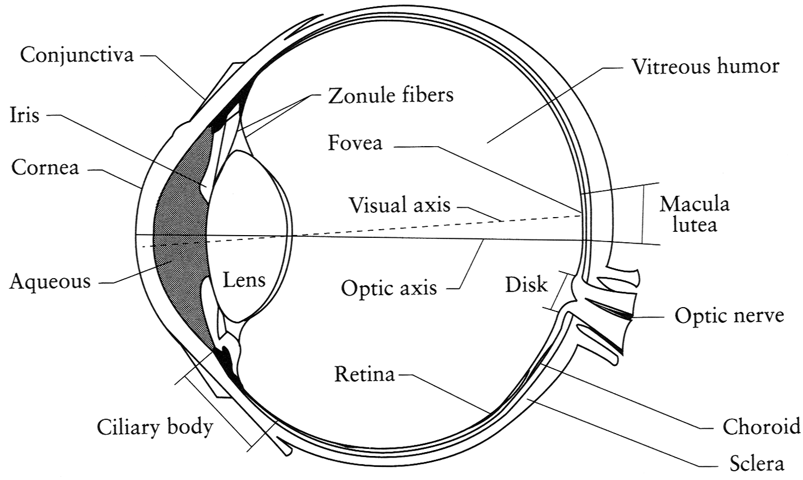
The Eye
The human eye is a camera!
  Iris - colored annulus with radial muscles
  Pupil - the hole (aperture) whose size is controlled by the iris
  What’s the “film”?
    photoreceptor cells (rods and cones) in the retina
Slide by Steve Seitz

Slide 12
The Retina

Slide 13
Two types of light-sensitive receptors
Cones
cone-shaped
less sensitive
operate in high light
color vision
Rods
rod-shaped
highly sensitive
operate at night
gray-scale vision
© Stephen E. Palmer, 2002

Slide 14
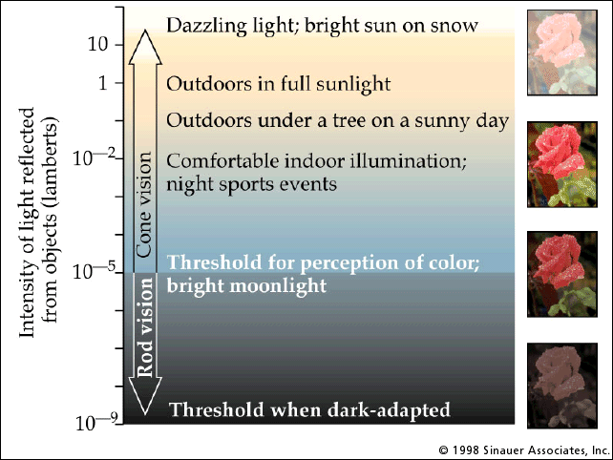
Rod / Cone sensitivity

Slide 15
Some Goals of Human Eye
Recognize food
Recognize friends, mates
Detect predators
Navigation -- identify 3D structure
Limited memory, computation budget
Highest resolution in fovea
- (2 degrees, 50% of visual cortex)
                Absolute luminance discarded
  Edges, corners retained
  Store only a tiny fraction of what is observed

Slide 16
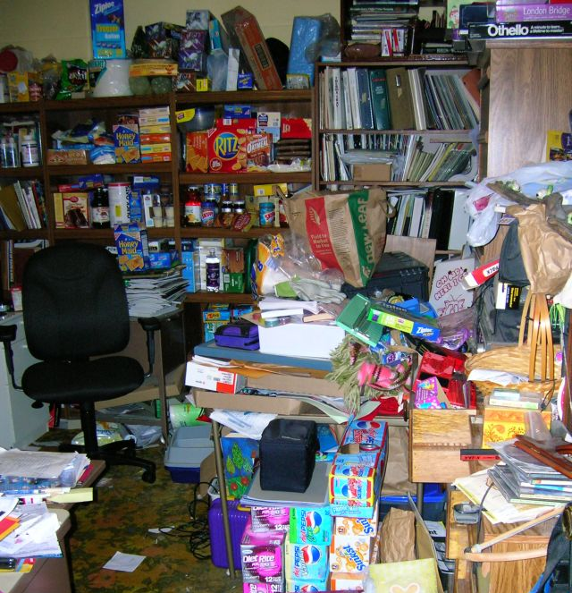
Visual Clutter - Bandwidth Overload

Slide 17
Eye Movements
Motion Magnification -- Eye Movements

Slide 18
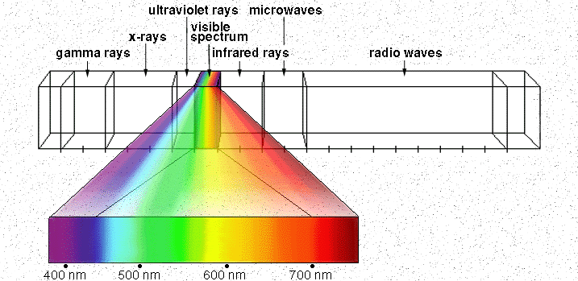
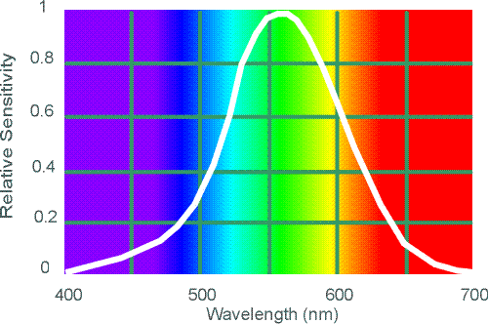
Electromagnetic Spectrum
Human Luminance Sensitivity Function
http://www.yorku.ca/eye/photopik.htm
Notes:
At least 3 spectral bands required (e.g. R,G,B)

Slide 19
Visible Light
Why do we see light of these wavelengths?
…because that’s where the
Sun radiates EM energy
© Stephen E. Palmer, 2002

Slide 20
The Physics of Light
Any patch of light can be completely described
physically by its spectrum: the number of photons
(per time unit) at each wavelength 400 - 700 nm.
© Stephen E. Palmer, 2002

Slide 21
The Physics of Light
Some examples of the spectra of light sources
© Stephen E. Palmer, 2002

Slide 22
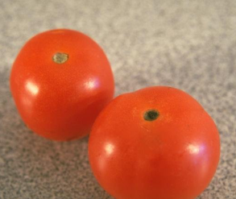
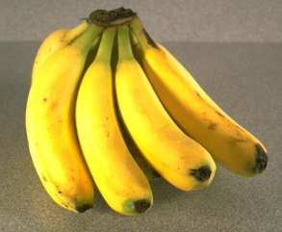
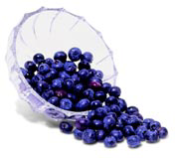
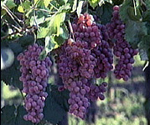
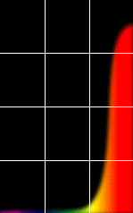
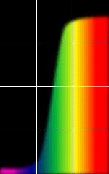
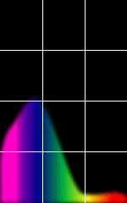
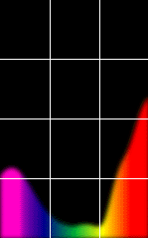
The Physics of Light
Some examples of the reflectance spectra of surfaces
Red
Yellow
Blue
Purple
% Photons Reflected
400 700
400 700
400 700
400 700
Wavelength (nm)
© Stephen E. Palmer, 2002

Slide 23
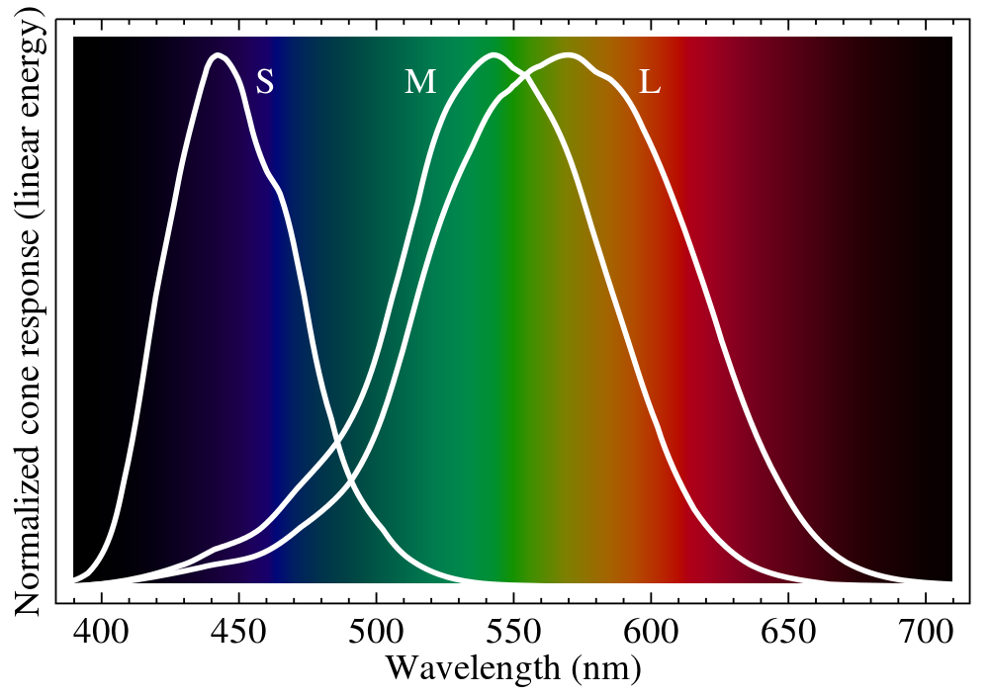
Ordinary Human Vision (Trichromatism)

Slide 24
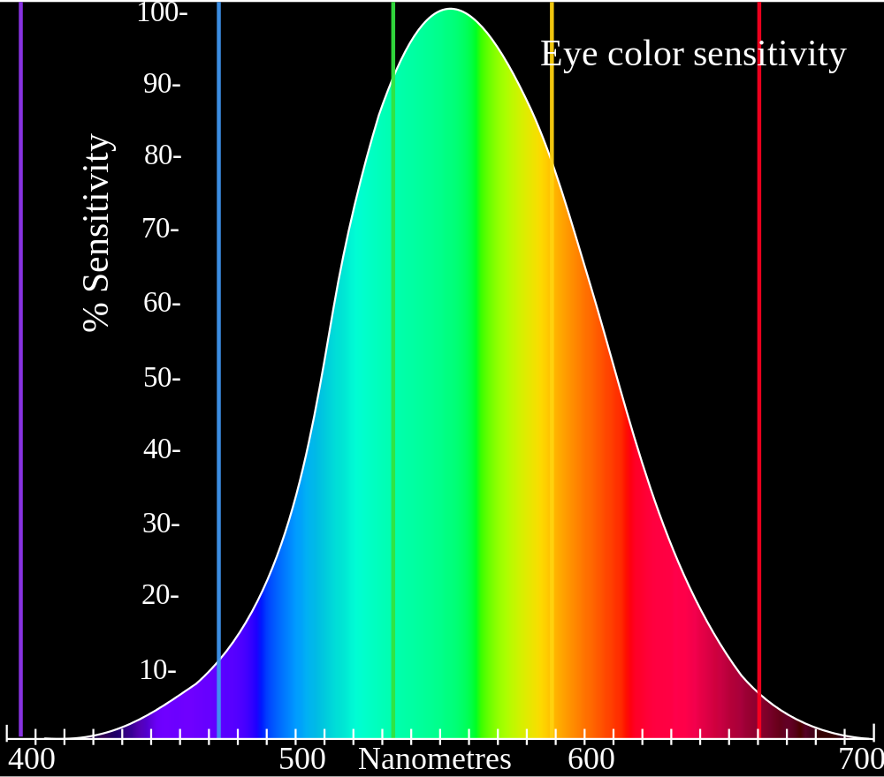
Perceptual Sensitivity
ITU Recommendation for HDTV:
Y = 0.21 R + 0.72 G + 0.07 B
Evolved to detect vegetation, berries?

Slide 25
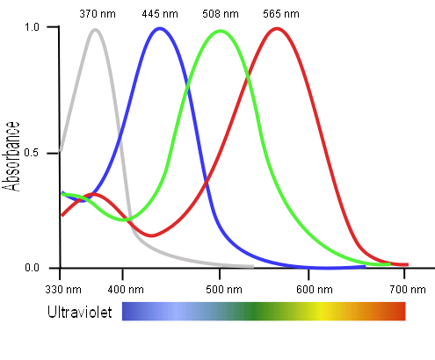
Tetrachromatism
Bird cone responses
Most birds, and many other animals, have cones for ultraviolet light.
Some humans, mostly female, seem to have slight tetrachromatism.

Slide 26
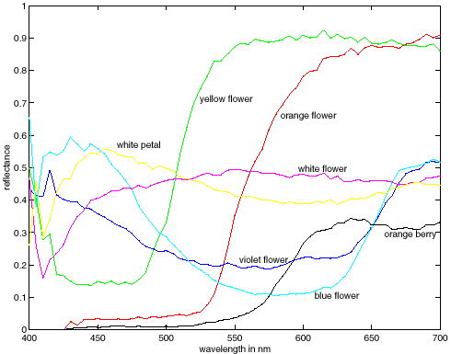
Color Spectra
metamers
Notes:
Metamerism can be illuminant based or observer based. Color blindness produced well known instances of metamerism.

Slide 27
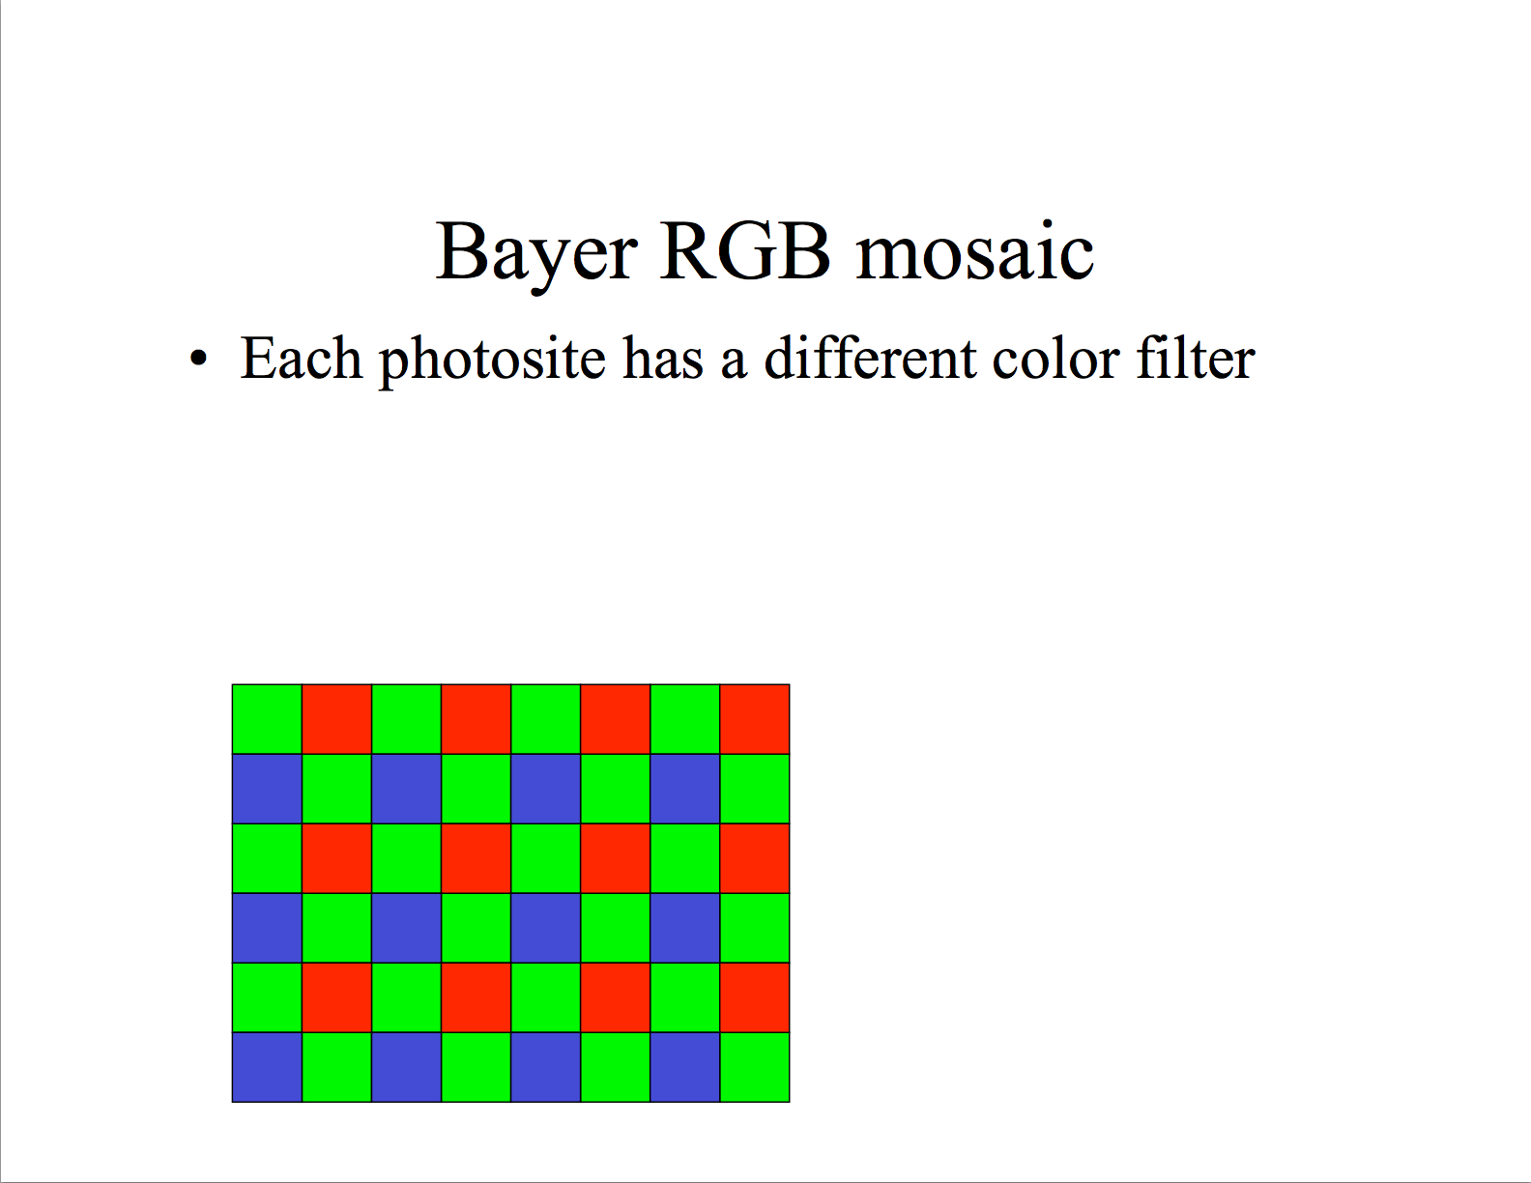
Slide by Fredo Durand

Slide 28
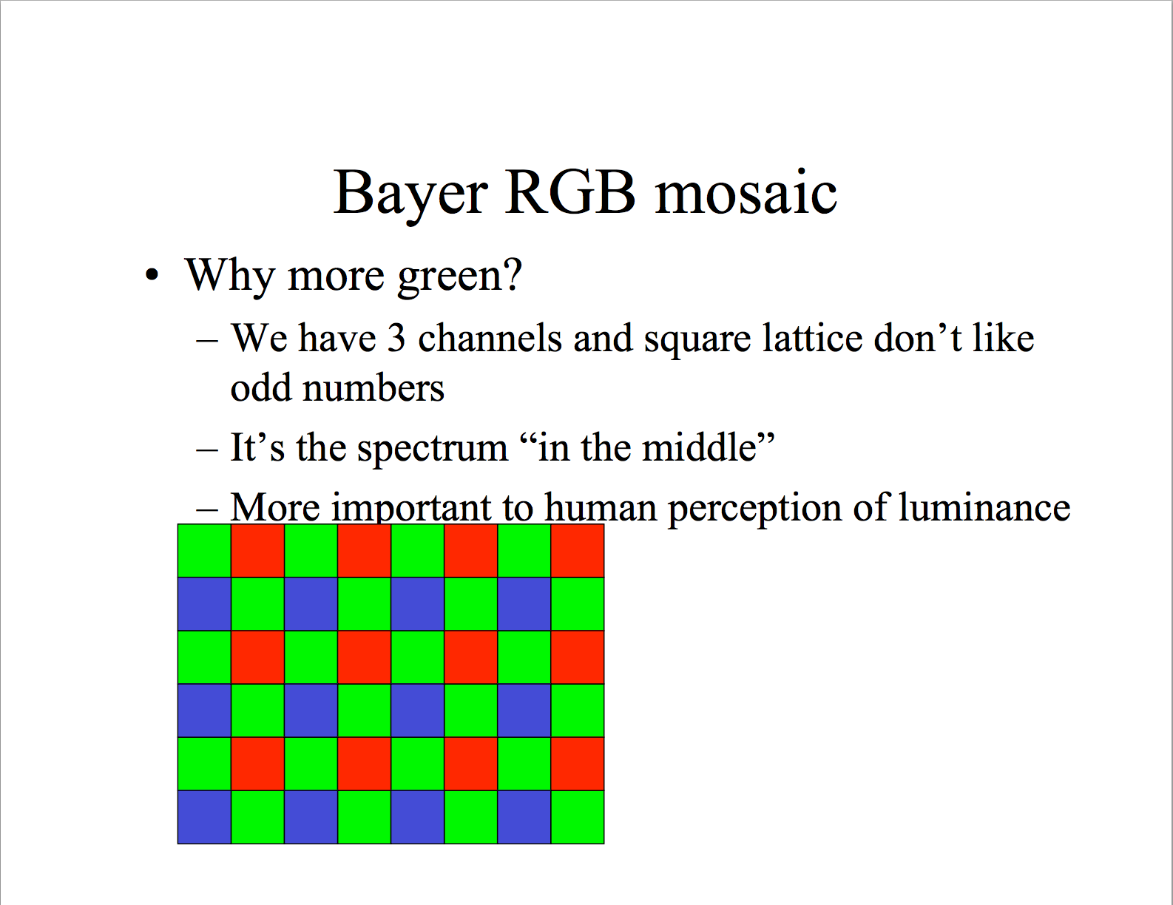
Slide by Fredo Durand

Slide 29
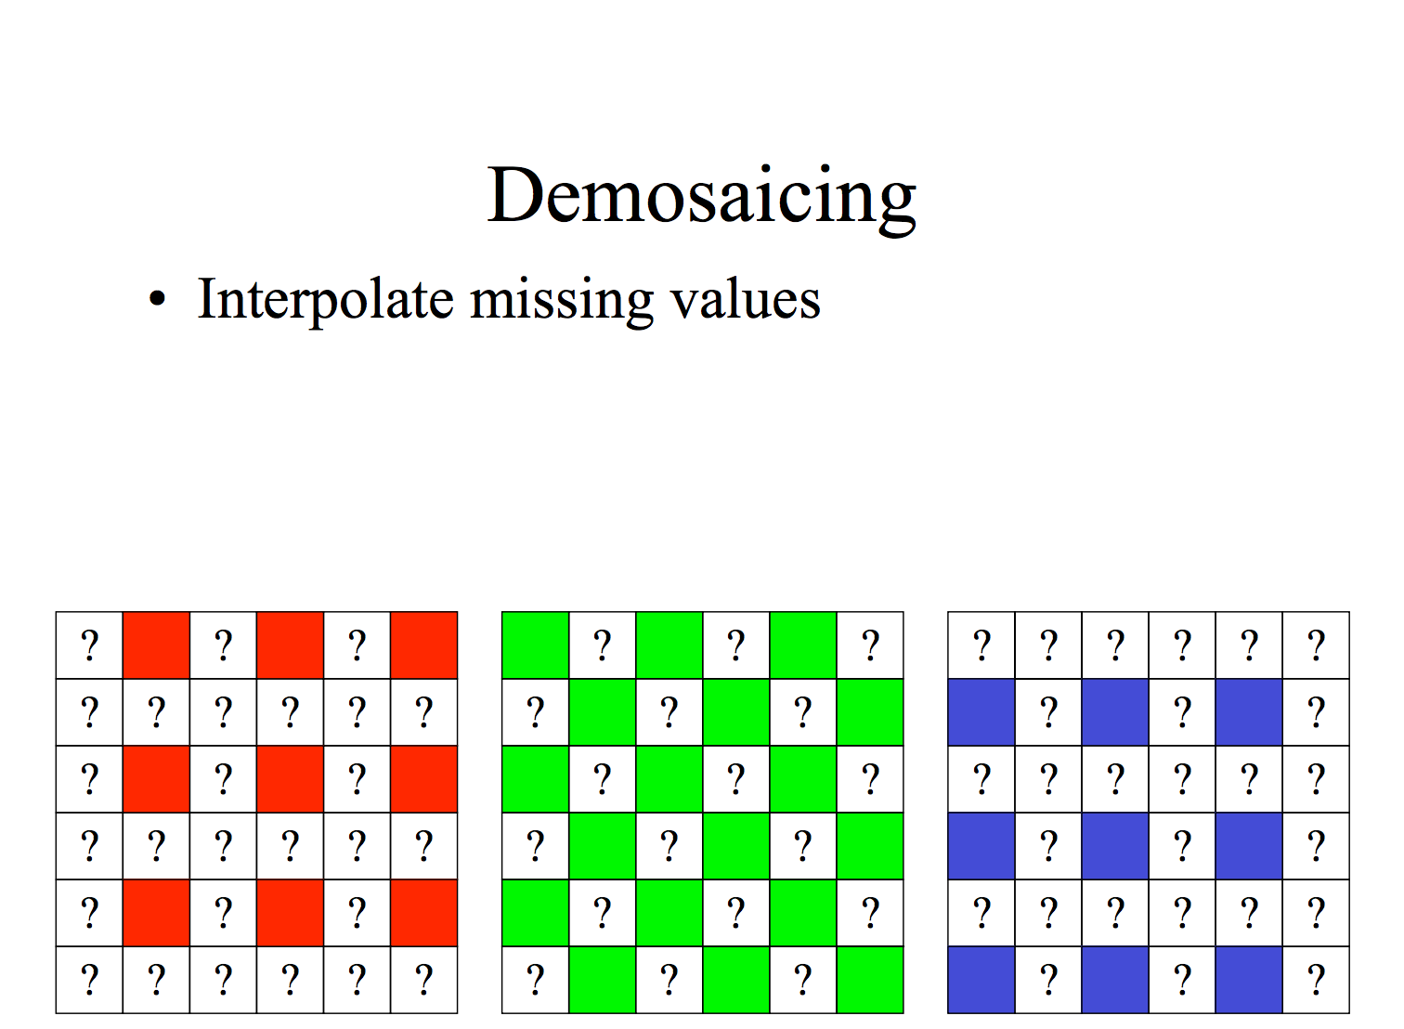
Slide by Fredo Durand

Slide 30
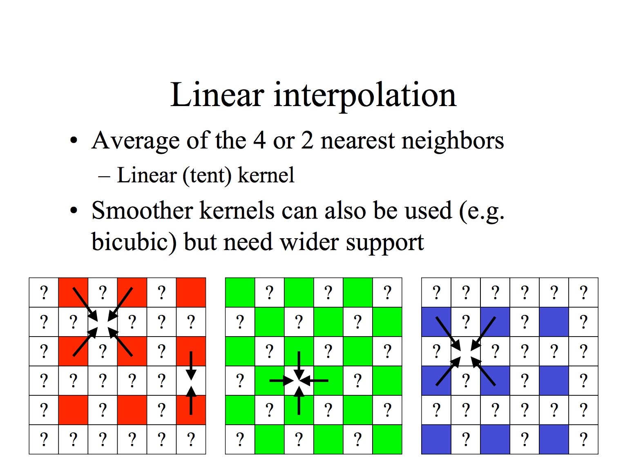
Slide by Fredo Durand

Slide 31
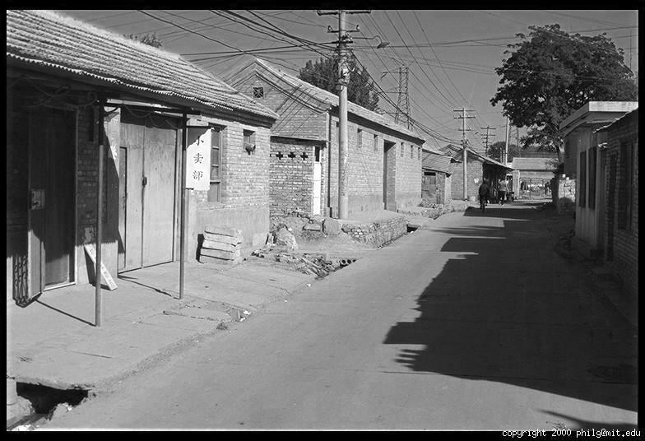
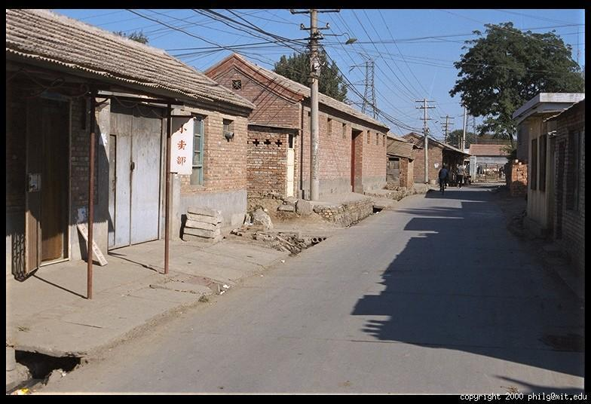
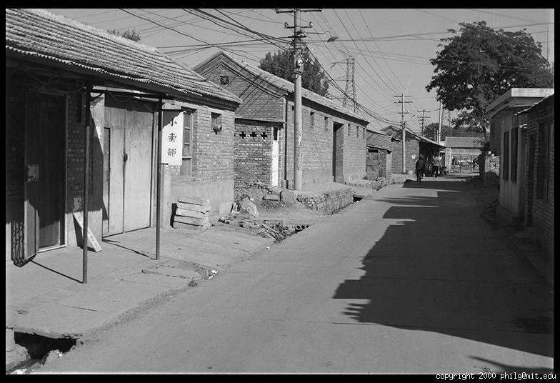
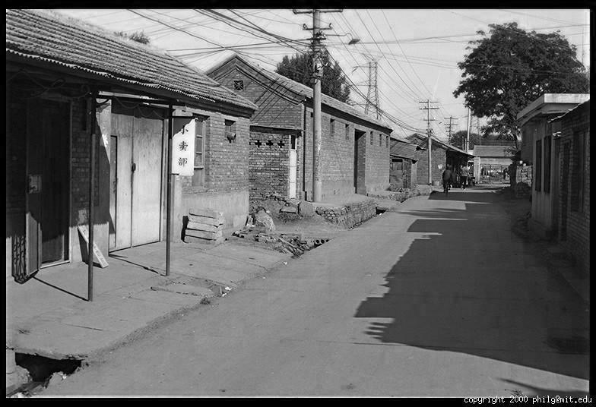
Color Image
R
G
B

Slide 32
Images in Python/MATLAB
Image as array: h x w x channels
  I(y,x,channel)
Red channel, upper left corner:
  MATLAB: I(1,1,1), Python: I[0,0,0]
column
R
row
0.92 | 0.93 | 0.94 | 0.97 | 0.62 | 0.37 | 0.85 | 0.97 | 0.93 | 0.92 | 0.99
0.95 | 0.89 | 0.82 | 0.89 | 0.56 | 0.31 | 0.75 | 0.92 | 0.81 | 0.95 | 0.91
0.89 | 0.72 | 0.51 | 0.55 | 0.51 | 0.42 | 0.57 | 0.41 | 0.49 | 0.91 | 0.92
0.96 | 0.95 | 0.88 | 0.94 | 0.56 | 0.46 | 0.91 | 0.87 | 0.90 | 0.97 | 0.95
0.71 | 0.81 | 0.81 | 0.87 | 0.57 | 0.37 | 0.80 | 0.88 | 0.89 | 0.79 | 0.85
0.49 | 0.62 | 0.60 | 0.58 | 0.50 | 0.60 | 0.58 | 0.50 | 0.61 | 0.45 | 0.33
0.86 | 0.84 | 0.74 | 0.58 | 0.51 | 0.39 | 0.73 | 0.92 | 0.91 | 0.49 | 0.74
0.96 | 0.67 | 0.54 | 0.85 | 0.48 | 0.37 | 0.88 | 0.90 | 0.94 | 0.82 | 0.93
0.69 | 0.49 | 0.56 | 0.66 | 0.43 | 0.42 | 0.77 | 0.73 | 0.71 | 0.90 | 0.99
0.79 | 0.73 | 0.90 | 0.67 | 0.33 | 0.61 | 0.69 | 0.79 | 0.73 | 0.93 | 0.97
0.91 | 0.94 | 0.89 | 0.49 | 0.41 | 0.78 | 0.78 | 0.77 | 0.89 | 0.99 | 0.93
G
0.92 | 0.93 | 0.94 | 0.97 | 0.62 | 0.37 | 0.85 | 0.97 | 0.93 | 0.92 | 0.99
0.95 | 0.89 | 0.82 | 0.89 | 0.56 | 0.31 | 0.75 | 0.92 | 0.81 | 0.95 | 0.91
0.89 | 0.72 | 0.51 | 0.55 | 0.51 | 0.42 | 0.57 | 0.41 | 0.49 | 0.91 | 0.92
0.96 | 0.95 | 0.88 | 0.94 | 0.56 | 0.46 | 0.91 | 0.87 | 0.90 | 0.97 | 0.95
0.71 | 0.81 | 0.81 | 0.87 | 0.57 | 0.37 | 0.80 | 0.88 | 0.89 | 0.79 | 0.85
0.49 | 0.62 | 0.60 | 0.58 | 0.50 | 0.60 | 0.58 | 0.50 | 0.61 | 0.45 | 0.33
0.86 | 0.84 | 0.74 | 0.58 | 0.51 | 0.39 | 0.73 | 0.92 | 0.91 | 0.49 | 0.74
0.96 | 0.67 | 0.54 | 0.85 | 0.48 | 0.37 | 0.88 | 0.90 | 0.94 | 0.82 | 0.93
0.69 | 0.49 | 0.56 | 0.66 | 0.43 | 0.42 | 0.77 | 0.73 | 0.71 | 0.90 | 0.99
0.79 | 0.73 | 0.90 | 0.67 | 0.33 | 0.61 | 0.69 | 0.79 | 0.73 | 0.93 | 0.97
0.91 | 0.94 | 0.89 | 0.49 | 0.41 | 0.78 | 0.78 | 0.77 | 0.89 | 0.99 | 0.93
B
0.92 | 0.93 | 0.94 | 0.97 | 0.62 | 0.37 | 0.85 | 0.97 | 0.93 | 0.92 | 0.99
0.95 | 0.89 | 0.82 | 0.89 | 0.56 | 0.31 | 0.75 | 0.92 | 0.81 | 0.95 | 0.91
0.89 | 0.72 | 0.51 | 0.55 | 0.51 | 0.42 | 0.57 | 0.41 | 0.49 | 0.91 | 0.92
0.96 | 0.95 | 0.88 | 0.94 | 0.56 | 0.46 | 0.91 | 0.87 | 0.90 | 0.97 | 0.95
0.71 | 0.81 | 0.81 | 0.87 | 0.57 | 0.37 | 0.80 | 0.88 | 0.89 | 0.79 | 0.85
0.49 | 0.62 | 0.60 | 0.58 | 0.50 | 0.60 | 0.58 | 0.50 | 0.61 | 0.45 | 0.33
0.86 | 0.84 | 0.74 | 0.58 | 0.51 | 0.39 | 0.73 | 0.92 | 0.91 | 0.49 | 0.74
0.96 | 0.67 | 0.54 | 0.85 | 0.48 | 0.37 | 0.88 | 0.90 | 0.94 | 0.82 | 0.93
0.69 | 0.49 | 0.56 | 0.66 | 0.43 | 0.42 | 0.77 | 0.73 | 0.71 | 0.90 | 0.99
0.79 | 0.73 | 0.90 | 0.67 | 0.33 | 0.61 | 0.69 | 0.79 | 0.73 | 0.93 | 0.97
0.91 | 0.94 | 0.89 | 0.49 | 0.41 | 0.78 | 0.78 | 0.77 | 0.89 | 0.99 | 0.93

Slide 33

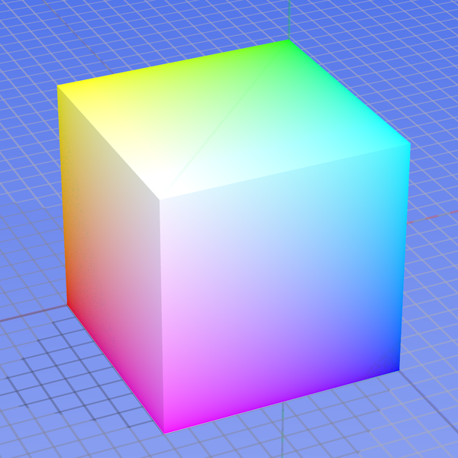
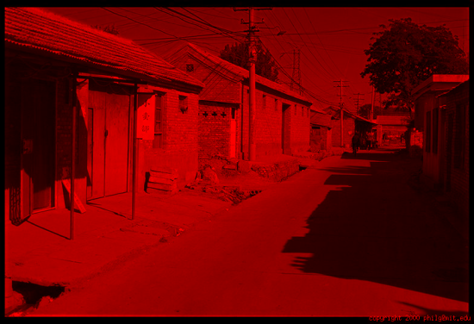
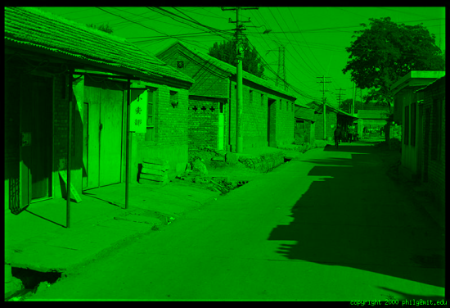
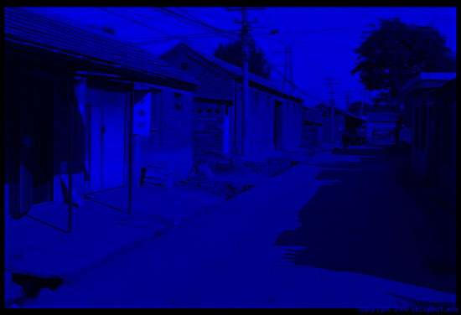
Color spaces: RGB
Default color space
0,1,0
R
(G=0,B=0)
1,0,0
G
(R=0,B=0)
0,0,1
B
(R=0,G=0)
Some drawbacks
Strongly correlated channels
Non-perceptual
Image from: http://en.wikipedia.org/wiki/File:RGB_color_solid_cube.png

Slide 34
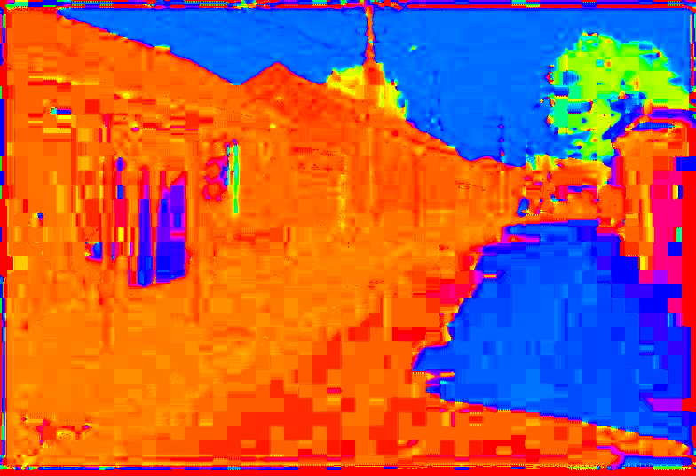
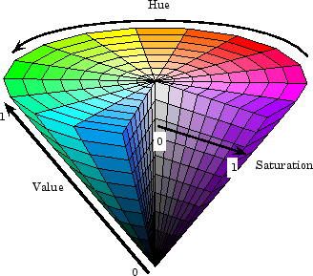
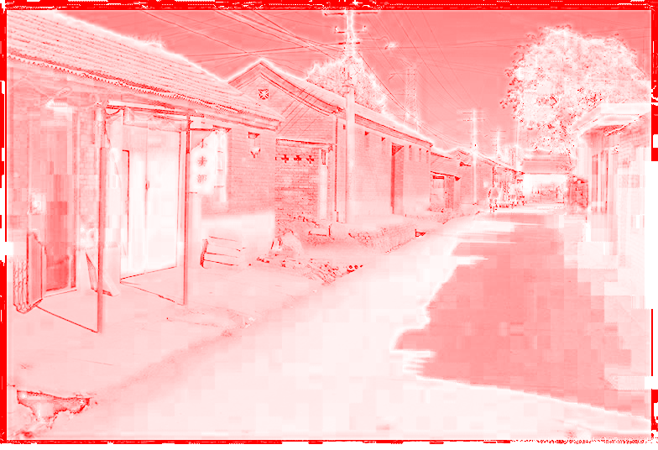
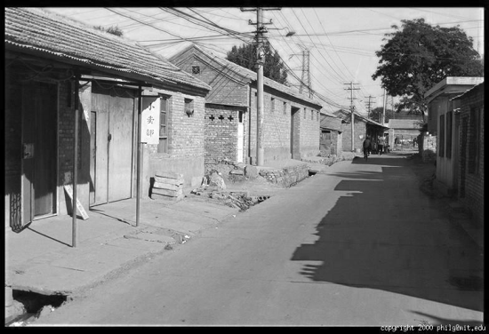
Color spaces: HSV
Intuitive color space
H
(S=1,V=1)
S
(H=1,V=1)
V
(H=1,S=0)

Slide 35
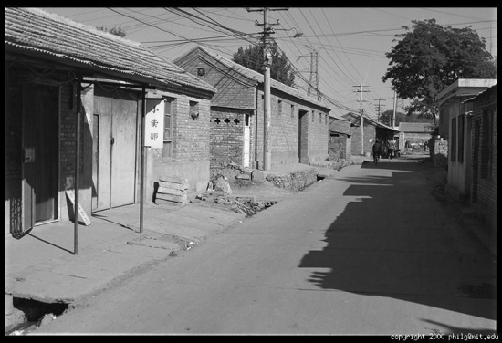
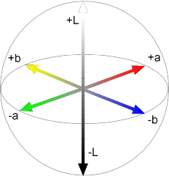
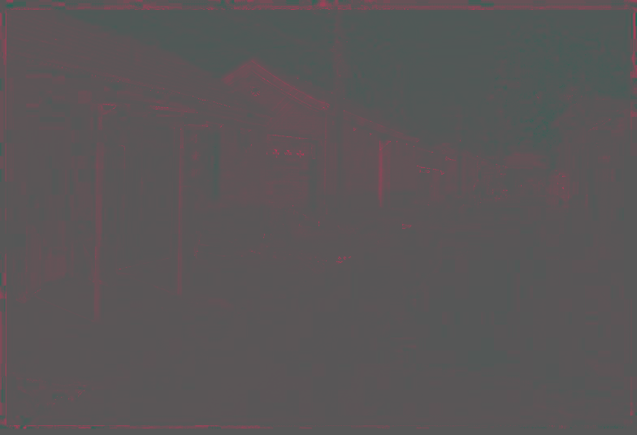

Color spaces: L*a*b*
“Perceptually uniform” color space
L
(a=0,b=0)
a
(L=65,b=0)
b
(L=65,a=0)

Slide 36
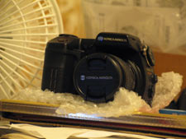

White Balance
Slide by Alexei Efros

Slide 37





Problem: Dynamic Range
The real world is
High dynamic range
1
1500
25,000
400,000
2,000,000,000
Slide by Alexei Efros

Slide 38
Is Camera a photometer?
Image
pixel (312, 284) = 42
42 photons?
Slide by Alexei Efros
Notes:
2

Slide 39
Long Exposure
10⁻⁶
High dynamic range
10⁶
Real world
10⁻⁶
10⁶
Picture
^{0 to 255}
Slide by Alexei Efros

Slide 40
Short Exposure
10⁻⁶
High dynamic range
10⁶
Real world
10⁻⁶
10⁶
Picture
^{0 to 255}
Slide by Alexei Efros

Slide 41
Image Acquisition Pipeline
Lens
Shutter
scene
radiance
(W/sr/m )
sensor
irradiance
∫
sensor
exposure
2
Δt
CCD
ADC
Remapping
analog
voltages
digital
values
pixel
values
Camera is NOT a photometer!
Notes:
3

Slide 42

Varying Exposure

Slide 43

What does the eye sees?
The eye has a huge dynamic range
Do we see a true radiance map?

Slide 44

Eye is Not a Photo-meter

Slide 45

Eye is Not a Photo-meter

