Slide 1
Blending and Compositing
Computational Photography
Connelly Barnes
Many slides from James Hays, Alexei Efros

Slide 2
Blending + Compositing
Previously:
Color perception in humans, cameras
Bayer mosaic
Color spaces (L*a*b*, RGB, HSV)

Slide 3
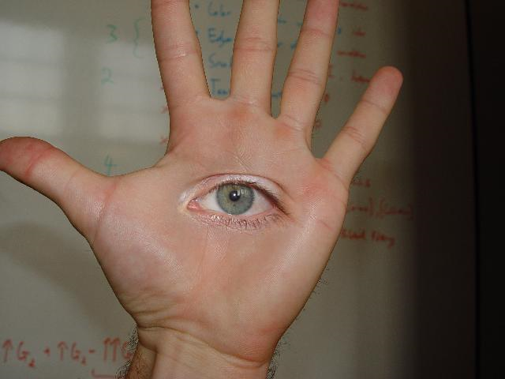
Blending + Compositing
Today
david dmartin (Boston College)

Slide 4
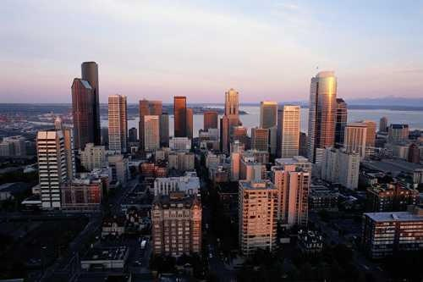
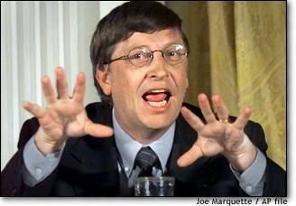
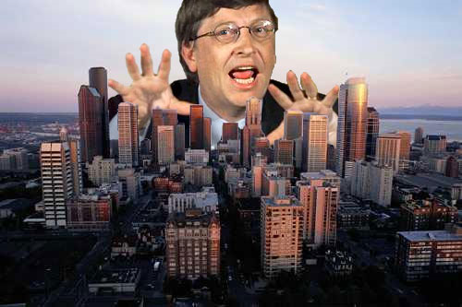
Compositing Procedure
1. Extract Sprites (e.g using Intelligent Scissors in Photoshop)
2. Blend them into the composite (in the right order)
Composite by
David Dewey

Slide 5
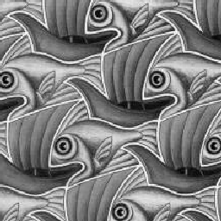
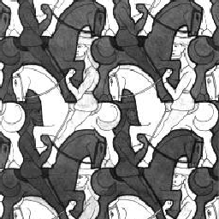
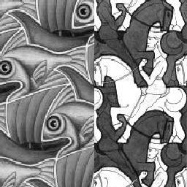
Need blending

Slide 6
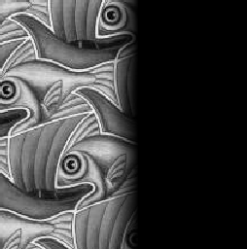
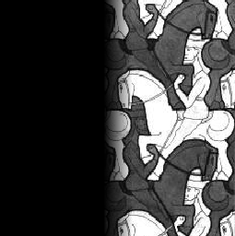
Alpha Blending / Feathering
+
1
1
0
0
I_{blend} = αI_{left} + (1-α)I_{right}
=

Slide 7
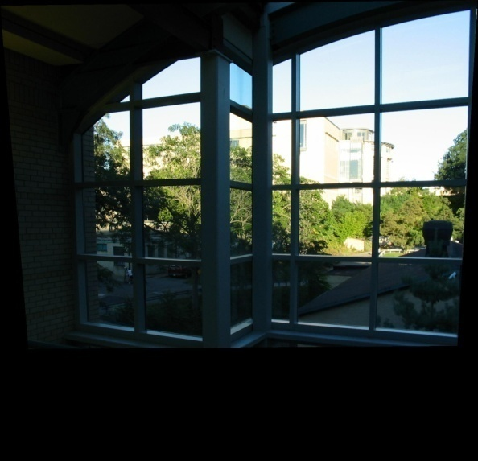
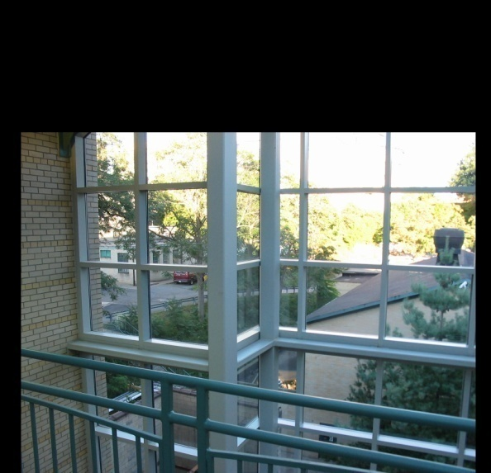
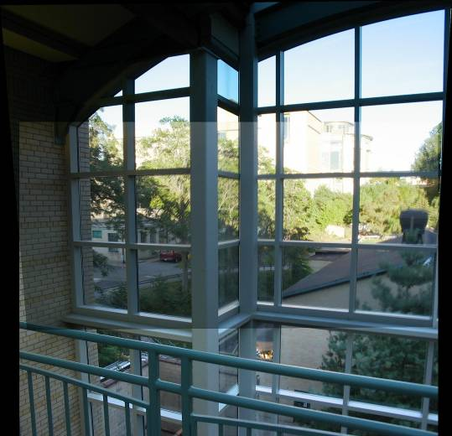
Setting alpha: simple averaging
Alpha = .5 in overlap region

Slide 8
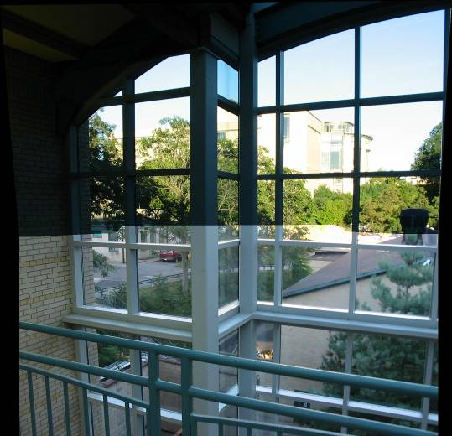
Setting alpha: center seam
Distance
Transform
bwdist (MATLAB)
Alpha = logical(dtrans1>dtrans2)

Slide 9
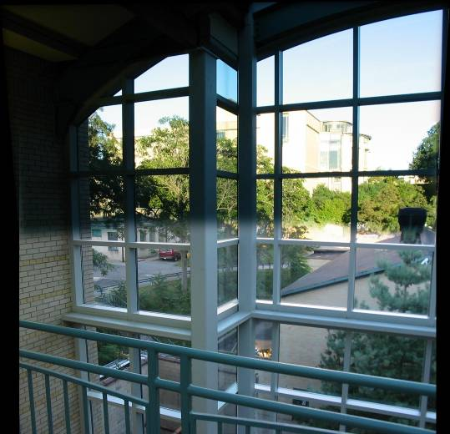
Setting alpha: blurred seam
Distance
transform
Alpha = blurred

Slide 10
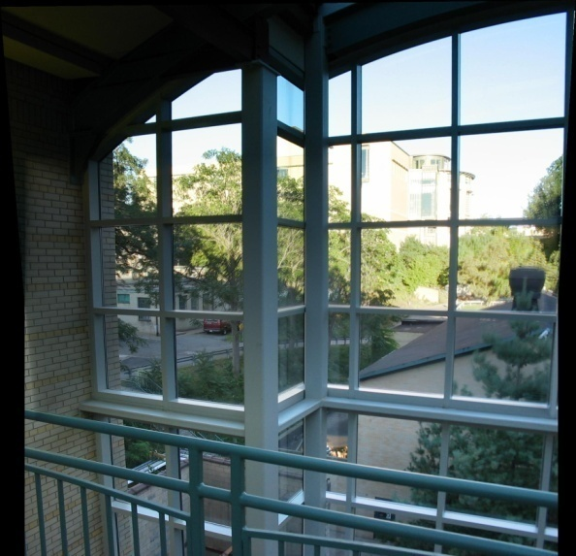
Setting alpha: center weighting
Distance
transform
Ghost!
Alpha = dtrans1 / (dtrans1+dtrans2)

Slide 11
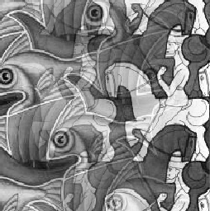
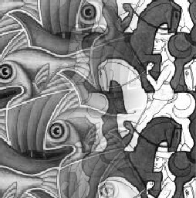
Effect of Window Size
1
left
1
right
0
0

Slide 12
Affect of Window Size
1
1
0
0

Slide 13
Good Window Size
1
0
“Optimal” Window: smooth but not ghosted

Slide 14
Band-pass filtering
Gaussian Pyramid (low-pass images)
Laplacian Pyramid (subband images)
Created from Gaussian pyramid by subtraction

Slide 15
Laplacian Pyramid
Need this!
Original
image
How can we reconstruct (collapse) this pyramid into the original image?

Slide 16
Pyramid Blending
1
0
1
0
1
0
Left pyramid
blend
Right pyramid

Slide 17
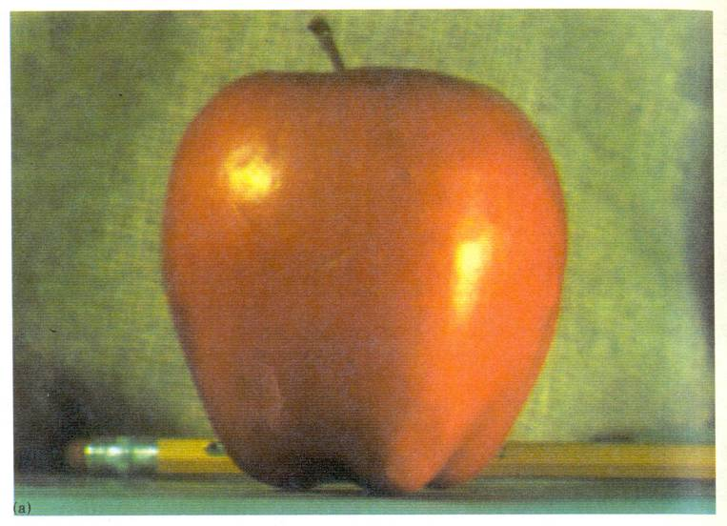
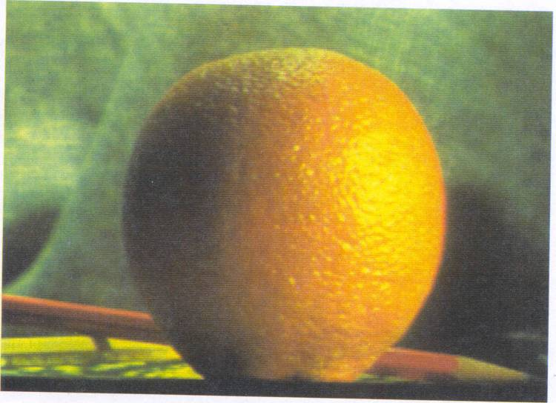
Pyramid Blending

Slide 18
laplacian
level
4
laplacian
level
2
laplacian
level
0
left pyramid
right pyramid
blended pyramid

Slide 19
Laplacian Pyramid: Blending
General Approach:
Build Laplacian pyramids LA and LB from images A and B
Build a Gaussian pyramid GR from selected region R
Form a combined pyramid LS from LA and LB using nodes of GR as weights:
LS(i,j) = GR(I,j,)*LA(I,j) + (1-GR(I,j))*LB(I,j)
Collapse the LS pyramid to get the final blended image

Slide 20
Laplacian Pyramid: Example
Show ongoing research project

Slide 21
Blending Regions

Slide 22
Horror Photo
david dmartin (Boston College)

Slide 23
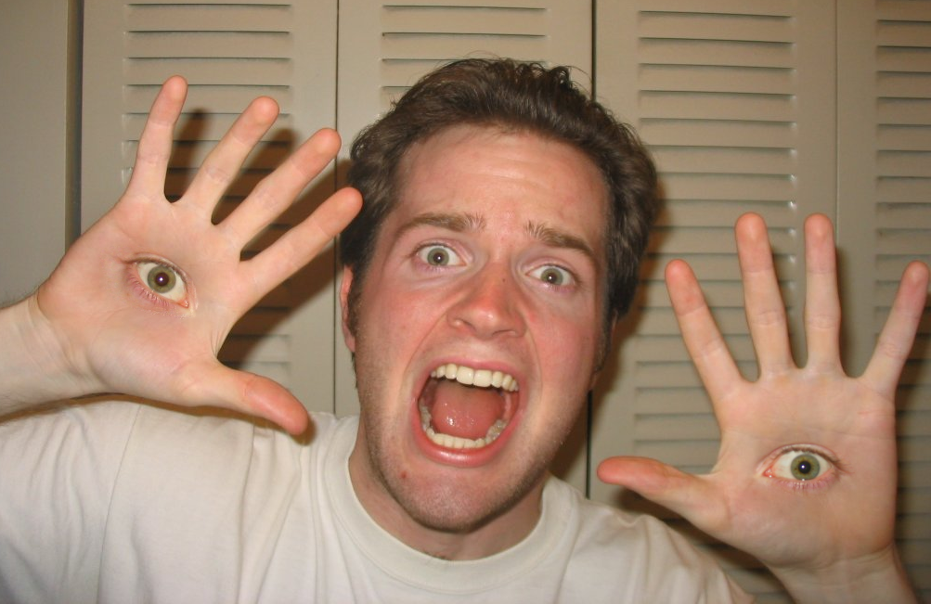
Chris Cameron

Slide 24
Simplification: Two-band Blending
Brown & Lowe, 2003
Only use two bands: high freq. and low freq.
Blends low freq. smoothly
Blend high freq. with no smoothing: use binary alpha

Slide 25
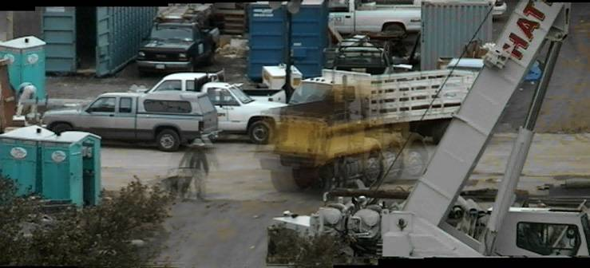
Don’t blend…cut
Moving objects become ghosts
So far we only tried to blend between two images. What about finding an optimal seam?

Slide 26
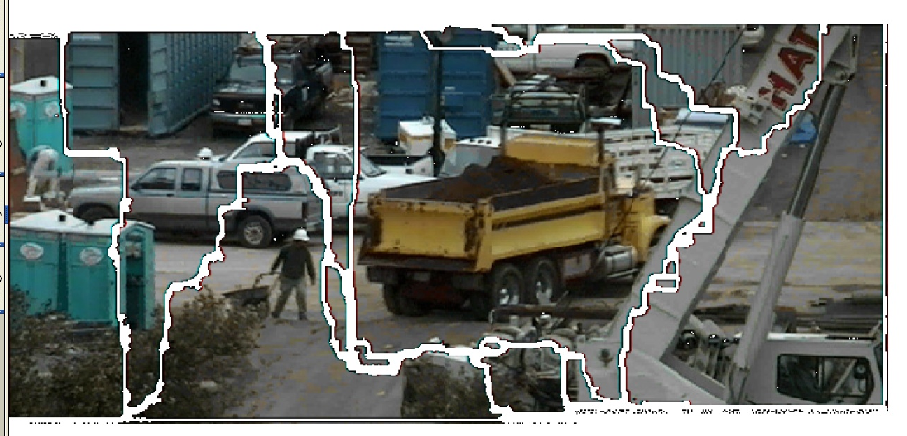
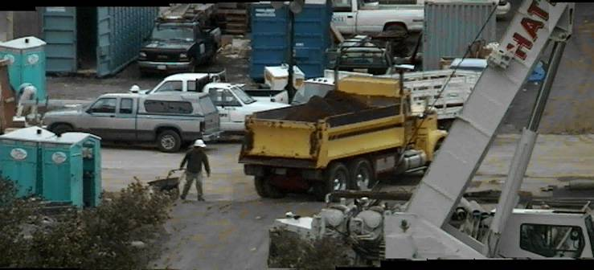
Davis, 1998
Segment the mosaic
Single source image per segment
Avoid artifacts along boundries
Dijkstra’s algorithm

Slide 27
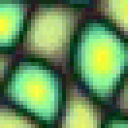
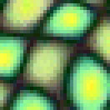
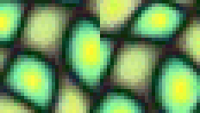
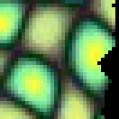
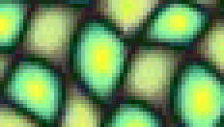
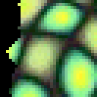
Dynamic programming cuts
overlapping blocks
vertical boundary
2
_
=
overlap error
min. error boundary

Slide 28
Graph cuts
What if we want similar “cut-where-things-agree” idea, but for closed regions?
Dynamic programming can’t handle loops

Slide 29
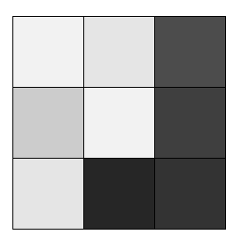
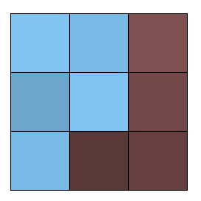
Graph cuts (simple example à la Boykov&Jolly, ICCV’01)
t
n-links
a cut
hard
constraint
hard
constraint
s
Minimum cost cut can be computed in polynomial time
(max-flow/min-cut algorithms)

Slide 30
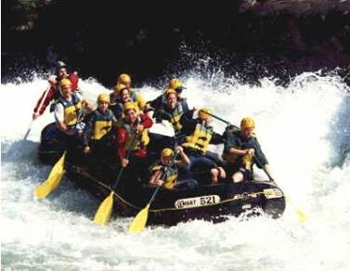
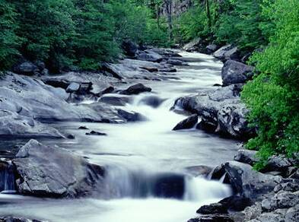
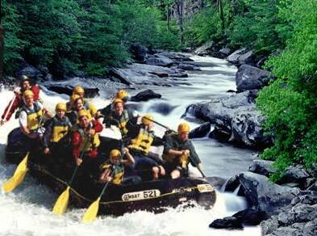
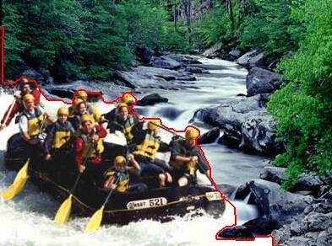
Kwatra et al, 2003
Actually, for this example, dynamic programming will work just as well…

Slide 31
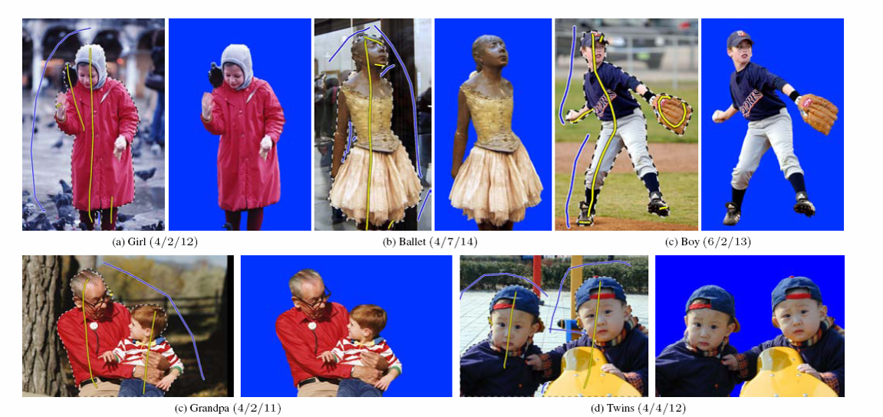
Lazy Snapping
Interactive segmentation using graph cuts

Slide 32
Gradient Domain Image Blending
In Pyramid Blending, we decomposed our image into 2nd derivatives (Laplacian) and a low-res image
Lets look at a more direct formulation:
No need for low-res image
captures everything (up to a constant)
Idea:
Differentiate
Composite
Reintegrate

Slide 33
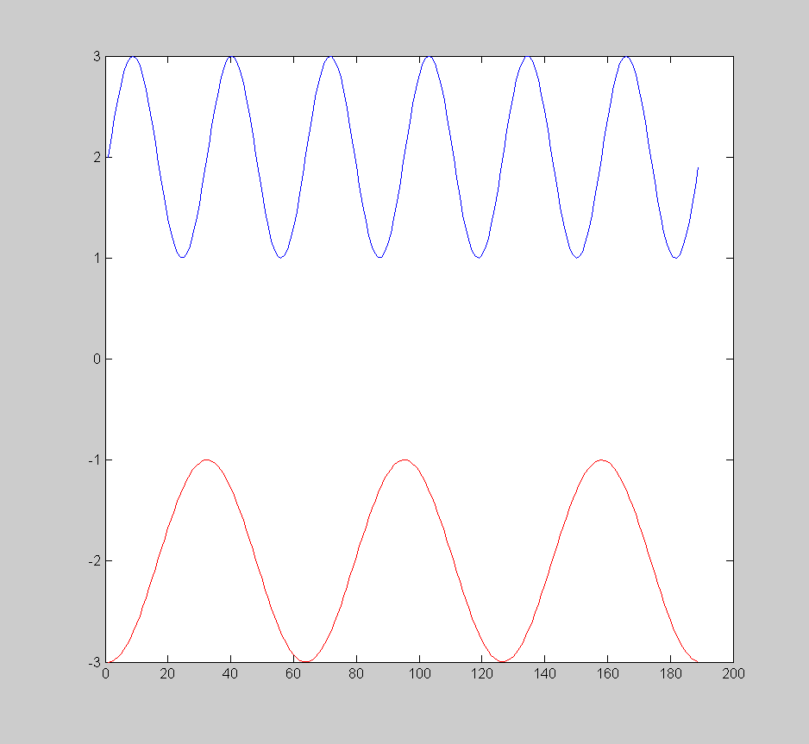
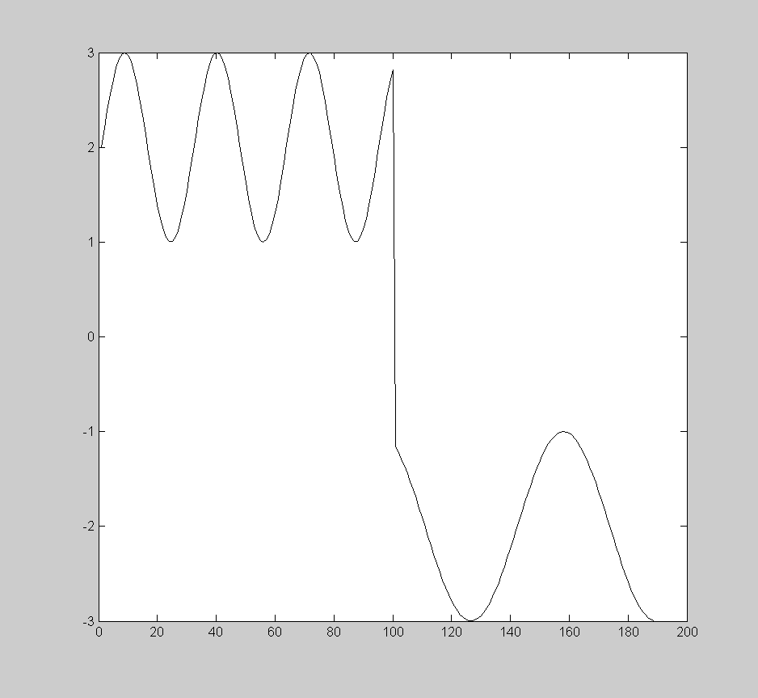
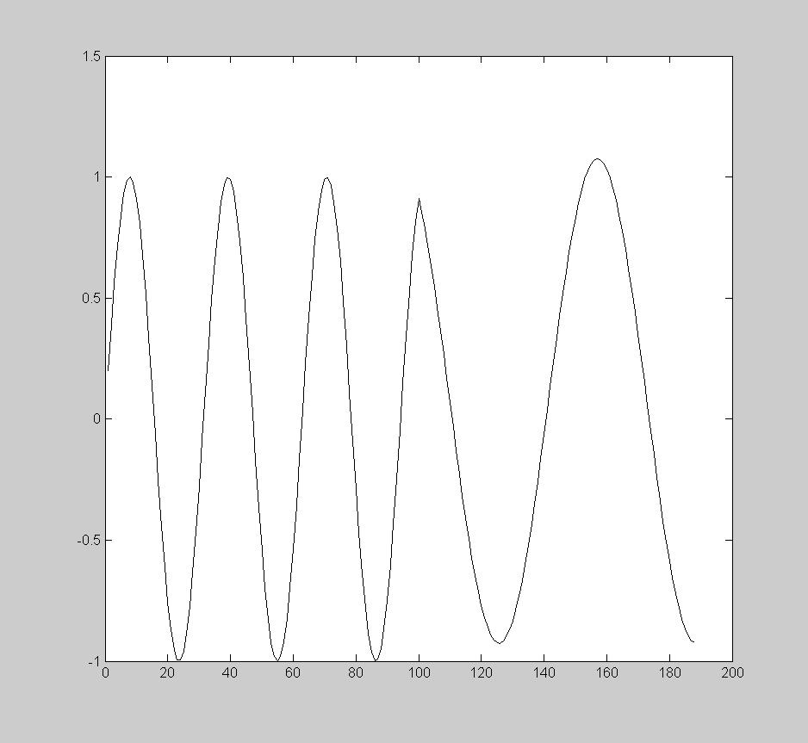
Gradient Domain blending (1D)
bright
Two
signals
dark
Regular
blending
Blending
derivatives

Slide 34
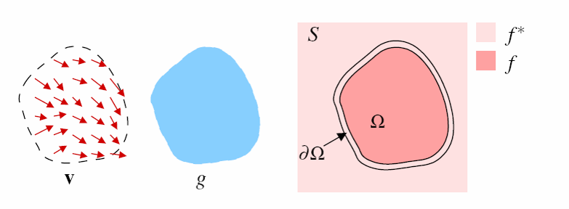
Gradient Domain Blending (2D)
Trickier in 2D:
Take partial derivatives dx and dy (the gradient field)
Fiddle around with them (smooth, blend, feather, etc)
Reintegrate
But now integral(dx) might not equal integral(dy)
Find the most agreeable solution
Equivalent to solving Poisson equation
Can use FFT, deconvolution, multigrid solvers, etc.

Slide 35
Gradient Domain: Math (1D)
f(x)
f’(x) = [-1 0 1] ⊗ f
f’(x)

Slide 36
Gradient Domain: Math (1D)
f(x)
f’(x) = [-1 0 1] ⊗ f
f’(x)

Slide 37
Gradient Domain: Math (1D)
f’(x)
Modify f’ to get target gradients g’
g’(x)

Slide 38
Gradient Domain: Math (1D)
Solve for g that has g’ as its gradients
g’(x)
Plus any boundary constraints on g
(write on board)

Slide 39
Gradient Domain: Math (1D)
Sparse linear system (after differentiating)
Solve with conjugate-gradient or direct solver
MATLAB A \ b, or Python scipy.sparse.linalg

Slide 40
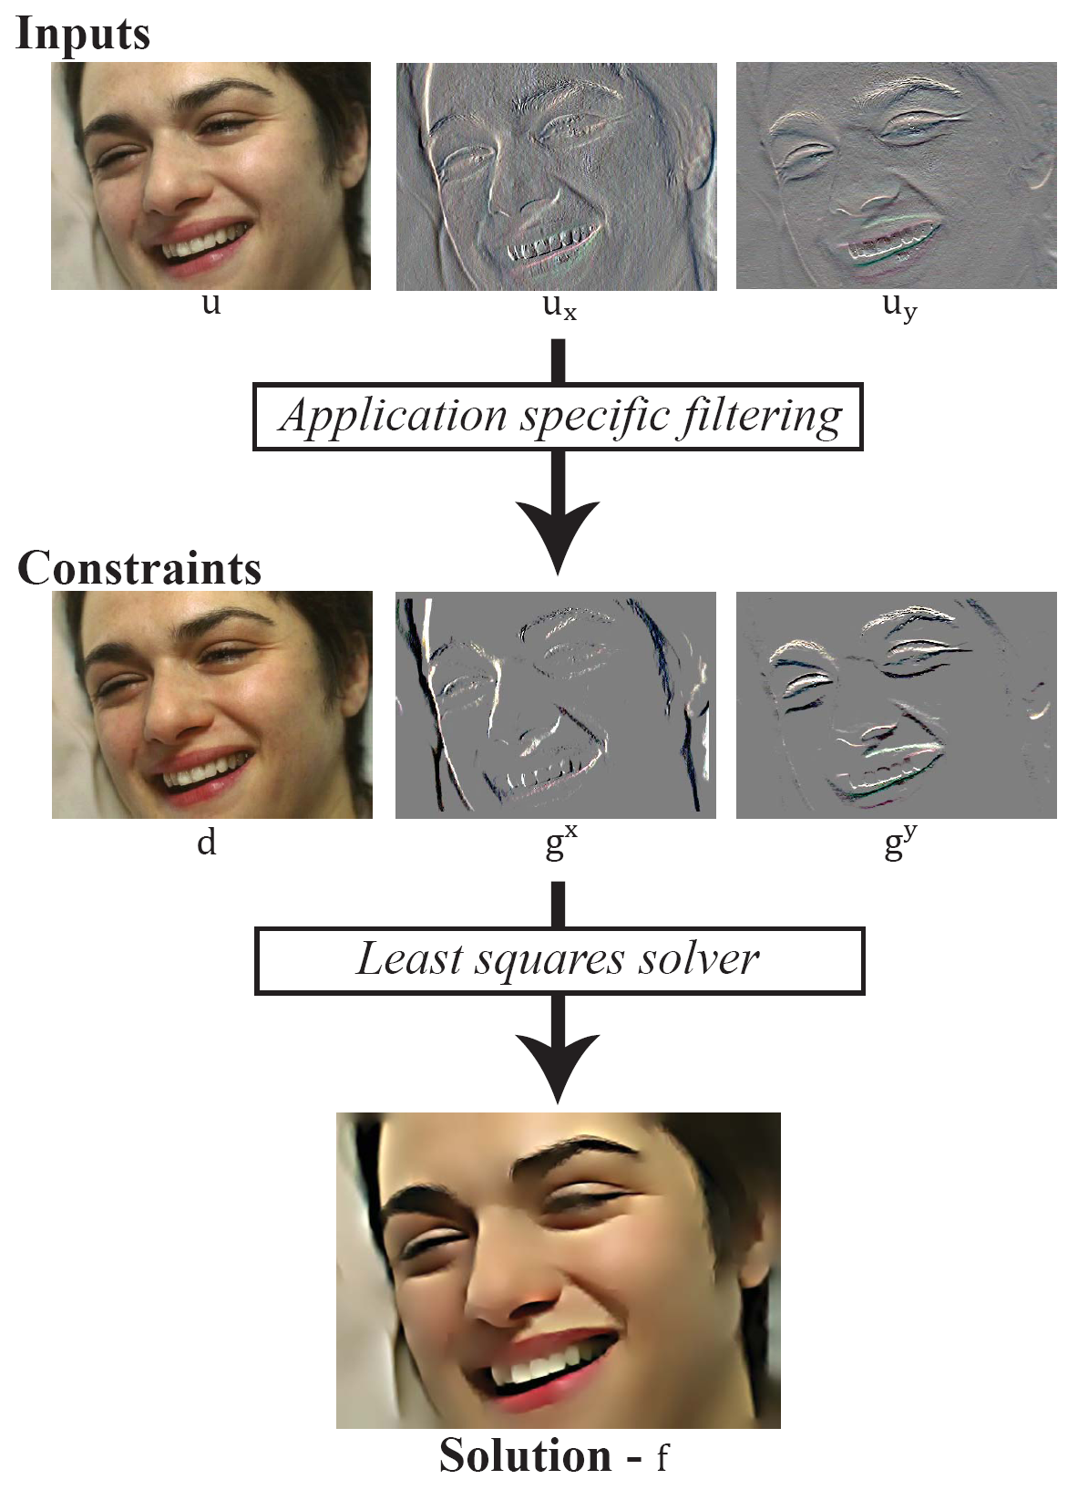
Gradient Domain: Math (2D)
Solve for g that has g_{x} as its x derivative,
And g_{y} as its y derivative
Slide from Pravin Bhat

Slide 41
Gradient Domain: Math (2D)
Slide from Pravin Bhat

Slide 42
Gradient Domain: Math (2D)
Output filtered image – f
Specify desired pixel-differences – (g^{x}, g^{y})
Specify desired pixel-values – d
Specify constraints weights – (w^{x}, w^{y}, w^{d})
Energy function (derive on board)
min w^{x}(f_{x} – g^{x})² + w^{y}(f_{y} – g^{y})² + w^{d}(f – d)²
_{f}
From Pravin Bhat

Slide 43
Gradient Domain: Example
GradientShop by Pravin Bhat: GradientShop

Slide 44
Gradient Domain: Example
Gradient domain painting by Jim McCann: Real-Time Gradient-Domain Painting

Slide 45
Thinking in Gradient Domain
James McCann Real-Time Gradient-Domain Painting, SIGGRAPH 2009

Slide 46
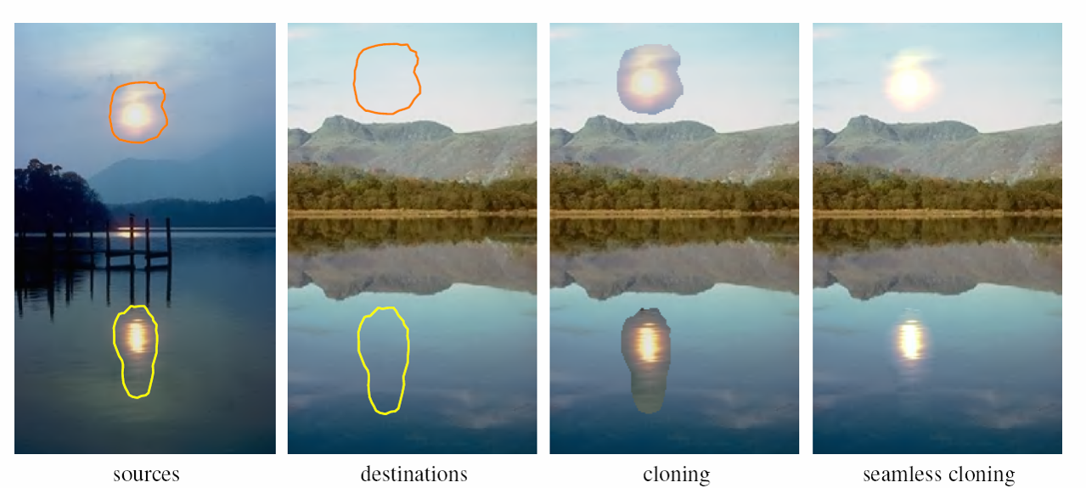
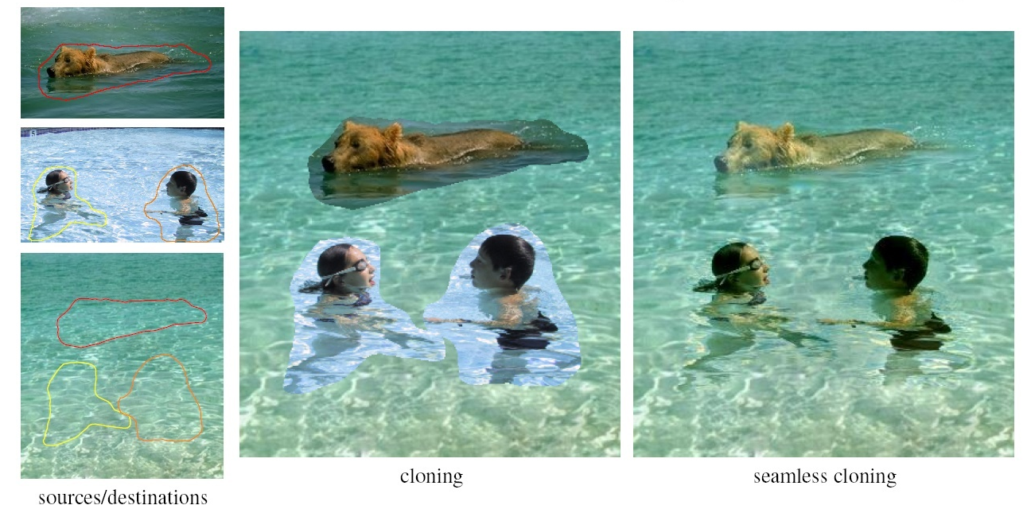
Perez et al., 2003

Slide 47
Perez et al, 2003
editing
Limitations:
Can’t do contrast reversal (gray on black -> gray on white)
Colored backgrounds “bleed through”
Images need to be very well aligned

Slide 48
Putting it all together
Compositing images
Have a clever blending function
Feathering
Center-weighted
Blend different frequencies differently
Gradient based blending
Choose the right pixels from each image
Dynamic programming – optimal seams
Graph-cuts
Now, let’s put it all together:
Interactive Digital Photomontage, 2004 (video)

