Slide 1
Texture Synthesis (Basic)
Connelly Barnes
Computational Photography
Many slides from James Hays, Alexei Efros

Slide 2
Texture
Texture depicts spatially repeating patterns
Many natural phenomena are textures
radishes
rocks
yogurt

Slide 3
Texture Synthesis
Goal of Texture Synthesis: create new samples of a given texture
Many applications: virtual environments, hole-filling, texturing surfaces

Slide 4
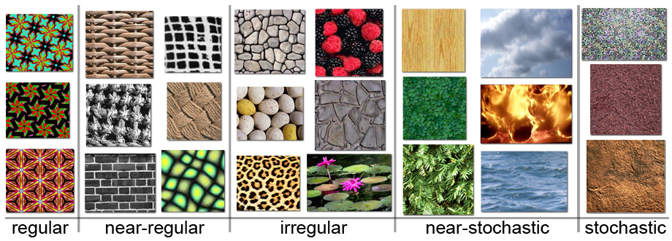
The Challenge
Need to model the whole spectrum: from repeated to stochastic texture

Slide 5
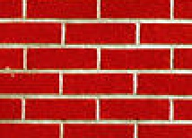
Efros & Leung Algorithm
non-parametric
sampling
p
Input image
Synthesizing a pixel
Assuming Markov property, compute P(p|N(p))
Building explicit probability tables infeasible
Instead, we search the input image for all similar neighborhoods — that’s our pdf for p
To sample from this pdf, just pick one match at random

Slide 6
Some Details
Growing is in “onion skin” order
Within each “layer”, pixels with most neighbors are synthesized first
If no close match can be found, the pixel is not synthesized until the end
Using Gaussian-weighted SSD is very important
to make sure the new pixel agrees with its closest neighbors
Approximates reduction to a smaller neighborhood window if data is too sparse

Slide 7
Neighborhood Window
input

Slide 8
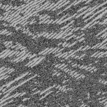
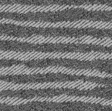
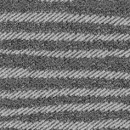
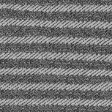
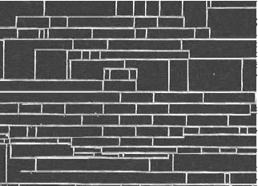
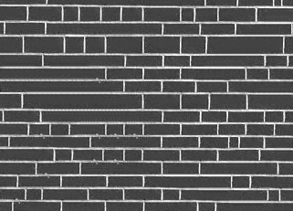
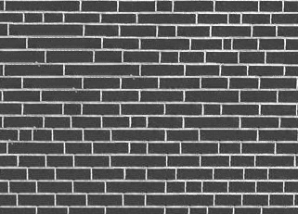
Varying Window Size
Increasing window size

Slide 9
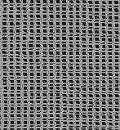
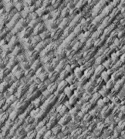
Synthesis Results
french canvas
rafia weave

Slide 10
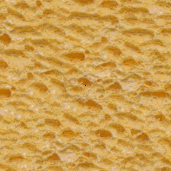
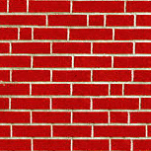
More Results
white bread
brick wall

Slide 11
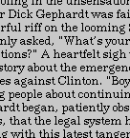
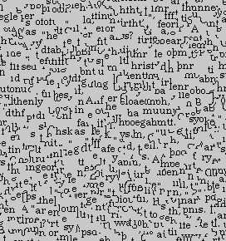
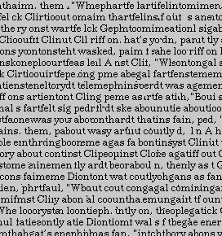
Homage to Shannon

Slide 12
n-gram Model (Shannon)
n-gram

Slide 13
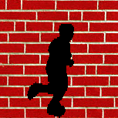
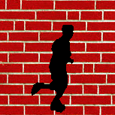
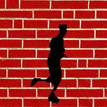
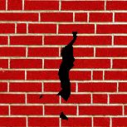
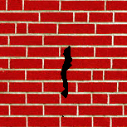
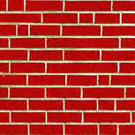
Hole Filling

Slide 14
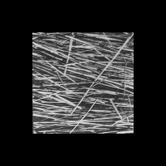
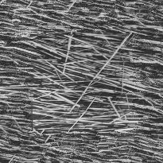
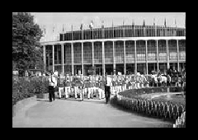
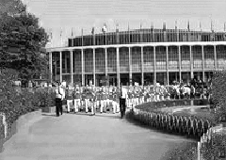
Extrapolation

Slide 15
Summary
The Efros & Leung algorithm
Very simple
Surprisingly good results
…but very slow

Slide 16
Image Quilting [Efros & Freeman]
non-parametric
sampling
p
B
Input image
Synthesizing a block
Observation: neighbor pixels are highly correlated
Idea: unit of synthesis = block
Exactly the same but now we want P(B|N(B))
Much faster: synthesize all pixels in a block at once
Not the same as multi-scale!

Slide 17
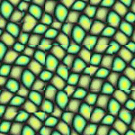
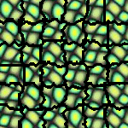
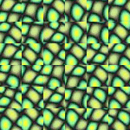
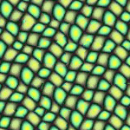
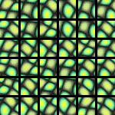
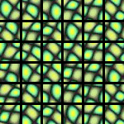
block
Input texture
B1
B2
B1
B2
B1
B2
Random placement
of blocks
Neighboring blocks
constrained by overlap
Minimal error
boundary cut

Slide 18
Minimal error boundary
overlapping blocks
vertical boundary
2
_
=
overlap error
min. error boundary

Slide 19
Quilting – Idea
The “Corrupt Professor’s Algorithm”:
Plagiarize as much of the source image as you can
Then try to cover up the evidence
Rationale:
Texture blocks are by definition correct samples of texture so problem only connecting them together

Slide 20
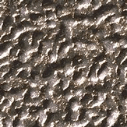
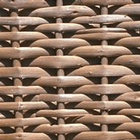
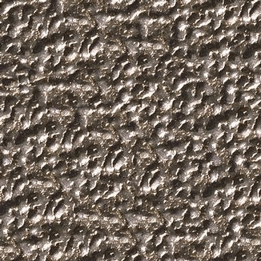
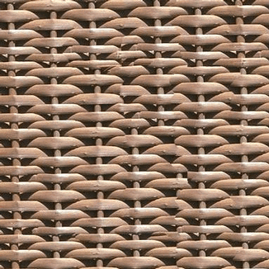

Slide 21
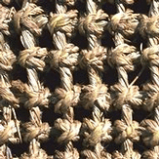
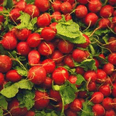
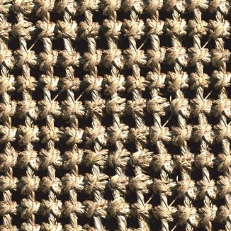
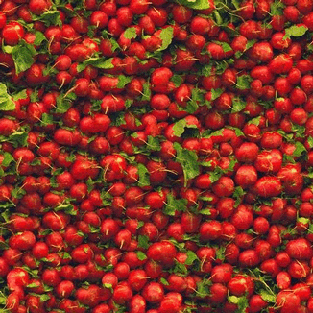

Slide 23
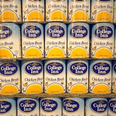
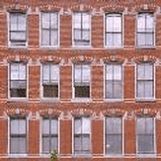
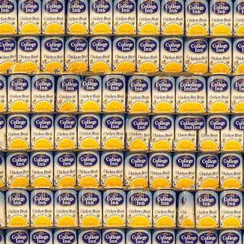
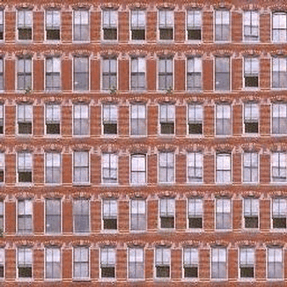

Slide 24
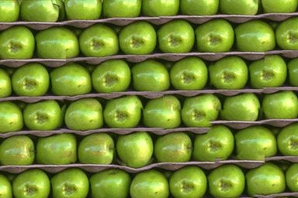
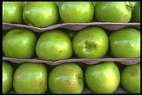

Slide 25
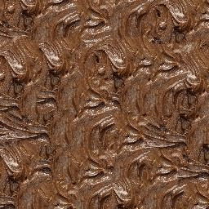
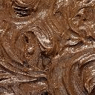
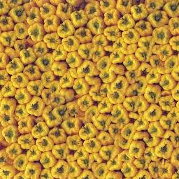
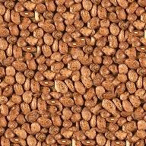

Slide 26
Failures
(Chernobyl
Harvest)

Slide 27
Portilla & Simoncelli
Xu, Guo & Shum
input image
Wei & Levoy
Image Quilting

Slide 28
Portilla & Simoncelli
Xu, Guo & Shum
input image
Wei & Levoy
Image Quilting

Slide 29
Portilla & Simoncelli
Xu, Guo & Shum
input image
Wei & Levoy
Image Quilting

Slide 30
Political Texture Synthesis!

Slide 31
Application: Texture Transfer
Try to explain one object with bits and pieces of another object:
+
=

Slide 32
Texture Transfer
Constraint
Texture sample

Slide 33
Texture Transfer
Take the texture from one image and “paint” it onto another object
Same as texture synthesis, except an additional constraint:
Consistency of texture
Similarity to the image being “explained”

Slide 34
+
=

Slide 36
PatchMatch
Open second slide deck

