Slide 1
Computational Photography Wavelets / Frequency Decompositions
Connelly Barnes
Slides from Fredo Durand, Bill Freeman, Sylvain Paris

Slide 2
Frequency Decompositions
Gaussian pyramid
Laplacian pyramid
Fourier transform
Haar wavelet
Steerable pyramid
Bilateral filter

Slide 3
Review – Gaussian Pyramid
Repeatedly: 1. Filter with Gaussian with sigma=1, 2. Retain only even rows/columns (halve resolution)
http://www-bcs.mit.edu/people/adelson/pub_pdfs/pyramid83.pdf

Slide 4
The computational advantage of pyramids
http://www-bcs.mit.edu/people/adelson/pub_pdfs/pyramid83.pdf

Slide 5
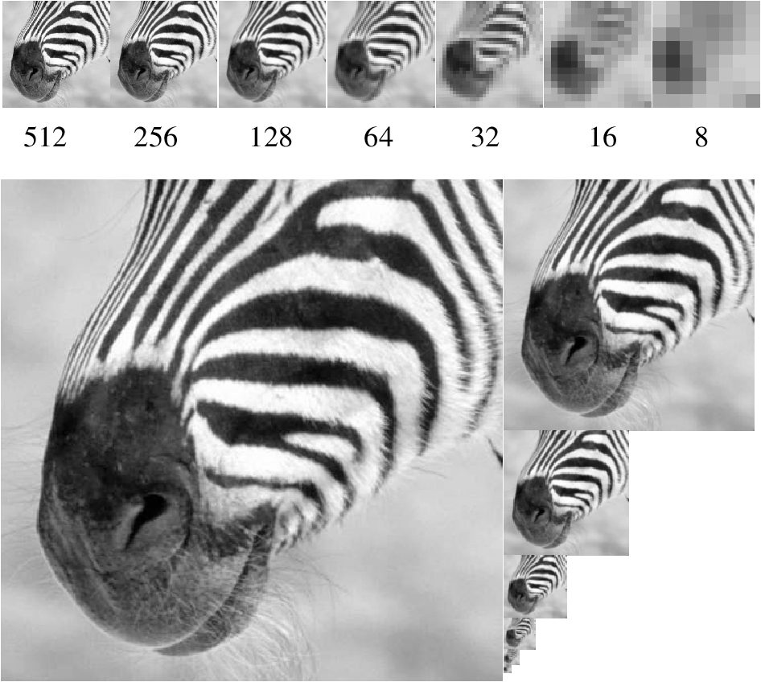

Slide 6
Gaussian Image Stack
Laplacian Image Stack

Slide 7
Gaussian Image Stack
Original input image

Slide 8
Laplacian Image Stack
"Residual"

Slide 9
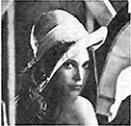
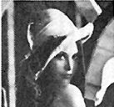
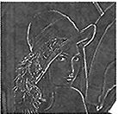
Laplacian Pyramid
-
-
-

Slide 10
Notes:
This is a Gaussian pyramid

Slide 11
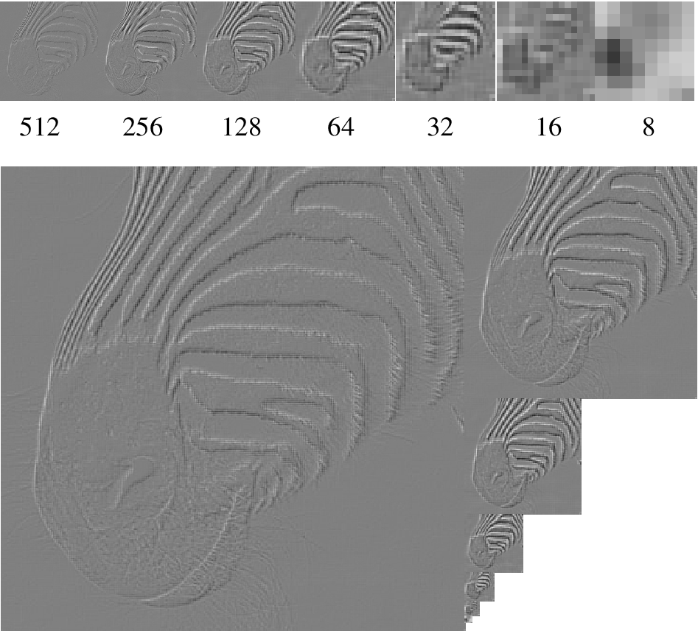
Notes:
And this a Laplacian pyramid. Notice that the lowest layer is the same in each case,
and that if I upsample the lowest layer and add to the next, I get the Gauss layer.
Notice also that each layer shows detail at a particular scale --- these are, basically, bandpass filtered versions of the image.

Slide 12
Frequency Decompositions
Gaussian pyramid
Laplacian pyramid
Fourier transform
Haar wavelet
Steerable pyramid
Bilateral filter

Slide 13
Discrete Fourier Transform (2D)

Slide 14
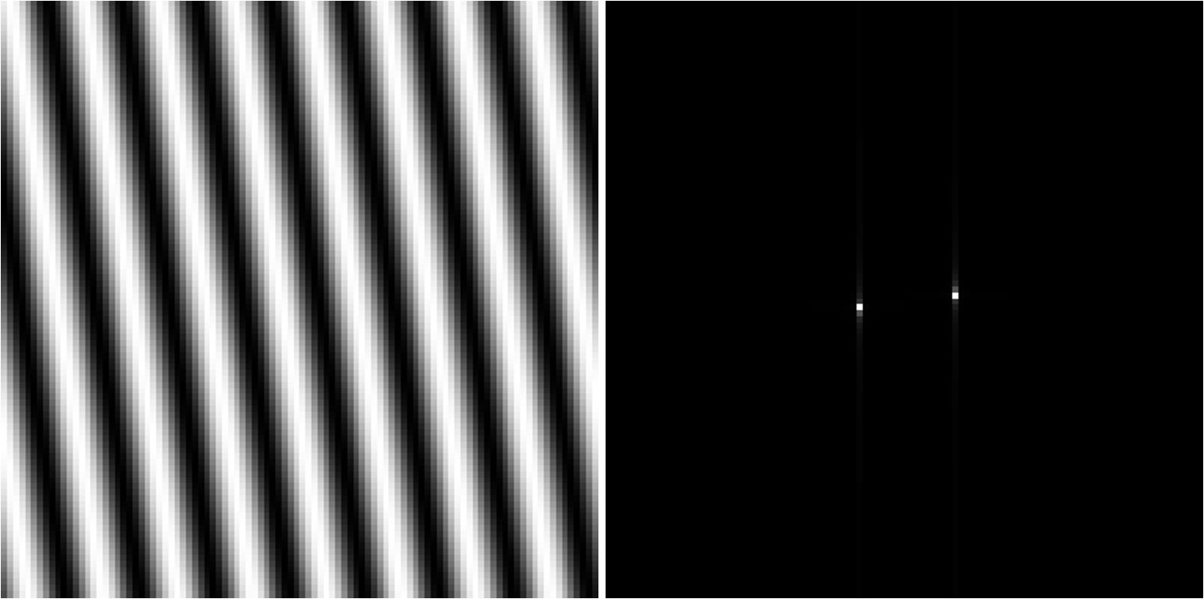
Discrete Fourier Transform (2D)

Slide 15
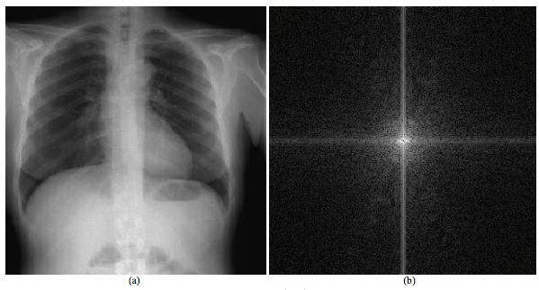
Discrete Fourier Transform (2D)

Slide 16
Discrete Fourier Transform (2D)
Output image vector
Unitary matrix
Linear transform:
Convolutions become pointwise multiply:
Input image vector

Slide 17
What is a good representation for image analysis? (Goldilocks and the three representations)
Fourier transform domain tells you “what” (textural properties), but not “where”. In space, this representation is too spread out.
Pixel domain representation tells you “where” (pixel location), but not “what”. In space, this representation is too localized
Want an image representation that gives you a local description of image events—what is happening where. That representation might be “just right”.

Slide 18
Frequency Decompositions
Gaussian pyramid
Laplacian pyramid
Fourier transform
Haar wavelet
Steerable pyramid
Bilateral filter

Slide 19
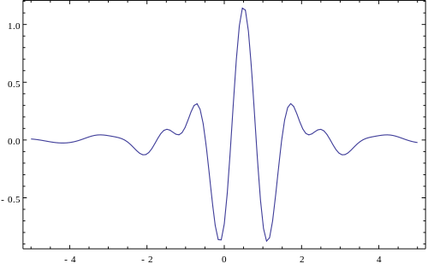
Wavelet
“A wave-like oscillation with an amplitude that begins at zero, increases, and then decreases back to zero.” - Wikipedia

Slide 20
Haar Wavelet Transform
transformed image
Vectorized image
Gaussian pyramid transform, or
Laplacian pyramid transform, or
Fourier transform, or
Wavelet transform, or
Steerable pyramid transform

Slide 21
Haar Wavelet Transform (1D)
haar(v): if length(v) == 1: return v
a =
b =
a’ = (a + b) /
b’ = (a – b) /
return [haar(a’) b’]

Slide 22
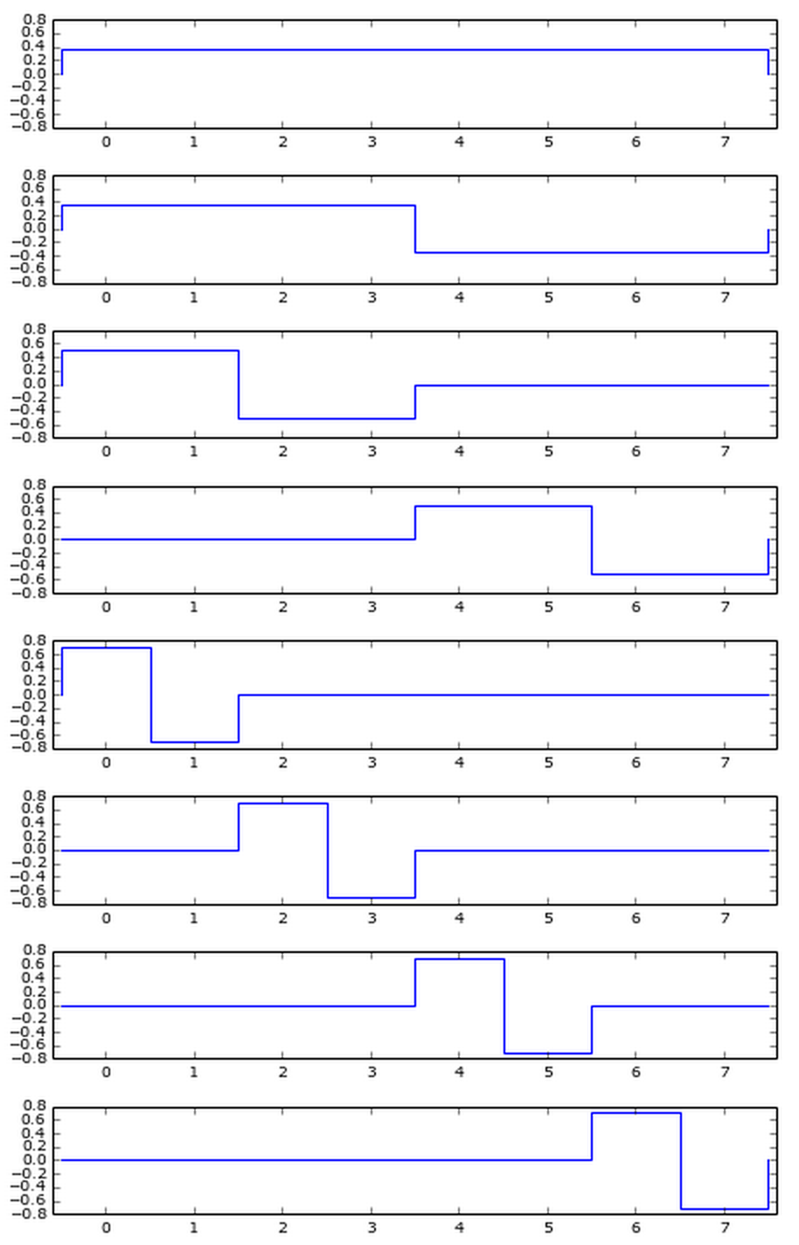
Haar Wavelet Transform (1D)
Basis
functions:
http://unix4lyfe.org/haar/

Slide 23
Haar Wavelet Transform (1D)
inv_haar(v):
if length(v) == 1: return v
a = inv_haar(first half of v) /
b = (second half of v) /
return u

Slide 24
Haar Wavelet Transform (2D)
Apply haar_x(), then haar_y()
(separable – order does not matter)

Slide 25
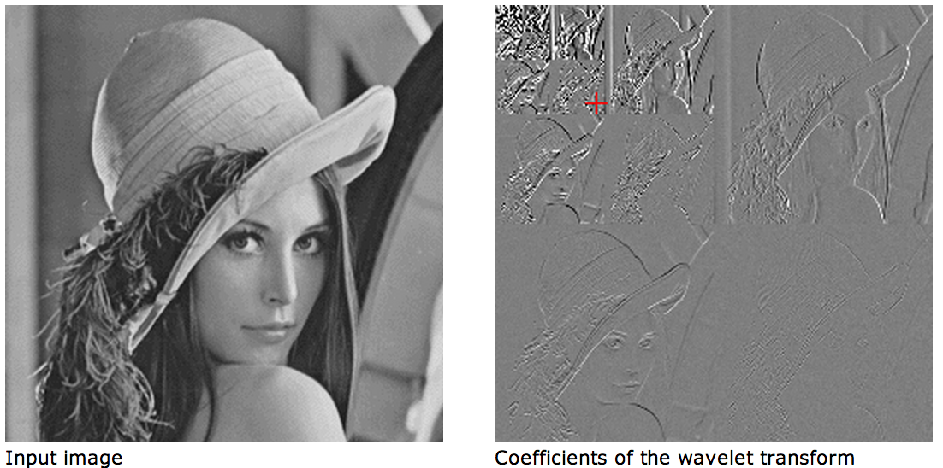
Haar Wavelet Transform (2D)

Slide 26
Question:
Why would we want to do this Haar transform?

Slide 27
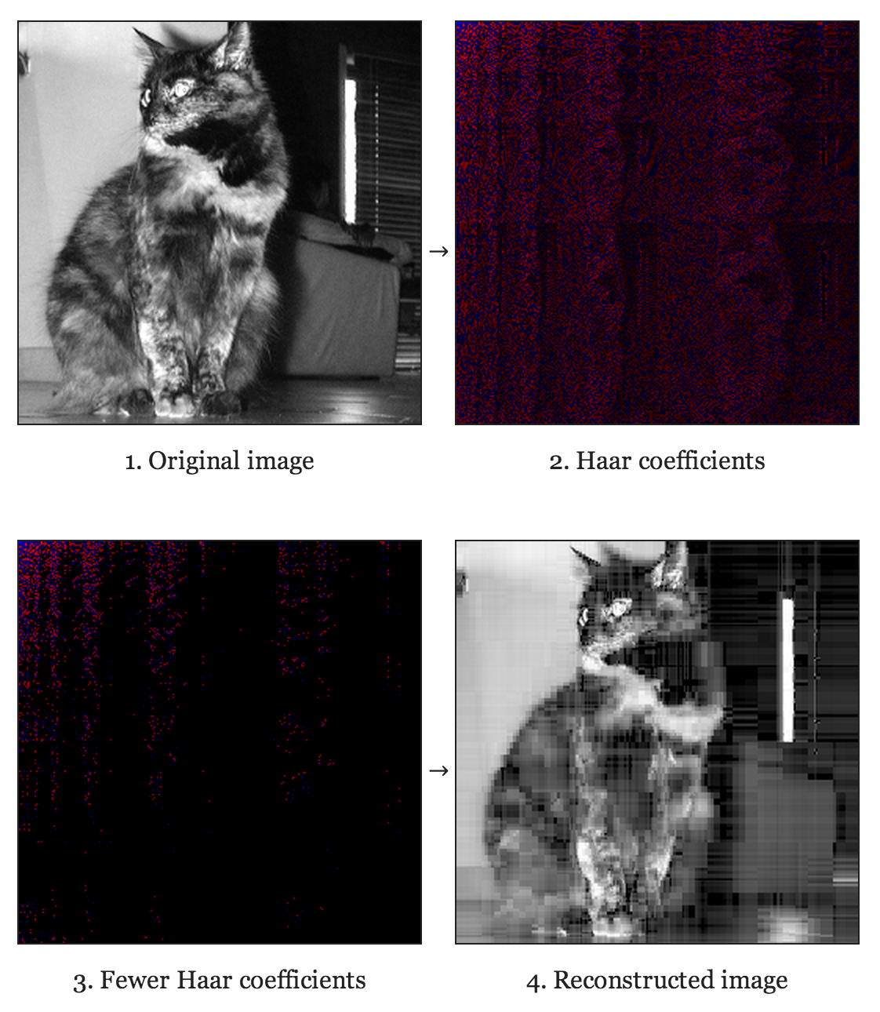
Haar Image Compression
http://unix4lyfe.org/haar/

Slide 28
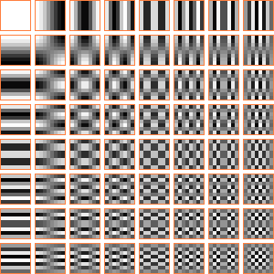
Discrete Cosine Transform
(1D)
(2D)
From ordern-y-concierto
Basis Functions (8x8) – JPEG compression

Slide 29
Frequency Decompositions
Gaussian pyramid
Laplacian pyramid
Fourier transform
Haar wavelet
Steerable pyramid
Bilateral filter

Slide 30
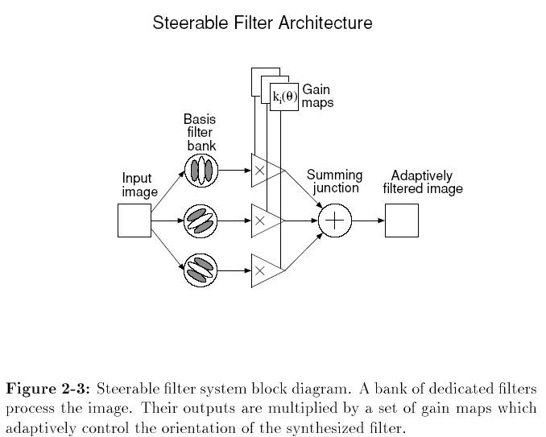
Steerable filters
http://people.csail.mit.edu/billf/freemanThesis.pdf

Slide 31
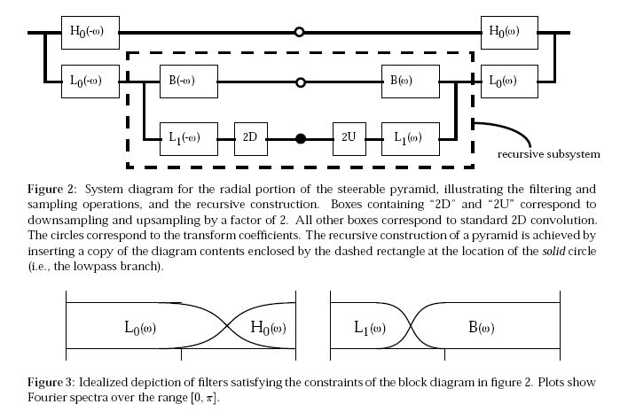
http://www.merl.com/reports/docs/TR95-15.pdf

Slide 32
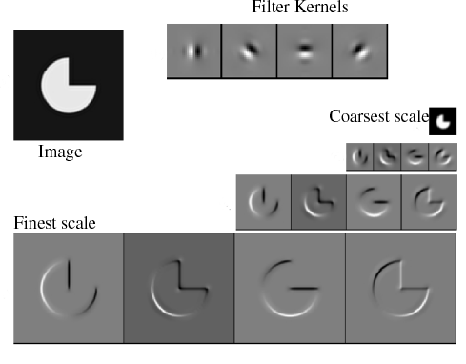
Reprinted from “Shiftable MultiScale Transforms,” by Simoncelli et al., IEEE Transactions
on Information Theory, 1992, copyright 1992, IEEE
Notes:
This is an example with four orientations at each layer

Slide 33
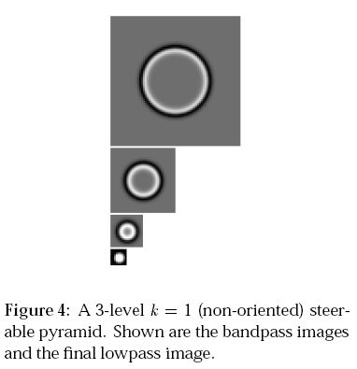
Non-oriented steerable pyramid
http://www.merl.com/reports/docs/TR95-15.pdf

Slide 34
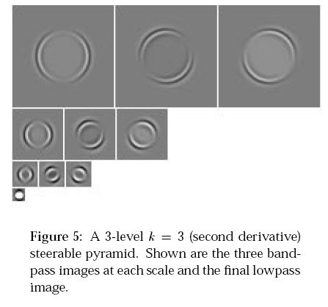
3-orientation steerable pyramid
http://www.merl.com/reports/docs/TR95-15.pdf

Slide 35
Steerable pyramids
Good:
Oriented subbands
Non-aliased subbands
Steerable filters
Bad:
Overcomplete

Slide 36
Oriented pyramids
Laplacian pyramid is orientation independent
Apply an oriented filter to determine orientations at each layer
by clever filter design, we can simplify synthesis
this represents image information at a particular scale and orientation

Slide 37
Image pyramids
Progressively blurred and subsampled versions of the image. Adds scale invariance to fixed-size algorithms.
Gaussian
Laplacian
Haar Wavelet
Steerable pyramid
Shows the information added in Gaussian pyramid at each spatial scale. Useful for noise reduction & coding & frequency manipulation.
Simplest wavelet, can be used for simple image compression (JPEG uses DCT)
Shows components at each scale and orientation separately. Non-aliased subbands. Good for texture and feature analysis.

Slide 38
Schematic pictures of each matrix transform
Shown for 1-d images
The matrices for 2-d images are the same idea, but more complicated, to account for vertical, as well as horizontal, neighbor relationships.
transformed image
Vectorized image
Fourier transform, or
Wavelet transform, or
Steerable pyramid transform

Slide 39
Fourier transform
=
*
Fourier transform
Fourier bases are global: each transform coefficient depends on all pixel locations.
pixel domain image

Slide 40
Gaussian pyramid
=
*
Gaussian pyramid
pixel image
Low-pass filters, sampled appropriately for their blur.
Question: Is this complete or overcomplete?

Slide 41
Laplacian pyramid
=
*
Laplacian pyramid
pixel image
Overcomplete representation. Transformed pixels represent bandpassed image information.

Slide 42
Haar Wavelet transform
Wavelet pyramid
=
*
Ortho-normal transform (like Fourier transform), but with localized basis functions.
pixel image

Slide 43
Steerable pyramid
Multiple orientations at one scale
=
*
Steerable pyramid
pixel image
Multiple orientations at the next scale
Over-complete representation, but non-aliased subbands.
the next scale…

Slide 44
Frequency Decompositions
Gaussian pyramid
Laplacian pyramid
Fourier transform
Haar wavelet
Steerable pyramid
Bilateral filter

Slide 45
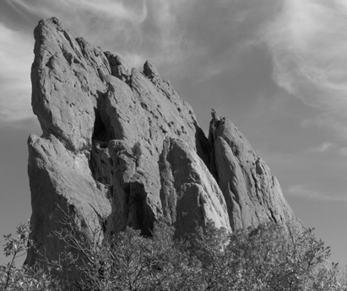
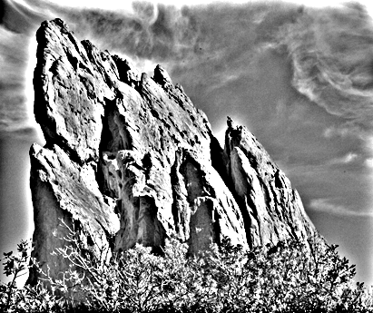
Naïve Approach: Gaussian Convolution
BLUR
HALOS
smoothed (structure, large scale)
residual (texture, small scale)
input
Gaussian Convolution

Slide 46
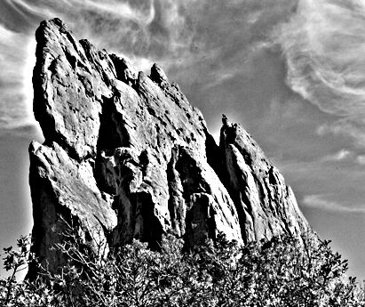
Impact of Blur and Halos
If the decomposition introduces blur and halos, the final result is corrupted.
Sample manipulation: increasing texture (residual × 3)

Slide 47
Question
How can we get rid of the halos?

Slide 48
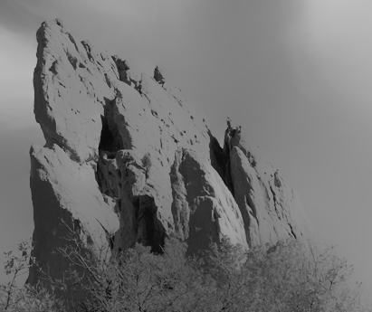
Bilateral Filter: no Blur, no Halos
smoothed (structure, large scale)
residual (texture, small scale)
input
edge-preserving: Bilateral Filter

Slide 49
input

Slide 50
increasing texture with Gaussian convolution H A L O S

Slide 51
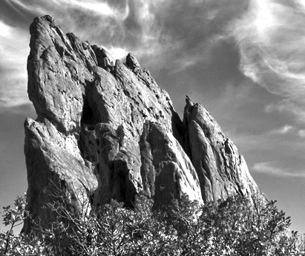
increasing texture with bilateral filter N O H A L O S

Slide 52
Illustration a 1D Image
1D image = line of pixels
Better visualized as a plot
pixel intensity
pixel position

Slide 53
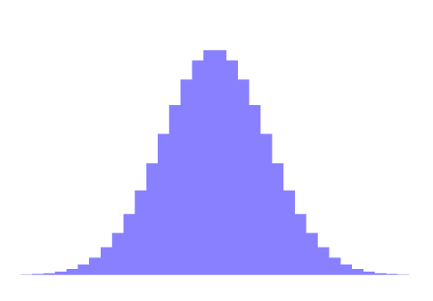
Definition
Gaussian blur
p
space
q
only spatial distance, intensity ignored
space
Bilateral filter [Aurich 95, Smith 97, Tomasi 98]
p
range
space
range
q
normalization
space
spatial and range distances
weights sum to 1

Slide 54
Bilateral Filter on 1D Signal
BF

Slide 55
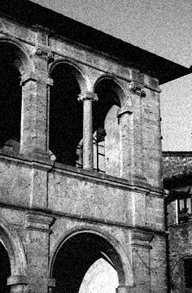
Example on a Real Image
Kernels can have complex, spatially varying shapes.
input
output
⊗
⊗
⊗

Slide 56
Source Code
Laplacian Pyramid, Steerable Filters:
Eero Simoncelli:
http://www.cns.nyu.edu/~eero/software.html
Bilateral filter:
Sylvain Paris:
http://people.csail.mit.edu/sparis/

Slide 57
Why use these representations?
Handle real-world size variations with a constant-size vision algorithm.
Remove noise
Analyze texture
Recognize objects
Label image features
Artistic filters
High dynamic range imaging

Slide 58
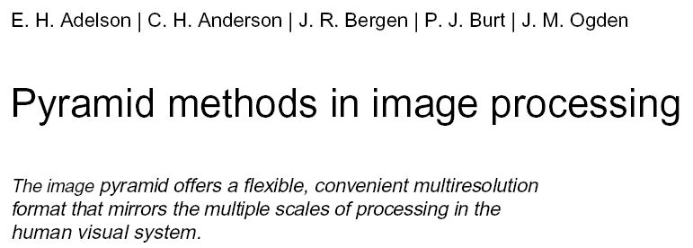
http://web.mit.edu/persci/people/adelson/pub_pdfs/RCA84.pdf

Slide 59
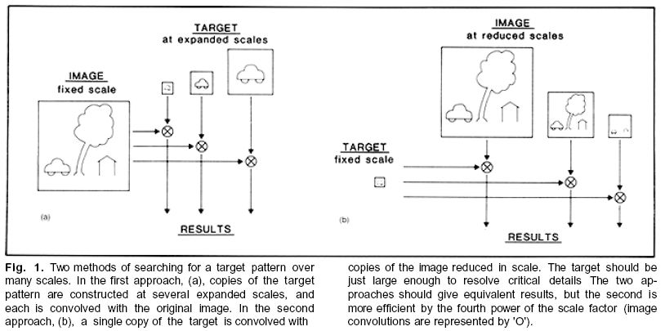
http://web.mit.edu/persci/people/adelson/pub_pdfs/RCA84.pdf

Slide 60
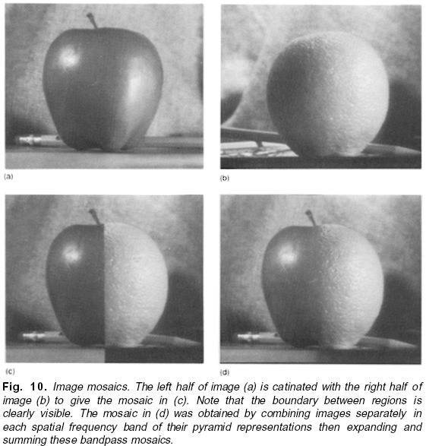
http://web.mit.edu/persci/people/adelson/pub_pdfs/RCA84.pdf

Slide 61
Noise removal results
Simoncelli and Adelson, Noise Removal via Bayesian Wavelet Coring
http://www-bcs.mit.edu/people/adelson/pub_pdfs/simoncelli_noise.pdf

Slide 62
Image texture

Slide 63
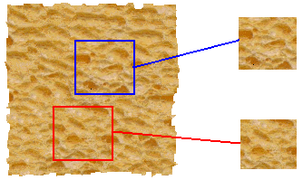
The Goal of Texture Synthesis
input image
SYNTHESIS
True (infinite) texture
generated image
Given a finite sample of some texture, the goal is to synthesize other samples from that same texture
The sample needs to be "large enough“

Slide 64
The Goal of Texture Analysis
input image
ANALYSIS
“Same” or “different”
True (infinite) texture
generated image
Compare textures and decide if they’re made of the same “stuff”.

Slide 65
Malik and Perona
Learn: use lots of filters, multi-ori&scale.
Malik J, Perona P. Preattentive texture discrimination with early vision mechanisms. J OPT SOC AM A 7: (5) 923-932 MAY 1990

Slide 66
Representing textures
Textures are made up of quite stylised subelements, repeated in meaningful ways
Representation:
find the subelements, and represent their statistics
But what are the subelements, and how do we find them?
recall normalized correlation
find subelements by applying filters, looking at the magnitude of the response
What filters?
experience suggests spots and oriented bars at a variety of different scales
details probably don’t matter
What statistics?
within reason, the more the merrier.
At least, mean and standard deviation
better, various conditional histograms.

Slide 67
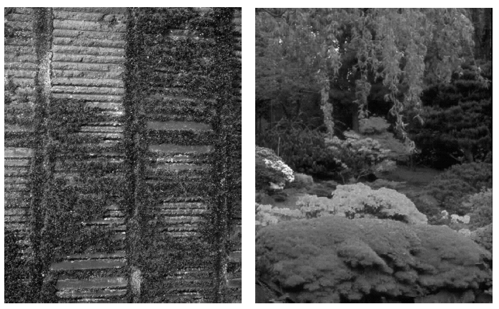
Notes:
Typical textured images. For materials such as brush, grass, foliage
and water, our perception of what the material is is quite intimately related to the
texture (for the figure on the left, what would the surface feel like if you ran your
fingers over it? is it wet?, etc.). Notice how much information you are getting
about the type of plants, their shape, etc. from the textures in the figure on the
right. These textures are also made of quite stylized subelements, arranged in a
rough pattern.

Slide 68
Squared responses
Spatially blurred
vertical filter
image
Threshold squared, blurred responses, then categorize texture based on those two bits
horizontal filter

Slide 69
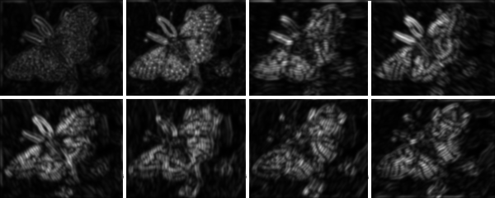
Notes:
Spots and bars at a fine scale for the butterfly; images show squared response for
corresponding filter

Slide 70
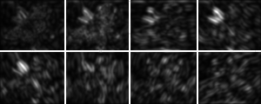
Notes:
ditto, for a coarser scale. The size of the filter has stayed fixed, but the image is half the
original size (this points to the utility of pyramids).

Slide 71
Notes:
I’ve scaled up the coarse scale responses so they can be compared. Notice that these
representations don’t respond uniquely --- i.e. there isn’t one peak at one orientation and
one scale for a given bar --- but they do give quite a good idea of what is there. If they
were tightly tuned, there would have to be a lot more filters. But looking at these pix
gives quite a good idea of where there are big bars, where there are little ones, and
at what orientation.

Slide 72
If matching the averaged squared filter values is a good way to match a given texture, then maybe matching the entire marginal distribution (eg, the histogram) of a filter’s response would be even better.
Jim Bergen proposed this…

Slide 73
SIGGRAPH 1994

Slide 74
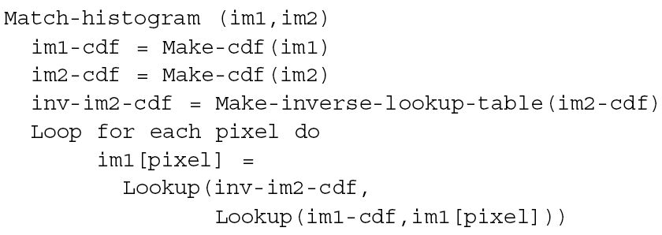
Histogram matching algorithm
“At this im1 pixel value, 10% of the im1 values are lower. What im2 pixel value has 10% of the im2 values below it?”

Slide 75
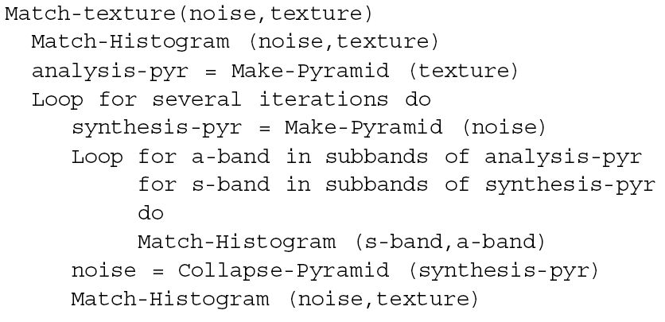
Heeger-Bergen texture synthesis algorithm
Alternate matching the histograms of all the subbands and matching the histograms of the reconstructed images.

Slide 76
Bergen and Heeger
Learn: use filter marginal statistics.
Heeger/Bergen, Siggraph 1994

Slide 77
Bergen and Heeger results
Heeger/Bergen, Siggraph 1994

Slide 78
Bergen and Heeger failures
Heeger/Bergen, Siggraph 1994

Slide 79
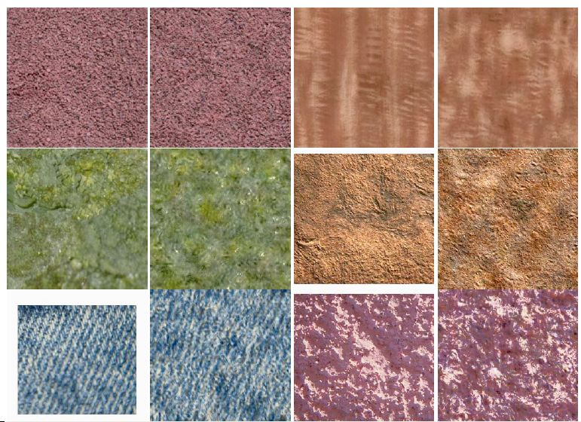
More examples
Heeger/Bergen, Siggraph 1994

Slide 80
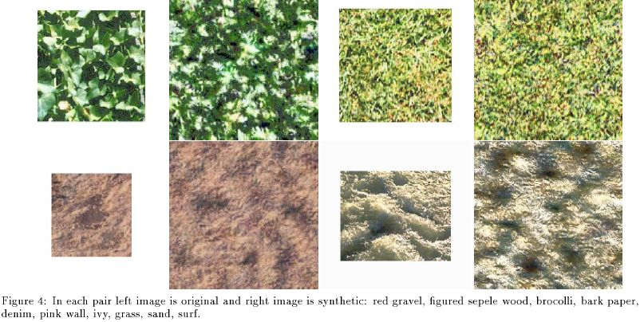
More examples
Heeger/Bergen, Siggraph 1994

Slide 81
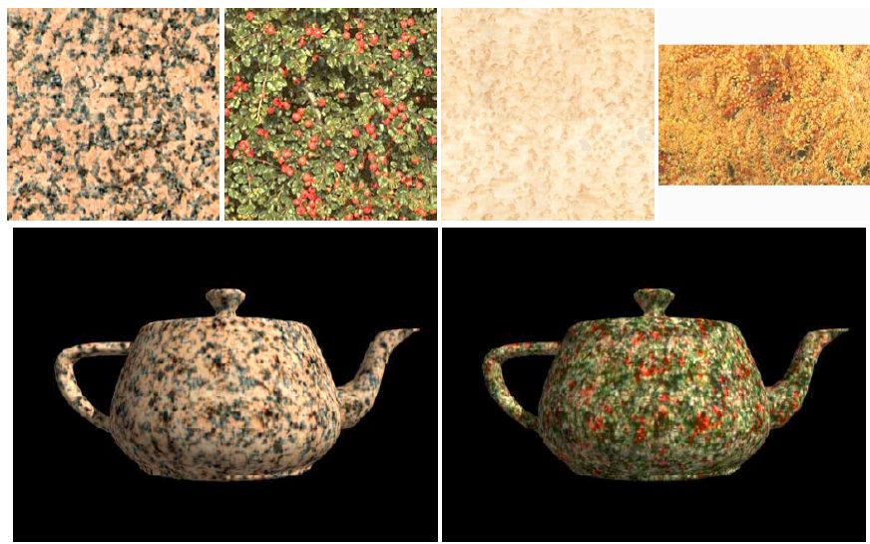
Synthetic surfaces
Heeger/Bergen, Siggraph 1994

Slide 82
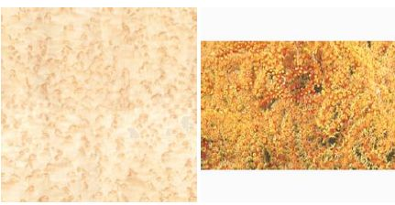
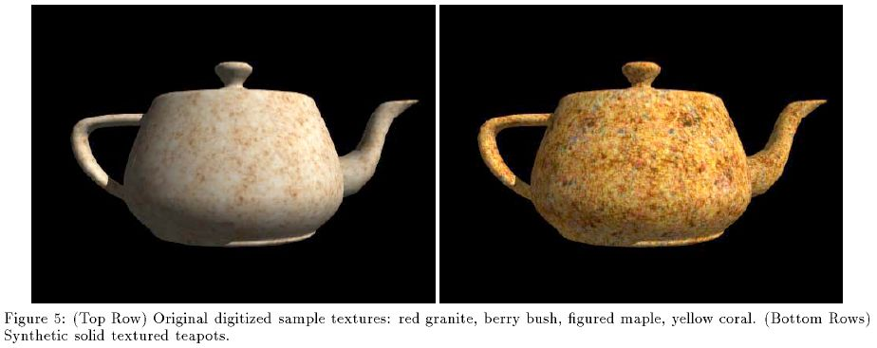
Synthetic surfaces
Heeger/Bergen, Siggraph 1994

Slide 83
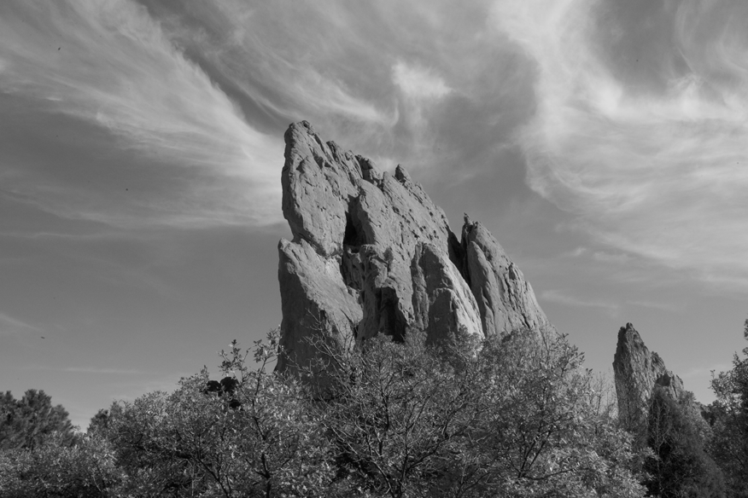
Bilateral Filters – Photographic Style Transfer [Bae 06]
input

Slide 84
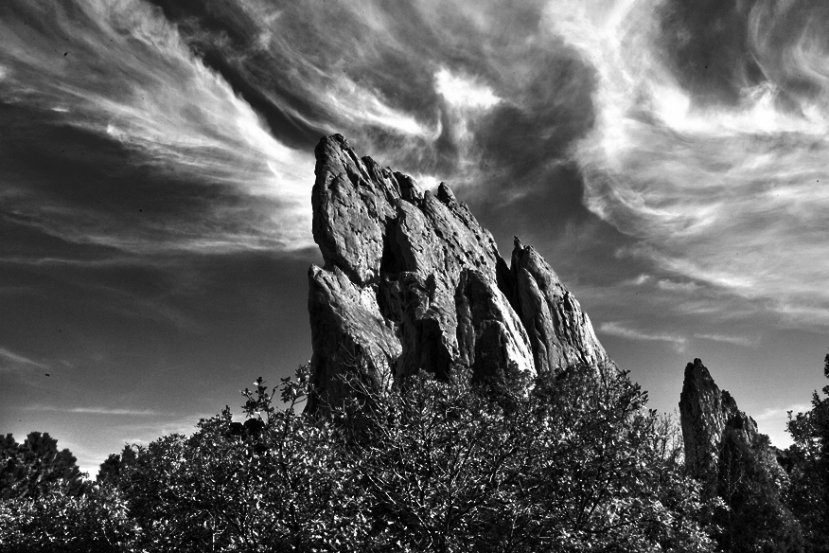
Bilateral Filters – Photographic Style Transfer [Bae 06]
output

Slide 85
Bilateral Filters – Tone Mapping [Durand 02]
HDR input

Slide 86
Bilateral Filters – Tone Mapping [Durand 02]
output

Slide 87
Bilateral Filters – Cartoon Rendition [Winnemöller 06]
input

Slide 88
Bilateral Filters – Cartoon Rendition [Winnemöller 06]
output

Slide 89
Conclusion
Frequency decompositions are important for many applications in vision, graphics, photographic adjustment.

