Slide 1
Image Warping / Morphing
[Wolberg 1996, Recent Advances in Image Morphing]
Computational Photography Connelly Barnes
Some slides from Fredo Durand, Bill Freeman, James Hays

Slide 2
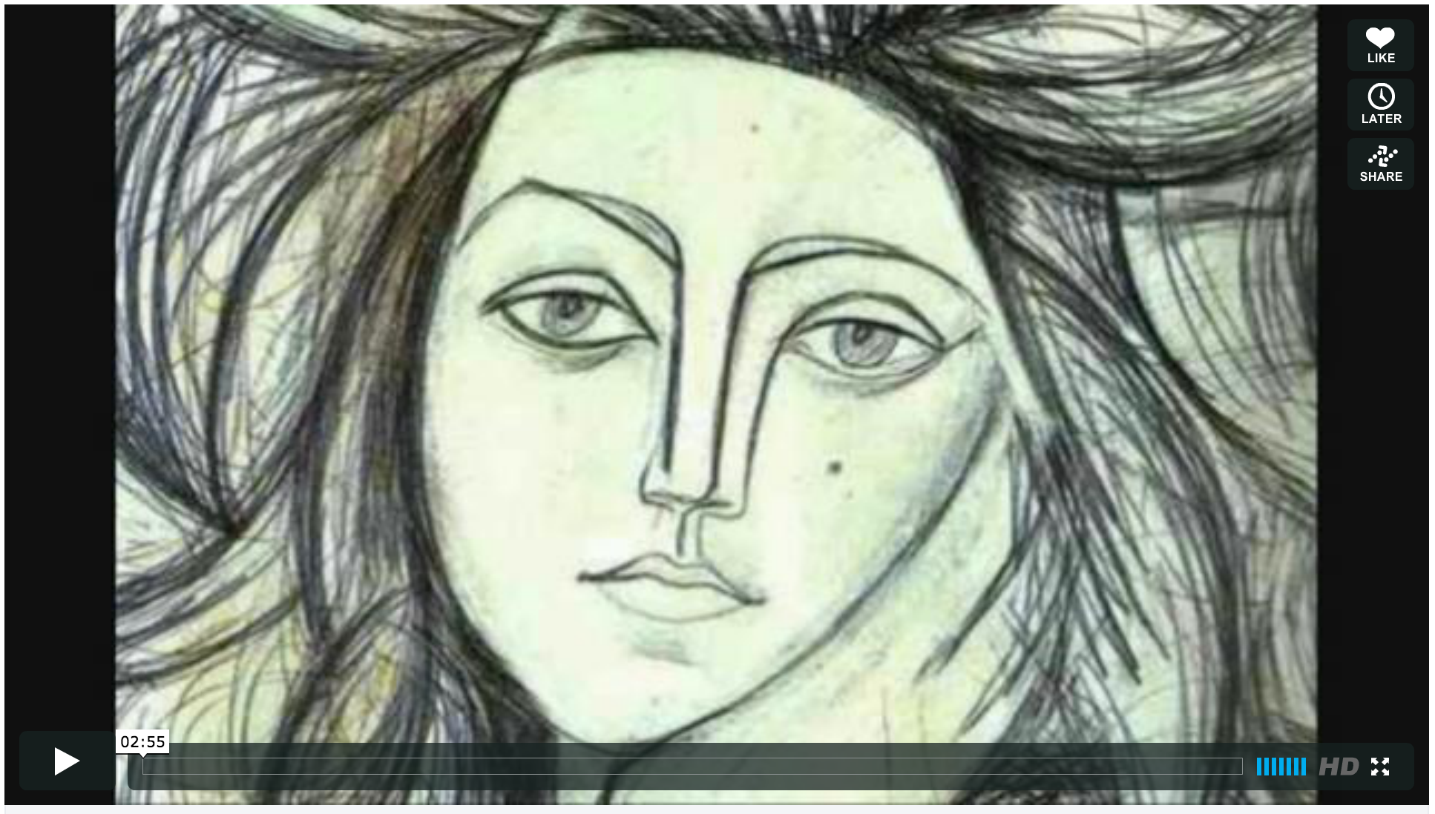
Morphing Video: Women in Art
http://www.vimeo.com/1456037

Slide 3
Terminator 2 Morphing (1991)
Terminator 2 Clip (YouTube)

Slide 4
Image Warping in Biology
D'Arcy Thompson
Importance of shape and structure in evolution
http://en.wikipedia.org/wiki/D'Arcy_Thompson
Slide by Durand and Freeman

Slide 5
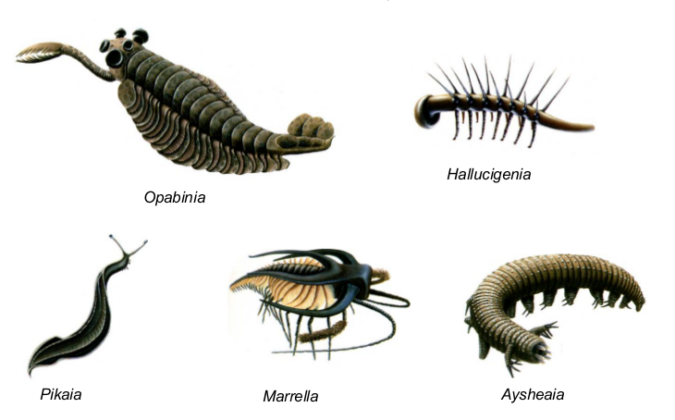
Cambrian Explosion
Source: http://www.earthlearningidea.com/

Slide 6
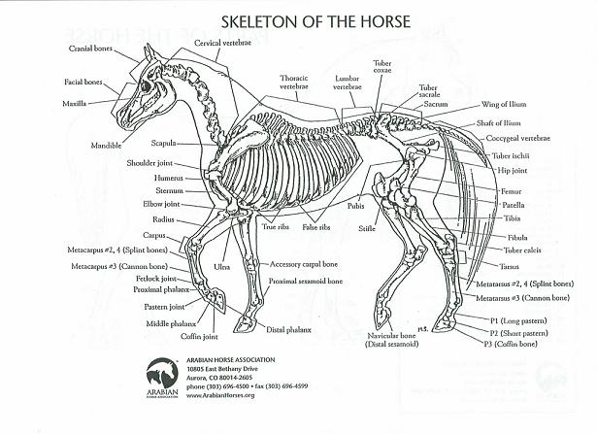
Skeletons

Slide 7
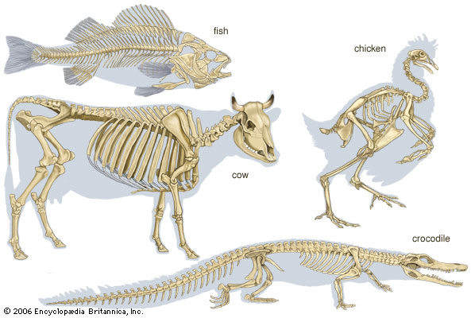
Skeletons

Slide 8
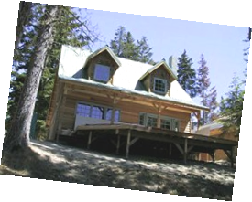
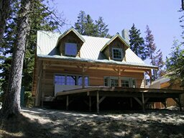
Recovering Transformations
?
T(x,y)
y
y’
x
x’
f(x,y)
g(x’,y’)
What if we know f and g and want to recover the transform T?
e.g. better align photographs you’ve taken
willing to let user provide correspondences
How many do we need?

Slide 9
Translation: # correspondences?
?
T(x,y)
y
y’
x
x’
How many correspondences needed for translation?
How many Degrees of Freedom?
What is the transformation matrix?

Slide 10
Translation + Rotation?
?
T(x,y)
y
y’
x
x’
How many correspondences needed for translation+rotation?
How many DOF?

Slide 11
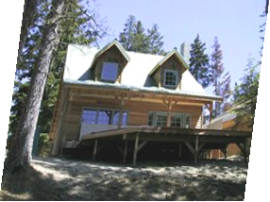
Affine: # correspondences?
?
T(x,y)
y
y’
x
x’
How many correspondences needed for affine transform?
How many DOF?

Slide 12
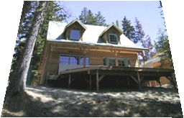
Projective / Homography
?
T(x,y)
y
y’
x
x’
How many correspondences needed for projective? How many DOF?

Slide 13
Image Warping
T(x,y)
y
y’
x
x’
f(x,y)
g(x’,y’)
Given a coordinate transform (x’,y’) = T(x,y) and a source image f(x,y), how do we compute a transformed image g(x’,y’) = f(T(x,y))?

Slide 14
Forward warping
T(x,y)
y
y’
x
x’
(x,y)
(x’,y’)
Send each pixel (x,y) to its corresponding location
(x’,y’) = T(x,y) in the second image

Slide 15
Forward warping
T(x,y)
y
y’
x
x’
f(x,y)
g(x’,y’)
Q: what if pixel lands “between” two pixels?
A: distribute color among neighboring pixels (x’,y’)
Known as “splatting”
Can also interpolate points in target image: griddata (Matlab), scipy.interpolate.griddata (Python)

Slide 16
Inverse warping
T⁻¹(x,y)
y
y’
x
x
x’
(x,y)
(x’,y’)
Get each pixel color g(x’,y’) from its corresponding location
(x,y) = T⁻¹(x’,y’) in the first image

Slide 17
Inverse warping
T⁻¹(x,y)
y
y’
x
x
x’
f(x,y)
g(x’,y’)
Q: what if pixel comes from “between” two pixels?
A: Interpolate color value from neighbors
nearest neighbor, bilinear, Gaussian, bicubic
See interp2 (Matlab), scipy.interpolate.interp2d (Python)

Slide 18
Forward vs. inverse warping
Q: Which is better?

Slide 19
Forward vs. inverse warping
Q: Which is better?
A: Usually inverse – eliminates holes
However, it requires an invertible warp function
Not always possible

Slide 20
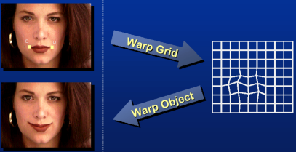
How to Obtain Warp Field?
Move control points to specify a spline warp
Spline produces a smooth vector field T(x, y)
Slide Alyosha Efros

Slide 21
Warp as Interpolation
We are looking for a warping field
A function that given a 2D point, returns a warped 2D point
We have a sparse number of correspondences
These specify values of the warping field
This is an interpolation problem
Given sparse data, find smooth function

Slide 22
Interpolation in 1D
We are looking for a function f
We have N data points: x_{i}, y_{i}
Scattered: spacing between x_{i} is non-uniform
We want f so that
For each i, f(x_{i})=y_{i}
f is smooth
Depending on notion of smoothness, different f

Slide 23
Radial Basis Functions (RBF)
Place a smooth kernel R centered on each data point x_{i}

Slide 24
Radial Basis Functions (RBF)
Place a smooth kernel R centered on each data point x_{i}
Find weights α_{i} to make sure we interpolate the data
for each i, f(x_{i})=y_{i}

Slide 25
Radial Basis Function Kernels
Linear
Cubic Quintic
Thin plate
Inverse
Multiquadratic

Slide 26
Solve RBF Interpolation Problem
For each j,
In 1D: N equations, N unknowns, linear solver.
In n-D: Denote α_{i}, x_{i}, y_{i} Solve Nm equations in Nm unknowns α_{i}.

Slide 27
RBF Summary
Interpolates “scattered data”, or data defined only at a few sparse locations.
Basis functions have infinite extent…
Python: scipy.interpolate.Rbf
MATLAB: Google “matlab rbf interpolation” (3rd party code)

Slide 28
Applying a warp: use inverse
Forward warp:
For each pixel in input image
Paste color to warped location in output
Problem: gaps
Inverse warp
For each pixel in output image
Lookup color from inverse-warped location

Slide 29
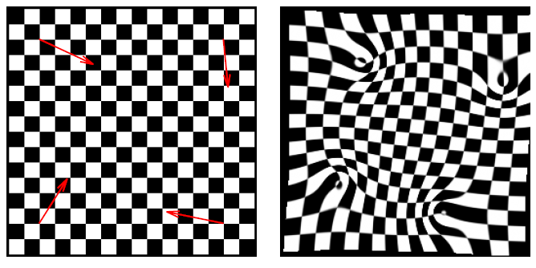
Example

Slide 30
Example
Fold problems
Oh well…

Slide 31
1D equivalent of folds
No guarantee that our 1D RBF is monotonic
input
result (remember, inverse warp)

Slide 32
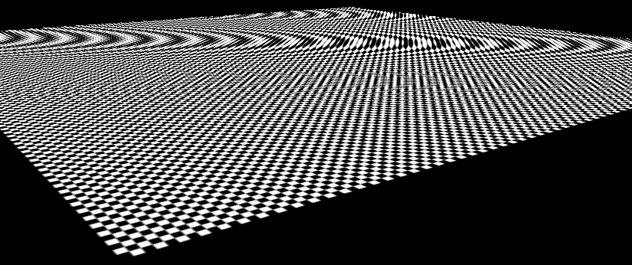
Aliasing Issues with Warping
Aliasing can happen if warps are extreme. This is especially noticeable during animation.
point sampling
mipmaps & linear interpolation

Slide 33
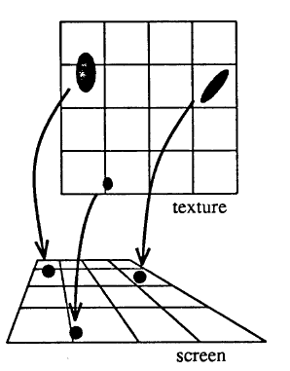
Aliasing Solution
Use an ellipsoidal Gaussian:
“Elliptical Weighted Average” (EWA)
Filter is deformed based on warping.
For inverse warping, each output (warped) pixel does a weighted average of nearby pixels against the filter.
Can approximate with circular Gaussian.
Paul Heckbert Master’s Thesis

Slide 34
Morphing = Object Averaging
The aim is to find “an average” between two objects
Not an average of two images of objects…
…but an image of the average object!
How can we make a smooth transition in time?
Do a “weighted average” over time t
How do we know what the average object looks like?
We haven’t a clue!
But we can often fake something reasonable
Usually required user/artist input

Slide 35
Linear Interpolation
Q
How can we linearly
transition between point P and point Q?
v = Q - P
P
P + t v
= (1-t)P + tQ, e.g. t = 0.5
P and Q can be anything:
points on a plane (2D) or in space (3D)
Colors in RGB or HSV (3D)
Whole images (m-by-n D)… etc.

Slide 36
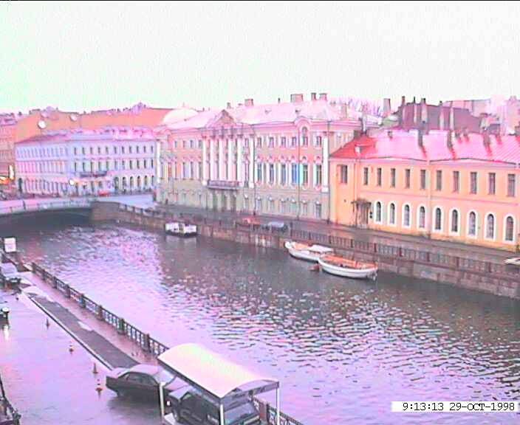
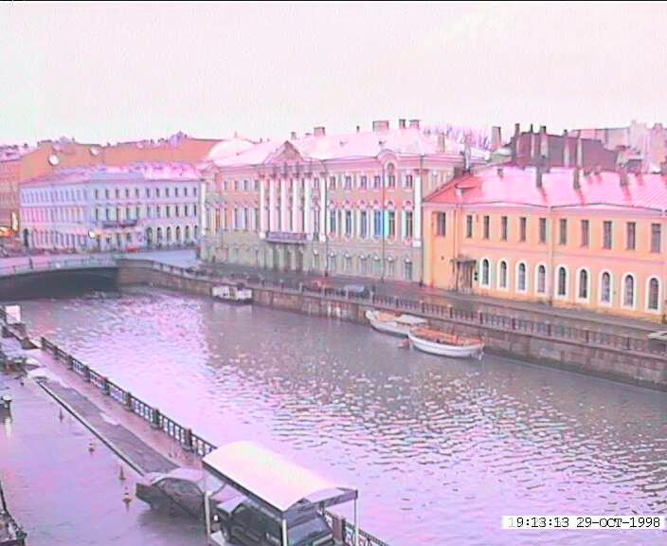
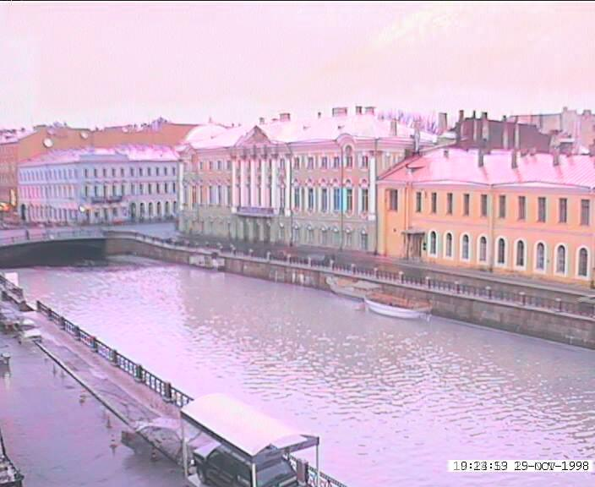
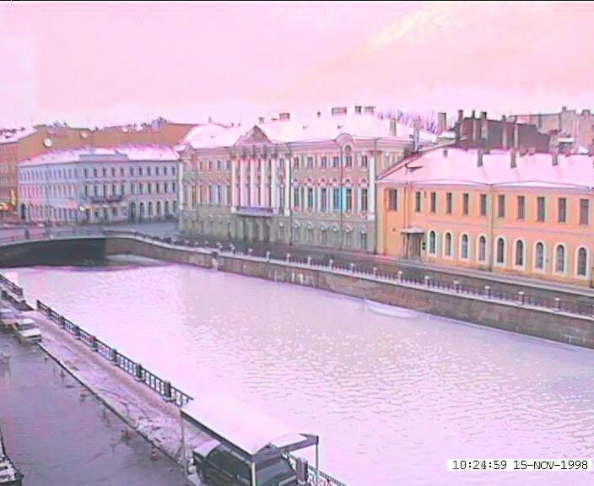
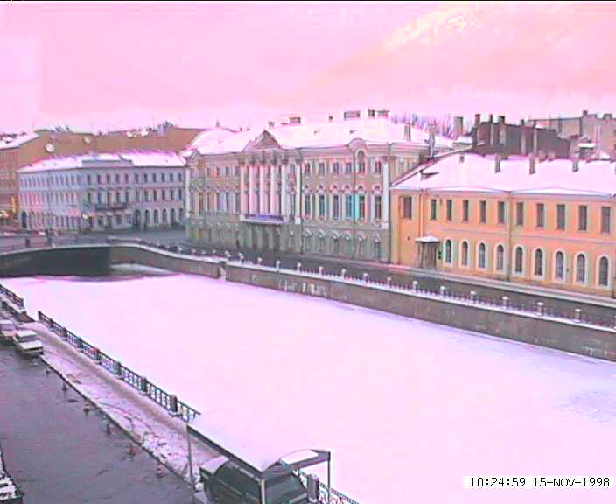
Idea #1: Cross-Dissolve
Interpolate whole images:
Image_{halfway} = (1-t)*Image₁ + t*image₂
This is called cross-dissolve in film industry
But what if the images are not aligned?

Slide 37
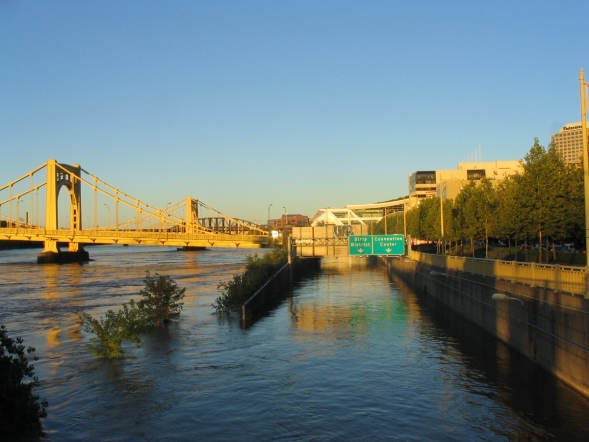
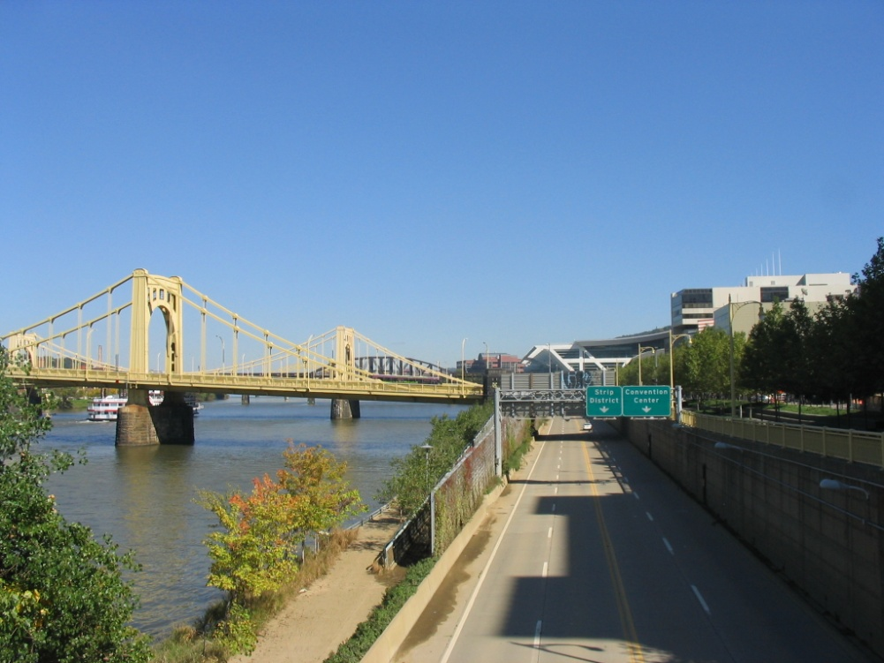
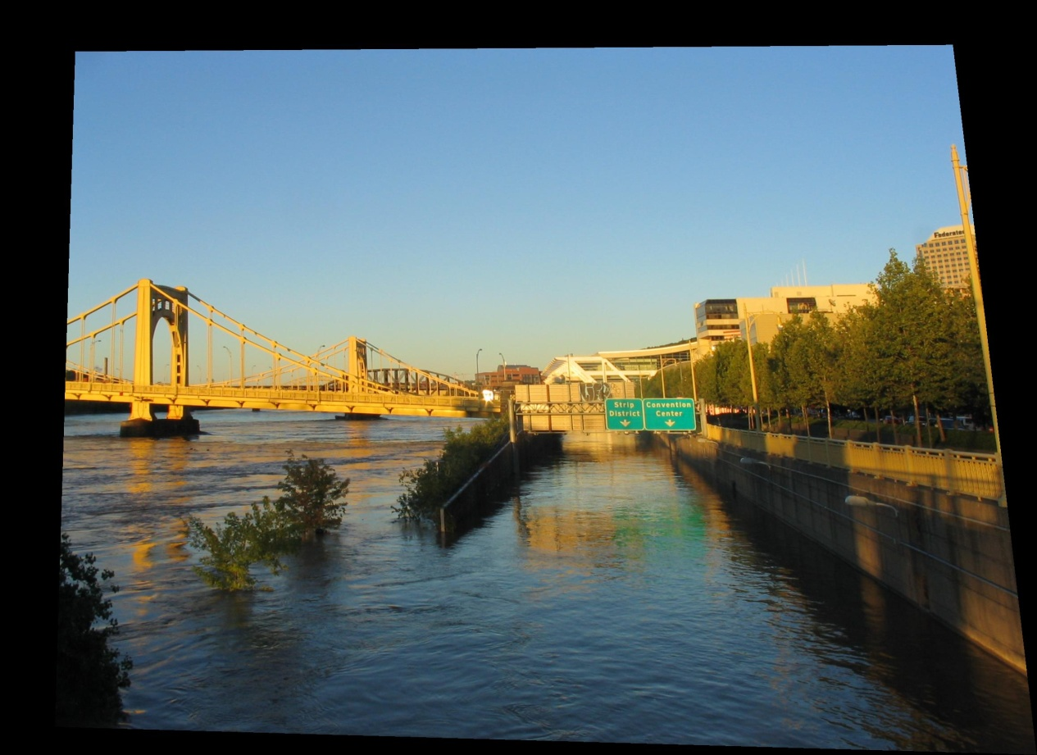
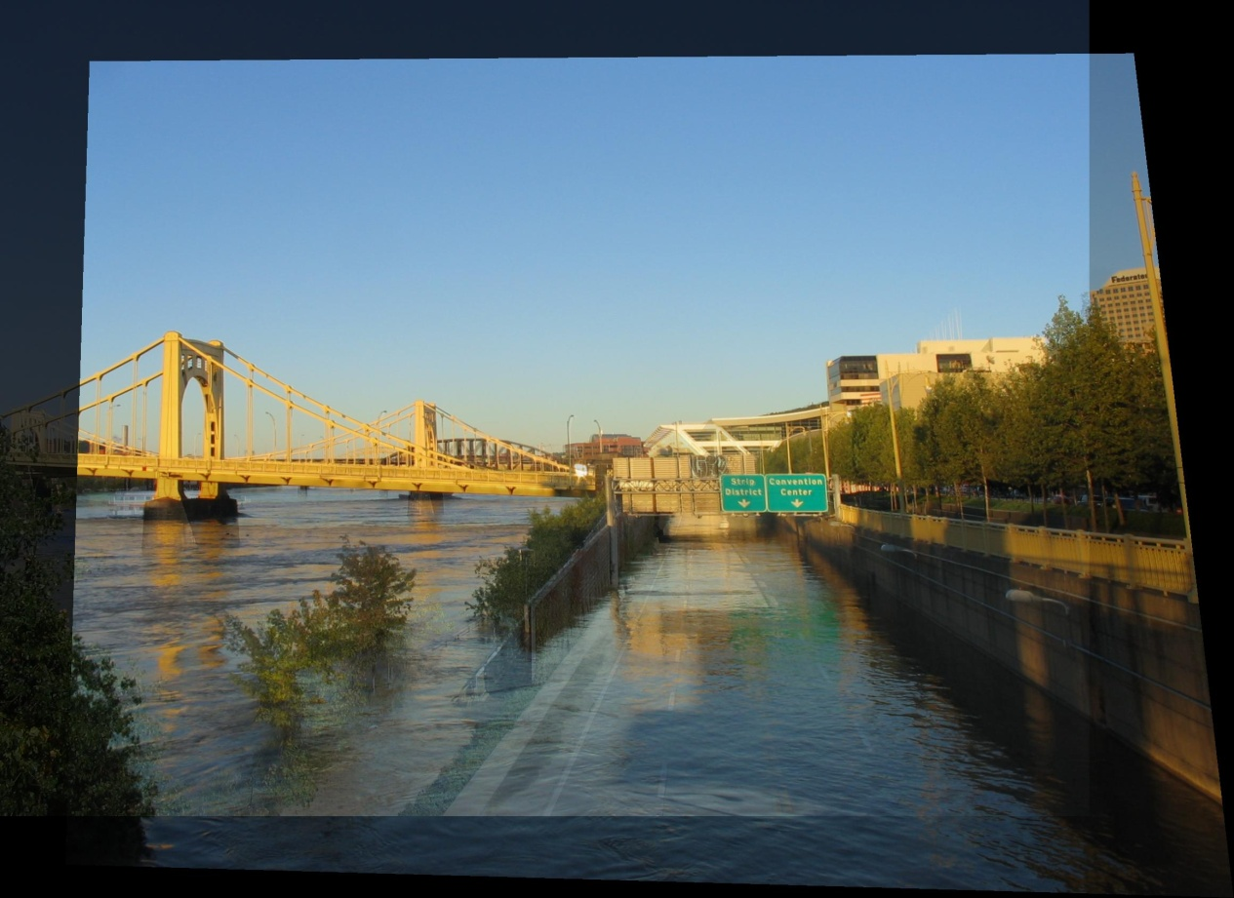
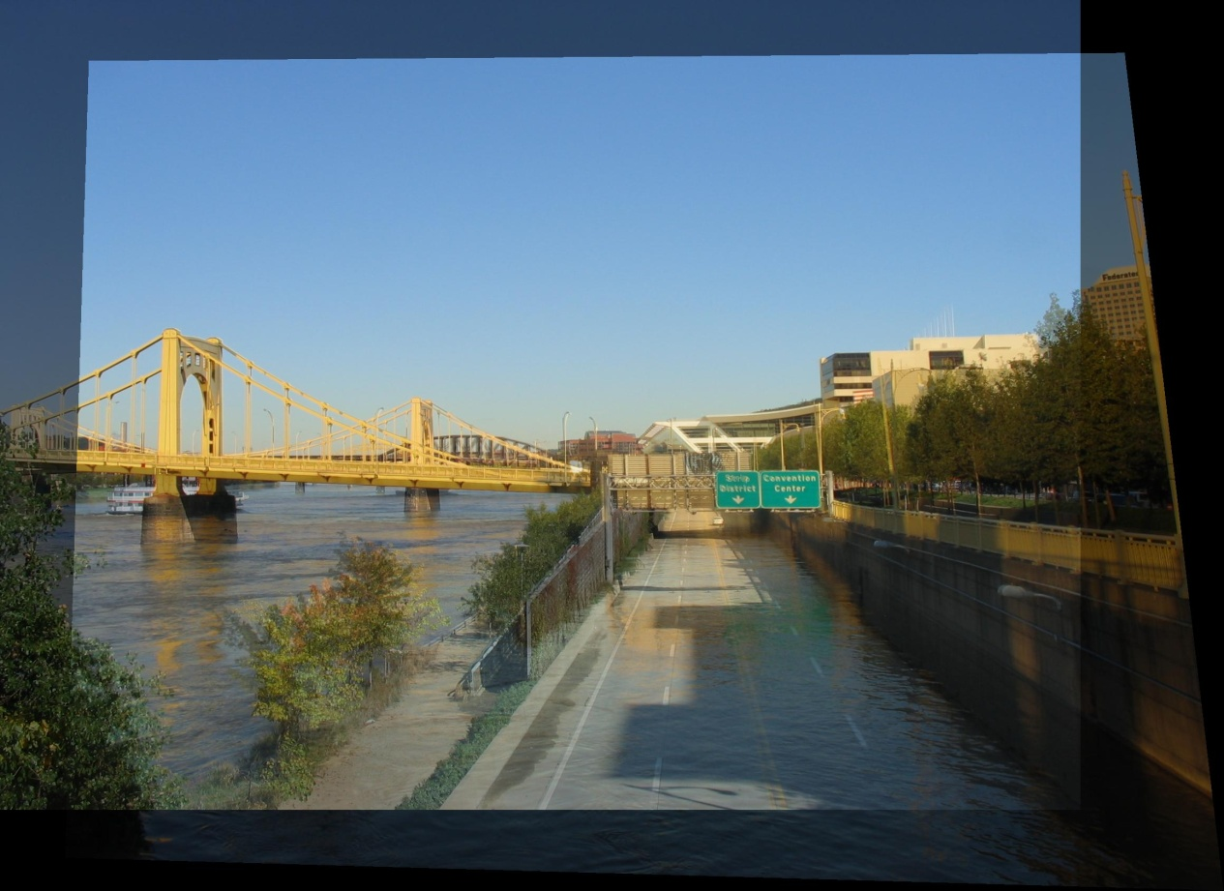
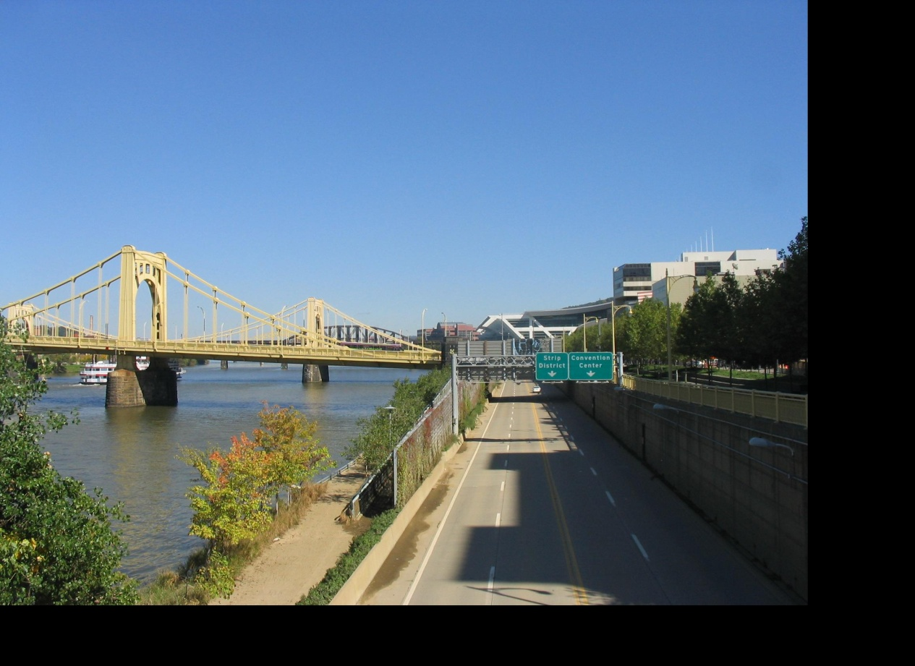
Idea #2: Align, then cross-disolve
Align first, then cross-dissolve
Alignment using global warp – picture still valid

Slide 38
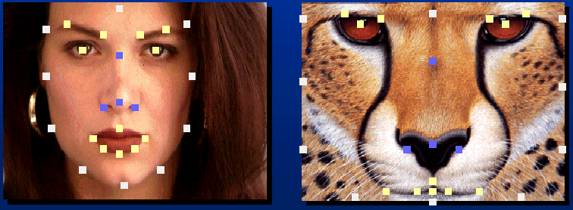
Full Morphing
A
B
What if there is no simple global function that aligns two images?
User specifies corresponding feature points
Construct warp animations A -> B and B -> A
Cross dissolve these

Slide 39
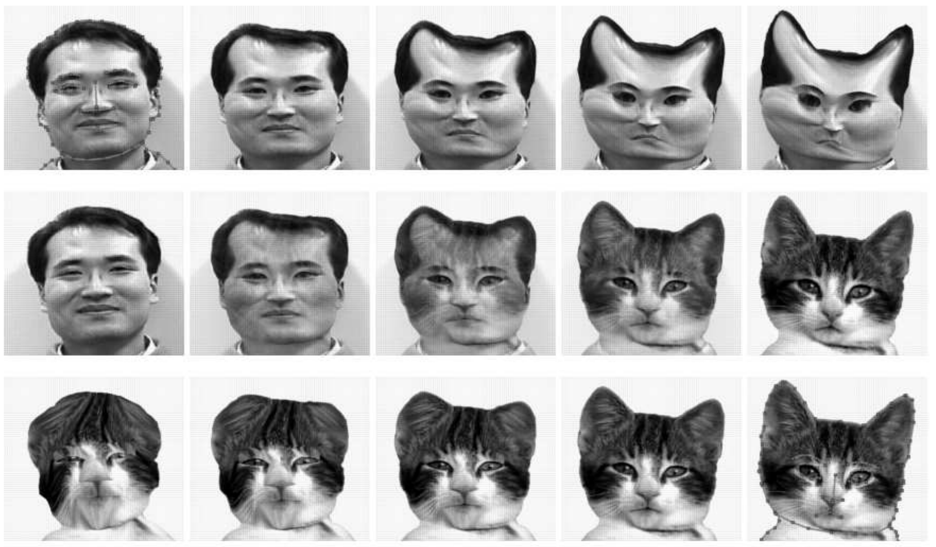
Full Morphing

Slide 40
Full Morphing
Image A
Image B
1. Find warping fields from user constraints (points or lines): Warp field T_{AB}(x, y) that maps A pixel to B pixel
Warp field T_{BA}(x, y) that maps B pixel to A pixel
2. Make video A(t) that warps A over time to the shape of B
Start warp field at identity and linearly interpolate to T_{BA}
Construct video B(t) that warps B over time to shape of A 3. Cross dissolve these two videos.

Slide 41
Full Morphing
A
Warped Image A: A(t)
Cross Dissolve: (1-t)A(t) + tB(t)
Warped Image B: B(t)
B

Slide 42
Catman!

Slide 43
Conclusion
Illustrates general principle in graphics:
First register, then blend
Avoids ghosting
Michael Jackson - Black or White

