Slide 1
Computational Photography
Connelly Barnes
Slides from James Hays, Alexei Efros, Paul Debevec

Slide 2
Review of Last Class
Matting foreground from background
Using a known background – ChromaKey/greenscreen
Using two known backgrounds – Background subtraction
Intelligent scissors
Poisson matting
Using many backgrounds to capture reflection/refraction

Slide 3
Now talk about HDR
Recovering high dynamic range images
Rendering high dynamic range back to
displayable low dynamic range (tone
mapping)

Slide 4
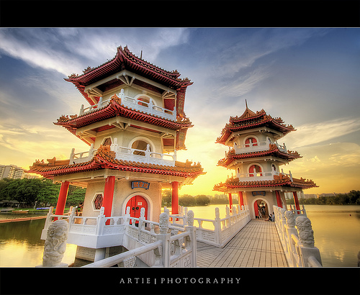
High Dynamic Range Images
Computational Photography
Notes:
http://www.flickr.com/photos/artiephotography/3513060620/

Slide 5
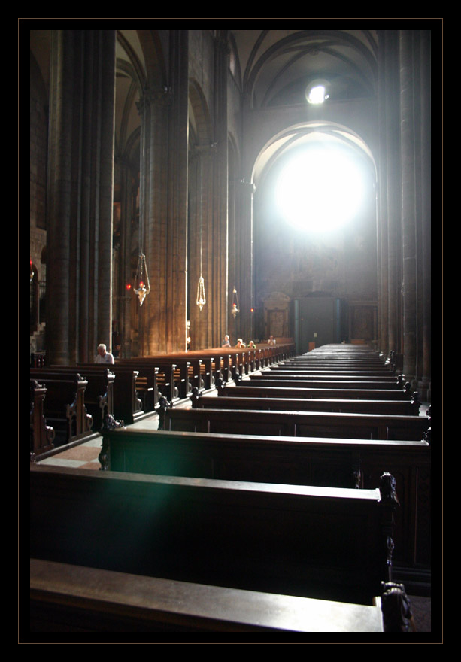
Limitations of Low Dynamic Range
Cathedral of Saint Vigilio by Flickr user Przemek Więch

Slide 6
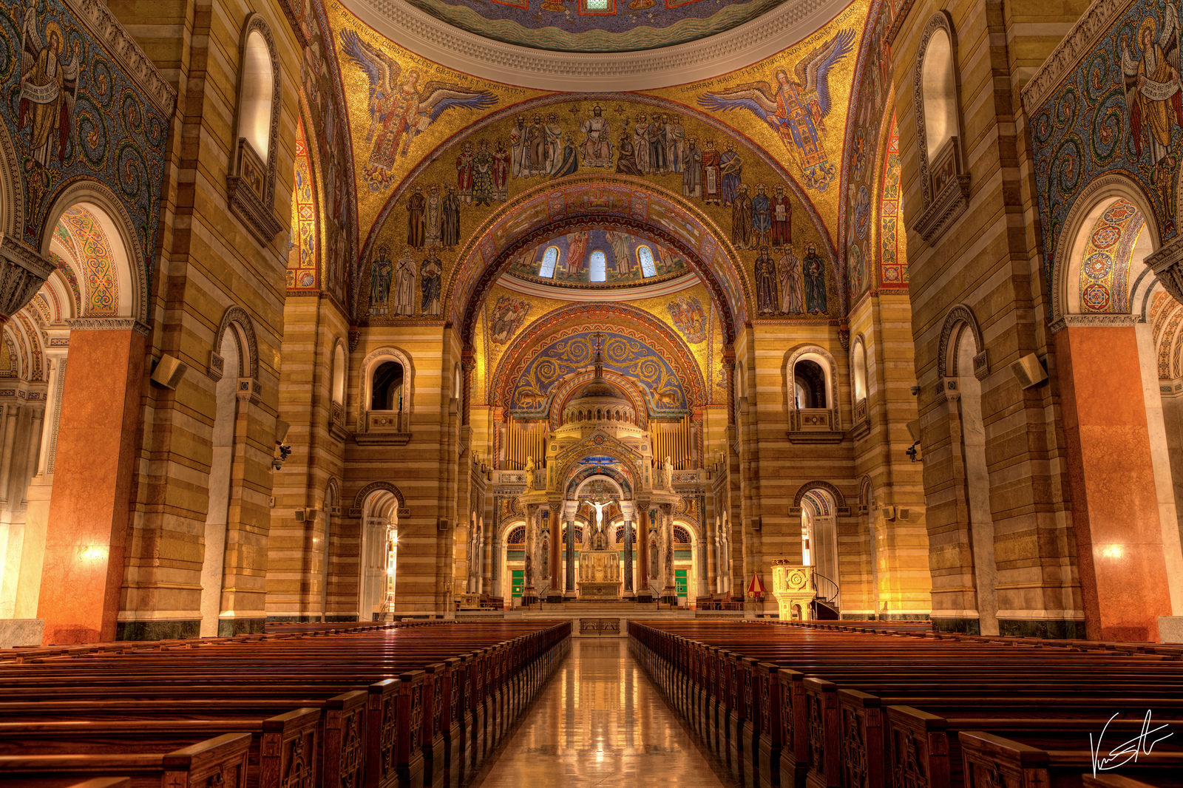
High Dynamic Range
Cathedral Basilica by Flickr user Zeitzeph

Slide 7
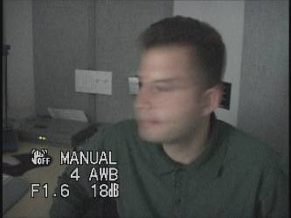
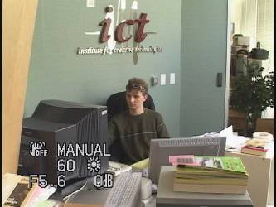
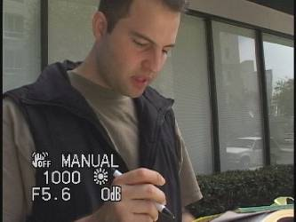
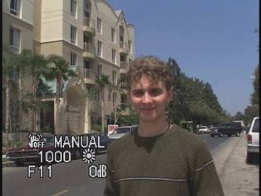
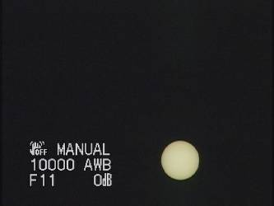
Problem: Dynamic Range
1
The real world is
high dynamic range.
1500
25,000
400,000
2,000,000,000

Slide 8
Long Exposure
10⁻⁶
High dynamic range
10⁶
Real world
10⁻⁶
10⁶
Picture
^{0 to 255}

Slide 9
Short Exposure
10⁻⁶
High dynamic range
10⁶
Real world
10⁻⁶
10⁶
Picture
^{0 to 255}

Slide 10
Image
pixel (312, 284) = 42
42 photons?
Notes:
2

Slide 11
Camera Calibration
Geometric
  How pixel coordinates relate to directions in the world
Photometric
  How pixel values relate to radiance amounts in the world

Slide 12
Camera Calibration
Geometric
  How pixel coordinates relate to directions in the world in other images.
Photometric
  How pixel values relate to radiance amounts in the world in other images.

Slide 13
The Image
Acquisition Pipeline
Lens
Shutter
scene
radiance
(W/sr/m )
sensor
irradiance
(W/m )
∫
sensor
exposure
2
2
Δt
CCD
ADC
Remapping
analog
voltages
digital
values
pixel
values
Raw
Image
JPEG
Image
Notes:
3

Slide 14
Imaging system response function
255
Pixel
value
0
log Exposure = log (Radiance * Δt)
(CCD photon count)
Notes:
1
is this curve sloped the wrong way? Isn’t more detail given to darker regions? No it’s correct because the x axis is log scale.

Slide 15
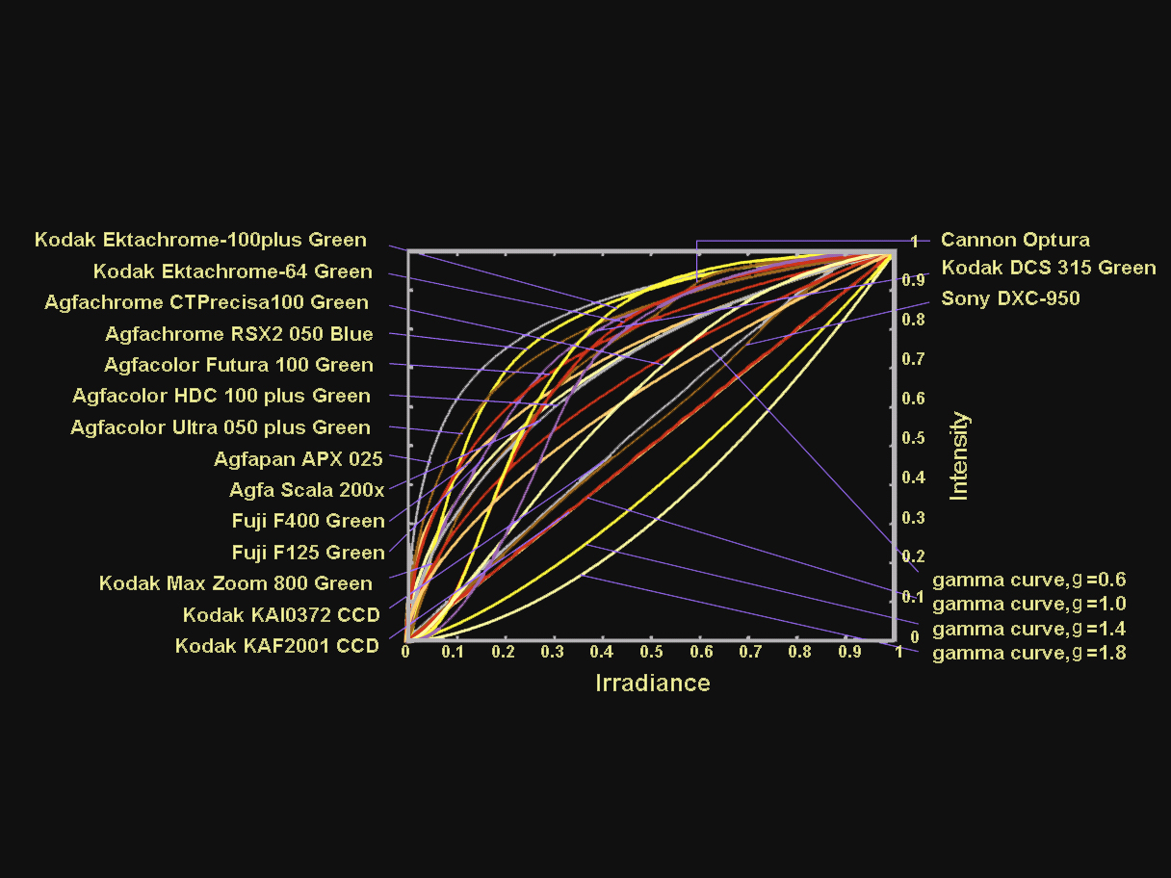
Camera Response Functions
From Shree Nayer: http://www1.cs.columbia.edu/CAVE/projects/rad_cal/rad_cal.php

Slide 16
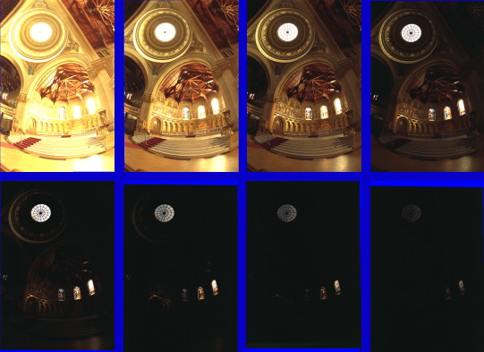
Varying Exposure
Notes:
memorial church, Stanford.

Slide 17
Camera is not a photometer!
Limited dynamic range
  Perhaps use multiple exposures?
Unknown, nonlinear response
  Not possible to convert pixel values to radiance
Solution:
  Recover response curve from multiple exposures, then reconstruct the radiance map
Notes:
4

Slide 18
Recovering High Dynamic Range
Radiance Maps from Photographs
Paul Debevec
Jitendra Malik
Computer Science Division
University of California at Berkeley
August 1997
Notes:
1

Slide 19
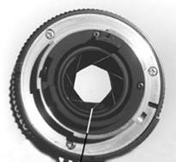
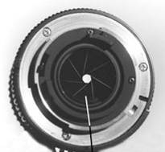
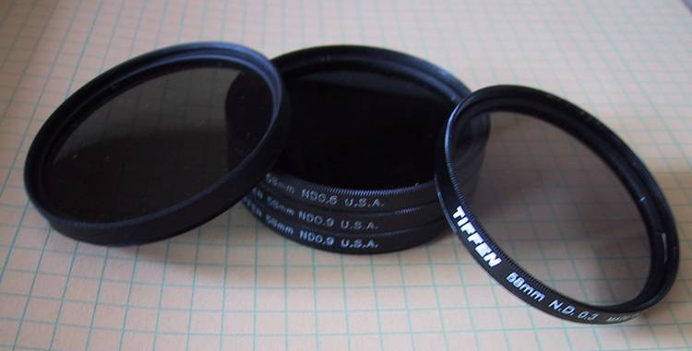
Ways to vary exposure
Shutter Speed (*)
F/stop (aperture, iris)
Neutral Density (ND) Filters

Slide 20
Shutter Speed
Ranges: Canon D30: 30 to 1/4,000 sec.
Sony VX2000: ¼ to 1/10,000 sec.
Pros:
Directly varies the exposure
Usually accurate and repeatable
Issues:
Noise in long exposures

Slide 21
Shutter Speed
Note: shutter times usually obey a power series – each “stop” is a factor of 2
¼, 1/8, 1/15, 1/30, 1/60, 1/125, 1/250, 1/500, 1/1000 sec
Usually really is:
¼, 1/8, 1/16, 1/32, 1/64, 1/128, 1/256, 1/512, 1/1024 sec

Slide 22
The Algorithm
Image series
• 1
• 1
• 1
• 1
• 1
• 2
• 2
• 2
• 2
•
2
• 3
• 3
• 3
• 3
• 3
Δt =
1/64 sec
Δt =
1/16 sec
Δt =
1/4 sec
Δt =
1 sec
Δt =
4 sec
Pixel Value Z = f(Exposure)
Exposure = Radiance ∗ Δt
log Exposure = log Radiance + log Δt
Notes:
10

Slide 23
The Algorithm
Image series
Plot which incorrectly assumes unit radiance
for each pixel
• 1
• 1
• 1
• 1
• 1
• 2
• 2
• 2
• 2
•
2
• 3
• 3
• 3
• 3
• 3
Δt =
1/64 sec
Δt =
1/16 sec
Δt =
1/4 sec
Δt =
1 sec
Δt =
4 sec
Pixel Value Z = f(Exposure)
3
Exposure = Radiance ∗ Δt
2
log Exposure = log Radiance + log Δt
Pixel value
1
ln Exposure
Notes:
10

Slide 24
Response Curve
Solve for unknown irradiance at each pixel to recover response function
Plot which incorrectly assumes unit radiance for each pixel
3
2
Pixel value
Pixel value
1
ln Exposure
ln Exposure

Slide 25
The Math
Let g(z) be the discrete inverse response function
For each pixel site i in each image j, want:
Solve the overdetermined linear system for g, Radiance_{i}:
Z=pixel value
fitting term
smoothness term

Slide 26
Matlab
Code
function [g,lE]=gsolve(Z,B,l,w)
n = 256;
A = zeros(size(Z,1)*size(Z,2)+n+1,n+size(Z,1));
b = zeros(size(A,1),1);
k = 1; %% Include the data-fitting equations
for i=1:size(Z,1)
for j=1:size(Z,2)
wij = w(Z(i,j)+1);
A(k,Z(i,j)+1) = wij; A(k,n+i) = -wij; b(k,1) = wij * B(i,j);
k=k+1;
end
end
A(k,129) = 1; %% Fix the curve by setting its middle value to 0
k=k+1;
for i=1:n-2 %% Include the smoothness equations
A(k,i)=l*w(i+1); A(k,i+1)=-2*l*w(i+1); A(k,i+2)=l*w(i+1);
k=k+1;
end
x = A\b; %% Solve the system using SVD
g = x(1:n);
lE = x(n+1:size(x,1));

Slide 27
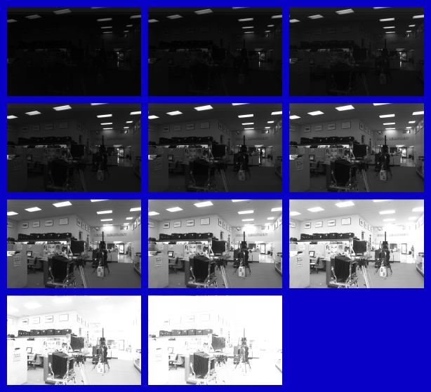
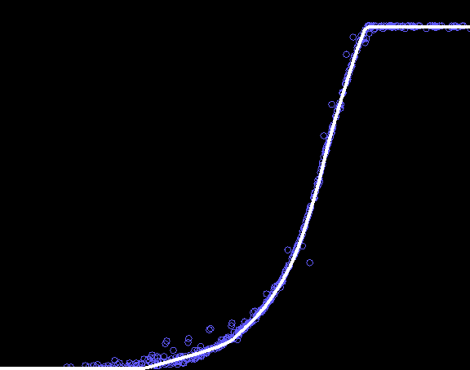
Results: Digital Camera
Kodak DCS460
1/30 to 30 sec
Recovered response curve
Pixel value
log Exposure
Notes:
13

Slide 28
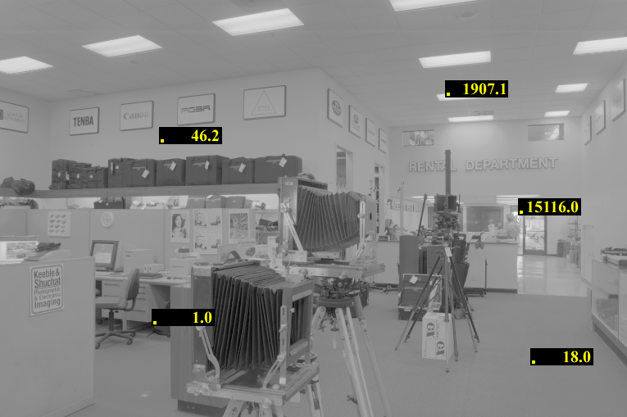
Reconstructed radiance map

Slide 29
Results: Color Film
Kodak Gold ASA 100, PhotoCD
Notes:
14

Slide 30
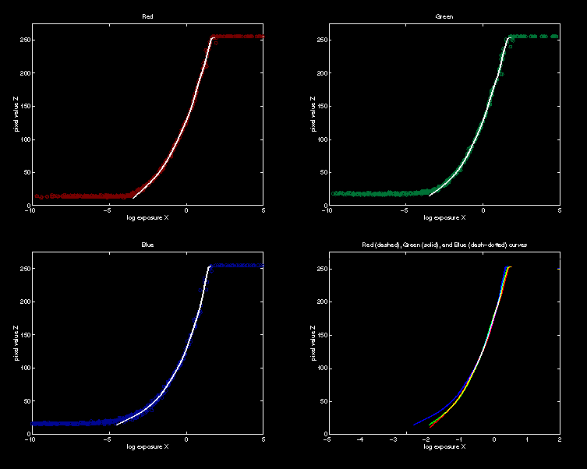
Recovered Response Curves
Red
Green
Blue
RGB
Notes:
15

Slide 31
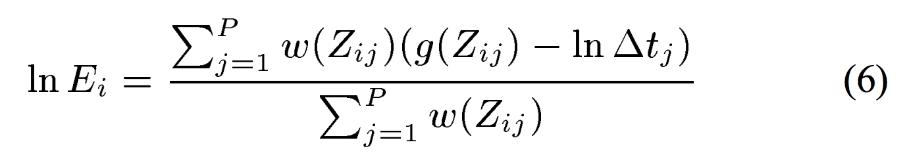
Reconstruct HDR via Response Curve
w(z)
z

Slide 32
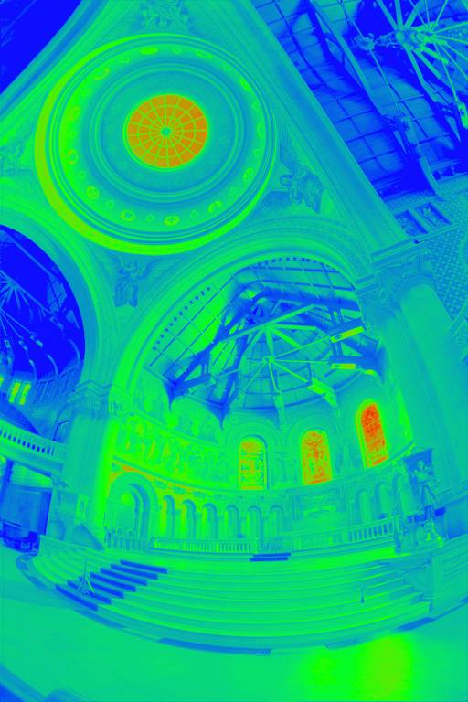
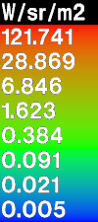
The Radiance Map
Notes:
17

Slide 33
How do we store this?

Slide 34
Portable FloatMap (.pfm)
12 bytes per pixel, 4 for each channel
sign
exponent
mantissa
Text header similar to Jeff Poskanzer’s .ppm
image format:
PF
768 512
1
<binary image data>
Floating Point TIFF similar

Slide 35
Radiance Format
(.pic, .hdr)
32 bits / pixel
Red Green Blue Exponent
(145, 215, 87, 149) =
(145, 215, 87) * 2^(149-128) =
(1190000, 1760000, 713000)
(145, 215, 87, 103) =
(145, 215, 87) * 2^(103-128) =
(0.00000432, 0.00000641, 0.00000259)
Ward, Greg. "Real Pixels," in Graphics Gems IV, edited by James Arvo, Academic Press, 1994

Slide 36
ILM’s OpenEXR (.exr)
6 bytes per pixel, 2 for each channel, compressed
sign
exponent
mantissa
Several lossless compression options, 2:1 typical
Compatible with the “half” datatype in NVidia's Cg
Supported natively on GeForce FX and Quadro FX
Available at http://www.openexr.net/

Slide 37
Now What?
Notes:
17

Slide 38
Tone Mapping
How can we do this?
  Linear scaling?, thresholding? Suggestions?
10⁻⁶
High dynamic range
10⁶
Real World
Ray Traced
World (Radiance)
10⁻⁶
10⁶
Display/
Printer
^{0 to 255}

Slide 39
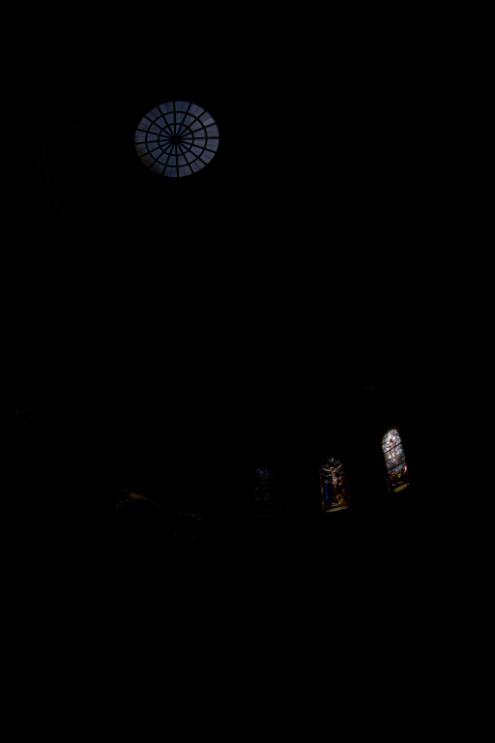
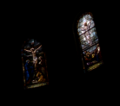
The
Radiance
Map
Linearly scaled to
display device
Notes:
16

Slide 40
Simple Global Operator
Compression curve needs to
  Bring everything within range
  Leave dark areas alone
In other words
  Asymptote at 255
  Derivative of 1 at 0

Slide 41
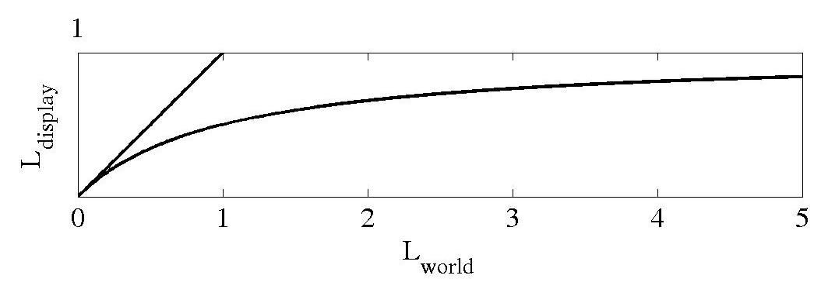
Global Operator (Reinhart et al)

Slide 42
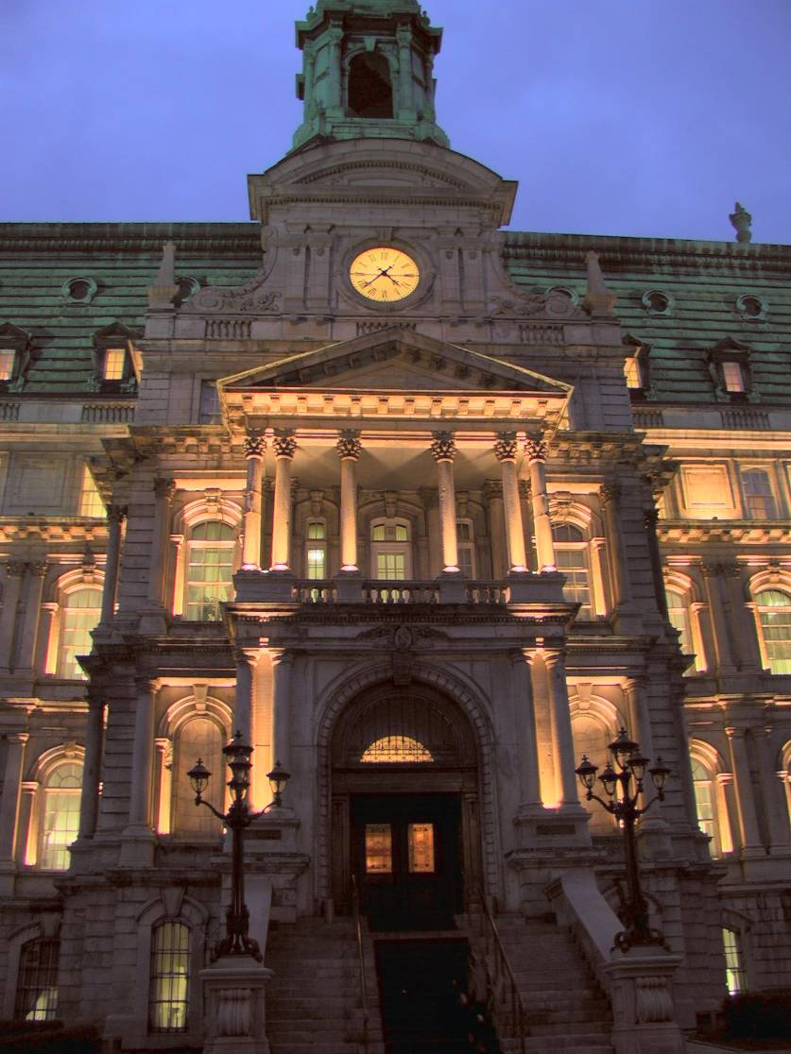
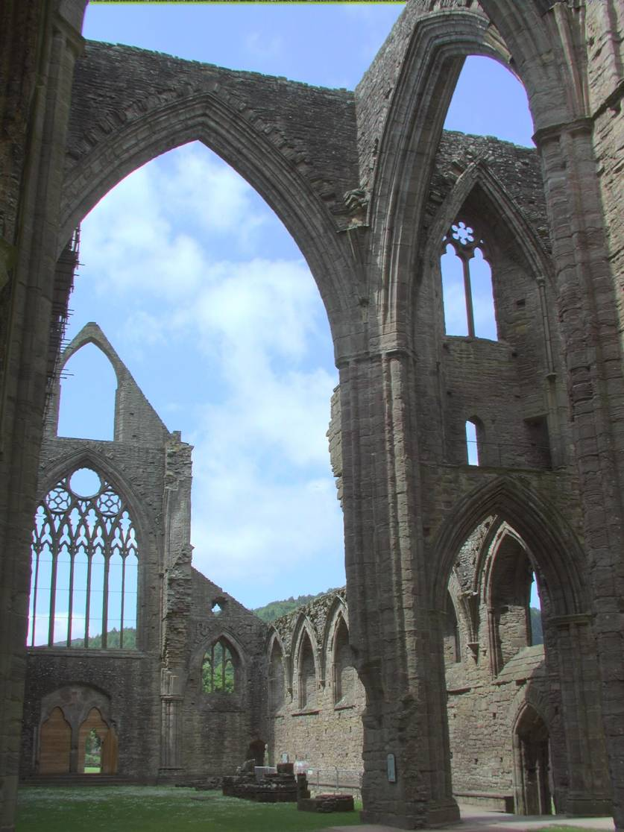
Global Operator Results

Slide 43
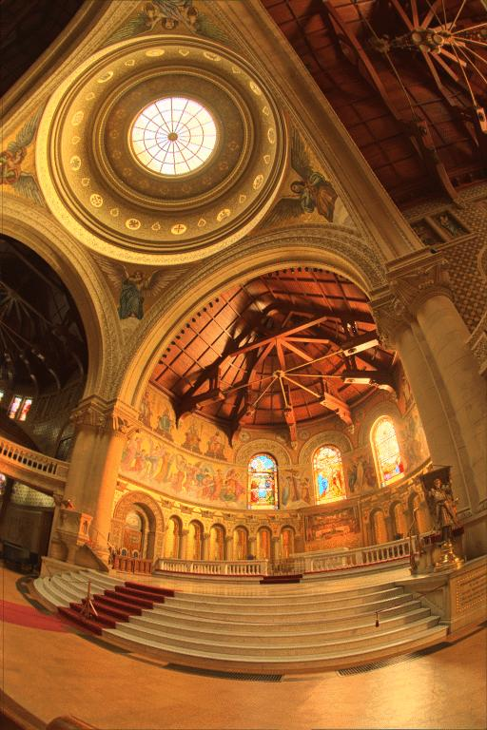
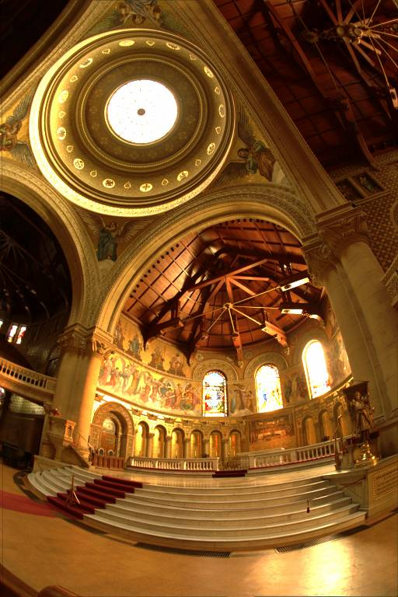
Reinhart Operator
Darkest 0.1% scaled
to display device

Slide 44
What do we see?
Vs.

Slide 45
Issues with multi-exposure HDR
Scene and camera need to be static
Camera sensors are getting better and better
Display devices are fairly limited anyway (although getting better).

Slide 46
Next:
Local tone mapping
Video

