Slide 1
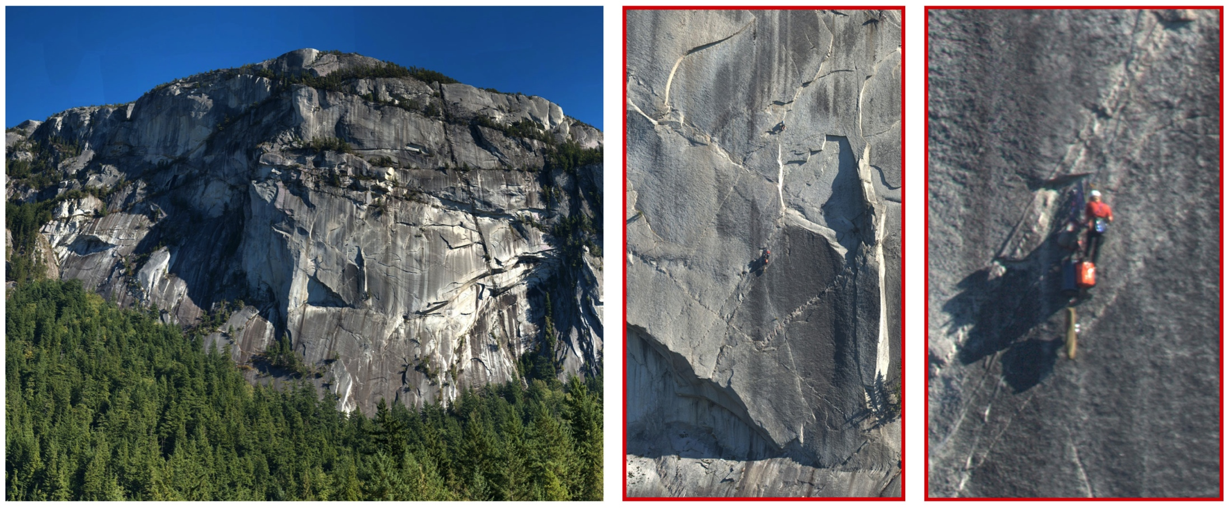
Gigapixel Panoramas
Source: Johannes Kopf
Computational Photography Class
Connelly Barnes

Slide 2
Web Example: GigaPan
gigapan.com

Slide 3
Film Cameras
Clifford Ross’s R1
Graham Flint’s Gigapxl Project
Discussion

Slide 4
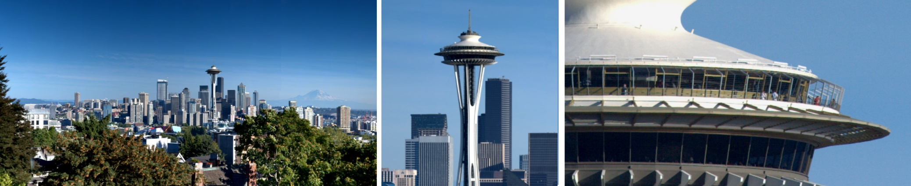
Capturing and Viewing
Gigapixel Images
Johannes Kopf ^{1,2}
Matt Uyttendaele ¹
Oliver Deussen ²
Michael Cohen ¹
1 Microsoft Research
2 Universität Konstanz

Slide 5
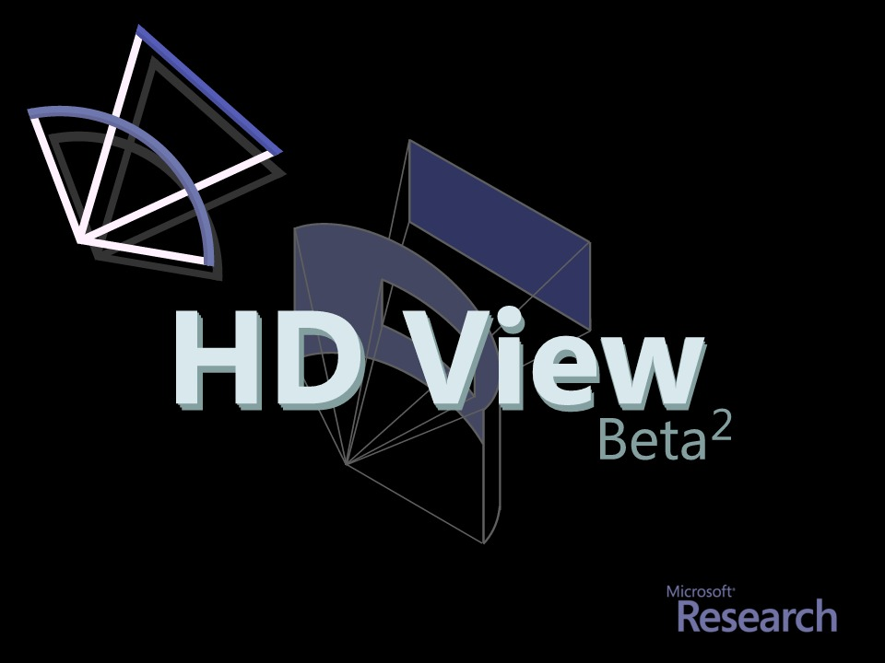

Slide 6

Browser is a Camera
Gigapixel Image == Slice of Lightfield
  Rays through Point
  Dense
Billions of Rays
Gigapixels

Slide 7
Browser is a Camera
Gigapixel Image == Slice of Lightfield
  Rays through Point
  Dense
  HDR

Slide 8
Browser is a Camera
Gigapixel Image == Slice of Lightfield
Viewer == Camera
  Point It

Slide 9
Browser is a Camera
Gigapixel Image == Slice of Lightfield
Viewer == Camera
  Point It
  Zoom in

Slide 10
Browser is a Camera
Gigapixel Image == Slice of Lightfield
Viewer == Camera
  Point It
  Zoom out

Slide 11
Browser is a Camera
Gigapixel Image == Slice of Lightfield
Viewer == Camera
  Point It
  Zoom in/out
  Warp Film

Slide 12
Browser is a Camera
Gigapixel Image == Slice of Lightfield
Viewer == Camera
  Point It
  Zoom in/out
  Warp Film
  Change
  Exposure

Slide 13

Browser is a Camera
Gigapixel Image == Slice of Lightfield
  Dense sampling in direction (i.e., high res)
  Deep bit depth in radiance (i.e., HDR)
  Single point in space and time (i.e., an image)
Viewer == Camera
  point it (i.e., panning)
  zoom (i.e., change the focal length of your lens)
  change exposure
  can’t move it, focus it (yet)

Slide 14
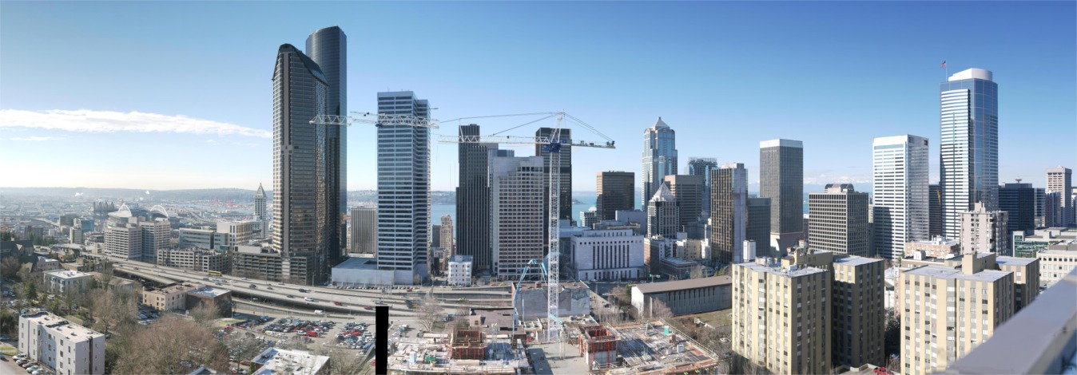
BIG
3,600,000,000 Pixels
Created from about 800 8 MegaPixel Images

Slide 15
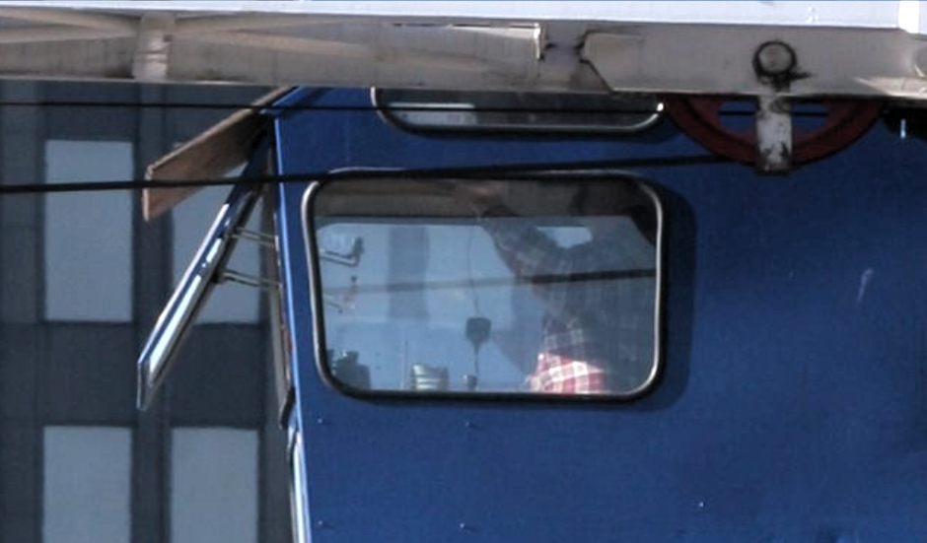
BIG

Slide 16
Wide
150 degrees
“Normal” perspective projections cause distortions.

Slide 17
Deep
100X variation in Radiance
High Dynamic Range

Slide 18
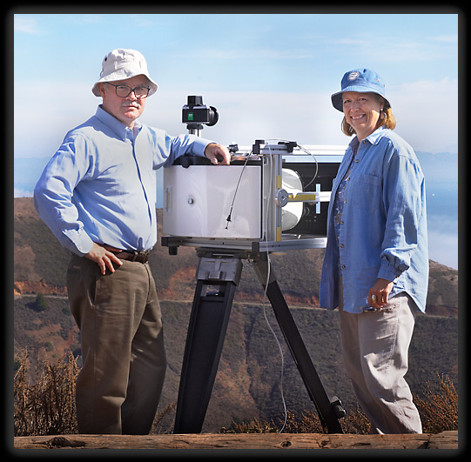
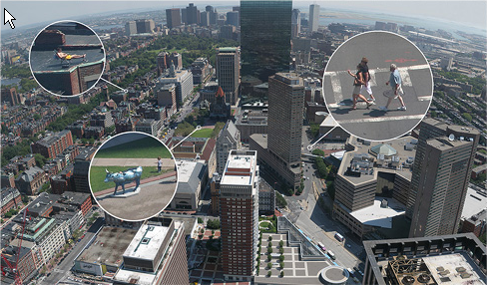
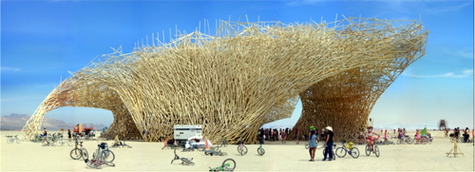
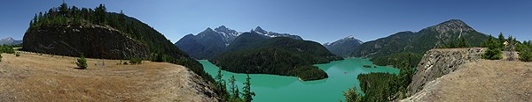
Related Work
Lots!
  Panoramic Stitching, High Dynamic Range and Tone Mapping, Perspective and Curved Projections, etc.
Gigapixel Image Capture
  Graham Flint (Gigapixl)
  Gigapan (@cmu)
  Max Lyons
  Haltadefinizione
  XRez
  Bradford Bohonus
Viewing
  Quicktime VR
  Zoomify
  Flash Based
Graham Flint
XRez
Gigapan
Bohonus

Slide 19
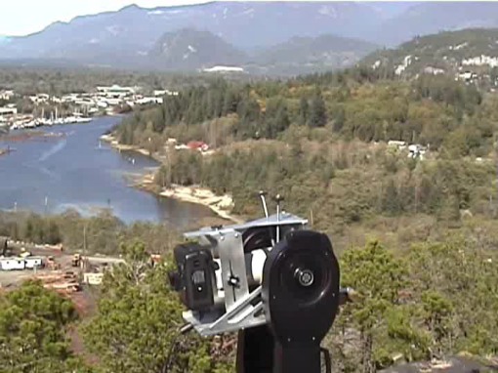
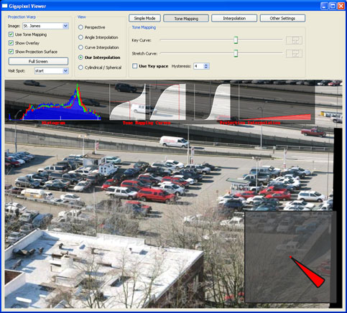

Capturing and Viewing
Gigapixel Images
Capture: Matt Uyttendaele
Viewer: Johannes Kopf
HD View: Matt Uyttendaele

Slide 20
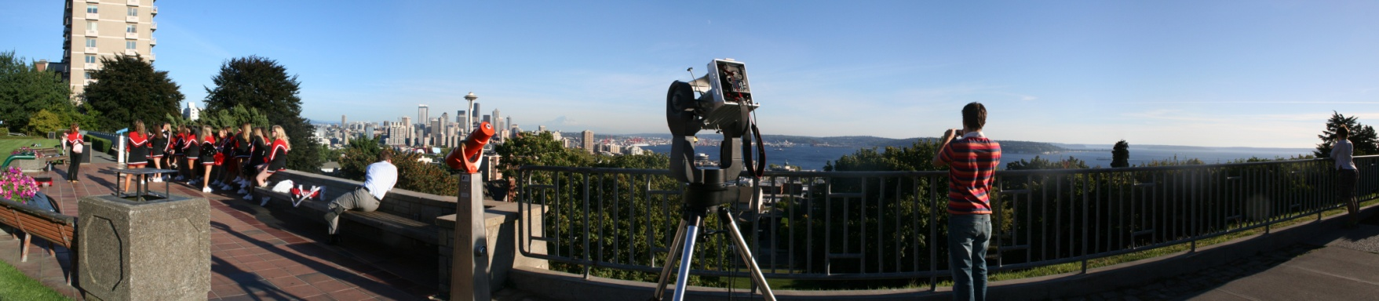
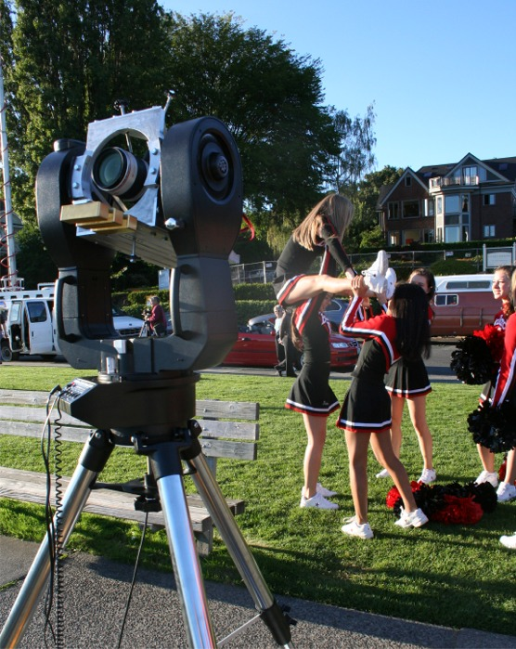

Capture

Slide 21
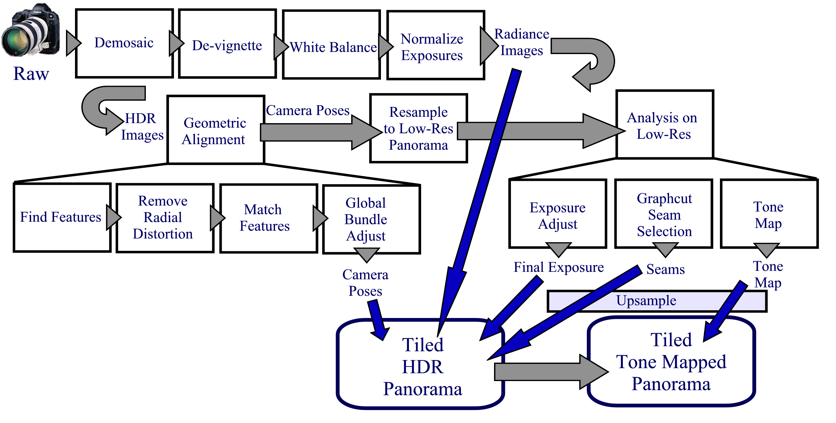
Capturing Gigapixel Images

Slide 22
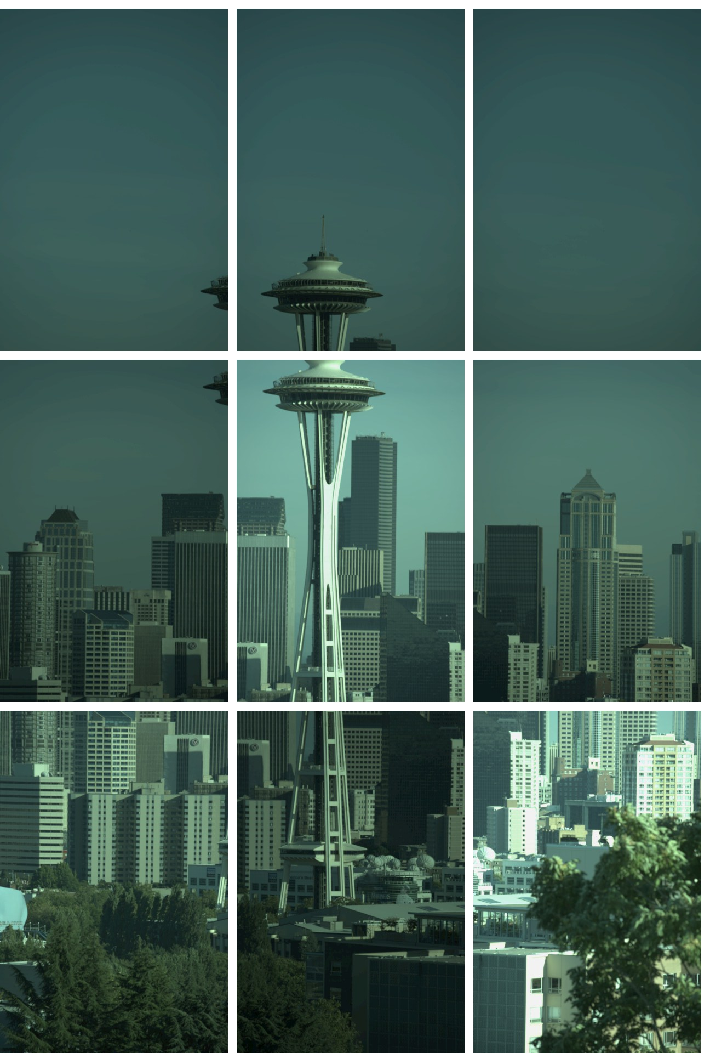
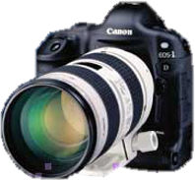
RAW

Slide 23
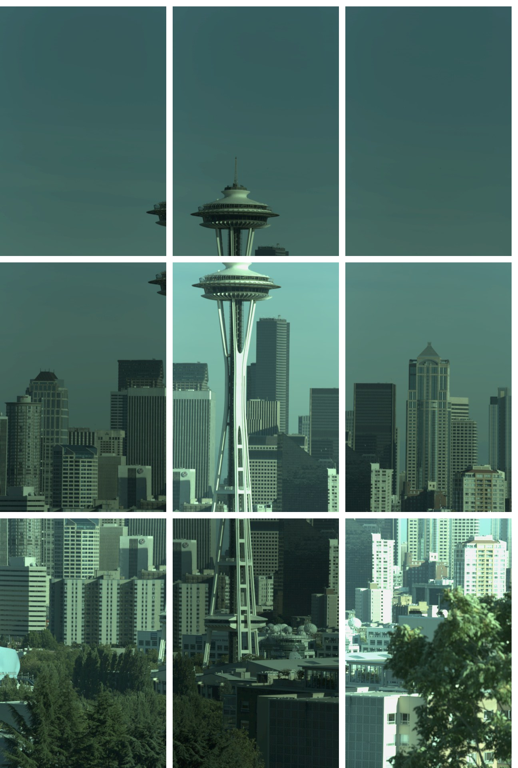
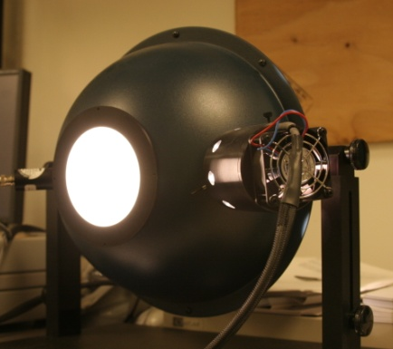

DeVignette

Slide 24
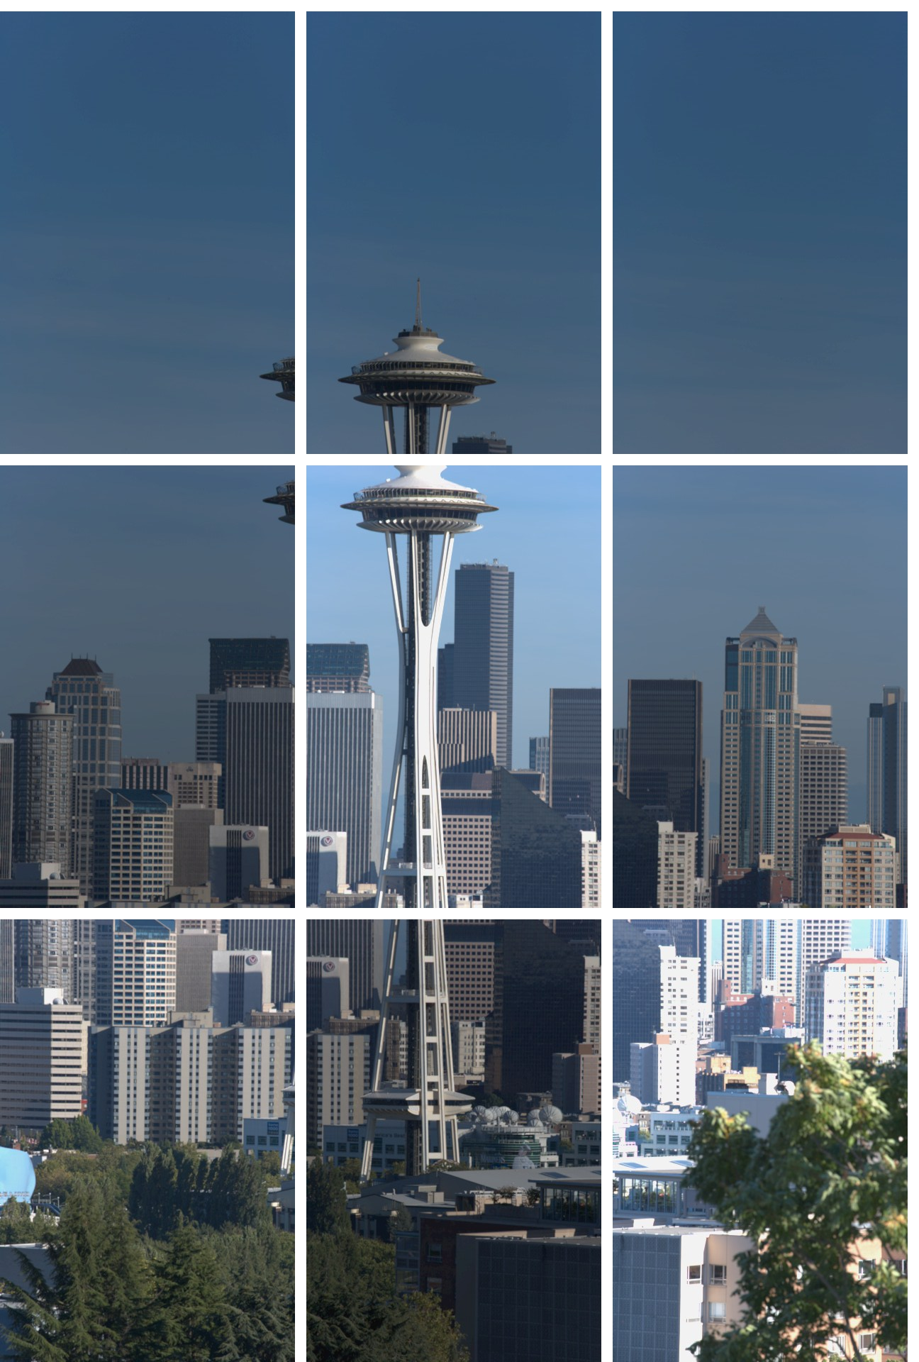
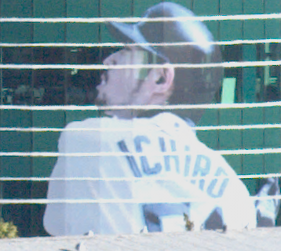
White
Balance

Slide 25
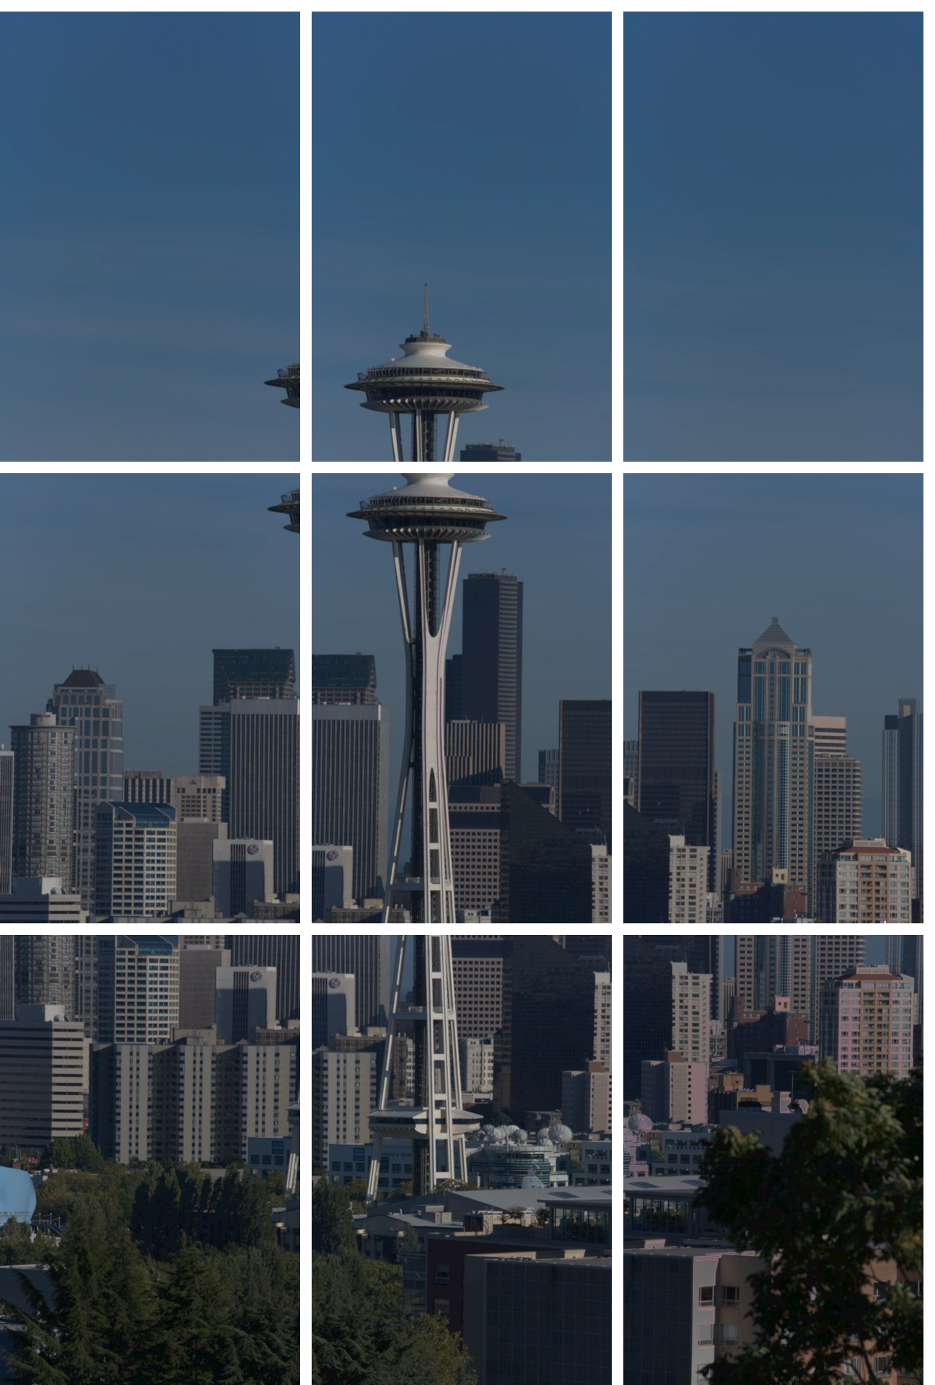
Exposure
Balance
Radiance
Map

Slide 26

Feature
Points

Slide 27
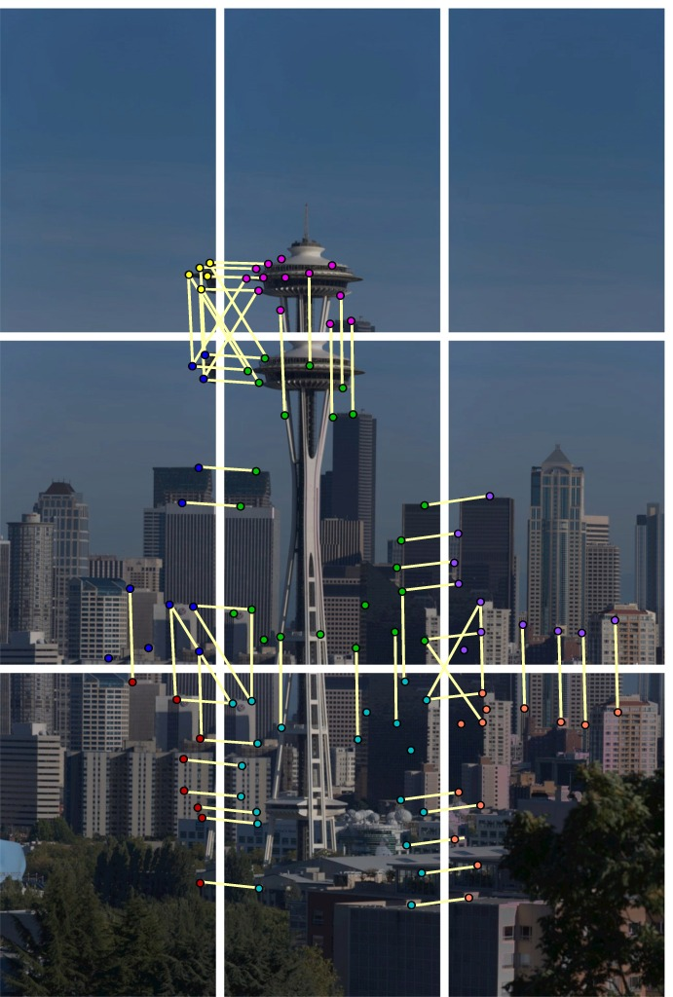
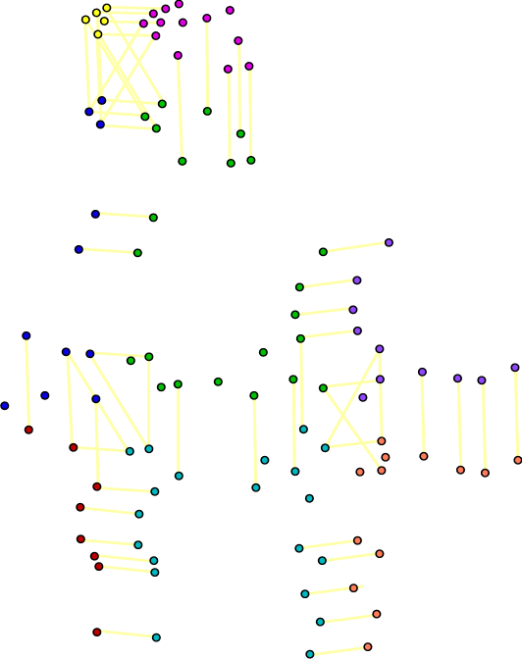
Feature
Matches

Slide 28
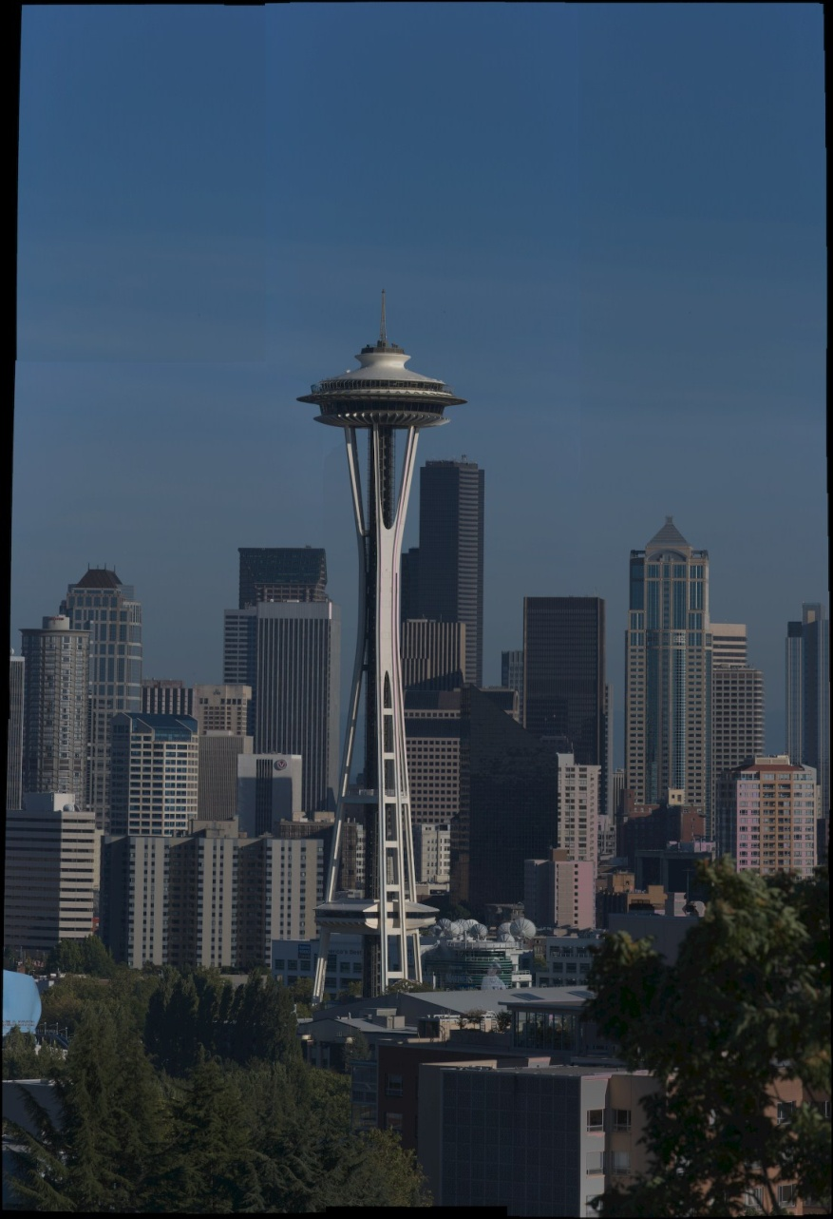
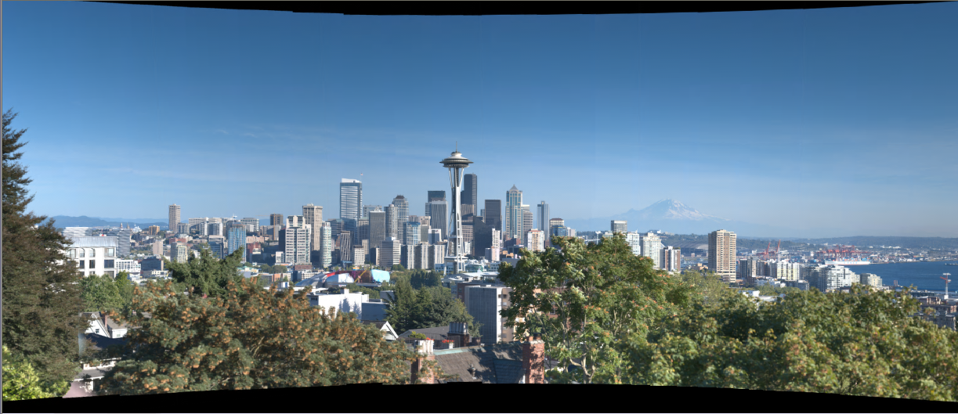
Align
Aligned
Tone Mapped

Slide 29
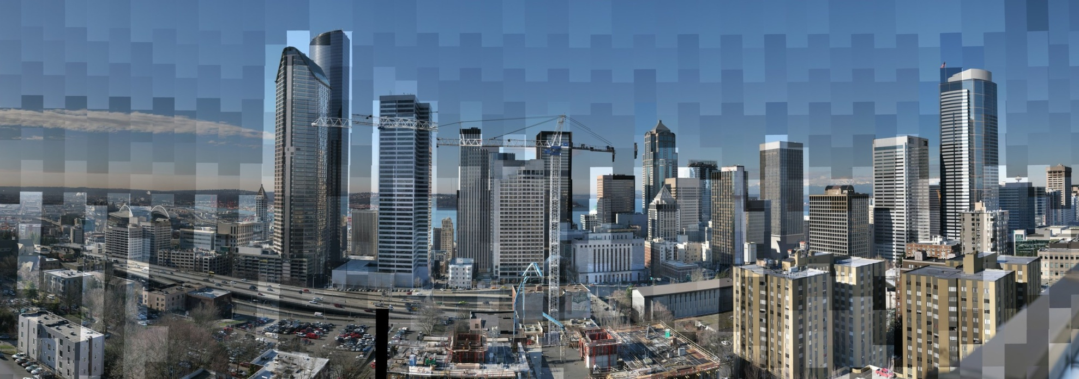
Radiometric Alignment
1 / 1000th
of a second
1 / 10th
of a second
High Dynamic Range

Slide 30
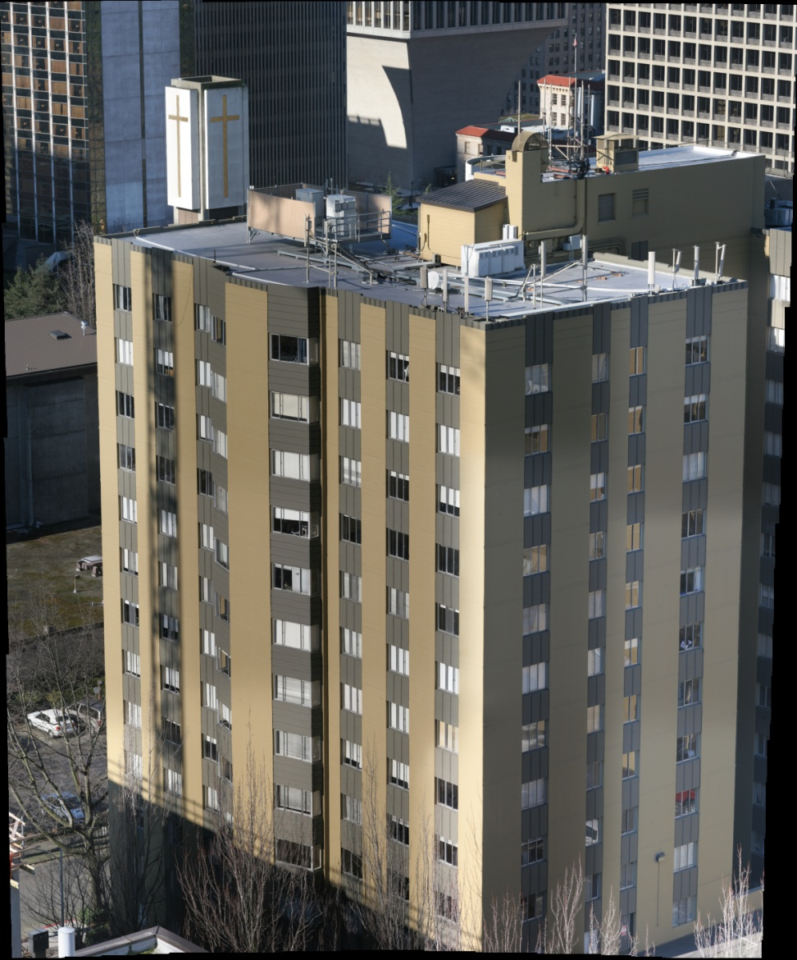
Radiometric Alignment
Laplacian Blend

Slide 31
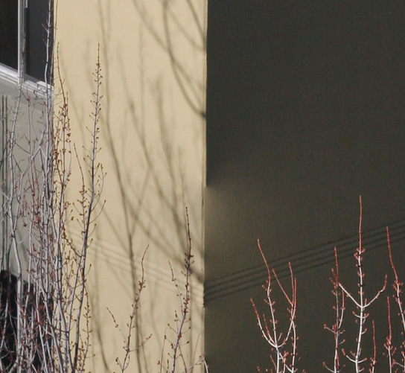
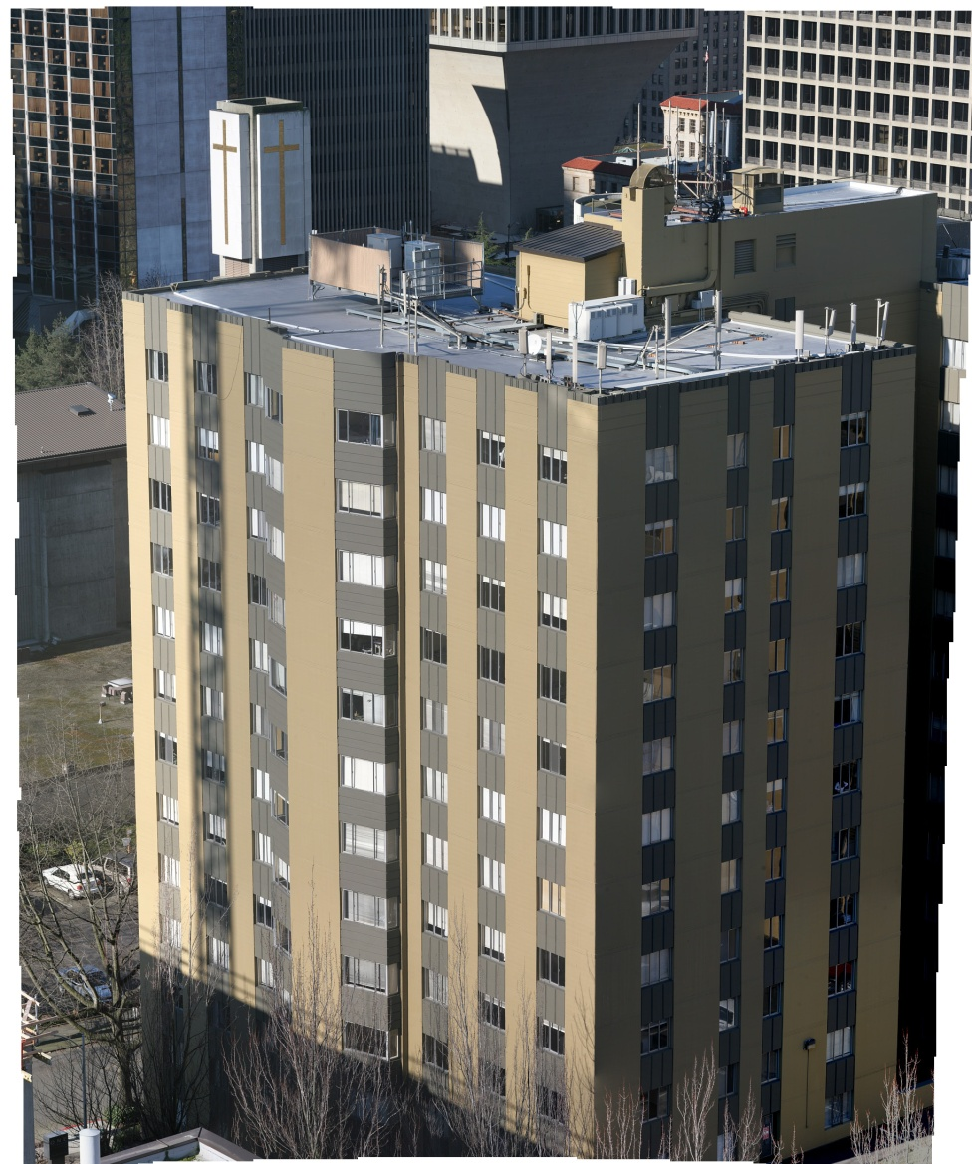
Radiometric Alignment
Poisson Blend

Slide 32
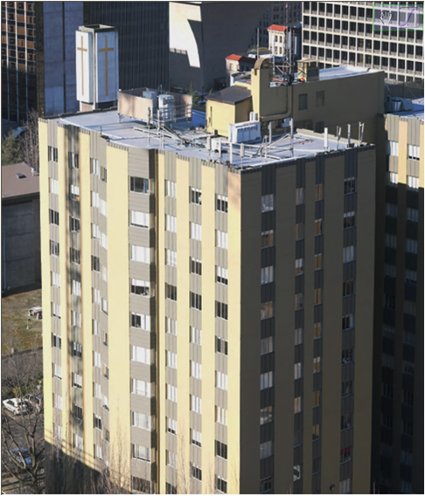
Radiometric Alignment
Pure Radiometric

Slide 33
Radiometric Alignment
High Dynamic Range

Slide 34
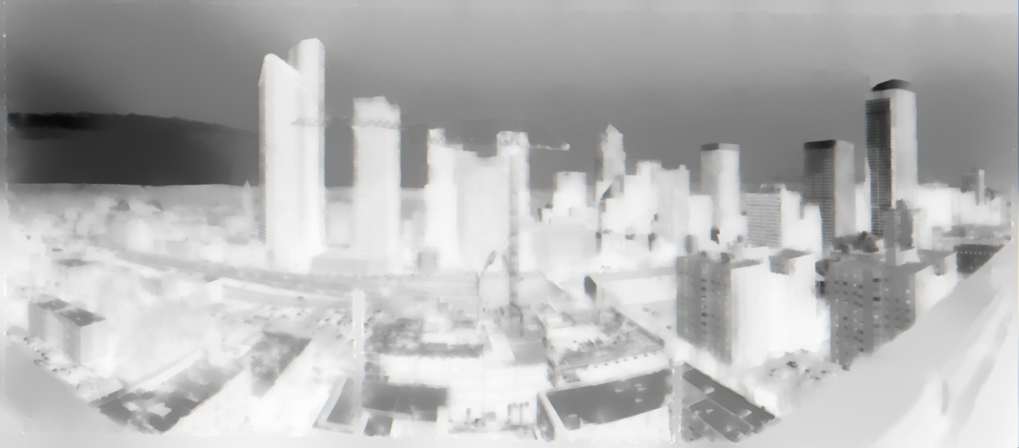
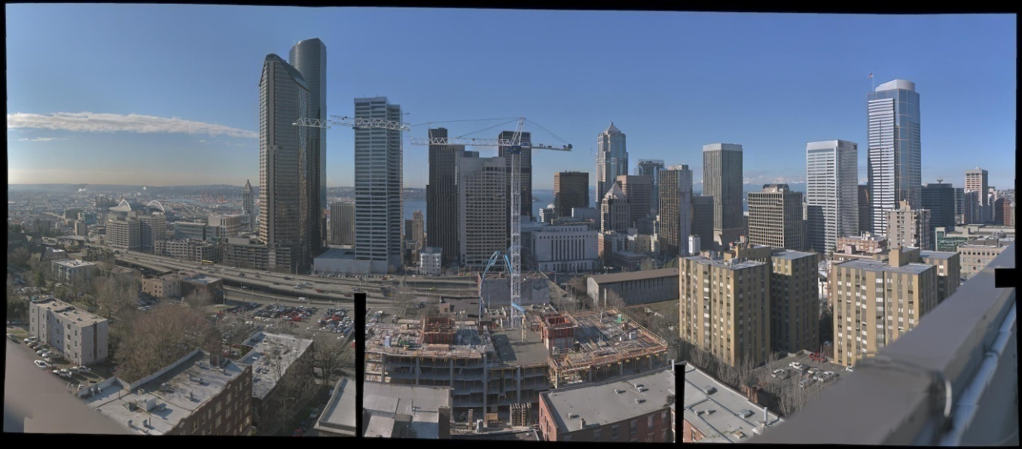
Solution Upsampling
2815 x 1238
90080 x 39616

Slide 35
Capturing Gigapixel Images

Slide 36
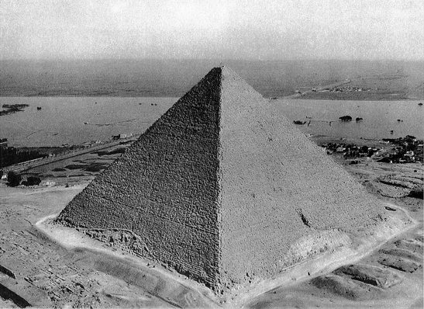
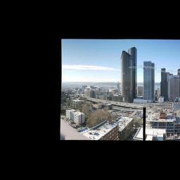
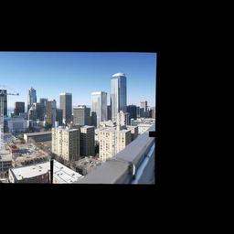
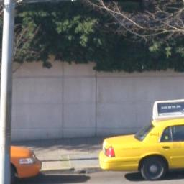
Tile Pyramid

Slide 37


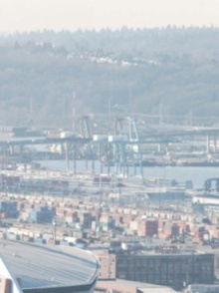
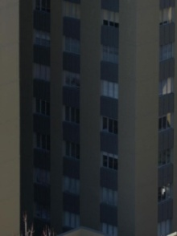

Viewer
Resolution >> Display
Dynamic Range >> Display
Field of view >> Display
150 degrees
Notes:
If we want to view the images on a computer screen, we really need a special viewer for a number of reasons that Michael mentioned in the beginning of the talk
The resolution of the images is much higher than the screen
Also, the dynamic range has double the bit depth
Finally, the FOV of the images is usually much wider than the FOV that your monitor subtends when you sit in front of it.
As I will show, all these issues can be alleviated with an interactive viewer

Slide 38
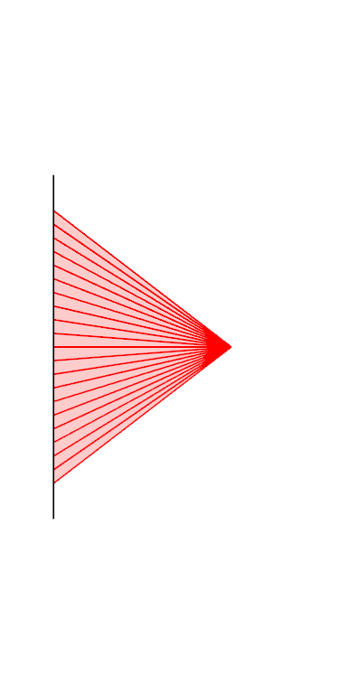
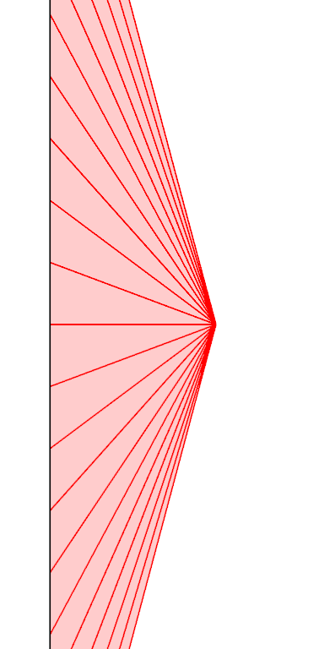

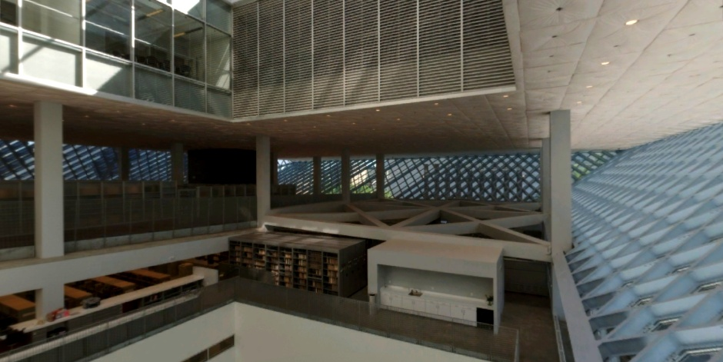
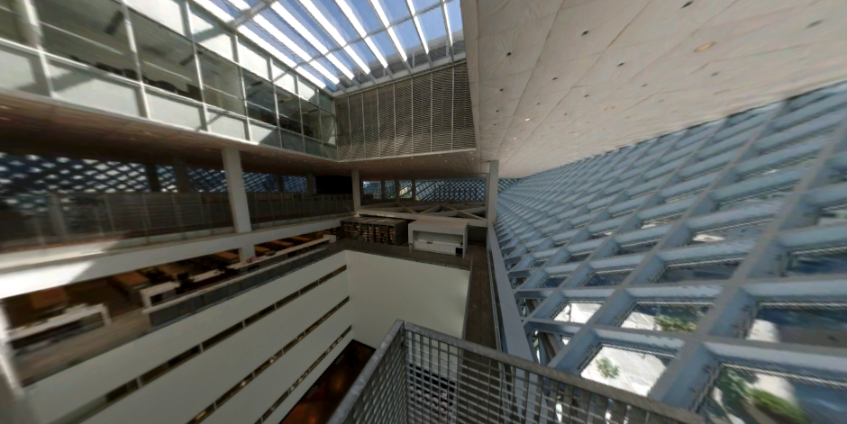
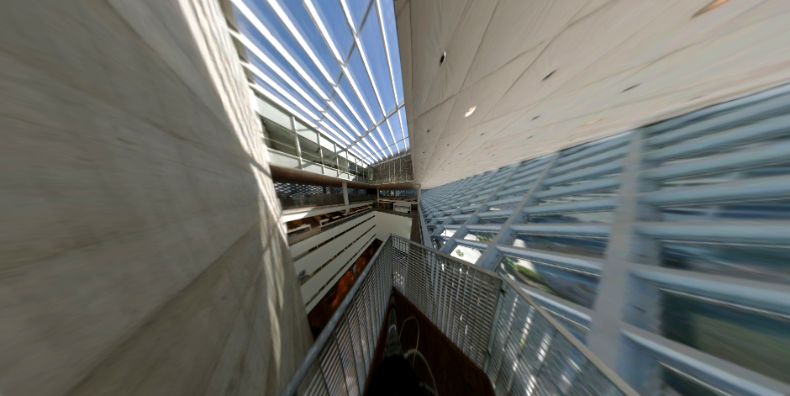
Perspective Projection

Slide 39
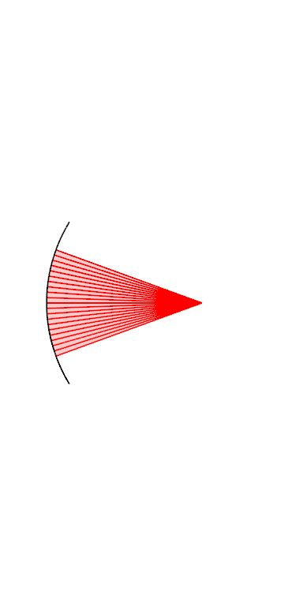
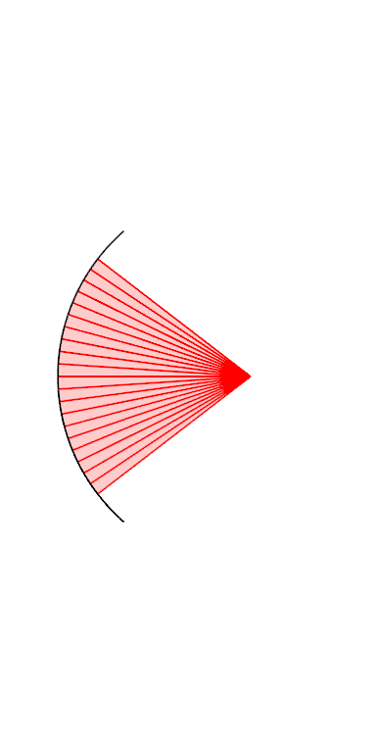
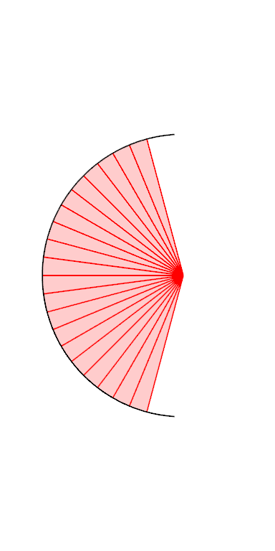
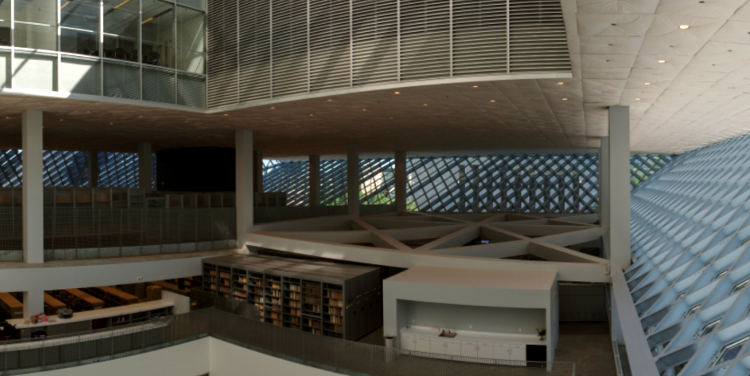
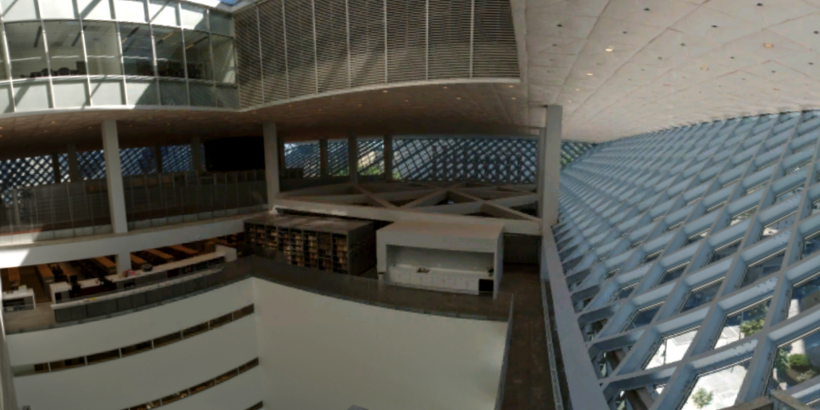
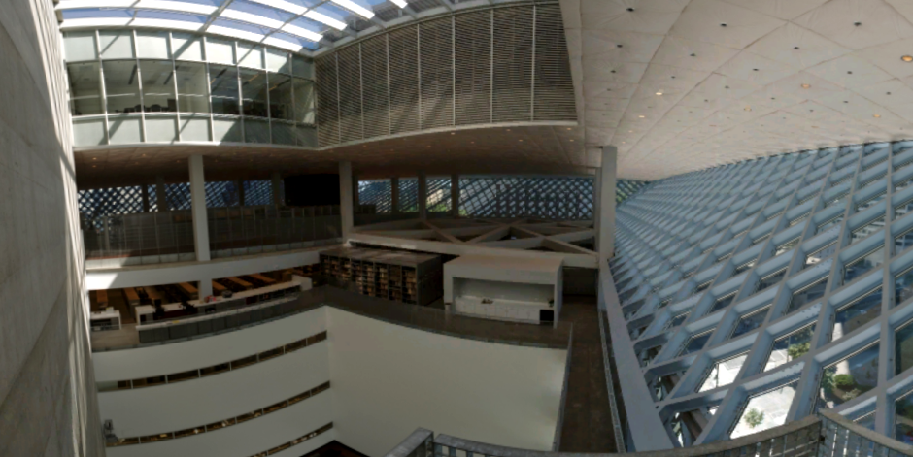
Cylindrical Projection

Slide 40
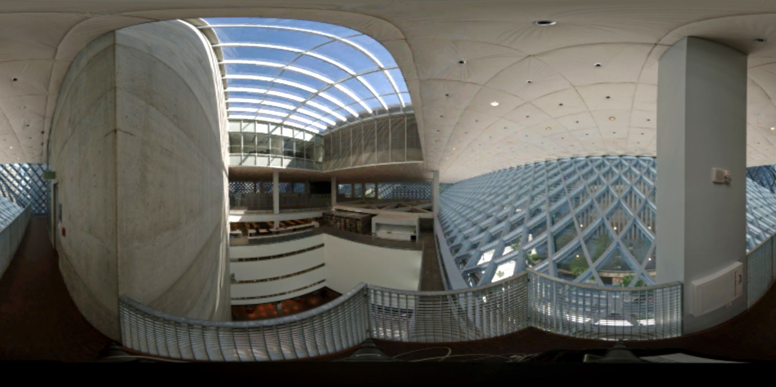
Spherical Projection

Slide 41


Perspective vs. Cylindrical/Spherical
Perspective | Cylindrical / Spherical
Close to human perception | Straight lines → curved
Straight lines → straight | Feels flat
Wide angle distorted | Whole FOV possible
= Best for narrow angles | = Best for wide angles

Slide 42

Projection Transition
Start Demo
Notes:
In our viewer, we combine the best of both projections by smoothly transitioning between them
For narrow FOVs we use perspective projection → as angles widen, we bend the projection surface around the center of projection so that we end up in a cylindrical projection
Internally, we are always in a cylindrical projection, however, we change the radius of the cylinder.
Varying the radius of the cylinder controls the curvature of the projection surface.
In this animation, the center of the cylinder is located at the green point.

Slide 43
Dynamic Tone Mapping

Slide 44




Dynamic Tone Mapping
Start Demo

Slide 45






Browser plugin –
  Internet Explorer or Firefox on Windows
Features
  GPU acceleration
  Dynamic FOV adjustment
  Dynamic Tone adjustment
  HD Photo (soon to be JPEG XR)
Content
  Lots of content already on the web
  Easy to create your own

Slide 46
Future Work
Better scene sampling
  More pixels interesting areas, less in blank areas e.g. sky
  Depth of field control
  HDR
  Deal with atmospheric effects
  Capture moving objects
Viewing
  Color temperature
  Better dynamic scene analysis
  Combine with Photosynth
High Dynamic Range Streaming
Editing/Annotating Gigapixel Images

Slide 47


Summary
Capturing Gigapixel Images
Stitching panorama into a radiance map.
A novel viewer
  Dynamically adapts to field of view
  Dynamically adapts tonal adjustment
New web content to browse
Thank You

Slide 48
Second Slide Deck
Shree Nayar, Gigapixel Computational Imaging

