Slide 1
2D/3D Shape Manipulation,
3D Printing
CS 6501
Shape Representations
Slides from Olga Sorkine

Slide 2
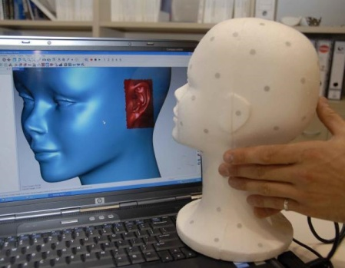
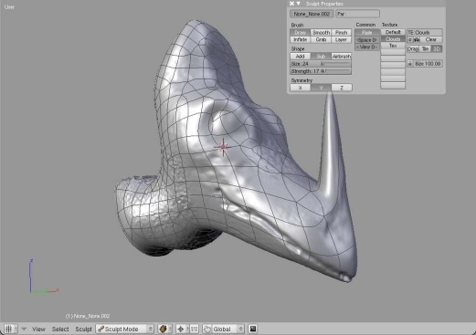
Shape Representation:
Origin- and Application-Dependent
Acquired real-world objects:
  Discrete sampling
  Points, meshes
Modeling “by hand”:
  Higher-level representations, amendable to modification, control
  Parametric surfaces, subdivision surfaces, implicits
Procedural modeling
  Algorithms, grammars

Slide 3


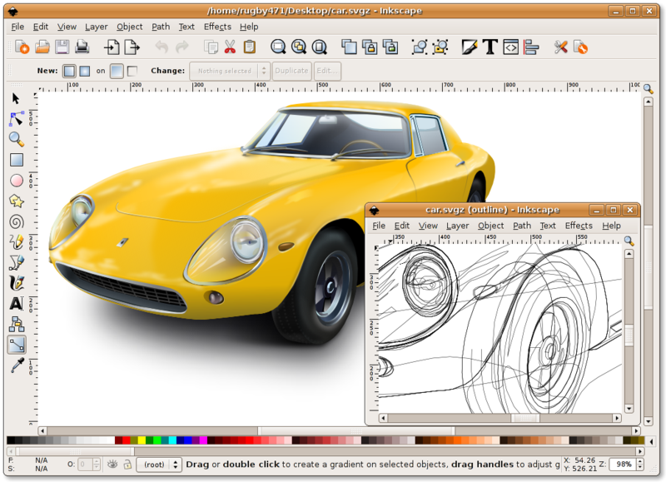
Similar to the 2D Image Domain
Acquired digital images:
  Discrete sampling
  Pixels on a grid
Painting “by hand”:
  Strokes + color/shading
  Vector graphics
  Controls for editing

Slide 4
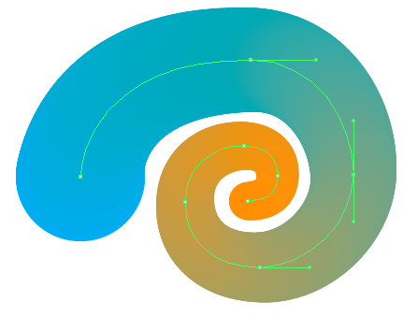
Similar to the 2D Image Domain
Acquired digital images:
  Discrete sampling
  Pixels on a grid
Painting “by hand”:
  Strokes + color/shading
  Vector graphics
  Controls for editing

Slide 5
Representation Considerations
How should we represent geometry?
  Needs to be stored in the computer
  Creation of new shapes
    Input metaphors, interfaces…
  What operations do we apply?
    Editing, simplification, smoothing, filtering, repair…
  How to render it?
    Rasterization, raytracing…

Slide 6
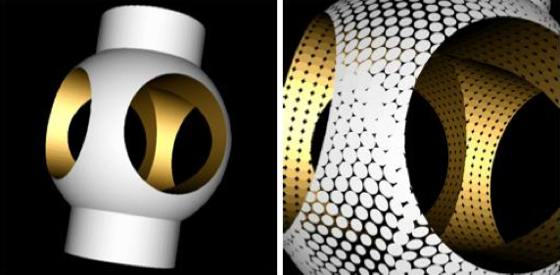
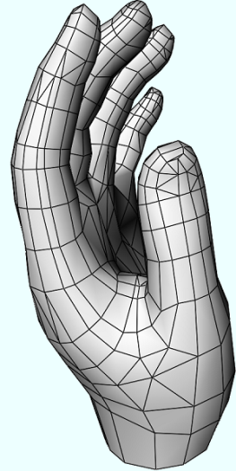
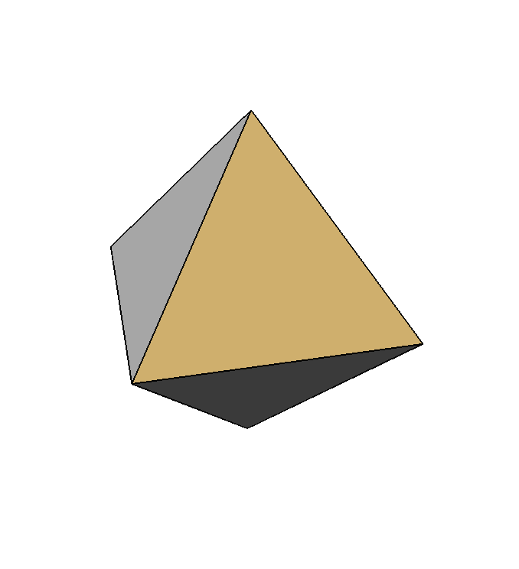
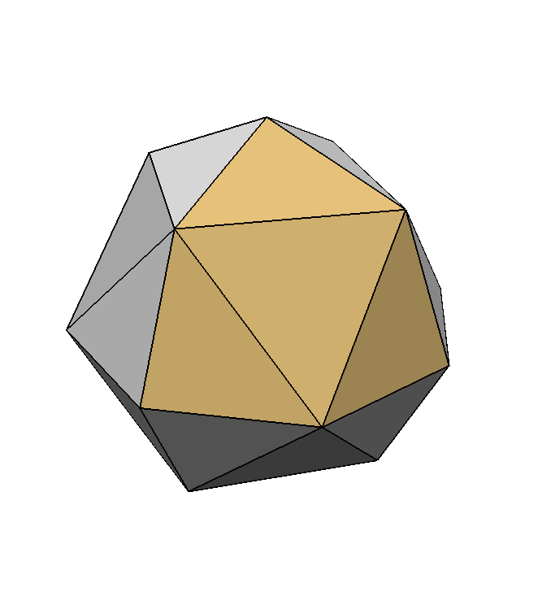
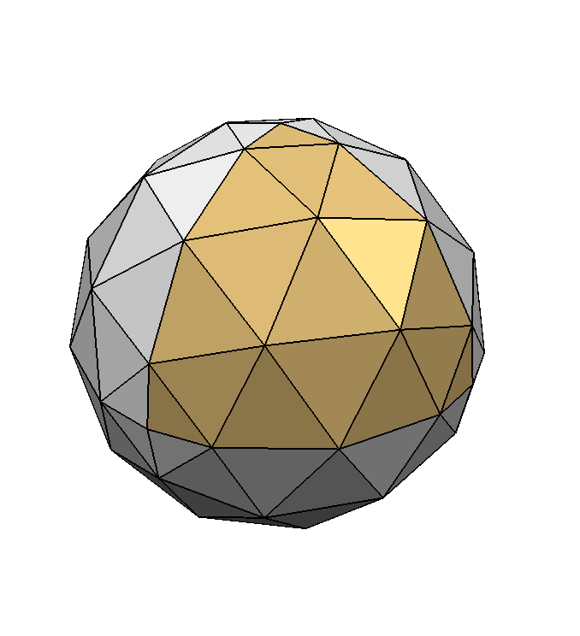
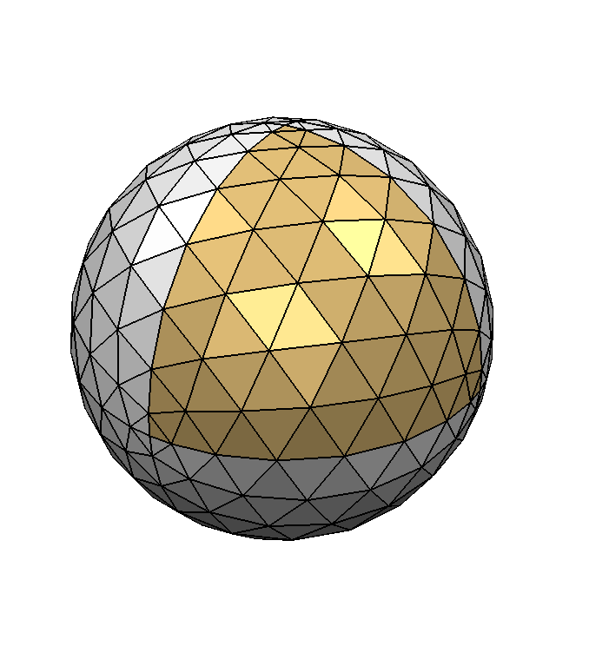
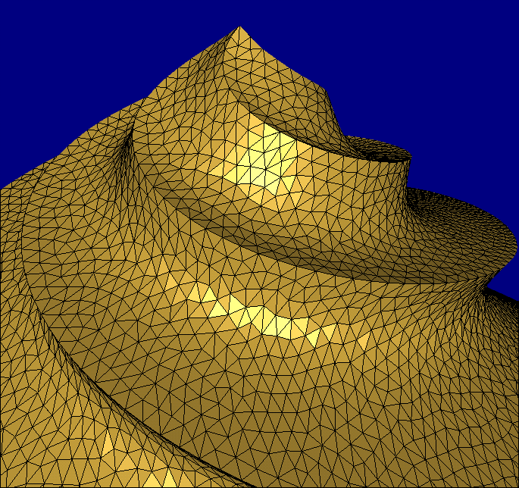
Shape Representations
Points
Polygonal meshes

Slide 7
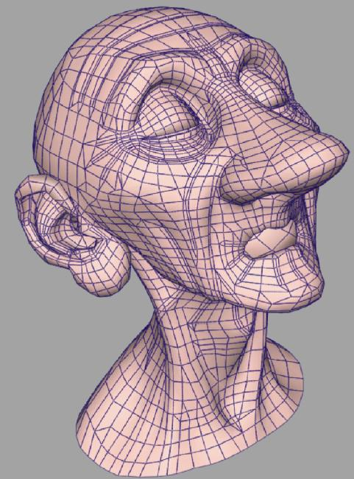

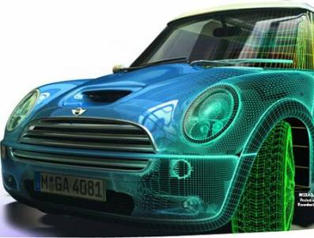
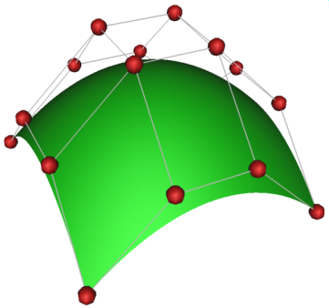
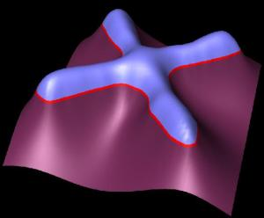
Shape Representations
Parametric surfaces
Implicit functions
Subdivision surfaces

Slide 8
Points

Slide 9
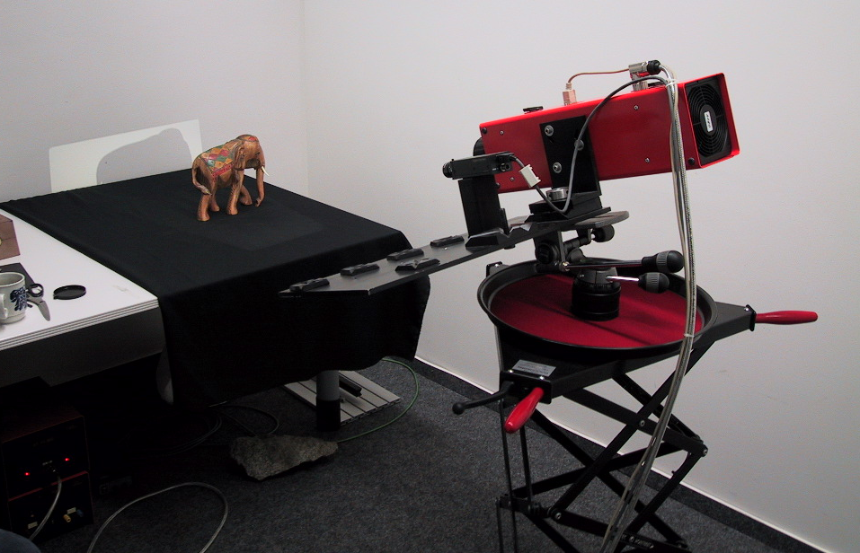
Output of Acquisition

Slide 10
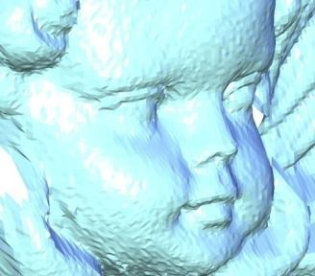
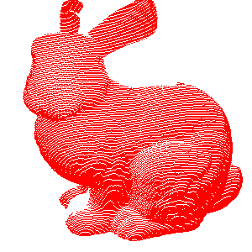
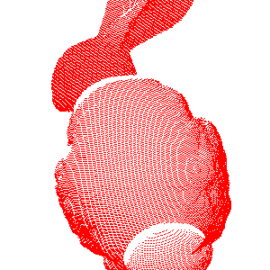
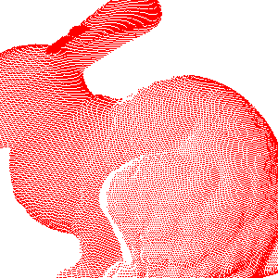
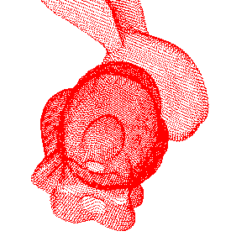
Points
Standard 3D data from a variety of sources
  Often results from scanners
  Potentially noisy
  Depth imaging (e.g. by triangulation)
  Registration of multiple images

Slide 11
Points
points = unordered set of 3-tuples
Often converted to other reps
  Meshes, implicits, parametric surfaces
  Easier to process, edit and/or render
Efficient point processing and modeling requires a spatial partitioning data structure
  To figure out neighborhoods

Slide 12
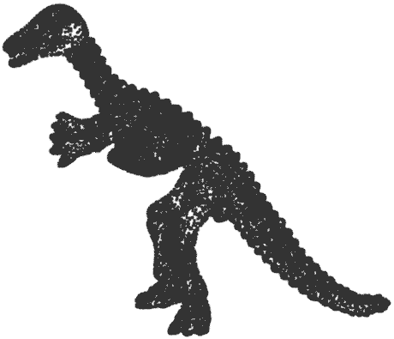
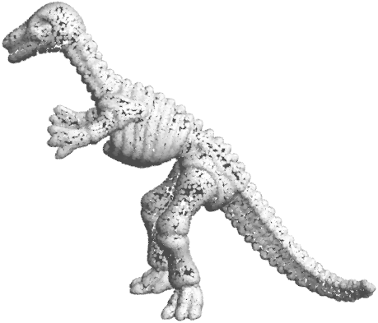
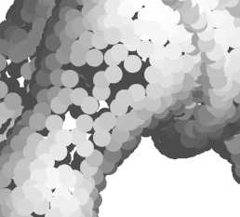
Points: Neighborhood information
Why do we need neighbors?
Need sub-linear implementations of
    k-nearest neighbors to point x
    In-radius search
need normals (for shading)
upsampling –
need to count density

Slide 13
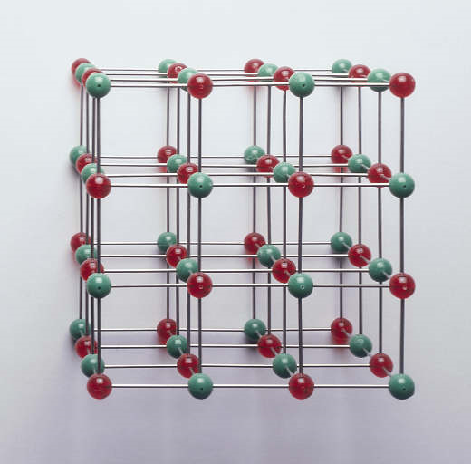
Spatial Data Structures
Regular uniform 3D lattice
  Simple point insertion by
  coordinate discretization
  Simple proximity queries by
  searching neighboring cells
  Determining lattice parameters
  (i.e. cell dimensions) is nontrivial
  Generally unbalanced, i.e. many empty cells

Slide 14
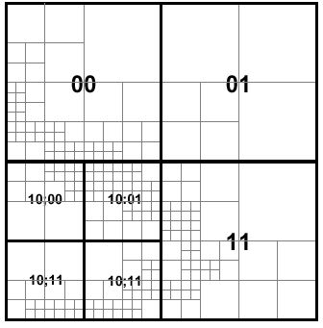
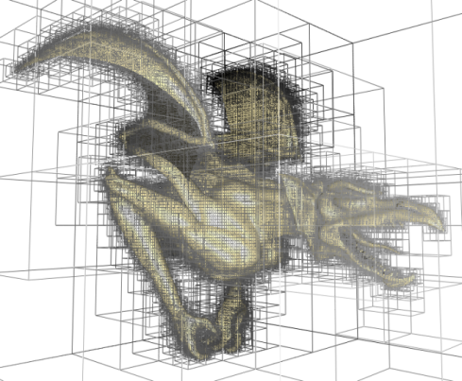
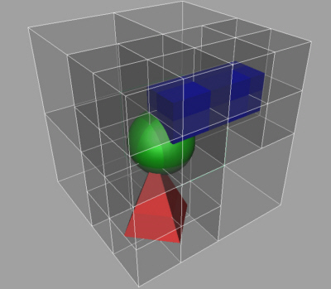
Spatial Data Structures
Octree
  Splits each cell into 8 equal cells
  Adaptive, i.e. only splits when
  too many points in cell
  Proximity search by (recursive)
  tree traversal and distance to
  neighboring cells
  Tree might not be balanced

Slide 15
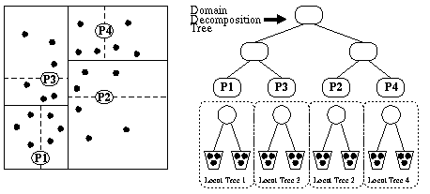
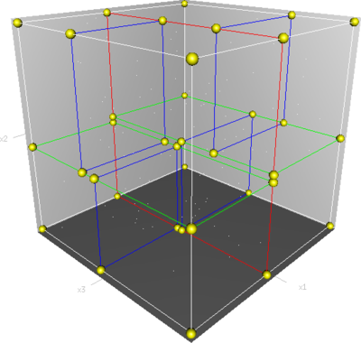
Spatial Data Structures
Kd-Tree
  Each cell is individually
  split along the median
  into two cells
  Same amount of points
  in cells
  Perfectly balanced tree
  Proximity search similar to
  the recursive search in an Octree
  More data storage required for
  inhomogeneous cell dimensions

Slide 16
Parametric Curves and Surfaces

Slide 17
Parametric Representation
Range of a function
  Planar curve:
  Space curve:

Slide 18
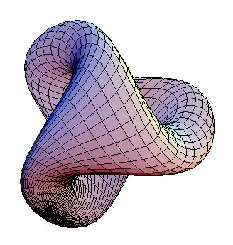
Parametric Representation
Range of a function
  Surface in 3D:

Slide 19
Parametric Curves
Explicit curve/circle in 2D

Slide 20
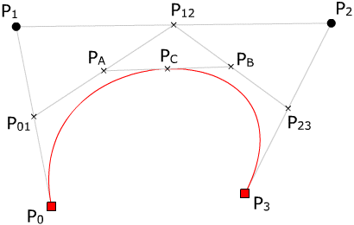
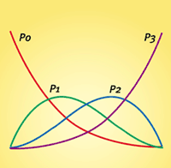
Parametric Curves
Bezier curves
Curve and
control polygon
Basis functions

Slide 21
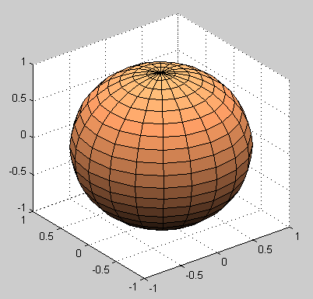
Parametric Surfaces
Sphere in 3D

Slide 22

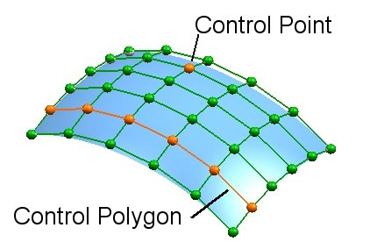
Parametric Surfaces
Curve swept by another curve
Bezier surface:

Slide 23
Tangents and Normal
if parameterization is regular
Tangent plane is normal to n
Notes:
All of these are functions of u,v

Slide 24
Parametric Curves and Surfaces
Advantages
  Easy to generate points on the curve/surface
  Separates x/y/z components
Disadvantages
  Hard to determine inside/outside
  Hard to determine if a point is on
  the curve/surface

Slide 25
Implicit Curves and Surfaces

Slide 26

Implicit Curves and Surfaces

Slide 27
Implicit Curves and Surfaces
Kernel of a scalar function
  Curve in 2D:
  Surface in 3D:
Space partitioning
Outside
Curve/Surface
Inside

Slide 28
Implicit Curves and Surfaces
Kernel of a scalar function
  Curve in 2D:
  Surface in 3D:
Zero level set of
signed distance function

Slide 29
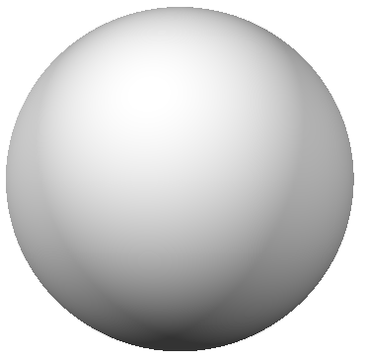
Implicit Curves and Surfaces
Implicit circle and sphere

Slide 30
Implicit Curves and Surfaces
The normal vector to the surface (curve) is given by the gradient of the implicit function
Example
Why?

Slide 31
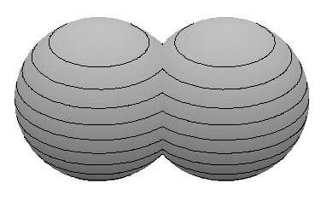
Boolean Set Operations
Union:
Intersection:

Slide 32
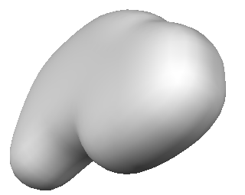
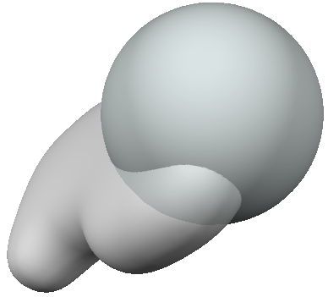
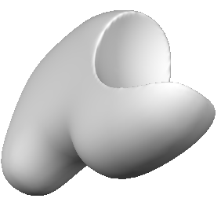
Boolean Set Operations
Positive = outside, negative = inside
Boolean subtraction:
Much easier than
for parametric surfaces!

Slide 33
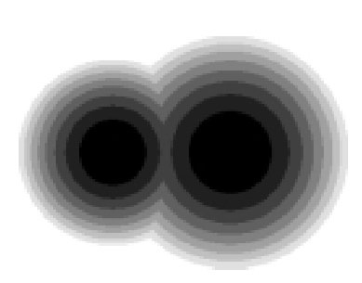
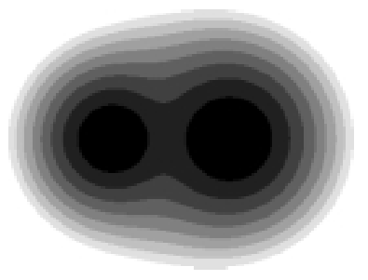
Smooth Set Operations
In many cases, smooth blending is desired
  Pasko and Savchenko [1994]

Slide 34
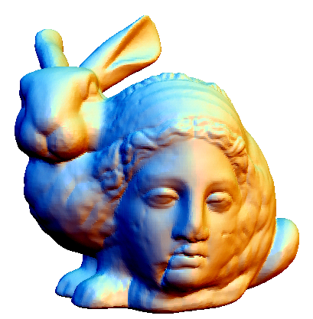
Smooth Set Operations
Examples
For α = 1, this is equivalent to min and max

Slide 35
Designing with Implicit Surfaces
Zero set (or level set) of a function:

Slide 36
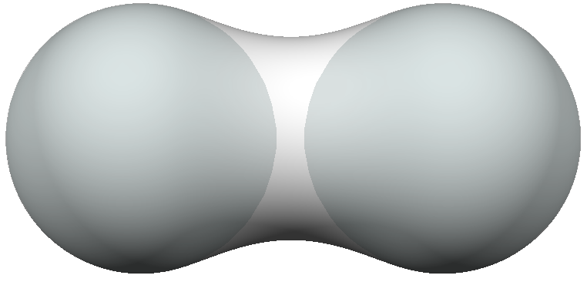
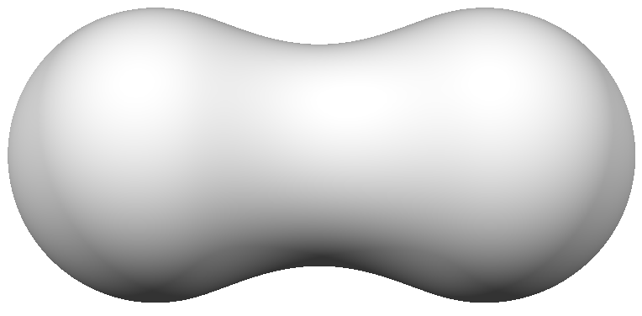
Designing with Implicit Surfaces
With smooth falloff functions, adding implicit functions generates a blend:
Called “Metaballs” or “Blobs”

Slide 37
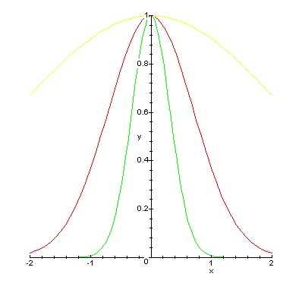
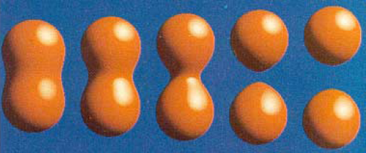
Blobs
Suggested by Blinn [1982]
  Defined implicitly by a potential function around a point p_{i} :
  Set operations by simple addition/subtraction

Slide 38
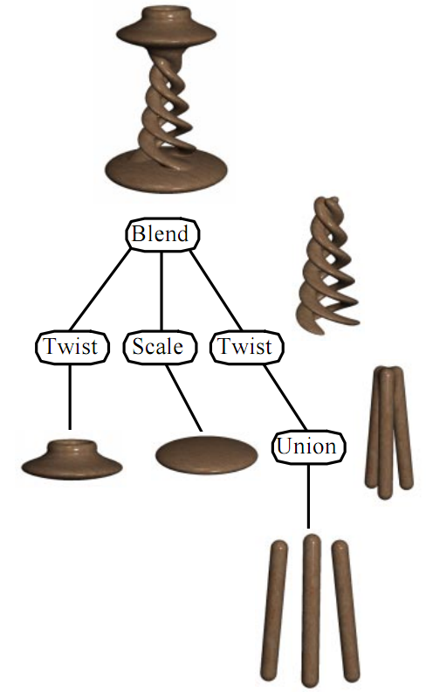
Procedural Implicits
Combine multiple operations into a tree
[Wyvill et al. 1999]
CSG tree

Slide 39
Implicit Curves and Surfaces
Advantages
  Easy to determine inside/outside
  Easy to determine if a point is on
  the curve/surface
Disadvantages
  Hard to generate points on the curve/surface
  Does not lend itself to (real-time) rendering

Slide 40
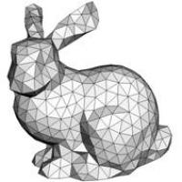
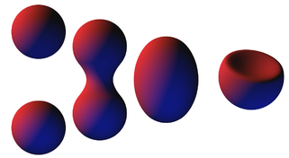



Summary
Parametric | Implicit | Discrete/Sampled
Splines, tensor-product surfaces Subdivision surfaces | Metaballs/blobs Distance fields Procedural, CSG | Meshes Point set surfaces

Slide 41

In the Next Lectures
How to get a nice, watertight surface mesh from a sampled point set
The most popular way:
points➔implicit function➔surface mesh

