Slide 1
2D/3D Shape Manipulation,
3D Printing
Geometry Acquisition
Meshes
Slides from Olga Sorkine

Slide 2
Geometry Acquisition Pipeline
Scanning:
results in range images
Registration:
bring all range images to one coordinate system
Stitching/reconstruction:
Integration of scans into a single mesh
Postprocess:
Topological and
geometric
filtering
Remeshing
Compression

Slide 3
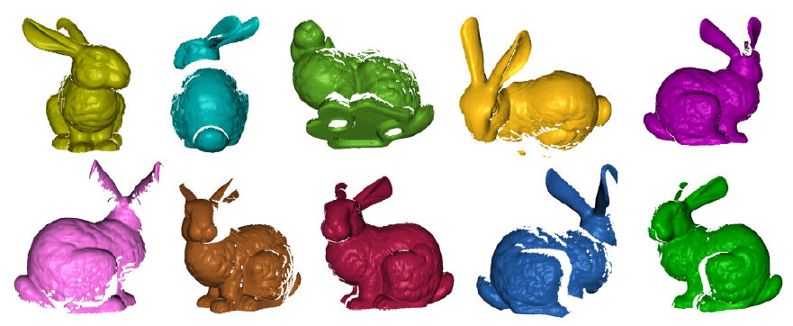
Geometry Acquisition Pipeline
Scanning:
results in range images
Registration:
bring all range images to one coordinate system
Stitching/reconstruction:
Integration of scans into a single mesh
Postprocess:
Topological and
geometric
filtering
Remeshing
Compression

Slide 4
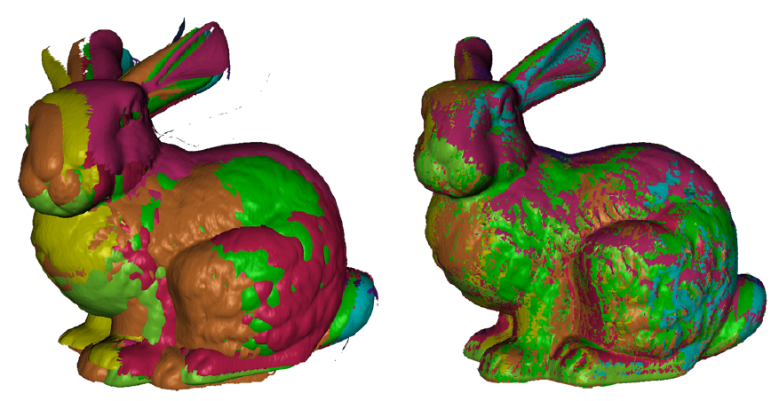
Geometry Acquisition Pipeline
Scanning:
results in range images
Registration:
bring all range images to one coordinate system
Stitching/reconstruction:
Integration of scans into a single mesh
Postprocess:
Topological and
geometric
filtering
Remeshing
Compression

Slide 5
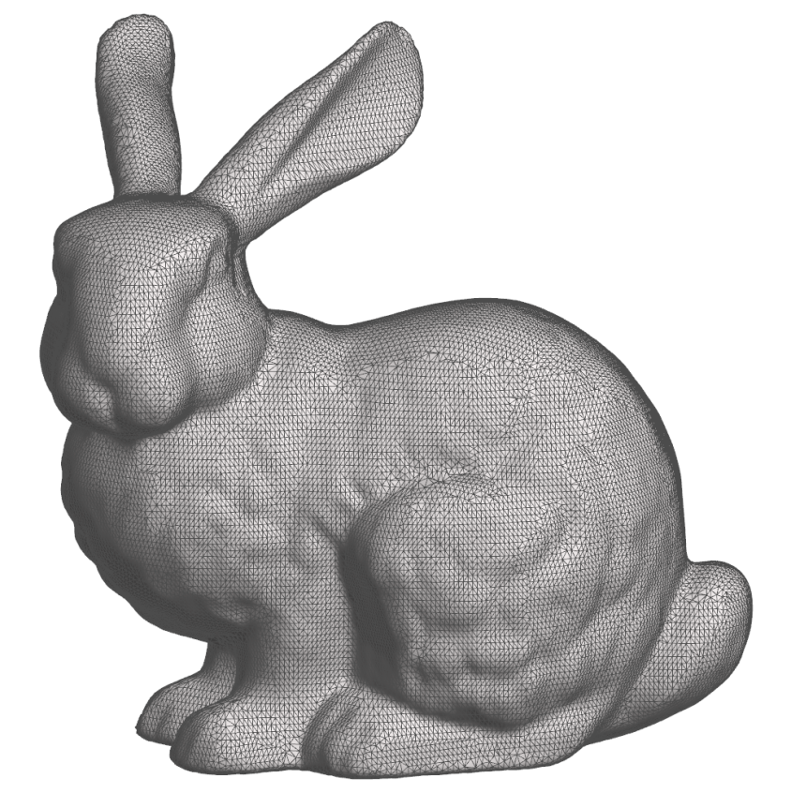
Geometry Acquisition Pipeline
Scanning:
results in range images
Registration:
bring all range images to one coordinate system
Stitching/reconstruction:
Integration of scans into a single mesh
Postprocess:
Topological and
geometric
filtering
Remeshing
Compression

Slide 6
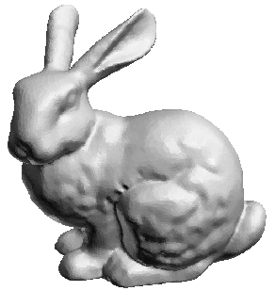

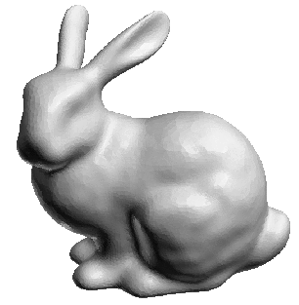
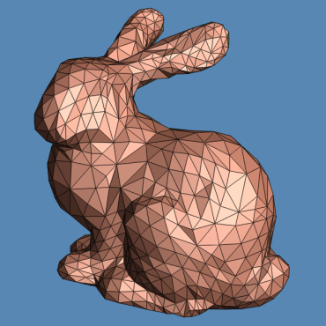
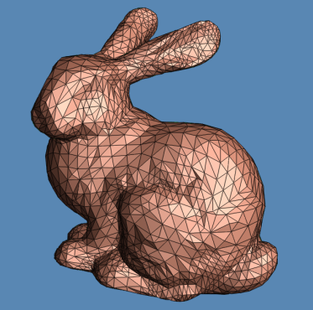
Geometry Acquisition Pipeline
Scanning:
results in range images
Registration:
bring all range images to one coordinate system
Stitching/reconstruction:
Integration of scans into a single mesh
Postprocess:
Topological and
geometric
filtering
Remeshing
Compression

Slide 7
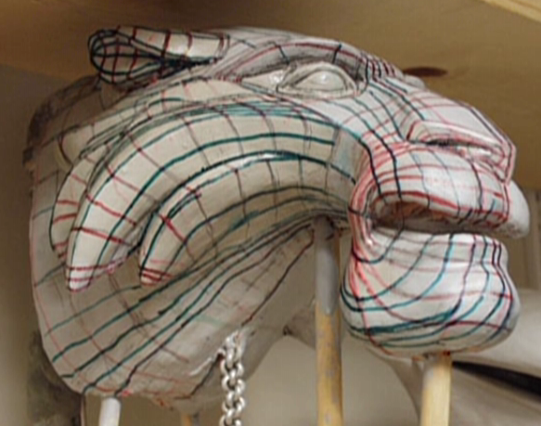
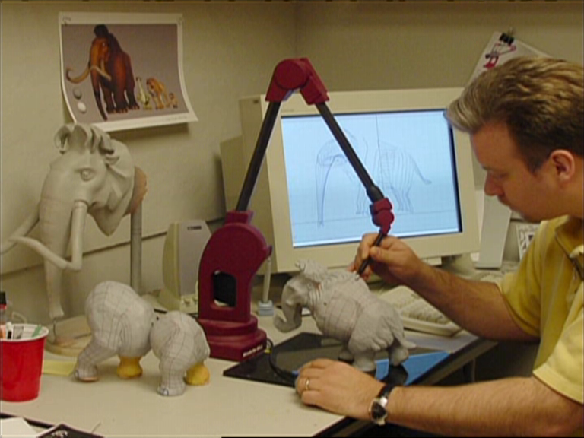
Touch Probes

Slide 8
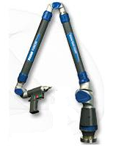
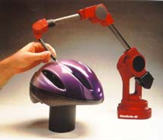
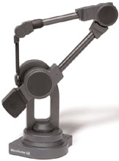
Touch Probes
Physical contact with the object
Manual or computer-guided
Advantages:
  Can be very precise
  Can scan any solid surface
Disadvantages:
  Slow, small scale
  Can’t use on fragile
  objects

Slide 9
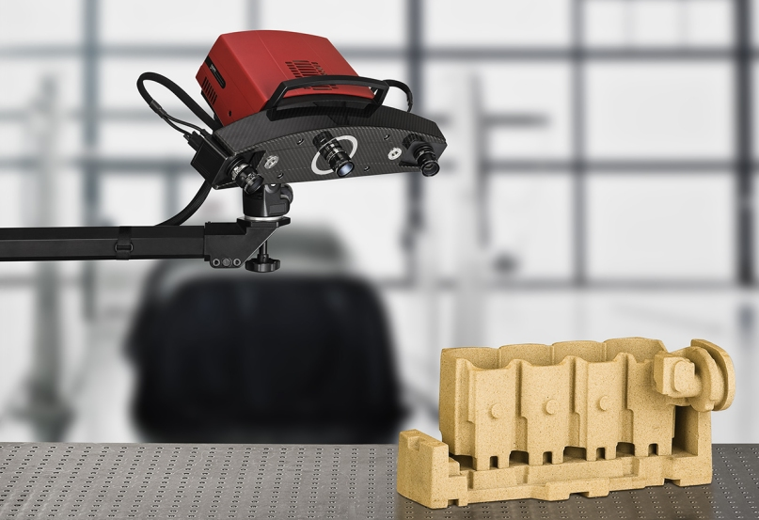
Optical Scanning
Infer the geometry from
light reflectance
Advantages:
  Less invasive than touch
  Fast, large scale possible
Disadvantages:
  Difficulty with transparent
  and shiny objects

Slide 10
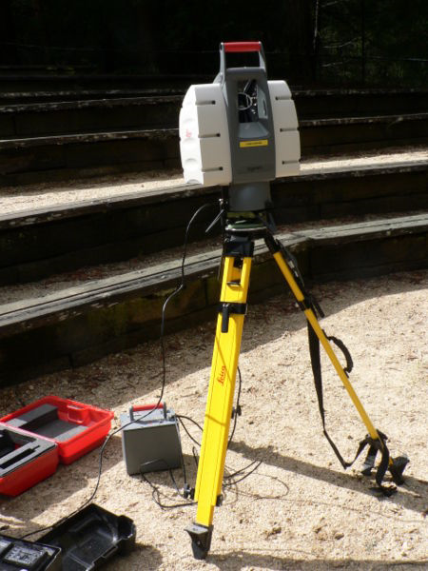
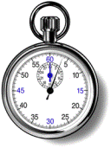
Optical scanning – active lighting
Time of flight laser
A type of laser
rangefinder (LIDAR)
Measures the time it takes
the laser beam to hit the object
and come back
d
laser
d = 0.5 t ⋅ c

Slide 11
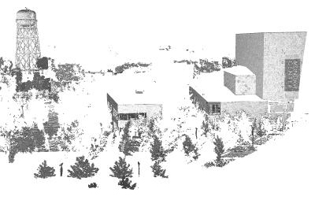
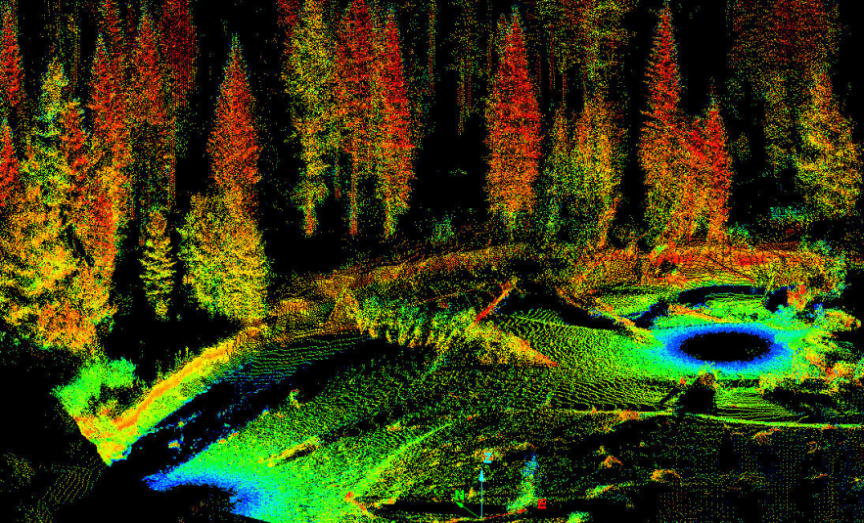
Optical scanning – active lighting
Accommodates large range – up to several miles (suitable for buildings, rocks)
Lower accuracy
  objects move while scanning

Slide 12
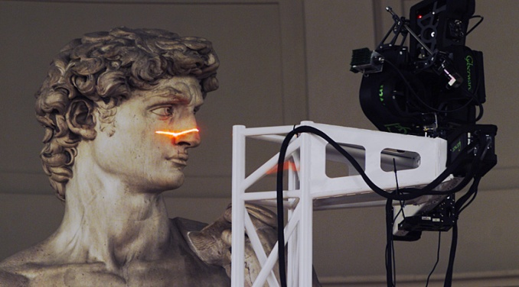
Optical scanning – active lighting
Triangulation laser
Laser beam and camera
Laser dot is photographed
The location of the dot in the
image allows triangulation:
we get the distance to the object
camera
(CCD)
lens
laser
d

Slide 13
Optical scanning – active lighting
Triangulation laser
Laser beam and camera
Laser dot is photographed
The location of the dot in the
image allows triangulation:
we get the distance to the object
camera
(CCD)
lens
laser
d

Slide 14
Optical scanning – active lighting
Triangulation laser
Laser beam and camera
Laser dot is photographed
The location of the dot in the
image allows triangulation:
we get the distance to the object
camera
(CCD)
lens
laser
d

Slide 15
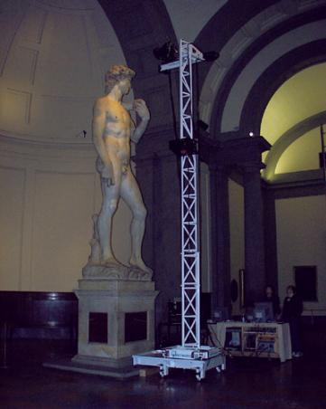
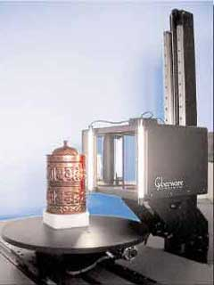
Optical scanning – active lighting
Triangulation laser
Very precise (tens of microns)
Small distances (meters)

Slide 16
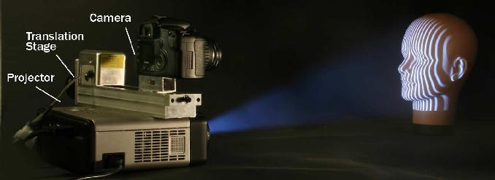
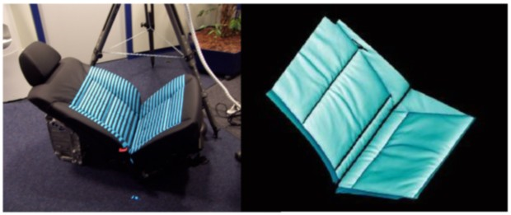
Optical scanning – active lighting
Structured light
Pattern of visible or infrared light is projected onto the object
The distortion of the pattern, recorded by the camera, provides geometric information
Very fast – 2D pattern at once
  Even in real time, like Kinect
Complex distance calculation, prone to noise

Slide 17
Optical scanning – passive
Stereo
No need for special lighting/radiation
Two (or more) cameras
Feature matching and triangulation
(x, y, z)
Right camera
focal point
Left camera
focal point
Epipolar
line
(x_{R}, y_{R})
(x_{L}, y_{L})
Right camera
projection plane
Left camera
projection plane

Slide 18
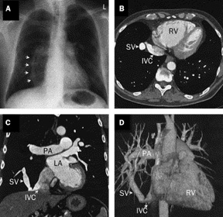
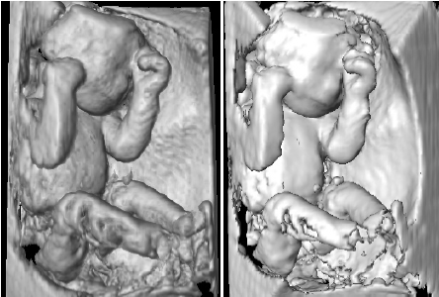
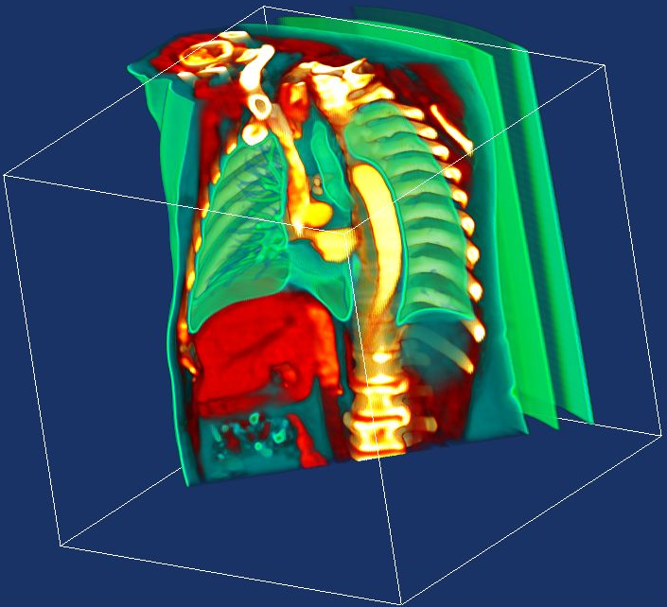
Imaging
Ultrasound, CT, MRI
Discrete volume of density data
First need to segment the
desired object (contouring)

Slide 19
Brief Mention of Implicit Functions / Surface Reconstruction

Slide 20
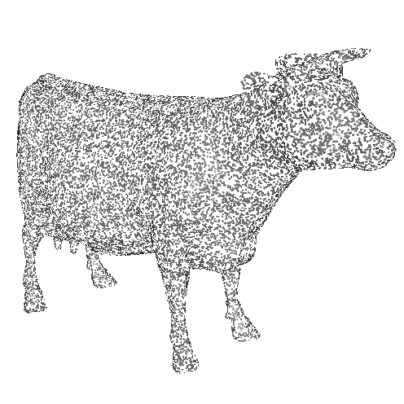
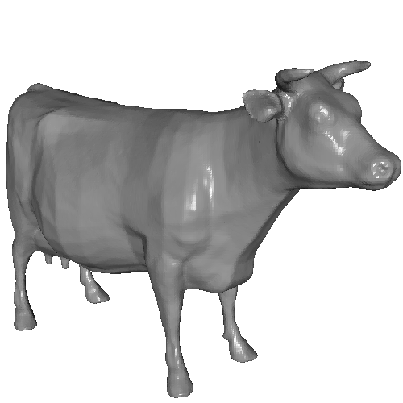
Surface Reconstruction
Generate a mesh from a set of surface samples

Slide 21
Implicit Function Approach

Slide 22

Implicit Function Approach
Define a function
with value > 0 outside the shape and < 0 inside
< 0
0
> 0

Slide 23
Implicit Function Approach
Define a function
with value > 0 outside the shape and < 0 inside
Extract the zero-set
< 0
0
> 0

Slide 24
Meshes
[Demo]

Slide 25
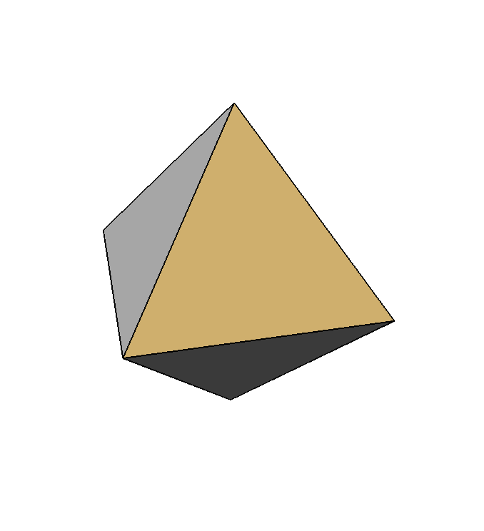
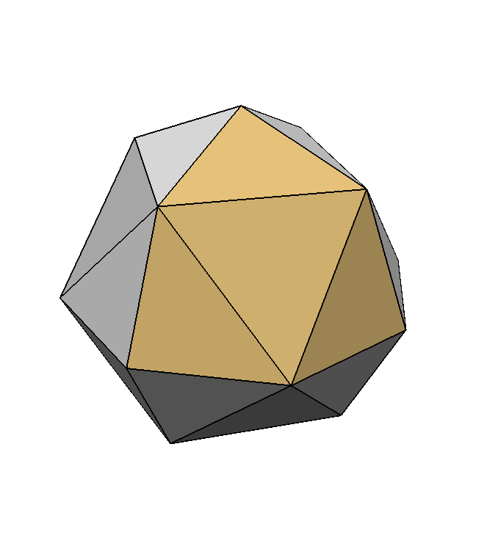
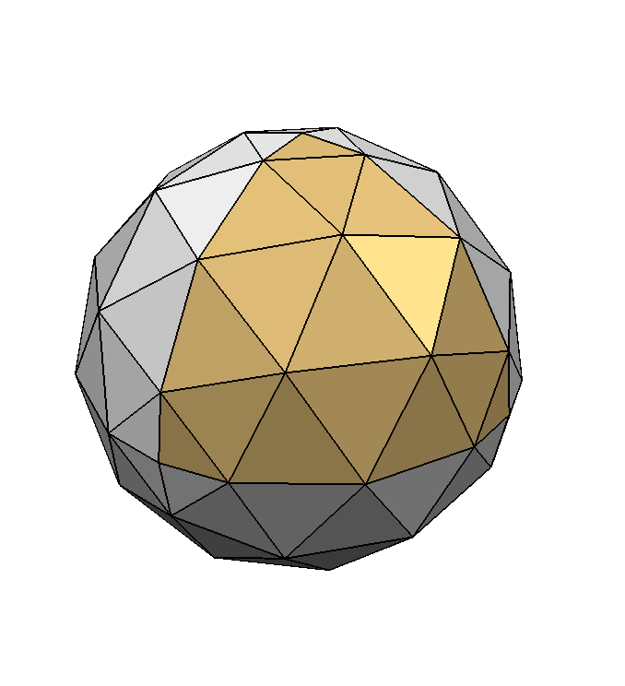
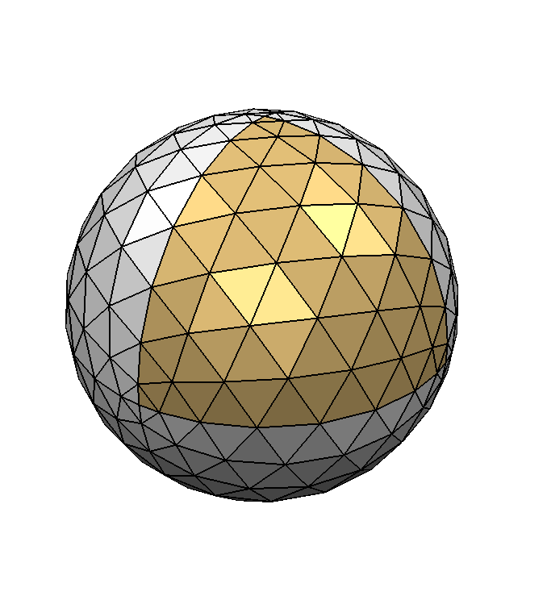
Polygonal Meshes
Boundary representations of objects

Slide 26
Meshes as Approximations of
Smooth Surfaces
Piecewise linear approximation
  Error is O(h²)
3
6
12
24
25%
6.5%
1.7%
0.4%
Q: This is in 2D. How is this argument different in 3D?

Slide 27
Meshes as Approximations of
Smooth Surfaces
Piecewise linear approximation
  Error is O(h²)
3
6
12
24
25%
6.5%
1.7%
0.4%

Slide 28
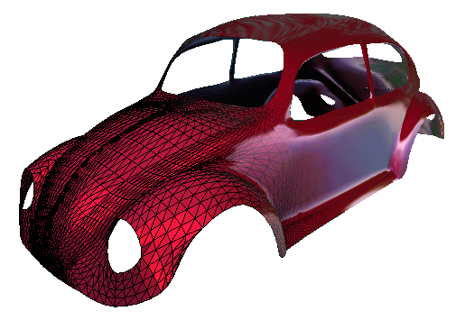
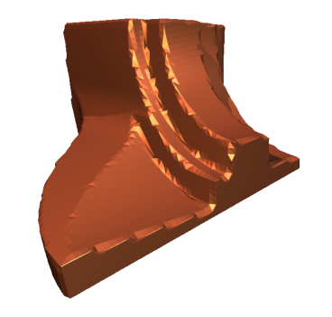
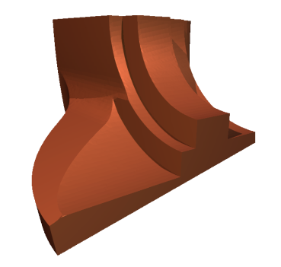
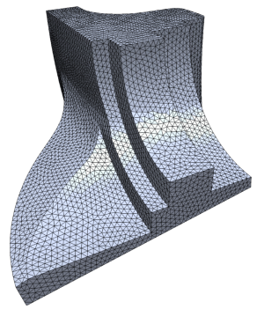
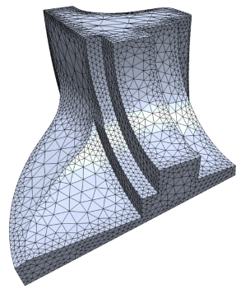
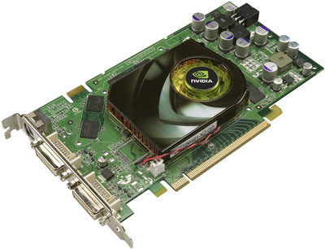
Polygonal Meshes
Polygonal meshes are a good representation
  approximation O(h²)
  arbitrary topology
  piecewise smooth surfaces
  adaptive refinement
  efficient rendering

Slide 29
Polygon
  Vertices:
  Edges:
  Closed:
  Planar: all vertices on a plane
  Simple: not self-intersecting

Slide 30
Polygonal Mesh
A finite set M of closed, simple polygons Q_{i} is a polygonal mesh
The intersection of two polygons in M is either empty, a vertex, or an edge
vertices
edges
faces

Slide 31
Polygonal Mesh
A finite set M of closed, simple polygons Q_{i} is a polygonal mesh
The intersection of two polygons in M is either empty, a vertex, or an edge
Every edge belongs to at least one polygon

Slide 32
Polygonal Mesh
A finite set M of closed, simple polygons Q_{i} is a polygonal mesh
The intersection of two polygons in M is either empty, a vertex, or an edge
Every edge belongs to at least one polygon
Each Q_{i} defines a face of the polygonal mesh

Slide 33
Polygonal Mesh
A finite set M of closed, simple polygons Q_{i} is a polygonal mesh
The intersection of two polygons in M is either empty, a vertex, or an edge
Every edge belongs to at least one polygon
Each Q_{i} defines a face of the polygonal mesh

Slide 34
Polygonal Mesh
A finite set M of closed, simple polygons Q_{i} is a polygonal mesh
The intersection of two polygons in M is either empty, a vertex, or an edge
Every edge belongs to at least one polygon
Each Q_{i} defines a face of the polygonal mesh

Slide 35
Polygonal Mesh
A finite set M of closed, simple polygons Q_{i} is a polygonal mesh
The intersection of two polygons in M is either empty, a vertex, or an edge
Every edge belongs to at least one polygon
Each Q_{i} defines a face of the polygonal mesh

Slide 36
Polygonal Mesh
Vertex degree or valence =
number of incident edges
4

Slide 37
Polygonal Mesh
Vertex degree or valence =
number of incident edges
2

Slide 38
Polygonal Mesh
Boundary: the set of all edges that belong to only one polygon
  Either empty or forms
  closed loops
  If empty, then the polygonal mesh is closed

Slide 39
Triangle Meshes
Connectivity: vertices, edges, triangles
Geometry: vertex positions

Slide 40
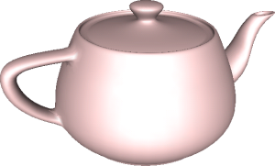
Manifolds
A surface is a closed 2-manifold if it is everywhere locally homeomorphic
to a disk

Slide 41
Manifolds
For every point x in M, there is an open ball
B_{x} (r) of radius r > 0 centered at x such that
M B_{x} is homeomorphic to an open disk

Slide 42
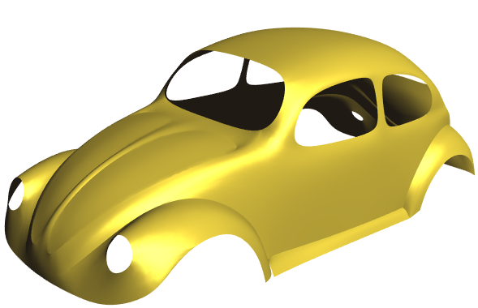
Manifolds
Manifold with boundary: a vicinity of each boundary point is homeomorphic to a half-disk
Homeomorphism: (1) Bijection, (2) Continuous, (3) Inverse is continuous

Slide 43
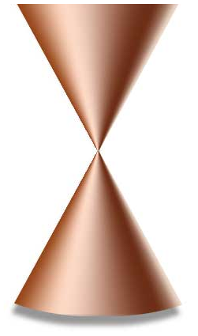
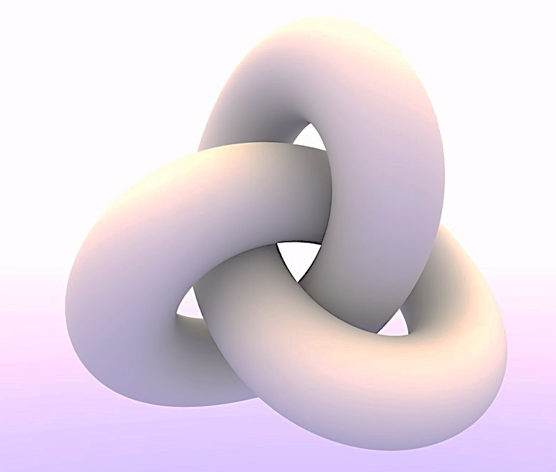
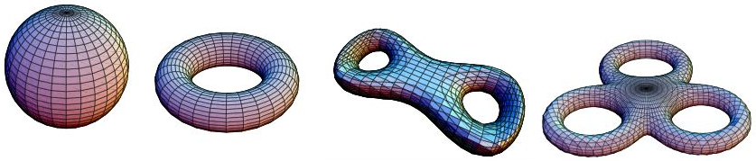
Democratic manifolds ☺
For each case, decide if it is a 2-manifold (possibly with boundary) or not. If not, explain why not.
Case 1
Case 2
Case 3
Case 4
Case 5

Slide 44
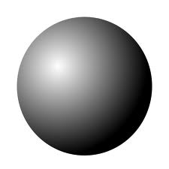
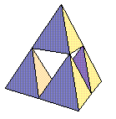
Democratic manifolds ☺
Bonus cases
Case 6
Case 7
Case 8

Slide 45
Manifolds
In a manifold mesh, there are at most 2 faces sharing an edge
  Boundary edges: have one incident face
  Inner edges have two incident faces
A manifold vertex has 1 connected ring of faces around it, or 1 connected half-ring (boundary)
manifold
non-manifold vertex
non-manifold edge
non-manifold vertex

Slide 46
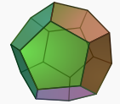
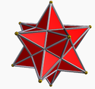
Manifolds
If closed, a manifold divides the space into inside and outside
A closed manifold polygonal mesh is called polyhedron

Slide 47
Orientation
Every face of a polygonal mesh is orientable
  Clockwise vs. counterclockwise order of face vertices
  Defines sign/direction of the surface normal
7
6
7
6
4
5
4
5
+
-
3
2
3
2
0
1
0
1

Slide 48
Orientation
Consistent orientation of neighboring faces:

Slide 49
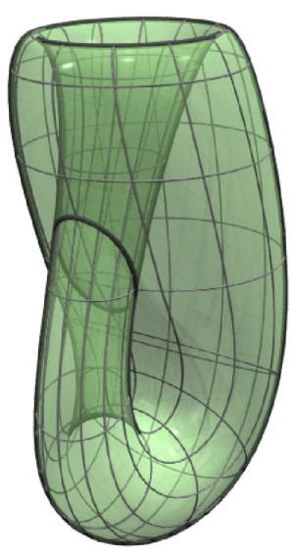
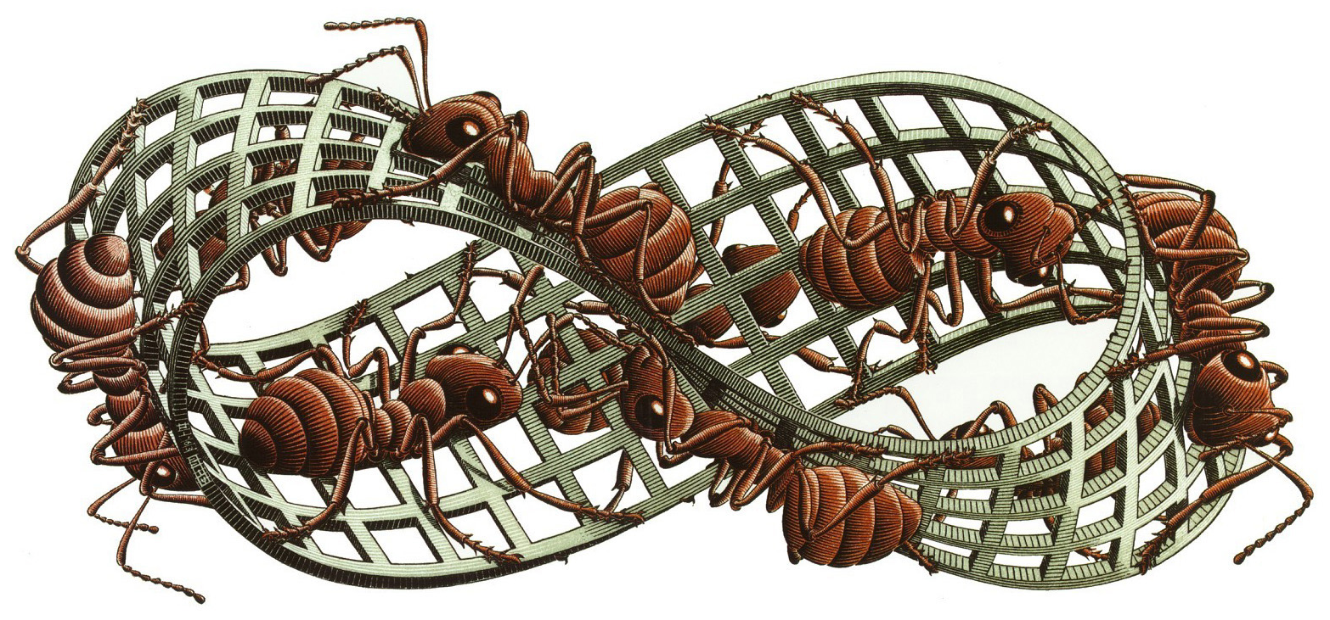
Orientability
A polygonal mesh is orientable, if the incident faces to every edge can be consistently oriented
  If the faces are consistently oriented
  for every edge, the mesh is oriented
Notes
  Every non-orientable closed mesh
  embedded in intersects itself
  The surface of a polyhedron is
  always orientable
Klein bottle
Möbius strip

Slide 50
Global Topology of Meshes
Genus: Half the maximal number of closed paths that do not disconnect the graph.
  Informally, the number of holes or handles.
Genus 0
Genus 1
Genus 2
Genus 3

Slide 51
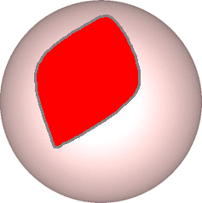
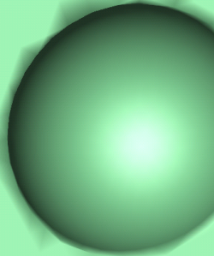

Global Topology of Meshes
Genus: Half the maximal number of closed paths that do not disconnect the graph.
  Informally, the number of holes or handles.
handle
This is not a handle,
it’s a boundary loop

Slide 52

Global Topology of Meshes
Genus: Half the maximal number of closed paths that do not disconnect the graph.
  Informally, the number of holes or handles.

Slide 53
Global Topology of Meshes
Genus: Half the maximal number of closed paths that do not disconnect the graph.
  Informally, the number of holes or handles.
?
Genus 0
Genus 1

Slide 54
Euler-Poincaré Characteristic
Theorem (Euler): The sum
is constant for a given surface topology, no matter which mesh we choose.
  v = number of vertices
  e = number of edges
  f = number of faces

Slide 55


Euler-Poincaré Formula
For orientable meshes:
  c = number of connected components
  g = genus
  b = number of boundary loops

Slide 56

Implication for Mesh Storage
Let‘s count the edges and faces in a closed triangle mesh:
  Ratio of edges to faces: e = 3/2 f
    each edge belongs to exactly 2 triangles
    each triangle has exactly 3 edges

Slide 57
Implication for Mesh Storage
Let‘s count the edges and faces in a closed triangle mesh:
  Ratio of edges to faces: e = 3/2 f
    each edge belongs to exactly 2 triangles
    each triangle has exactly 3 edges
  Ratio of vertices to faces: f ~ 2v
    2 = v – e + f = v – 3/2 f + f
    2 + f / 2 = v

Slide 58
Implication for Mesh Storage
Let‘s count the edges and faces in a closed triangle mesh:
  Ratio of edges to faces: e = 3/2 f
    each edge belongs to exactly 2 triangles
    each triangle has exactly 3 edges
  Ratio of vertices to faces: f ~ 2v
    2 = v – e + f = v – 3/2 f + f
    2 + f / 2 = v
  Ratio of edges to vertices: e ~ 3v
  Average degree of a vertex: 6
Notes:
I ONLY GOT TO HERE ON 27/2/2013 (SECOND WEEK OF THE SEMESTER).

Slide 59
Regularity
Triangle mesh: average valence = 6
Quad mesh: average valence = 4
Regular mesh: all faces have the same number of edges and all vertex degrees are equal
Quasi-regular mesh:
  a lot of vertices have degree 6 (4). Sometimes also refers to mostly equilateral faces.

Slide 60

Regularity
Quasi-regular

Slide 61




Regularity
Semi-regular mesh:
connectivity is a result
of N>0 subdivision steps

Slide 62
Regularity
Semi-regular mesh:
connectivity is a result
of N>0 subdivision steps

Slide 63
Triangulation
Polygonal mesh where every face is a triangle
Simplifies data structures
Simplifies rendering
Simplifies algorithms
Each face planar and convex
Any polygon can be triangulated

Slide 64
Triangulation
Polygonal mesh where every face is a triangle
Simplifies data structures
Simplifies rendering
Simplifies algorithms
Each face planar and convex
Any polygon can be triangulated

Slide 65


Polygonal vs. Triangle Meshes
Triangles are flat and convex
  Easy rasterization, normals
  Uniformity (same # of vertices)
3-way symmetry is less natural
General polygons are flexible
  Quads have natural symmetry
Can be non-planar, non-convex
  Difficult for graphics hardware
Varying number of vertices

Slide 66

Data Structures
What should be stored?
  Geometry: 3D coordinates
  Connectivity
    Adjacency relationships
  Attributes
    Normal, color, texture coordinates
    Per vertex, face, edge

Slide 67
Data Structures
What should be supported?
  Rendering
  Geometry queries
    What are the vertices of face #2?
    Is vertex A adjacent to vertex H?
    Which faces are adjacent to face #1?
  Modifications
    Remove/add a vertex/face
    Vertex split, edge collapse
B
A
3
1
4
E
F
C
D
2
I
H
G
J
K

Slide 68
Data Structures
How good is a data structure?
  Time to construct
  Time to answer a query
  Time to perform an operation
  Space complexity
  Redundancy
Criteria for design
  Expected number of vertices
  Available memory
  Required operations
  Distribution of operations
B
A
3
1
4
E
F
C
D
2
I
H
G
J
K

Slide 69
Triangle List
STL format (used in CAD)
Storage
  Face: 3 positions
  4 bytes per coordinate
  36 bytes per face
    Euler: f = 2v
    72*v bytes for a mesh
    with v vertices
No connectivity information
Triangles
0 | x0 | y0 | z0
1 | x1 | x1 | z1
2 | x2 | y2 | z2
3 | x3 | y3 | z3
4 | x4 | y4 | z4
5 | x5 | y5 | z5
6 | x6 | y6 | z6
... | ... | ... | ...

Slide 70
Indexed Face Set
Vertices
v0 | x0 | y0 | z0
v1 | x1 | x1 | z1
v2 | x2 | y2 | z2
v3 | x3 | y3 | z3
v4 | x4 | y4 | z4
v5 | x5 | y5 | z5
v6 | x6 | y6 | z6
... | ... | ... | ...
Triangles
t0 | v0 | v1 | v2
t1 | v0 | v1 | v3
t2 | v2 | v4 | v3
t3 | v5 | v2 | v6
... | ... | ... | ...
Used in formats
OBJ, OFF, WRL
Storage
  Vertex: position
  Face: vertex indices
  12 bytes per vertex
  12 bytes per face
  36*v bytes for the mesh
No explicit neighborhood info

Slide 71
Indexed Face Set: Problems
Information about neighbors is not explicit
  Finding neighboring vertices/edges/faces costs O(v) time!
  Local mesh modifications cost O(v)
  Breadth-first search costs O(k*v)
  where k = # found vertices

Slide 72
Neighborhood Relations
All possible neighborhood relationships:
  Vertex – Vertex VV
  Vertex – Edge VE
  Vertex – Face VF
  Edge – Vertex EV
  Edge – Edge EE
  Edge – Face EF
  Face – Vertex FV
  Face – Edge FE
  Face – Face FF
VV
VE
VF
EV
EE
EF
FV
FE
FF
E
We’d like O(1) time for queries and local updates of these relationships
V
F

Slide 73
Halfedge data structure
Introduce orientation into data structure
  Oriented edges

Slide 74
Halfedge data structure
Introduce orientation into data structure
  Oriented edges

Slide 75
Halfedge data structure
Introduce orientation into data structure
  Oriented edges
Vertex
  Position
  1 outgoing halfedge index
Halfedge
  1 origin vertex index
  1 incident face index
  3 next, prev, twin halfedge indices
Face
  1 adjacent halfedge index
Easy traversal, full connectivity

Slide 76
Halfedge data structure
One-ring traversal
Q: For what applications would you want a one-ring traversal?

Slide 77
Halfedge data structure
One-ring traversal
  Start at vertex

Slide 78
Halfedge data structure
One-ring traversal
  Start at vertex
  Outgoing halfedge

Slide 79
Halfedge data structure
One-ring traversal
  Start at vertex
  Outgoing halfedge
  Twin halfedge

Slide 80
Halfedge data structure
One-ring traversal
  Start at vertex
  Outgoing halfedge
  Twin halfedge
  Next halfedge

Slide 81
Halfedge data structure
One-ring traversal
  Start at vertex
  Outgoing halfedge
  Twin halfedge
  Next halfedge
  Twin ...

Slide 82
Halfedge data structure
Pros: (assuming bounded vertex valence)
  O(1) time for neighborhood relationship queries
  O(1) time and space for local modifications (edge collapse, vertex insertion…)
Cons:
  Heavy – requires storing and managing extra pointers
  Not as trivial as Indexed Face Set for rendering with OpenGL / Vertex Buffer Objects

Slide 83
Halfedge Libraries
CGAL
  www.cgal.org
  Computational geometry
OpenMesh
  www.openmesh.org
  Mesh processing

Slide 84
Thank you

