Slide 1
2D/3D Shape Manipulation,
3D Printing
Surface Reconstruction
Slides from Olga Sorkine

Slide 2
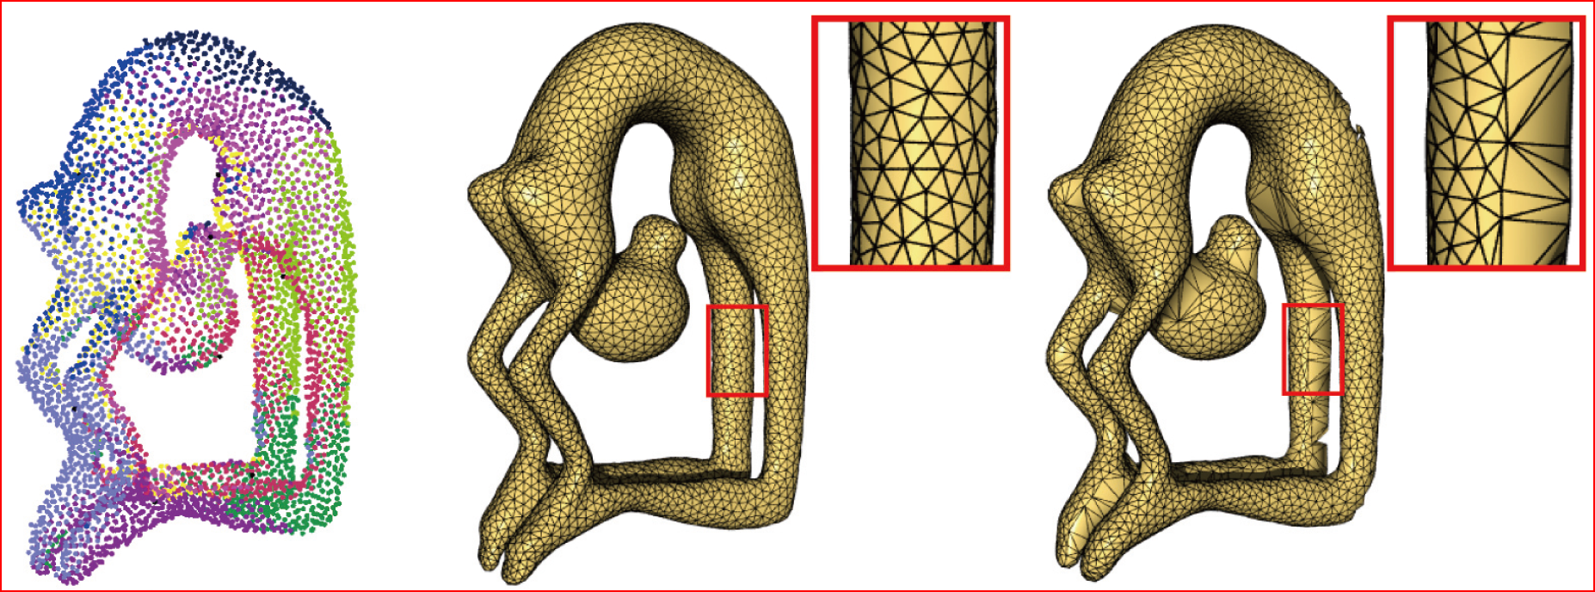
Geometry Acquisition Pipeline
Scanning:
results in range images
Registration:
bring all range images to one coordinate system
Stitching/reconstruction:
Integration of scans into a single mesh
Postprocess:
Topological and
geometric
filtering
Remeshing
Compression

Slide 3
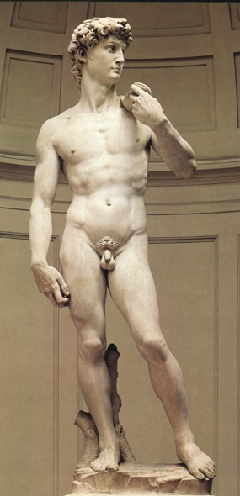
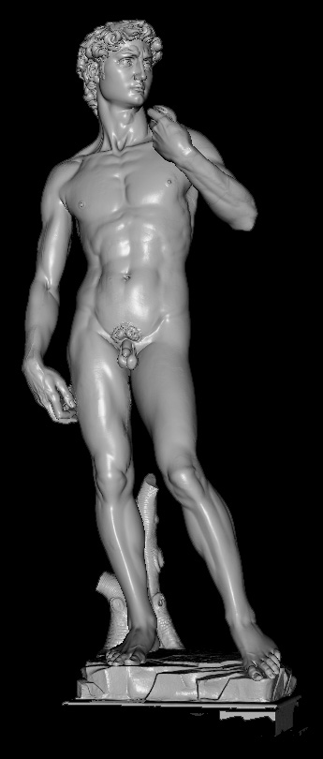
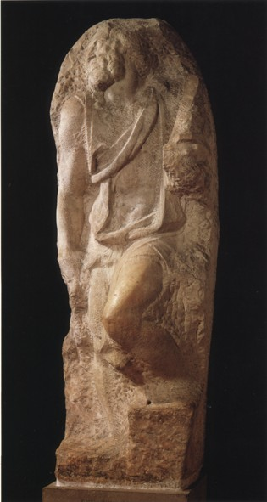
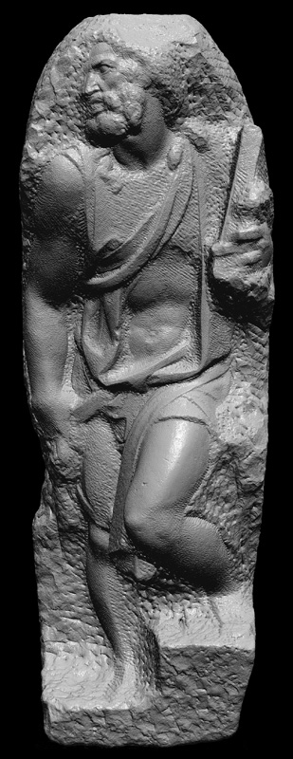
Digital Michelangelo Project
1G sample points → 8M triangles
4G sample points → 8M triangles

Slide 4
Registration
Iterative Closest Points (ICP):
Efficient Variants of the ICP Algorithm

Slide 5
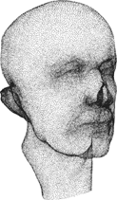
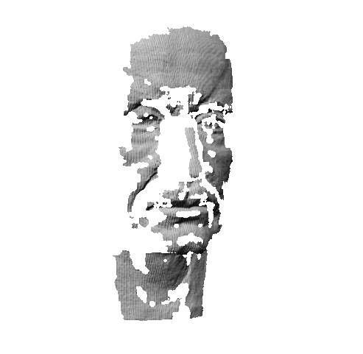
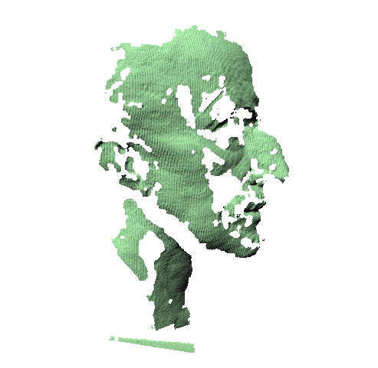
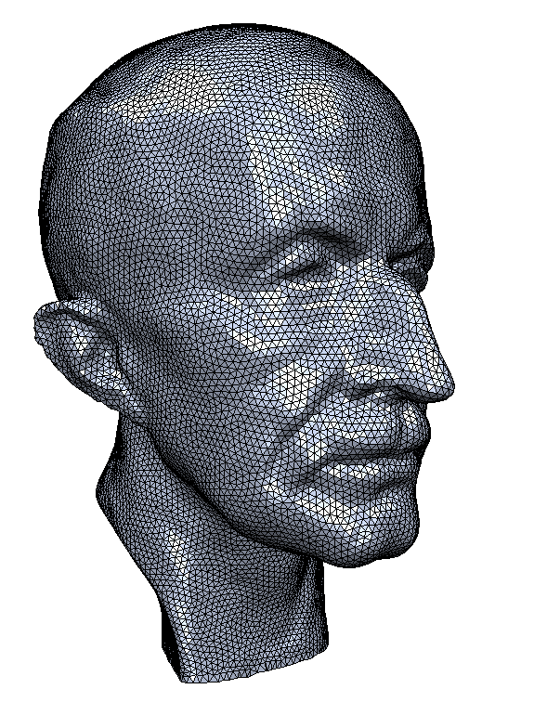
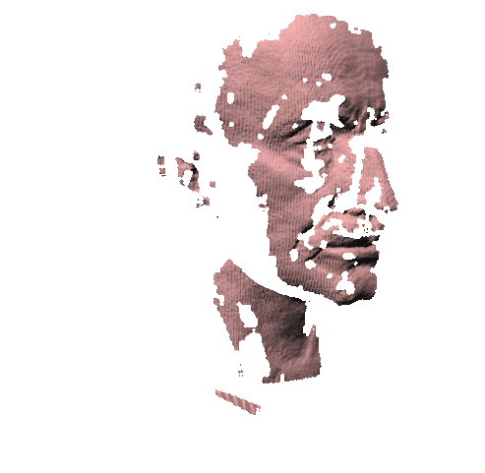
Input to Reconstruction Process
Input option 1: just a set of 3D points, irregularly spaced
  Need to estimate normals ➔ next class
Input option 2:
normals come from the range scans
set of raw scans
reconstructed model

Slide 6
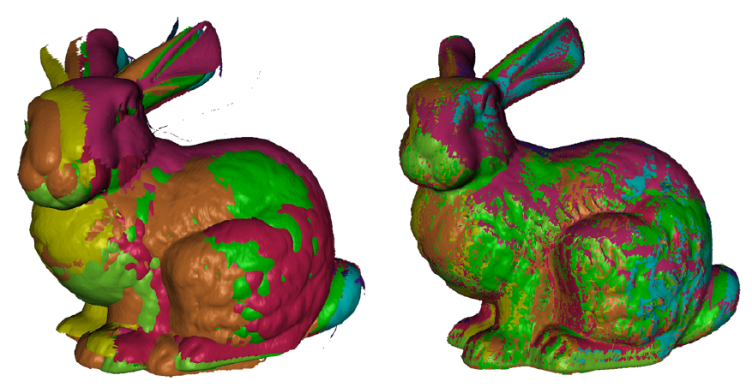
How to Connect the Dots?
Explicit reconstruction:
stitch the range scans together

Slide 7
How to Connect the Dots?
Explicit reconstruction:
stitch the range scans together
  Connect sample points by triangles
  Exact interpolation of sample points
  Bad for noisy or misaligned data
  Can lead to holes or non-manifold situations

Slide 8
How to Connect the Dots?
Implicit reconstruction: estimate a signed distance function (SDF); extract 0-level set mesh using Marching Cubes

Slide 9
How to Connect the Dots?
Implicit reconstruction: estimate a signed distance function (SDF); extract 0-level set mesh using Marching Cubes

Slide 10
How to Connect the Dots?
Implicit reconstruction: estimate a signed distance function (SDF); extract 0-level set mesh using Marching Cubes
  Approximation of input points
  Watertight manifold results by construction

Slide 11
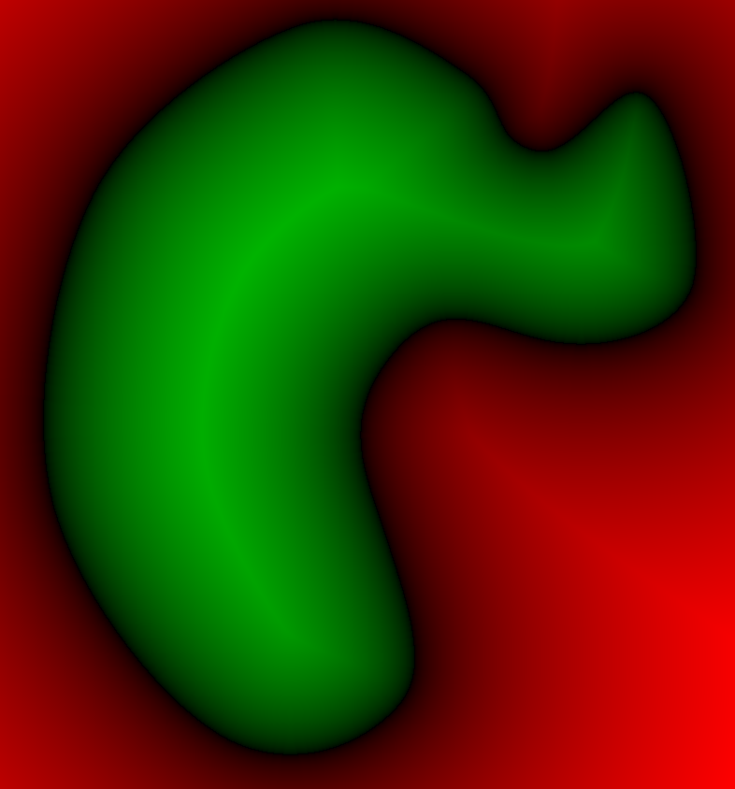
How to Connect the Dots?
Implicit reconstruction: estimate a signed distance function (SDF); extract 0-level set mesh using Marching Cubes
  Approximation of input points
  Watertight manifold results by construction
< 0
0
> 0

Slide 12
Implicit vs. Explicit
Input
Implicit
Explicit

Slide 13
SDF from Points and Normals
Compute signed distance to the tangent plane of the closest point
Normals help to distinguish between inside and outside
-
+

Slide 14
SDF from Points and Normals
Compute signed distance to the tangent plane of the closest point
Problem??

Slide 15
SDF from Points and Normals
Compute signed distance to the tangent plane of the closest point
The function will be discontinuous

Slide 16
Smooth SDF
Instead find a smooth formulation for F.
Scattered data interpolation:
  F is smooth
  Avoid trivial
0
0
0
0

Slide 17
Smooth SDF
Scattered data interpolation:
  F is smooth
  Avoid trivial
Add off-surface constraints
0
0
0
0

Slide 18
Radial Basis Function Interpolation
RBF: Weighted sum of shifted, smooth kernels
Smooth kernels
(basis functions)
centered at constrained
points.
For example:
Scalar weights
Unknowns

Slide 19
Radial Basis Function Interpolation
Interpolate the constraints:
0
0
0
0

Slide 20
Radial Basis Function Interpolation
Interpolate the constraints:
  Symmetric linear system to get the weights:

Slide 21
RBF Kernels
Triharmonic:
  Globally supported
  Leads to dense symmetric linear system
  C² smoothness
  Works well for highly irregular sampling

Slide 22
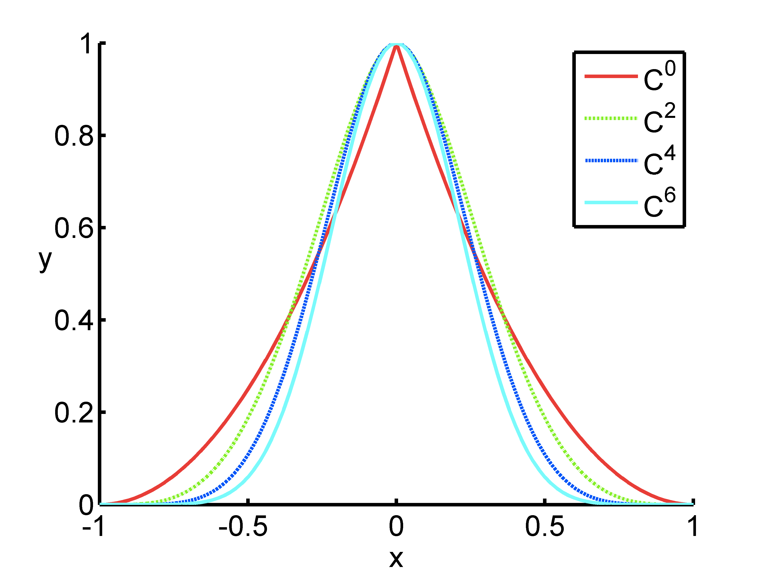
RBF Kernels
Polyharmonic spline
Multiquadratic
Gaussian
B-Spline (compact support)

Slide 23
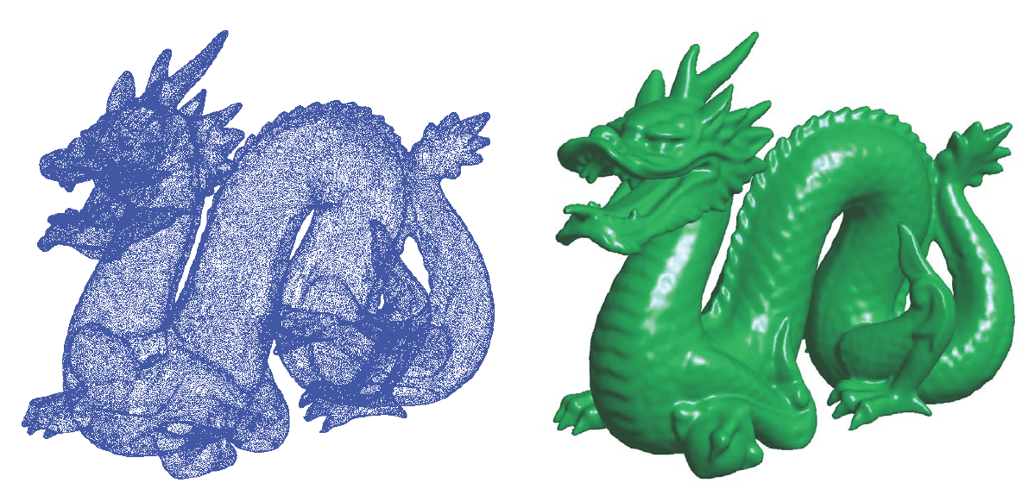
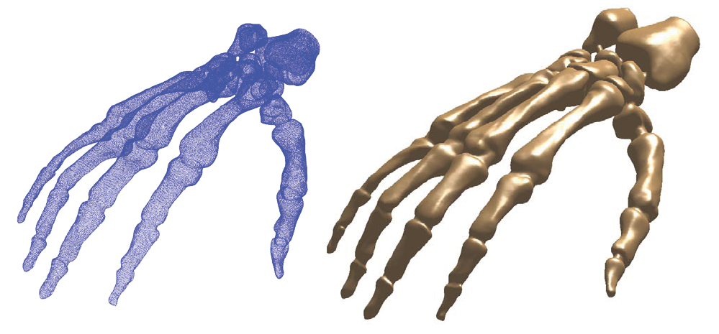
RBF Reconstruction Examples

Slide 24
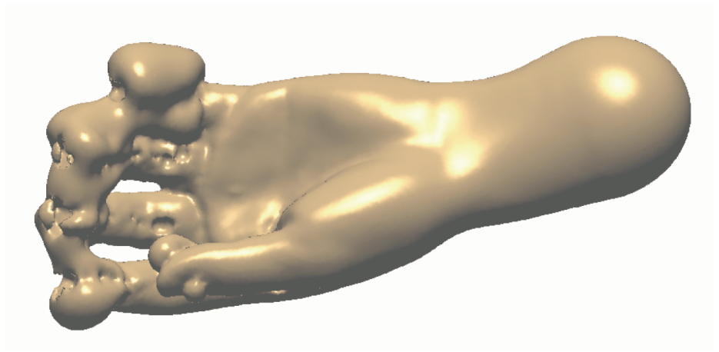
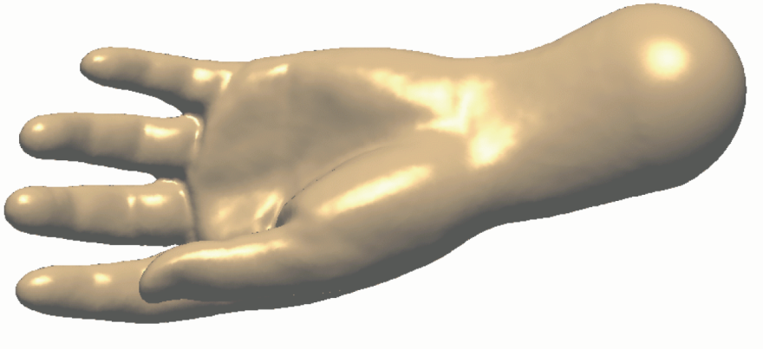
Off-Surface Points
Insufficient number/
badly placed off-surface points
Properly chosen off-surface points

Slide 25
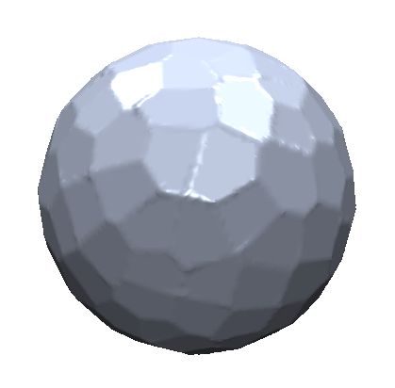
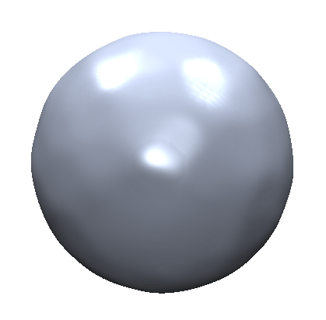
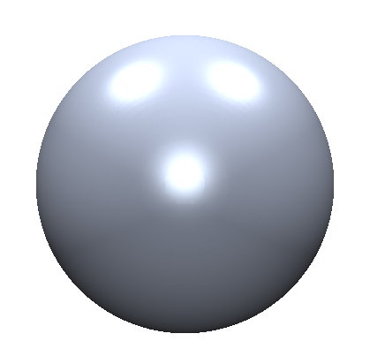
Comparison of the various SDFs so far
Distance
to plane
Compact RBF
Global RBF
Triharmonic

Slide 26
RBF – Discussion
Global definition!
Global optimization of
the weights, even if the
basis functions are local
0
0
0
0

Slide 27
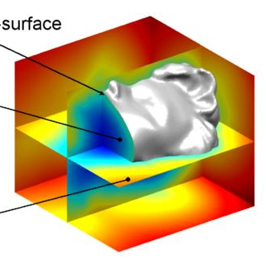
Extracting the Surface
Wish to compute a manifold mesh of the level set
F(x) = 0 → surface
F(x) < 0 → inside
F(x) > 0 → outside
Image from: www.farfieldtechnology.com

Slide 28
Sample the SDF

Slide 29
Sample the SDF

Slide 30
Tessellation
Want to approximate an implicit surface with a mesh
Can‘t explicitly compute all the roots
  Sampling the level set is hard (root finding)
Solution: find approximate roots by trapping the implicit surface in a grid (lattice)
+
-
-
-

Slide 31
Marching Squares
16 different configurations in 2D
4 equivalence classes (up to rotational and reflection symmetry + complement)
…
…

Slide 32
Tessellation in 2D
4 equivalence classes (up to rotational and reflection symmetry + complement)
?

Slide 33
Tessellation in 2D
Case 4 is ambiguious:
Always pick consistently to avoid problems with the resulting mesh

Slide 34
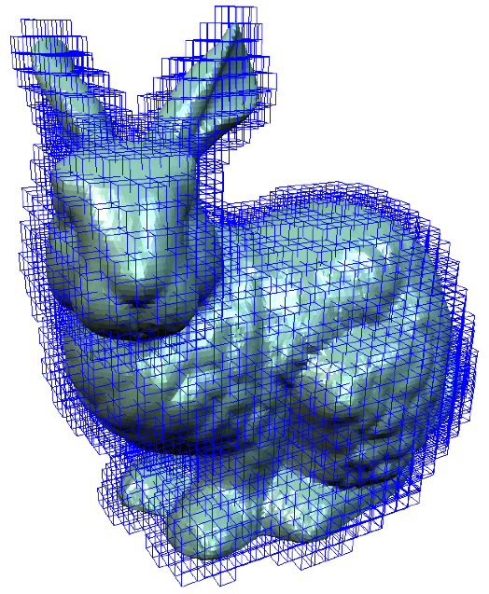
3D: Marching Cubes
Layer k+1
Layer k

Slide 35
Marching Cubes
Marching Cubes (Lorensen and Cline 1987)
  Load 4 layers of the grid
  into memory
  Create a cube whose
  vertices lie on the two
  middle layers
  Classify the vertices of
  the cube according to the
  implicit function (inside,
  outside or on the surface)
Layer k+1
Layer k

Slide 36
Marching Cubes
Compute case index. We have 2⁸= 256 cases (0/1 for each of the eight vertices) – can store as 8 bit (1 byte) index.
v₈
e₇
v₇
e₈
e₆
e₆
v₅
e₅
v₆
e₅
v₆
e₁₁
e₁₂
e₉
v₄
e₁₀
e₉
e₁₀
e₃
v₃
e₄
e₂
e₄
v₁
e₁
v₂
v₁
e₁
index =
v₁
v₂
v₃
v₄
v₅
v₆
v₇
v₈
index =
0
0
1
0
0
0
0
1
= 33

Slide 37
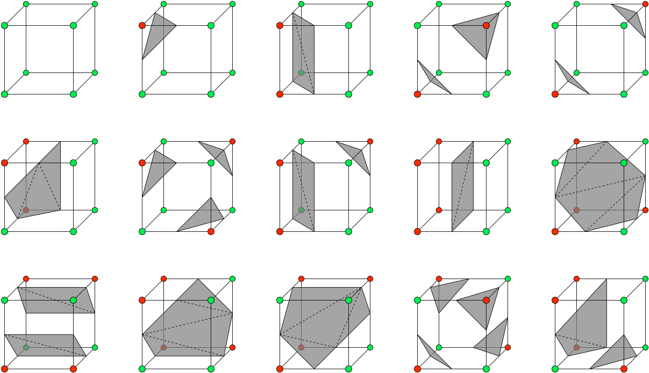
Marching Cubes
Unique cases (by rotation, reflection and complement)

Slide 38
Tessellation
3D – Marching Cubes
Using the case index, retrieve the connectivity in the look-up table
Example: the entry for index 33 in the look-up table indicates that the cut edges are e₁; e₄; e₅; e₆; e₉ and e₁₀ ; the output triangles are (e₁; e₉; e₄) and (e₅; e₁₀; e₆).
e₆
e₅
v₆
e₉
e₁₀
e₄
index =
0
0
1
0
0
0
0
1
= 33
v₁
e₁

Slide 39
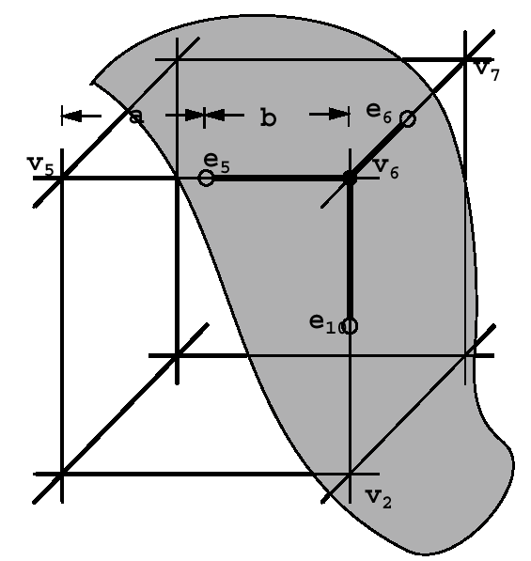
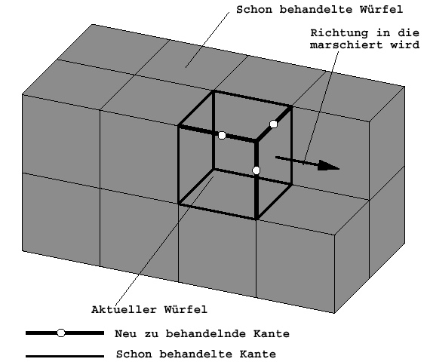
Marching Cubes
Compute the position of the cut vertices by linear interpolation:
Move to the next cube

Slide 40
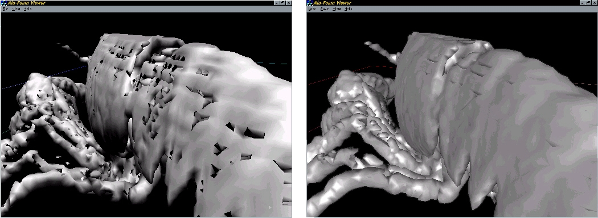
Marching Cubes – Problems
Have to make consistent choices for neighboring cubes – otherwise get holes
3
–
3

Slide 41
Marching Cubes – Problems
Resolving ambiguities
Ambiguity
No Ambiguity

Slide 42
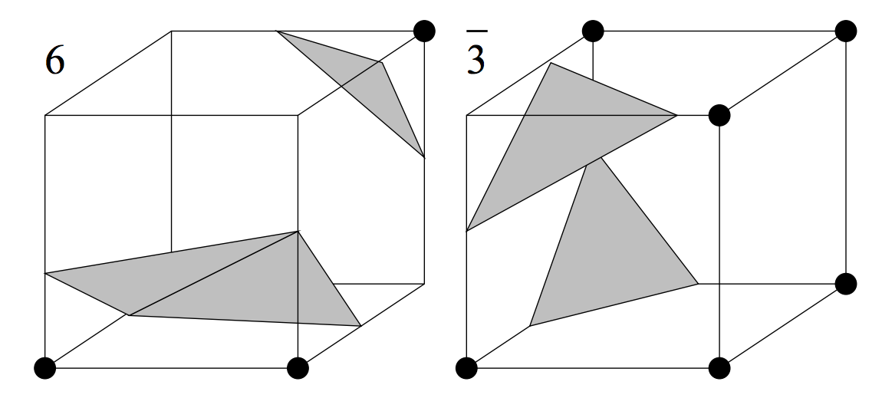
Resolving Ambiguities
Marching Cubes 33

Slide 43
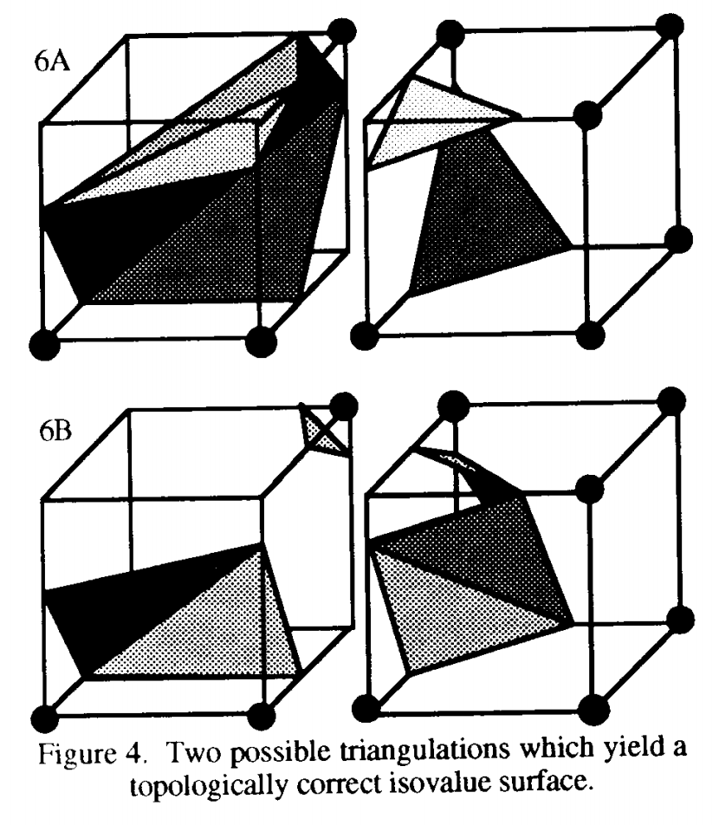
Resolving Ambiguities

Slide 44
Resolving Ambiguities

Slide 45
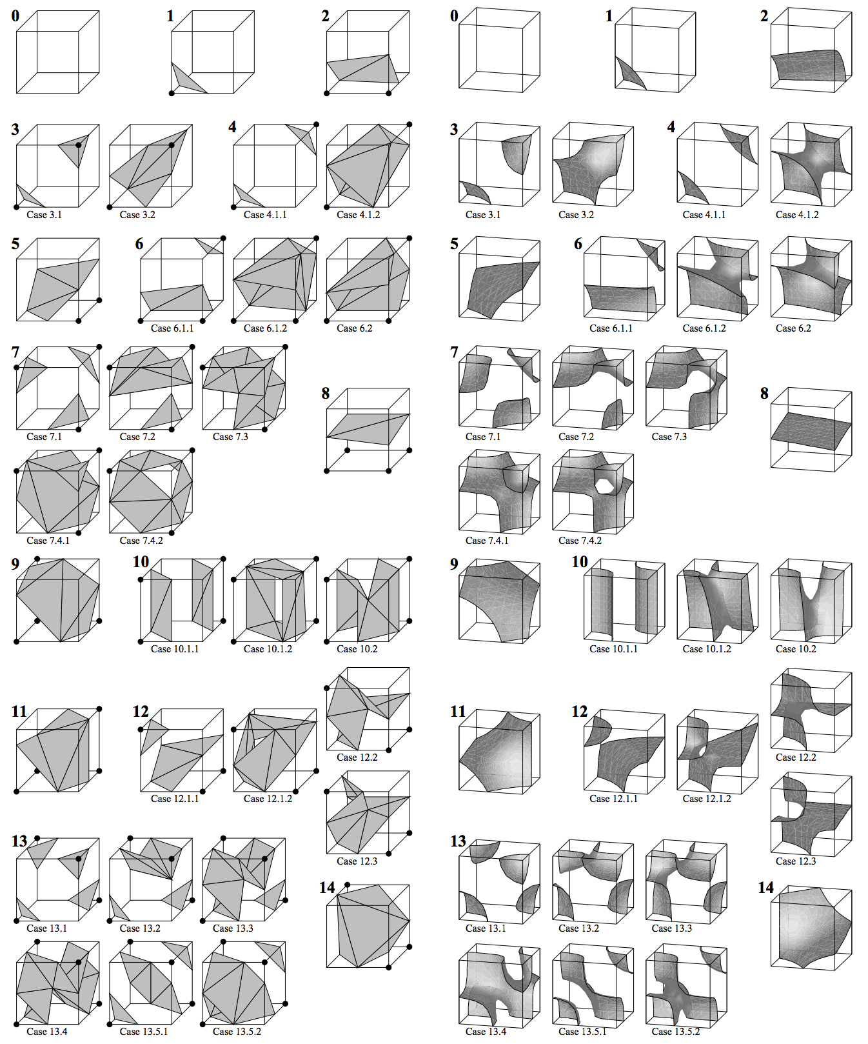
Marching Cubes 33

Slide 46
Marching Cubes 33

Slide 47
Libraries
Short, portable code:
  Paul Bourke -- Marching Cubes / Marching Tetrahedrons
Part of larger libraries/programs:
  OpenMesh
  MeshLab

Slide 48
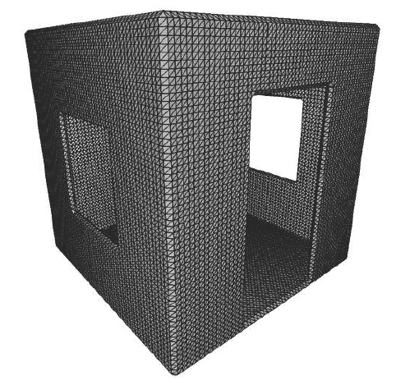
Marching Cubes – Problems
Grid not adaptive
Many polygons required to represent small features
Images from: “Dual Marching Cubes: Primal Contouring of Dual Grids” by Schaeffer et al.

Slide 49
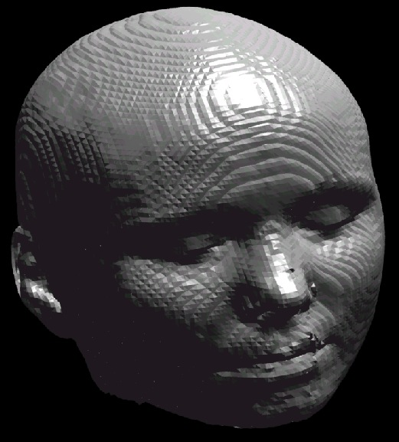
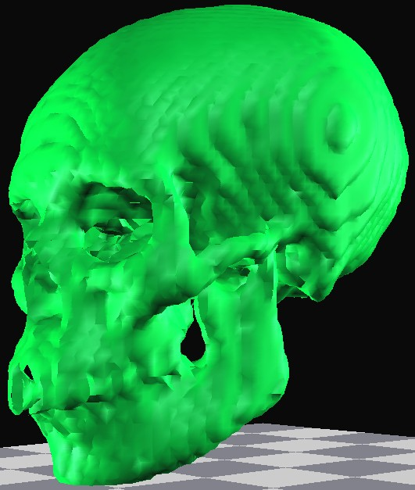
Marching Cubes – Problems

Slide 50
Marching Cubes – Problems
Problems with short triangle edges
  When the surface intersects the cube close to a corner, the resulting tiny triangle doesn‘t contribute much area to the mesh
  When the intersection is close to an edge of the cube, we get skinny triangles (bad aspect ratio)
Triangles with short edges waste resources but don‘t contribute to the surface mesh representation

Slide 51
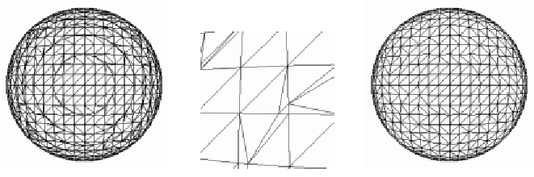
Grid Snapping
Solution: threshold the distances between the created vertices and the cube corners
When the distance is smaller than d_{snap} we snap the vertex to the cube corner
If more than one vertex of a triangle is snapped to the same point, we discard that triangle altogether

Slide 52
Grid Snapping
With Grid-Snapping one can obtain significant reduction of space consumption
Parameter | 0 | 0,1 | 0,2 | 0,3 | 0,4 | 0,46 | 0,495
Vertices | 1446 | 1398 | 1254 | 1182 | 1074 | 830 | 830
Reduction | 0 | 3,3 | 13,3 | 18,3 | 25,7 | 42,6 | 42,6

Slide 53
Sharp Corners and Features
(Kobbelt et al. 2001, a.k.a "Extended Marching Cubes"):
  Evaluate the normals (use gradient of F)
  When they significantly differ, create additional vertex

Slide 54
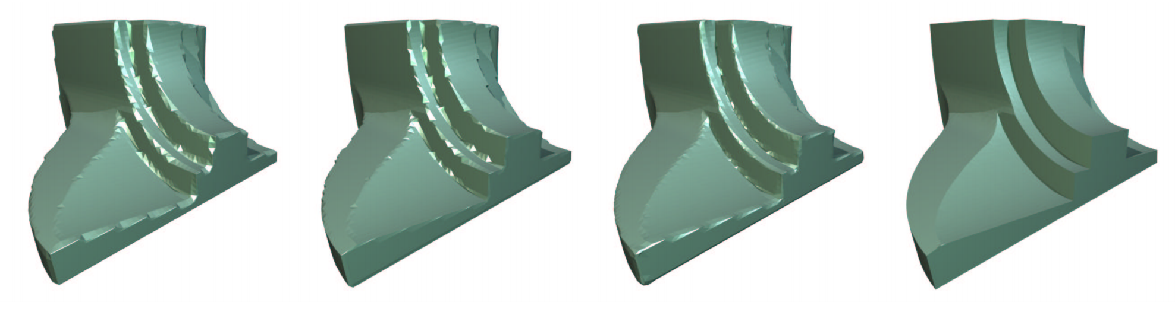
Sharp Corners and Features

Slide 55
Thank You

