Slide 1
2D/3D Shape Manipulation,
3D Printing
Normal Estimation in
Point Clouds
Slides from Olga Sorkine

Slide 2
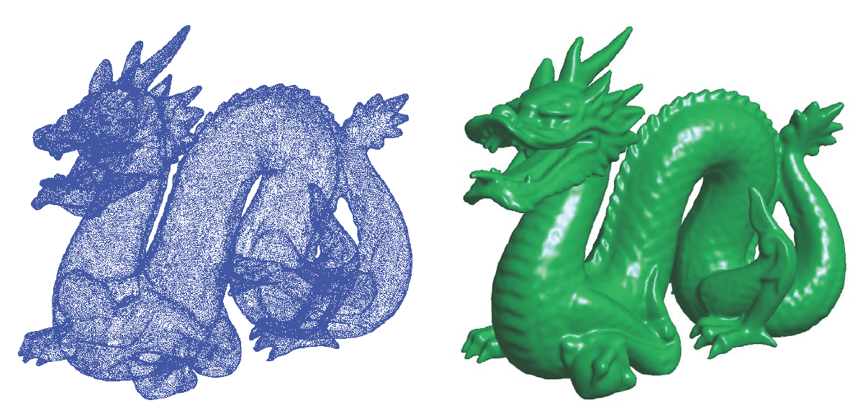

Implicit Surface Reconstruction
Implicit function from point clouds
Need consistently oriented normals
< 0
0
> 0

Slide 3
Normal Estimation
Assign a normal vector n at each point cloud
point x
  Estimate the direction by fitting a local plane
  Find consistent global orientation by propagation (spanning tree)

Slide 4
Normal Estimation
Assign a normal vector n at each point cloud
point x
  Estimate the direction by fitting a local plane
  Find consistent global orientation by propagation (spanning tree)

Slide 5
Normal Estimation
Assign a normal vector n at each point cloud
point x
  Estimate the direction by fitting a local plane
  Find consistent global orientation by propagation (spanning tree)

Slide 6
Normal Estimation
Assign a normal vector n at each point cloud
point x
  Estimate the direction by fitting a local plane
  Find consistent global orientation by propagation (spanning tree)

Slide 7
Normal Estimation
Assign a normal vector n at each point cloud
point x
  Estimate the direction by fitting a local plane
  Find consistent global orientation by propagation (spanning tree)

Slide 8
Normal Estimation
Assign a normal vector n at each point cloud
point x
  Estimate the direction by fitting a local plane
  Find consistent global orientation by propagation (spanning tree)

Slide 9
Normal Estimation
Assign a normal vector n at each point cloud
point x
  Estimate the direction by fitting a local plane
  Find consistent global orientation by propagation (spanning tree)

Slide 10
Normal Estimation
Assign a normal vector n at each point cloud
point x
  Estimate the direction by fitting a local plane
  Find consistent global orientation by propagation (spanning tree)

Slide 11
Normal Estimation
Assign a normal vector n at each point cloud
point x
  Estimate the direction by fitting a local plane
  Find consistent global orientation by propagation (spanning tree)

Slide 12
Normal Estimation
Assign a normal vector n at each point cloud
point x
  Estimate the direction by fitting a local plane
  Find consistent global orientation by propagation (spanning tree)

Slide 13
Normal Estimation
Assign a normal vector n at each point cloud
point x
  Estimate the direction by fitting a local plane
  Find consistent global orientation by propagation (spanning tree)

Slide 14
Normal Estimation
Assign a normal vector n at each point cloud
point x
  Estimate the direction by fitting a local plane
  Find consistent global orientation by propagation (spanning tree)

Slide 15
Normal Estimation
Assign a normal vector n at each point cloud
point x
  Estimate the direction by fitting a local plane
  Find consistent global orientation by propagation (spanning tree)

Slide 16
Normal Estimation
Assign a normal vector n at each point cloud
point x
  Estimate the direction by fitting a local plane
  Find consistent global orientation by propagation (spanning tree)

Slide 17
Normal Estimation
Assign a normal vector n at each point cloud
point x
  Estimate the direction by fitting a local plane
  Find consistent global orientation by propagation (spanning tree)

Slide 18
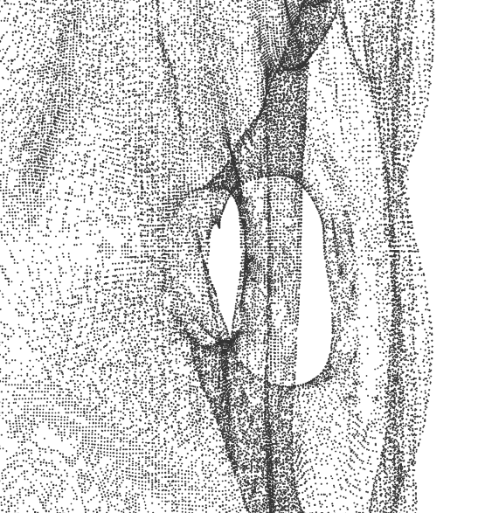
Local Plane Fitting
For each point x in the cloud, pick k nearest neighbors or all points in r-ball:
Find a plane Π that minimizes the sum of square distances:

Slide 19
Local Plane Fitting
For each point x in the cloud, pick k nearest neighbors or all points in r-ball:
Find a plane Π that minimizes the sum of square distances:

Slide 20
Linear Least Squares?
y
x

Slide 21
Linear Least Squares?
Find a line y = ax+b s.t.
y
x

Slide 22
Linear Least Squares?
Find a line y = ax+b s.t.
But we would like true orthogonal distances
y
x

Slide 23
Best Fit with SSD
y
y′
x′
x

Slide 24
Principle Component Analysis (PCA)
PCA finds an orthogonal basis that best represents a given data set
PCA finds the best approximating line/plane/orientation… (in terms of Σdistances²)
z
y
y′
x′
x
y
x

Slide 25
Notations
Input points:
Looking for a (hyper) plane
passing through c with
normal n s.t.

Slide 26
Notations
Input points:
Centroid:
Vectors from the centroid:
m

Slide 27
Centroid: 0-dim Approximation
It can be shown that:
m minimizes SSD
m will be the origin of
the (hyper)-plane
Our problem becomes:
m

Slide 28
Hyperplane Normal
Minimize!

Slide 29
Hyperplane Normal
Minimize!

Slide 30
Hyperplane Normal
Constrained minimization – Lagrange multipliers

Slide 31
Hyperplane Normal
Constrained minimization – Lagrange multipliers

Slide 32
Hyperplane Normal
Constrained minimization – Lagrange multipliers
What can be said about n ??

Slide 33
Hyperplane Normal
Constrained minimization – Lagrange multipliers
n is the eigenvector of S with the smallest eigenvalue

Slide 34
Best Fitting Plane Recipe -- PCA
Solution with Principal Components Analysis (PCA):
  Just use PCA
Input:
Compute centroid = plane origin
Compute SVD of
Singular Value Decomposition: Y = UΣV*
Plane normal n is last column vector of U.

Slide 35
Relation between SVD / Eigenvectors
If we have a Singular Value Decomposition of a matrix Y:
Y = UΣV*
Then the column vectors of U are the eigenvectors of YY*.

Slide 36
Best Fitting Plane Recipe -- Eigenvectors
Input:
Compute centroid = plane origin
Solution using Eigenvectors:
Compute scatter matrix
The plane normal n is the eigenvector of S with the smallest eigenvalue

Slide 37
What does Scatter Matrix do?
Let’s look at a line l through the center of mass m with direction vector v, and project our points x_{i} onto it. The variance of the projected points x′_{i} is:
x_{i}
y_{i}
x′_{i}
l
v
m
l
l
l
l
Original set
Small variance
Large variance

Slide 38
What does Scatter Matrix do?
The scatter matrix measures the variance of
our data points along the direction v
x_{i}
y_{i}
x′_{i}
l
v
m
l
l
l
l
Original set
Small variance
Large variance

Slide 39
Principal Components
Eigenvectors of S that correspond to big eigenvalues are the directions in which the data has strong components (= large variance).
If the eigenvalues are more or less the same – there is no preferable direction.

Slide 40
Principal Components
There’s no preferable direction
S looks like this:
Any vector is an eigenvector
There’s a clear preferable direction
S looks like this:
μ is close to zero, much smaller than λ

Slide 41
Normal Orientation
PCA may return arbitrarily oriented eigenvectors
Wish to orient consistently
Neighboring points should have similar normals

Slide 42
Normal Orientation
Build graph connecting neighboring points
  Edge (i,j) exists if xi ∈ kNN(xj) or xj ∈ kNN(xi)
Propagate normal orientation through graph
  For neighbors xi, xj : Flip nj if ni^{T}nj < 0
  Fails at sharp edges/corners
Propagate along “safe” paths (parallel normals)
  Minimum spanning tree with angle-based edge weights wij = 1- | ni^{T}nj |

Slide 43
Normal Orientation
Build graph connecting neighboring points
  Edge (i,j) exists if xi ∈ kNN(xj) or xj ∈ kNN(xi)
Propagate normal orientation through graph
  For neighbors xi, xj : Flip nj if ni^{T}nj < 0
  Fails at sharp edges/corners
Propagate along “safe” paths (parallel normals)
  Minimum spanning tree with angle-based edge weights

