Slide 1
2D/3D Shape Manipulation,
3D Printing
Discrete Differential Geometry
Planar Curves
Slides from Olga Sorkine, Eitan Grinspun

Slide 2
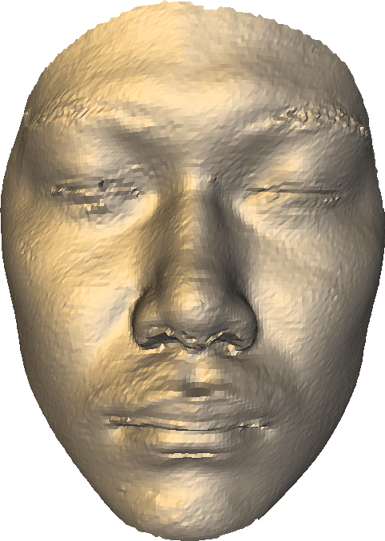

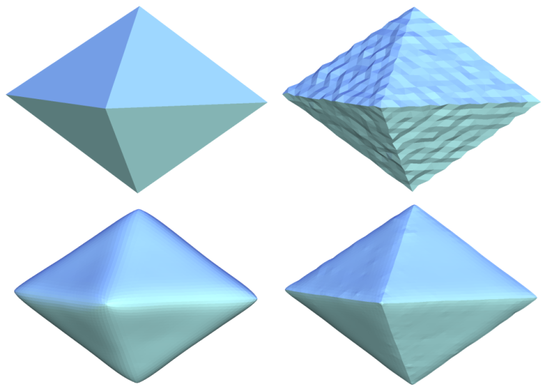
Differential Geometry – Motivation
Describe and analyze geometric characteristics of shapes
  e.g. how smooth?

Slide 3
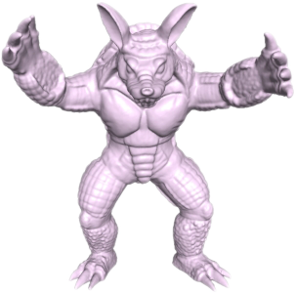
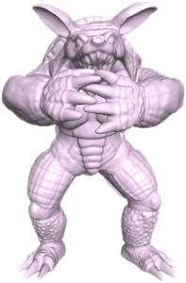
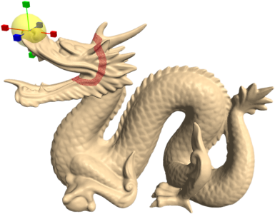
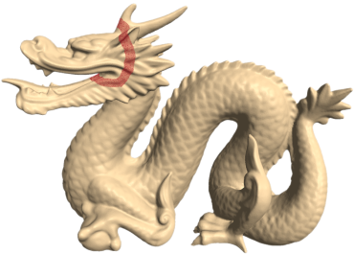

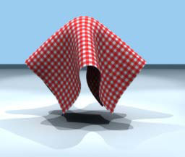
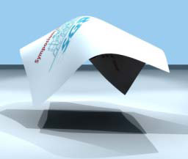
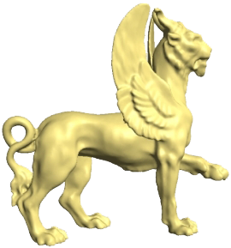
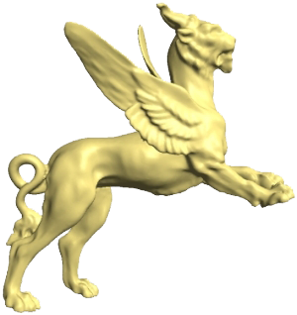
Differential Geometry – Motivation
Describe and analyze geometric characteristics of shapes
  e.g. how smooth?
  how shapes deform

Slide 4
Differential Geometry Basics
Geometry of manifolds
Things that can be discovered by local observation: point + neighborhood

Slide 5
Differential Geometry Basics
Geometry of manifolds
Things that can be discovered by local observation: point + neighborhood
manifold point

Slide 6
Differential Geometry Basics
Geometry of manifolds
Things that can be discovered by local observation: point + neighborhood
manifold point

Slide 7
Differential Geometry Basics
Geometry of manifolds
Things that can be discovered by local observation: point + neighborhood
manifold point
continuous 1-1 mapping

Slide 8
Differential Geometry Basics
Geometry of manifolds
Things that can be discovered by local observation: point + neighborhood
manifold point
continuous 1-1 mapping
non-manifold point

Slide 9
Differential Geometry Basics
Geometry of manifolds
Things that can be discovered by local observation: point + neighborhood
manifold point
continuous 1-1 mapping
non-manifold point
x

Slide 10
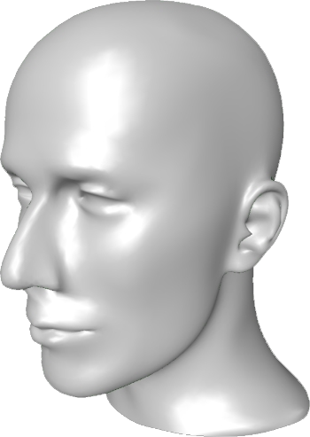
Differential Geometry Basics
Geometry of manifolds
Things that can be discovered by local observation: point + neighborhood

Slide 11
Differential Geometry Basics
Geometry of manifolds
Things that can be discovered by local observation: point + neighborhood
continuous 1-1 mapping

Slide 12
Differential Geometry Basics
Geometry of manifolds
Things that can be discovered by local observation: point + neighborhood
If a sufficiently smooth mapping can be constructed, we can look at its first and second derivatives
continuous 1-1 mapping
v
Tangents, normals, curvatures
u
Distances, curve angles, topology

Slide 13
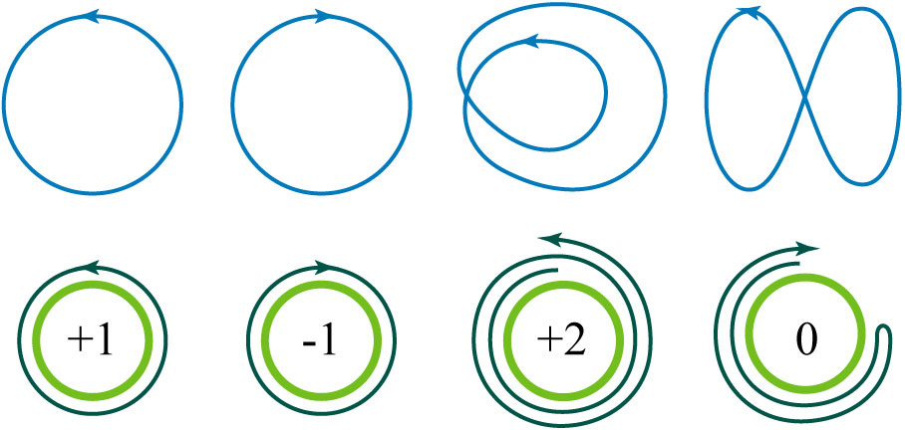
Planar Curves

Slide 14
Curves
2D:
must be continuous

Slide 15
Arc Length Parameterization
Equal pace of the parameter
along the curve
len (p(t₁), p(t₂)) = |t₁ – t₂|

Slide 16
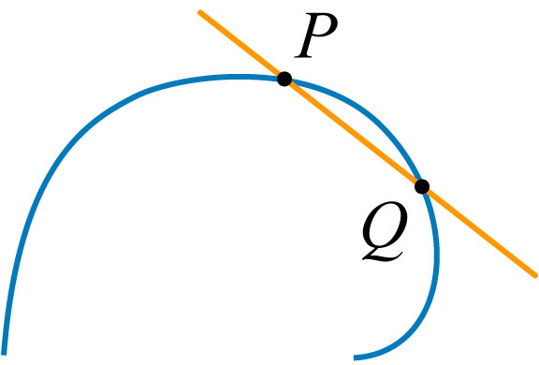
Secant
A line through two points on the curve.

Slide 17
Secant
A line through two points on the curve.

Slide 18
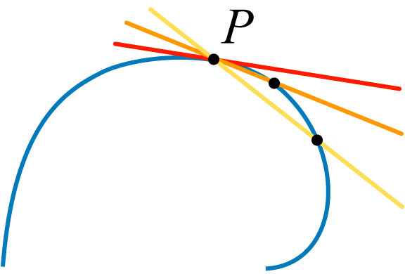
Tangent
The limiting secant as the two points come together.
Notes:
definite position

Slide 19
Secant and Tangent – Parametric Form
Secant: p(t) – p(s)
Tangent: p′(t) = (x′(t), y′(t), …)^{T}
If t is arc-length:
||p′(t)|| = 1
Notes:
definite position

Slide 20
Tangent, normal, radius of curvature
Osculating circle
“best fitting circle”
r
p

Slide 21
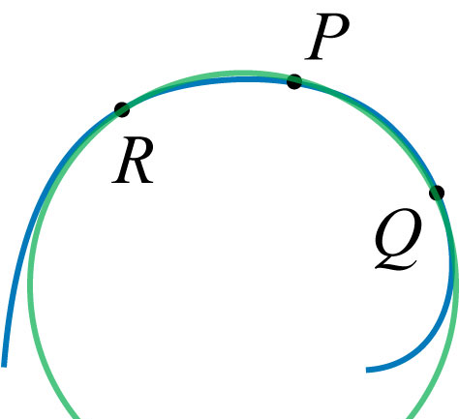
Circle of Curvature
Consider the circle passing through three points on the curve…

Slide 22
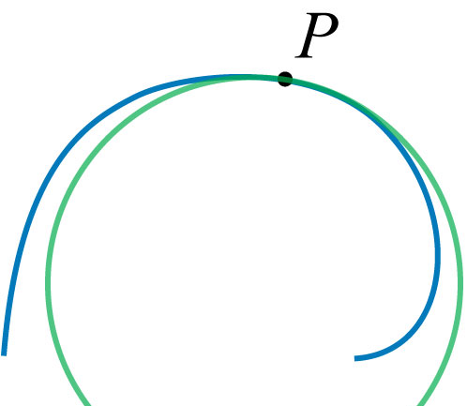
Circle of Curvature
…the limiting circle as three points come together.

Slide 23
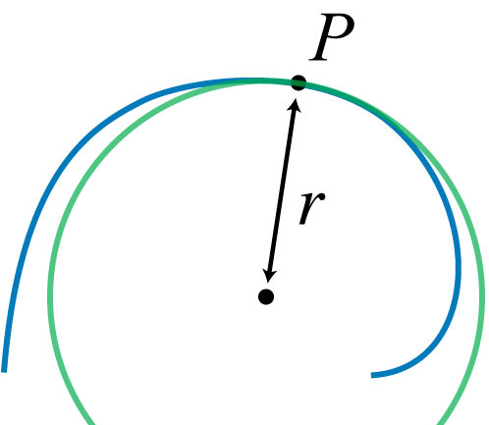
Radius of Curvature, r

Slide 24
Radius of Curvature, r = 1/κ
Curvature

Slide 25
Signed Curvature
Clockwise vs counterclockwise
traversal along curve.
+κ
–κ

Slide 26
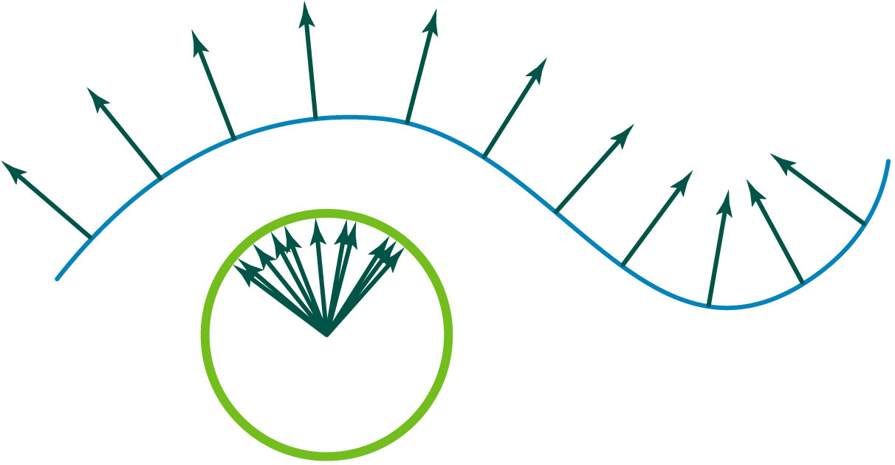
Gauss map
Point on curve maps to point on unit circle.

Slide 27
Curvature = change in normal direction
Absolute curvature (assuming arc length t)
Parameter-free view: via the Gauss map
curve
Gauss map
curve
Gauss map

Slide 28
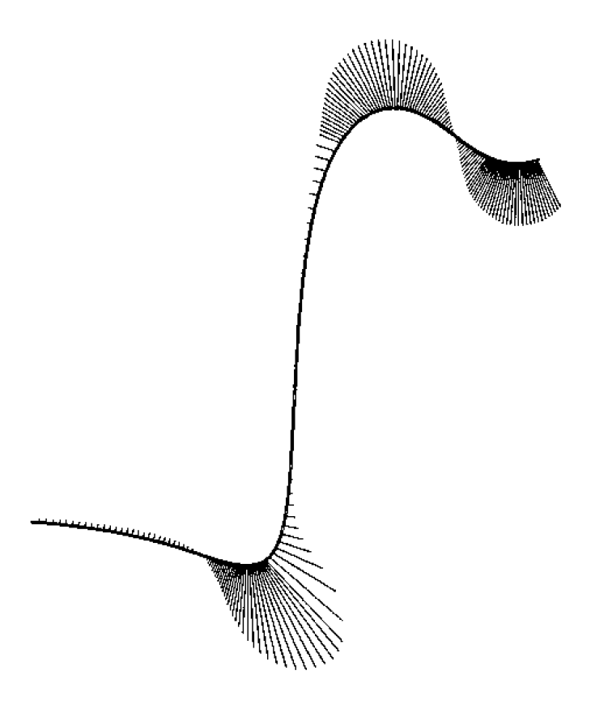
Curvature Normal
Assume t is arc-length parameter
p(t)
p′(t)
[Kobbelt and Schröder]

Slide 29
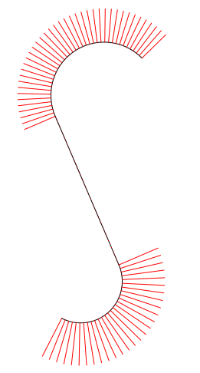
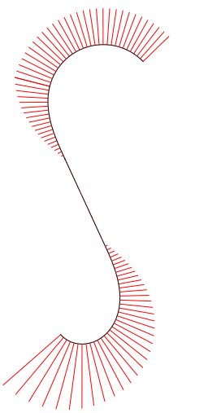
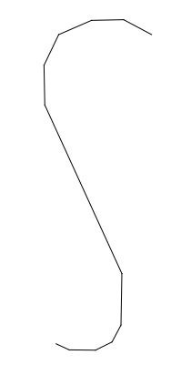


Curvature Normal – Examples
Notes:
G2 is curvature continuous. Industrial designers claim to be able to tell G2 from G3

Slide 30
Turning Number, k
Number of orbits in Gaussian image.

Slide 31
Turning Number Theorem
For a closed curve,
the integral of curvature is
an integer multiple of 2π.
Question: How to find curvature
of circle using this formula?
+2π
–2π
+4π
0

Slide 32
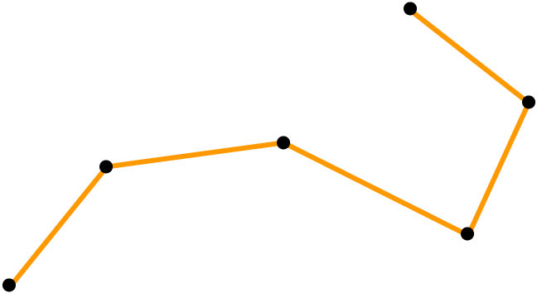
Discrete Planar Curves

Slide 33
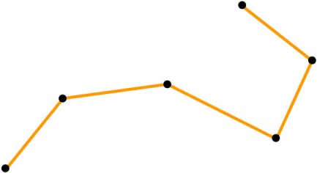
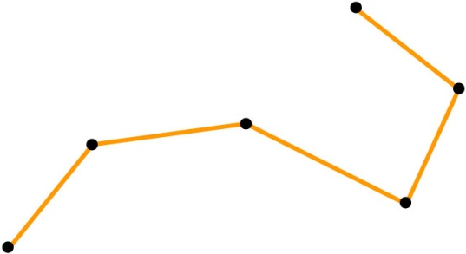
Discrete Planar Curves
Piecewise linear curves
Not smooth at vertices
Can’t take derivatives
Generalize notions from
the smooth world for
the discrete case!

Slide 34
Tangents, Normals
For any point on the edge, the tangent is simply the unit vector along the edge and the normal is the perpendicular vector

Slide 35
Tangents, Normals
For vertices, we have many options

Slide 36
Tangents, Normals
Can choose to average the adjacent edge normals

Slide 37
Tangents, Normals
Weight by edge lengths

Slide 38
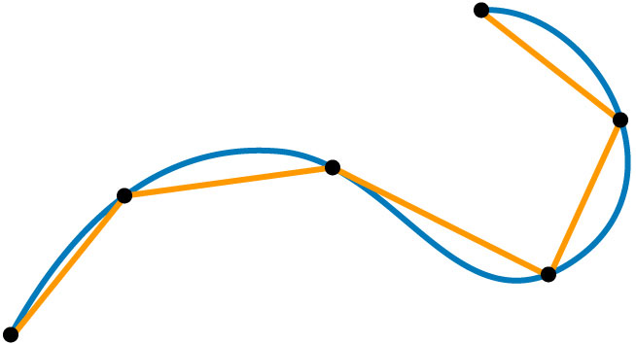
Inscribed Polygon, p
Connection between discrete and smooth
Finite number of vertices
each lying on the curve,
connected by straight edges.

Slide 39
The Length of a Discrete Curve
Sum of edge lengths
p₃
p₂
p₄
p₁

Slide 40
The Length of a Continuous Curve
Length of longest of all inscribed polygons.
sup = “supremum”. Equivalent to maximum if maximum exists.

Slide 41
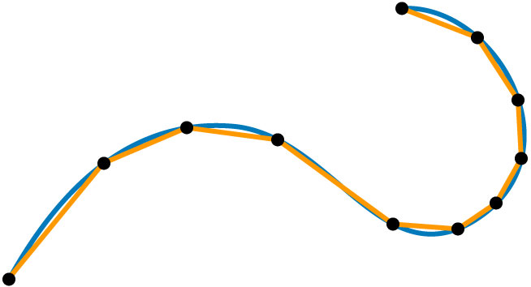
The Length of a Continuous Curve
…or take limit over a refinement sequence
h = max edge length

Slide 42
Curvature of a Discrete Curve
Curvature is the change in normal direction as we travel along the curve
no change along each edge –
curvature is zero along edges

Slide 43
Curvature of a Discrete Curve
Curvature is the change in normal direction as we travel along the curve
normal changes at vertices –
record the turning angle!

Slide 44
Curvature of a Discrete Curve
Curvature is the change in normal direction as we travel along the curve
normal changes at vertices –
record the turning angle!

Slide 45
Curvature of a Discrete Curve
Curvature is the change in normal direction as we travel along the curve
same as the turning angle
between the edges

Slide 46


Curvature of a Discrete Curve
Zero along the edges
Turning angle at the vertices
= the change in normal direction
α₁
α₂
α₁, α₂ > 0, α₃ < 0
α₃

Slide 47
Total Signed Curvature
Sum of turning
angles
α₁
α₂
α₃

Slide 48
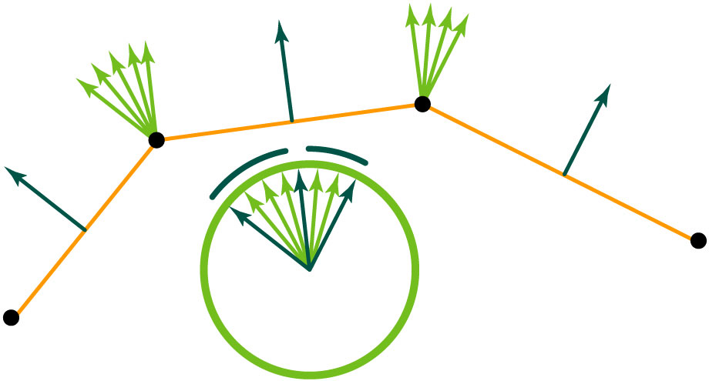
Discrete Gauss Map
Edges map to points, vertices map to arcs.

Slide 49
Discrete Gauss Map
Turning number well-defined for discrete curves.

Slide 50
Discrete Turning Number Theorem
For a closed curve,
the total signed curvature is
an integer multiple of 2π.
  proof: sum of exterior angles

Slide 51
Discrete Curvature – Integrated Quantity!
Integrated over a local area associated with a vertex
α₁
α₂

Slide 52
Discrete Curvature – Integrated Quantity!
Integrated over a local area associated with a vertex
α₁
α₂
A₁

Slide 53
Discrete Curvature – Integrated Quantity!
Integrated over a local area associated with a vertex
α₁
α₂
A₁
A₂

Slide 54
Discrete Curvature – Integrated Quantity!
Integrated over a local area associated with a vertex
α₁
α₂
A₁
A₂
The vertex areas A_{i} form a covering of the curve.
They are pairwise disjoint (except endpoints).

Slide 55
Structure Preservation
Arbitrary discrete curve
  total signed curvature obeys
  discrete turning number theorem
  even coarse mesh (curve)
  which continuous theorems to preserve?
    that depends on the application…
discrete analogue
of continuous theorem

Slide 56
Convergence
Consider refinement sequence
  length of inscribed polygon approaches length of smooth curve
  in general, discrete measure approaches continuous analogue
  which refinement sequence?
    depends on discrete operator
    pathological sequences may exist
  in what sense does the operator converge?
  (point-wise, L₂; linear, quadratic)

Slide 57
Recap
Structure-
preservation
Convergence
For an arbitrary (even coarse) discrete curve, the discrete measure of curvature obeys the discrete turning number theorem.
In the limit of a refinement sequence, discrete measures of length and curvature agree with continuous measures.

Slide 58
Thank You

