Slide 1
2D/3D Shape Manipulation,
3D Printing
CS 6501
Discrete Differential Geometry
Surfaces
Slides from Olga Sorkine, Eitan Grinspun

Slide 2
Surfaces, Parametric Form
Continuous surface
Tangent plane at point
p(u,v) is spanned by
n
p_{u}
p_{v}
p(u,v)
v
u

Slide 3
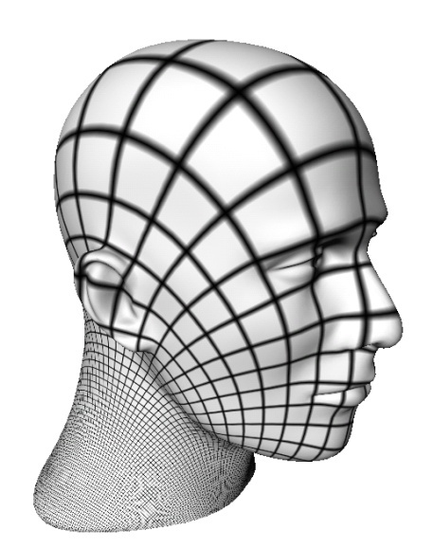
Isoparametric Lines
Lines on the surface when
keeping one parameter fixed
v
u

Slide 4
Surface Normals
Surface normal:
  Assuming regular
  parameterization, i.e.,
n
p_{u}
p_{v}
p(u,v)
v
u

Slide 5
Normal Curvature
n
p_{u}
p_{v}
t
p
Direction t in the tangent plane
(if p_{u} and p_{v} are orthogonal):
t
ϕ
Tangent plane

Slide 6
Normal Curvature
The curve γ is the intersection
of the surface with the plane
through n and t.
Normal curvature:
κ_{n}(ϕ) = κ(γ(p))
n
p_{u}
p_{v}
t
p
γ
t
ϕ
Tangent plane
Notes:
Make video of the normal plane?

Slide 7
Surface Curvatures
Principal curvatures
  Maximal curvature
  Minimal curvature
Mean curvature
Gaussian curvature

Slide 8
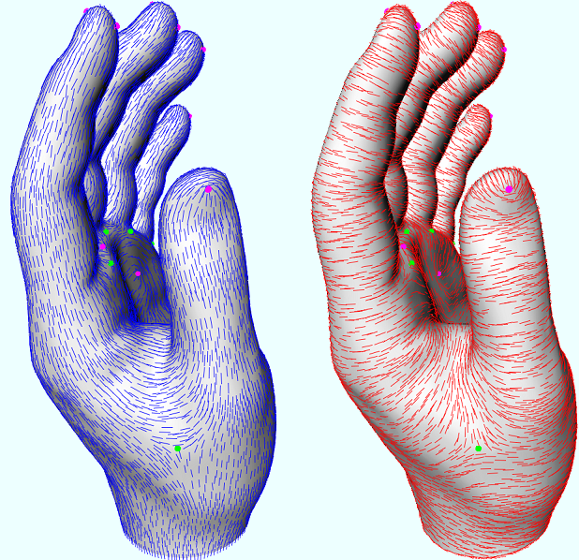
Principal Directions
Principal directions:
tangent vectors
corresponding to
ϕ_{max} and ϕ_{min}
t₂
t₁
ϕ _{max}
tangent plane
min curvature
max curvature

Slide 9
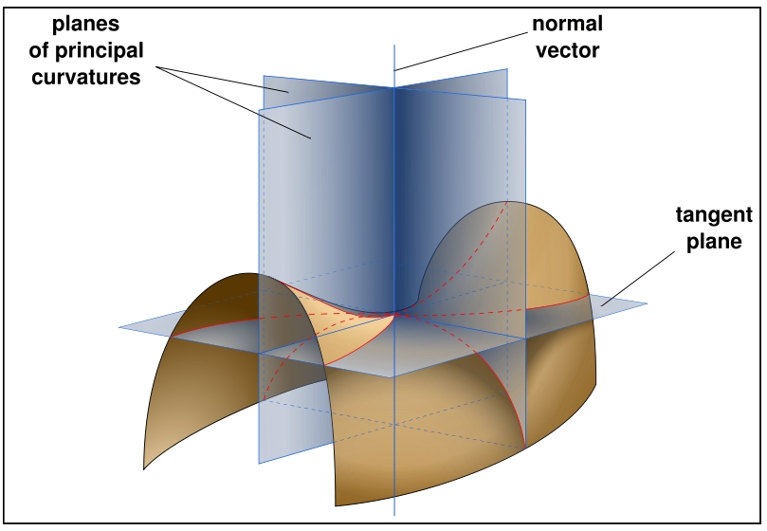
Principal Directions
Euler’s Theorem: Planes of principal curvature are orthogonal
and independent of parameterization.
Notes:
תמונה

Slide 10
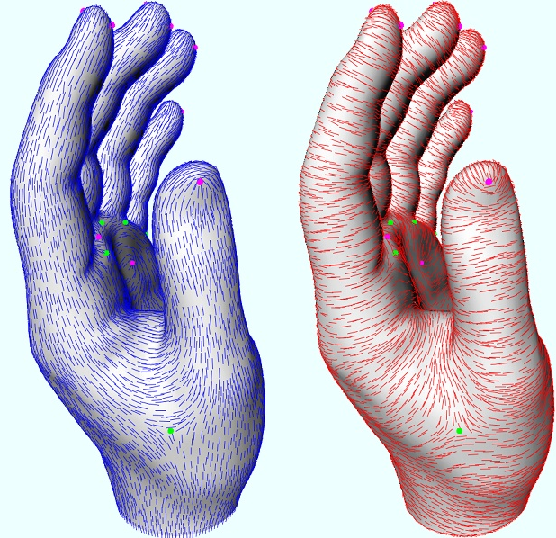
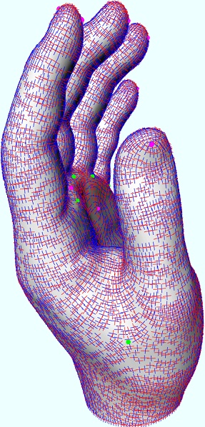
Principal Directions
Notes:
תמונה

Slide 11
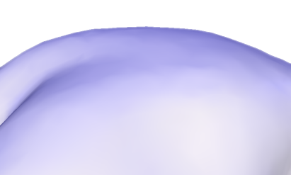
Mean Curvature
Intuition for mean curvature

Slide 12
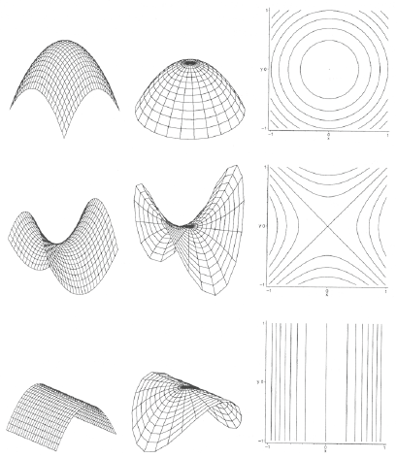
Classification
A point p on the surface is called
  Elliptic, if K > 0
  Parabolic, if K = 0
  Hyperbolic, if K < 0
  Umbilical, if
Developable surface
iff K = 0

Slide 13
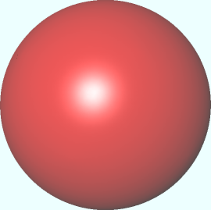

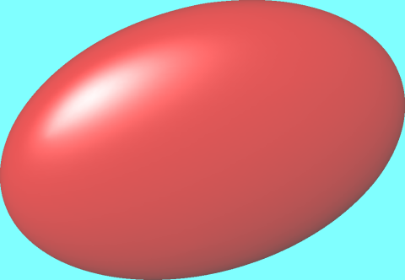
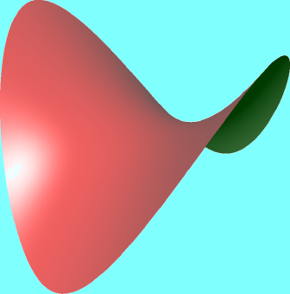
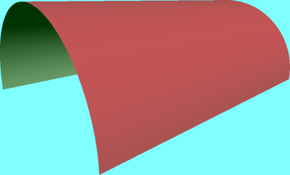
Local Surface Shape By Curvatures
K > 0, κ₁= κ₂
K = 0
Isotropic:
all directions are
principal directions
spherical (umbilical)
planar
K > 0
K = 0
K < 0
κ₂ < 0
Anisotropic:
2 distinct principal directions
κ₂ = 0
κ₂ > 0, κ₁ > 0
κ₁ > 0
κ₁ > 0
elliptic
parabolic
hyperbolic

Slide 14
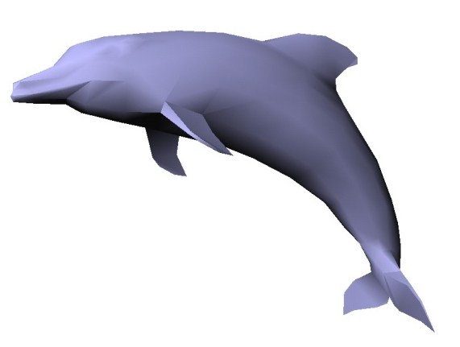
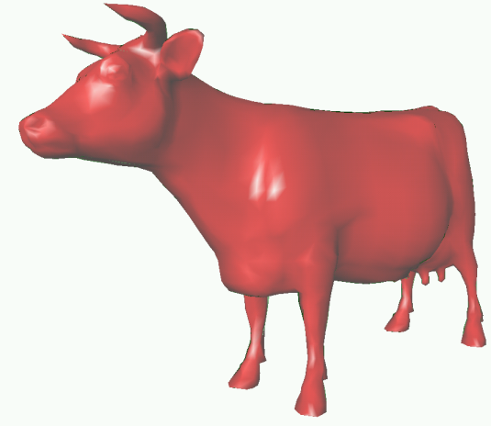
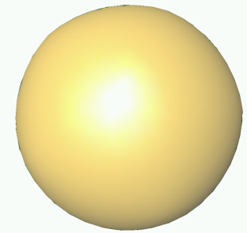
Gauss-Bonnet Theorem
For a closed surface M:

Slide 15
Gauss-Bonnet Theorem
For a closed surface M:
Compare with planar curves:

Slide 16
Fundamental Forms
First fundamental form
Second fundamental form
Together, they define a surface (given some compatibility conditions)
Notes:
Intuitive explanation for I and II!

Slide 17
Fundamental Forms
I and II allow to measure
  length, angles, area, curvature
  arc element
  area element
Notes:
here is just I, maybe add things that II measures…

Slide 18
Intrinsic Geometry
Properties of the surface that only depend on the first fundamental form
  length
  angles
  Gaussian curvature (Theorema Egregium)

Slide 19
Laplace Operator
gradient
operator
2nd partial
derivatives
Laplace
operator
function in
Euclidean space
Cartesian
coordinates
divergence
operator

Slide 20
Laplace-Beltrami Operator
Extension of Laplace to functions on manifolds
gradient
operator
Laplace-
Beltrami
function on
surface M
divergence
operator

Slide 21
Laplace-Beltrami Operator
For coordinate functions:
gradient
operator
mean
curvature
Laplace-
Beltrami
function on
surface M
unit
surface
normal
divergence
operator

Slide 22
Differential Geometry on Meshes
Assumption: meshes are piecewise linear approximations of smooth surfaces
Can try fitting a smooth surface locally (say, a polynomial) and find differential quantities analytically
But: it is often too slow for interactive setting and error prone

Slide 23
Discrete Differential Operators
Approach: approximate differential properties at point v as spatial average over local mesh neighborhood N(v) where typically
  v = mesh vertex
  N_{k}(v) = k-ring neighborhood

Slide 24
Discrete Laplace-Beltrami
Uniform discretization: L(v) or ∆v
Depends only on connectivity
= simple and efficient
Bad approximation for
irregular triangulations
v_{i}
v_{j}

Slide 25
Discrete Laplace-Beltrami
Intuition for uniform discretization

Slide 26
Discrete Laplace-Beltrami
Intuition for uniform discretization
v_{i-1}
v_{i}
v_{i+1}
γ

Slide 27
Discrete Laplace-Beltrami
Intuition for uniform discretization
v_{j1}
v_{j2}
v_{j6}
v_{i}
v_{j3}
v_{j5}
v_{j4}

Slide 28
Discrete Laplace-Beltrami
Cotangent formula
v_{i}
A_{i}
α_{ij}
v_{i}
v_{i}
v_{j}
v_{j}
β_{ij}
v_{j}

Slide 29
Voronoi Vertex Area
Unfold the triangle flap onto the plane (without distortion)
v_{i}
θ
v_{j}

Slide 30
Voronoi Vertex Area
Flattened flap
v_{i}
v_{i}
θ
c_{j+1}
v_{j}
c_{j}
Notes:
needs a better picture and definition!

Slide 31
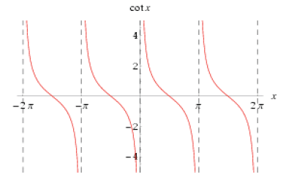
Discrete Laplace-Beltrami
Cotangent formula
  Accounts for mesh
  geometry
  Potentially negative/
  infinite weights

Slide 32
Discrete Laplace-Beltrami
Cotangent formula
  Can be derived using linear Finite Elements
  Nice property: gives zero for planar 1-rings!

Slide 33
Discrete Laplace-Beltrami
v_{i}
Uniform Laplacian L_{u}(v_{i})
Cotangent Laplacian L_{c}(v_{i})
Mean curvature normal
β
α
v_{j}

Slide 34
Discrete Laplace-Beltrami
v_{i}
Uniform Laplacian L_{u}(v_{i})
Cotangent Laplacian L_{c}(v_{i})
Mean curvature normal
For nearly equal edge lengths
Uniform ≈ Cotangent
β
α
v_{j}

Slide 35
Discrete Laplace-Beltrami
v_{i}
Uniform Laplacian L_{u}(v_{i})
Cotangent Laplacian L_{c}(v_{i})
Mean curvature normal
For nearly equal edge lengths
Uniform ≈ Cotangent
β
α
v_{j}
Cotan Laplacian allows computing discrete normal

Slide 36
Discrete Curvatures
Mean curvature (sign defined according to normal)
Gaussian curvature
Principal curvatures
A_{i}
θ_{j}

Slide 37
Discrete Gauss-Bonnet Theorem
Total Gaussian curvature is fixed for a given topology

Slide 38
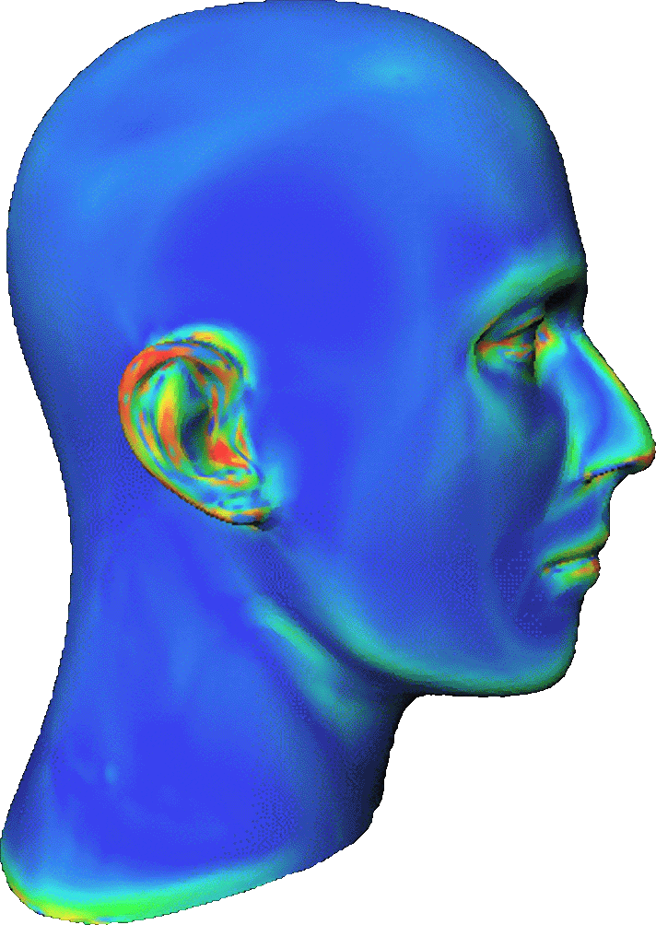
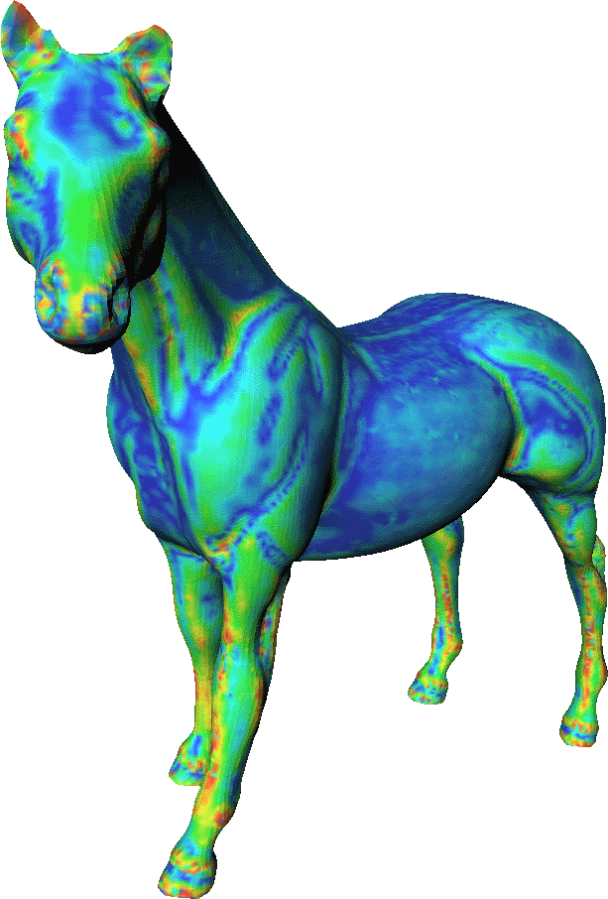
Example: Discrete Mean Curvature

Slide 39
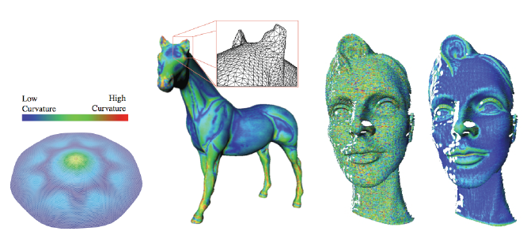
Links and Literature
M. Meyer, M. Desbrun, P. Schroeder, A. Barr
Discrete Differential-Geometry Operators for Triangulated 2-Manifolds, VisMath, 2002

Slide 40
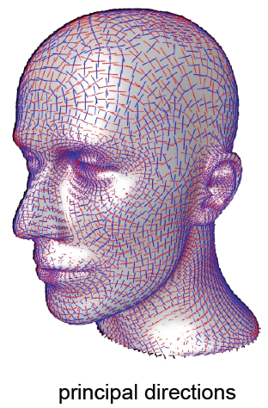
Links and Literature
P. Alliez, Estimating Curvature Tensors on Triangle Meshes, Source Code
http://www-sop.inria.fr/geometrica/team/Pierre.Alliez/demos/curvature/
principal directions

Slide 41
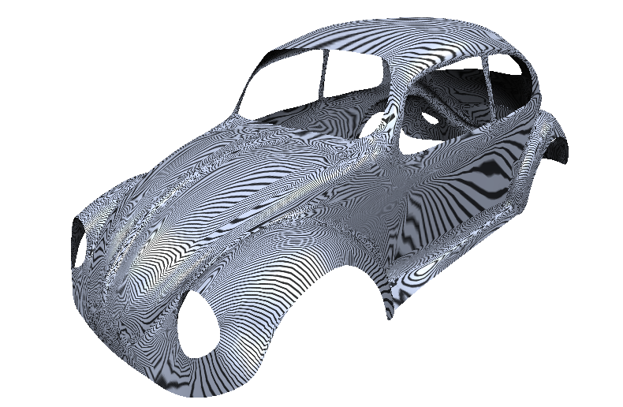
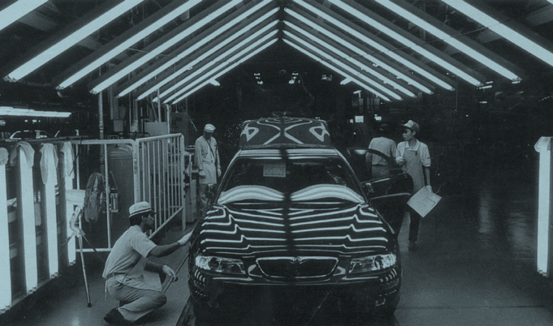
Measuring Surface Smoothness

Slide 42
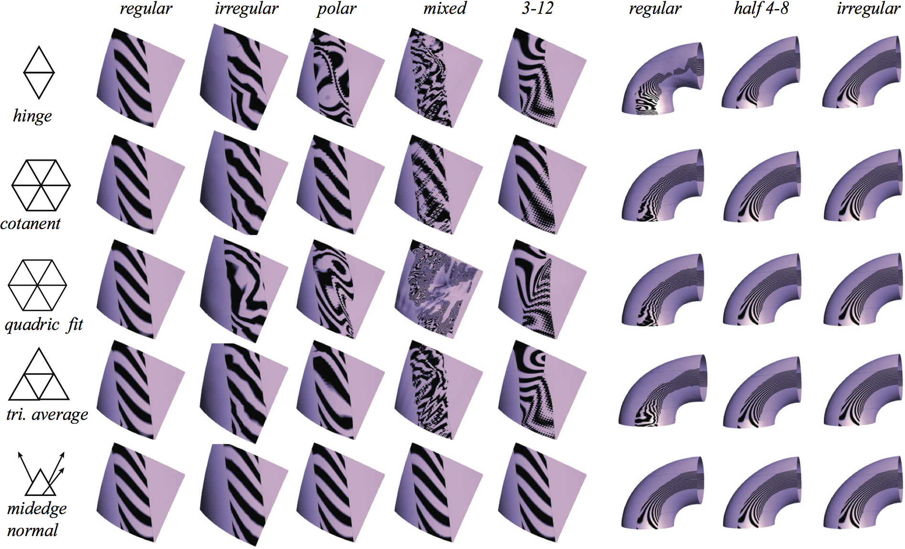
Links and Literature
Grinspun et al.:Computing discrete shape operators on general meshes, Eurographics 2006

Slide 43
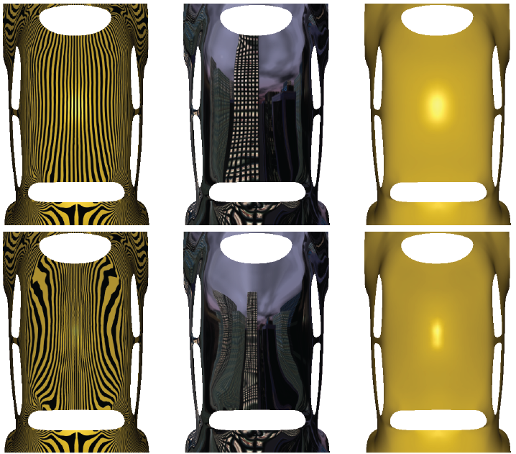
Reflection Lines as an Inspection Tool
Shape optimization using reflection lines
E. Tosun, Y. I. Gingold, J. Reisman, D. Zorin
Symposium on Geometry Processing 2007

Slide 44
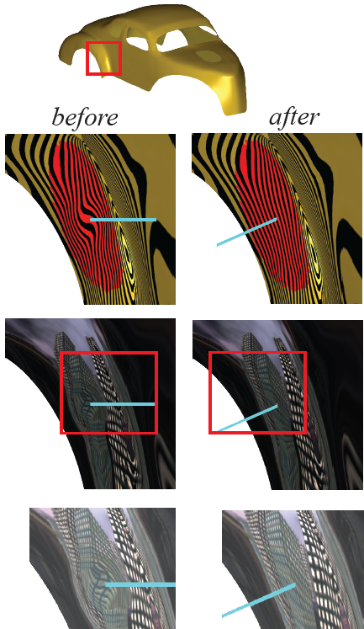
Reflection Lines as an Inspection Tool
Shape optimization using reflection lines
E. Tosun, Y. I. Gingold, J. Reisman, D. Zorin
Symposium on Geometry Processing 2007

Slide 45
Thank You

