Slide 1
2D/3D Shape Manipulation,
3D Printing
CS 6501
Digital Geometry Processing --
Mesh Smoothing

Slide 2
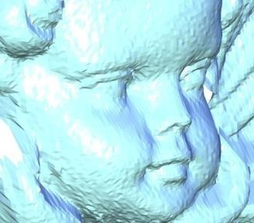
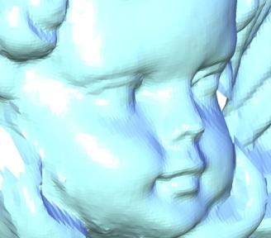
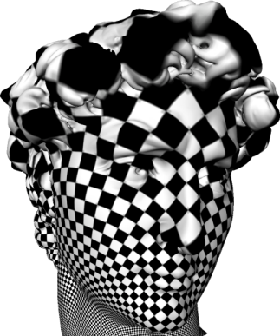
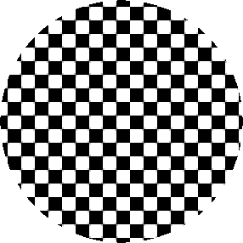
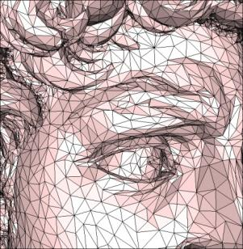
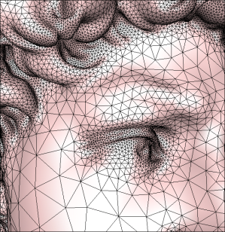
Outlook – Topics
Smoothing
Parameterization
Remeshing

Slide 3
Surface Smoothing – Motivation
Scanned surfaces can be noisy

Slide 4
Surface Smoothing – Motivation
Scanned surfaces can be noisy

Slide 5
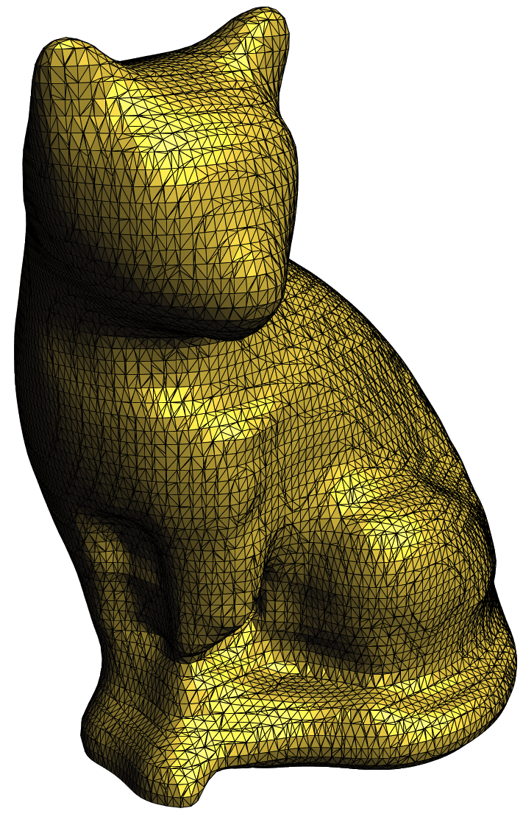
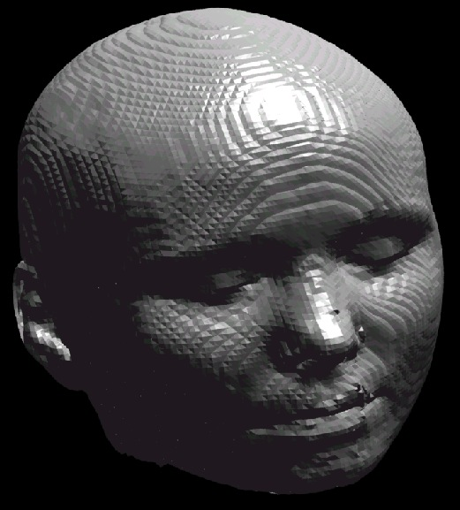
Surface Fairing – Motivation
Marching Cubes meshes can be ugly
    Why is the left mesh ugly?
    Why is the right mesh ugly?
      What is the problem with such triangles?

Slide 6
Filtering Curves
Discrete second derivative:
In matrix-vector form for the whole curve

Slide 7
Filtering Curves
Gaussian filtering
Scale factor 0 < λ < 1
Matrix-vector form:

Slide 8
Filtering Curves
Gaussian filtering
Scale factor 0 < λ < 1
Drawbacks
  ?

Slide 9
Filtering Curves
Gaussian filtering
Scale factor 0 < λ < 1
Drawbacks
  Causes the curve/mesh to shrink; slow

Slide 10
Filtering Curves
Original curve

Slide 11
Filtering Curves
1st iteration; λ=0.5

Slide 12
Filtering Curves
2nd iteration; λ=0.5

Slide 13
Filtering Curves
8th iteration; λ=0.5

Slide 14
Filtering Curves
27th iteration; λ=0.5

Slide 15
Filtering Curves
50th iteration; λ=0.5

Slide 16
Filtering Curves
500th iteration; λ=0.5

Slide 17
Filtering Curves
1000th iteration; λ=0.5

Slide 18
Filtering Curves
5000th iteration; λ=0.5

Slide 19
Filtering Curves
10000th iteration; λ=0.5

Slide 20
Filtering Curves
50000th iteration; λ=0.5

Slide 21
Recap: Laplace-Beltrami
High-pass filter: extracts local surface detail
Detail = smooth(surface) – surface
Smoothing = averaging

Slide 22
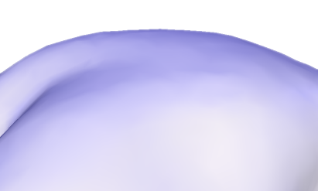
Recap: Laplace-Beltrami
The direction of δ_{i} approximates the normal
The size approximates the mean curvature
γ

Slide 23
L-B: Weighting Schemes
Ignore geometry
Integrate over Voronoi
region of the vertex
δ_{uniform} : W_{i} = 1, w_{ij} = 1/d_{i}
γ
n
δ_{cotan} : w_{ij} = 0.5(cot α_{ij} + cot β_{ij})
α_{ij}
β_{ij}
W_{i} =A_{i}

Slide 24
Laplacian Matrix
The transition between xyz and δ is linear:
L
x
δ_{x}
=
L
y
δ_{y}
=
L
z
δ_{z}
=

Slide 25
Laplacian Matrix
Breaking down the Laplace matrix:
M = mass matrix; L_{w} = stiffness matrix
L
M^{–1}
L_{w}
=

Slide 26
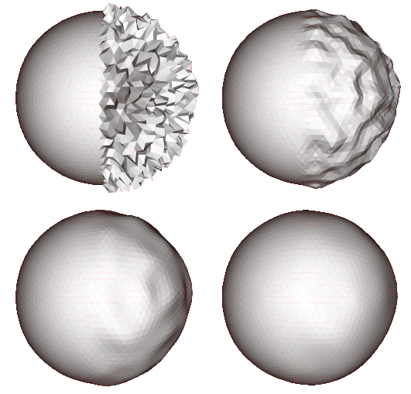
Taubin Smoothing: Explicit Steps
Iterate:
λ > 0 to smooth;
μ < 0 to inflate
Originally proposed with
uniform Laplacian
weights
original
10 iterations
50 iterations
200 iterations
A Signal Processing Approach to Fair Surface Design
Gabriel Taubin
ACM SIGGRAPH 95

Slide 27
Taubin Smoothing: Explicit Steps
Per-vertex iterations
Simple to implement
Requires many
iterations
Need to tweak μ and λ
original
10 iterations
50 iterations
200 iterations
A Signal Processing Approach to Fair Surface Design
Gabriel Taubin
ACM SIGGRAPH 95

Slide 28
Example
0 iterations
5 iterations
20 iterations

Slide 29
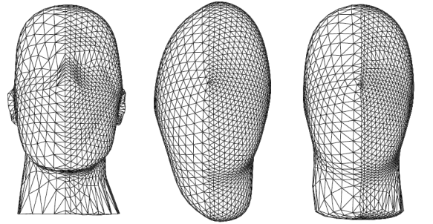
Mesh Independence
Result of smoothing with uniform Laplacian depends on triangle density and shape
  Why?
Asymmetric results although underlying geometry is symmetric
original
uniform
cotan

Slide 30
Mesh Independence
Result of smoothing with uniform Laplacian depends on triangle density and shape
  Why?
Asymmetric results although underlying geometry is symmetric
original
uniform
cotan

Slide 31
Implicit Fairing: Implicit Euler Steps
In each iteration, solve for the smoothed x′:
Implicit fairing of irregular meshes using diffusion and curvature flow
M. Desbrun, M. Meyer, P. Schroeder, A. Barr
ACM SIGGRAPH 99

Slide 32
Smoothing as (mean curvature) Flow
Model smoothing as a diffusion process
Discretize in time, forward differences:

Slide 33
Smoothing as (mean curvature) Flow
Model smoothing as a diffusion process
Discretize in time, forward differences:
Explicit integration
Unstable unless time step dt is small

Slide 34
Smoothing as (mean curvature) Flow
Model smoothing as a diffusion process
Backward Euler for unconditional stability

Slide 35
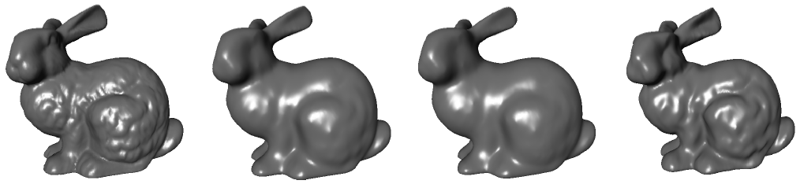
Implicit Fairing
Implicit fairing of irregular meshes using diffusion and curvature flow
M. Desbrun, M. Meyer, P. Schroeder, A. Barr
ACM SIGGRAPH 99

Slide 36
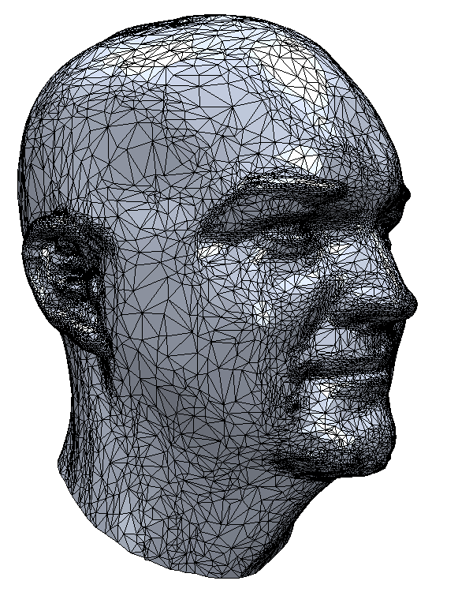
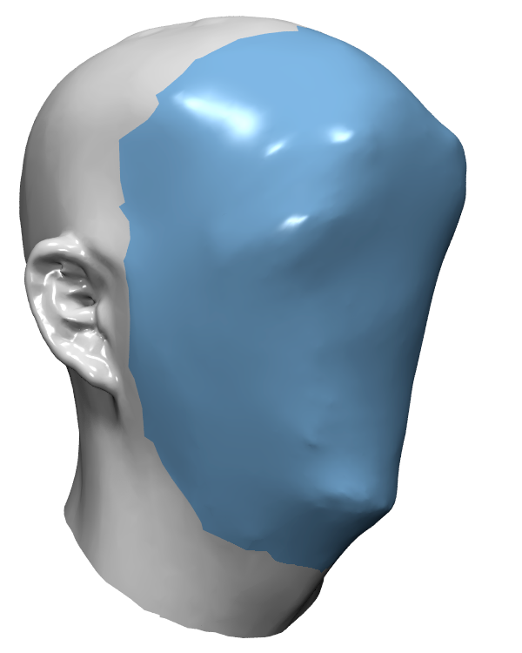
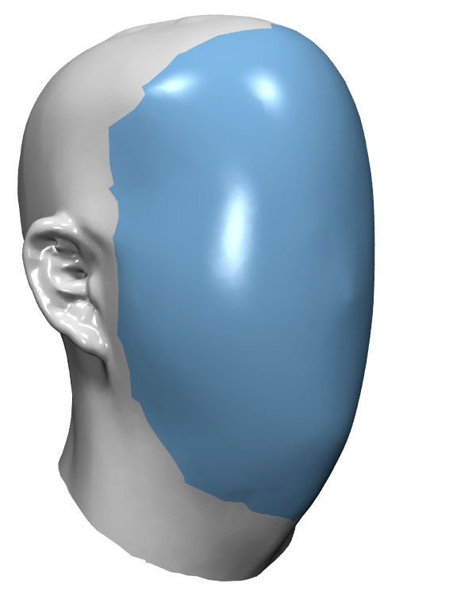
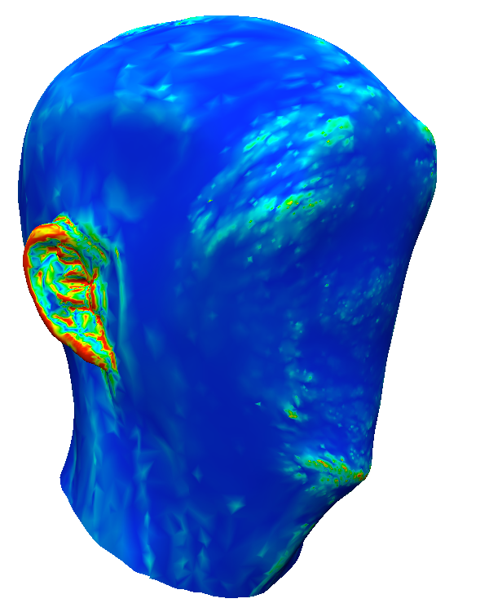
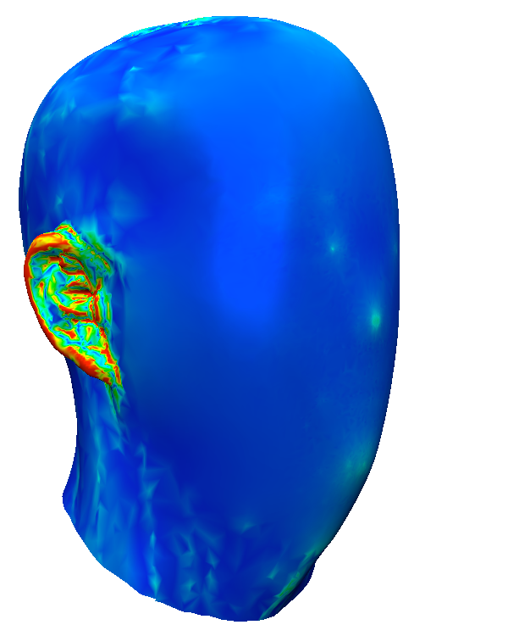
Implicit Fairing
The importance of using the right weights
Mean
curvature
Mean
curvature
Uniform
(umbrella)
cotan

Slide 37
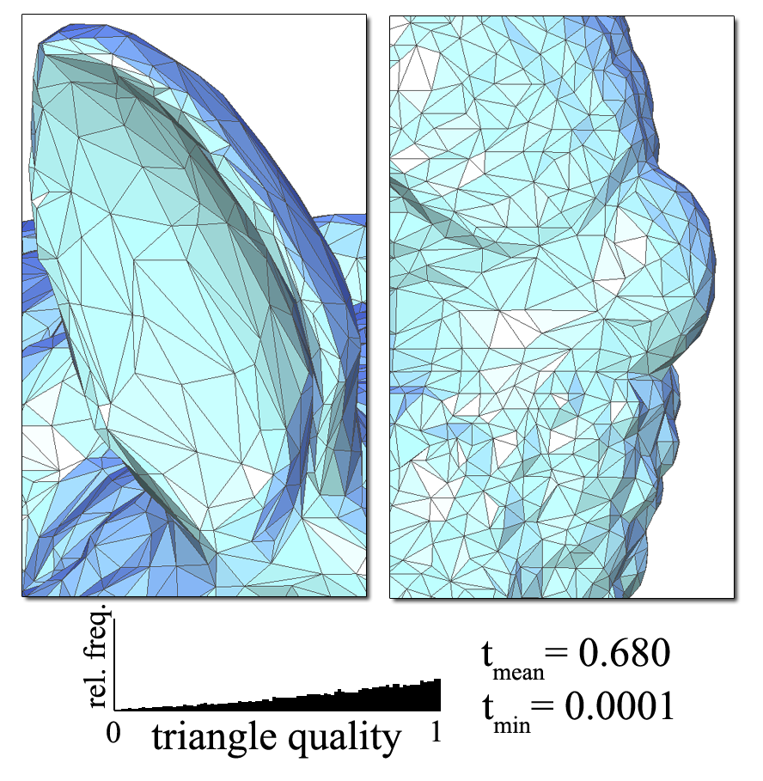
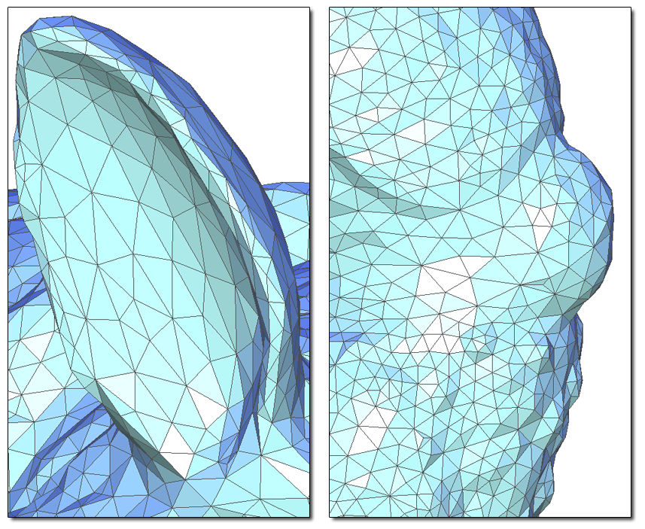
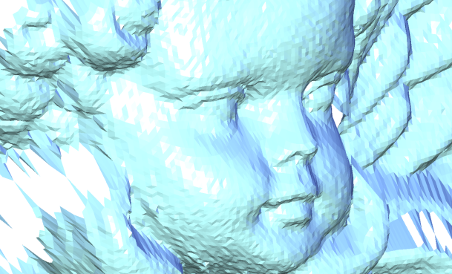
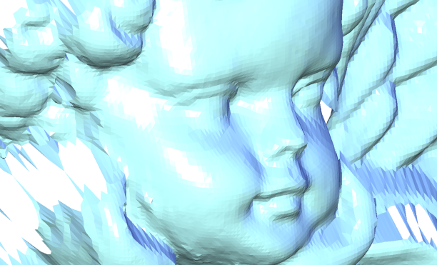
Laplacian Mesh Optimization
Smoothing, improving of triangle shapes
Basic idea: formulate a “shopping list”, solve with least squares
Laplacian Mesh Optimization
ACM GRAPHITE 2006
A. Nealen, T. Igarashi, O. Sorkine, M. Alexa

Slide 38
Laplacian Mesh Optimization
Smoothing, improving of triangle shapes
Basic idea: formulate a “shopping list”, solve with least squares
  Smooth mesh: Lx′ = 0
  Passes close to input data set: x′ = x
  Well-shaped triangles: L_{uni} x′ = L_{cot} x
  The terms are weighted according
  to importance and geometry
Laplacian Mesh Optimization
ACM GRAPHITE 2006
A. Nealen, T. Igarashi, O. Sorkine, M. Alexa
Notes:
Next year: formulate the terms as least-squares energies: ||Lx’ – 0||^2, ||x’ – x||^2 …

Slide 39
Smoothing
Mesh smoothing L = L_{cot} (outer fairness) or L = L_{uni} (outer and inner fairness)
Controlled by W_{P} and W_{L} (Intensity, Features)
L
x′
0
=
Lx′ = 0
W_{L}
W_{L}
n
X
x′ = x
W_{P}
W_{P}
α_{ij}
β_{ij}

Slide 40
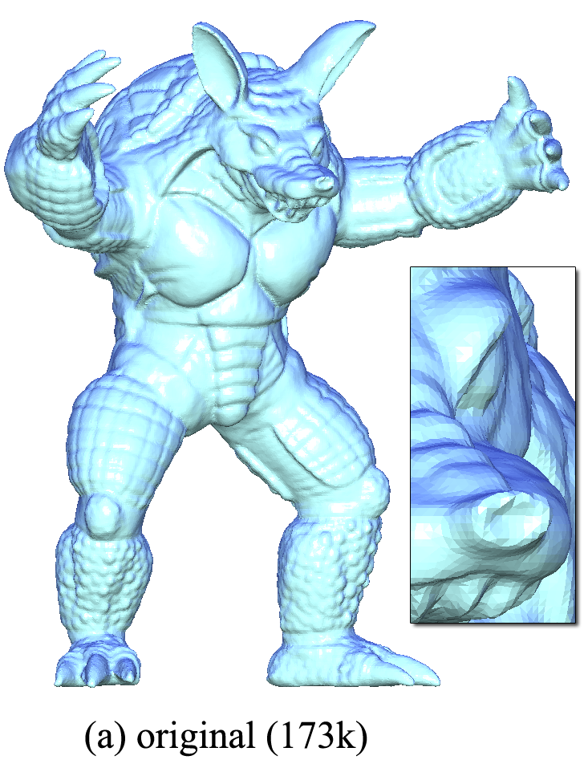
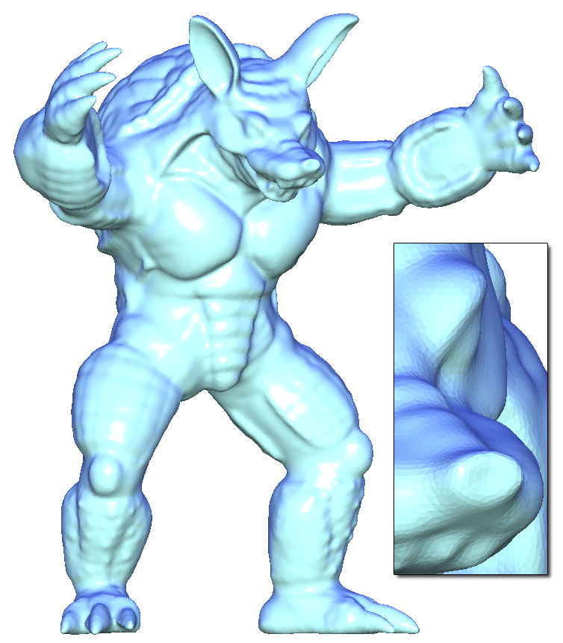
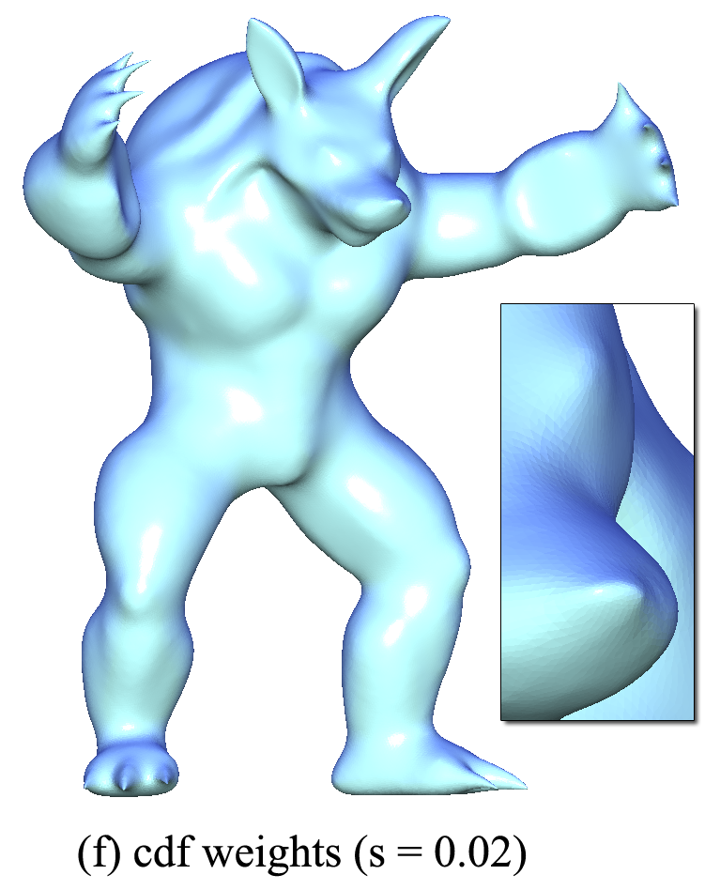
Using W_{P}
original
w = 0.2
w = 0.02

Slide 41
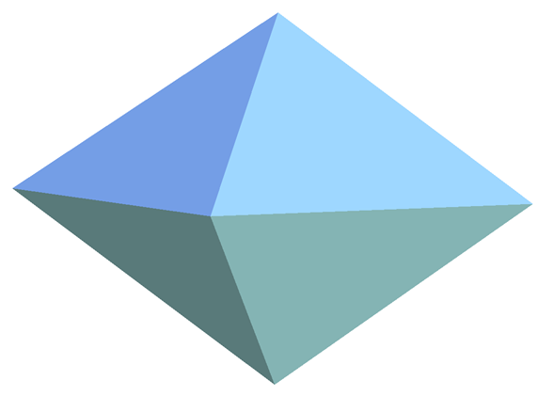
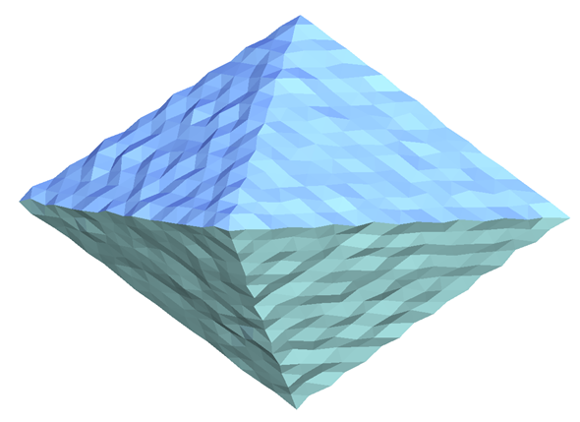
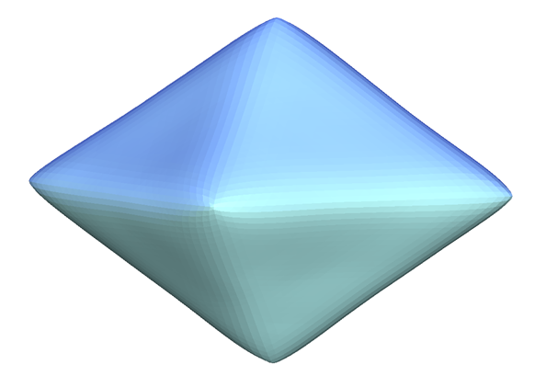
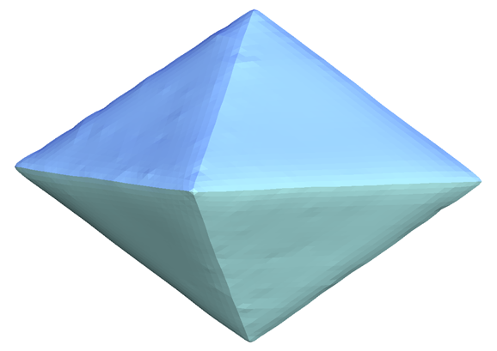
Using W_{P} and W_{L}
test model
with added noise
without W_{L}
with W_{L}

Slide 42
Triangle Shape Optimization
L_{uni}
x′
δ_{cot}
=
x
W_{P}
W_{P}
n
n
L_{uni} x′ = L_{cot} x

Slide 43
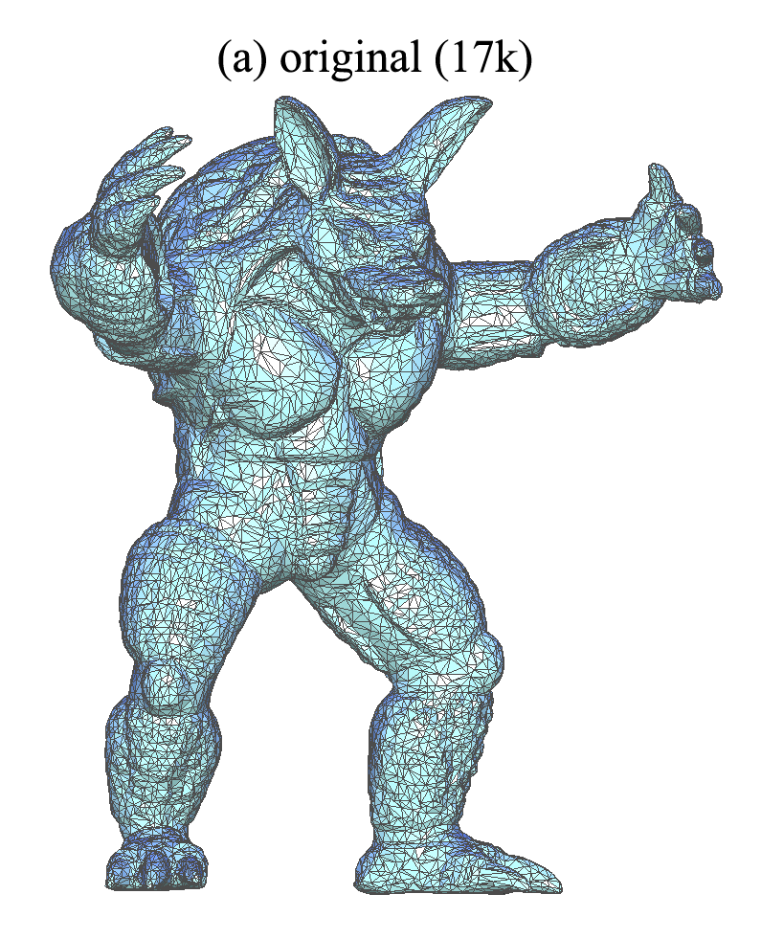
Positional Weights

Slide 44
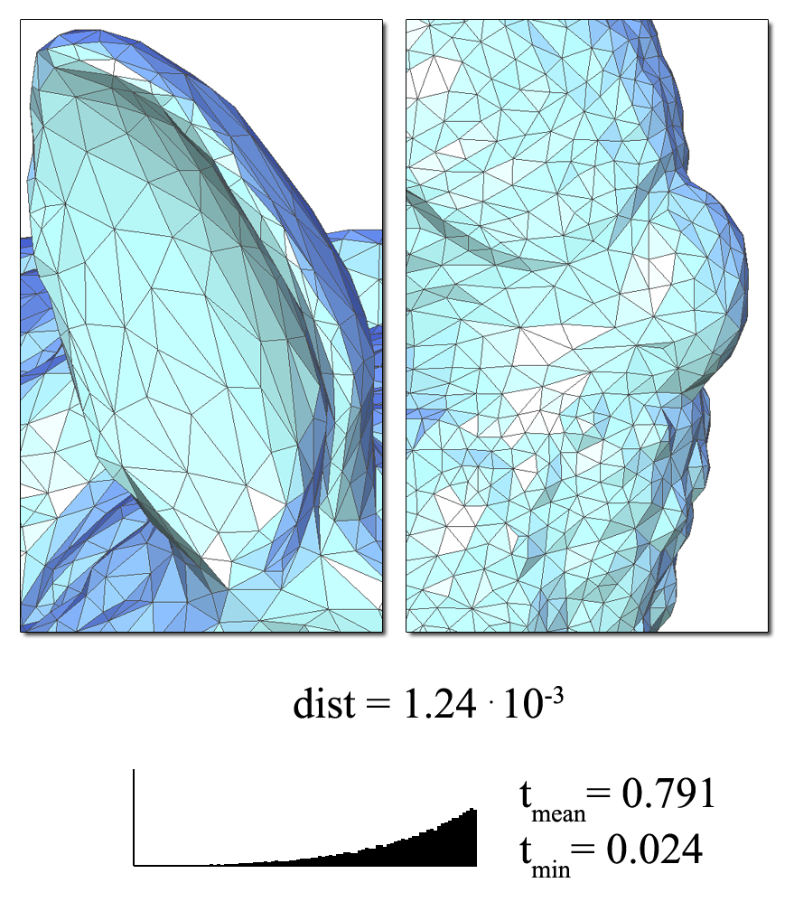
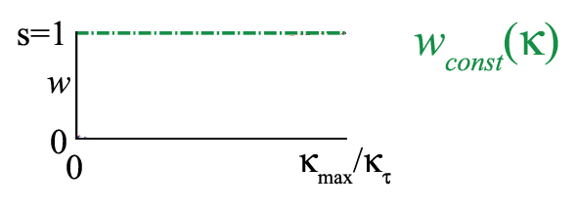
Constant Weights

Slide 45

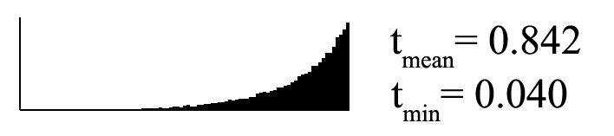
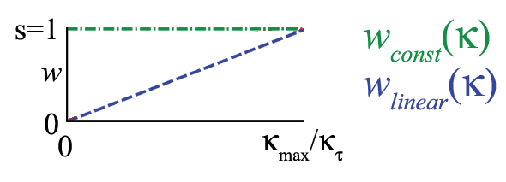
Linear Weights

Slide 46
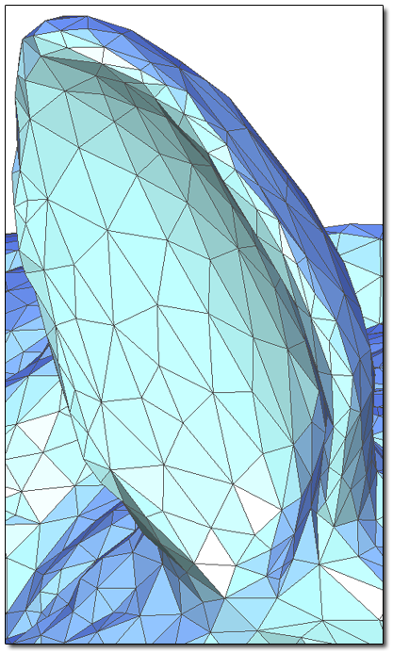
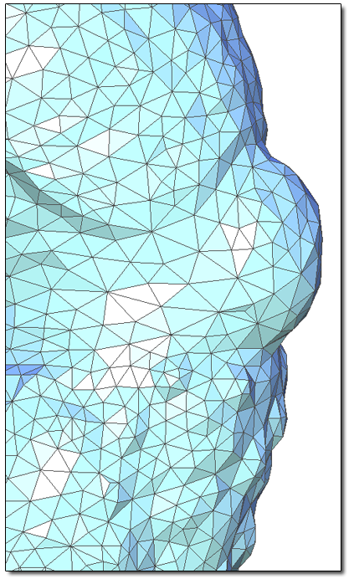
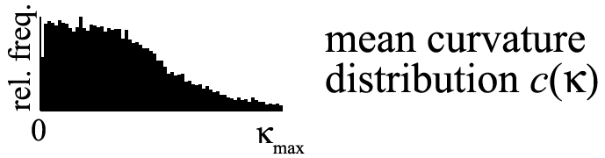

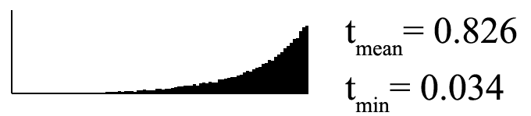
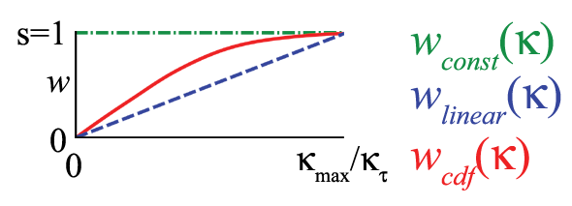
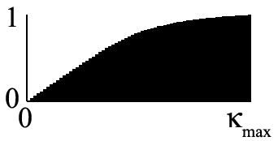
CDF Weights

Slide 47
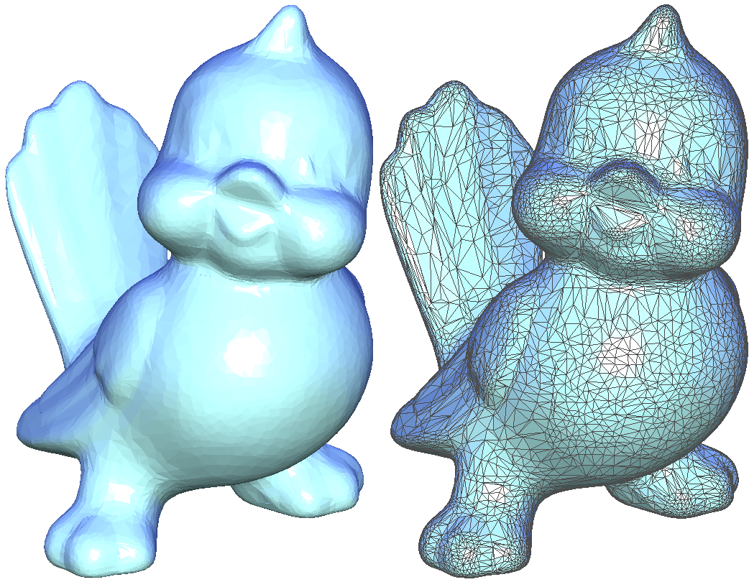
Original

Slide 48
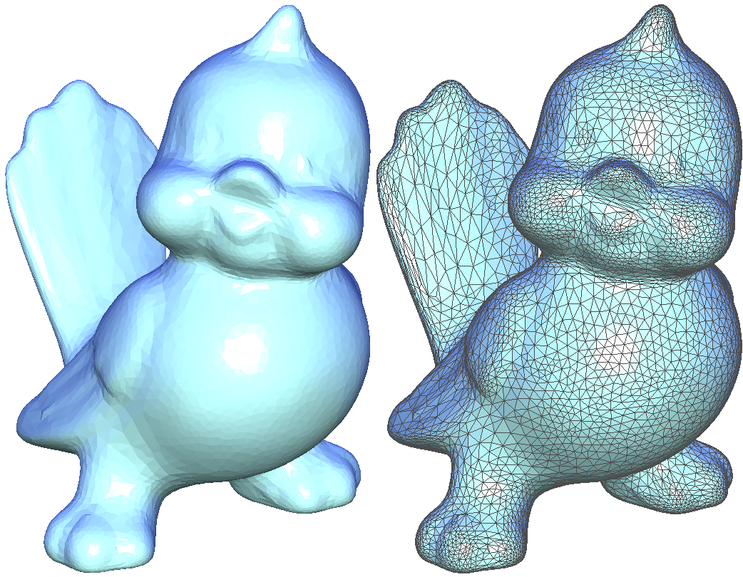
Triangle Shape Optimization

Slide 49
Thank You

