Slide 1
2D/3D Shape Manipulation,
3D Printing
CS 6501
Mesh Parameterization
Slides from Olga Sorkine

Slide 2
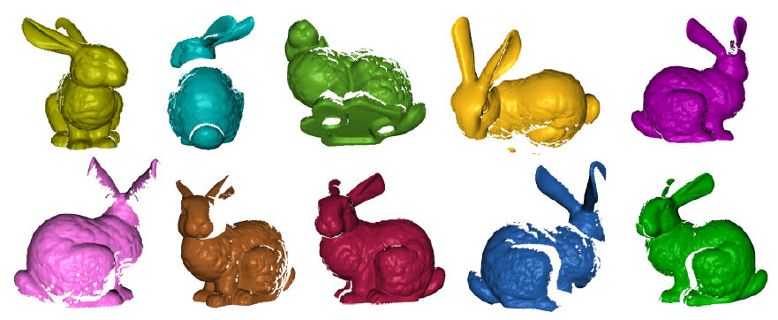
Geometry Processing Pipeline
Scanning:
results in range images
Registration:
bring all range images to one coordinate system
Stitching/reconstruction:
Integration of scans into a single mesh
Processing:
Topological and
geometric
filtering
Remeshing
Compression

Slide 3
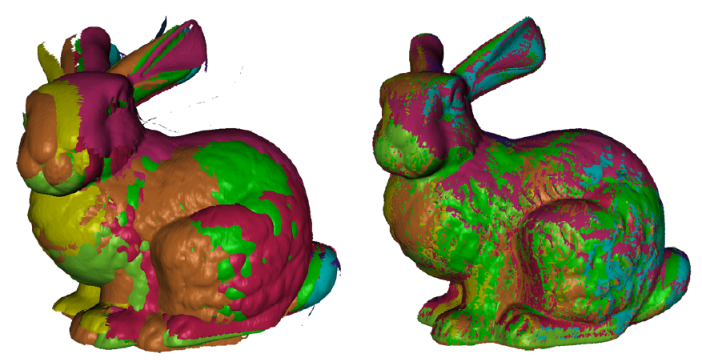
Geometry Processing Pipeline
Scanning:
results in range images
Registration:
bring all range images to one coordinate system
Stitching/reconstruction:
Integration of scans into a single mesh
Processing:
Topological and
geometric
filtering
Remeshing
Compression

Slide 4
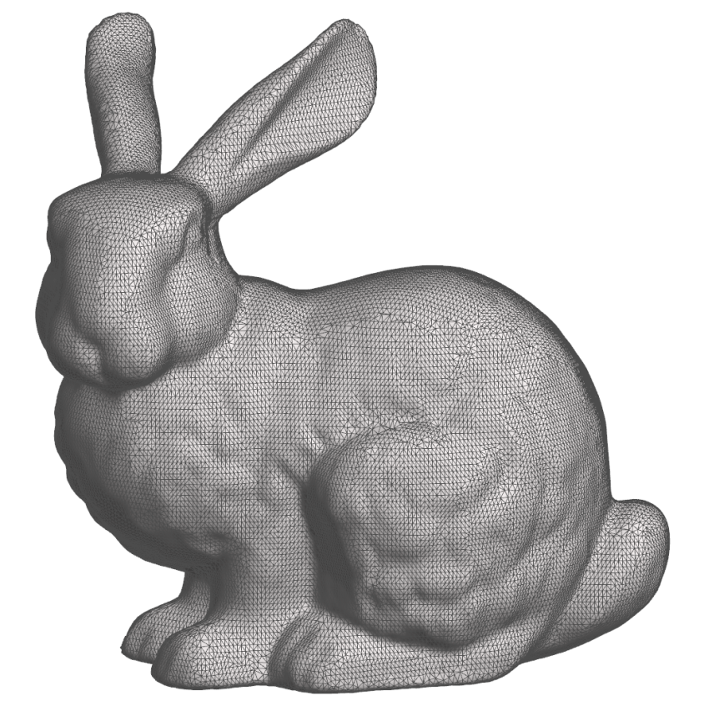
Geometry Processing Pipeline
Scanning:
results in range images
Registration:
bring all range images to one coordinate system
Stitching/reconstruction:
Integration of scans into a single mesh
Processing:
Topological and
geometric
filtering
Remeshing
Compression

Slide 5
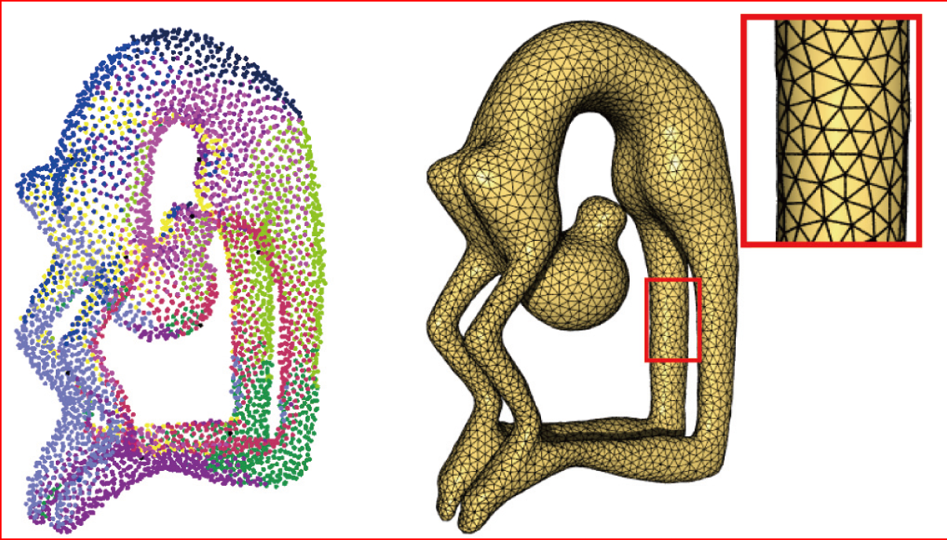
Geometry Processing Pipeline
Scanning:
results in range images
Registration:
bring all range images to one coordinate system
Stitching/reconstruction:
Integration of scans into a single mesh
Processing:
Topological and
geometric
filtering
Remeshing
Compression

Slide 6
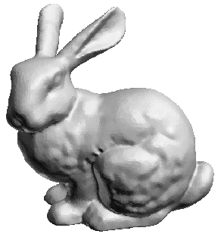

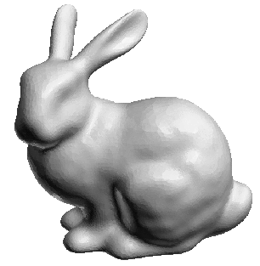
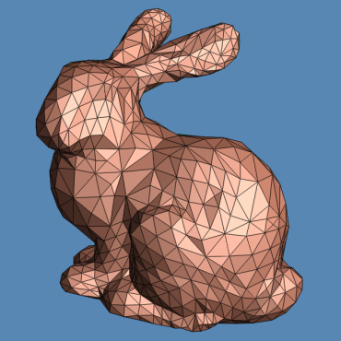
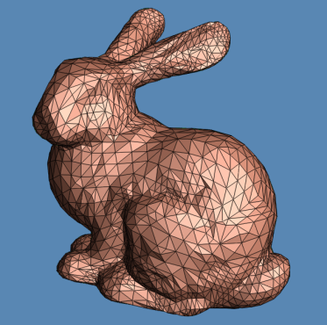
Geometry Processing Pipeline
Scanning:
results in range images
Registration:
bring all range images to one coordinate system
Stitching/reconstruction:
Integration of scans into a single mesh
Processing:
Topological and
geometric
filtering
Remeshing
Compression
Smoothing
Simplification/compression

Slide 7
Parameterization – What Is It?

Slide 8
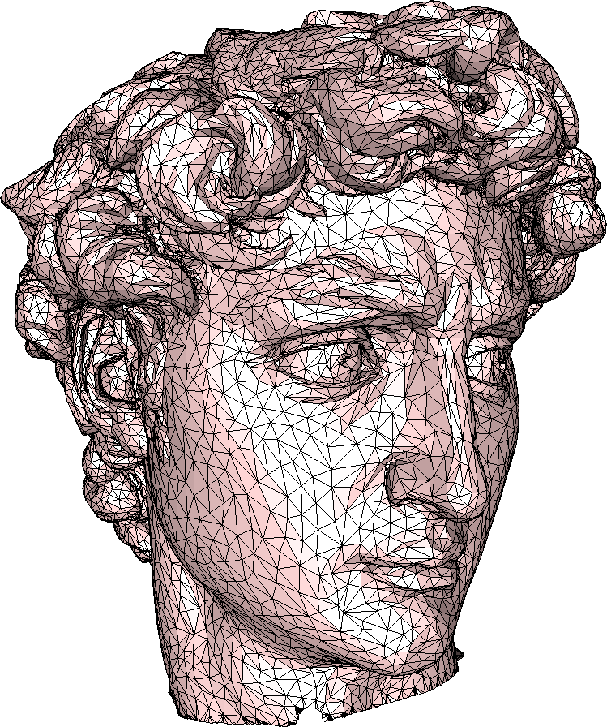
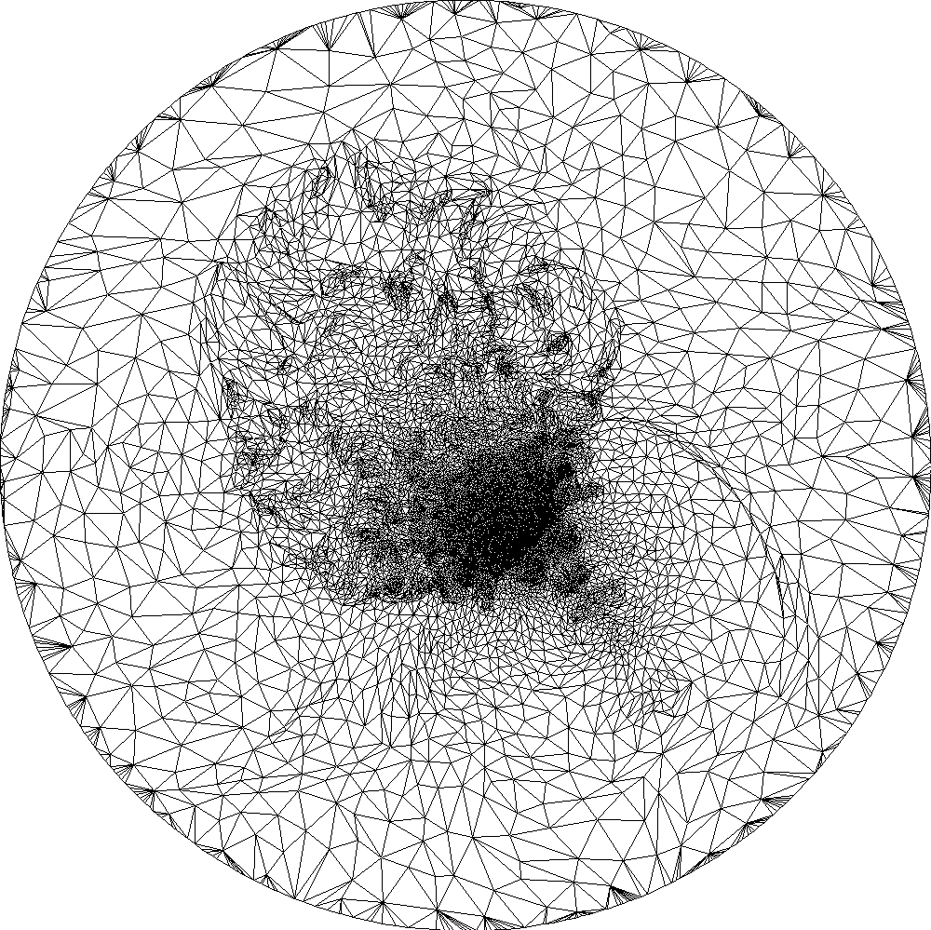
Surface Parameterization
3D space (x,y,z)
2D parameter domain (u,v)
U
boundary
boundary

Slide 9
Parameterization – Definition
Mapping P between a 2D domain Ω and
the mesh S embedded in 3D (the opposite = flattening)
Each mesh vertex has a corresponding 2D position:
Inside each triangle, the mapping is affine (barycentric coordinates)
P
U

Slide 10
Parameterization –
What Is It Good For??

Slide 11
Parameterization – What Is It Good For?
In groups of 3-4, discuss :
Based on your experience / fantasy,
Which Computer Graphics or
Geometry Processing applications
could use parameterization?
[Hint: Where can it simplify algorithms or
enable new applications? How?]
Write down your ideas on the blackboard
  Each group uses different color
  Write down the application, and the role of
  parameterization in it
5 minutes

Slide 12
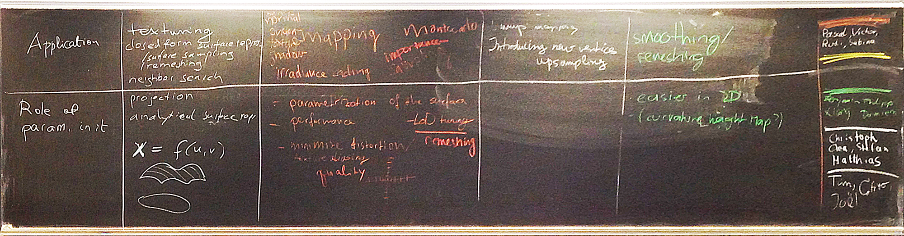
Results of Brainstorming 1

Slide 13
Parameterization – What Is It Good For?
For each application category, assess which properties the parameterization should have for good/successful results of that application
Discuss with your group and then present your ideas. I will write them down.
5 minutes

Slide 14
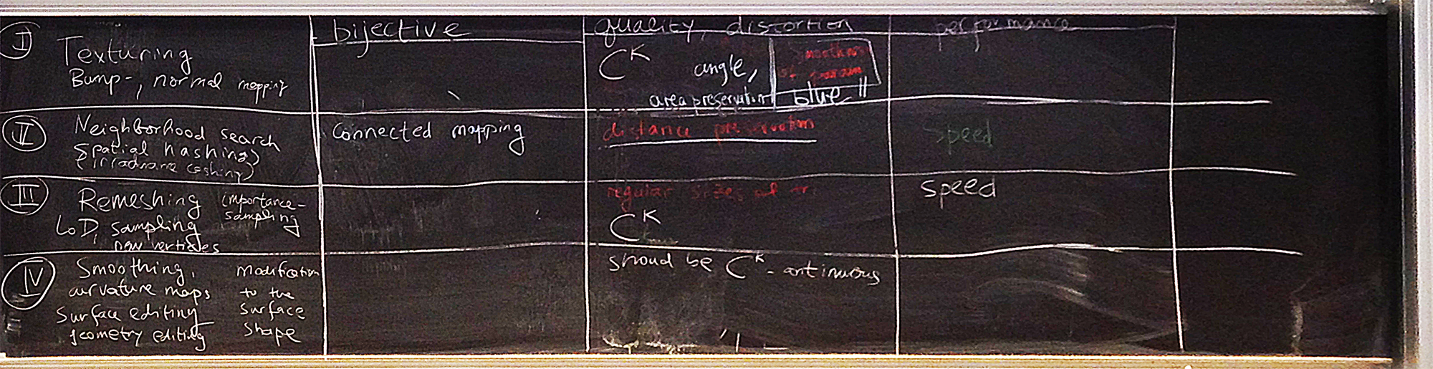
Results of Brainstorming 2

Slide 15
Why Parameterization?
Allows us to do many things in 2D and then map those actions onto the 3D surface
It is often easier to operate in the 2D domain
Mesh parameterization allows to use some notions from continuous surface theory

Slide 16
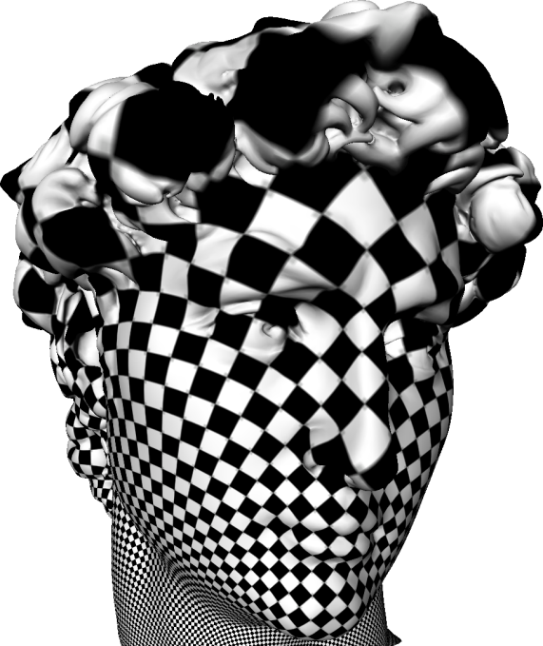
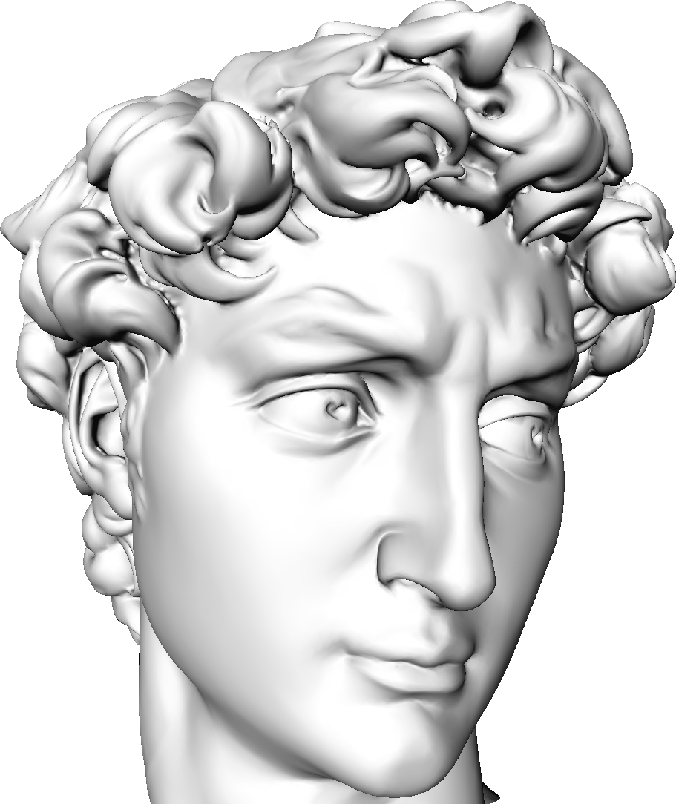
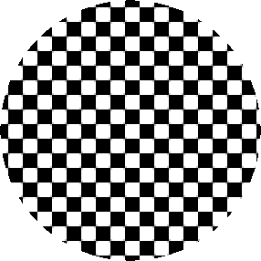
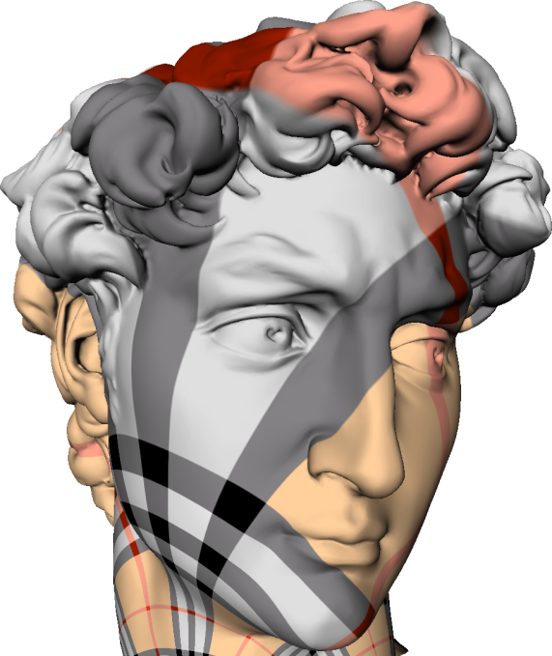
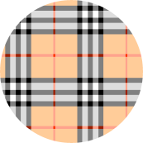
Main Application: Texture Mapping

Slide 17
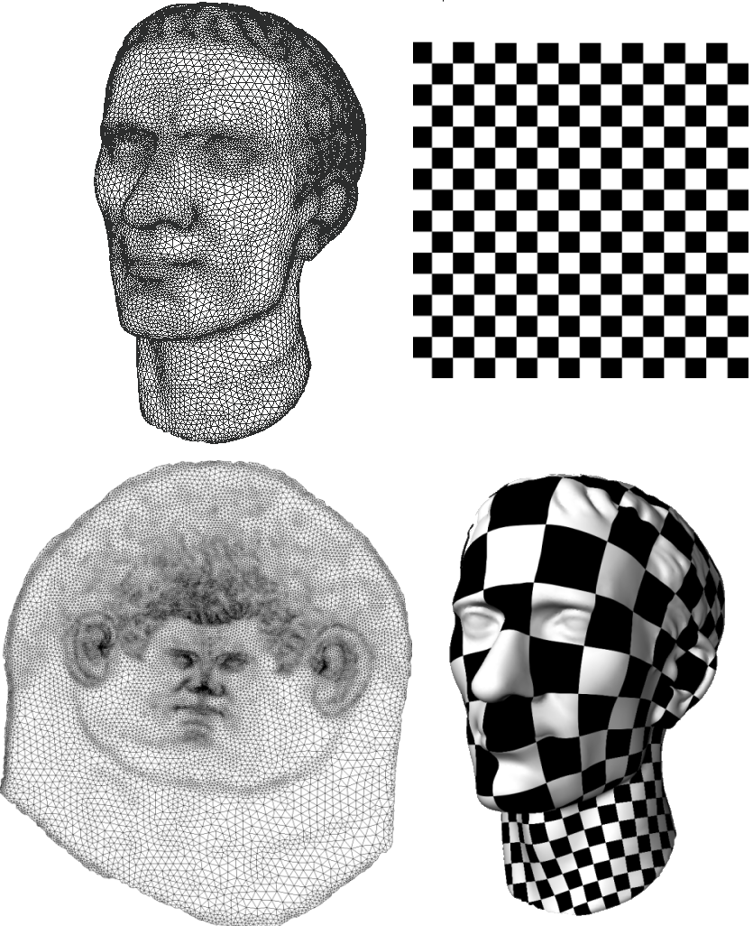
Main Application: Texture Mapping

Slide 18
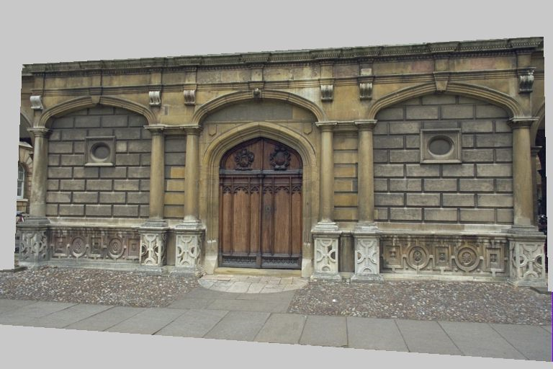
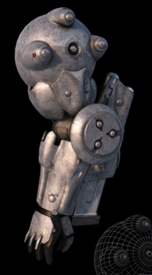
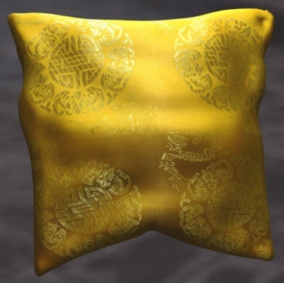
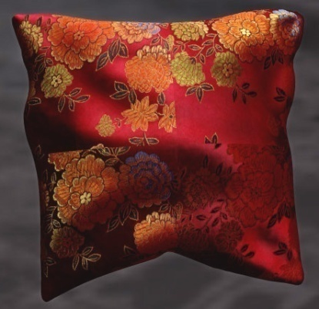
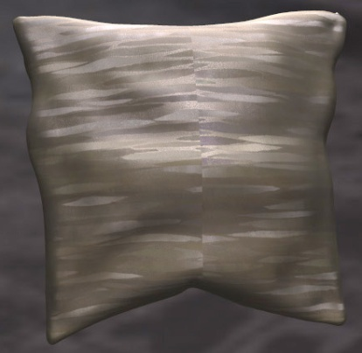
Texture Mapping

Slide 19
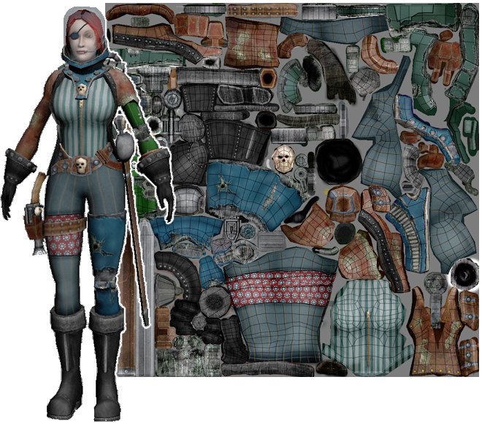
Texture Mapping
Image from Vallet and Levy, techreport INRIA

Slide 20
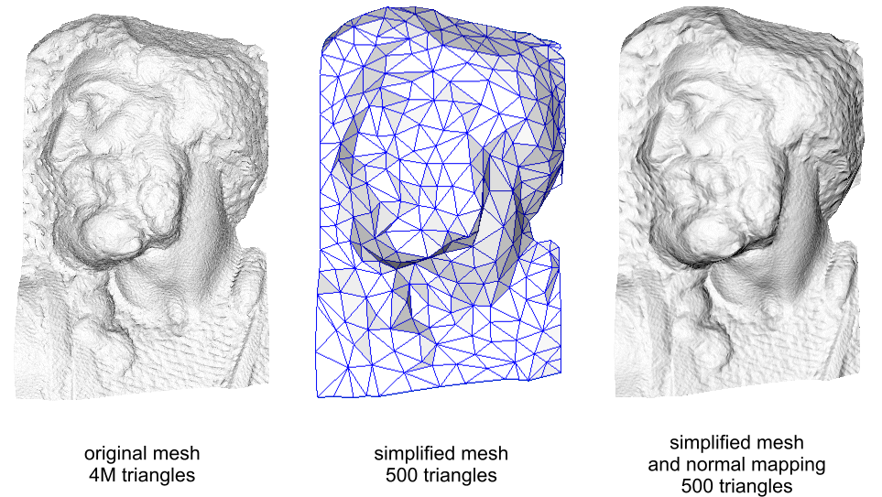
Normal/Bump Mapping
original mesh
4M triangles
simplified mesh
500 triangles
simplified mesh
and normal mapping
500 triangles

Slide 21
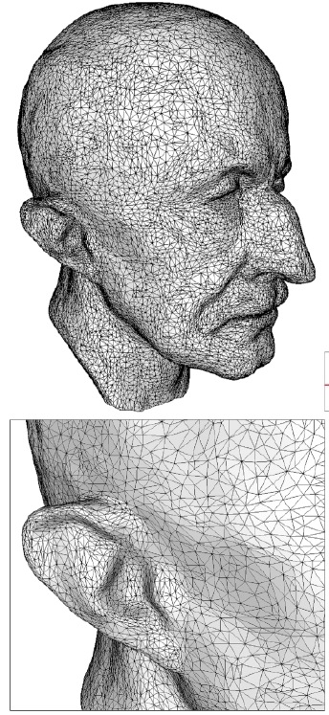
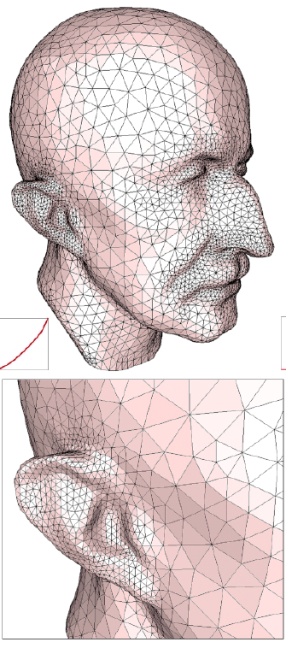
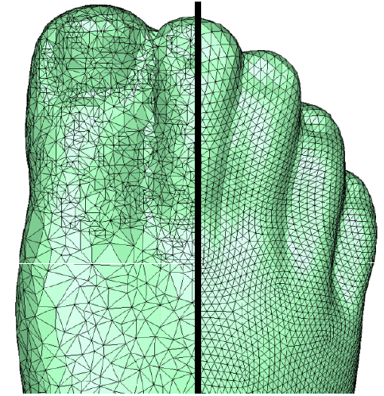
Remeshing

Slide 22
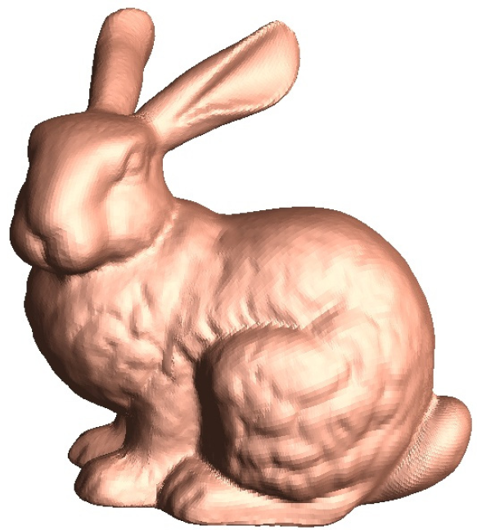
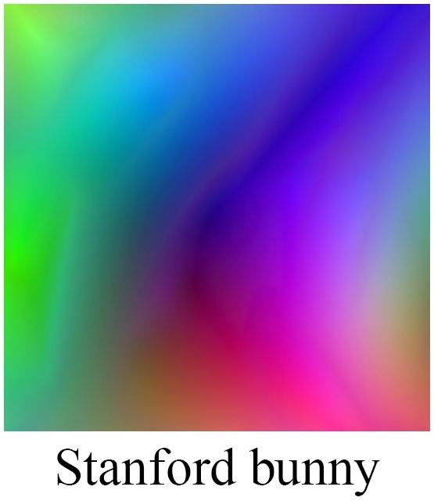
Compression
₌
Geometry images, Gu et al.

Slide 23
Parameterization Properties?
What are “good” parameterizations?
How do we define “good”?

Slide 24

Bijectivity
Bijective (1-1 and onto): No triangles fold over.
Globally: no areas overlap

Slide 25
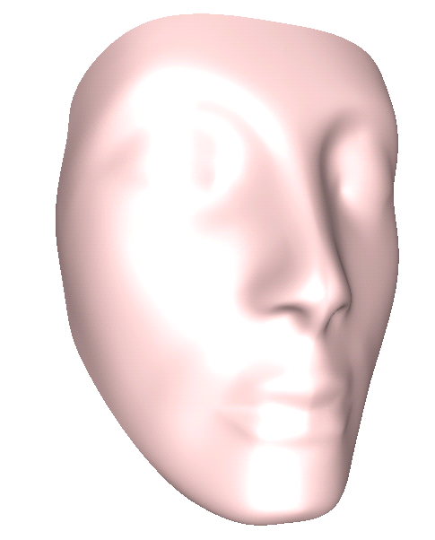
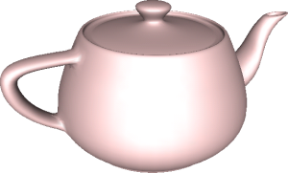
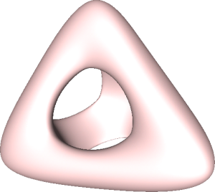
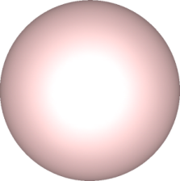
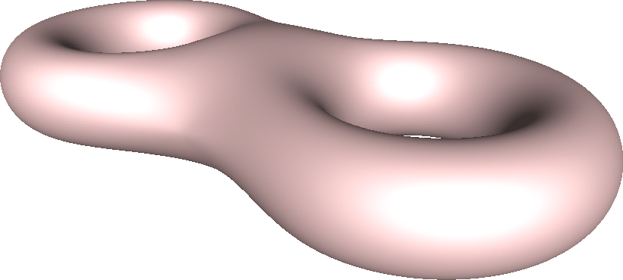
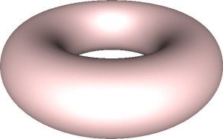
Bijectivity: Non-Disk Domains

Slide 26
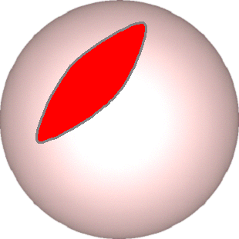
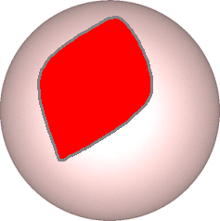
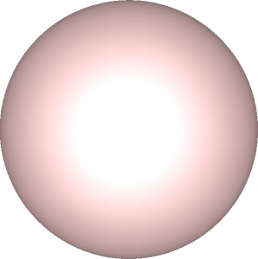
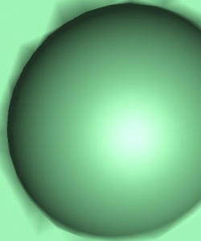
Topological Cutting

Slide 27
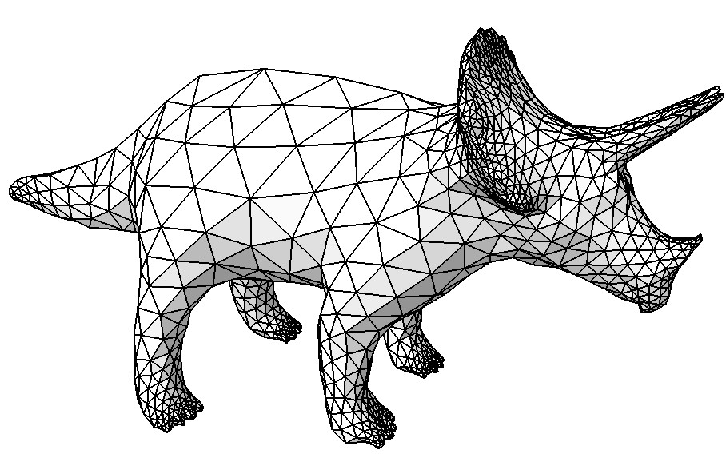
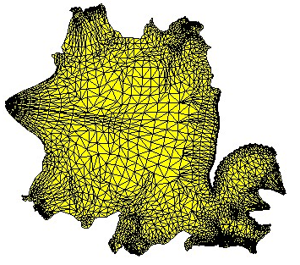
Topological Cutting
A. Sheffer, J. Hart:
Seamster: Inconspicuous Low-Distortion Texture Seam Layout, IEEE Vis 2002

Slide 28
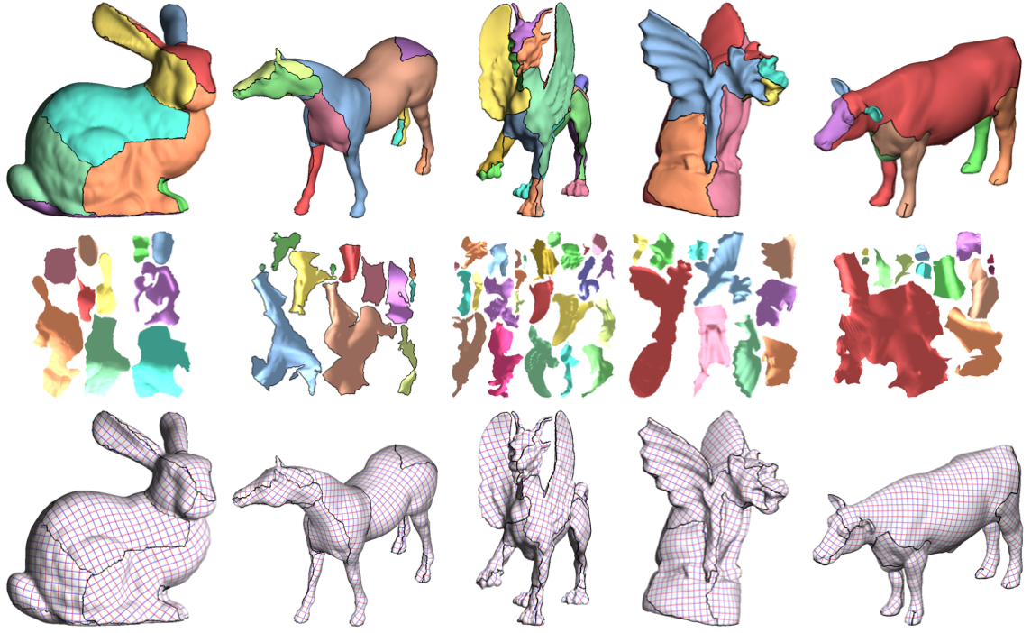
Segmentation

Slide 29
Segmentation
D-Charts: Quasi-Developable Mesh Segmentation,
D. Julius,V. Kraevoy, A. Sheffer, EUROGRAPHICS 2005
Find patches that align to mesh features and are close to being developable surfaces
Developable surface =
Zero Gaussian curvature =
Can be flattened to plane without distortion

Slide 30
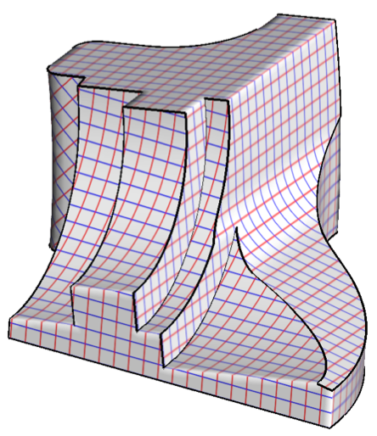
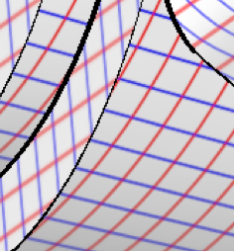
Good Cuts/Segmentations?
Hide seams
Small number/length of seams
Or: make parameterization continuous across seams!
  Next lecture

Slide 31
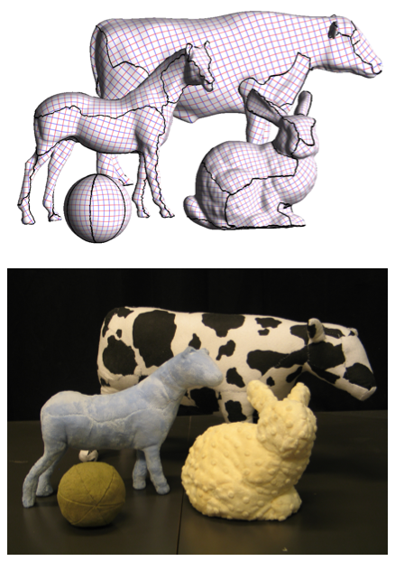
Good Cuts/Segmentations?
Hide seams
Small number/length of seams
Or: make parameterization continuous across seams!
  Next lecture

Slide 32
How to Measure Distortion?

Slide 33
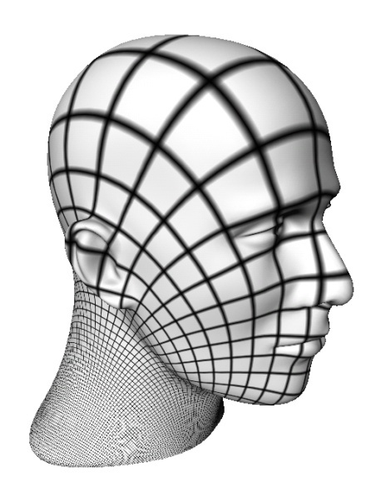
Measures of Local Distortion
Remember differential geometry
v
What happens to tangent vectors?
u

Slide 34
Measures of Local Distortion
Remember differential geometry
v
What happens to tangent vectors?
u

Slide 35
Measures of Local Distortion
How do lengths and angles of tangents change?
  First fundamental form!
v
What happens to tangent vectors?
u

Slide 36
Measures of Local Distortion
How do lengths and angles of tangents change?
  First fundamental form!
  Area distortion: area element:
Angle change
Length change

Slide 37
Measures of Local Distortion
How do lengths and angles of tangents change?
  First fundamental form!
  The eigenvalues of I tell us the maximal/minimal stretching of a tangent vector

Slide 38
Distortion on Triangle Meshes?
Triangle in 3D is mapped to triangle in 2D
Unique affine mapping
T
Jacobian

Slide 39
Distortion on Triangle Meshes?
SVD of the Jacobian reveals directions of extreme stretching
T

Slide 40
Distortion on Triangle Meshes?
Possible distortion measures:
T

Slide 41
How To Compute (Good) Parameterizations? And Quickly?

Slide 42
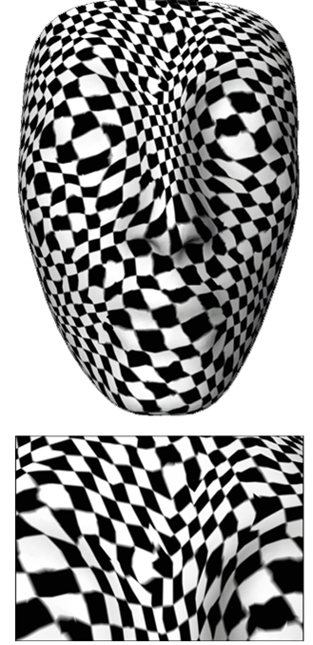
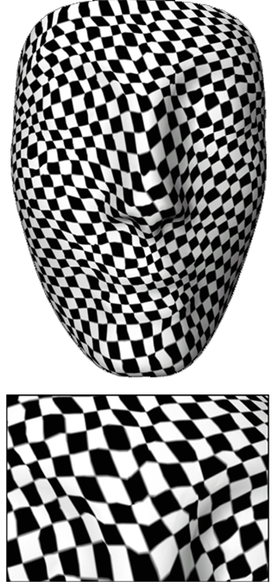
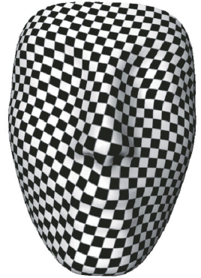

Distortion Minimization
Texture map
Kent et al ‘92
Floater 97
Sander et al ‘01

Slide 43
Distortion Minimization
Texture map
Kent et al ‘92
Floater 97
Sander et al ‘01

Slide 44




Mesh Dependence
Alg. 1 – mesh-independent
Alg. 2 – … less mesh-independent

Slide 45



Area Distortion vs. Angle Distortion
Is it possible to preserve both angles and areas at the same time?

Slide 46


Conformal Parameterization
Angle preservation; circles are mapped to circles

Slide 47
Conformal Parameterization
Angle preservation; circles are mapped to circles

Slide 48
Harmonic Mapping – Idea
Want to flatten the mesh → no curvature → Laplace operator gives zero.
need boundary constraints
to prevent trivial solution;
which Laplacian operator?
(which weights?)
u = (u,v) domain

Slide 49


Convex Mapping (Tutte, Floater)
Boundary vertices are fixed
Convex weights
– inner vertices
– boundary vertices

Slide 50
Convex Mapping (Tutte, Floater)
j
Boundary vertices are fixed
Convex weights
w_{i,j}
i

Slide 51
Convex mapping (Tutte, Floater)
Solve the linear system
The values of the boundary vertices are known and thus substituted (transfer to right-hand side)
What u should be used for boundary?

Slide 52
Harmonic Mapping
Inner mesh edges as springs
Find minimum-energy state where all vertices lie in the 2D plane

Slide 53
Harmonic Mapping
Inner mesh edges as springs
Find minimum-energy state where all vertices lie in the 2D plane

Slide 54
Harmonic Mapping
Inner mesh edges as springs
Find minimum-energy state where all vertices lie in the 2D plane

Slide 55
Harmonic Mapping
Inner mesh edges as springs
Find minimum-energy state where all vertices lie in the 2D plane

Slide 56
Harmonic Mapping
Inner mesh edges as springs
Find minimum-energy state where all vertices lie in the 2D plane

Slide 57
Harmonic Mapping
Inner mesh edges as springs
Find minimum-energy state where all vertices lie in the 2D plane

Slide 58
Harmonic Mapping
Inner mesh edges as springs
Find minimum-energy state where all vertices lie in the 2D plane

Slide 59
Harmonic Mapping
Inner mesh edges as springs
Find minimum-energy state where all vertices lie in the 2D plane
Spring energy:

Slide 60
Harmonic Mapping
Inner mesh edges as
springs
Find minimum-energy
state where all vertices
lie in the 2D plane
Total spring energy of the flattened mesh:

Slide 61
Minimizing Spring Energy
– inner vertices
– boundary vertices
unknown flat vertex positions
known fixed boundary positions

Slide 62
Minimizing Spring Energy
Sparse linear system of n equations to solve!

Slide 63
Choice of spring constants k_i
Uniform
Cotan

Slide 64
Tutte’s Theorem
If the weights are nonnegative, and the boundary is fixed to a convex polygon, the parameterization is bijective
(Tutte proved for uniform weights, Floater extended to arbitrary nonnegative weights)

Slide 65
Comparison of Weights
uniform
weights
cotan
weights

Slide 66
Discussion
The results of cotan-weights mapping are better than those of uniform convex mapping (local area and angles preservation).
But: the mapping is not always legal (the cotan weights can be negative for badly-shaped triangles…)
In any case: sparse system to solve, so robust and efficient numerical solvers exist

Slide 67

Discussion
Both mappings have the problem of fixed boundary –
it constrains the minimization and causes distortion.
More advanced methods do not require boundary conditions.
ABF++ method,
Sheffer et al.

Slide 68
Advanced Methods – Free Boundary

Slide 69
Parameterization -- Source Codes
http://www.riken.jp/brict/Yoshizawa/Research/Param.html
GRAPHITE (INRIA, France)

Slide 70
Thank You

