Slide 1
2D/3D Shape Manipulation,
3D Printing
CS 6501
Mesh Editing:
Introduction;
Differential Deformations
Slides from Olga Sorkine

Slide 2
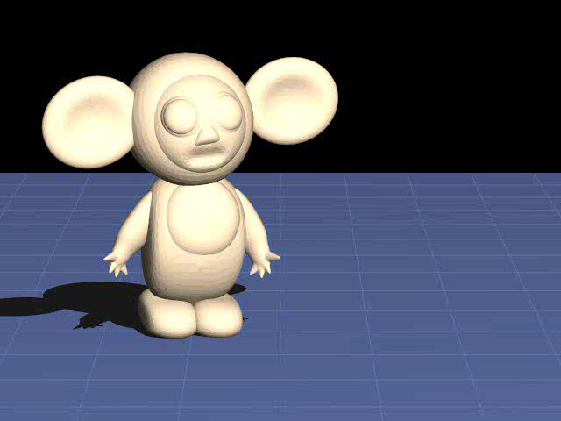
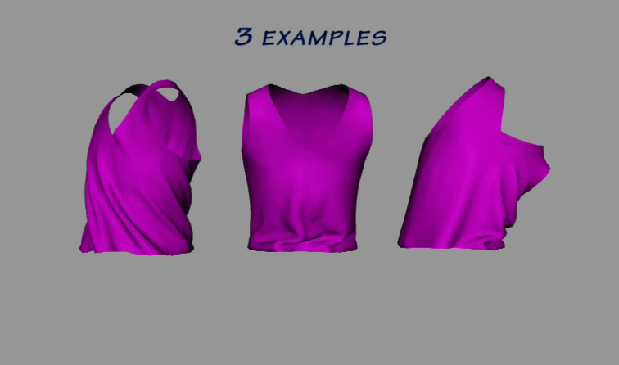
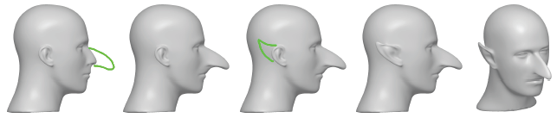
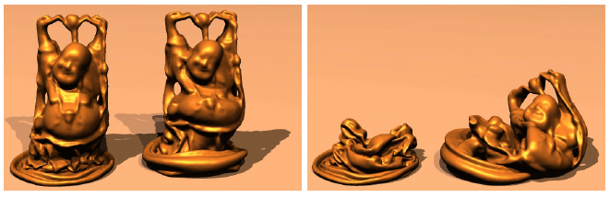
Why Shape Deformation?
Animation
Editing
Simulation

Slide 3
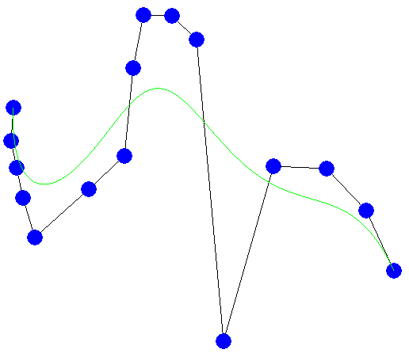
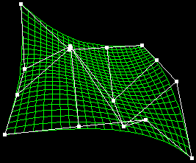
Parametric Curves and Surfaces
Deformation by control
point manipulation
Built-in deformation
mechanism
Control structure is
pre-set (can’t pull on
arbitrary points)

Slide 4
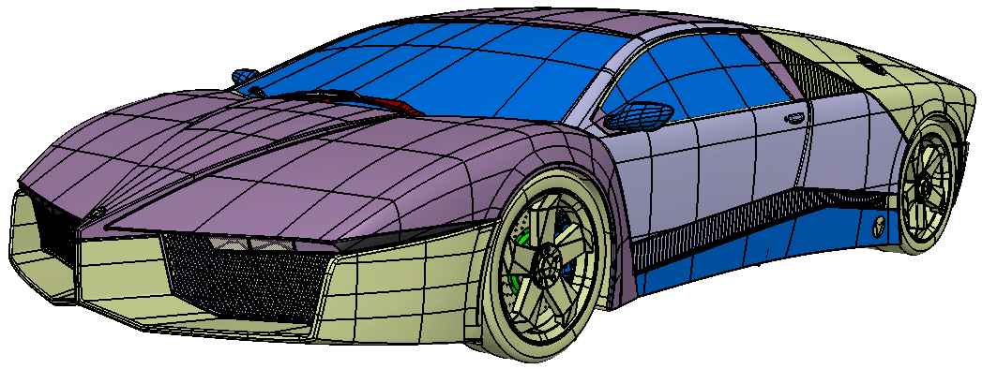
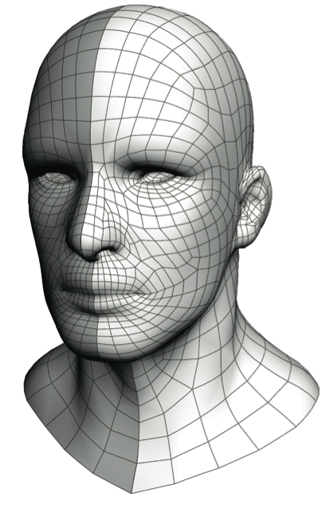
Parametric Curves and Surfaces
Hard to change / adapt control structure to user needs
Hard to experiment, need a precise idea of what will be modeled.

Slide 5
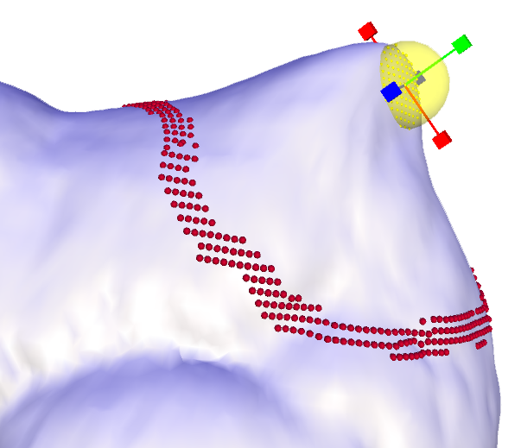
Mesh Deformation
Naïve method: dragging single vertices
Smarter:
  Introduce a small set of
  deformation handles
    Makes deformation/editing easier
    Introduces a trade-off between
    degrees of freedom and simplicity
    of the deformation task
  Create a small set of
  control parameters
    Affine transformations

Slide 6
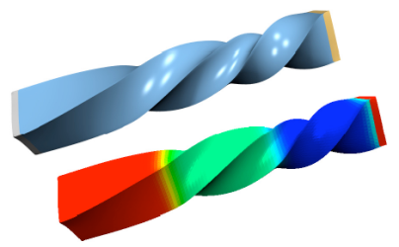
Deformation: Common Paradigms
Surface based deformation
  Optimization on the surface
  Physically motivated: variants of
  elastic energy minimization
Space deformation
  Deforms some 2D/3D space using a cage
  Deformation propagation to all points in the space
  Independent of shape representation

Slide 7
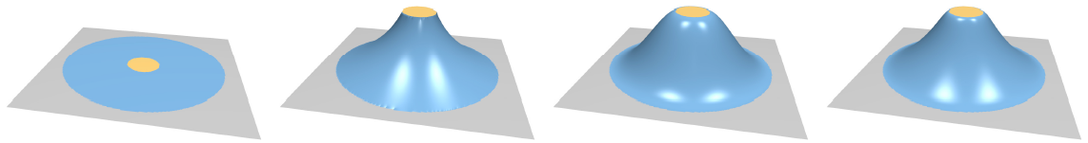
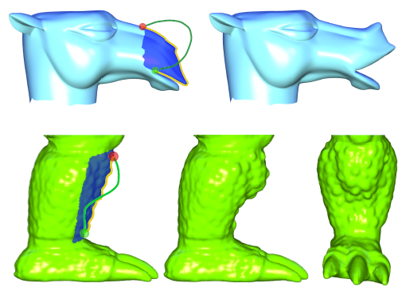
Surface-based Deformations: Examples
Region of interest (ROI) + affine deformation handle with variable boundary continuity
Intuitive sketch-
based deformation
interfaces

Slide 8
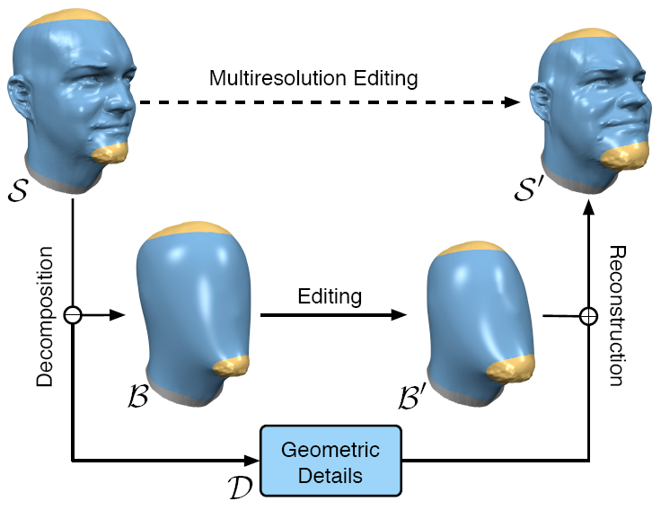
Surface-based Deformations: Examples
Multi-resolution mesh editing

Slide 9
Surface-based Deformations:
General Framework
Find a mesh that optimizes some objective functional and satisfies modeling constraints

Slide 10

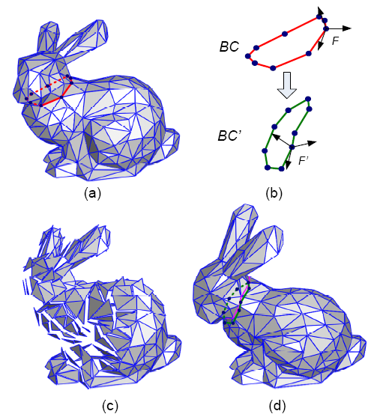
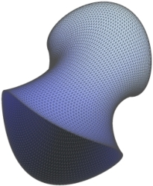
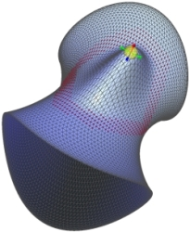
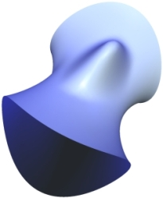
Surface-based Deformations:
Linear Methods
Triangle gradient methods
(2004-2005)
Laplacian surface editing
(2004-2005)

Slide 11
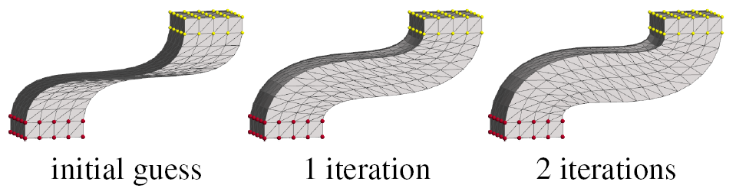
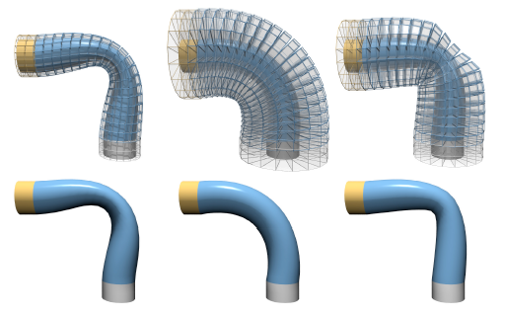
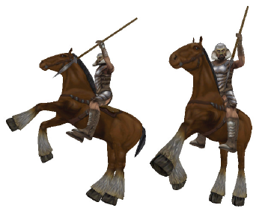
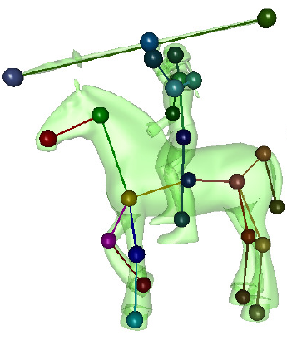
Surface-based Deformations:
Nonlinear Methods
As rigid as possible
surface modeling
(SGP 2007)
PriMo (SGP 2006)
Mesh Puppetry
(SIGGRAPH 2007)

Slide 12
Surface-based Deformations:
Summary So Far
Objective functional expressed in the mesh elements (vertices)
Complexity depends on the mesh resolution
Linear methods:
  Solve a global linear system on the mesh
  Usually suffer from some artifacts
Nonlinear methods
  Fewer artifacts but slower, and harder to implement

Slide 13
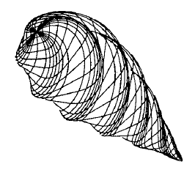
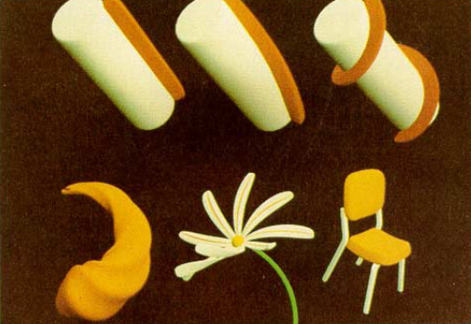
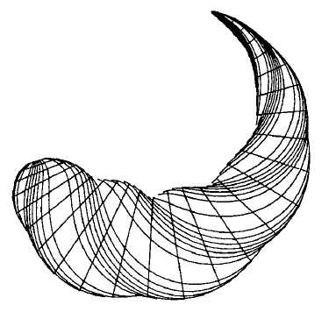
Space Deformations
Early seminal work in computer graphics
Global and local deformation of solids
[Barr 1984]

Slide 14
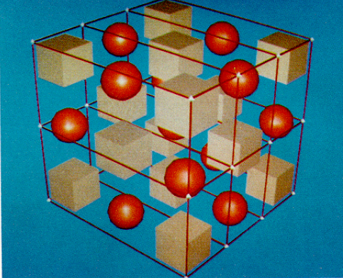
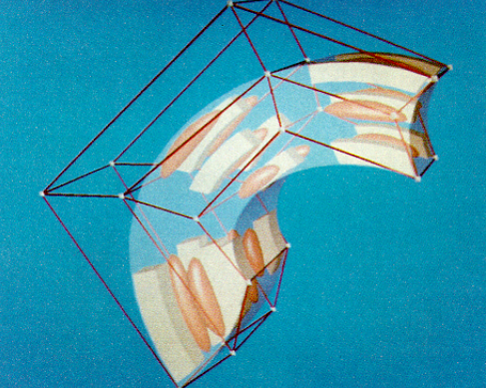
Space Deformations
Early seminal work in computer graphics
Free form deformations
[Sederberg and Parry 1986]
  Uses trivariate tensor product
  polynomial basis

Slide 15

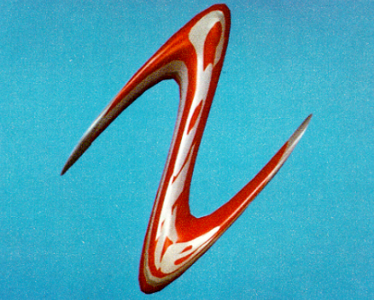
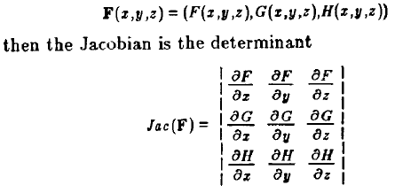
Space Deformations
Early seminal work in computer graphics
Can be designed to be
volume preserving

Slide 16
Space Deformations: Basic Idea
Design a set of coordinates for all points in R^{d}
w.r.t. the “cage” vertices
  Each point x can be represented as a weighted sum of cage points p_{i}
  When the cage changes the coords stay the same, substitute the new cage geometry:

Slide 17
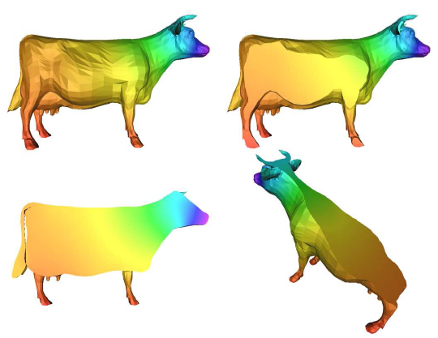
Space Deformations: Basic Idea
Design a set of coordinates for all points in R^{d}
w.r.t. the “cage” vertices
  Each point x can be represented as a weighted sum of cage points p_{i}
  The coordinates are
  smoothly varying and
  guarantee continuity
  inside the volume

Slide 18
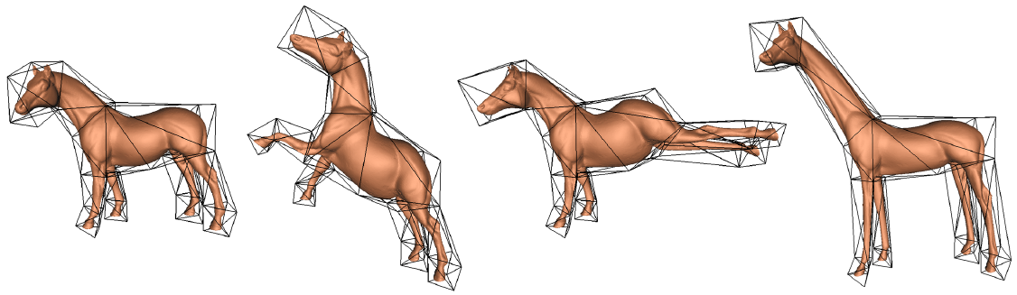
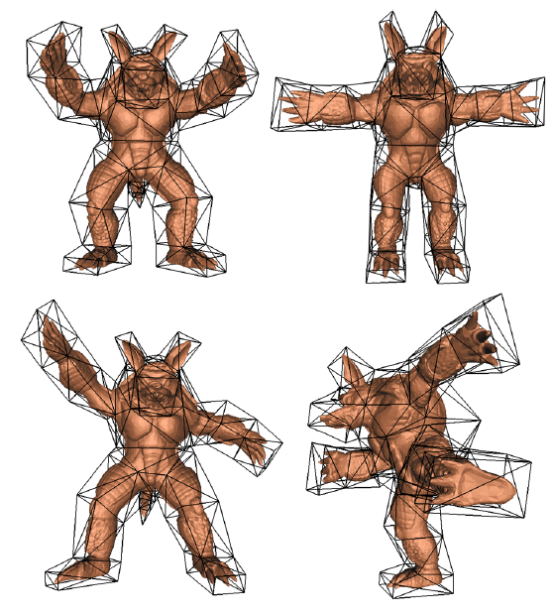
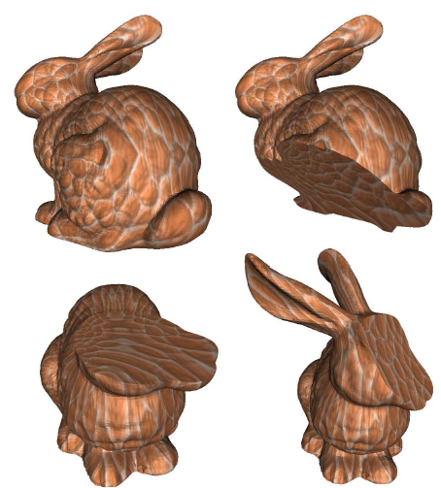
Space Deformations: Examples
Mean value coordinates for closed tri meshes
[Ju et al. 2005]

Slide 19
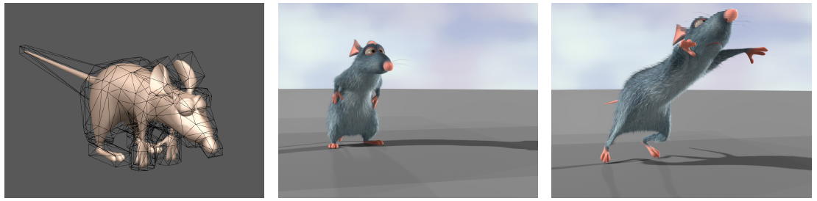
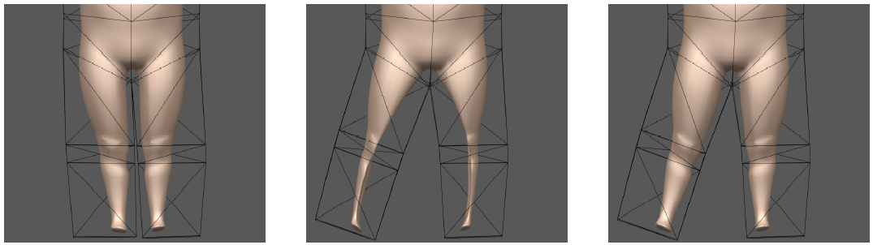
Space Deformations: Examples
Harmonic coordinates [Joshi et al. 2007]

Slide 20
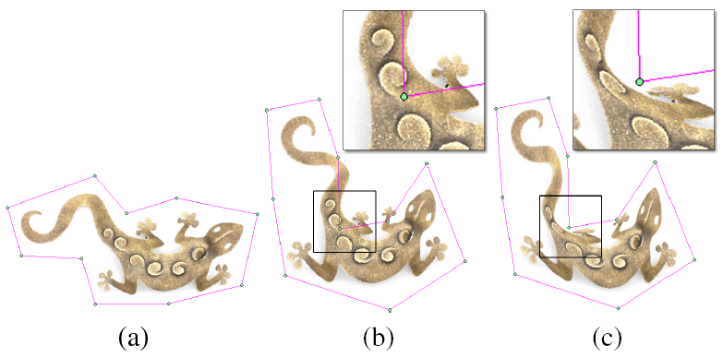
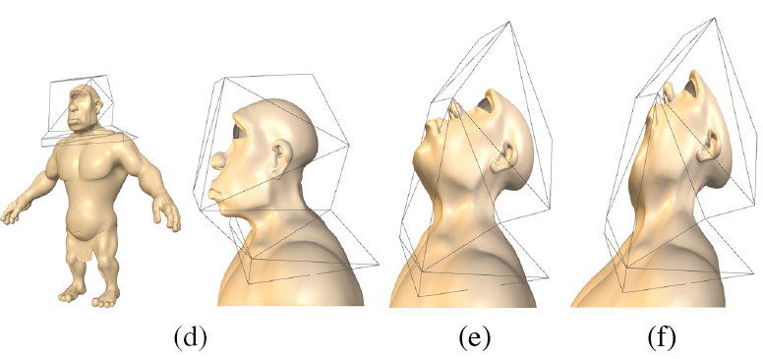
Space Deformations: Examples
Green coordinates
[Lipman et al. 2008]

Slide 21
Space Deformations:
Summary So Far
Complexity depends mainly on the cage; linear in the number of mesh elements
  Parallel execution, GPU!
Can handle disconnected components or even just point sets
Harder to control the surface properties since the whole space is being warped

Slide 22
Surface-based Differential Deformations

Slide 23
Surface-based Deformation:
ROI-Handle Editing Metaphor
ROI is bounded by a belt (static anchors)
Manipulation through handle(s) – affine transformations
ROI

Slide 24
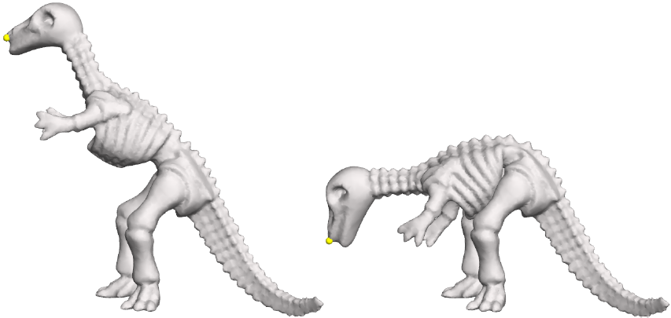
How to Define ?
Intuitive deformations:
  Smooth deformation on the global scale
  Preserve local details (curvatures)
Invariants: should be zero if is a rigid
transformation of original geometry

Slide 25
Recap: Differential Coordinates
Detail = smooth(surface) – surface
Smoothing = averaging

Slide 26
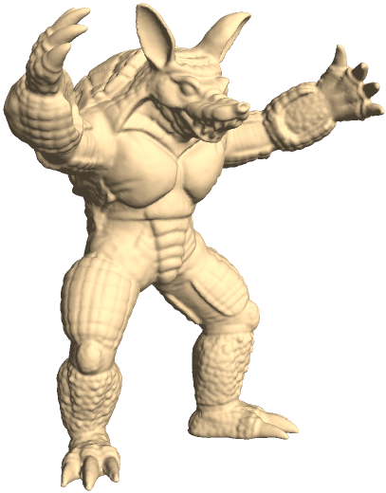
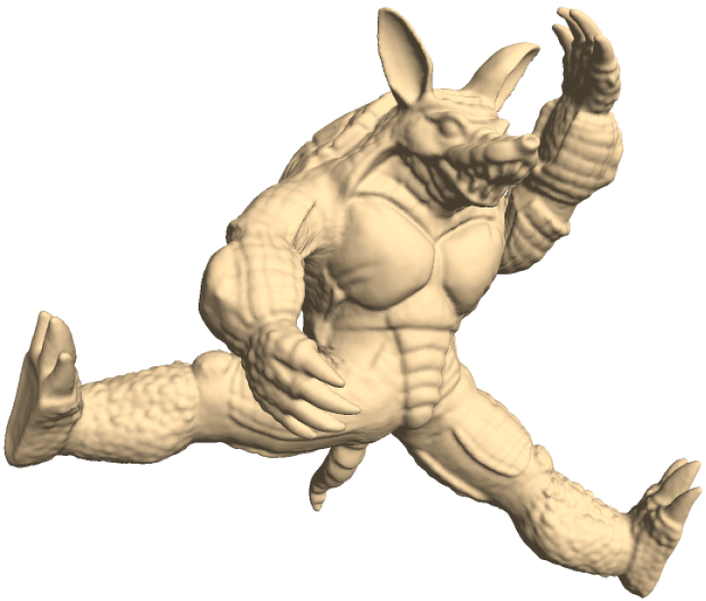
Recap: Differential Coordinates
Represent local detail at each surface point
  More descriptive of the shape than just xyz
Linear transition from xyz to δ
Useful for operations on surfaces where surface details are important

Slide 27
Simple Laplacian Editing
Preserve mean curvature normal [≈differential coordinates] at every point in the ROI [≈ every vertex of the ROI]
continuous:
discreet:

Slide 28
Simplifying the Laplacian Energy
L
M^{–1}
L_{w}
=
cotan
matrix
Symmetric sparse matrix!

Slide 29
Minimizing the Laplacian Energy
To find the minimum, gradient = 0 and substitute the modeling constraints

Slide 30
Minimizing the Laplacian Energy
Matrix depends on the
initial mesh and the indices
of the constraints only.
Matrix is fixed!
Right-hand side contains
the coordinates of the
constraints (handles)

Slide 31
Minimizing the Laplacian Energy
Sparse Cholesky
decomposition:
At run-time: just back-substitution!

Slide 32
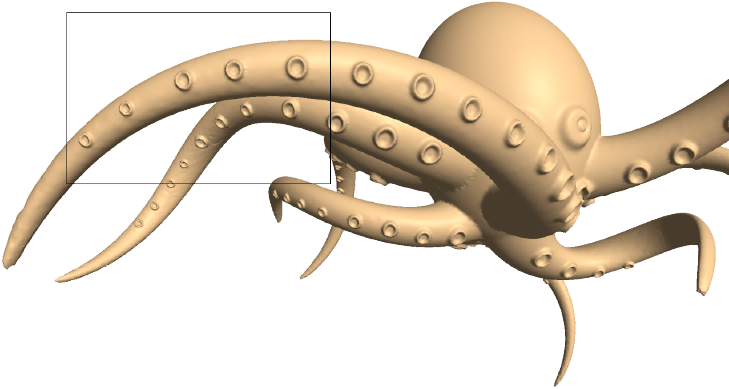
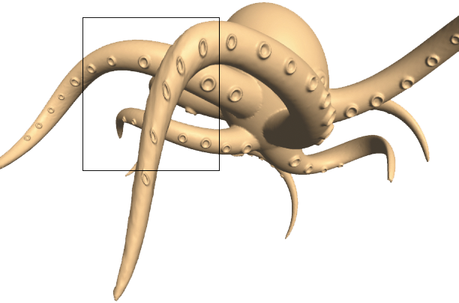
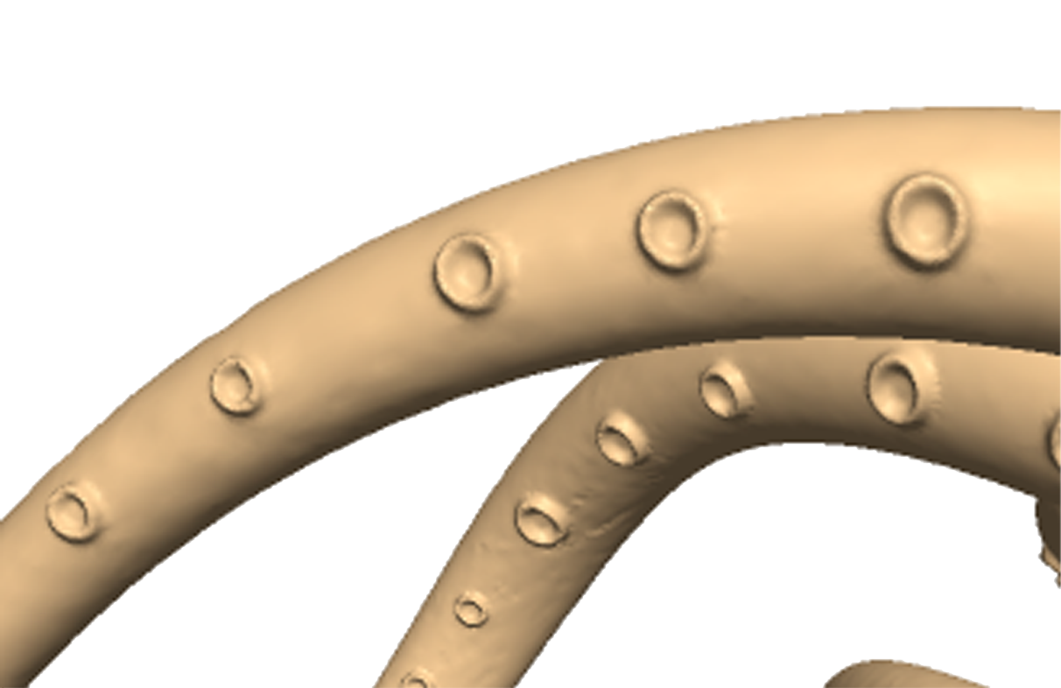
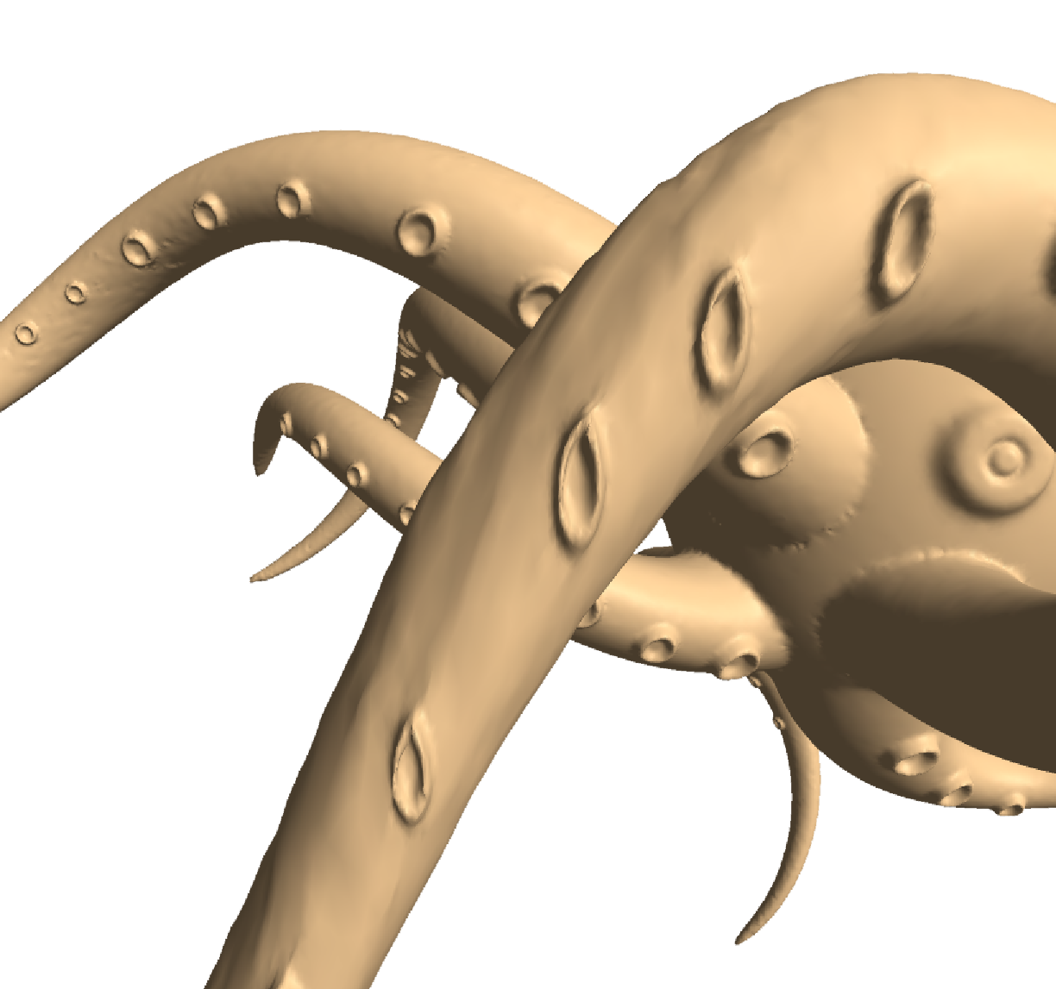
Fundamental Problem:
Invariance to Transformations
The basic Laplacian operator is translation-invariant, but not rotation-invariant
E(x’) attempts to preserve the original global orientation of the details (the normal directions)

Slide 33
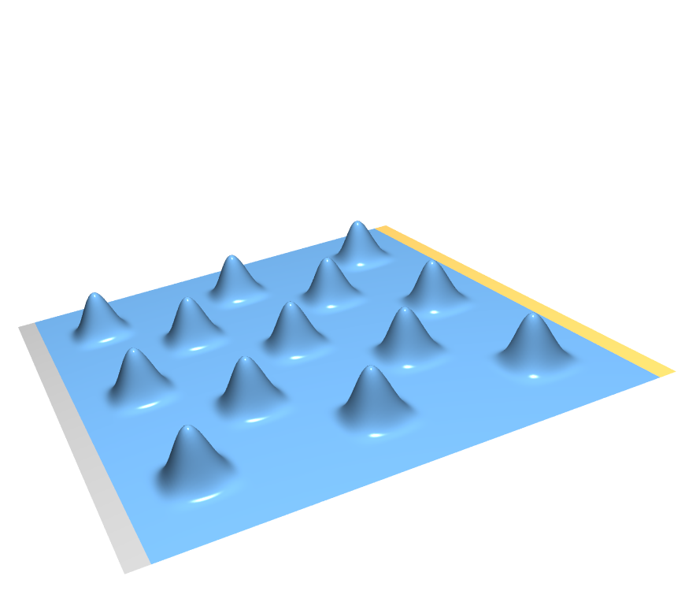
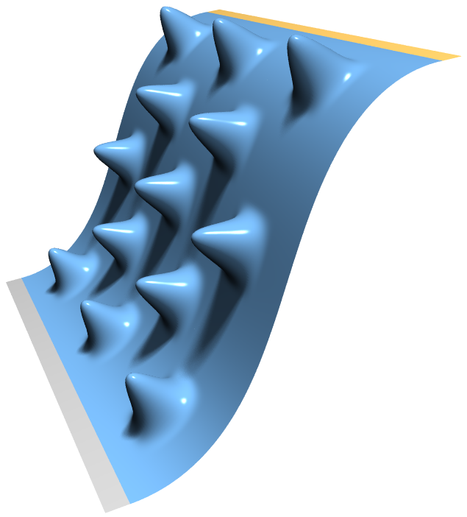
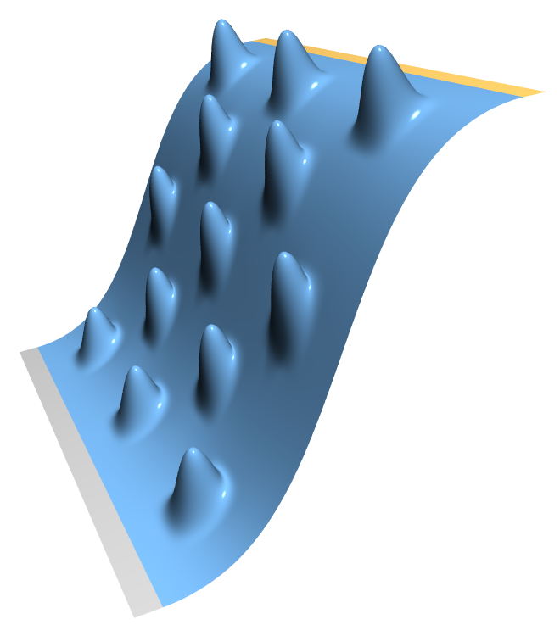
Fundamental Problem:
Invariance to Transformations
fixed
vertices
input
intuitive expectation
actual result

Slide 34
Fundamental Problem:
Invariance to Transformations
The basic Laplacian operator is translation-invariant, but not rotation-invariant
E(x’) attempts to preserve the original global orientation of the details (the normal directions)

Slide 35
Fundamental Problem:
Invariance to Transformations
The basic Laplacian operator is translation-invariant, but not rotation-invariant
E(x’) attempts to preserve the original global orientation of the details (the normal directions)

Slide 36
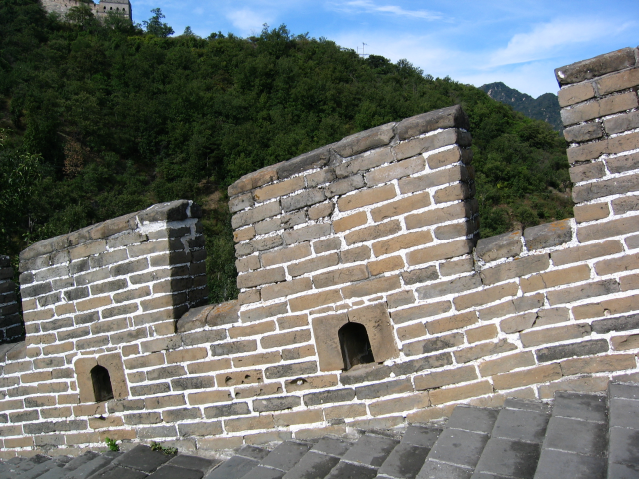
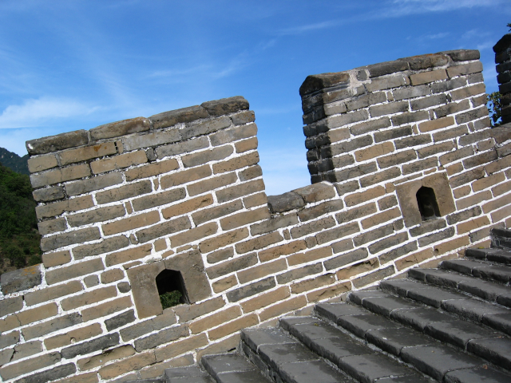
Fundamental Problem:
Invariance to Transformations
Similar problem with the Great Wall of China...

Slide 37
Energy Functional
We need a rigid-invariant energy…
Need to locally rotate the target m.c. normals

Slide 38
Fixing Local Rotations:
Multiresolution Approach
input

Slide 39
Fixing Local Rotations:
Multiresolution Approach
Smooth base surface

Slide 40
Fixing Local Rotations:
Multiresolution Approach
Details – displacement vectors

Slide 41
Fixing Local Rotations:
Multiresolution Approach
Encode details in the local frame of B
d_{i} = a₁t_{i} + a₂n_{i}

Slide 42
Fixing Local Rotations:
Multiresolution Approach
Deform smooth base surface

Slide 43
Fixing Local Rotations:
Multiresolution Approach
Local frames on B′

Slide 44
Fixing Local Rotations:
Multiresolution Approach
Add details back – in local frame!
d_{i} ′ = a₁t_{i}′ + a₂n_{i}′

Slide 45
Fixing Local Rotations:
Multiresolution Approach
Displace the vertices to get the result

Slide 46
Fixing Local Rotations:
Multiresolution Approach
Kobbelt et al. SIGGRAPH 98, Botsch and Kobbelt SIGGRAPH 2004

Slide 47
Fixing Local Rotations:
Multiresolution Approach
Kobbelt et al. SIGGRAPH 98, Botsch and Kobbelt SIGGRAPH 2004
Smooth base surface: defined by Laplacian smoothing of the input mesh (1998) or the bi-Laplacian surface (2004): solve
constraints: handles

Slide 48
Fixing Local Rotations:
Multiresolution Approach
Kobbelt et al. SIGGRAPH 98, Botsch and Kobbelt SIGGRAPH 2004
Smooth base surface: defined by Laplacian smoothing of the input mesh (1998) or the bi-Laplacian surface (2004): solve
constraints: handles

Slide 49
Fixing Local Rotations:
Multiresolution Approach
Kobbelt et al. SIGGRAPH 98, Botsch and Kobbelt SIGGRAPH 2004
Geometric details: simply the difference vectors between base surface B and input S
For each vertex, compute
d_{i} = v_{i} – b_{i}
Represent d_{i} in the local frame of b_{i}
n_{i}
d_{i}
d_{i} = a₁t₁ + a₂t₂ + a₃n_{i}

Slide 50
Fixing Local Rotations:
Multiresolution Approach
Kobbelt et al. SIGGRAPH 98, Botsch and Kobbelt SIGGRAPH 2004
Editing the base surface: move the handle vertices, solve again
with the new handle constraints

Slide 51
Fixing Local Rotations:
Multiresolution Approach
Kobbelt et al. SIGGRAPH 98, Botsch and Kobbelt SIGGRAPH 2004
Add back details – in the local frame!

Slide 52
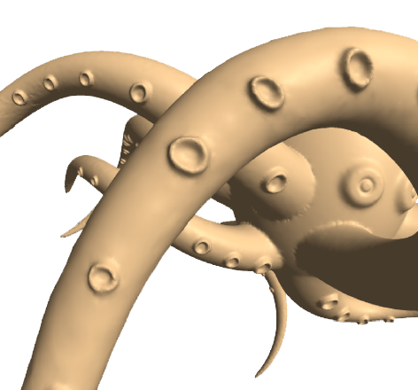
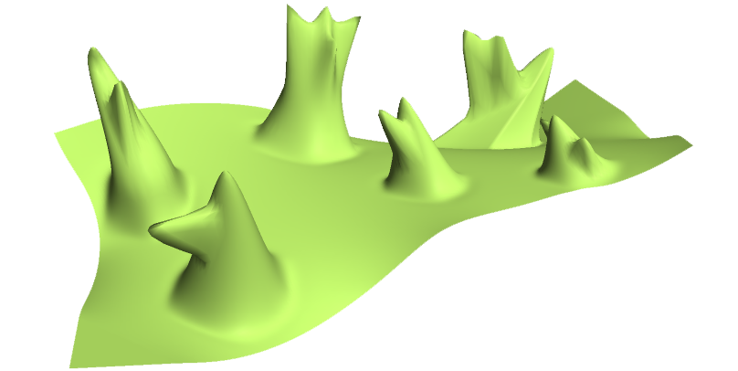
Multiresolution Framework: Discussion
Advantages:
  Fast! Linear solve for the base surface deformation, and then add back displacements
  Intuitive, easy to implement
Problem: works only for small height fields (when details vectors are small)
almost a height field
not a height field

Slide 53


Multiresolution Framework: Discussion
Problem: If detail vectors are too big we get overshooting and self-intersections,
especially in concave cases

Slide 54
Local Rotations – Single Resolution Solutions
Come up with a rotation field on the surface based on the modeling constraints
Rotate the differential coordinates; solve

Slide 55
Estimation of Rotations
Lipman et al. 2004
Edit the surface using the original Laplacians δ (naïve Laplacian editing)
Compute smoothed local frames, estimate rotation

Slide 56

Estimation of Rotations
Lipman et al. 2004
Then solve the optimization again with the rotated δ’s!

Slide 57
Estimation of Rotations
Lipman et al. 2004
Advantages:
  Sparse linear solve
  Less or no self-intersections thanks to global optimization (no more local displacements that fight each other)
Disadvantages:
  Heuristic estimation of the rotations
  Speed depends on the support of the smooth local frame estimation operator; for highly detailed surfaces it must be large
  Unclear how much we need to smooth (what is detail?)
Notes:
I only got till here

Slide 58
Rotation Propagation
[Yu et al. SIGGRAPH 2004][Zayer et al. EG 2005][Lipman et al. SIGGRAPH 2005]
Assume more user input: the user also specifies handle rotation, not just translation
The rotation is diffused to the rest of the ROI

Slide 59




Rotation Propagation
Geodesic distance [Yu et al. 2004]
Harmonic field [Zayer et al. 2005]
Optimization [Lipman et al. 2005, 2006]
Harmonic field

Slide 60
Harmonic Fields on Meshes
Scalar function, attains 1 on the active handle, 0 on the static handles
Smooth in-between, no local extrema
Solve:
with constraints f_{i} = 1 on active handle,
f_{i} = 0 on static handle
f_{i} = 1
Example: in this simple case,
the harmonic field is a just a
linear ramp
f_{i} = 0

Slide 61








Rotation Propagation w/Harmonic Fields
Why does this happen?

Slide 62

Rotation Propagation w/Harmonic Fields
If rotations are provided and consistent with the desired transformation, this works well
However, the method is translation-insensitive (doesn’t generate rotations when there are none provided)

Slide 63




Sketch-based Editing
Nealen et al. 2005
Can use curves as handles in e.g. Laplacian Editing
Silhouettes are intuitive curves to reshape

Slide 64
Silhouette Sketching
Using silhouettes as handles
  Detect object space silhouette
  Project to screen space
  and parametrize [0,1]
  Parametrize sketch [0,1]
  Find correspondences

Slide 65
Silhouette Sketching
Using silhouettes as handles
  Detect object space silhouette
  Project to screen space
  and parametrize [0,1]
  Parametrize sketch [0,1]
  Find correspondences
  Use as positional constraints
  while retaining depth value

Slide 66
Silhouette Sketching
What is a good silhouette?
viewer

Slide 67
Silhouette Sketching
Positional constraints on linear combinations of mesh vertices
viewer
Illustrating Smooth Surfaces
[Hertzmann and Zorin 00]

Slide 68
List of Literature from Today
Kobbelt et al. 1998: Interactive Multi-Resolution Modeling on Arbitrary Meshes, ACM SIGGRAPH 1998
Botsch and Kobbelt 2004: An Intuitive Framework for Real-Time Freeform Modeling, ACM SIGGRAPH 2004
Lipman et al. 2004: Differential Coordinates for Interactive Mesh Editing, Shape Modeling International 2004
Sorkine et al. 2004: Laplacian Surface Editing, Symposium on Geometry Processing 2004
Yu et al. 2004: Mesh Editing with Poisson-Based Gradient Field Manipulation, ACM SIGGRAPH 2004
Lipman et al. 2005: Linear Rotation-Invariant Coordinates for Meshes, ACM SIGGRAPH 2005
Igarashi et al. 2005: As-Rigid-As-Possible Shape Manipulation, ACM SIGGRAPH 2005
Zayer et al. 2005: Harmonic Guidance for Surface Deformation, EUROGRAPHICS 2005

Slide 69
Thank You

