Slide 1
Subdivision Surfaces
Connelly Barnes

Slide 17
Loop Subdivision

Slide 21
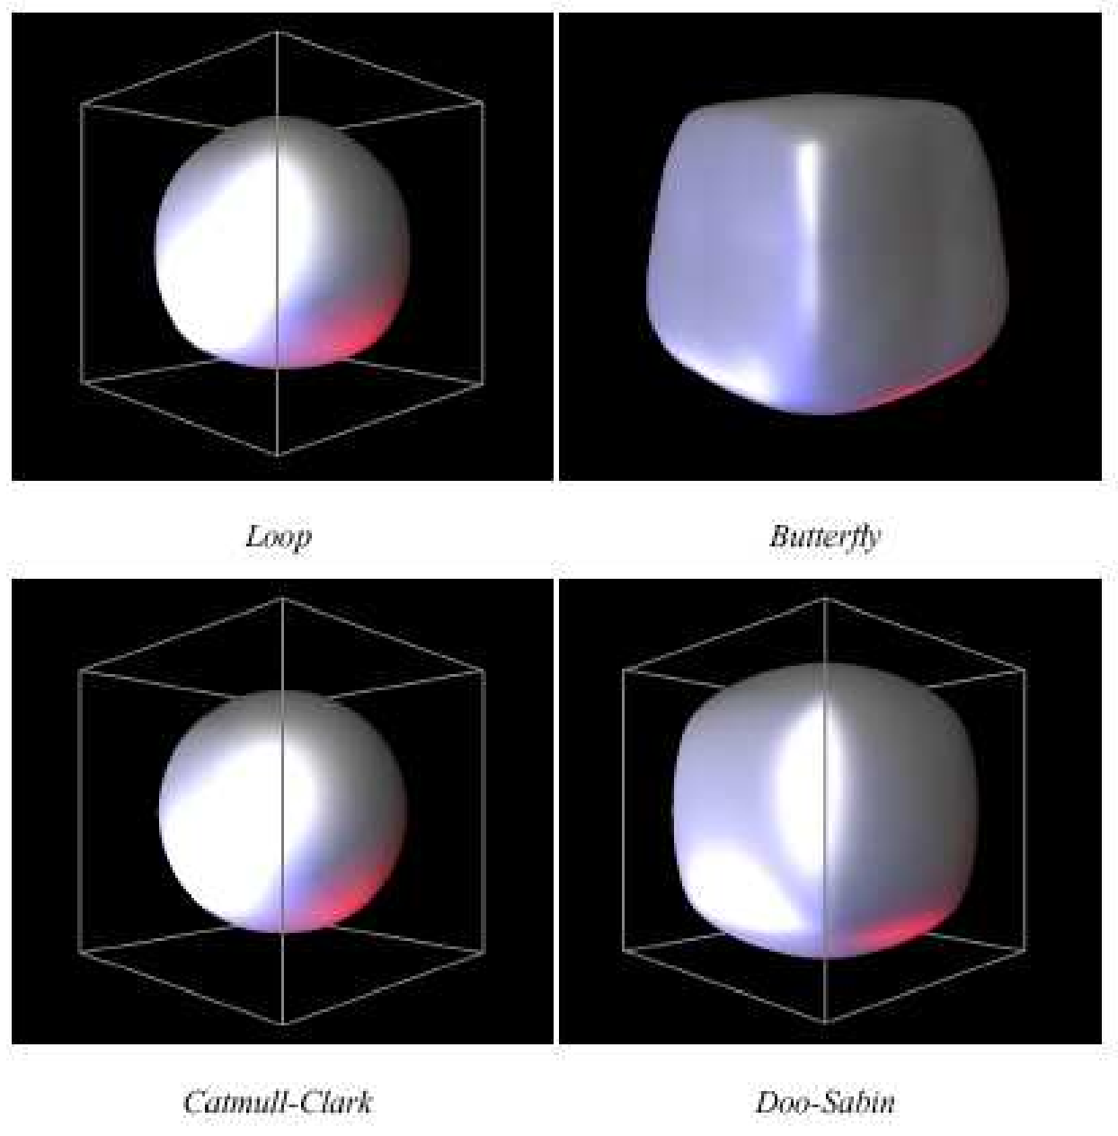
Results

Slide 22
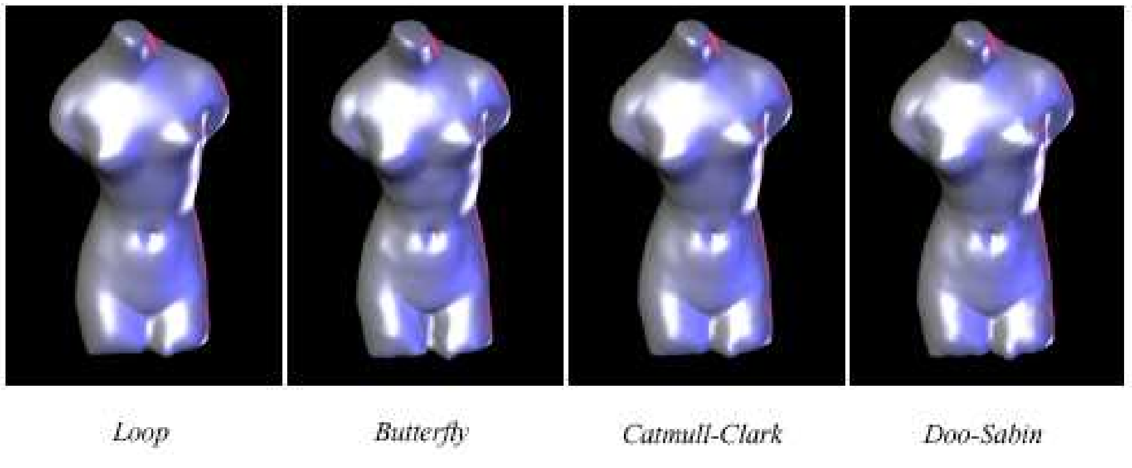
Results

