Slide 1
Self-driving cars
Connelly Barnes CS 6501 – Large-scale data-driven graphics and vision

Slide 2
Google Self-Driving Car
Overview Video
More Technical Video
Sensors:
Velodyne LIDAR Laser System
September 2015 status:
1.2 million miles driven
14 minor traffic accidents, 0 were fault of vehicle
Plan to be sold to the public in 2020.

Slide 3
Limitations
Not tested in heavy rain or snow
Do not obey temporary traffic lights
Revert to slow “extra cautious” mode in complex unmapped intersections.
Cannot spot officers directing traffic.
Swerve unnecessarily for minor debris

Slide 4
Partners
Manufacturers:
GM, Ford, Toyota, Daimler, and Volkswagen

Slide 5
Robo-Taxis
Patent by Google:
“Advertising fee funded transportation service which included autonomous vehicles as a method of transport.”
Uber has research center on driverless vehicles.
The Economist: “while some personal cars will remain, a fleet of shared vehicles will likely fill the streets of towns and cities.”

Slide 6
Robo-Taxis
Discussion:
What would be the effects on the economy, daily life, road utilization, parking, jobs in the transportation industry, …?
Robustness in cases of the Internet being disrupted for extended periods of time due to natural disasters, warfare, …?
How many self-driving car companies will there be? Which will be #1?

Slide 7
Predictions
Columbia University Earth Institute predicts reduction in U.S. fleet of vehicles by 10x.
PricewaterhouseCoopers forecasts reduction in traffic accidents by 10x, reduction in fleet by 100x.
Morgan Stanley estimates autonomous cars could save the U.S. $1.3 trillion annually ($169B in fuel consumption, $488B crash costs, $645B in boosted productivity)
IEEE committee predicts 75% of vehicles will be autonomous by 2040.

Slide 8
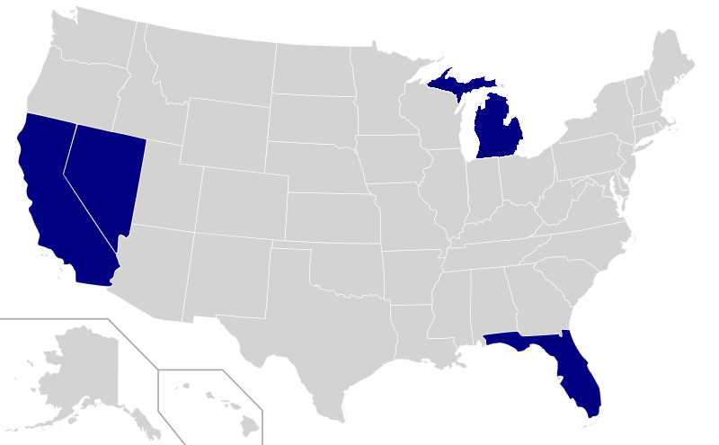
Legal Status (2015)
As of 2014, legal in 4 states: California, Michigan, Florida, Nevada, plus Washington D.C.

Slide 9
International Legal Status (2015)
Tests under way:
Germany
Netherlands
Spain
France
U.K.
China (Baidu and BMW, driving in Beijing and Shanghai)
Tests planned:
Belgium
Italy

Slide 10
National Highway Traffic Safety Administration Classification System
Level 0: Driver controls vehicle at all times.
Level 1: Individual vehicle controls automated, such as electronic stability control or automatic braking.
Level 2: Two controls can be automated in unison, such as adaptive cruise control with automated braking.
Level 3: Driver can cede all control, but car may require driver to re-take control.
Level 4: Driver does not control car at any time.

Slide 11
Slides from California DMV CIO
“Autonomous Vehicles in California” by Bernard Soriano and Stephanie Dougherty

Slide 12
Public workshops and meetings
Nissan • Volvo • VW Group
Chrysler • GM • Toyota
Honda • Google • Bosch
Autonomous vehicle technology advancing quickly
Adoption by the public will not be dependent on technology
Human factors (HMI)
Potential traffic safety improvements are immense
Over 30,000 traffic fatalities per year
Almost all (95%) of traffic fatalities were the result of human error
In over 35% of traffic fatalities, the brakes were not applied
Government and industry need to work collaboratively

Slide 13
Volvo
No fatalities in a Volvo vehicle by the year 2020
Collision avoidance systems
Commercial trucking industry
Road train or platooning
Gothenburg, Sweden
Nissan
Autonomous car will be available for sale before 2020
Price will be $1,000 - $2,000 above current prices
Audi A-7 demo at the 2013 CES

