Slide 1
CS 6501: Deep Learning for Computer Graphics Introduction / Overview
Connelly Barnes

Slide 2
Outline
Course info:
Website
Goals / topics
Grading
Sign up sheet
Background: machine learning, neural networks, computer vision
Recent impact on computer graphics
Examples of papers we will cover

Slide 3
Course Website
http://www.connellybarnes.com/work/class/2016/deep_learning_graphics/
Other ways to find the website:
Linked to from UVa Collab
Linked to from Lou’s list
Linked to from my website connellybarnes.com

Slide 4
Course Goals
Learn math and computer science behind deep (artificial) neural networks
Understand in a general way how deep learning has been applied to areas such as natural language processing, robotics, games, finance
Understand in moderate depth how deep learning is used in computer vision
Understand in greater depth how deep learning is used in graphics
Gain experience building your own deep networks for visual computing problems (computer graphics, computer vision)

Slide 5
Course Topics (More Detail)
Neural networks
Fully connected
Convolutional
Recurrent
Autoencoders
How to initialize
How to train
How to prevent problems: e.g. vanishing/exploding gradients

Slide 6
Grading
Quizzes in class (15%)
Student paper presentations (20%)
Programming assignments (35%)
Final course project (30%)
No mid-term

Slide 7
Sign Up Sheet
Everyone sign up for student presentation of a paper
Also enter your username if you do not have CS department account
Obtain sign up sheet URL from Collab.

Slide 8
What is Machine Learning?
“The field of study that gives computers the ability to learn without being explicitly programmed.” – Arthur Samuel

Slide 9
What is Machine Learning?
3 broad categories:
Supervised learning: computer presented with example inputs and desired outputs by a “teacher”, goal is to learn general rule that maps inputs to outputs.
Unsupervised learning: No output labels are given to the algorithm, leaving it on its own to find structure in the inputs.
Reinforcement learning: An agent determines what actions to best take in an environment to maximize some notion of cumulative reward.

Slide 10
Background: Artificial Neural Networks
“An artificial neural network is a network inspired by biological neural networks, which are used to estimate or approximate functions that can depend on a large number of inputs that are generally unknown.” - Wikipedia
In this class, we can call these “neural networks” for short.

Slide 11
Historical Background: Neural Networks
1943: McCulloch and Pitts
Warren McCulloch (a psychiatrist and neuroanatomist)
Walter Pitts (a mathematician)
Examined computational capabilities of networks made of very simple neurons.
McCulloch-Pitts network fires if sum of excitatory inputs exceeds threshold, as long as it does not receive an inhibitory input.
Can construct AND and OR gates, so one can construct any logical function.

Slide 12
McCulloch-Pitts Neuron (1943)
Activation function
Output (Binary)
Inputs (Binary)
Threshold T, fixed
Restrictions on weights, and weights fixed

Slide 13
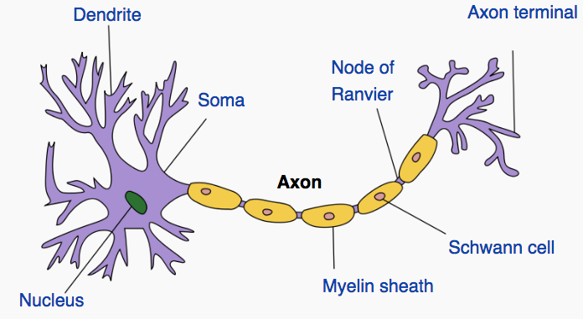
Historical Background: Neural Networks
1949: Psychologist Donald Hebb created learning hypothesis for neurons in the brain.
Neuron diagram from Wikipedia

Slide 14
Hebbian Learning (1949)
“Let us assume that the persistence or repetition of a reverberatory activity (or "trace") tends to induce lasting cellular changes that add to its stability.… When an axon of cell A is near enough to excite a cell B and repeatedly or persistently takes part in firing it, some growth process or metabolic change takes place in one or both cells such that A's efficiency, as one of the cells firing B, is increased.” - Hebb “Simultaneous activation of cells leads to pronounced increases in synaptic strength between those cells.” – Wikipedia

Slide 15
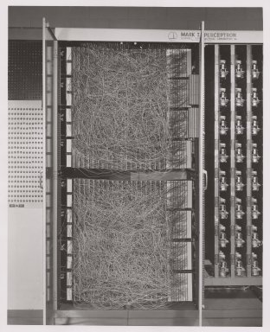
Perceptron (1957, Cornell)
400 pixel camera
Designed for image recognition
Weights encoded in potentiometers (variable resistors)
Weight updates during learning performed by electric motors

Slide 16
Perceptron (1957, Cornell)
In machine learning, a classifier identifies which out of a set of categories a new observation belongs to, on the basis of a training set of data containing observations whose category is known.
Perceptron is a binary classifier (classes are 0 and 1):
Weights w and bias b are learned from the training data.

Slide 17
Perceptron (1957, Cornell)
Output (Class)
Inputs
Bias b: arbitrary, learned parameter
Weights: arbitrary, learned parameters

Slide 18
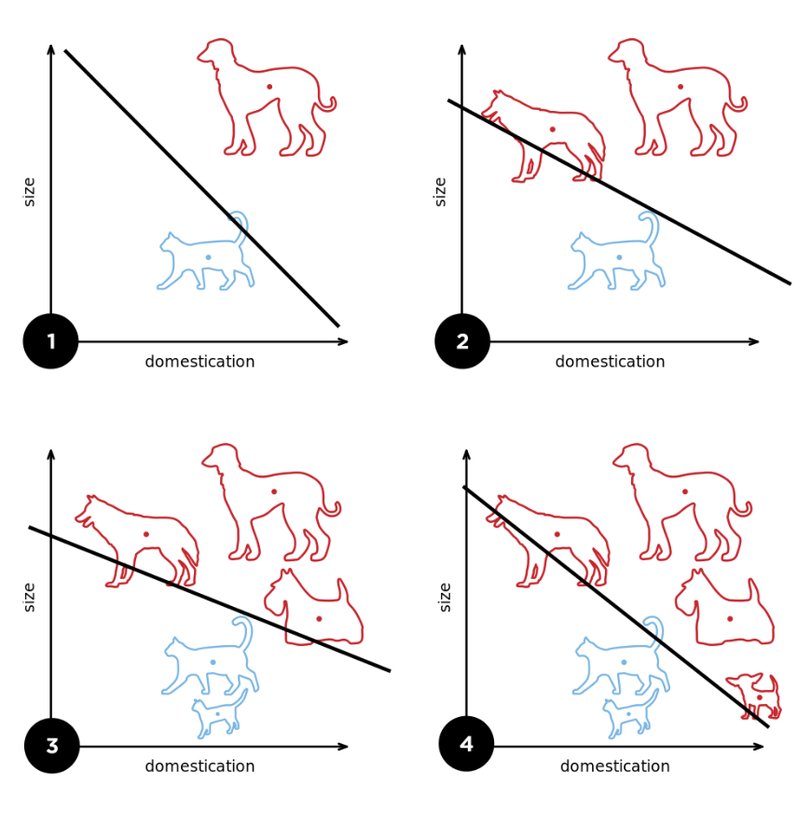
Perceptron (1957, Cornell)
Can learn linearly separable patterns.
How could one train e.g. the Perceptron?
Diagram from Wikipedia

Slide 19
Multilayer Neural Networks (1965)
Alexey Ivakhnenko trained multi-layer networks (as deep as 8 layers) that had polynomial activation functions.
First deep learning?

Slide 20
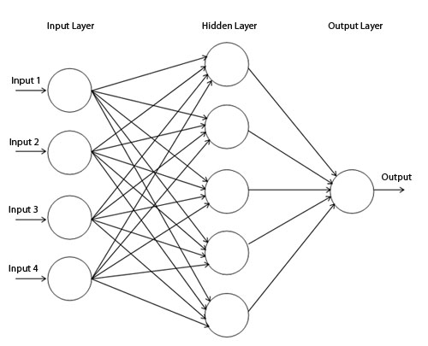
Multilayer Perceptron (1960s)

Slide 21
Backpropagation (1960-1980s)
Popular method used in training neural networks that have differentiable units.
Early forms: Henry Kelley (1960), Arthur Bryson (1961), Stuart Dreyfus (1962).
Modern variant: Seppo Linnainmaa (1970)
If there is a loss function or objective that is to be minimized (reflecting the accuracy of the classifier), backpropagation finds the gradient of objective with respect to each parameter in the network.
This allows optimization methods to improve the weights: for example by going “downhill” (negative gradient direction).

Slide 22
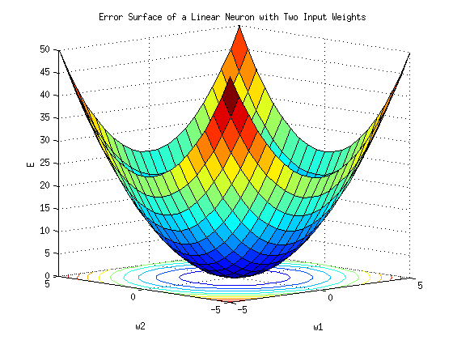
Backpropagation and Gradient Descent
Diagram from Wikipedia

Slide 23
Neocognitron (1980s)
Kunihiko Fukushima
Biologically inspired:
Local features extracted by S-cells
Deformation of those features is tolerated by C-cells
Inspired convolutional neural networks

Slide 24
Convolutional Neural Networks (1990s)
Yann LeCun, Leon Bottou, Yoshua Bengio, Patrick Haffner
Diagram from Wikipedia

Slide 25
Fast GPUs + Big Data => Deep Learning (2000s)
More data means we can train deeper networks
Fast GPUs mean we can run the training process more efficiently
Dramatic improvement in performance in computer vision and natural language processing.
GoogLeNet

Slide 26
What is Computer Vision?
“An interdisciplinary field that deals with how computers can be made to gain high-level understanding from digital images or video. From the perspective of engineering, it seeks to automate tasks that the human visual system can do.” - Wikipedia

Slide 27
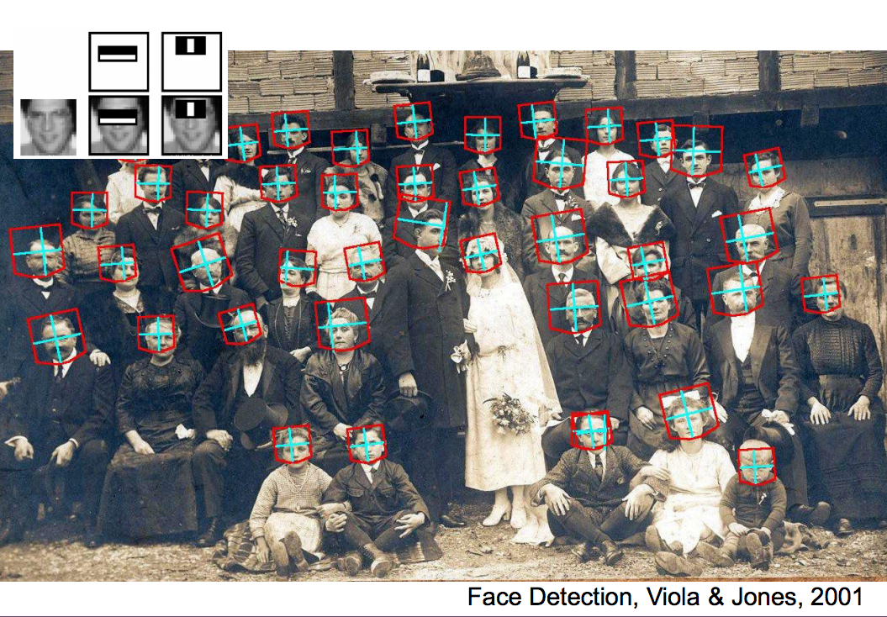
Computer Vision Example: Face Detection
Slides from Stanford CS 231n

Slide 28
What is Computer Graphics?
“Pictures and movies created using computers --- usually referring to image data created by a computer specifically with help from specialized graphical hardware and software.” – Wikipedia
Computer graphics and computer vision are inverses of each other
Graphics: input: knowledge/models/descriptions, output: images
Vision: input: images, output: knowledge/models/descriptions

Slide 29
Computer Graphics Example: Special Effects
Creating Gollum

Slide 30
This Class
Neural Networks
This Class
Computer Vision
Computer Graphics

Slide 31
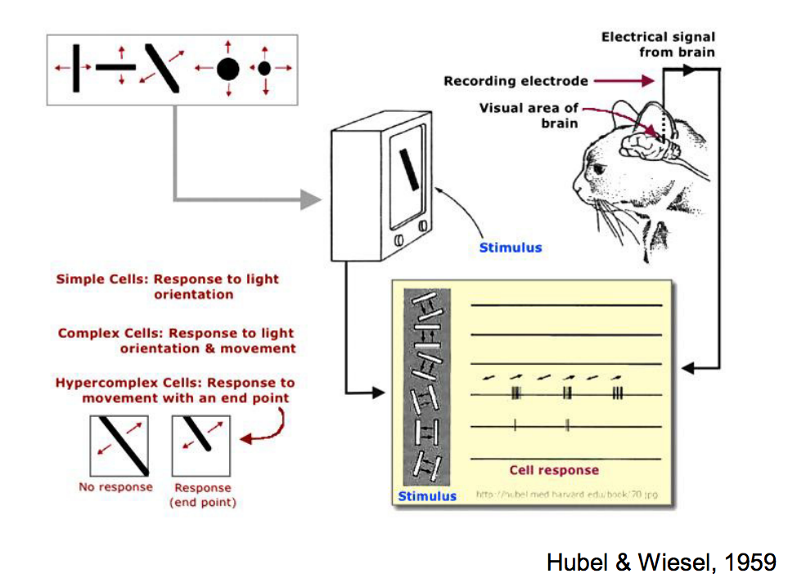
History of Computer Vision: Hubel & Wiesel (1959)
Slides from Stanford CS 231n

Slide 32
History of Computer Vision: Block World (1963)
Slides from Stanford CS 231n

Slide 33
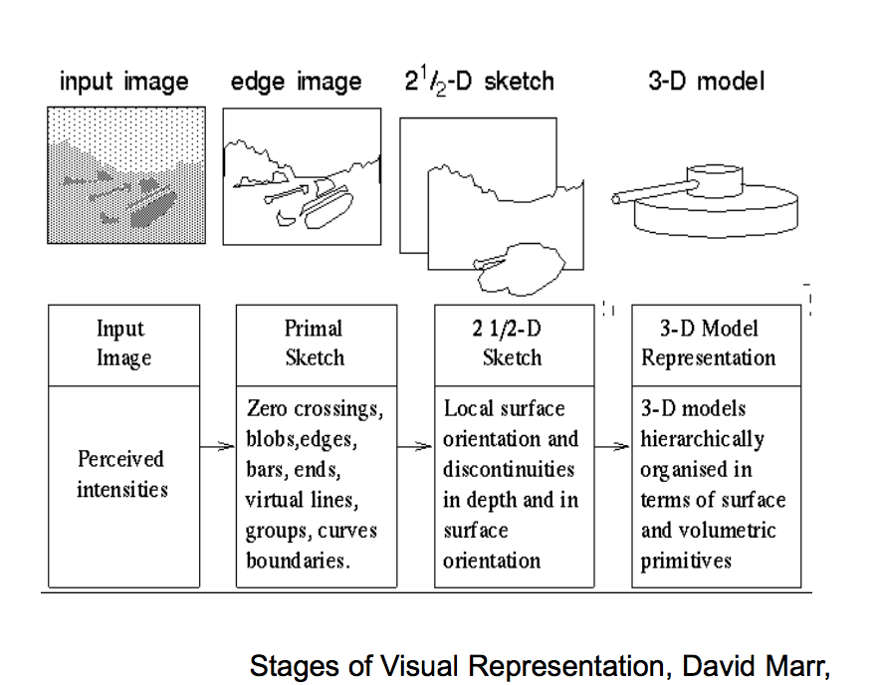
History of Computer Vision: David Marr (1970s)
Slides from Stanford CS 231n

Slide 34
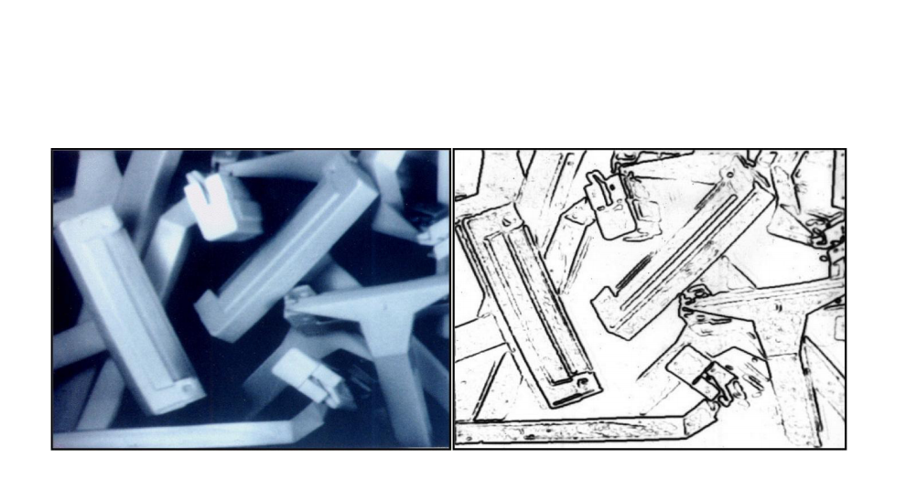
History of Computer Vision: 1980s
David Lowe 1987: 3D Object Recognition from Single 2D Images
Slides from Stanford CS 231n

Slide 35
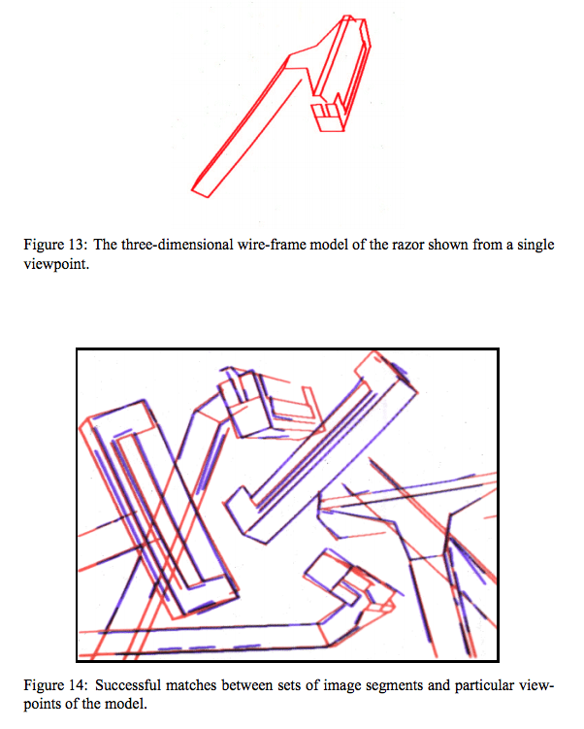
History of Computer Vision: 1980s
David Lowe 1987: 3D Object Recognition from Single 2D Images
Slides from Stanford CS 231n

Slide 36
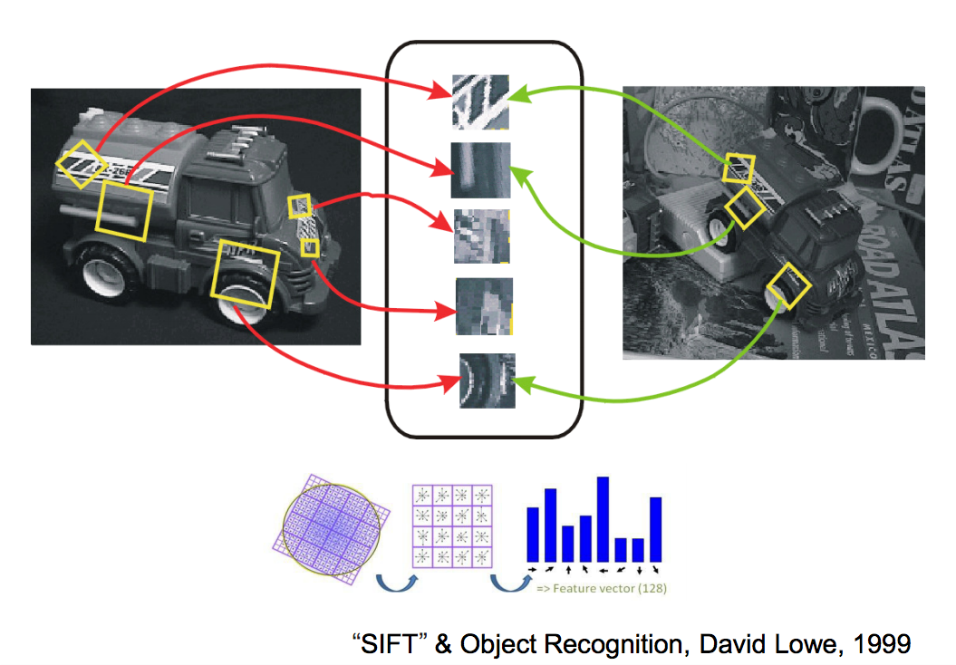
Scale-Invariant Feature Transform (SIFT, 1999)
Slides from Stanford CS 231n

Slide 37
Face Detection (2001)
Slides from Stanford CS 231n

Slide 38
HoG and Deformable Part Models (2000s)
Slides from Stanford CS 231n

Slide 39
ImageNet (2009)
Jia Deng, Wei Dong, Richard Socher, Lia-Jia Li, Kai Li, Li Fei-Fei
Currently over 10 million images in tens of thousands of categories
http://image-net.org/explore
ImageNet Large Scale Visual Recognition Competition (ILSVRC)

Slide 40
Computer Vision: Deep Learning (2012-)
In 2012, the AlexNet classifier gained a significant performance improvement on the ILSVRC by using deep neural networks.
Deep learning on ImageNet surpassed human performance for object recognition in 2015
Recently, computer vision predominantly uses deep learning.

Slide 41
Question: What is the Inverse of Artificial Intelligence?

Slide 42
Question: What is the Inverse of Artificial Intelligence?
Artificial stupidity

Slide 43
Recent Impact on Computer Graphics
As computer vision works better, we can now use techniques from computer vision and deep learning for the generation of synthetic pictures in computer graphics.
Increasing number of papers after 2014.
Predict this will be a trend:
It is expensive and challenging to manually author computer graphics programs, especially those related to content in virtual worlds, e.g. shaders, geometric and texture variations, etc.
Cameras are cheap and there is an enormous amount of visual data to learn from to construct plausible virtual replicas.

Slide 44
Examples of Papers We Will Cover: Text
Random generation of Shakespeare text using recurrent neural networks (RNNs):

Slide 45
Examples of Papers We Will Cover: Games
How Google DeepMind used reinforcement learning to train a neural network to play Atari games.

Slide 46
Examples of Papers: Computer Vision
How convolutional neural networks can be trained to segment video into semantically meaningful regions.

Slide 47
Examples of Papers: Computer Vision
How to use deep learning to find body correspondences.

Slide 48
Examples of Papers We Will Cover: Graphics
How to use deep learning to replace faces.

Slide 49
Examples of Papers We Will Cover: Graphics
How to use deep learning to synthesize character motion.

Slide 50
Examples of Papers We Will Cover: Graphics
How to use deep learning to semantically label objects in 3D.

Slide 51
Examples of Papers We Will Cover: Graphics
Shaders are (typically short) programs that run on each pixel during 3D rendering, to determine the pixel’s color based on lighting, material, and camera parameters.
Recent research demonstrates that we can use deep learning to replace the process of manually writing shaders.

Slide 52
Discussion Question: Suggested Topics / Papers?
Are there any additional topics or papers people suggest?
You can also email them to me.

