Slide 1
CS 6501: Deep Learning for
Computer Graphics
Basics of Machine Learning
Connelly Barnes

Slide 2
Overview
Supervised, unsupervised, and reinforcement learning
Simple learning models
  Clustering
  Linear regression
  Linear Support Vector Machines (SVM)
  k-Nearest Neighbors
Overfitting and generalization
Training, testing, validation
Balanced datasets
Measuring performance of a classifier

Slide 3
Supervised, Unsupervised, Reinforcement
3 broad categories:
  Supervised learning: computer presented with example inputs and desired outputs by a “teacher”, goal is to learn general rule that maps inputs to outputs.
  Unsupervised learning: No output labels are given to the algorithm, leaving it on its own to find structure in the inputs.
  Reinforcement learning: An agent determines what actions to best take in an environment to maximize some notion of cumulative reward.

Slide 4

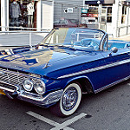
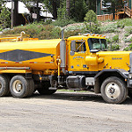
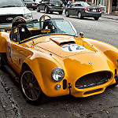
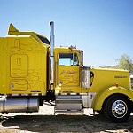
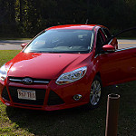
What Kind of Learning is This?
Learn given input image, whether it is truck or car? Training data:
Label(
) = Truck
Label(
) = Car
Label(
) = Truck
Label(
) = Car
Label(
) = Truck
Label(
) = Car
Images are Creative Commons, sources: [1], [2], [3], [4], [5], [6]

Slide 5
What Kind of Learning is This?
We have a dataset of customers, each with 2 associated attributes (x₁ and x₂). We want to discover groups of similar customers.
What features could we use as inputs
for a machine learning algorithm?
x₁
x₂

Slide 6
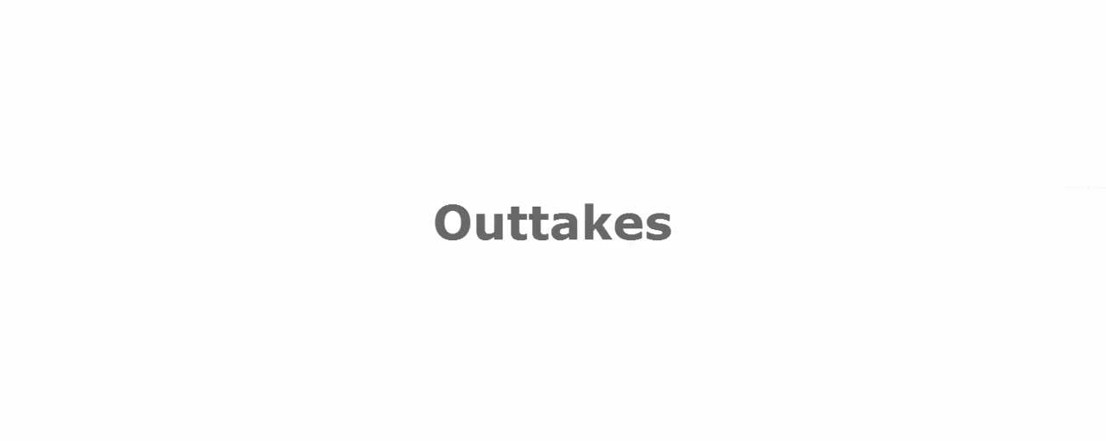
What Kind of Learning is This?
[Peng et al., Terrain-Adaptive Locomotion…, SIGGRAPH 2016]

Slide 7
Overview
Supervised, unsupervised, and reinforcement learning
Simple learning models
  Clustering
  Linear regression
  Linear Support Vector Machines (SVM)
  k-Nearest Neighbors
Overfitting and generalization
Training, testing, validation
Balanced datasets
Measuring performance of a classifier

Slide 8
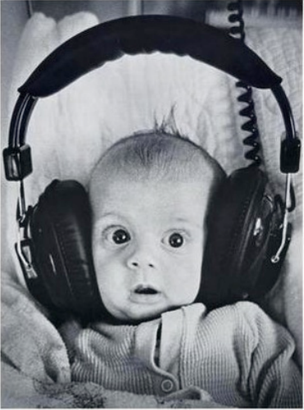
Clustering
Unsupervised learning
Requires input data, but no labels
Detects patterns, e.g.
  Groups of similar emails, similar web-pages in search results
  Similar customer shopping patterns
  Regions of images
Slides adapted from David Sontag, Luke Zettlemoyer, Vibhav, Gogate, Carlos Guestrin, Andrew Moore, Dan Klein

Slide 9
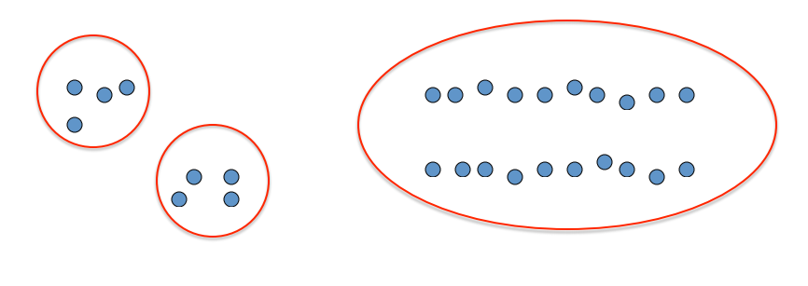
Clustering
Idea: group together similar instances
Example: 2D point patterns
Slides adapted from David Sontag, Luke Zettlemoyer, Vibhav, Gogate, Carlos Guestrin, Andrew Moore, Dan Klein

Slide 10
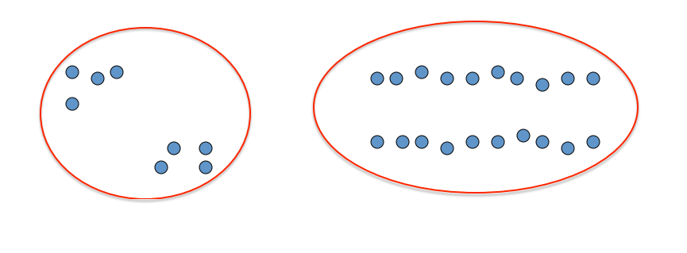
Clustering
Idea: group together similar instances
Example: 2D point patterns
Slides adapted from David Sontag, Luke Zettlemoyer, Vibhav, Gogate, Carlos Guestrin, Andrew Moore, Dan Klein

Slide 11
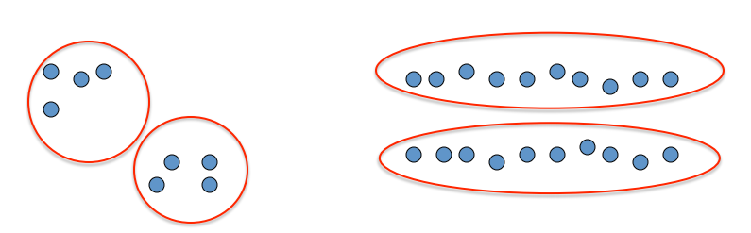
Clustering
Idea: group together similar instances
Example: 2D point patterns
Slides adapted from David Sontag, Luke Zettlemoyer, Vibhav, Gogate, Carlos Guestrin, Andrew Moore, Dan Klein

Slide 12
Clustering
Idea: group together similar instances
Problem: How to define “similar”?
Problem: How many clusters?
Slides adapted from David Sontag, Luke Zettlemoyer, Vibhav, Gogate, Carlos Guestrin, Andrew Moore, Dan Klein

Slide 13

Clustering
Similarity: in Euclidean space R^{n}, could be a distance function.
For example: $D\left(x,y\right)={\left\|x−y\right\|}_{2}^{2}$
Clustering results will depend on measure of similarity / dissimilarity
Slides adapted from David Sontag, Luke Zettlemoyer, Vibhav, Gogate, Carlos Guestrin, Andrew Moore, Dan Klein

Slide 14
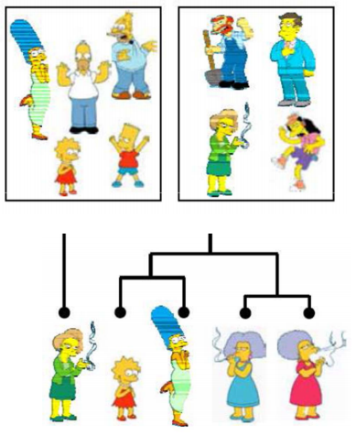
Clustering Algorithms
Partitioning algorithms (flat)
  K-means
Hierarchical algorithms
  Bottom-up: agglomerative
  Top-down: divisive
Slides adapted from David Sontag, Luke Zettlemoyer, Vibhav, Gogate, Carlos Guestrin, Andrew Moore, Dan Klein

Slide 15
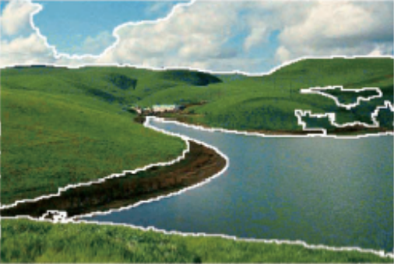
Clustering Examples: Image Segmentation
Divide an image into regions that are perceptually similar to humans.
Slides adapted from James Hays, David Sontag, Luke Zettlemoyer, Vibhav, Gogate, Carlos Guestrin, Andrew Moore, Dan Klein

Slide 16
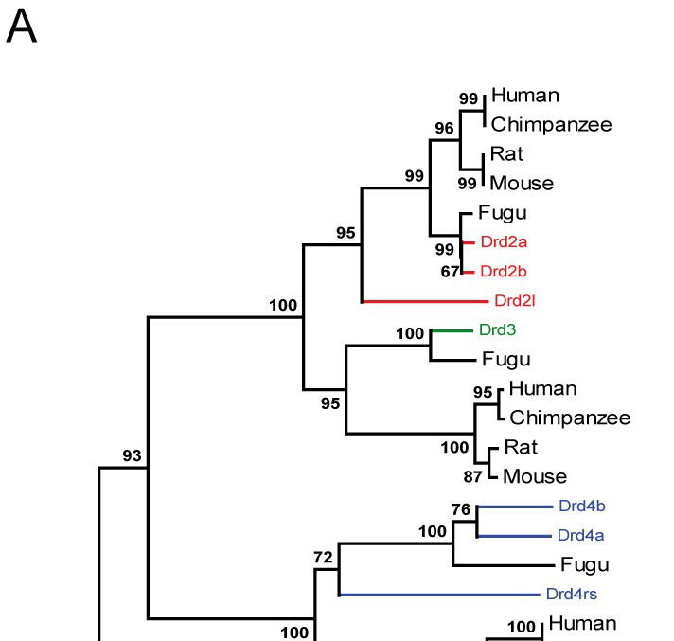
Clustering Examples: Biology
Cluster species based on e.g. genetic or phenotype similarity.
Slides adapted from David Sontag, Luke Zettlemoyer, Vibhav, Gogate, Carlos Guestrin, Andrew Moore, Dan Klein. Image: [1]

Slide 17
Clustering: k-Means
Iterative clustering algorithm based on partitioning (flat).
Initialize: Pick k random points as cluster centers.
Iterate until convergence:
  Assign each point based on the closest cluster center.
  Update each cluster center based on the mean of the points assigned to it.

Slide 18
Clustering: k-Means
Cluster centers
Iterative clustering algorithm based on partitioning (flat).
Initialize: Pick k random points as cluster centers.
Iterate until convergence:
  Assign each point based on the closest cluster center.
  Update each cluster center based on the mean of the points assigned to it.

Slide 19
Clustering: k-Means
What color
should this
point be?
Iterative clustering algorithm based on partitioning (flat).
Initialize: Pick k random points as cluster centers.
Iterate until convergence:
  Assign each point based on the closest cluster center.
  Update each cluster center based on the mean of the points assigned to it.

Slide 20
Clustering: k-Means
What color
should this
point be?
Iterative clustering algorithm based on partitioning (flat).
Initialize: Pick k random points as cluster centers.
Iterate until convergence:
  Assign each point based on the closest cluster center.
  Update each cluster center based on the mean of the points assigned to it.

Slide 21
Clustering: k-Means
What color
should this
point be?
Iterative clustering algorithm based on partitioning (flat).
Initialize: Pick k random points as cluster centers.
Iterate until convergence:
  Assign each point based on the closest cluster center.
  Update each cluster center based on the mean of the points assigned to it.

Slide 22
Clustering: k-Means
What color
should this
point be?
Iterative clustering algorithm based on partitioning (flat).
Initialize: Pick k random points as cluster centers.
Iterate until convergence:
  Assign each point based on the closest cluster center.
  Update each cluster center based on the mean of the points assigned to it.

Slide 23
Clustering: k-Means
Iterative clustering algorithm based on partitioning (flat).
Initialize: Pick k random points as cluster centers.
Iterate until convergence:
  Assign each point based on the closest cluster center.
  Update each cluster center based on the mean of the points assigned to it.

Slide 24
Clustering: k-Means
Iterative clustering algorithm based on partitioning (flat).
Initialize: Pick k random points as cluster centers.
Iterate until convergence:
  Assign each point based on the closest cluster center.
  Update each cluster center based on the mean of the points assigned to it.

Slide 25
Clustering: k-Means
Cluster centers
Iterative clustering algorithm based on partitioning (flat).
Initialize: Pick k random points as cluster centers.
Iterate until convergence:
  Assign each point based on the closest cluster center.
  Update each cluster center based on the mean of the points assigned to it.
Any changes?

Slide 26
Clustering: k-Means
Iterative clustering algorithm based on partitioning (flat).
Initialize: Pick k random points as cluster centers.
Iterate until convergence:
  Assign each point based on the closest cluster center.
  Update each cluster center based on the mean of the points assigned to it.

Slide 27
Clustering: k-Means
Result of k-Means:
Iterative clustering algorithm based on partitioning (flat).
Initialize: Pick k random points as cluster centers.
Iterate until convergence:
  Assign each point based on the closest cluster center.
  Update each cluster center based on the mean of the points assigned to it.

Slide 28
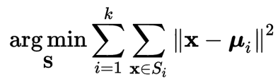
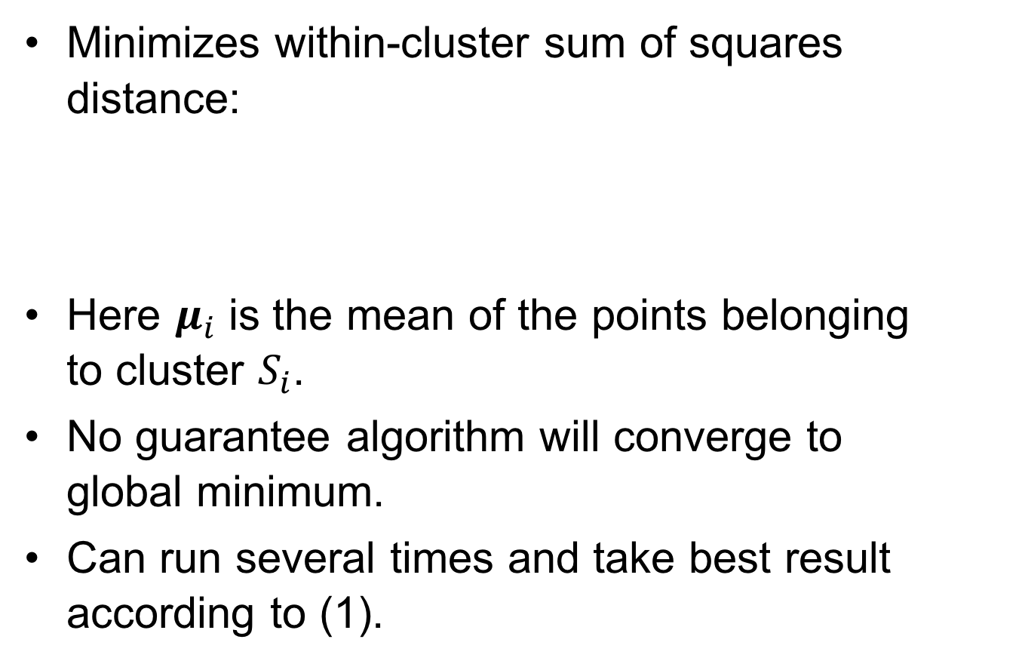
Clustering: k-Means
Result of k-Means:
Minimizes within-cluster sum of squares distance:
Here $μ_{i}$ is the mean of the points belonging
to cluster $S_{i}$.
No guarantee algorithm will converge to
global minimum.
Can run several times and take best result
according to (1).
(1)

Slide 29
Overview
Supervised, unsupervised, and reinforcement learning
Simple learning models
  Clustering
  Linear regression
  Linear Support Vector Machines (SVM)
  k-Nearest Neighbors
Overfitting and generalization
Training, testing, validation
Balanced datasets

Slide 30

Linear Regression
Uses a linear model to model relationship between dependent variable $y∈ℝ$, and input (independent) variables x₁, …, x_{n} $∈ℝ^{n}$
Is this supervised or unsupervised learning?
y
x₁

Slide 31

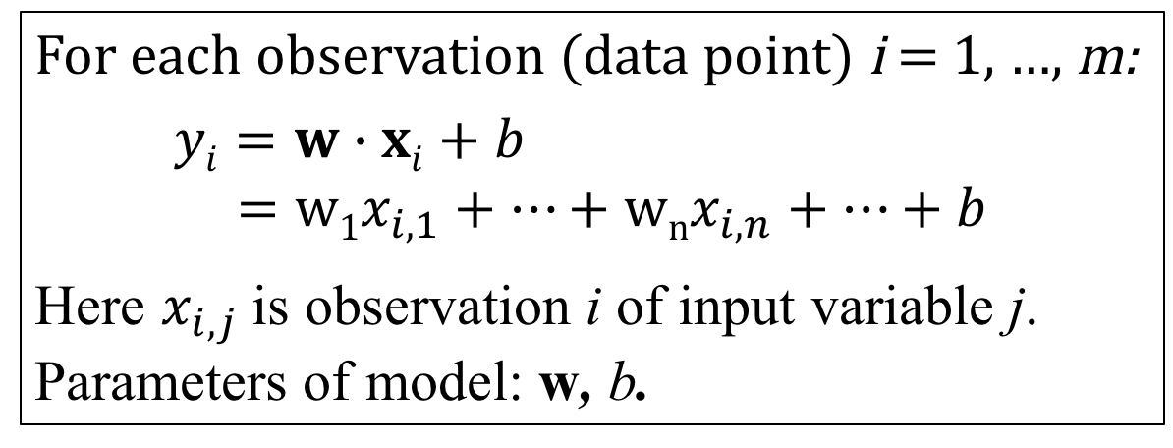
Linear Regression
Uses a linear model to model relationship between dependent variable $y∈ℝ$, and input (independent) variables x₁, …, x_{n} $∈ℝ^{n}$
y
For each observation (data point) i = 1, …, m:
$$yi=w∙xi+b$$
$$=w1x_{i,1}+…+wnx_{i,n}+…+b$$
Here $x_{i,j}$ is observation i of input variable j.
Parameters of model: w, b.
x₁

Slide 32
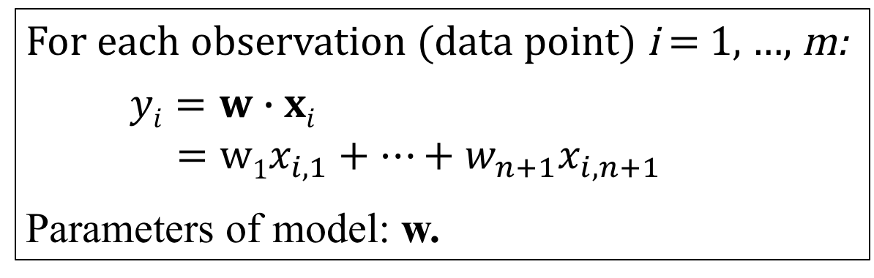
Linear Regression
Can simply the model by adding additional input that is always one: x_{i,n+1} = 1 i = 1, …, m
The corresponding parameter in w is called the intercept.
y
For each observation (data point) i = 1, …, m:
$$yi=w∙xi$$
$$=w1x_{i,1}+…+w_{n+1}x_{i,n+1}$$
Parameters of model: w.
x₁

Slide 33

Linear Least Squares Regression
Define an objective function or loss function to optimize the model
One loss function: least squares (“least squared error”).
y
$$E= \sum_{i=1}^{m}{{\left(w∙xi−yi\right)}^{2}}$$
Parameters of model: w.
What is E for the 2D line
fitting case at right? (blackboard)
How to minimize E?
x₁

Slide 34

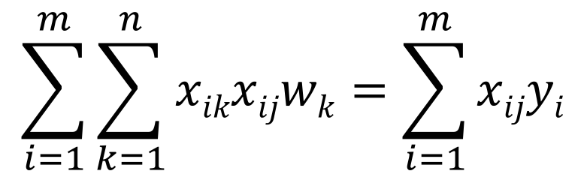
Linear Least Squares Regression
Set derivatives of objective function with respect to parameters equal to zero.
$$\frac{∂E}{∂w_{j}}=\frac{∂}{∂w_{j}}\sum_{i=1}^{m}{{\left(w∙xi−yi\right)}^{2}}=0$$
$$2\sum_{i=1}^{m}{\left(w∙xi−yi\right)xij}=0$$
$$\sum_{i=1}^{m}{\left(\sum_{k=1}^{n}{xikwk}−yi\right)xij}=0$$
Normal equations:
$$\sum_{i=1}^{m}{\sum_{k=1}^{n}{xikxijwk}}=\sum_{i=1}^{m}{xijyi}$$

Slide 35
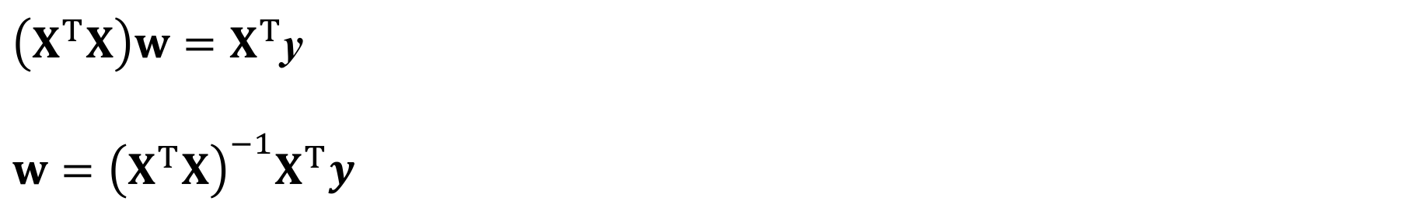
Linear Least Squares Regression
Normal equations in matrix form:
X is the matrix with x_{ij}
being observation i of input variable j.
y is the vector of dependent variable
(output) observations.
$\left(X^{T}X\right)w=X^{T}$y
$$w={\left(X^{T}X\right)}^{−1}X^{T}y$$

Slide 36
Linear Least Squares Example
Suppose we have three observations (m=3) of one input variable x₁:
x₁ | y
0 | 0
0.5 | 0.6
1 | 0.9

Slide 37

Linear Least Squares Example
Suppose we have three observations (m=3) of one input variable x₁.
Add additional constant variable x₂:
X = $\left[\begin{matrix}0 & 1 \\ 0.5 & 1 \\ 1 & 1\end{matrix}\right]$, y = $\left[\begin{matrix}0 \\ 0.6 \\ 0.9\end{matrix}\right]$ , so $w={\left(X^{T}X\right)}^{−1}X^{T}y= \left[\begin{matrix}0.9 \\ 0.05\end{matrix}\right]$
x₁ | x₂ | y
0 | 1 | 0
0.5 | 1 | 0.6
1 | 1 | 0.9

Slide 38
Linear Least Squares Example

Slide 39
Overview
Supervised, unsupervised, and reinforcement learning
Simple learning models
  Clustering
  Linear regression
  Linear Support Vector Machines (SVM)
  k-Nearest Neighbors
Overfitting and generalization
Training, testing, validation
Balanced datasets
Measuring performance of a classifier

Slide 40
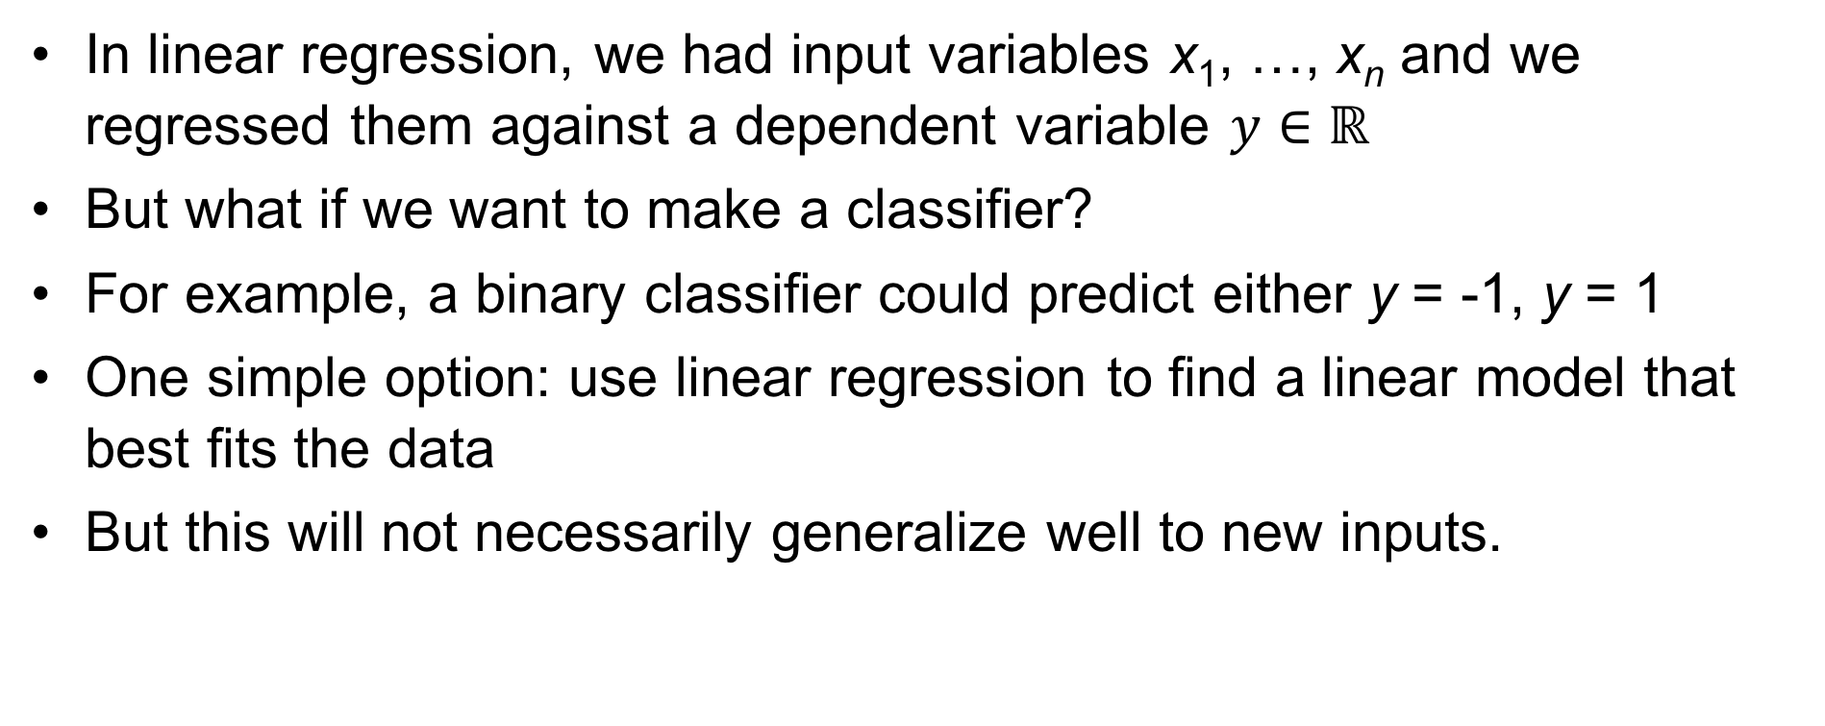
Linear Support Vector Machines (SVM)
In linear regression, we had input variables x₁, …, x_{n} and we regressed them against a dependent variable $y∈ℝ$
But what if we want to make a classifier?
For example, a binary classifier could predict either y = -1, y = 1
One simple option: use linear regression to find a linear model that best fits the data
But this will not necessarily generalize well to new inputs.

Slide 41
Linear Support Vector Machines (SVM)
Idea: if data are separable by a linear hyperplane, then maximize separation distance (margin) between points.
From Wikipedia

Slide 42
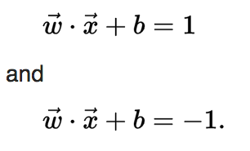


Linear Support Vector Machines (SVM)
Two hyperplanes:
Distance between hyperplanes is:
So to maximize distance, minimize
From Wikipedia

Slide 43
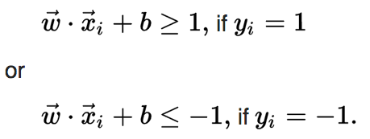

Linear Support Vector Machines (SVM)
For each point i, either:
This can be rewritten as, for each i:
From Wikipedia

Slide 44
Linear Support Vector Machines (SVM)
Support Vectors
So our minimization problem becomes:
Minimize subject to the constraint:
Can be solved with quadratic programming
Maximizes distance (margin) between two classes of data
i = 1,…, m
From Wikipedia

Slide 45
Linear Support Vector Machines (SVM)
If data are not linearly separable, can use a soft margin classifier, which has an objective function that sums for all data points i, a penalty of zero if the data point is correctly classified, otherwise, the distance to the margin.
Penalty
Penalty

Slide 46
How to Use Linear SVMs in Deep Learning?
Linear SVMs tend to perform well with small amounts of training data
Deep learning tends to perform well with large amounts of data
What to do if we have a new problem with only a small dataset?
One solution: use linear SVM
Another solution: transfer learning.
  Use a deep learning model trained on different problem
  Train a linear SVM using features extracted from neural network.

Slide 47
Overview
Supervised, unsupervised, and reinforcement learning
Simple learning models
  Clustering
  Linear regression
  Linear Support Vector Machines (SVM)
  k-Nearest Neighbors
Overfitting and generalization
Training, testing, validation
Balanced datasets
Measuring performance of a classifier

Slide 48
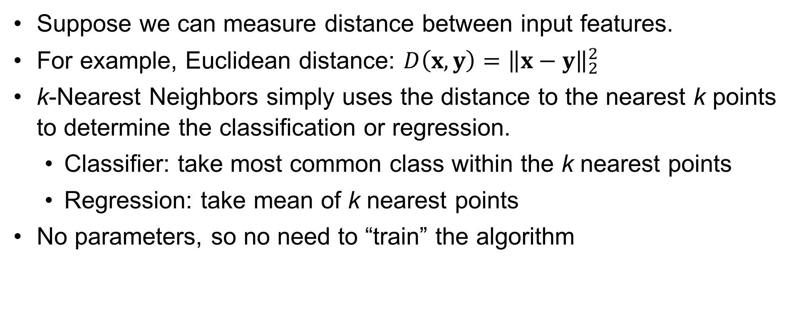
k-Nearest Neighbors
Suppose we can measure distance between input features.
For example, Euclidean distance: $D\left(x,y\right)={\left\|x−y\right\|}_{2}^{2}$
k-Nearest Neighbors simply uses the distance to the nearest k points to determine the classification or regression.
  Classifier: take most common class within the k nearest points
  Regression: take mean of k nearest points
No parameters, so no need to “train” the algorithm

Slide 49
k-Nearest Neighbors Example, k=3
?

Slide 50
k-Nearest Neighbors Example, k=5
?

Slide 51
Overview
Supervised, unsupervised, and reinforcement learning
Simple learning models
  Clustering
  Linear regression
  Linear Support Vector Machines (SVM)
  k-Nearest Neighbors
Overfitting and generalization
Training, testing, validation
Balanced datasets
Measuring performance of a classifier

Slide 52
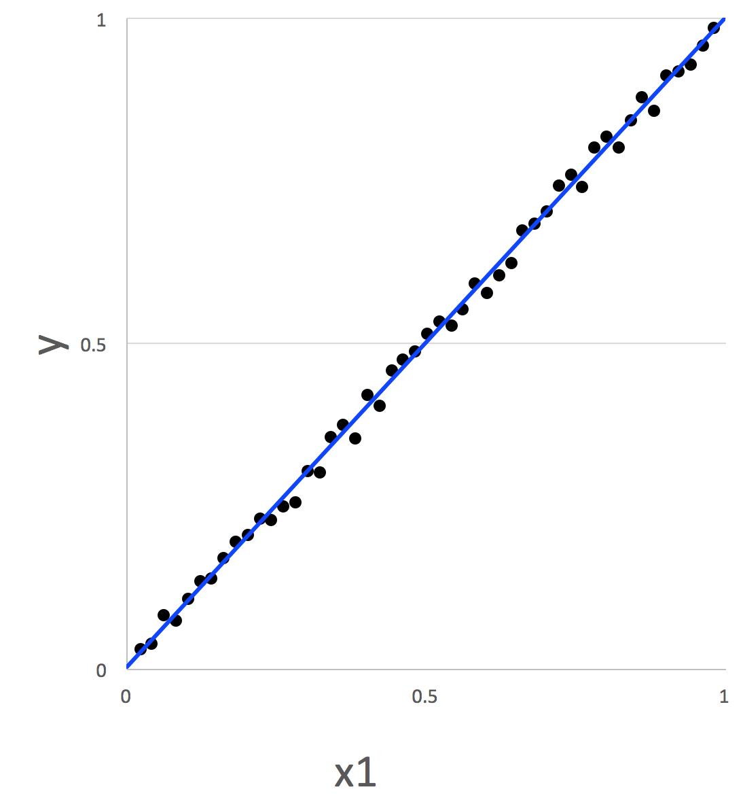
Overfitting and generalization
Will this model have decent prediction for new inputs?
(i.e. inputs similar to the training exemplars in blue)

Slide 53
Overfitting and generalization
How about the model here, shown as the blue curve?
y
x1
From Wikipedia

Slide 54
Overfitting and generalization
Overfitting: the model describes random noise or errors instead of the underlying relationship.
y
x1
From Wikipedia

Slide 55
Overfitting and generalization
Overfitting: the model describes random noise or errors instead of the underlying relationship.
Frequently occurs when model is overly complex (e.g. has too many parameters) relative to the number of observations.
Has poor predictive performance.
y
x1
From Wikipedia

Slide 56
Overfitting and generalization
Overfitting: the model describes random noise or errors instead of the underlying relationship.
Frequently occurs when model is overly complex (e.g. has too many parameters) relative to the number of observations.
Has poor predictive performance.
y
x1
From Wikipedia

Slide 57
Overfitting and generalization
A rule of thumb for linear regression: one in ten rule
One predictive variable can be studied for every ten events.
In general, want number of data points >> number of parameters.
But models with more parameters often perform better!
One solution: gradually increase number of parameters in model until it starts to overfit, and then stop.
From Wikipedia

Slide 58
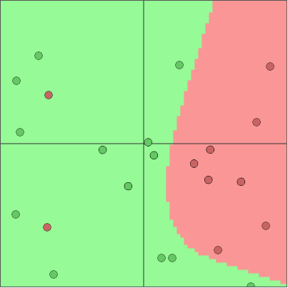
Overfitting Example with 2D Classifier
From ConvnetJS Demo: 2D Classification with Neural Networks
23 data points, 17 parameters (5 neurons)

Slide 59
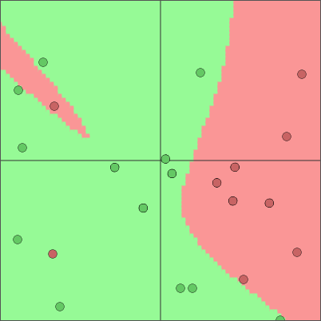
Overfitting Example with 2D Classifier
From ConvnetJS Demo: 2D Classification with Neural Networks
23 data points, 32 parameters (10 neurons)

Slide 60
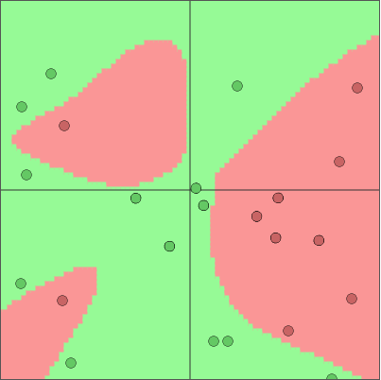
Overfitting Example with 2D Classifier
From ConvnetJS Demo: 2D Classification with Neural Networks
23 data points, 102 parameters (22 neurons total)

Slide 61
Generalization
Generalization error is a measure of how accurately an algorithm is able to predict outcome values for previously unseen data.
A model that is overfit will have poor generalization.

Slide 62
Overview
Supervised, unsupervised, and reinforcement learning
Simple learning models
  Clustering
  Linear regression
  Linear Support Vector Machines (SVM)
  k-Nearest Neighbors
Overfitting and generalization
Training, testing, validation
Balanced datasets
Measuring performance of a classifier

Slide 63
Training, testing, validation
Break dataset into three parts by random sampling:
  Training dataset: model is fit directly to this data
  Testing dataset: model sees this data only once;
  used to measure the final performance of the classifier.
  Validation dataset: model is repeatedly “tested” on this data
  during the training process to gain insight into overfitting
Common percentages:
  Training (80%), testing (15%), validation (5%).

Slide 64
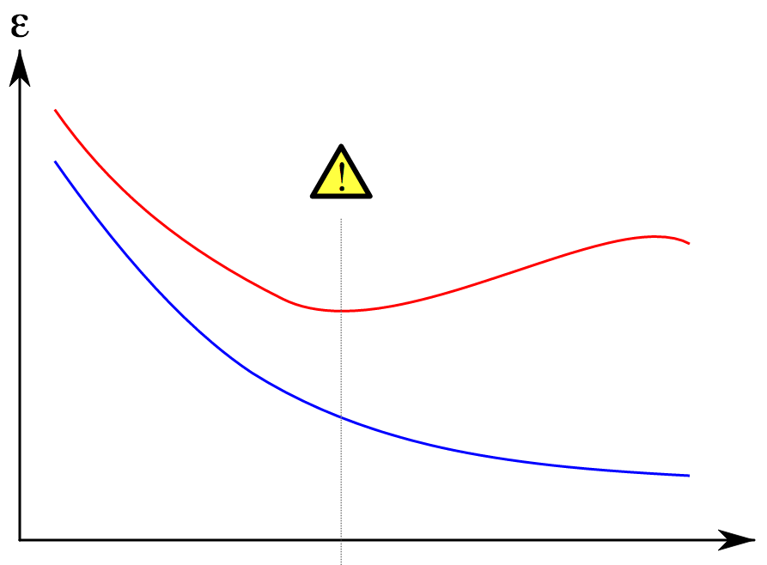
Training, testing, validation
For neural networks, typically keep running training until validation error increases, then stop.
Final model
Error
(Objective
Function)
Validation Error
(Uses validation dataset)
Training Error
(Uses training dataset)
Iterations
Image from Wikipedia [1]

Slide 65
Cross-validation
Repeatedly partition data into subsets: training and test.
Take mean performance of classifier over all such partitions.
Leave one out: train on n-1 samples, test on 1 sample.
  Requires training n times.
k-fold cross-validation: randomly partition data into k subsets (folds), at each iteration, train on k-1 folds, test on the other fold.
  Requires training k times.
  Common: 10-fold cross-validation
Less common for deep learning (why?)

Slide 66
Overview
Supervised, unsupervised, and reinforcement learning
Simple learning models
  Clustering
  Linear regression
  Linear Support Vector Machines (SVM)
  k-Nearest Neighbors
Overfitting and generalization
Training, testing, validation
Balanced datasets
Measuring performance of a classifier

Slide 67
Balanced datasets
Unbalanced dataset:
  Suppose we have a binary classification problem (labels: 0, 1)
  Suppose 99% of our observations are class 0.
  We might learn the model “everything is zero.”
  This model would be 99% accurate, but not model class 1 at all.
Balanced dataset:
  Equal numbers of observations of each class

Slide 68
Overview
Supervised, unsupervised, and reinforcement learning
Simple learning models
  Clustering
  Linear regression
  Linear Support Vector Machines (SVM)
  k-Nearest Neighbors
Overfitting and generalization
Training, testing, validation
Balanced datasets
Measuring performance of a classifier

Slide 69
Confusion Matrix
If n classes, n x n matrix comparing actual versus predicted classes.
 |  | Class Predicted by Model
 |  | Cat | Dog
Actual Class | Cat | 9 | 1
 | Dog | 4 | 6

Slide 70
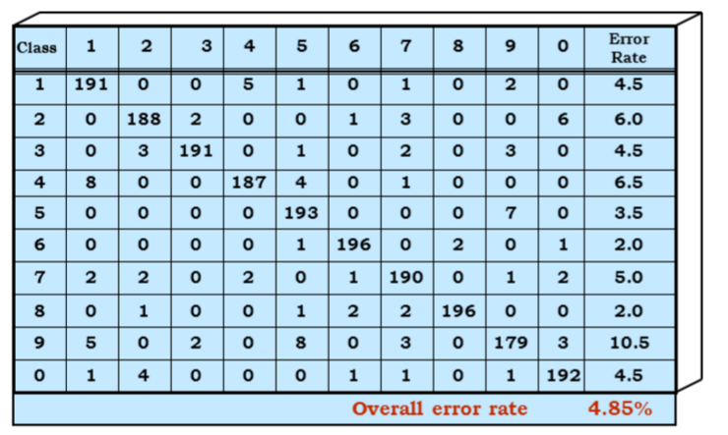
Example: Handwritten Digit Recognition
Slide from Nelson Morgan at ICSI / Berkeley

Slide 71
Example: Handwritten Digit Recognition
Visualization from MathWorks

Slide 72
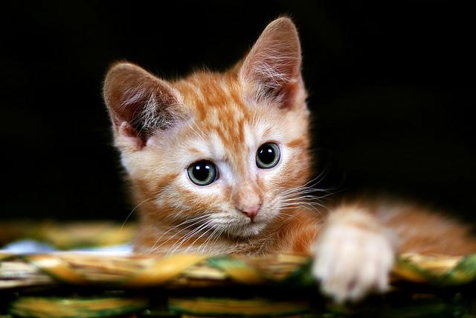
Confusion Matrix
For binary classifier, can call one class positive, the other negative.
Should we call cats positive or negative?
 |  | Class Predicted by Model
 |  | Cat | Dog
Actual Class | Cat | 9 | 1
 | Dog | 4 | 6
Photo from [1]

Slide 73
Confusion Matrix
For binary classifier, can call one class positive, the other negative.
Cats are cuter, so cats = positive.
 |  | Class Predicted by Model
 |  | Positive | Negative
Actual Class | Positive | 9 | 1
 | Negative | 4 | 6

Slide 74
Confusion Matrix
For binary classifier, can call one class positive, the other negative.
 |  | Class Predicted by Model
 |  | Positive | Negative
Actual Class | Positive | True positive | 1
 | Negative | 4 | True negative

Slide 75
Confusion Matrix
For binary classifier, can call one class positive, the other negative.
 |  | Class Predicted by Model
 |  | Positive | Negative
Actual Class | Positive | True positive | ?
 | Negative | ? | True negative

Slide 76
Confusion Matrix
For binary classifier, can call one class positive, the other negative.
 |  | Class Predicted by Model
 |  | Positive | Negative
Actual Class | Positive | True positive | False negative
 | Negative | False positive | True negative

Slide 77
Classifier Performance
Accuracy: (TP + TN) / (Population Size)
Precision: TP / (Predicted Positives) = (TP + FP)
Recall: TP / (Actual Positives) = TP / (TP + FN)
(also known as sensitivity, true positive rate)
Specificity: TN / (Actual Negatives) = TN / (TN + FP)
(also known as true negative rate)
 |  | Class Predicted by Model
 |  | Positive | Negative
Actual Class | Positive | True positive | False negative
 | Negative | False positive | True negative

Slide 78
Classifier Performance: Unbalanced Dataset
Accuracy: (TP + TN) / (Population Size)
Precision: TP / (Predicted Positives) = (TP + FP)
Recall: TP / (Actual Positives) = TP / (TP + FN)
(also known as sensitivity, true positive rate)
Specificity: TN / (Actual Negatives) = TN / (TN + FP)
(also known as true negative rate)
 |  | Class Predicted by Model
 |  | Positive | Negative
Actual Class | Positive | TP: 99 | FN: 0
 | Negative | FP: 1 | TN: 0

Slide 79
Classifier Performance: Unbalanced Dataset
Accuracy: (TP + TN) / (Population Size) = ?
Precision: TP / (Predicted Positives) = (TP + FP)
Recall: TP / (Actual Positives) = TP / (TP + FN)
(also known as sensitivity, true positive rate)
Specificity: TN / (Actual Negatives) = TN / (TN + FP)
(also known as true negative rate)
 |  | Class Predicted by Model
 |  | Positive | Negative
Actual Class | Positive | TP: 99 | FN: 0
 | Negative | FP: 1 | TN: 0

Slide 80
Classifier Performance: Unbalanced Dataset
Accuracy: (TP + TN) / (Population Size) = 99%
Precision: TP / (Predicted Positives) = (TP + FP) = ?
Recall: TP / (Actual Positives) = TP / (TP + FN)
(also known as sensitivity, true positive rate)
Specificity: TN / (Actual Negatives) = TN / (TN + FP)
(also known as true negative rate)
 |  | Class Predicted by Model
 |  | Positive | Negative
Actual Class | Positive | TP: 99 | FN: 0
 | Negative | FP: 1 | TN: 0

Slide 81
Classifier Performance: Unbalanced Dataset
Accuracy: (TP + TN) / (Population Size) = 99%
Precision: TP / (Predicted Positives) = (TP + FP) = 99%
Recall: TP / (Actual Positives) = TP / (TP + FN)
(also known as sensitivity, true positive rate)
Specificity: TN / (Actual Negatives) = TN / (TN + FP)
(also known as true negative rate)
 |  | Class Predicted by Model
 |  | Positive | Negative
Actual Class | Positive | TP: 99 | FN: 0
 | Negative | FP: 1 | TN: 0

Slide 82
Classifier Performance: Unbalanced Dataset
Accuracy: (TP + TN) / (Population Size) = 99%
Precision: TP / (Predicted Positives) = (TP + FP) = 99%
Recall: TP / (Actual Positives) = TP / (TP + FN) = ?
(also known as sensitivity, true positive rate)
Specificity: TN / (Actual Negatives) = TN / (TN + FP)
(also known as true negative rate)
 |  | Class Predicted by Model
 |  | Positive | Negative
Actual Class | Positive | TP: 99 | FN: 0
 | Negative | FP: 1 | TN: 0

Slide 83
Classifier Performance: Unbalanced Dataset
Accuracy: (TP + TN) / (Population Size) = 99%
Precision: TP / (Predicted Positives) = (TP + FP) = 99%
Recall: TP / (Actual Positives) = TP / (TP + FN) = 100%
(also known as sensitivity, true positive rate)
Specificity: TN / (Actual Negatives) = TN / (TN + FP)
(also known as true negative rate)
 |  | Class Predicted by Model
 |  | Positive | Negative
Actual Class | Positive | TP: 99 | FN: 0
 | Negative | FP: 1 | TN: 0

Slide 84
Classifier Performance: Unbalanced Dataset
Accuracy: (TP + TN) / (Population Size) = 99%
Precision: TP / (Predicted Positives) = (TP + FP) = 99%
Recall: TP / (Actual Positives) = TP / (TP + FN) = 100%
(also known as sensitivity, true positive rate)
Specificity: TN / (Actual Negatives) = 0%
(also known as true negative rate)
 |  | Class Predicted by Model
 |  | Positive | Negative
Actual Class | Positive | TP: 99 | FN: 0
 | Negative | FP: 1 | TN: 0

Slide 85
Summary
Supervised, unsupervised, and reinforcement learning
Simple learning models
  Clustering
  Linear regression
  Linear Support Vector Machines (SVM)
  k-Nearest Neighbors
Overfitting and generalization
Training, testing, validation
Balanced datasets
Measuring performance of a classifier

