Slide 1
CS 6501: Deep Learning for Computer Graphics Basics of Neural Networks, and Training Neural Nets I
Connelly Barnes

Slide 2
Overview
Simple neural networks
Perceptron
Feedforward neural networks
Multilayer perceptron and properties
Autoencoders
How to train neural networks
Gradient descent
Stochastic gradient descent
Automatic differentiation
Backpropagation

Slide 3
Perceptron (1957, Cornell)
Output (Class)
Inputs
Bias b: arbitrary, learned parameter
Weights: arbitrary, learned parameters

Slide 4
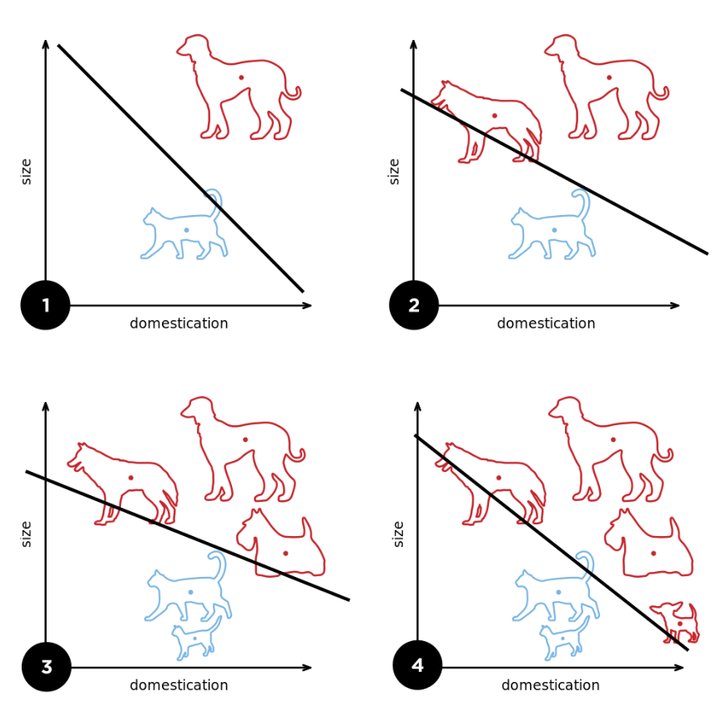
Perceptron (1957, Cornell)
Binary classifier, can learn linearly separable patterns.
Diagram from Wikipedia

Slide 5
Feedforward neural networks
We could connect units (neurons) in any arbitrary graph
Input
Output

Slide 6
Feedforward neural networks
We could connect units (neurons) in any arbitrary graph
If no cycles in the graph we call it a feedforward neural network.
Input
Output

Slide 7
Recurrent neural networks (later)
If cycles in the graph we call it a recurrent neural network.
Input
Output

Slide 8
Overview
Simple neural networks
Perceptron
Feedforward neural networks
Multilayer perceptron and properties
Autoencoders
How to train neural networks
Gradient descent
Stochastic gradient descent
Automatic differentiation
Backpropagation

Slide 9
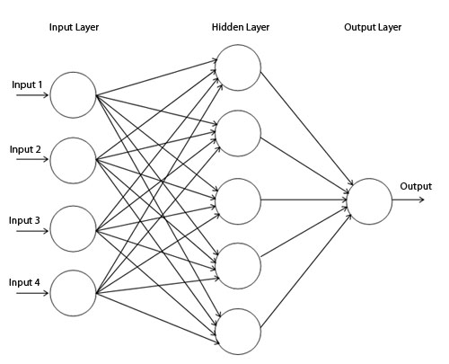
Multilayer Perceptron (1960s)
In matrix notation:
,$i≥1$
i
$$L_{1}:$$
Input layer (inputs) vector
$L_{2}$:
Hidden layer vector
$$L_{3}:$$
Output layer vector
$$W_{i}:$$
Weight matrix for connections from layer i-1 to layer i
$$b_{i}:$$
Biases for neurons in layer i
f_{i}:
Activation function for layer i

Slide 10
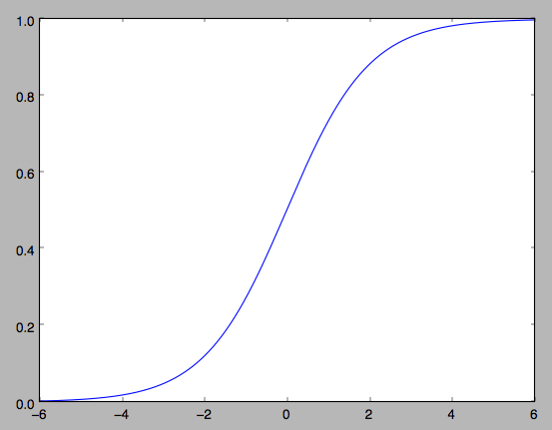
Activation Functions: Sigmoid / Logistic
$$f\left(x\right)=\frac{1}{1+e^{−x}}$$
$$\frac{df}{dx}=f(x)(1−f\left(x\right))$$
Problems:
Gradients at tails are almost zero
Outputs are not zero-centered

Slide 11
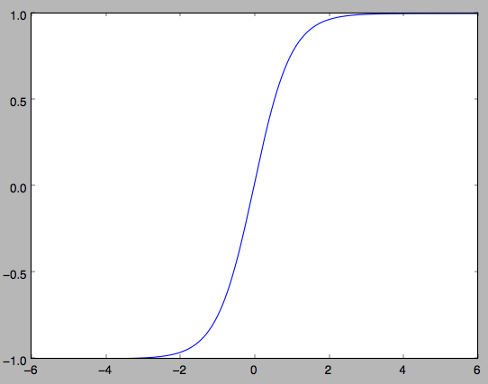
Activation Functions: Tanh
$$f\left(x\right)=\tanh\left(x\right)=\frac{2}{1+e^{−2x}}−1$$
$$\frac{df}{dx}=1−{f\left(x\right)}^{2}$$
Problems:
Gradients at tails are almost zero

Slide 12
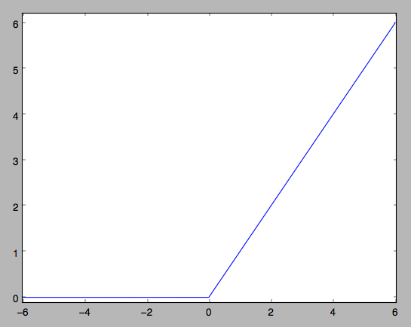
Activation Functions: ReLU (Rectified Linear Unit)
$$\frac{df}{dx}=\left\{\begin{matrix}1, & if x>0 \\ 0, & if x<0\end{matrix}\right.$$
$$f\left(x\right)=max⁡(x,0)$$
Pros:
Accelerates training stage by 6x over sigmoid/tanh [1]
Simple to compute
Sparser activation patterns
Cons:
Neurons can “die” by getting stuck in zero gradient region
Summary:
Currently preferred kind of neuron

Slide 13
Universal Approximation Theorem
Multilayer perceptron with a single hidden layer and linear output layer can approximate any continuous function on a compact subset of $ℝ^{n}$ to within any desired degree of accuracy.
Assumes activation function is bounded, non-constant, monotonically increasing.
Also applies for ReLU activation function.

Slide 14
Universal Approximation Theorem
In the worst case, exponential number of hidden units may be required.
Can informally show this for binary case:
If we have n bits input to a binary function, how many possible inputs are there?
How many possible binary functions are there?
So how many weights do we need to represent a given binary function?

Slide 15
Why Use Deep Networks?
Functions representable with a deep rectifier network can require an exponential number of hidden units with a shallow (one hidden layer) network (Goodfellow 6.4)
Piecewise linear networks (e.g. using ReLU) can represent functions that have a number of regions exponential in depth of network.
Can capture repeating / mirroring / symmetric patterns in data.
Empirically, greater depth often results in better generalization.

Slide 16
Neural Network Architecture
Architecture: refers to which parameters (e.g. weights) are used in the network and their topological connectivity.
Fully connected: A common connectivity pattern for multilayer perceptrons. All possible connections made between layers i-1 and i.
Is this network fully connected?

Slide 17
Neural Network Architecture
Architecture: refers to which parameters (e.g. weights) are used in the network and their topological connectivity.
Fully connected: A common connectivity pattern for multilayer perceptrons. All possible connections made between layers i-1 and i.
Input
Output
Is this network fully connected?

Slide 18
How to Choose Network Architecture?
Long discussion
Summary:
Rules of thumb do not work.
“Need 10x [or 30x] more training data than weights.”
Not true if very low noise
Might need even more training data if high noise
Try many networks with different numbers of units and layers
Check generalization using validation dataset or cross-validation.

Slide 19
Overview
Simple neural networks
Perceptron
Feedforward neural networks
Multilayer perceptron and properties
Autoencoders
How to train neural networks
Gradient descent
Stochastic gradient descent
Automatic differentiation
Backpropagation

Slide 20
Autoencoders
Learn the identity function $h_{w}\left(x\right)=x$
Is this supervised or unsupervised learning?
Input
Hidden
Output
Encode
Decode

Slide 21
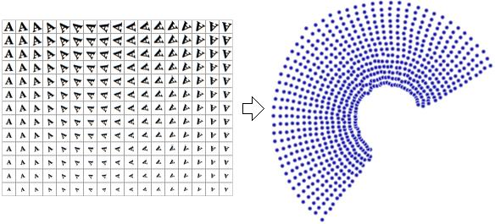
Autoencoders
Input
Hidden
Output
Applications:
Dimensionality reduction
Learning manifolds
Hashing for search problems
Encode
Decode

Slide 22
Overview
Simple neural networks
Perceptron
Feedforward neural networks
Multilayer perceptron and properties
Autoencoders
How to train neural networks
Gradient descent
Stochastic gradient descent
Automatic differentiation
Backpropagation

Slide 23
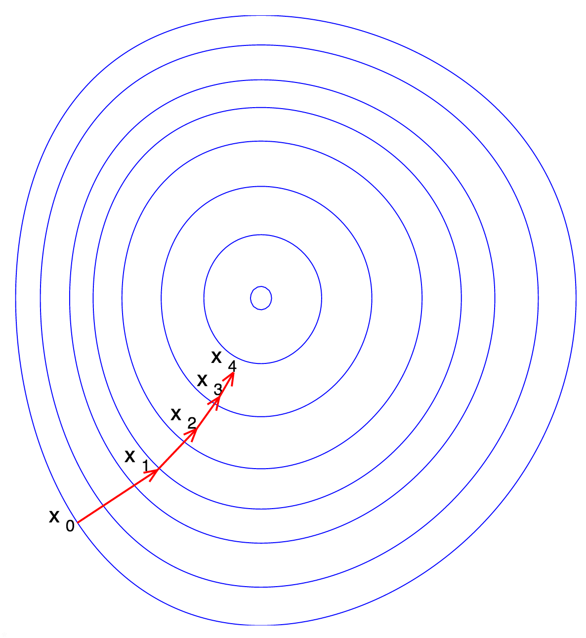
Gradient Descent
Discuss amongst students near you:
What are some problems that could be easily optimized with gradient descent?
Problems where this is difficult?
Should the learning rate be constant or change?
Step size
or
Learning rate

Slide 24
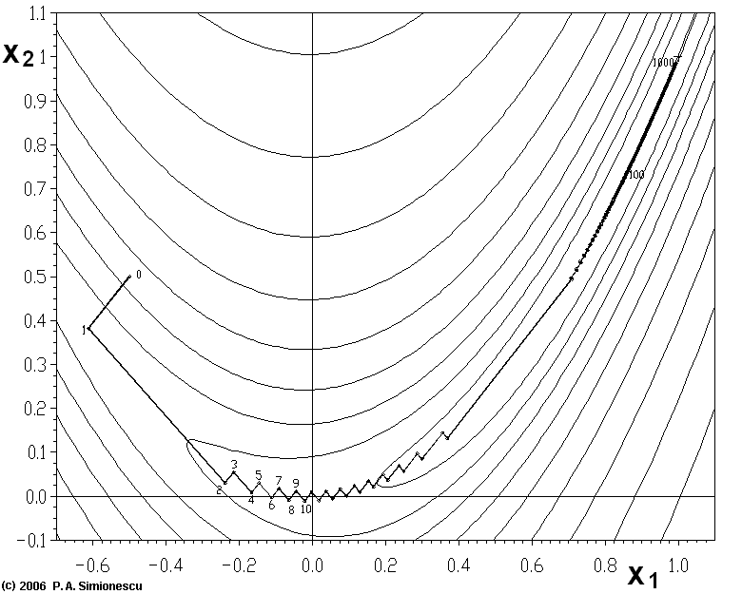
Gradient Descent with Energy Functions that have Narrow Valleys
“Zig-zagging problem”
Source: "Banana-SteepDesc" by P.A. Simionescu – Wikipedia English

Slide 25
Gradient Descent with Momentum
$${x_{n+1}=x_{n}−∆}_{n}$$
Momentum
Could use small value e.g. m=0.5 at first Could use larger value e.g. m=0.9 near end
of training when there are more oscillations.

Slide 26
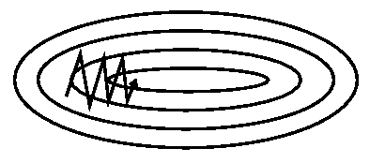
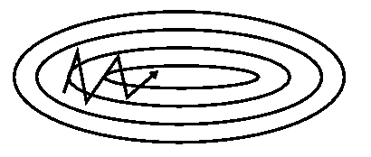
Gradient Descent with Momentum
Without Momentum
With Momentum
Figure from Genevieve B. Orr, Willamette.edu

Slide 27
Stochastic gradient descent
Stochastic gradient descent (Wikipedia)
Gradient of sum of n terms where n is large
Sample rather than computing the full sum
Sample size s is “mini-batch size”
Could be 1 (very noisy gradient estimate)
Could be 100 (collect photos 100 at a time to find each noisy “next” estimate for the gradient)
Use same step as in gradient descent to the estimated gradient

Slide 28
Stochastic gradient descent
Pseudocode:
From Wikipedia

Slide 29
Problem Statement
Take the gradient of an arbitrary program or model (e.g. a neural network) with respect to the parameters in the model (e.g. weights).
If we can do this, we can use gradient descent!

Slide 30
Review: Chain Rule in One Dimension
Suppose $f:ℝ→ℝ$ and $g:ℝ→ℝ$
Define
Then what is $h^{′}\left(x\right)=dh/dx$?
$$h\left(x\right)=f(g\left(x\right))$$
$$h′\left(x\right)=f^{′}\left(g\left(x\right)\right)g′(x)$$

Slide 31
Chain Rule in Multiple Dimensions
Suppose $f:ℝ^{m}→ℝ^{}$ and $g:ℝ^{n}→ℝ^{m}$, and ${x∈ℝ}^{n}$
Define
Then we can define partial derivatives using the multidimensional chain rule:
$$h\left(x\right)=f(g_{1}\left(x\right),…,g_{m}\left(x\right))$$
$$\frac{∂f}{∂x_{i}}=\sum_{l=1}^{m}{\frac{∂f}{∂g_{j}}\frac{∂g_{j}}{∂x_{i}}}$$

Slide 32
The Problem with Symbolic Derivatives
What if our program takes 5 exponential operations: $y=exp\left(exp\left(exp\left(exp\left(exp\left(x\right)\right)\right)\right)\right)$
What is dy/dx? (blackboard)
How many exponential operations in the resulting expression?
What if the program contained n exponential operations?

Slide 33
Solution: Automatic Differentiation (1960s, 1970s)
Write an arbitrary program as consisting of basic operations f₁, ..., f_{n} (e.g. +, -, *, cos, sin, …) that we know how to differentiate.
Label the inputs of the program as $x_{1}, …,x_{n}$, and the output $x_{N}.$
The computation: For $i=n+1,…,N$
Reverse mode automatic differentiation: apply the chain rule from the end of the program $x_{N}$ back towards the beginning.
$π(i)$: Sequence of “parent” values (e.g. if $π\left(3\right)=(1,2)$, and f₃=+, then x₃=x₁+x₂)
$x_{i}=f_{i}(x_{π(i)}$)
Explanation from Justin Domke

Slide 34
Solution for Simplified Chain of Dependencies
For example:
Suppose $π\left(i\right)=i−1$
The computation: For $i=n+1,…,N$
What is ?
Input
Output
$$x_{2}=$$
$f_{2}(x_{1}$)
$$x_{3}=$$
$f_{3}(x_{2}$)
x₁
$x_{i}=f_{i}(x_{i−1}$)
$$\frac{dx_{N}}{dx_{N}}$$

Slide 35
Solution for Simplified Chain of Dependencies
For example:
Suppose $π\left(i\right)=i−1$
The computation: For $i=n+1,…,N$
What is =
Input
Output
$$x_{2}=$$
$f_{2}(x_{1}$)
$$x_{3}=$$
$f_{3}(x_{2}$)
x₁
$x_{i}=f_{i}(x_{i−1}$)
$$\frac{dx_{N}}{dx_{N}}$$
1

Slide 36
Solution for Simplified Chain of Dependencies
For example:
Suppose $π\left(i\right)=i−1$
The computation: For $i=n+1,…,N$
What is in terms of ?
Input
Output
$$x_{2}=$$
$f_{2}(x_{1}$)
$$x_{3}=$$
$f_{3}(x_{2}$)
What is this?
x₁
$x_{i}=f_{i}(x_{i−1}$)
$$\frac{dx_{N}}{dx_{i}}$$
$$\frac{dx_{N}}{dx_{i+1}}$$
$$\frac{{dx}_{N}}{dx_{i}}=\frac{{dx}_{N}}{dx_{i+1}}\left(\frac{∂x_{i+1}}{∂x_{i}}\right)$$
$${dx}_{i+1}={dx}_{i}\left(\frac{∂x_{i+1}}{∂x_{i}}\right)$$
$$\frac{{dx}_{i+1}}{dx_{N}}=\frac{{dx}_{i}}{dx_{N}}\left(\frac{∂x_{i+1}}{∂x_{i}}\right)$$

Slide 37
Solution for Simplified Chain of Dependencies
For example:
Suppose $π\left(i\right)=i−1$
The computation: For $i=n+1,…,N$
What is in terms of ?
Conclusion: run the computation forwards. Then initialize and work backwards through the computation to find for each i from . This gives us the gradient of the output ($x_{N}\text{) }\text{with} \text{respect} \text{to} \text{every} \text{expression} \text{in} \text{our} \text{compute} \text{graph}\text{!}$
Input
Output
$$x_{2}=$$
$f_{2}(x_{1}$)
$$x_{3}=$$
$f_{3}(x_{2}$)
x₁
$x_{i}=f_{i}(x_{i−1}$)
$$\frac{dx_{N}}{dx_{i}}$$
$$\frac{dx_{N}}{dx_{i+1}}$$
$$\frac{{dx}_{N}}{dx_{i}}=\frac{{dx}_{N}}{dx_{i+1}}\left(\frac{∂x_{i+1}}{∂x_{i}}\right)$$
$$\frac{dx_{N}}{dx_{N}}=1$$
$$\frac{dx_{N}}{dx_{i}}$$
$$\frac{dx_{N}}{dx_{i+1}}$$

Slide 38
What if the Dependency Graph is More Complex?
$$x_{3}=$$
$f_{3}(x_{2}$)
Input
Output
$$x_{2}=$$
$f_{2}(x_{1}$)
$$x_{5}=$$
$f_{5}(x_{3},x_{4}$)
x₁
The computation: For $i=n+1,…,N$
Solution: apply multi-dimensional chain rule.
$$x_{4}=$$
$f_{4}(x_{2}$)
$π(i)$: Sequence of “parent” values (e.g. if $π\left(3\right)=(1,2)$, and f₃=+, then x₃=x₁+x₂)
$x_{i}=f_{i}(x_{π(i)}$)

Slide 39
Solution: Automatic Differentiation (1960s, 1970s)
Computation:
Multidimensional chain rule:
Result:
$x_{i}=f_{i}(x_{π(i)}$)
$$\frac{∂f}{∂x_{i}}=\sum_{l=1}^{m}{\frac{∂f}{∂g_{j}}\frac{∂g_{j}}{∂x_{i}}}$$
$$f(g_{1}\left(x\right),…,g_{m}\left(x\right))$$
$$\frac{dx_{N}}{dx_{i}}=\sum_{j:i∈π(j)}{\frac{dx_{N}}{{dx}_{j}}\frac{∂x_{j}}{∂x_{i}}}$$
Explanation from Justin Domke

Slide 40
Solution: Automatic Differentiation (1960s, 1970s)
Algorithm: initialize:
For i = N – 1, N – 2, …, 1, compute:
Now we have differentiated the output of the program $x_{N}$ with respect to the inputs $x_{1}, …,x_{n}$, as well as every computed expression $x_{i}$.
$$\frac{dx_{N}}{dx_{N}}=1$$
Example on blackboard
for a program with one addition.
$$\frac{dx_{N}}{dx_{i}}=\sum_{j:i∈π(j)}{\frac{dx_{N}}{{dx}_{j}}\frac{∂x_{j}}{∂x_{i}}}$$
Explanation from Justin Domke

Slide 41
Backpropagation Algorithm (1960s-1980s)
Apply reverse mode automatic differentiation to a neural network’s loss function.
A special case of what we just derived.
If we have one output neuron, squared error is:
From Wikipedia

Slide 42
Backpropagation Algorithm (1960s-1980s)
From Wikipedia

Slide 43
Backpropagation Algorithm (1960s-1980s)
Apply the chain rule twice:
Last term is easy:
From Wikipedia

Slide 44
Backpropagation Algorithm (1960s-1980s)
Apply the chain rule twice:
Second term is easy:
$$\frac{∂o_{j}}{∂{net}_{j}}=φ′({net}_{j})$$
From Wikipedia

Slide 45
Backpropagation Algorithm (1960s-1980s)
Apply the chain rule twice:
If the neuron is in output layer, first term is easy:
(Derivation on board)
From Wikipedia

Slide 46
Backpropagation Algorithm (1960s-1980s)
Apply the chain rule twice:
If the neuron is interior neuron, we use the chain rule from automatic differentiation.
To do this, we need to know what expressions depend on the current neuron’s output o_{j}?
Answer: other neurons input sums, i.e. net_{l} for all neurons l receiving inputs from the current neuron.
From Wikipedia

Slide 47
Backpropagation Algorithm (1960s-1980s)
Apply the chain rule twice:
If the neuron is an interior neuron, chain rule:
All neurons receiving input from the current neuron.
From Wikipedia

Slide 48
Backpropagation Algorithm (1960s-1980s)
Partial derivative of error E with respect to weight w_{ij}:
$$\frac{∂E}{∂w_{ij}}=δ_{j}o_{i}$$
$$δ_{j}=\frac{∂E}{∂o_{j}}\frac{∂o_{j}}{∂{net}_{j}}=φ′(o_{j})\left\{\begin{matrix}{(o}_{j}−t_{j}) & if j is an output neuron \\ \sum_{l∈L}{δ_{l}w_{jl}} & if j is an interior neuron\end{matrix}\right.$$
All neurons receiving input from the current neuron.
From Wikipedia

Slide 49
Backpropagation Algorithm (1960s-1980s)
Forward direction
Calculate network and error.

Slide 50
Backpropagation Algorithm (1960s-1980s)
Backward direction
$$\frac{∂E}{∂w_{ij}}=∇_{w}E$$
Backpropagate: from output to input, recursively compute

Slide 51
Gradient Descent with Backpropagation
Initialize weights at good starting point w₀
Repeatedly apply gradient descent step (1)
Continue training until validation error hits a minimum.
Step size
or
Learning rate
$$w_{n+1}=w_{n}−γ_{n}∇_{w}E(w_{n})$$
(1)

Slide 52
Stochastic Gradient Descent with Backpropagation
Initialize weights at good starting point w₀
Repeat until validation error hits a minimum:
Randomly shuffle dataset
Loop through mini-batches of data, batch index is i
Calculate stochastic gradient using backpropagation for each, and apply update rule (1)
Step size
or
Learning rate
$$w_{n+1}=w_{n}−γ_{n}∇_{w}E_{i} (w_{n})$$
(1)

