Slide 1
CS 6501: Deep Learning for Computer Graphics Training Neural Networks II
Connelly Barnes

Slide 2
Overview
Preprocessing
Initialization
Vanishing/exploding gradients problem
Batch normalization
Dropout
Additional neuron types:
Softmax

Slide 3
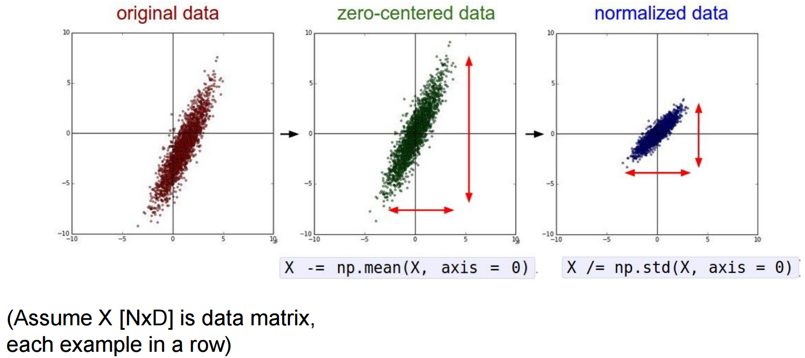
Preprocessing
Common: zero-center, can normalize variance.
Slide from Stanford CS231n

Slide 4
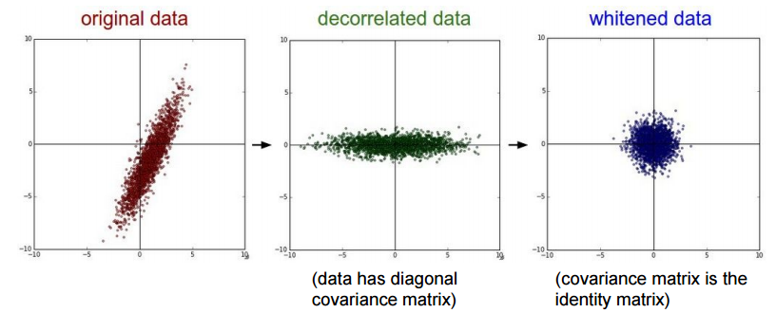
Preprocessing
Can also decorrelate the data by using PCA, or whiten data
Slide from Stanford CS231n

Slide 5
Preprocessing for Images
Center the data only
Compute a mean image (examples of mean faces)
Either grayscale or compute separate mean for channels (RGB)
Subtract the mean from your dataset

Slide 6
Overview
Preprocessing
Initialization
Vanishing/exploding gradients problem
Batch normalization
Dropout
Additional neuron types:
Softmax

Slide 7
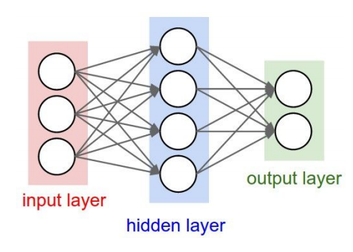
Initialization
Need to start gradient descent at an initial guess
What happens if we initialize all weights to zero?
Slide from Stanford CS231n

Slide 8
Initialization
Idea: random numbers (e.g. normal distribution)
OK for shallow networks, but what about deep networks?
$$w_{ij}=𝒩(μ,σ)$$
$μ$=0,
$σ$ = const

Slide 9
Initialization, $σ$= 0.01
Simulation: multilayer perceptron, 10 fully-connected hidden layers
Tanh() activation function
Hidden layer activation function statistics:
Are there any problems with this?
Hidden Layer 1
Hidden Layer 10
Slide from Stanford CS231n

Slide 10
Initialization, $σ$= 1
Simulation: multilayer perceptron, 10 fully-connected hidden layers
Tanh() activation function
Hidden layer activation function statistics:
Are there any problems with this?
Hidden Layer 1
Hidden Layer 10
Slide from Stanford CS231n

Slide 11
Xavier Initialization
$σ= \frac{1}{\sqrt{n_{in}}}$
$n_{in}$: Number of neurons feeding into given neuron (actually, Xavier used a uniform distribution)
Hidden layer activation function statistics:
Reasonable initialization for tanh() activation function. But what happens with ReLU?
Hidden Layer 1
Hidden Layer 10
Slide from Stanford CS231n

Slide 12
Xavier Initialization, ReLU
$σ= \frac{1}{\sqrt{n_{in}}}$
$n_{in}$: Number of neurons feeding into given neuron
Hidden layer activation function statistics:
Hidden Layer 1
Hidden Layer 10
Slide from Stanford CS231n

Slide 13
He et al. 2015 Initialization, ReLU
$σ= \frac{\sqrt{2}}{\sqrt{n_{in}}}$
$n_{in}$: Number of neurons feeding into given neuron
Hidden layer activation function statistics:
Hidden Layer 1
Hidden Layer 10
Slide from Stanford CS231n

Slide 14
Other Ways to Initialize?
Start with an existing pre-trained neural network’s weights, fine tune its weights by re-running gradient descent
This is really transfer learning, since it also transfers knowledge from the previously trained network
Previously, people used unsupervised pre-training with autoencoders
But we have better initializations now

Slide 15
Overview
Preprocessing
Initialization
Vanishing/exploding gradients problem
Batch normalization
Dropout
Additional neuron types:
Softmax

Slide 16
Vanishing/exploding gradient problem
Recall from the backpropagation algorithm (last class slides):
Take $\left\|δ\right\|$ over all neurons in a layer.
We can call this a “learning speed.”
$$\frac{∂E}{∂w_{ij}}=δ_{j}o_{i}$$
$$δ_{j}=\frac{∂E}{∂o_{j}}\frac{∂o_{j}}{∂{net}_{j}}=φ′(o_{j})\left\{\begin{matrix}{(o}_{j}−t_{j}) & if j is an output neuron \\ \sum_{l∈L}{δ_{l}w_{jl}} & if j is an interior neuron\end{matrix}\right.$$

Slide 17
Vanishing/exploding gradient problem
Vanishing gradients problem: neurons in earlier layers learn more slowly than in latter layers.
Image from Nielson 2015

Slide 18
Vanishing/exploding gradient problem
Vanishing gradients problem: neurons in earlier layers learn more slowly than in latter layers.
Exploding gradients problem: gradients are significantly larger in earlier layers than latter layers.
How to avoid?
Use a good initialization
Do not use sigmoid for deep networks
Use momentum with carefully tuned schedules, e.g.:
Image from Nielson 2015

Slide 19
Overview
Preprocessing
Initialization
Vanishing/exploding gradients problem
Batch normalization
Dropout
Additional neuron types:
Softmax

Slide 20
Batch normalization
It would be great if we could just whiten the inputs to all neurons in a layer: i.e. zero mean, variance of 1.
Avoid vanishing gradients problem, improve learning rates!
For each input k to the next layer:
Slight problem: this reduces representation ability of network
Why?

Slide 21
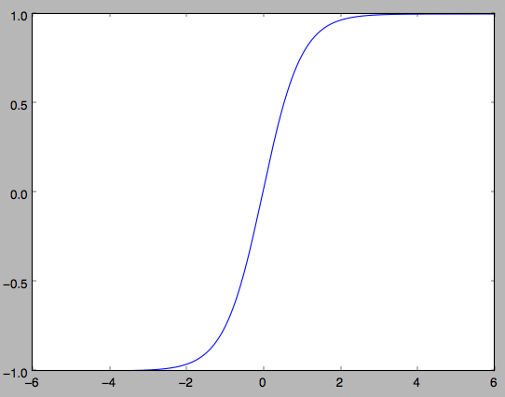
Batch normalization
It would be great if we could just whiten the inputs to all neurons in a layer: i.e. zero mean, variance of 1.
Avoid vanishing gradients problem, improve learning rates!
For each input k to the next layer:
Slight problem: this reduces representation ability of network
Why?
Get stuck in this part of the activation function

Slide 22
Batch normalization
First whiten each input k independently, using statistics from the mini-batch:
Then introduce parameters to scale and shift each input:
These parameters are learned by the optimization.

Slide 23
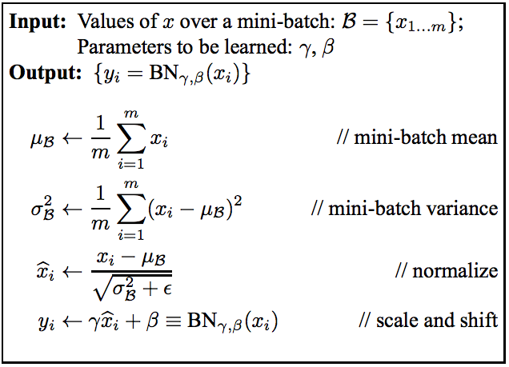
Batch normalization

Slide 24
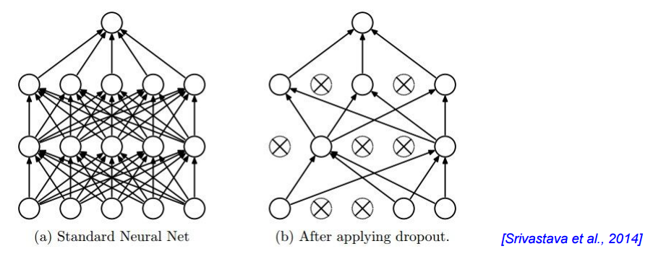
Dropout: regularization
Randomly zero outputs of p fraction of the neurons during training
Can we learn representations that are robust to loss of neurons?
Intuition: learn and remember useful information even if there are some errors in the computation (biological connection?)
Slide from Stanford CS231n

Slide 25
Dropout
Another interpretation: we are learning a large ensemble of models that share weights.
Slide from Stanford CS231n

Slide 26
Dropout
Another interpretation: we are learning a large ensemble of models that share weights.
What can we do during testing to correct for the dropout process?
Multiply all neurons outputs by p.
Or equivalently (inverse dropout) simply divide all neurons outputs by p during training.
Slide from Stanford CS231n

Slide 27
Overview
Preprocessing
Initialization
Vanishing/exploding gradients problem
Batch normalization
Dropout
Additional neuron types:
Softmax

Slide 28
Softmax
Often used in final output layer to convert neuron outputs into a class probability scores that sum to 1.
For example, might want to convert the final network output to:
P(dog) = 0.2 (Probabilities in range [0, 1])
P(cat) = 0.8
(Sum of all probabilities is 1).

Slide 29
Softmax
Softmax takes a vector z and outputs a vector of the same length.

