Slide 1
CS 6501: Deep Learning for Computer Graphics Convolutional and Recurrent Neural Networks
Connelly Barnes

Slide 2
Outline
Convolutional Neural Networks (“CNNs”, “ConvNets”)
Useful for images
Recurrent Neural Networks (“RNNs”)
Useful for processing sequential data (e.g. text)

Slide 3
Outline
Convolutional Neural Networks
History
Convolutional layers
Downsampling: stride and pooling layers
Fully connected layers
Residual networks
Data augmentation
Recurrent Neural Networks
Deep learning libraries

Slide 4
History
Slide from Stanford CS231N

Slide 5
History
Slide from Stanford CS231N

Slide 6
History
Slide from Stanford CS231N

Slide 7
History
Slide from Stanford CS231N

Slide 8
History
Slide from Stanford CS231N

Slide 9
History
Slide from Stanford CS231N

Slide 10
Today: CNNs Widely Used
Self-driving cars

Slide 11
Today: CNNs Widely Used
Image Classification

Slide 12
Convolutional Neural Networks
Similar to multilayer neural network, but weight matrices now have a special structure (Toeplitz or block Toeplitz) due to convolutions.
The convolutions typically sum over all color channels.

Slide 13
Convolutional Neural Network Neuron Layout
Input layer: RGB image
Centered, i.e. subtract mean over training set
Usually crop to fixed size (square) input image
R
G
B
Image from Wikipedia

Slide 14
Convolutional Neural Network Neuron Layout
Hidden layer
Feature
map 1
Feature
map n
Image from Wikipedia

Slide 15
Receptive Field
Weights (Shared)
Hidden Layer Neuron
Receptive Field: Input Region
Image from Wikipedia

Slide 16
Mathematically…
Weights for Feature Map 1
Weights for Feature Map n
Activation Function
Biases
$L_{i}=φ(L_{i−1}∗[W_{1},W_{2},$…$W_{n}]+[b_{1},$…, $b_{n}])$
h x w x d
k₁ x k₂ x d
Current Layer Feature Maps
Previous Layer Feature Maps
Convolution (Shares Weights Spatially)

Slide 18
Outline
Convolutional Neural Networks
History
Convolutional layers
Downsampling: stride and pooling layers
Fully connected layers
Residual networks
Data augmentation
Recurrent neural networks
Deep learning libraries

Slide 19
Stride
Stride m indicates that instead of computing every pixel in the convolution, compute only every mth pixel.

Slide 20
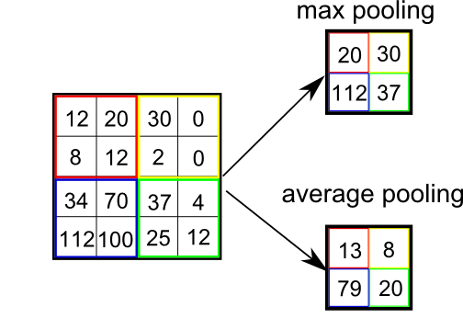
Max/average pooling
“Downsampling” using max() operator
Downsampling factor f could differ from neighborhood size N that is pooled over.

Slide 21
Max/average pooling
For max pooling, backpropagation just propagates error back to to whichever neuron had the maximum value.
For average pooling, backpropagation splits error equally among all the input neurons.

Slide 22
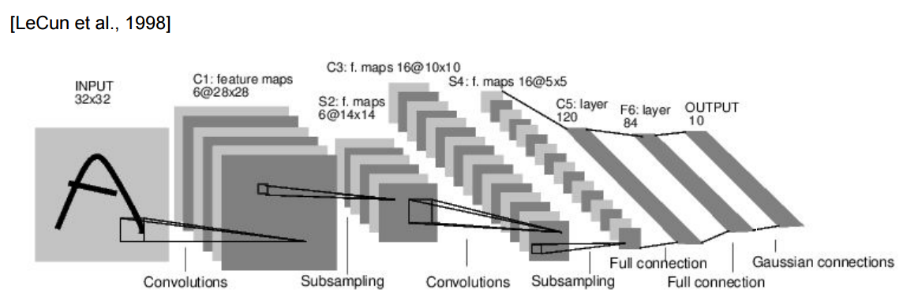
Fully connected layers
Connect every neuron to every other neuron, as with multilayer perceptron.
Common at end of ConvNets.

Slide 23
Outline
Convolutional Neural Networks
History
Convolutional layers
Downsampling: stride and pooling layers
Fully connected layers
Residual networks
Data augmentation
Recurrent Neural Networks
Deep learning libraries

Slide 24
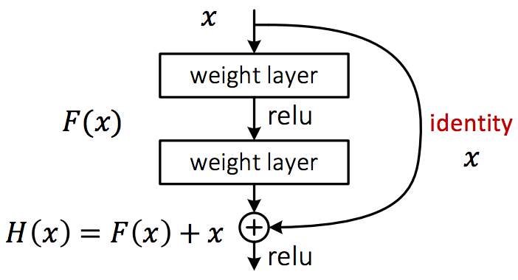
Residual networks
Make it easy to learn the identity function:
Network with all zero weights gives identity function.
Helps with vanishing/exploding gradients.

Slide 25
Outline
Convolutional Neural Networks
History
Convolutional layers
Downsampling: stride and pooling layers
Fully connected layers
Residual networks
Data augmentation
Recurrent neural networks
Deep learning libraries

Slide 26
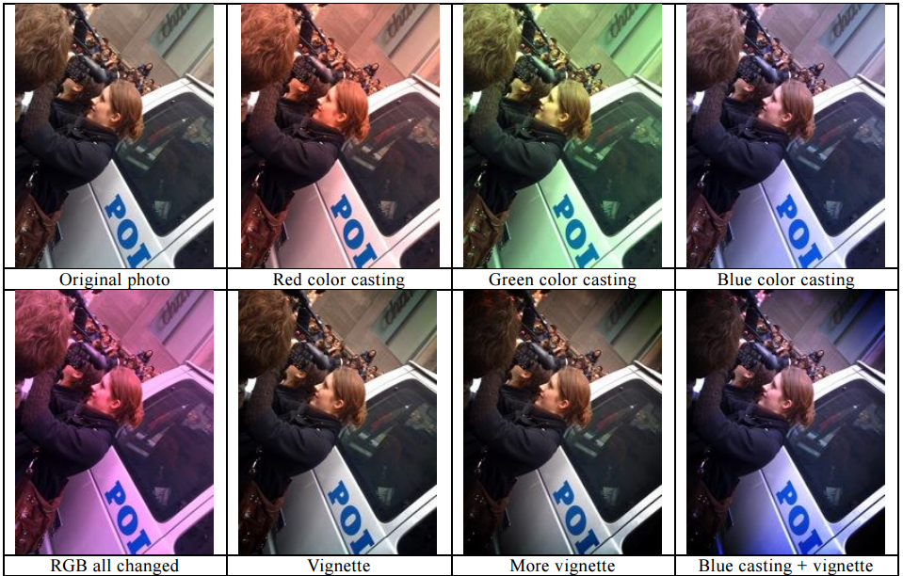
Data Augmentation
Many weights to train
Often would be helpful to have more training data
Fake having more training data
Random rotations
Random flips
Random shifts
Recolorings
etc
Figure from BaiduVision

Slide 27
Outline
Convolutional Neural Networks
Recurrent Neural Networks
Simple RNNs
LSTM, GRU
Applications
Deep learning libraries

Slide 28
Recurrent Neural Networks
Feedforward neural networks have no memory: cannot remember the state of the world between one instant of time and the next
Cannot remember important events and recall them in the future
Cannot perform loops
Cannot implement arbitrary algorithms
Recurrent networks help by adding memory to the computation

Slide 29
Recurrent Neural Networks
Outputs
Hidden State (Memory)
Inputs
Slide from Stanford CS231N

Slide 30
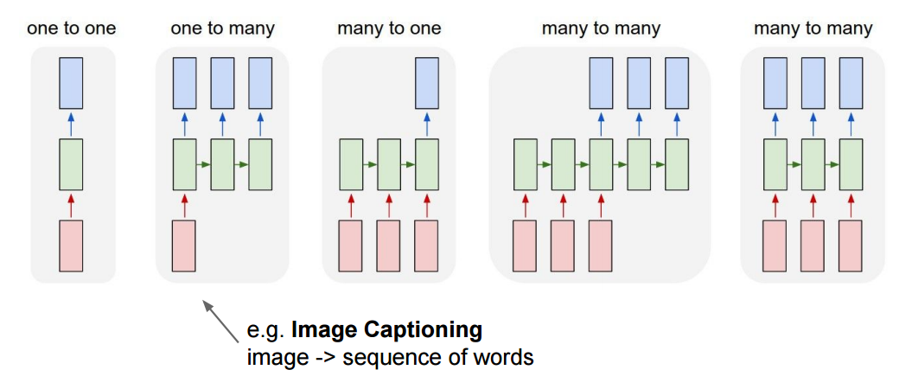
Recurrent Neural Networks
Slide from Stanford CS231N

Slide 31
Recurrent Neural Networks
Slide from Stanford CS231N

Slide 32
Recurrent Neural Networks
Slide from Stanford CS231N

Slide 33
Recurrent Neural Networks
Slide from Stanford CS231N

Slide 34
Simple Recurrent Neural Network
Slide from Stanford CS231N

Slide 35
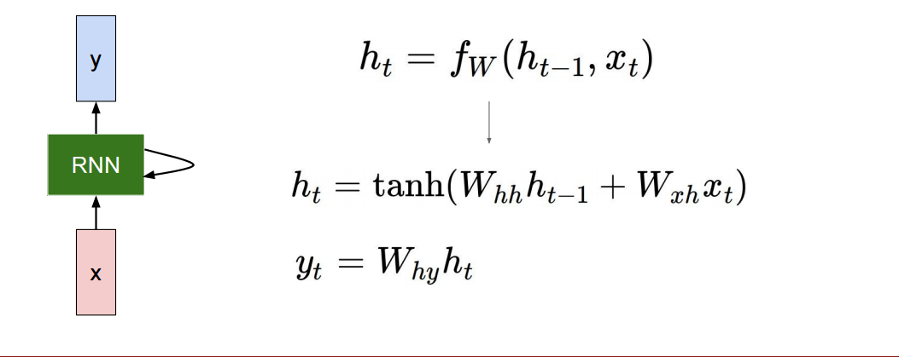
Simple Recurrent Neural Network
Hidden state:
Output:
Slide from Stanford CS231N

Slide 36
How to Train?
Backpropagation through time
Image from Wikipedia

Slide 37
How to Train?
More efficient: Truncated backpropagation through time
(1) Only run backpropagation every k₁ time steps
(2) Limit number of times (k₂) unfolded
Image from Wikipedia

Slide 38
Application of Recurrent Neural Network
Text synthesis (student presentation)

Slide 39
Vanishing Gradients Revisited
Suppose we want to “remember” an event at time 0 and use this in our model of the world at some later time t.
Error gradients vanish exponentially quickly in the size of the time lag between these events.
Fancier RNN models help with this problem:
Long Short Term Memory (LSTM)
Gated Recurrent Units (GRU)

Slide 40
Long Short Term Memory
How to better remember hidden state for a long time?
Idea: use gates to create cells that can remember for a long time.
Rough analogy: ternary logic gates used in transistors, AND, OR, …
But use sigmoid activations so we have continuous values in [0, 1]
Transistor diagram (from Wikipedia)

Slide 41
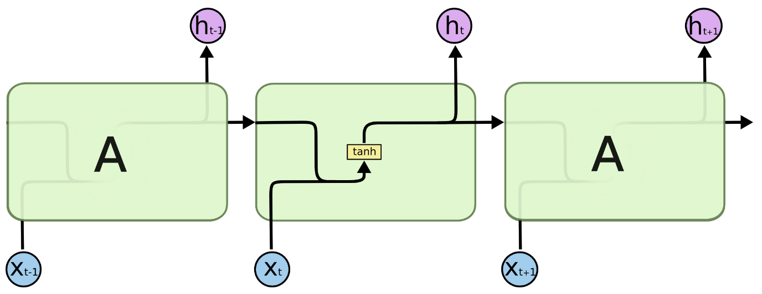
Simple Recurrent Neural Network
Outputs
No gates!
Hidden State (Memory)
Inputs
Diagrams from Christopher Olah

Slide 42
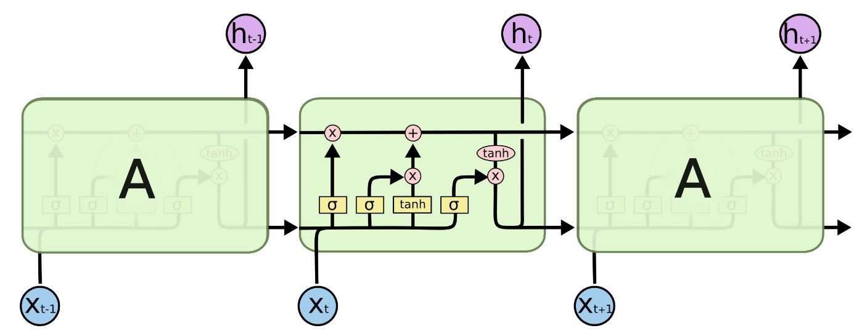
Long Short Term Memory
Gates: forget, input, output
Diagrams from Christopher Olah

Slide 43
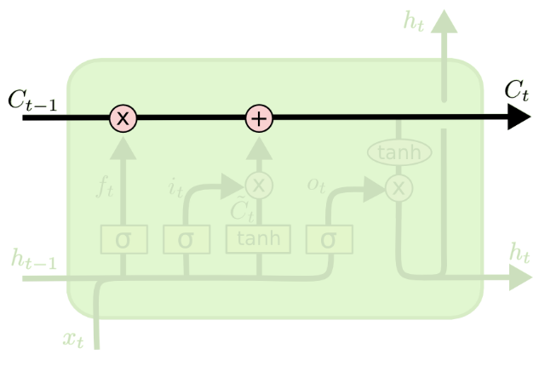
Long Short Term Memory
Easy to have hidden state C_{t} just flow through time, unchanged.
Diagrams from Christopher Olah

Slide 44
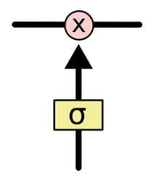
Long Short Term Memory
Gate: pointwise multiplication.
Multiply by zero: let nothing through.
Multiply by one: let everything through.
Diagrams from Christopher Olah

Slide 45
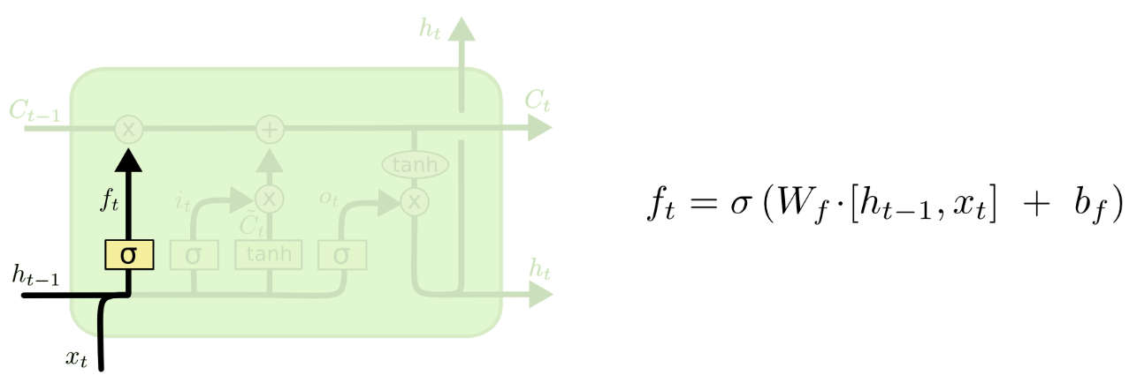
Long Short Term Memory
Forget gate: conditionally discard previously remembered information.
Diagrams from Christopher Olah

Slide 46
Long Short Term Memory
Input gate: conditionally remember new information.
Diagrams from Christopher Olah

Slide 47
Long Short Term Memory
Output gate: conditionally output a relevant part of our memory.
Diagrams from Christopher Olah

Slide 48
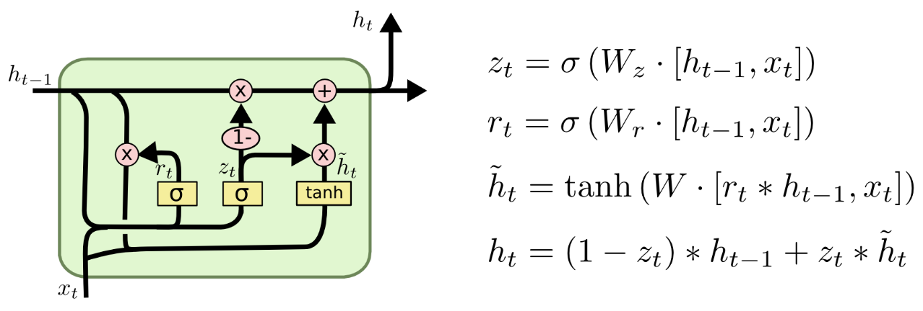
Gated Recurrent Units (GRUs)
Merge input / forget units into a single “update unit.”
Merge hidden states.
Diagrams from Christopher Olah

Slide 49
Outline
Convolutional Neural Networks
Recurrent Neural Networks
Deep learning libraries

Slide 50
Libraries
Deep learning:
Caffe (C++ with Python bindings),
Torch (Lua)
TensorFlow (C++ with Python bindings)
Python: Keras, built on Theano
Recurrent networks (search for your framework + LSTM):
Caffe
Torch
TensorFlow
Keras

