Slide 1
CS 6501: Deep Learning for
Computer Graphics
(Deep) Reinforcement Learning
Connelly Barnes
Slides based on those by David Silver

Slide 2
Outline
Introduction to Reinforcement Learning
Value-based deep reinforcement learning
  Q-learning

Slide 3
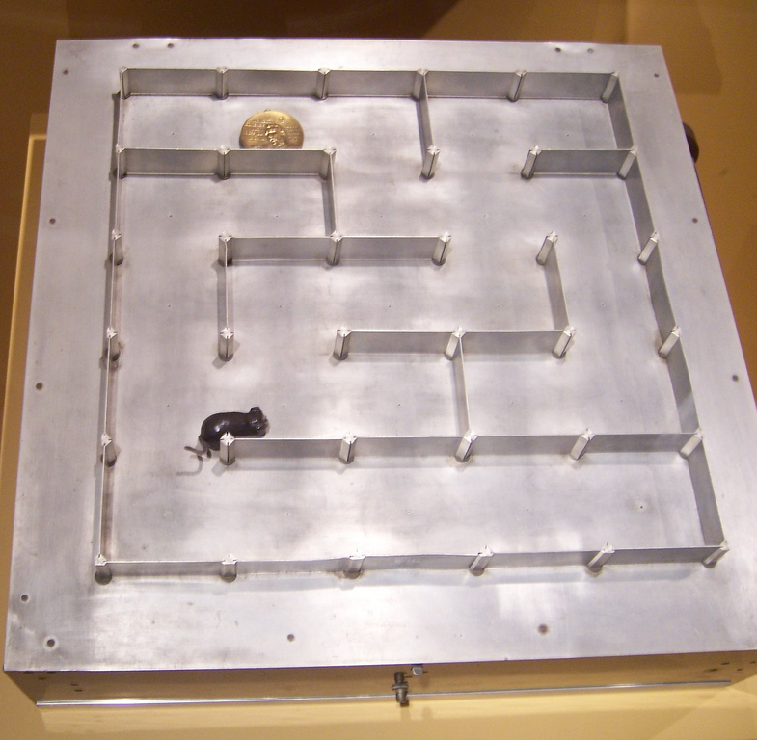
Introduction to Reinforcement Learning
“How software agents ought to take actions in an environment so as to maximize some notion of cumulative reward.” – Wikipedia
Studied in various disciplines:
  Game theory
  Control theory
  Operations research
  Swarm intelligence
  Statistics
  Economics
  …
Photo from Flickr

Slide 4
Introduction to Reinforcement Learning
Goal: determine the best action for every state.
Optimize an objective function, such as average reward per time unit, or discounted reward.
Few states: dynamic programming.
Many states: reinforcement learning,
deep reinforcement learning.

Slide 5
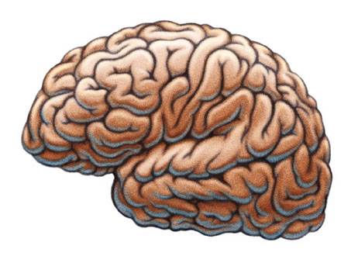
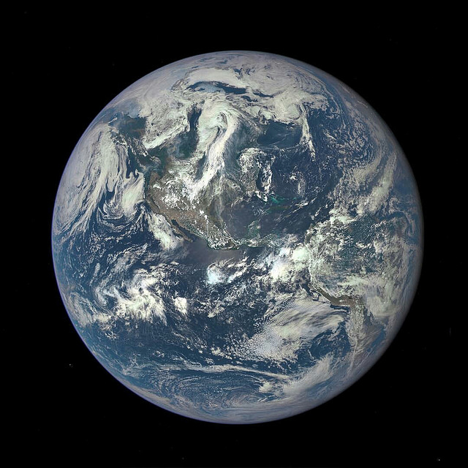
Terminology
Agent
At each time step t the agent:
  Receives observation o_{t}
  Receives scalar reward r_{t}
  Executes action a_{t}
The environment:
  Receives action a_{t}
  Determines observation o_{t+1}
  Determines scalar reward r_{t+1}
Observation
o_{t}
Reward r_{t}
Action
a_{t}
Environment
Slides based on those by David Silver, images [1], [2]

Slide 6
Modeling Agent Behavior
Agent
Agent can include these components:
  Policy: agent’s behavior function
  Value function: how good
  is each state/action?
  Model: agent’s understanding
  of the environment
Which one did we work with on the
Tic Tac Toe assignment?
Observation
o_{t}
Reward r_{t}
Action
a_{t}
Environment
Slides based on those by David Silver, images [1], [2]

Slide 7

Policy
Determines agent’s behavior directly
Maps from state to action
  Deterministic policy: $a=π\left(s\right)$
  Stochastic policy: $π\left(a | s\right)=P[a|s]$
Slides based on those by David Silver

Slide 8
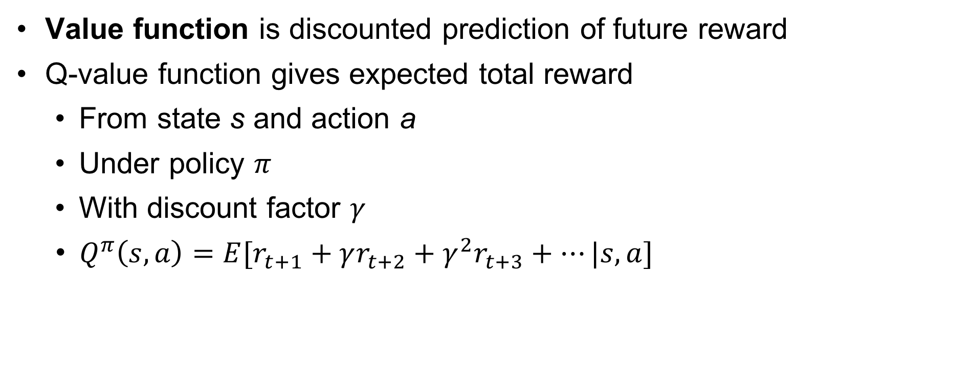
Value Function
Value function is discounted prediction of future reward
Q-value function gives expected total reward
  From state s and action a
  Under policy $π$
  With discount factor $γ$
  $Q^{π}\left(s,a\right)=E[r_{t+1}+γr_{t+2}+γ^{2}r_{t+3}+…|s,a]$
Slides based on those by David Silver

Slide 9
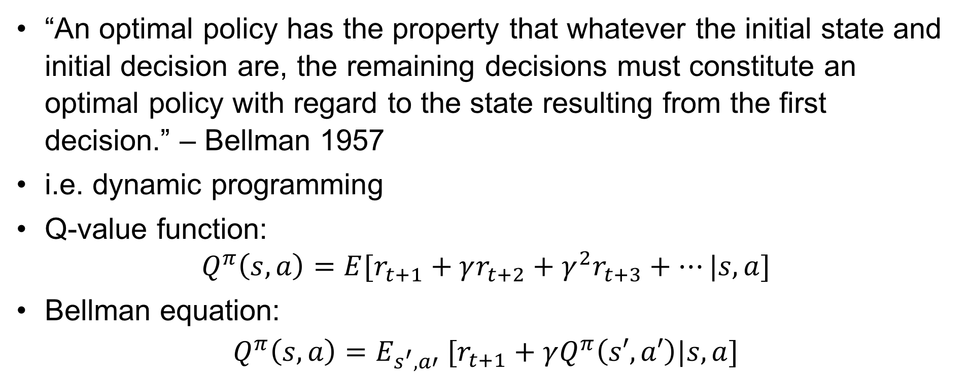
Bellman’s Principle of Optimality
“An optimal policy has the property that whatever the initial state and initial decision are, the remaining decisions must constitute an optimal policy with regard to the state resulting from the first decision.” – Bellman 1957
i.e. dynamic programming
Q-value function:
$Q^{π}\left(s,a\right)=E[r_{t+1}+γr_{t+2}+γ^{2}r_{t+3}+…|s,a]$
Bellman equation:
$$Q^{π}\left(s,a\right)=E_{s^{′},a′} [r_{t+1}+γQ^{π}\left(s′,a′\right)|s,a]$$
Slides based on those by David Silver

Slide 10

Optimal Value Function
The maximum achievable value:
$Q^{∗}\left(s,a\right)=\max_{π}(Q^{π}\left(s,a\right)$)
Once we have Q* we can act optimally:
$π^{∗}\left(s\right)={argmax}_{a}(Q^{∗}\left(s,a\right)$)
Slides based on those by David Silver

Slide 11
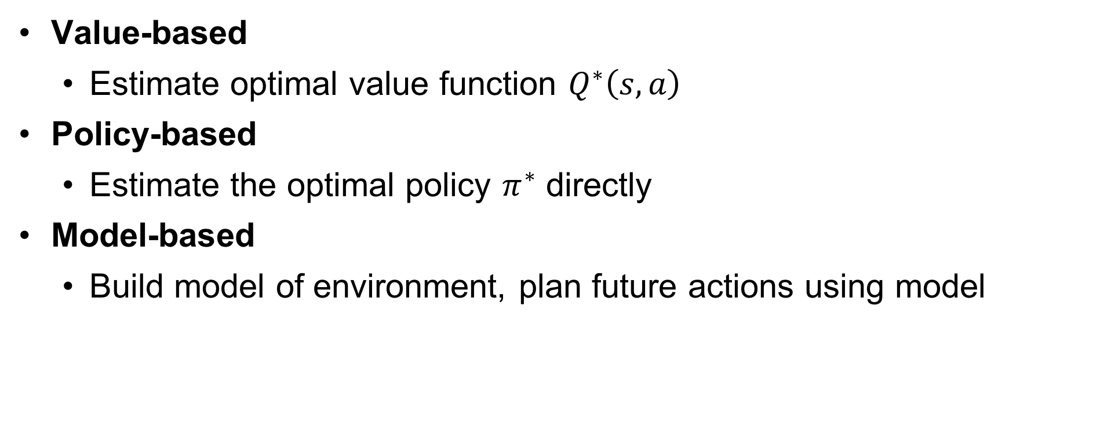
Reinforcement Learning Approaches
Value-based
  Estimate optimal value function $Q^{∗}\left(s,a\right)$
Policy-based
  Estimate the optimal policy $π^{∗}$ directly
Model-based
  Build model of environment, plan future actions using model
Slides based on those by David Silver

Slide 12
Outline
Introduction to Reinforcement Learning
Value-based deep reinforcement learning
  Q-learning

Slide 13
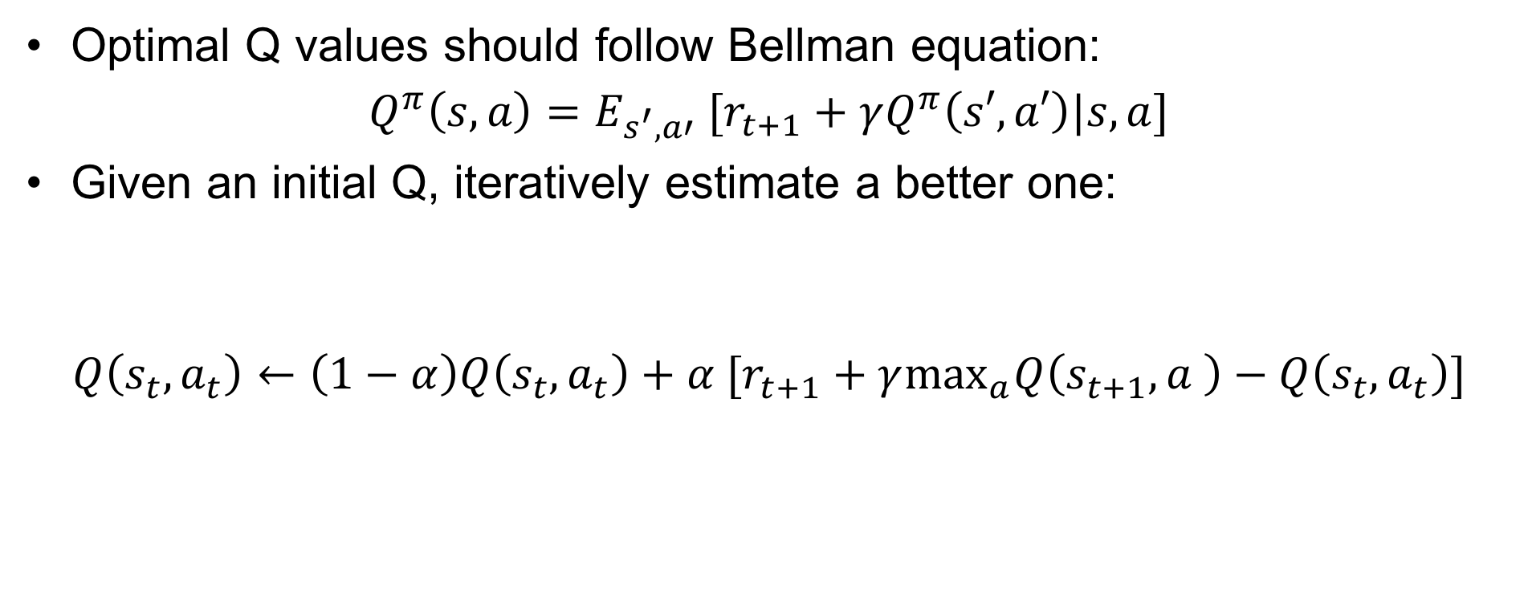
Q-Learning
Optimal Q values should follow Bellman equation:
$$Q^{π}\left(s,a\right)=E_{s^{′},a′} [r_{t+1}+γQ^{π}\left(s′,a′\right)|s,a]$$
Given an initial Q, iteratively estimate a better one:
$$Q\left(s_{t},a_{t}\right)←\left(1−α\right)Q\left(s_{t},a_{t}\right)+α [r_{t+1}+γ\max_{a}Q\left(s_{t+1},a \right)−Q\left(s_{t},a_{t}\right)]$$
Estimate of
future optimal value
Reward
Old
value
Learning
rate
Discount
factor
Slides based on those by David Silver

Slide 14
Q-learning Details
Initial conditions
  Often high values to encourage exploration
  No matter what action is selected, update rule will cause it to have lower value than alternatives, so alternatives will be explored also.
Learning rate
  Often a constant such as 0.1

Slide 15

Q-Learning and Neural Networks
If there is a large number of (state, action) pairs, cannot store
$Q\left(s,a\right)$ directly.
Instead, approximate $Q\left(s,a\right)$ using a neural network:
  Q-function.

Slide 16
Q-Learning and Neural Networks
Supervised learning: can take the value from the right-hand side of the Q-learning rule as the target for a neural network with weights w.
Minimize:
Diverges using neural networks due to:
  Correlations between samples
  Non-stationary learning target
$$E=\left[r_{t+1}+γ\max_{a′}Q\left(s^{′},a^{′},w\right)−Q\left(s,a,w\right)\right]2$$
Slides based on those by David Silver

Slide 17
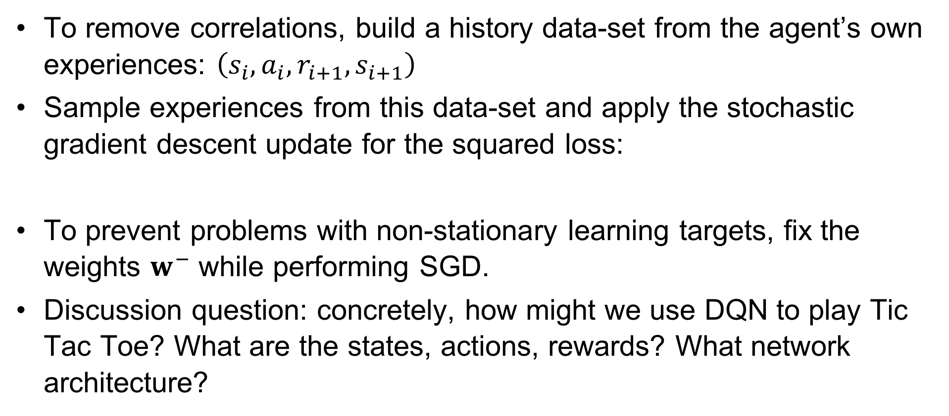
Deep Q-Networks (DQN): Experience Replay
To remove correlations, build a history data-set from the agent’s own experiences: $\left(s_{i},a_{i},r_{i+1},s_{i+1}\right)$
Sample experiences from this data-set and apply the stochastic gradient descent update for the squared loss:
To prevent problems with non-stationary learning targets, fix the weights $w^{−}$ while performing SGD.
Discussion question: concretely, how might we use DQN to play Tic Tac Toe? What are the states, actions, rewards? What network architecture?
$$E=\left[r_{t+1}+γ\max_{a′}Q\left(s^{′},a^{′},w^{−}\right)−Q\left(s,a,w\right)\right]2$$
Slides based on those by David Silver

Slide 18
Deep Q-Networks (DQN)
For more details, see the tutorial by David Silver

Slide 19
Software Packages
https://gym.openai.com/
https://github.com/VinF/deer
https://github.com/rlpy/rlpy

