Slide 1
CS 6501: 3D Reconstruction and Understanding Camera Models and Calibration
Connelly Barnes
Slides from Fei Fei Li, Juan Carlos Niebles, Jason Lawrence, Szymon Rusinkiewicz, David Dobkin, Adam Finkelstein, Tom Funkhouser

Slide 2
Outline
Human eyes
How do they sense light?
Visible light and human color perception
Electronic eyes
How do they sense light?
Image and color representation
Camera models
Pinhole camera and lenses
Transformation matrices
Camera calibration

Slide 3
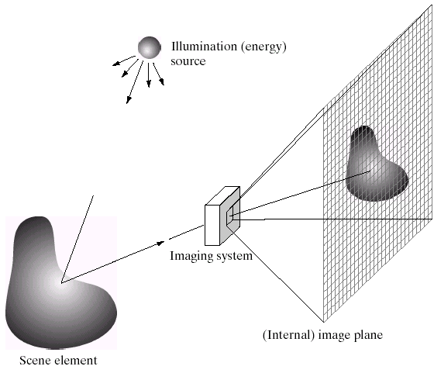
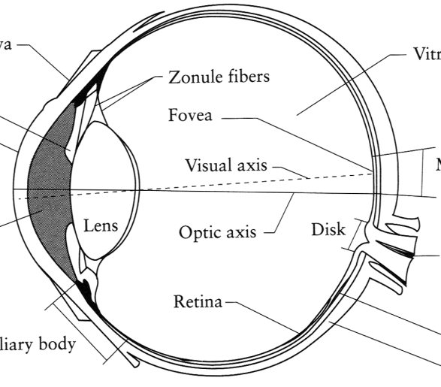
Image Formation
Digital Camera
Film
The Eye
Slide by Efros

Slide 4
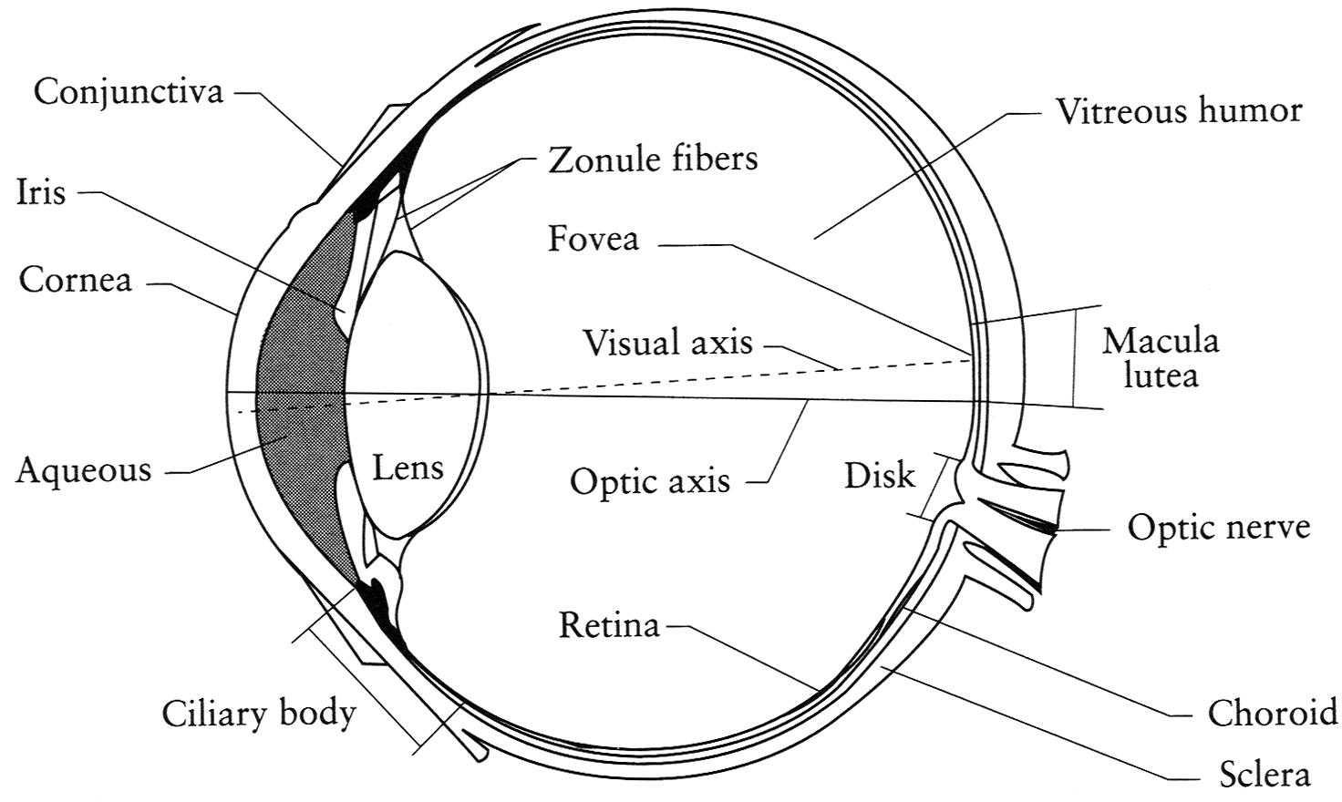
The Eye
The human eye is a camera!
Iris - colored annulus (ring) with radial muscles
Pupil - the hole (aperture) whose size is controlled by the iris
What’s the “film”?
photoreceptor cells (rods and cones) in the retina
Slide by Steve Seitz

Slide 5
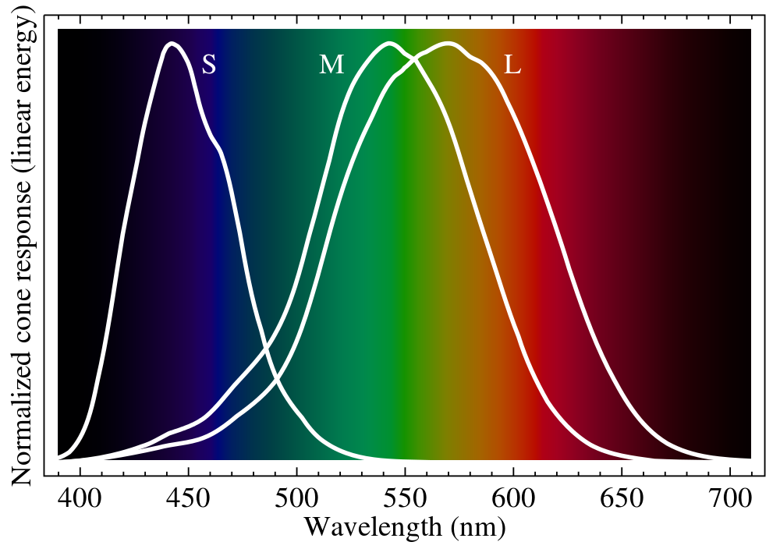
Ordinary Human Vision (Trichromatism)

Slide 6
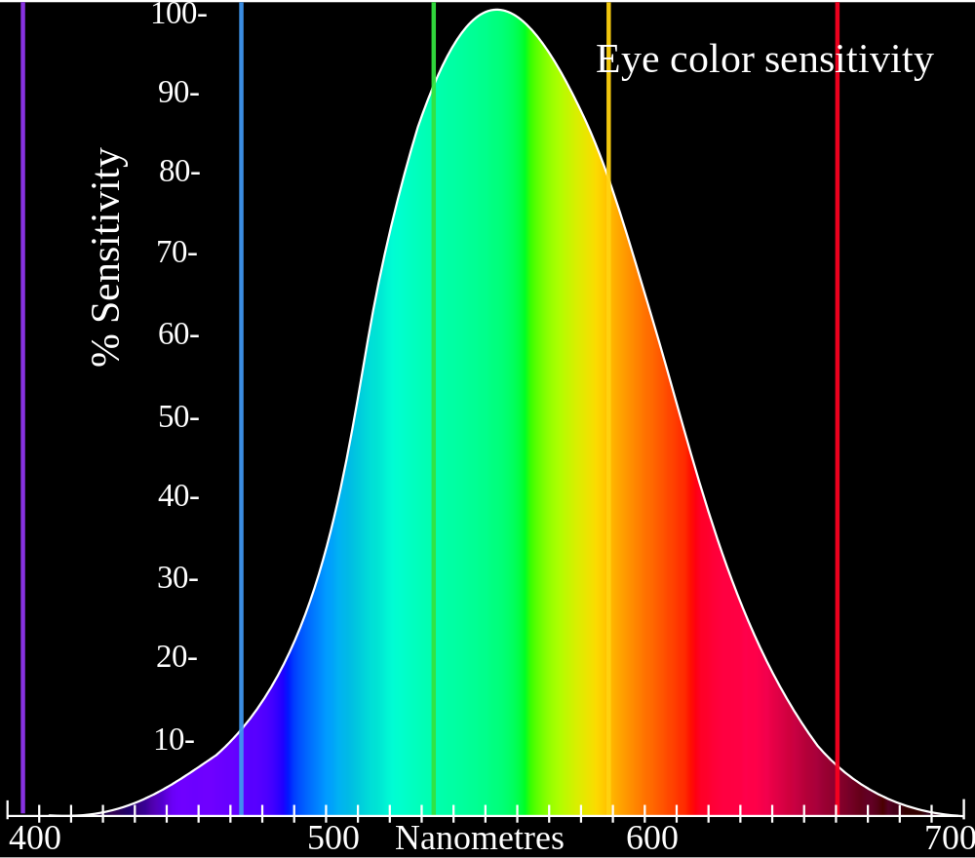
Perceptual Sensitivity

Slide 7
Outline
Human eyes
How do they sense light?
Visible light and human color perception
Electronic eyes
How do they sense light?
Image and color representation
Camera models
Pinhole camera and lenses
Transformation matrices
Camera calibration

Slide 8
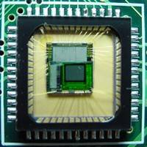
Electronic Eyes: Sensor Arrays
CMOS sensor
CCD sensor
Slide by Efros

Slide 9
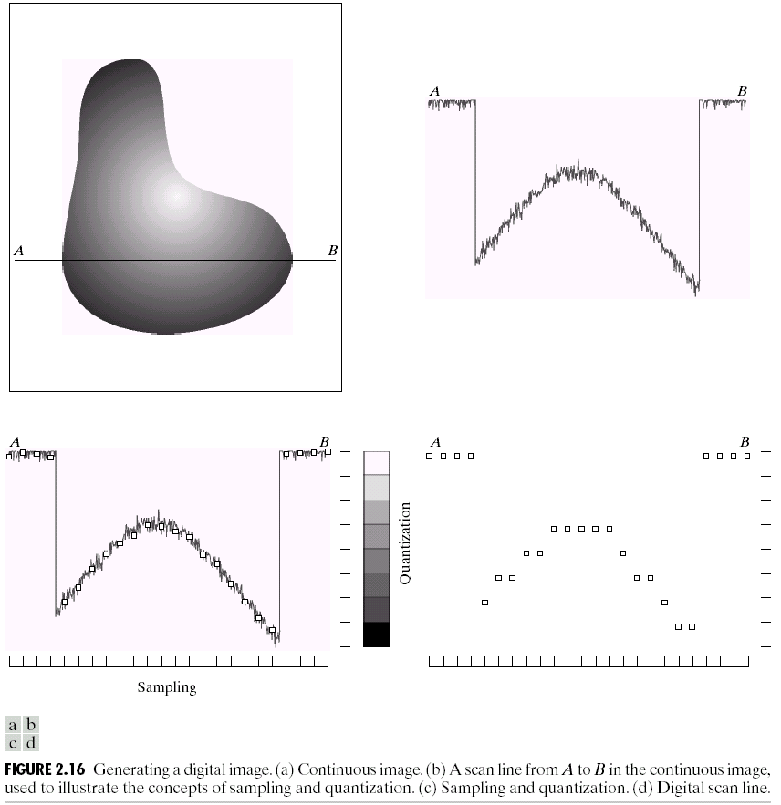
Sampling and Quantization

Slide 10
Outline
Human eyes
How do they sense light?
Visible light and human color perception
Electronic eyes
How do they sense light?
Image and color representation
Camera models
Pinhole camera and lenses
Transformation matrices
Camera calibration

Slide 11
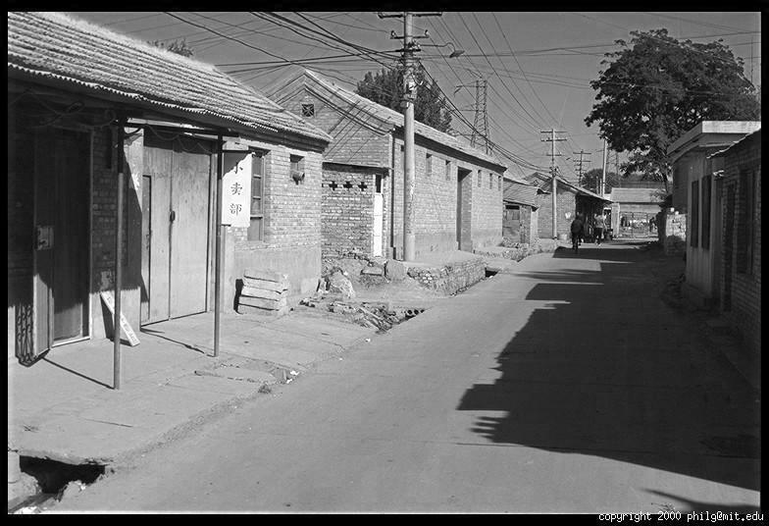
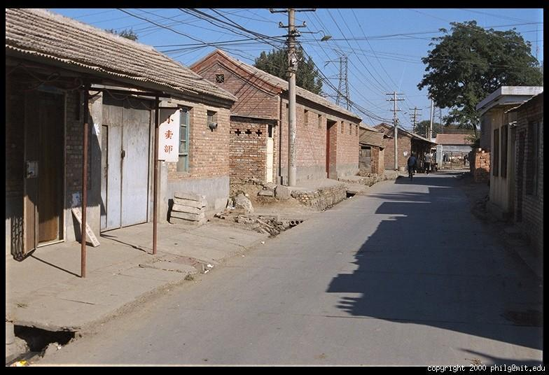
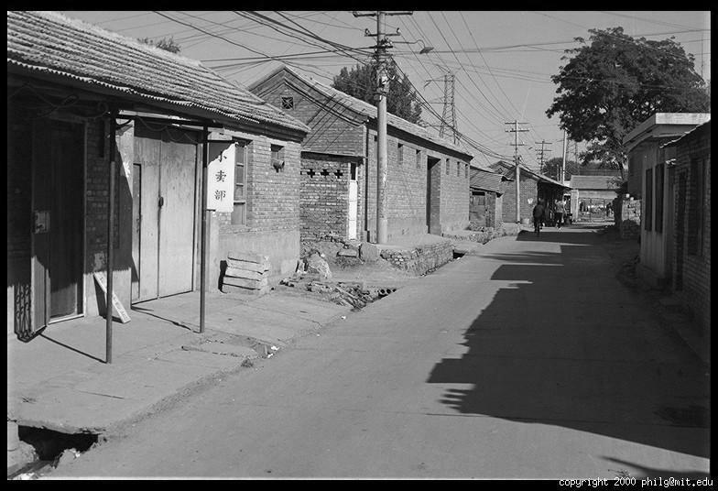
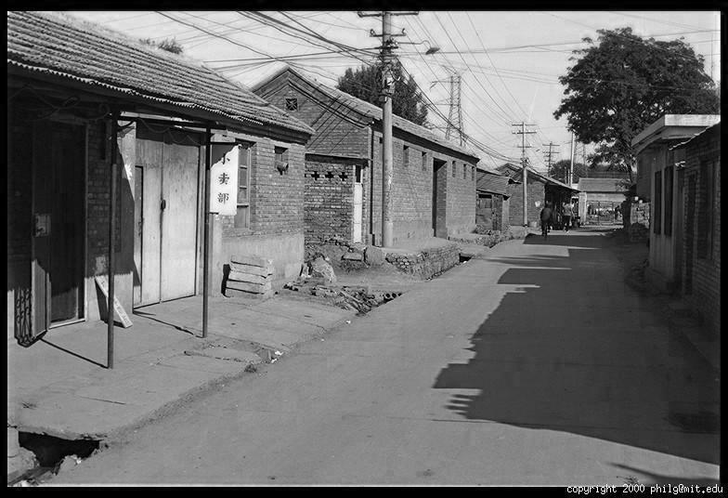
Color Image
R
Color
channels
G
B

Slide 12
Images in Python
Image as array: h x w x channels
I[y,x,channel]
Red channel, upper left corner:
MATLAB: I(1,1,1), Python: I[0,0,0]
Common ranges of pixel values:
Float (typical range: [0, 1])
Unsigned 8-bit integer (range: [0, 255])
Which is easier to work with?
column
R
row
0.92 | 0.93 | 0.94 | 0.97 | 0.62 | 0.37 | 0.85 | 0.97 | 0.93 | 0.92 | 0.99
0.95 | 0.89 | 0.82 | 0.89 | 0.56 | 0.31 | 0.75 | 0.92 | 0.81 | 0.95 | 0.91
0.89 | 0.72 | 0.51 | 0.55 | 0.51 | 0.42 | 0.57 | 0.41 | 0.49 | 0.91 | 0.92
0.96 | 0.95 | 0.88 | 0.94 | 0.56 | 0.46 | 0.91 | 0.87 | 0.90 | 0.97 | 0.95
0.71 | 0.81 | 0.81 | 0.87 | 0.57 | 0.37 | 0.80 | 0.88 | 0.89 | 0.79 | 0.85
0.49 | 0.62 | 0.60 | 0.58 | 0.50 | 0.60 | 0.58 | 0.50 | 0.61 | 0.45 | 0.33
0.86 | 0.84 | 0.74 | 0.58 | 0.51 | 0.39 | 0.73 | 0.92 | 0.91 | 0.49 | 0.74
0.96 | 0.67 | 0.54 | 0.85 | 0.48 | 0.37 | 0.88 | 0.90 | 0.94 | 0.82 | 0.93
0.69 | 0.49 | 0.56 | 0.66 | 0.43 | 0.42 | 0.77 | 0.73 | 0.71 | 0.90 | 0.99
0.79 | 0.73 | 0.90 | 0.67 | 0.33 | 0.61 | 0.69 | 0.79 | 0.73 | 0.93 | 0.97
0.91 | 0.94 | 0.89 | 0.49 | 0.41 | 0.78 | 0.78 | 0.77 | 0.89 | 0.99 | 0.93
G
0.92 | 0.93 | 0.94 | 0.97 | 0.62 | 0.37 | 0.85 | 0.97 | 0.93 | 0.92 | 0.99
0.95 | 0.89 | 0.82 | 0.89 | 0.56 | 0.31 | 0.75 | 0.92 | 0.81 | 0.95 | 0.91
0.89 | 0.72 | 0.51 | 0.55 | 0.51 | 0.42 | 0.57 | 0.41 | 0.49 | 0.91 | 0.92
0.96 | 0.95 | 0.88 | 0.94 | 0.56 | 0.46 | 0.91 | 0.87 | 0.90 | 0.97 | 0.95
0.71 | 0.81 | 0.81 | 0.87 | 0.57 | 0.37 | 0.80 | 0.88 | 0.89 | 0.79 | 0.85
0.49 | 0.62 | 0.60 | 0.58 | 0.50 | 0.60 | 0.58 | 0.50 | 0.61 | 0.45 | 0.33
0.86 | 0.84 | 0.74 | 0.58 | 0.51 | 0.39 | 0.73 | 0.92 | 0.91 | 0.49 | 0.74
0.96 | 0.67 | 0.54 | 0.85 | 0.48 | 0.37 | 0.88 | 0.90 | 0.94 | 0.82 | 0.93
0.69 | 0.49 | 0.56 | 0.66 | 0.43 | 0.42 | 0.77 | 0.73 | 0.71 | 0.90 | 0.99
0.79 | 0.73 | 0.90 | 0.67 | 0.33 | 0.61 | 0.69 | 0.79 | 0.73 | 0.93 | 0.97
0.91 | 0.94 | 0.89 | 0.49 | 0.41 | 0.78 | 0.78 | 0.77 | 0.89 | 0.99 | 0.93
B
0.92 | 0.93 | 0.94 | 0.97 | 0.62 | 0.37 | 0.85 | 0.97 | 0.93 | 0.92 | 0.99
0.95 | 0.89 | 0.82 | 0.89 | 0.56 | 0.31 | 0.75 | 0.92 | 0.81 | 0.95 | 0.91
0.89 | 0.72 | 0.51 | 0.55 | 0.51 | 0.42 | 0.57 | 0.41 | 0.49 | 0.91 | 0.92
0.96 | 0.95 | 0.88 | 0.94 | 0.56 | 0.46 | 0.91 | 0.87 | 0.90 | 0.97 | 0.95
0.71 | 0.81 | 0.81 | 0.87 | 0.57 | 0.37 | 0.80 | 0.88 | 0.89 | 0.79 | 0.85
0.49 | 0.62 | 0.60 | 0.58 | 0.50 | 0.60 | 0.58 | 0.50 | 0.61 | 0.45 | 0.33
0.86 | 0.84 | 0.74 | 0.58 | 0.51 | 0.39 | 0.73 | 0.92 | 0.91 | 0.49 | 0.74
0.96 | 0.67 | 0.54 | 0.85 | 0.48 | 0.37 | 0.88 | 0.90 | 0.94 | 0.82 | 0.93
0.69 | 0.49 | 0.56 | 0.66 | 0.43 | 0.42 | 0.77 | 0.73 | 0.71 | 0.90 | 0.99
0.79 | 0.73 | 0.90 | 0.67 | 0.33 | 0.61 | 0.69 | 0.79 | 0.73 | 0.93 | 0.97
0.91 | 0.94 | 0.89 | 0.49 | 0.41 | 0.78 | 0.78 | 0.77 | 0.89 | 0.99 | 0.93

Slide 13
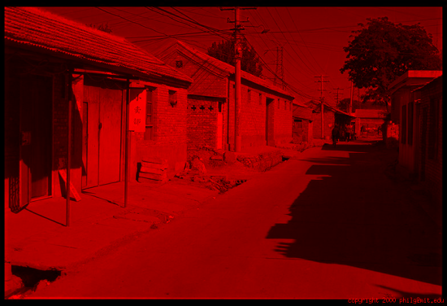
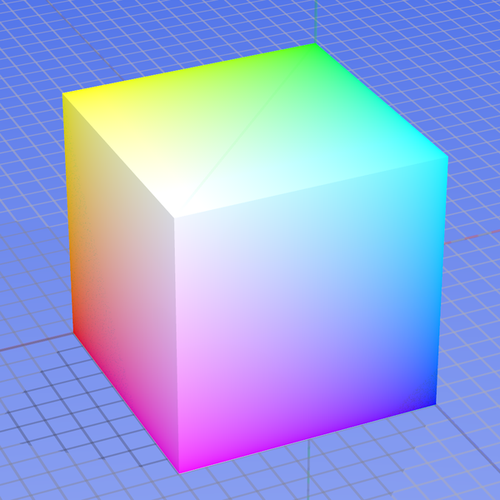
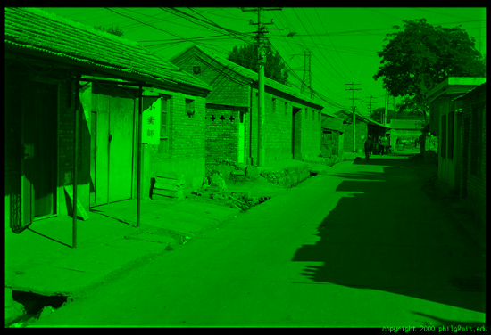
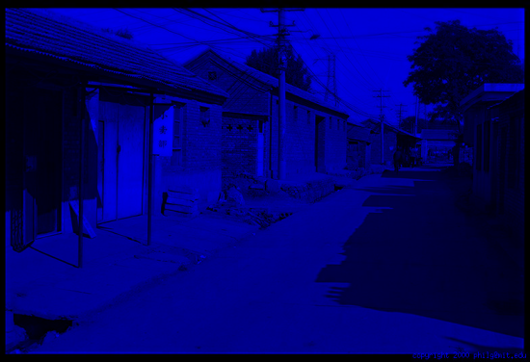
Color spaces: RGB
Default color space
0,1,0
R
(G=0,B=0)
G
(R=0,B=0)
1,0,0
0,0,1
B
(R=0,G=0)
Some drawbacks
Strongly correlated channels
Non-perceptual
Image from: http://en.wikipedia.org/wiki/File:RGB_color_solid_cube.png

Slide 14
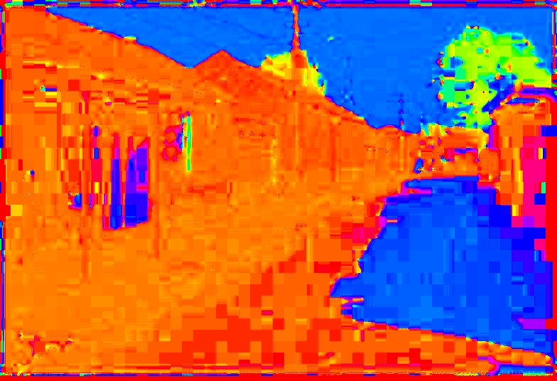
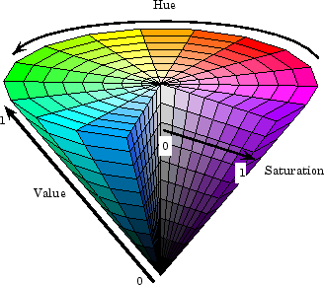
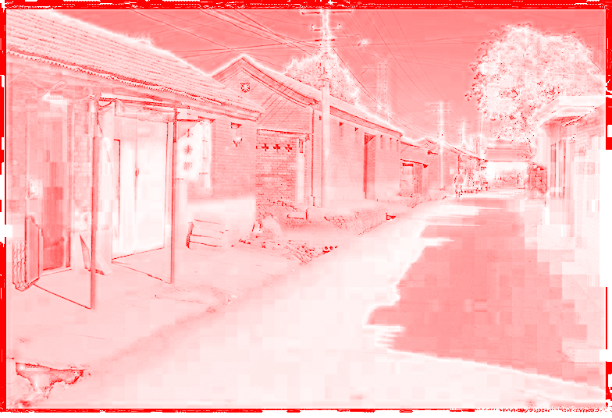
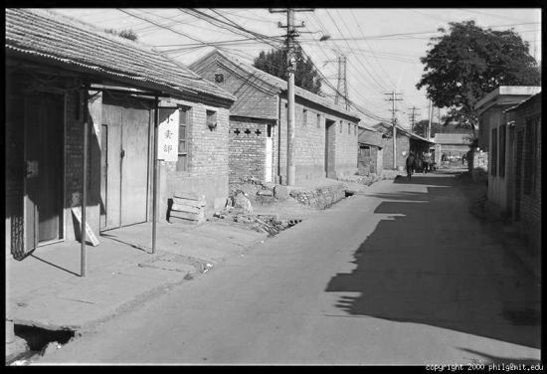
Color spaces: HSV
Intuitive color space
H
(S=1,V=1)
S
(H=1,V=1)
V
(H=1,S=0)

Slide 15
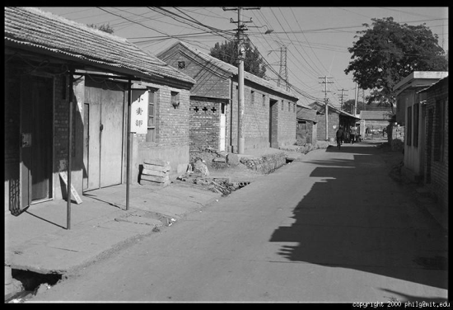
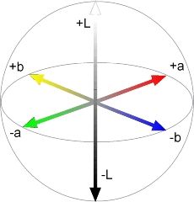
Color spaces: L*a*b*
“Perceptually uniform” color space
L
(a=0,b=0)
a
(L=65,b=0)
b
(L=65,a=0)
Python tip: skimage.color can convert between color spaces

Slide 16
Color spaces: Grayscale
From the video coding standards PAL and NTSC, convert RGB to Y:
Y [Luminance] = 0.30 R + 0.59 G + 0.11 B

Slide 17
Outline
Human eyes
How do they sense light?
Visible light and human color perception
Electronic eyes
How do they sense light?
Image and color representation
Camera models
Pinhole camera and lenses
Transformation matrices
Camera calibration

Slide 18
Pinhole Camera
Center of Projection
Illustration by Steve Seitz
- Pinhole camera has small aperture size.
- All objects are in focus – depth of field infinite

Slide 19
Pinhole Camera
Screen
Object
h_{o}
d_{i}
d_{o}
h_{i}
Image
h_{i}
d_{i}
=
Similar triangles gives optics law:
h_{o}
d_{o}

Slide 20
Pinhole Camera
h_{o}
d_{i}
d_{o}
h_{i}
1
Fix object size and imaging plane distance:
h_{i}
∝
d_{o}

Slide 21
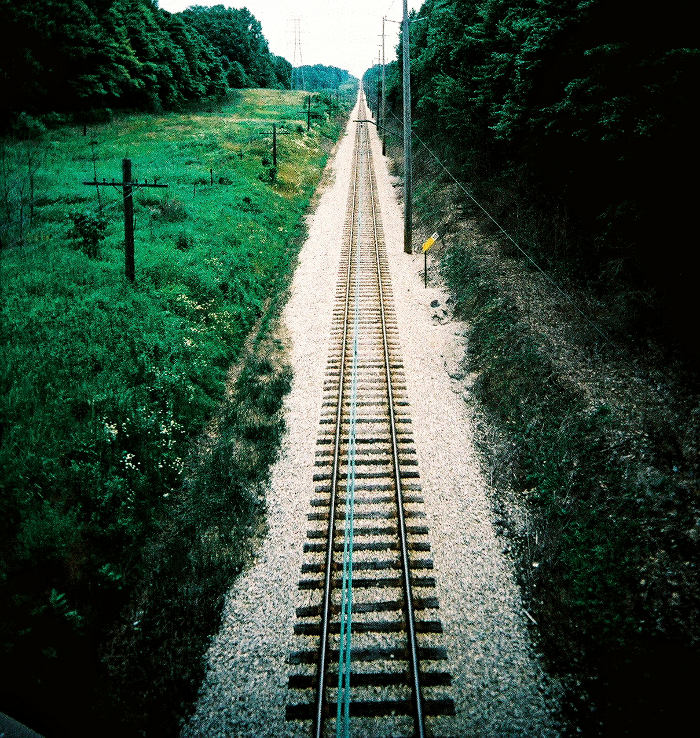
Perspective

Slide 22
Limitations of a Physical Pinhole Camera
Pros:
Infinite depth of field
Reasonable math model for 2D/3D correspondence (but, typically need to compensate for lens distortion)
Cons:
Not much light => higher noise
Diffraction for small aperture size

Slide 23
Lenses
Focal Length
f
Object
Focal Point
d_{o}
d_{i}
Image
Let in more light!

Slide 24
Lenses
Focal Length
f
Object
Focal Point
d_{o}
d_{i}
Image
1
1
1
=
+
Thin lens equation:
f
d_{o}
d_{i}

Slide 25
Lenses
Focal Length
f
Object
Focal Point
d_{o}
d_{i}
Image
- Focal length reported in mm, e.g. 50 mm lens.
- For zoom lenses, a range, e.g. 18-55 mm.

Slide 26
Angle of View (Field of View)
Focal Point
α
Sensor Dimension d
Focal length f
α = 2 tan⁻¹ [d/(2f)] ≈ d / f (radians)

Slide 27
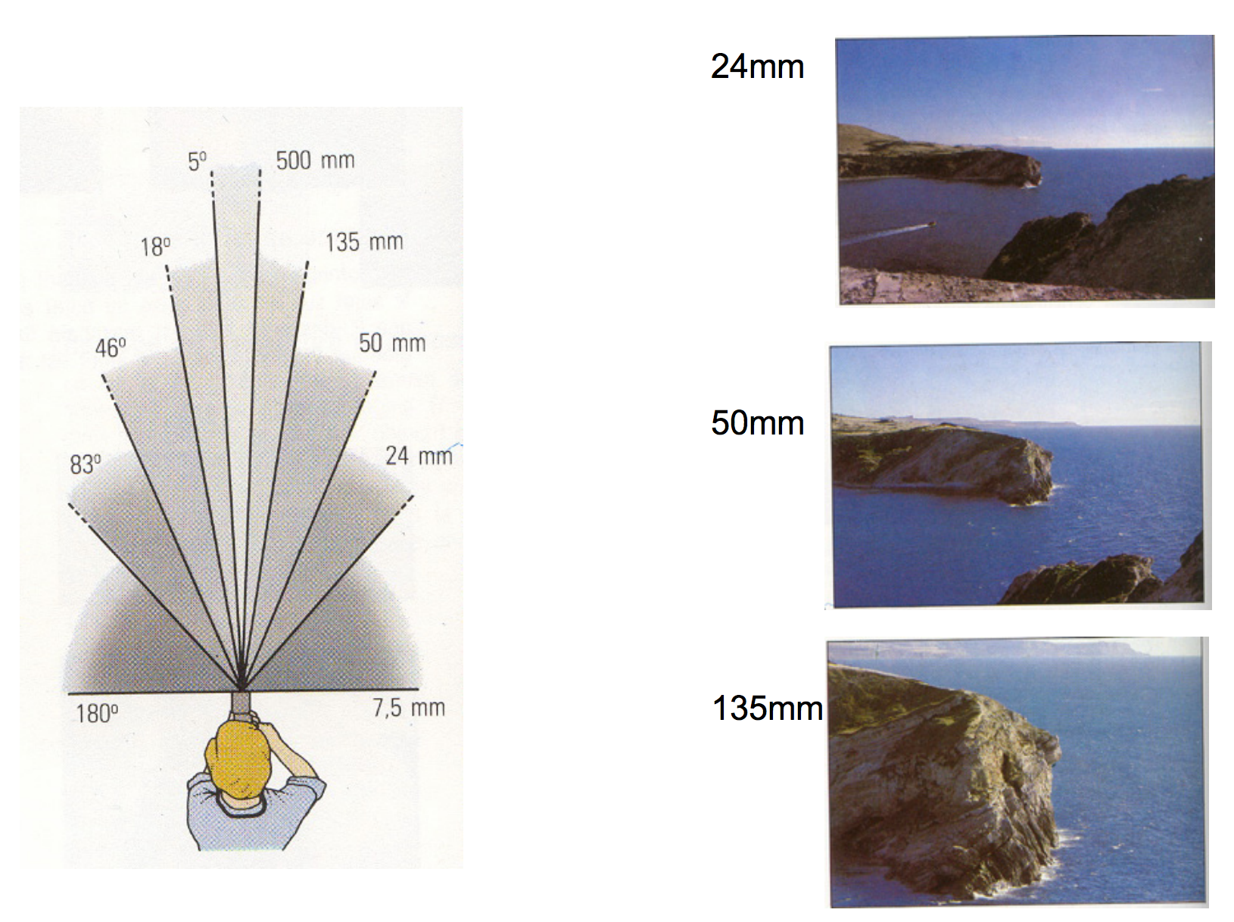
Angle of View (Field of View)
[Slide content from Fredo Durand]

Slide 28
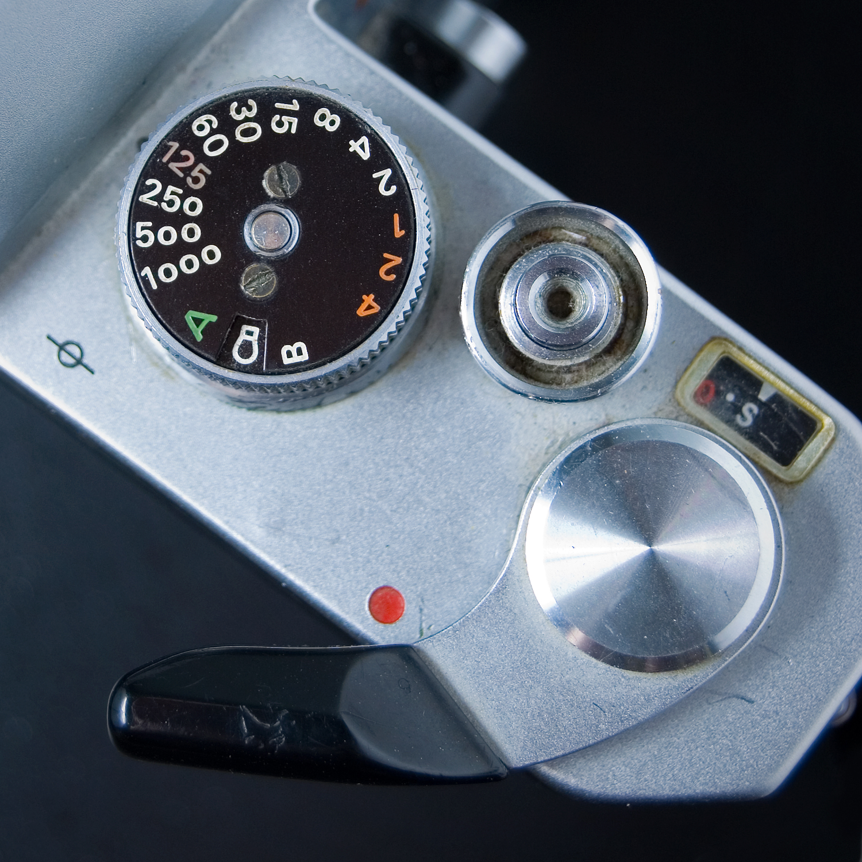
Shutter Speed
Expressed in fractions of a second, e.g. 1/100 sec
If shutter is open longer, integrates across a longer time
If shutter open too short, can cause noise

Slide 29
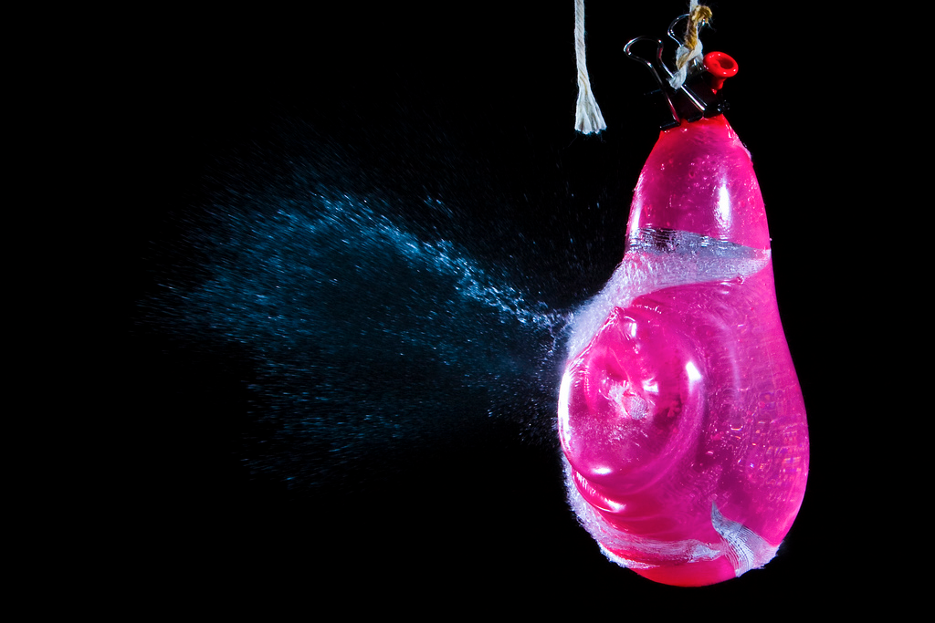
Shutter Speed
Was the shutter open a long time or a short time?
[Photo by Terence Tam]

Slide 30
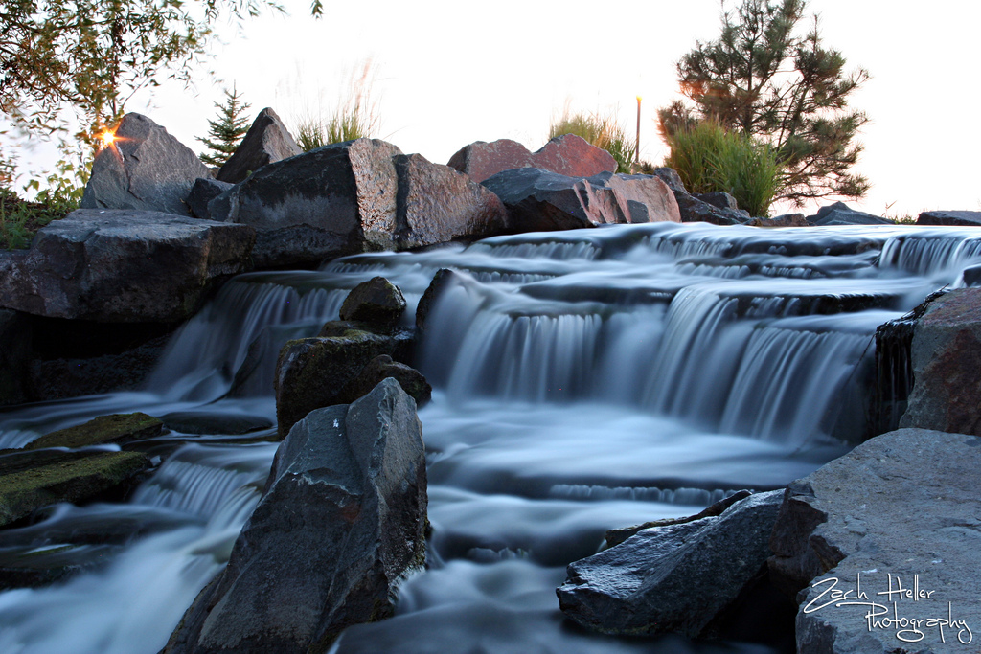
Shutter Speed
Was the shutter open a long time or a short time?
[Photo by Zach Heller]

Slide 31
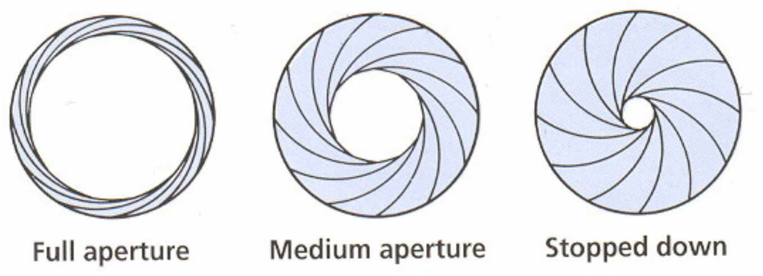
Aperture
[Slide content from Fredo Durand]
f/1.4
f/16
- Trades off more/less light.
- Controls depth of field

Slide 32
Outline
Human eyes
How do they sense light?
Visible light and human color perception
Electronic eyes
How do they sense light?
Image and color representation
Camera models
Pinhole camera and lenses
Transformation matrices
Camera calibration

Slide 33
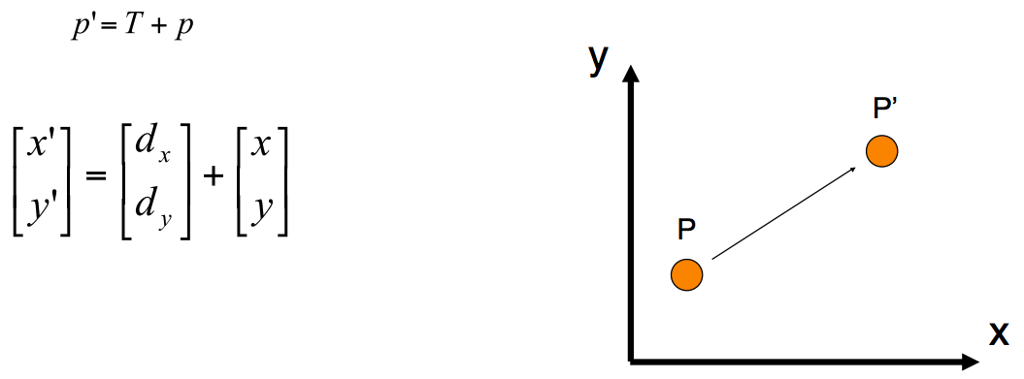
2D Transformations: Translation

Slide 34
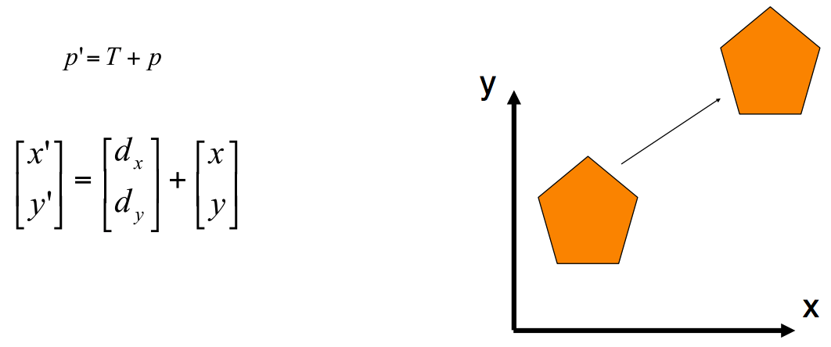
2D Transformations: Translation

Slide 35
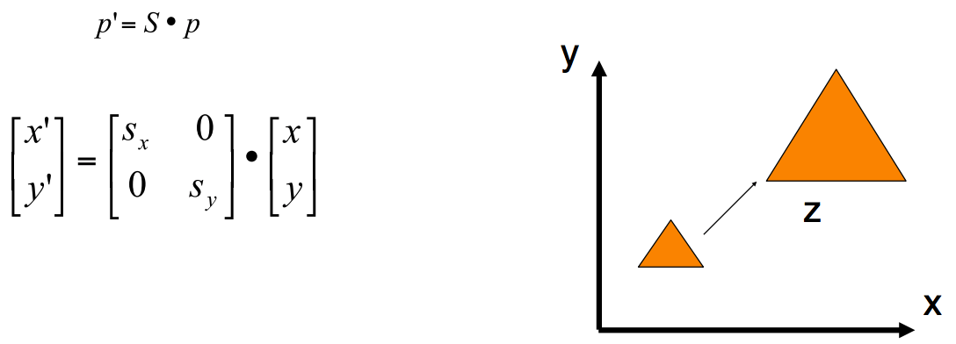
2D Transformations: Scaling

Slide 36
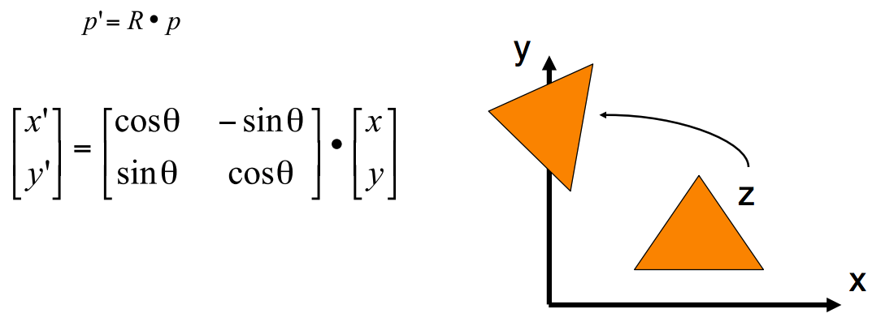
2D Transformations: Rotation
Inverse of any rotation matrix R is just R^{T}.

Slide 37
Transformation Matrices
Slide from Fei-Fei Li and Juan Carlos Niebles

Slide 38
Homogeneous Coordinates
Slide from Fei-Fei Li and Juan Carlos Niebles

Slide 39
Homogeneous Coordinates
Slide from Fei-Fei Li and Juan Carlos Niebles

Slide 40
2D Translation Using Homogeneous Coordinates
$$p^{′}=Tp$$
$\left[\begin{matrix}x′ \\ y′ \\ 1\end{matrix}\right]=\left[\begin{matrix}1 & 0 & t_{x} \\ 0 & 1 & t_{y} \\ 0 & 0 & 1\end{matrix}\right]$ $\left[\begin{matrix}x \\ y \\ 1\end{matrix}\right]$

Slide 41
2D Transformations: Scaling
$$p^{′}=Sp$$
$\left[\begin{matrix}x′ \\ y′ \\ 1\end{matrix}\right]=\left[\begin{matrix}s_{x} & 0 & 0 \\ 0 & s_{y} & 0 \\ 0 & 0 & 1\end{matrix}\right]$ $\left[\begin{matrix}x \\ y \\ 1\end{matrix}\right]$

Slide 42
2D Rotation Using Homogeneous Coordinates
$$p^{′}=Rp$$
$$\left[\begin{matrix}x′ \\ y′ \\ 1\end{matrix}\right]=\left[\begin{matrix}cosθ & −sinθ & 0 \\ sinθ & cosθ & 0 \\ 0 & 0 & 1\end{matrix}\right]\left[\begin{matrix}x \\ y \\ 1\end{matrix}\right]$$

Slide 43
3D Homogeneous Coordinates
Represent a 3D point as:
If last coordinate ends up non-one, convention is to divide by it:
$$\left[\begin{aligned}\begin{matrix}x \\ y\end{matrix} \\ z \\ 1\end{aligned}\right]$$
$$\left[\begin{aligned}\begin{matrix}x \\ y\end{matrix} \\ z \\ w\end{aligned}\right]=>\left[\begin{aligned}\begin{matrix}x/w \\ y/w\end{matrix} \\ z/w \\ 1\end{aligned}\right]$$

Slide 44
3D Homogeneous Coordinates
Translation by (t_{x}, t_{y}, t_{z}):
$$p^{′}=Tp$$
$\left[\begin{matrix}x^{′} \\ \begin{aligned}y^{′} \\ z^{′}\end{aligned} \\ 1\end{matrix}\right]=\left[\begin{matrix}1 & 0 & 0 & t_{x} \\ 0 & 1 & 0 & t_{y} \\ 0 & 0 & 1 & t_{z} \\ 0 & 0 & 0 & 1\end{matrix}\right]$ $\left[\begin{matrix}x \\ \begin{aligned}y \\ z\end{aligned} \\ 1\end{matrix}\right]$

Slide 45
3D Homogeneous Coordinates
Scaling by (s_{x}, s_{y}, s_{z}):
$$p^{′}=Sp$$
$\left[\begin{matrix}x^{′} \\ \begin{aligned}y^{′} \\ z^{′}\end{aligned} \\ 1\end{matrix}\right]=\left[\begin{matrix}s_{x} & 0 & 0 & 0 \\ 0 & s_{y} & 0 & 0 \\ 0 & 0 & s_{z} & 0 \\ 0 & 0 & 0 & 1\end{matrix}\right]$ $\left[\begin{matrix}x \\ \begin{aligned}y \\ z\end{aligned} \\ 1\end{matrix}\right]$

Slide 46
3D Homogeneous Coordinates
Rotation around z axis:
$$p^{′}=Rzp$$
$\left[\begin{matrix}x^{′} \\ \begin{aligned}y^{′} \\ z^{′}\end{aligned} \\ 1\end{matrix}\right]=\left[\begin{matrix}cosθ & −sinθ & 0 & 0 \\ sinθ & cosθ & 0 & 0 \\ 0 & 0 & 1 & 0 \\ 0 & 0 & 0 & 1\end{matrix}\right]$ $\left[\begin{matrix}x \\ \begin{aligned}y \\ z\end{aligned} \\ 1\end{matrix}\right]$

Slide 47
Outline
Human eyes
How do they sense light?
Visible light and human color perception
Electronic eyes
How do they sense light?
Image and color representation
Camera models
Pinhole camera and lenses
Transformation matrices
Camera calibration

Slide 48
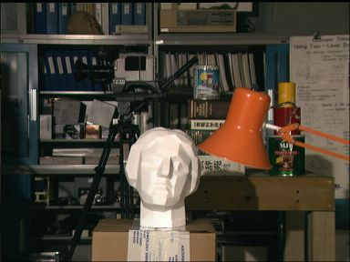
Camera Calibration
Determine mathematical relationship between points in 3D and their projection onto a 2D imaging plane
3D scene
Imaging
device
2D image
[Tsukuba]

Slide 49
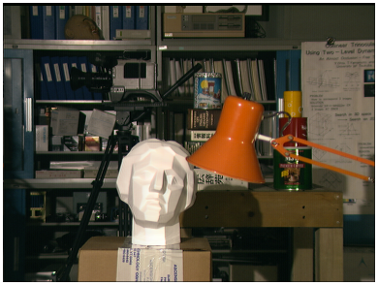
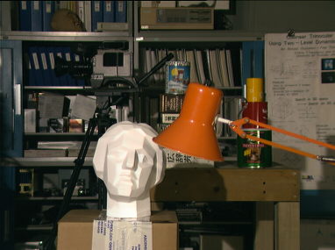
Stereo Vision

Slide 50
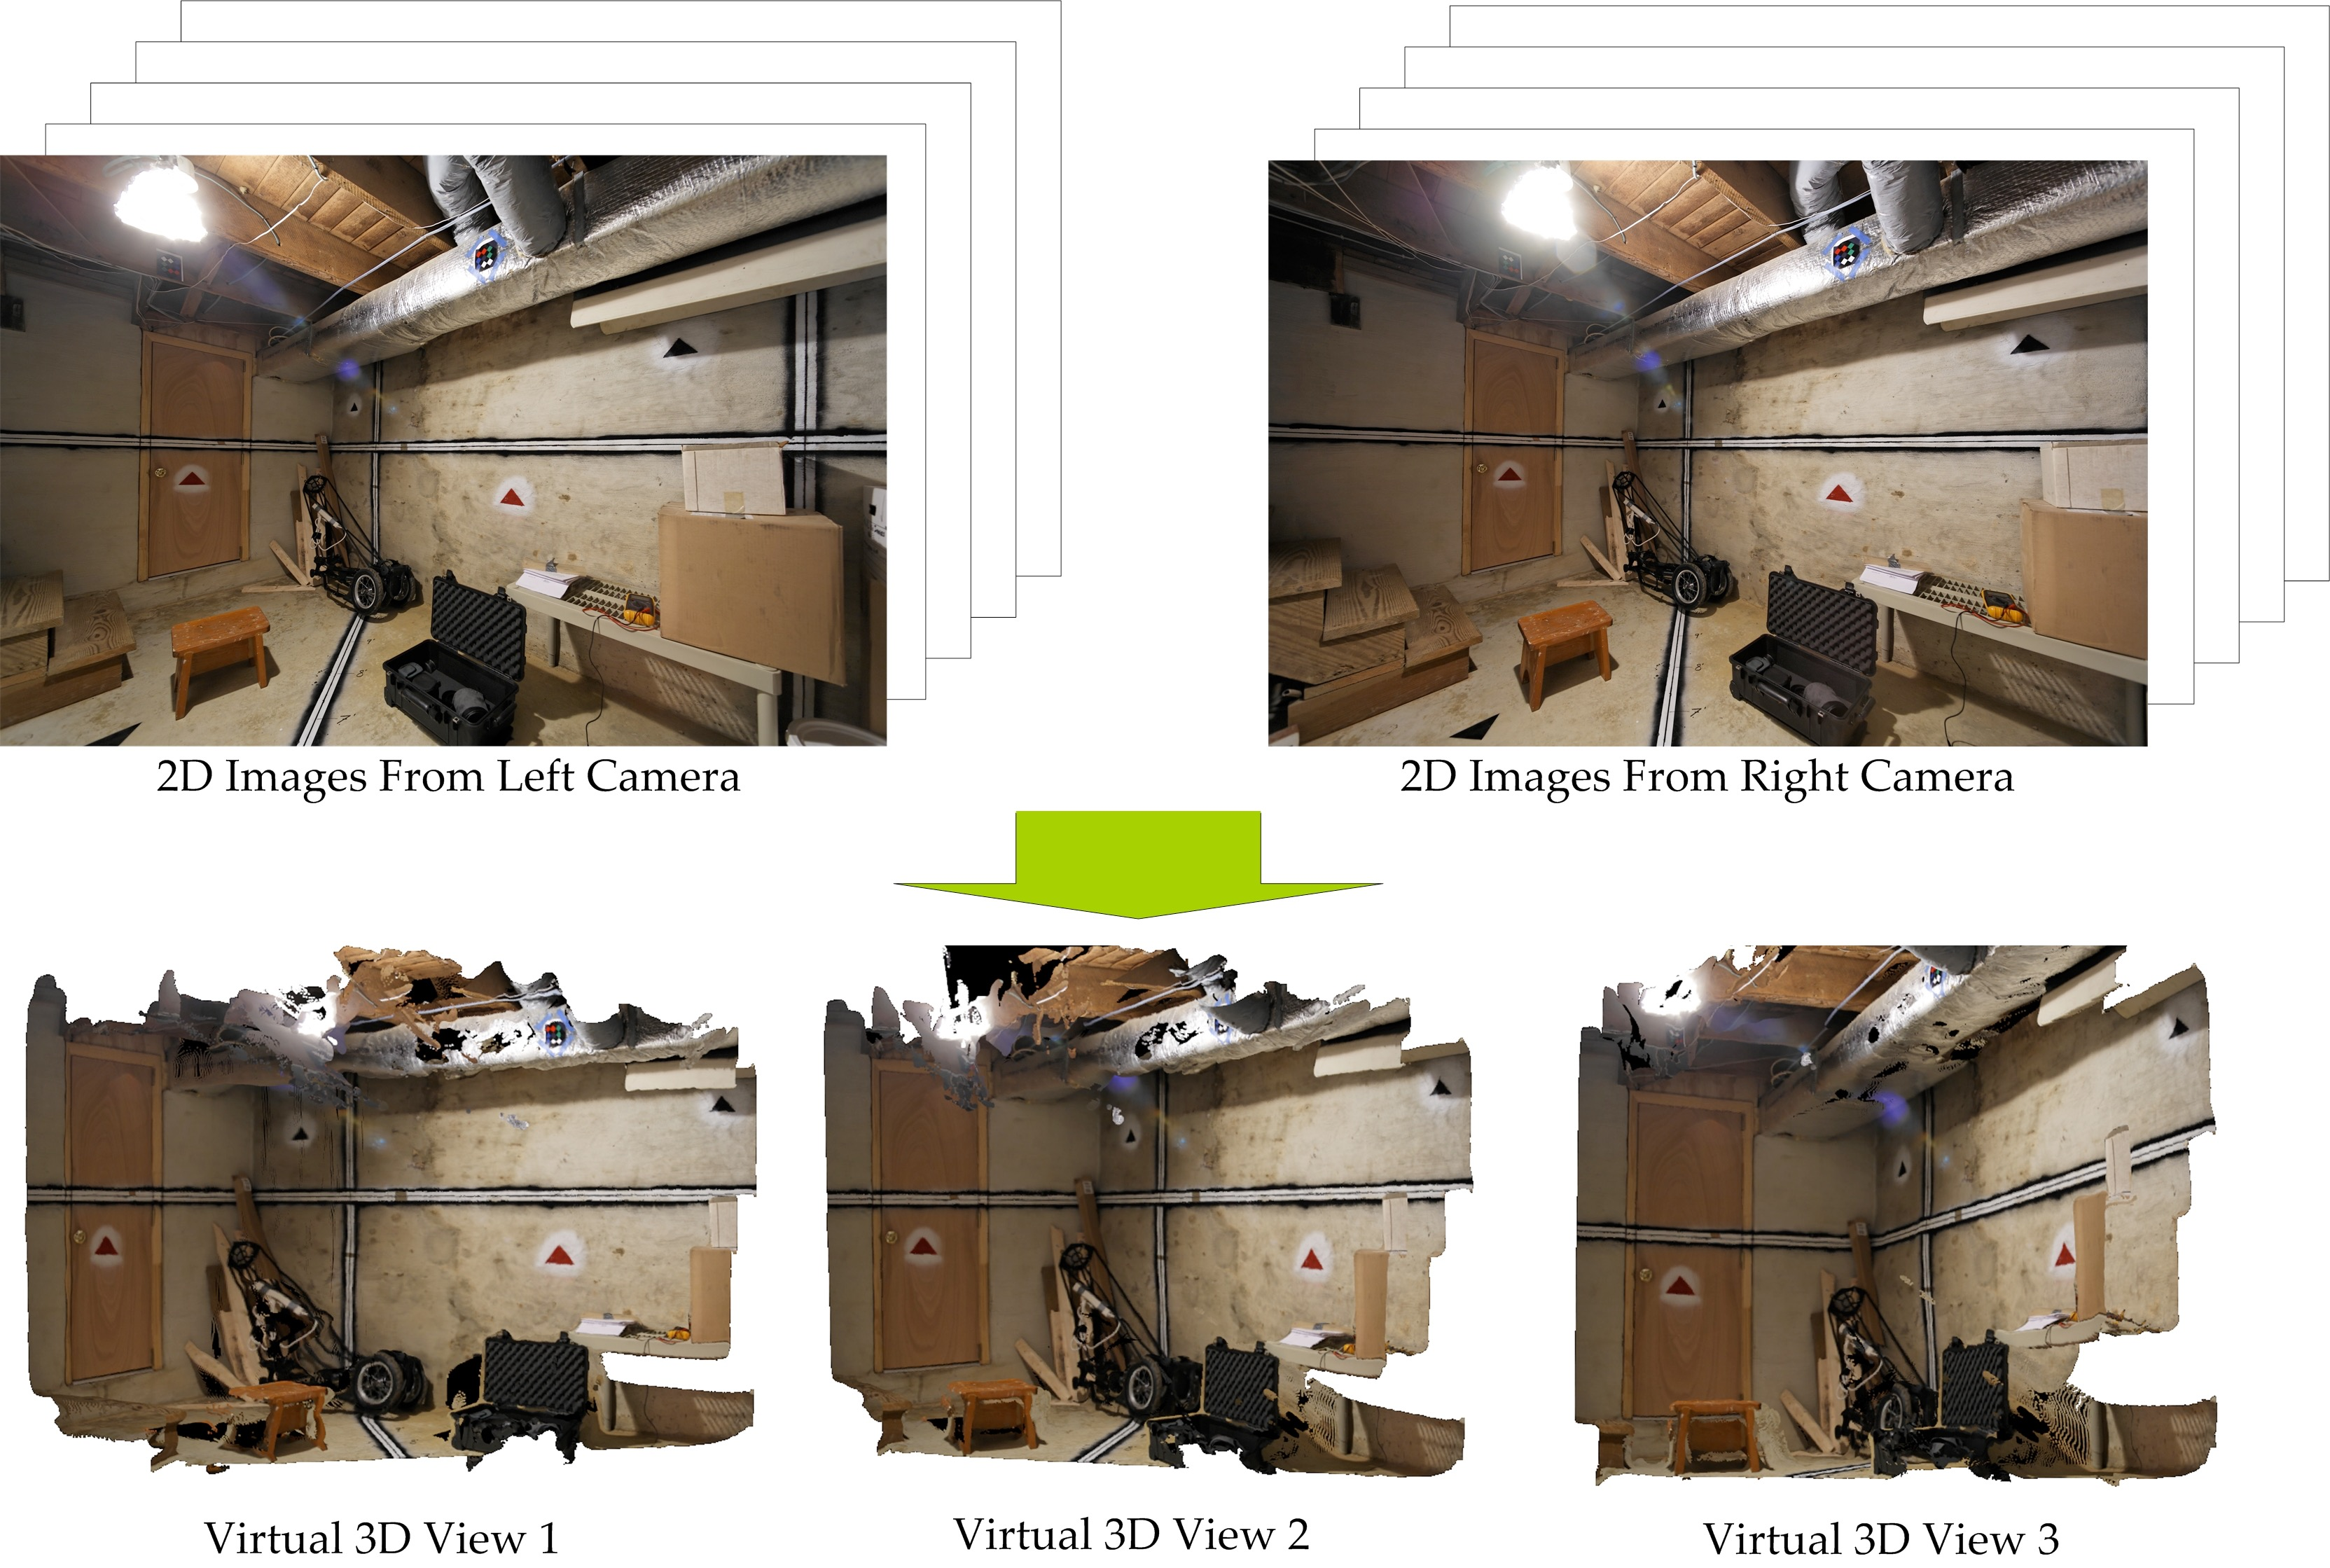
Principal Application: 3D Scene Reconstruction
[Zhu and Humphreys]

Slide 51
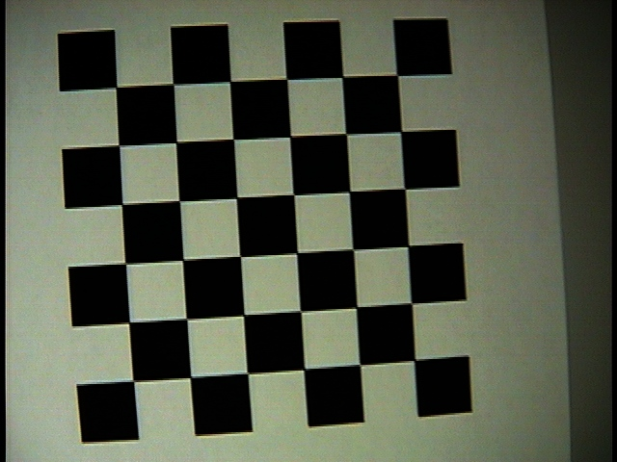
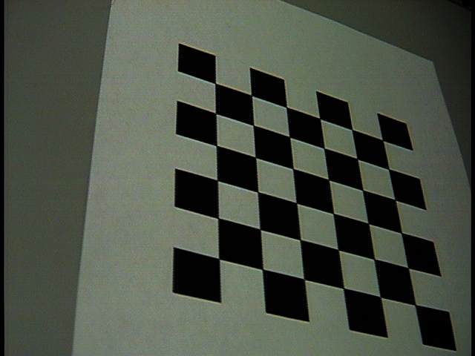
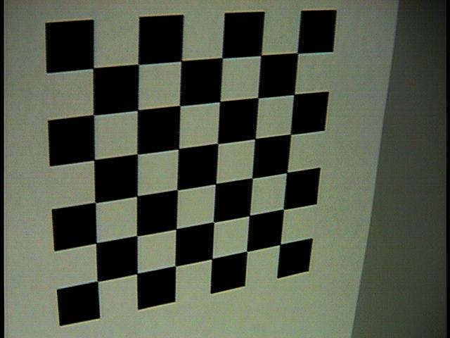
Camera Calibration
Take pictures of scene with known 3D structure and solve for free parameters in projection:
y
x
z

Slide 52
Camera Calibration
Need to address these issues:
How do we model the way a camera projects 3D points onto a 2D image?
How many parameters are involved in this projection and what is their relationship (linear/non-linear)?
Which measurements/how many allow us to robustly estimate these parameters?

Slide 53
Pinhole Camera Model: Camera Matrix
Camera matrix: a 3x4 matrix that transforms from 3D scene points (x, y, z) to 2D screen points (x$′$/w$′$, y$′$/w$′$):
How many free parameters in the camera matrix?
$\left[\begin{matrix}x^{′} \\ y^{′} \\ w^{′}\end{matrix}\right]=\left[\begin{matrix}c_{11} & c_{12} & c_{13} & c_{14} \\ c_{21} & c_{22} & c_{23} & c_{24} \\ c_{31} & c_{32} & c_{33} & c_{34}\end{matrix}\right]$ $\left[\begin{matrix}x \\ \begin{aligned}y \\ z\end{aligned} \\ 1\end{matrix}\right]$

Slide 54
Pinhole Camera Model
Can rewrite the camera matrix in terms of intrinsic and extrinsic parameters.
How many intrinsic parameters?
How many extrinsic parameters?
How many parameters in total?
$\left[\begin{matrix}x^{′} \\ y^{′} \\ w^{′}\end{matrix}\right]=K \left[\begin{matrix}R & t\end{matrix}\right]$ $\left[\begin{matrix}x \\ \begin{aligned}y \\ z\end{aligned} \\ 1\end{matrix}\right]$
K=$\left[\begin{matrix}α_{x} & γ & u_{0} \\ 0 & α_{x} & v_{0} \\ 0 & 0 & 1\end{matrix}\right]$
Intrinsic matrix
Screen coordinates
World coordinates
$α_{x}$, $α_{y}$ focal length in pixels, $γ$ skew between x and y axes (often zero), $u_{0}$, $v_{0}$ principal point (typically center of image).

Slide 55
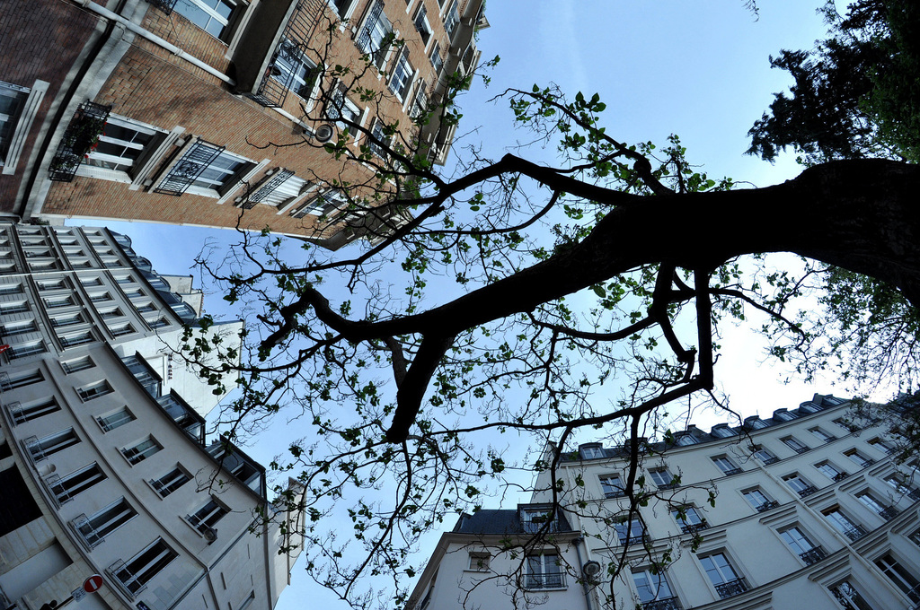
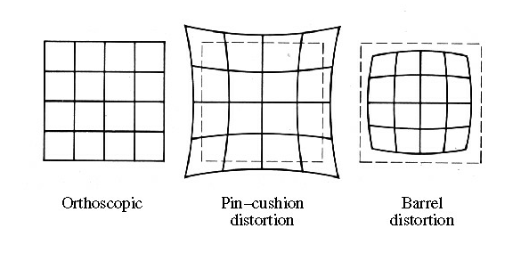
Real Camera Model: Radial Distortion
Photo by Renaud Leon, Creative Commons Licensed

Slide 56
Real Camera Model: Radial Distortion
These nonlinear effects cannot be represented by a matrix
Additional intrinsic parameters (for more accuracy, can also include r⁴, r⁶ terms)

Slide 57
Camera Calibration
Take pictures of scene with known 3D structure and solve for free parameters in projection:
y
x
z

Slide 58
Calibration Algorithms
Particular method used depends on:
What data is available!
Intrinsics only vs. extrinsics only vs. both
Camera model being used (pinhole, affine, etc.)
Typical model (e.g. OpenCV): pinhole + radial distortion

Slide 59
Camera Calibration: Example #1
Given:
3D <=> 2D correspondences
Pinhole camera model (no radial distortion)
Convert camera matrix into system of equations:
$\left[\begin{matrix}x^{′} \\ y^{′} \\ w^{′}\end{matrix}\right]=\left[\begin{matrix}c_{11} & c_{12} & c_{13} & c_{14} \\ c_{21} & c_{22} & c_{23} & c_{24} \\ c_{31} & c_{32} & c_{33} & c_{34}\end{matrix}\right]$ $\left[\begin{matrix}x \\ \begin{aligned}y \\ z\end{aligned} \\ 1\end{matrix}\right]$

Slide 60
Camera Calibration: Example #1
Known 3D point 1
Convert camera matrix into system of equations:
$$u_{1}^{}=\frac{c_{11}x_{1}+c_{12}y_{1}+c_{13}z_{1}+c_{14}}{c_{31}x_{1}+c_{32}y_{1}+c_{33}z_{1}+c_{34}}$$
Known screen point 1
$$v_{1}^{}=\frac{c_{21}x_{1}+c_{22}y_{1}+c_{23}z_{1}+c_{24}}{c_{31}x_{1}+c_{32}y_{1}+c_{33}z_{1}+c_{34}}$$
.
.
.
Can solve with nonlinear least squares (e.g. scipy.optimize.least_squares)

Slide 61
Camera Calibration in Practice
Camera Calibration with OpenCV
YouTube Video

