Slide 1
CS 6501: 3D Reconstruction and Understanding
Feature Detection and Matching
Connelly Barnes
Slides from Jason Lawrence, Fei Fei Li, Juan Carlos Niebles, Alexei Efros, Rick Szeliski, Fredo Durand, Kristin Grauman, James Hays

Slide 2
Outline
Motivation for sparse features
Harris corner detector
Difference of Gaussian (blob) feature detector
Sparse feature descriptor: SIFT
Robust model fitting
  Hough transform
  RANSAC
Application: panorama stitching

Slide 3
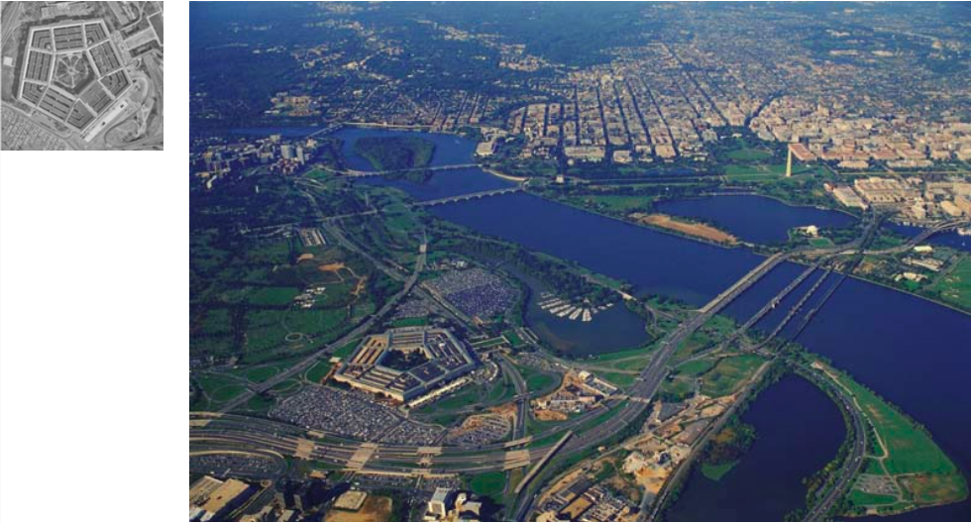
Motivation: Image Matching (Hard Problem)
Slide from Fei Fei Li, Juan Carlos Niebles

Slide 4
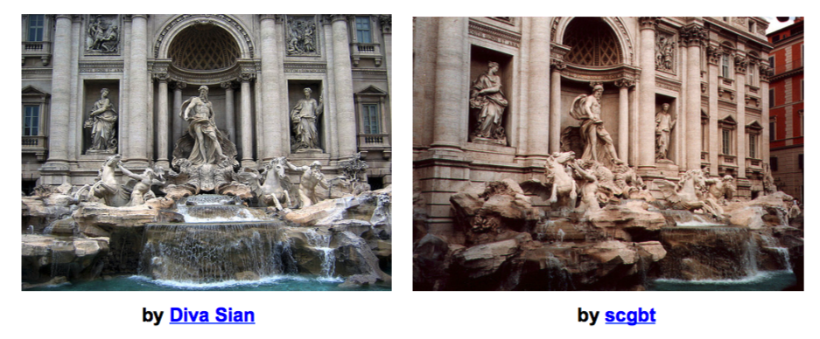
Motivation: Image Matching (Harder Case)
Slide from Fei Fei Li, Juan Carlos Niebles, Steve Seitz

Slide 5
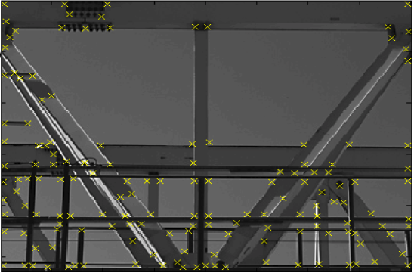
What is a Feature?
  In computer vision, a feature refers to a region of interest in an image: typically, low-level features, such as corner, edge, blob.
Corner features
Slide from Krystian Mikolajczyk

Slide 6
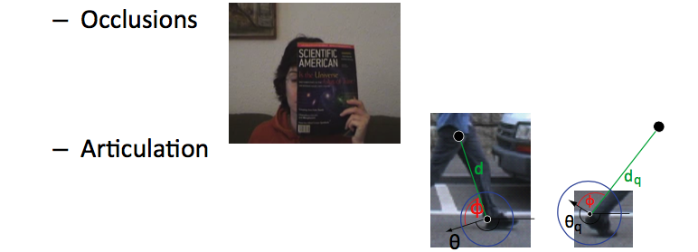
Motivation for sparse/local features
  Global features can only summarize the overall content of the image.
Local (or sparse) features can allow us to match local regions with more geometric accuracy.
Increased robustness to:
Slide from Fei Fei Li, Juan Carlos Niebles

Slide 7

Motivating Application: Panorama Stitching
Are you getting the whole picture?
  Compact Camera FOV = 50 x 35°
Slide from Brown & Lowe

Slide 8
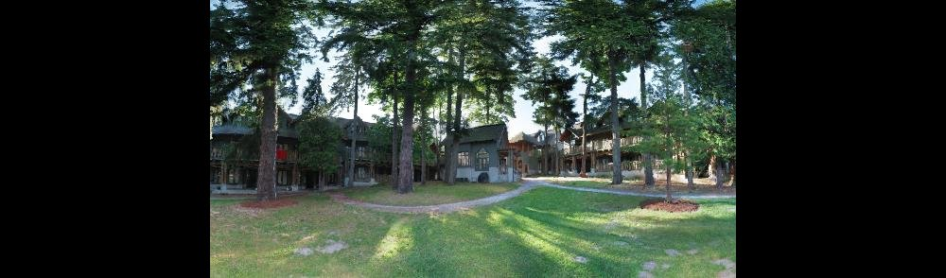
Motivating Application: Panorama Stitching
Are you getting the whole picture?
  Compact Camera FOV = 50 x 35°
  Human FOV = 200 x 135°
Slide from Brown & Lowe

Slide 9
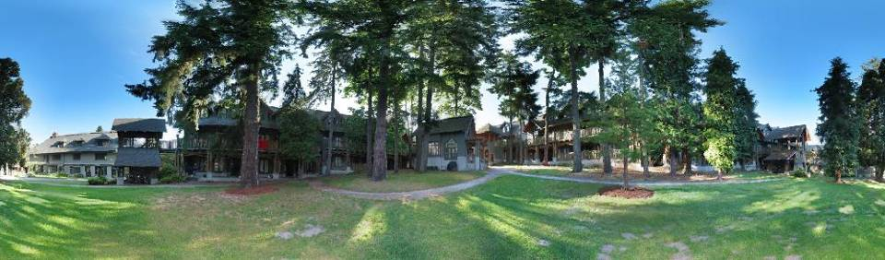
Motivating Application: Panorama Stitching
Are you getting the whole picture?
  Compact Camera FOV = 50 x 35°
  Human FOV = 200 x 135°
  Panoramic Mosaic = 360 x 180°
Slide from Brown & Lowe

Slide 10
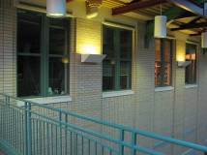
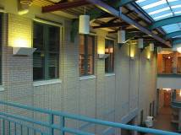
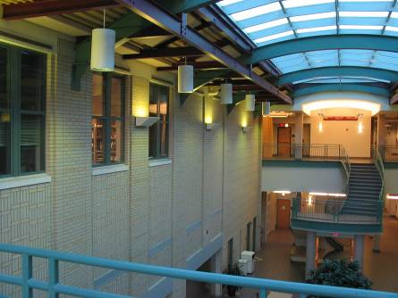
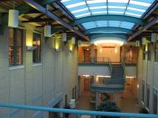
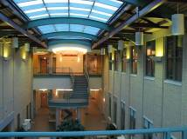
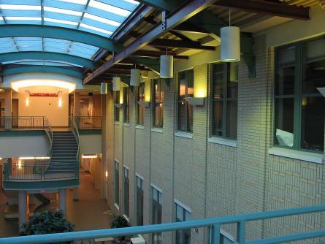
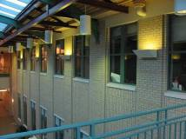
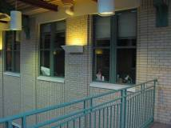
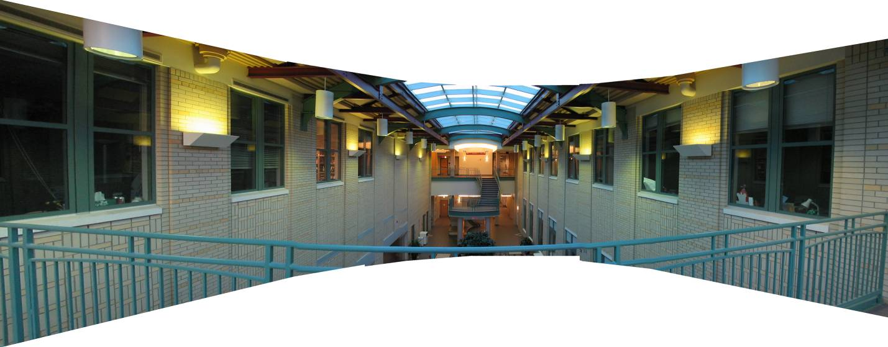
Mosaics: stitching images together
virtual wide-angle camera

Slide 11
Image Alignment
How do we align two images automatically?
Two broad approaches:
  Feature-based alignment
    Find a few matching features in both images
    Compute alignment
  Direct (pixel-based) alignment
    Search for alignment where most pixels agree
    High computation requirements if many unknown alignment parameters

Slide 12
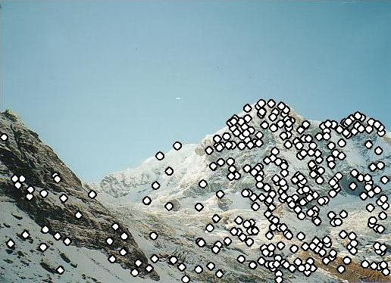
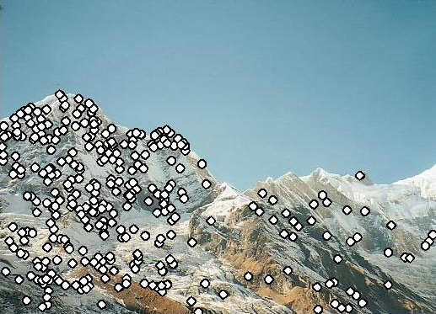
Feature-based Panorama Stitching
Find corresponding feature points
Fit a model placing the two images in correspondence
Blend / cut
?

Slide 13
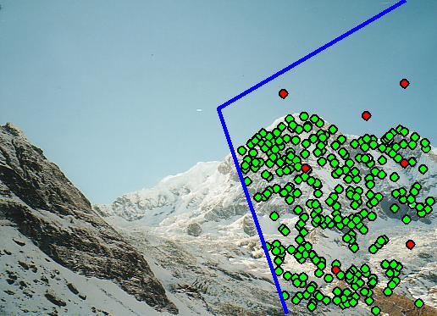
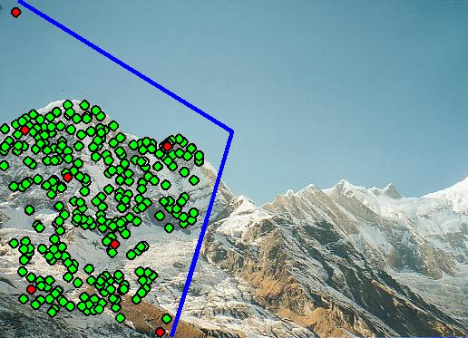
Feature-based Panorama Stitching
Find corresponding feature points
Fit a model placing the two images in correspondence
Blend / cut

Slide 14
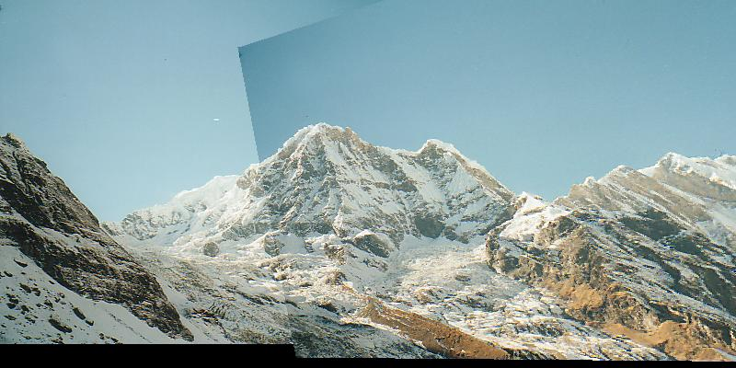
Feature-based Panorama Stitching
Find corresponding feature points
Fit a model placing the two images in correspondence
Blend / cut

Slide 15
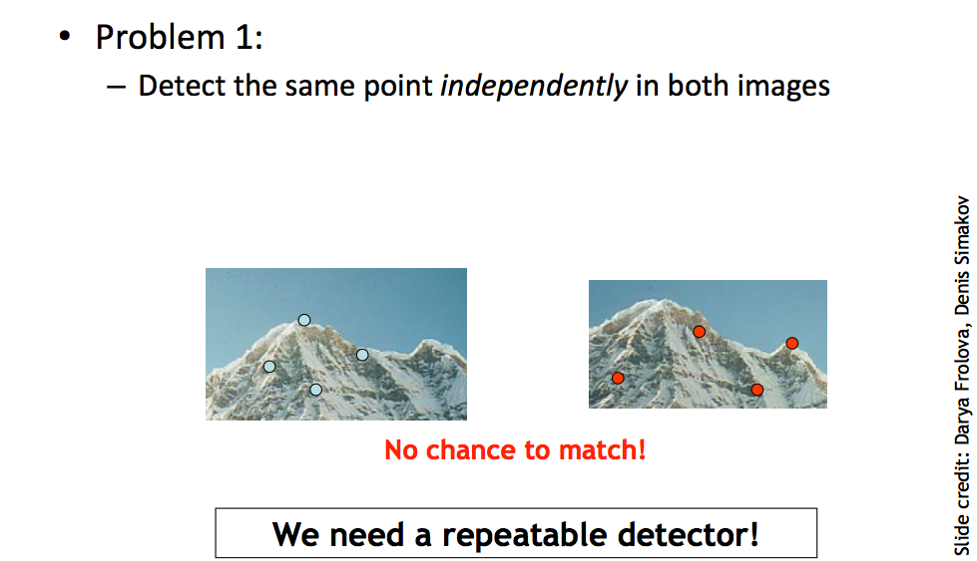
Requirements for the Features

Slide 16
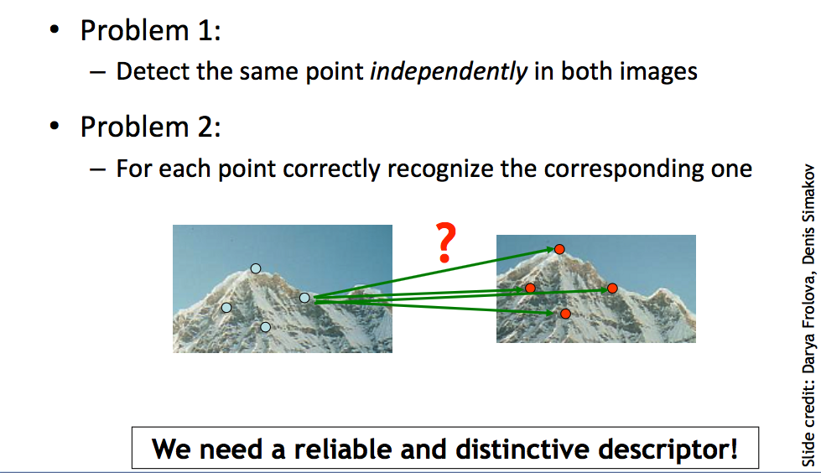
Requirements for the Features

Slide 17
Outline
Motivation for sparse features
Harris corner detector
Difference of Gaussian (blob) feature detector
Sparse feature descriptor: SIFT
Robust model fitting
  Hough transform
  RANSAC
Application: panorama stitching

Slide 18
Harris Corner Detector: Basic Idea
We should easily recognize the point by looking through a small window
Shifting a window in any direction should give a large change in intensity

Slide 19
Harris Corner Detector: Basic Idea
“flat” region:
no change in all directions
“edge”:
no change along the edge direction
“corner”:
significant change in all directions

Slide 20

Gradient covariance matrix
Summarizes second-order statistics of the gradient (F_{x}, F_{y})
in a window u = -m … m, v = -m … m around the center pixel (x, y).

Slide 21
Harris Detector: Mathematics
Classification of image points using eigenvalues of M:
λ₂
“Edge”
λ₂ >> λ₁
“Corner”
λ₁ and λ₂ are large,
λ₁ ~ λ₂;
E increases in all directions
λ₁ and λ₂ are small;
E is almost constant in all directions
“Flat” region
“Edge”
λ₁ >> λ₂
λ₁

Slide 22
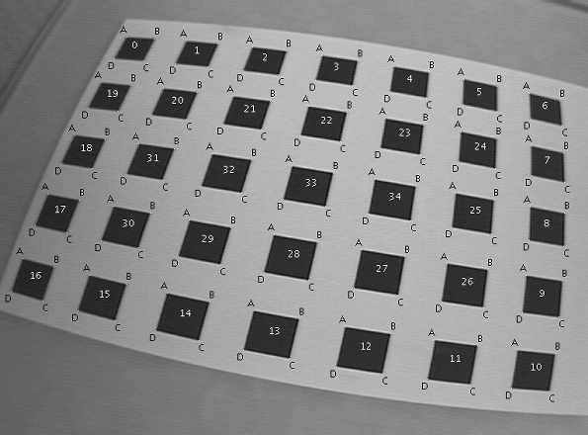
Applications of Corner Detectors

Slide 23
Applications of Corner Detectors
Augmented reality (video puppetry)
3D photography / light fields

Slide 24
Outline
Motivation for sparse features
Harris corner detector
Difference of Gaussian (blob) feature detector
Sparse feature descriptor: SIFT
Robust model fitting
  Hough transform
  RANSAC
Application: panorama stitching

Slide 25
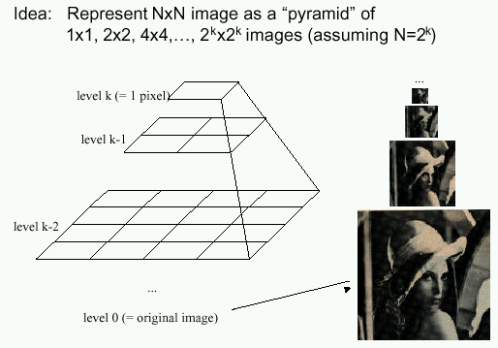
Gaussian Pyramids
Known as a Gaussian Pyramid [Burt and Adelson, 1983]
  In computer graphics, a mip map [Williams, 1983]
  A precursor to wavelet transform
Slide by Steve Seitz

Slide 26
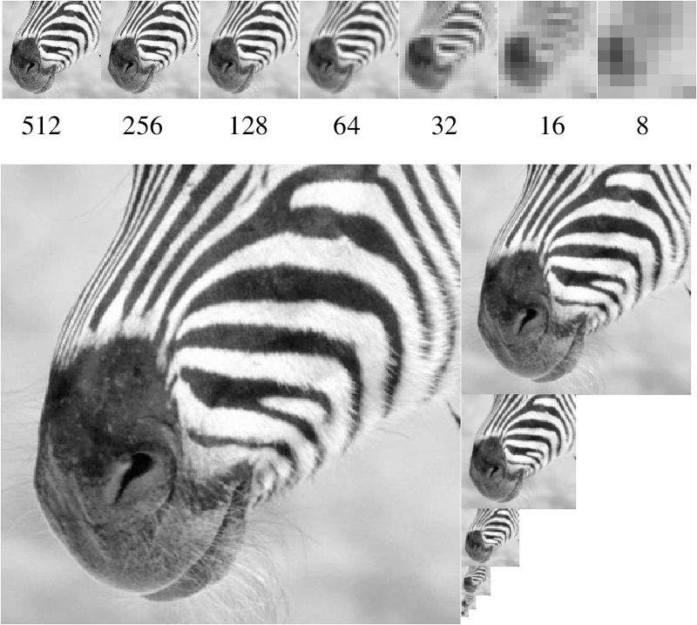
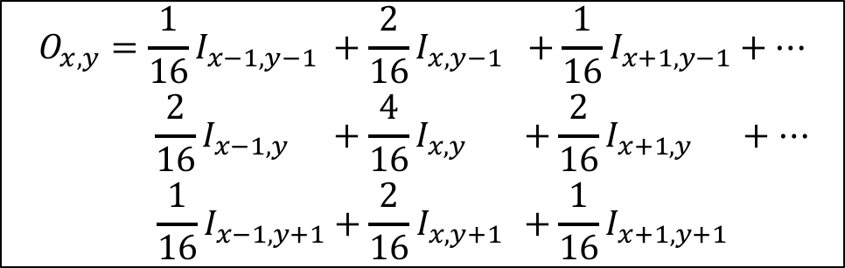
To generate the next level in the pyramid:
1. Filter with Gaussian filter (blurs image)
Typical filter:
2. Discard every other row and column
(nearest neighbor subsampling).
1/16 | 2/16 | 1/16
2/16 | 4/16 | 2/16
1/16 | 2/16 | 1/16
$$\begin{aligned}{O_{x,y}=\frac{1}{16}I}_{x−1,y−1} +\frac{2}{16}I_{x,y−1} +\frac{1}{16}I_{x+1,y−1}+… \\ {\frac{2}{16}I}_{x−1,y }+\frac{4}{16}I_{x,y }+\frac{2}{16}I_{x+1,y }+… \\ {\frac{1}{16}I}_{x−1,y+1}+\frac{2}{16}I_{x,y+1 }+\frac{1}{16}I_{x+1,y+1} \end{aligned}$$
Figure from David Forsyth

Slide 27
What are they good for?
Improve Search
  Search over translations
    E.g. convolve with a filter of what we are looking for (circle filter?)
    Can use “coarse to fine” search: discard regions that are not of interest at coarse levels.
  Search over scale
    Template matching
    E.g. find a face at different scales
Pre-computation
  Need to access image at different blur levels
  Useful for texture mapping at different resolutions (called mip-mapping)

Slide 28
Difference of Gaussians Feature Detector
Idea: Find blob regions of various sizes
Approach:
  Run linear filter (Difference of Gaussians)
  At different resolutions of image pyramid
Often used for computing SIFT.
“SIFT” = DoG detector + SIFT descriptor

Slide 29
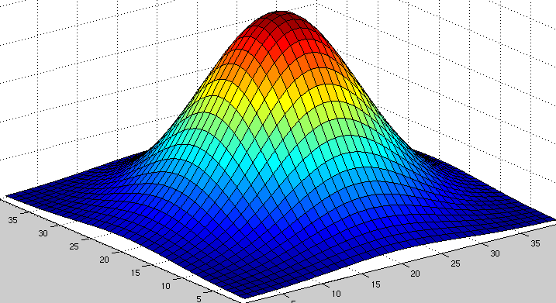
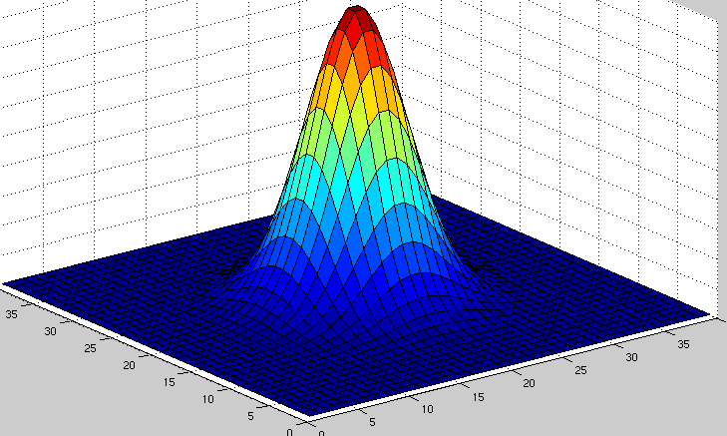
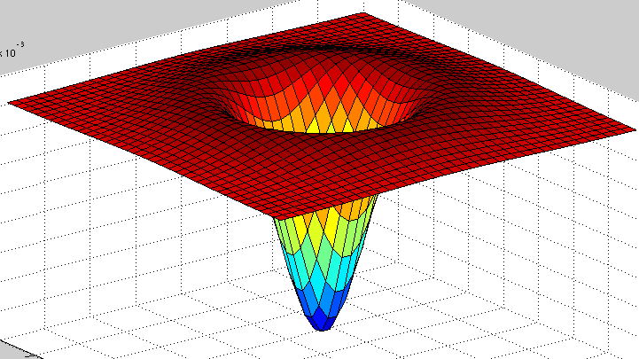
Difference of Gaussians
Minus
Gaussian with
parameter Kσ
Gaussian with
parameter σ
Equals
Typical K = 1.6

Slide 30
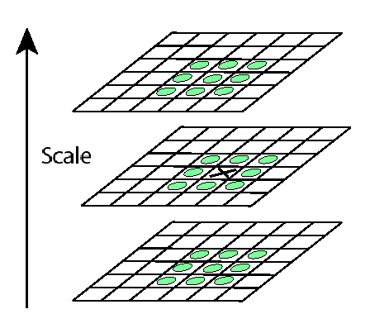
Non-maxima (non-minima) suppression
Detect maxima and minima of difference-of-Gaussian in scale space
For local maximum, how should the value of X be related to the value of the green circles?

Slide 31
Difference of Gaussian Detected Keypoints
Image from Ravimal
Bandara at CodeProject

Slide 32
Outline
Motivation for sparse features
Harris corner detector
Difference of Gaussian (blob) feature detector
Sparse feature descriptor: SIFT
Robust model fitting
  Hough transform
  RANSAC
Application: panorama stitching

Slide 33
Feature Descriptors
We know how to detect points (corners, blobs)
Next question: How to match them?
?
Point descriptor should be:
  Invariant 2. Distinctive

Slide 34
Descriptors Invariant to Rotation
Find local orientation
  Make histogram of 36 different angles (10 degree increments).
  Vote into histogram based on magnitude of gradient.
  Detect peaks from histogram.
Dominant direction of gradient
Extract image patches relative to this orientation

Slide 35
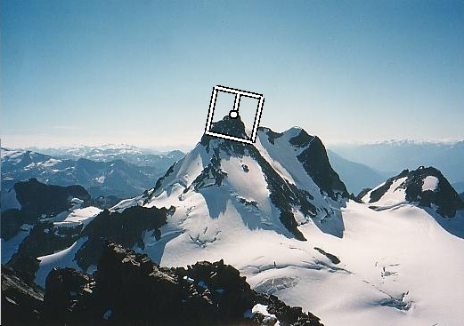
SIFT Keypoint: Orientation
Orientation = dominant gradient
Rotation Invariant Frame
  Scale-space position (x, y, s) + orientation (θ)

Slide 36
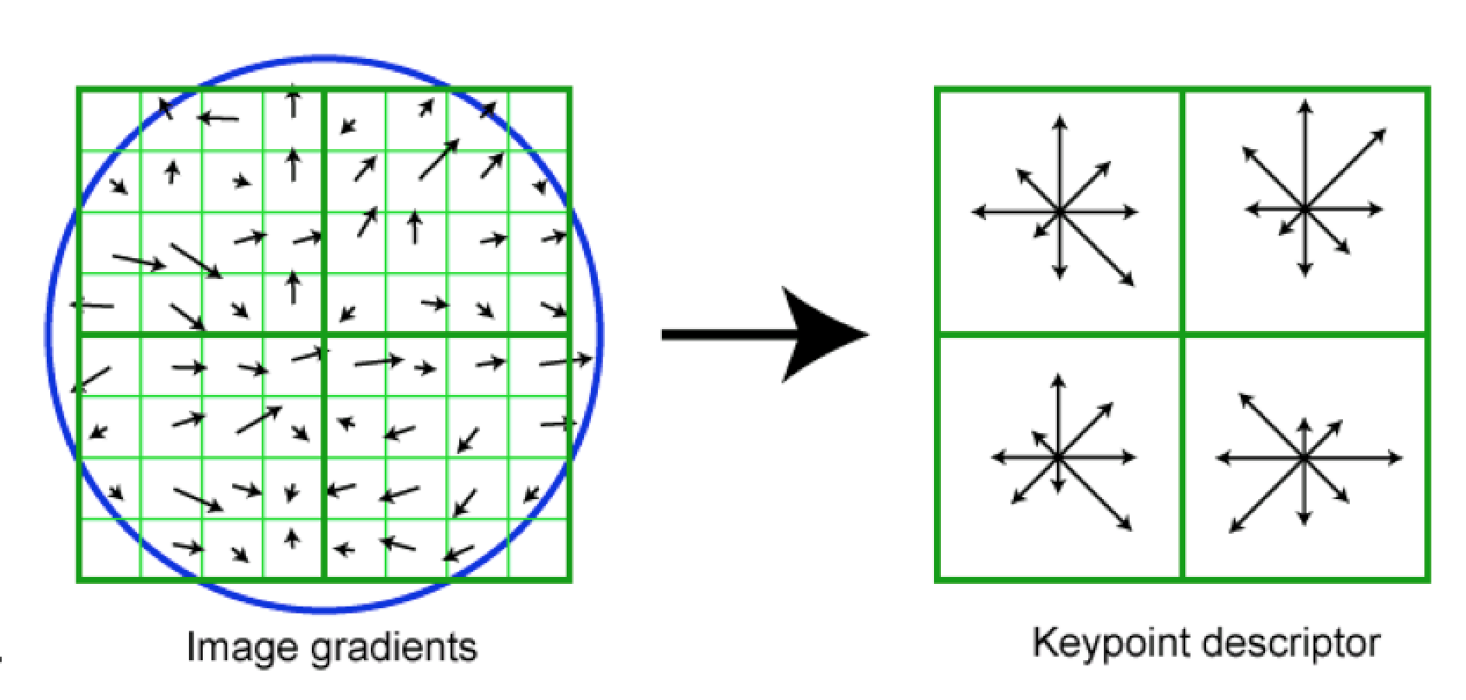
SIFT Descriptor (A Feature Vector)
Image gradients are sampled over 16x16 array of locations.
Find gradient angles relative to keypoint orientation (in blue)
Accumulate into array of orientation histograms
8 orientations x 4x4 histogram array = 128 dimensions
Keypoint

Slide 37
SIFT Descriptor (A Feature Vector)
Often “SIFT” =
  Difference of Gaussian keypoint detector, plus
  SIFT descriptor
  But you can also use SIFT descriptor computed at other locations
  (e.g. at Harris corners, at every pixel, etc)
More details: Lowe 2004 (especially Sections 3-6)

Slide 38
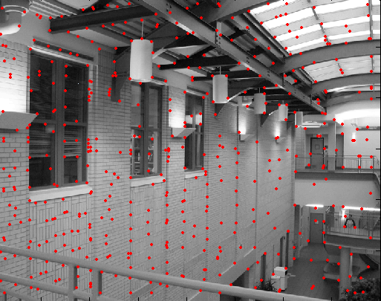
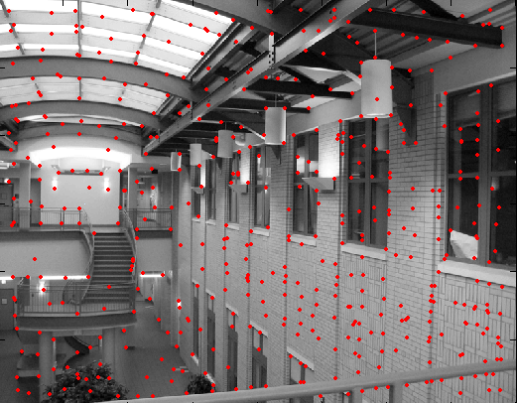
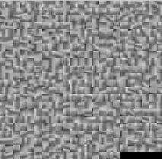
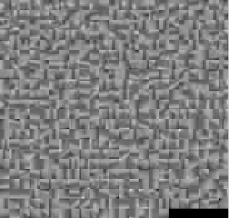
Feature Matching
?

Slide 39
Feature Matching
Exhaustive search
  for each feature in one image, look at all the other features in the other image(s)
Hashing (see locality sensitive hashing)
  Project into a lower k dimensional space, e.g. by random projections, use that as a “key” for a k-d hash table, e.g. k=5.
Nearest neighbor techniques
  kd-trees (available in libraries, e.g. SciPy, OpenCV, FLANN, Faiss).

Slide 40
What about outliers?
?

Slide 41
Feature-space outlier rejection
From [Lowe, 1999]:
  1-NN: SSD of the closest match
  2-NN: SSD of the second-closest match
  Look at how much better 1-NN is than 2-NN, e.g. 1-NN/2-NN
  That is, is our best match so much better than the rest?
  Reject if 1-NN/2-NN > threshold.

Slide 42
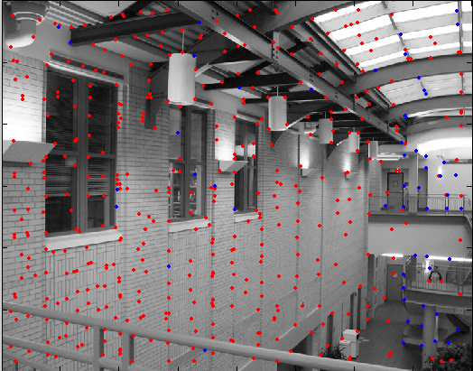
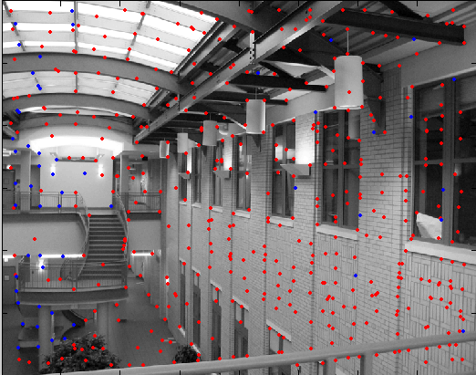
Feature-space outlier rejection
Can we now compute an alignment from the blue points? (the ones that survived the “feature space outlier rejection” test)
  No! Still too many outliers…
  What can we do?

Slide 43
Outline
Motivation for sparse features
Harris corner detector
Difference of Gaussian (blob) feature detector
Sparse feature descriptor: SIFT
Robust model fitting
  Hough transform
  RANSAC
Application: panorama stitching

Slide 44
Model fitting
Fitting: find the parameters of a model that best fit the data
Alignment: find the parameters of the transformation that best align matched points
Slide from James Hays

Slide 45
Example: Aligning Two Photographs

Slide 46
Example: Estimating a transformation
H
Slide from Silvio Savarese

Slide 47
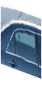
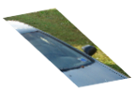
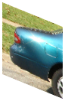
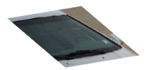
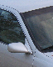
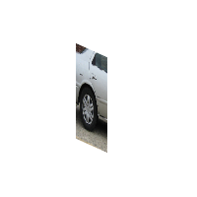

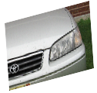
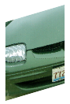
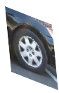

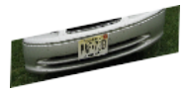

Example: fitting a 3D object model
Slide from Silvio Savarese
Notes:
As shown at the beginning, it interesting to visualize the geometrical relationship between canonical parts.
Notice that:
These 2 canonical parts share the same pose. All parts that share the same pose form a canonical pose.
These are other examples of canonical poses
Part belonging to different canonical poses are linked by a full homograhic transformation
Here we see examples of canonical poses mapped into object instances
%%
This plane collect canonical parts that share the same pose. All this canonical parts are related by a pure translation constraint.
- These canonical parts do not share the same pose and belong to different planes. This change of pose is described by the homographic transformation Aij.
- Canonical parts that are not visible at the same time are not linked.
Canonical parts that share the same pose forms a single-view submodel.
%Canonical parts that share the same pose form a single view sub-model of the object class. Canonical parts that do not belong to the same plane, correspond to different %poses of the 3d object. The linkage stucture quantifies this relative change of pose through the homographic transformations. Canonical parts that are not visible at the same %time are not linked.
Notice this representation is more flexible than a full 3d model yet, much richer than those where parts are linked by 'right to left', 'up to down‘ relationship, yet. . Also it is different from aspect graph: in that: aspect graphs are able to segment the object in stable regions across views

Slide 48
Critical issues: outliers
H
Slide from Silvio Savarese

Slide 49
Critical issues: missing data (occlusions)
Slide from Silvio Savarese
Notes:
As shown at the beginning, it interesting to visualize the geometrical relationship between canonical parts.
Notice that:
These 2 canonical parts share the same pose. All parts that share the same pose form a canonical pose.
These are other examples of canonical poses
Part belonging to different canonical poses are linked by a full homograhic transformation
Here we see examples of canonical poses mapped into object instances
%%
This plane collect canonical parts that share the same pose. All this canonical parts are related by a pure translation constraint.
- These canonical parts do not share the same pose and belong to different planes. This change of pose is described by the homographic transformation Aij.
- Canonical parts that are not visible at the same time are not linked.
Canonical parts that share the same pose forms a single-view submodel.
%Canonical parts that share the same pose form a single view sub-model of the object class. Canonical parts that do not belong to the same plane, correspond to different %poses of the 3d object. The linkage stucture quantifies this relative change of pose through the homographic transformations. Canonical parts that are not visible at the same %time are not linked.
Notice this representation is more flexible than a full 3d model yet, much richer than those where parts are linked by 'right to left', 'up to down‘ relationship, yet. . Also it is different from aspect graph: in that: aspect graphs are able to segment the object in stable regions across views

Slide 50
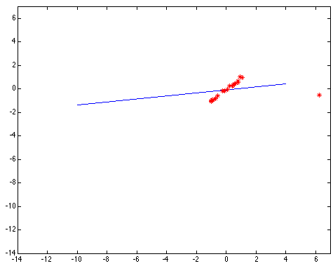
Non-robust Model Fitting
Least squares fit with an outlier:
Problem: squared error heavily penalizes outliers

Slide 51
Outline
Motivation for sparse features
Harris corner detector
Difference of Gaussian (blob) feature detector
Sparse feature descriptor: SIFT
Robust model fitting
  Hough transform
  RANSAC
Application: panorama stitching

Slide 52
Hough transform
P.V.C. Hough, Machine Analysis of Bubble Chamber Pictures, Proc. Int. Conf. High Energy Accelerators and Instrumentation, 1959
Suppose we want to fit a line.
For each point, vote in “Hough space” for all lines that the point may belong to.
y
m
x
b
Hough space
y = m x + b
Slide from S. Savarese
Notes:
􀁑 Basic ideas
• A line is represented as . Every line in the image corresponds
to a point in the parameter space
• Every point in the image domain corresponds to a line in the parameter
space (why ? Fix (x,y), (m,n) can change on the line . In other
words, for all the lines passing through (x,y) in the image space, their
parameters form a line in the parameter space)
• Points along a line in the space correspond to lines passing through the
same point in the parameter space (why ?)

Slide 53
Hough transform
y
m
x
b
y
m
3
5
3
3
2
2
3
7
11
10
4
3
2
3
1
4
5
2
2
1
0
1
3
3
x
b
Slide from S. Savarese
Notes:
􀁑 Basic ideas
• A line is represented as . Every line in the image corresponds
to a point in the parameter space
• Every point in the image domain corresponds to a line in the parameter
space (why ? Fix (x,y), (m,n) can change on the line . In other
words, for all the lines passing through (x,y) in the image space, their
parameters form a line in the parameter space)
• Points along a line in the space correspond to lines passing through the
same point in the parameter space (why ?)

Slide 54
Hough transform
P.V.C. Hough, Machine Analysis of Bubble Chamber Pictures, Proc. Int. Conf. High Energy Accelerators and Instrumentation, 1959
Issue : parameter space [m,b] is unbounded…
Use a polar representation for the parameter space
y
x
Hough space
Slide from S. Savarese
Notes:
􀁑 Basic ideas
• A line is represented as . Every line in the image corresponds
to a point in the parameter space
• Every point in the image domain corresponds to a line in the parameter
space (why ? Fix (x,y), (m,n) can change on the line . In other
words, for all the lines passing through (x,y) in the image space, their
parameters form a line in the parameter space)
• Points along a line in the space correspond to lines passing through the
same point in the parameter space (why ?)

Slide 55
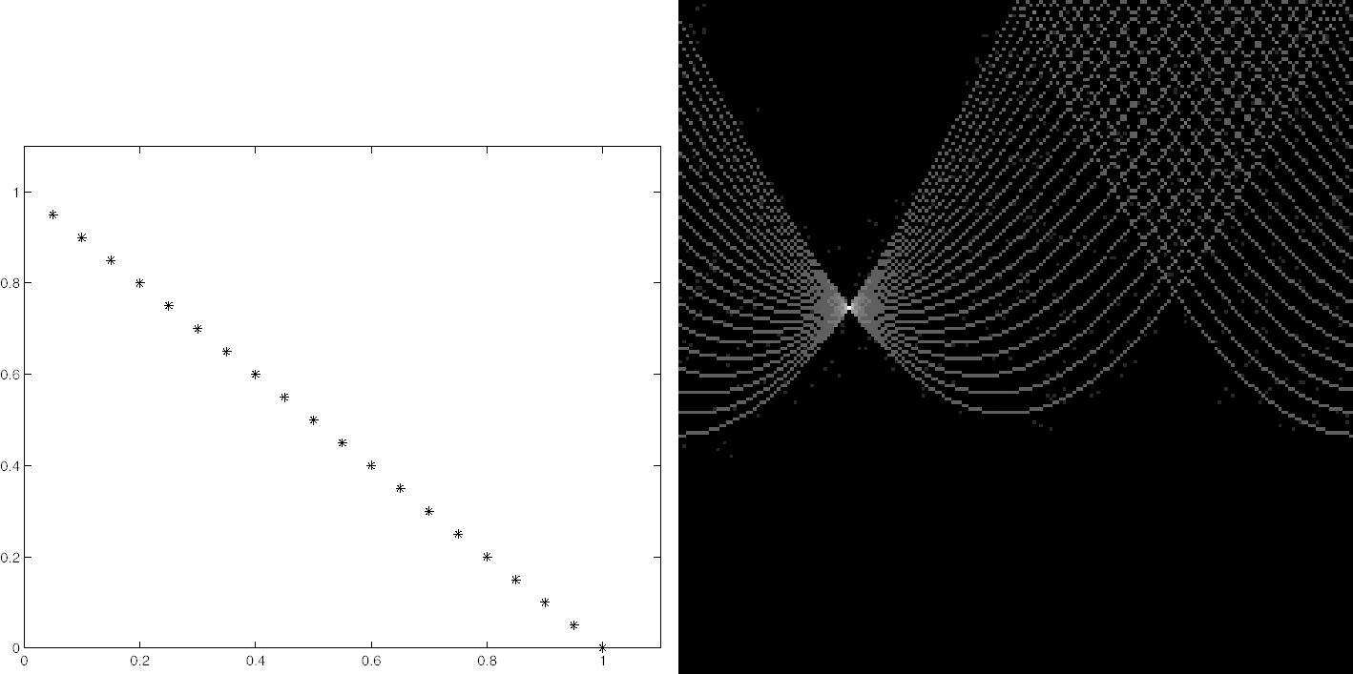
Hough Transform: Effect of Noise
[Forsyth & Ponce]

Slide 56

Hough Transform: Effect of Noise
Need to set grid / bin size based on amount of noise
[Forsyth & Ponce]

Slide 57
Discussion
Could we use Hough transform to fit:
Diamonds of a known size?
  What kinds of points would we first detect?
  What are the dimensions that we would “vote” in?
Diamonds of unknown size?
  What are the dimensions that we would “vote” in?
Ellipses?

Slide 58
Hough Transform Conclusions
Pros:
  Robust to outliers
Cons:
  Bin size has to be set carefully to trade of noise/precision/memory
  Grid size grows exponentially in number of parameters
Slide from James Hays

Slide 59
RANSAC
_{(RANdom SAmple Consensus) :}
Fischler & Bolles in ‘81.
Algorithm:
Sample (randomly) the number of points required to fit the model
Solve for model parameters using samples
Score by the fraction of inliers within a preset threshold of the model
Repeat 1-3 until the best model is found with high confidence
Notes:
Let me give you an intuition of what is going on. Suppose we have the standard line fitting problem in presence of outliers.
We can formulate this problem as follows: want to find the best partition of points in inlier set and outlier set such that…
The objective consists of adjusting the parameters of a model function so as to best fit a data set.
"best" is defined by a function f that needs to be minimized.
Such that the best parameter of fitting the line give rise to a residual error lower that delta
as when the sum, S, of squared residuals

Slide 60
RANSAC
Line fitting example
Algorithm:
Sample (randomly) the number of points required to fit the model (#=2)
Solve for model parameters using samples
Score by the fraction of inliers within a preset threshold of the model
Repeat 1-3 until the best model is found with high confidence
Illustration by Savarese
Notes:
Let me give you an intuition of what is going on. Suppose we have the standard line fitting problem in presence of outliers.
We can formulate this problem as follows: want to find the best partition of points in inlier set and outlier set such that…
The objective consists of adjusting the parameters of a model function so as to best fit a data set.
"best" is defined by a function f that needs to be minimized.
Such that the best parameter of fitting the line give rise to a residual error lower that delta
as when the sum, S, of squared residuals

Slide 61
RANSAC
Line fitting example
Algorithm:
Sample (randomly) the number of points required to fit the model (#=2)
Solve for model parameters using samples
Score by the fraction of inliers within a preset threshold of the model
Repeat 1-3 until the best model is found with high confidence
Notes:
Let me give you an intuition of what is going on. Suppose we have the standard line fitting problem in presence of outliers.
We can formulate this problem as follows: want to find the best partition of points in inlier set and outlier set such that…
The objective consists of adjusting the parameters of a model function so as to best fit a data set.
"best" is defined by a function f that needs to be minimized.
Such that the best parameter of fitting the line give rise to a residual error lower that delta
as when the sum, S, of squared residuals

Slide 62
RANSAC
Line fitting example
Algorithm:
Sample (randomly) the number of points required to fit the model (#=2)
Solve for model parameters using samples
Score by the fraction of inliers within a preset threshold of the model
Repeat 1-3 until the best model is found with high confidence
Notes:
Let me give you an intuition of what is going on. Suppose we have the standard line fitting problem in presence of outliers.
We can formulate this problem as follows: want to find the best partition of points in inlier set and outlier set such that…
The objective consists of adjusting the parameters of a model function so as to best fit a data set.
"best" is defined by a function f that needs to be minimized.
Such that the best parameter of fitting the line give rise to a residual error lower that delta
as when the sum, S, of squared residuals

Slide 63
RANSAC
Algorithm:
Sample (randomly) the number of points required to fit the model (#=2)
Solve for model parameters using samples
Score by the fraction of inliers within a preset threshold of the model
Repeat 1-3 until the best model is found with high confidence
Notes:
Let me give you an intuition of what is going on. Suppose we have the standard line fitting problem in presence of outliers.
We can formulate this problem as follows: want to find the best partition of points in inlier set and outlier set such that…
The objective consists of adjusting the parameters of a model function so as to best fit a data set.
"best" is defined by a function f that needs to be minimized.
Such that the best parameter of fitting the line give rise to a residual error lower that delta
as when the sum, S, of squared residuals

Slide 64
Choosing the parameters
Initial number of points s
  Minimum number needed to fit the model
Distance threshold t
  Choose t so probability for inlier is p (e.g. 0.95)
  Zero-mean Gaussian noise with std. dev. σ: t =1.96σ
Number of iterations N
  Choose N so that, with probability p, at least one random sample is free from outliers (e.g. p=0.99) (outlier ratio: e)
 | proportion of outliers e
s | 5% | 10% | 20% | 25% | 30% | 40% | 50%
2 | 2 | 3 | 5 | 6 | 7 | 11 | 17
3 | 3 | 4 | 7 | 9 | 11 | 19 | 35
4 | 3 | 5 | 9 | 13 | 17 | 34 | 72
5 | 4 | 6 | 12 | 17 | 26 | 57 | 146
6 | 4 | 7 | 16 | 24 | 37 | 97 | 293
7 | 4 | 8 | 20 | 33 | 54 | 163 | 588
8 | 5 | 9 | 26 | 44 | 78 | 272 | 1177
Source: M. Pollefeys

Slide 65
RANSAC Conclusions
Pros:
  Robust to outliers
  Can use models with more parameters than Hough transform
Cons:
  Computation time grows quickly with fraction of outliers and number of model parameters
Slide from James Hays

Slide 66
Outline
Motivation for sparse features
Harris corner detector
Difference of Gaussian (blob) feature detector
Sparse feature descriptor: SIFT
Robust model fitting
  Hough transform
  RANSAC
Application: panorama stitching

Slide 67
Feature-based Panorama Stitching
Find corresponding feature points (SIFT)
Fit a model placing the two images in correspondence
Blend / cut
?

Slide 68
Feature-based Panorama Stitching
Find corresponding feature points
Fit a model placing the two images in correspondence
Blend / cut

Slide 69
Feature-based Panorama Stitching
Find corresponding feature points
Fit a model placing the two images in correspondence
Blend / cut

Slide 70

Aligning Images with Homographies
left on top
right on top
  Translations are not enough to align the images

Slide 71

Homographies
/ maps pixels between cameras at the same position but different rotations.
Example: planar ground textures in classic games (e.g. Super Nintendo Mario Kart)
Any other examples?
(Write out matrix multiplication on board
for students without
linear algebra)

Slide 72




Julian Beever: Manual Homographies
http://users.skynet.be/J.Beever/pave.htm

Slide 73

Homography
…
…
To compute the homography given pairs of corresponding points in the images, we need to set up an equation where the parameters of H are the unknowns…

Slide 74
Solving for homographies
p’ = Hp
Can set scale factor i=1. So, there are 8 unknowns.
Set up a system of linear equations:
Ah = b
Where vector of unknowns h = [a,b,c,d,e,f,g,h]^{T}
Multiply everything out so there are no divisions.
Need at least 8 eqs, but the more the better…
Solve for h using least-squares:
Matlab: p = A \ y;
Python: p = numpy.linalg.lstsq(A, y)

Slide 75


im2
im1

Slide 76
im2
im1

Slide 77

im1
im1 warped into reference frame of im2.
im2
Can use skimage.transform.ProjectiveTransform to ask for the colors (possibly interpolated) from im1 at all the positions needed in im2’s reference frame.

Slide 78


Slide 79

Matching features with RANSAC + homography
What do we do about the “bad” matches?

Slide 80
RANSAC for estimating homography
RANSAC loop:
Select four feature pairs (at random)
Compute homography H (exact)
Compute inliers where SSD(p_{i}’, H p_{i)} < ε
Keep largest set of inliers
Re-compute least-squares H estimate on all of the inliers

Slide 81
RANSAC
The key idea is not that there are more inliers than outliers, but that the outliers are wrong in different ways.
“All happy families are alike; each unhappy family is unhappy in its own way.”
– Tolstoy, Anne Karenina

Slide 82
Feature-based Panorama Stitching
Find corresponding feature points
Fit a model placing the two images in correspondence
Blend
Easy blending: for each pixel in the overlap region, use linear interpolation with weights based on distances.
Fancier blending: Poisson blending

Slide 83

Panorama Blending
Pick one image (red)
Warp the other images towards it (usually, one by one)
Blend

Slide 84
Applications
Visual Odometry with OpenCV

