Slide 1
CS 6501: 3D Reconstruction and Understanding
Linear Filters
Connelly Barnes
Slides from Jason Lawrence, Fei Fei Li, Juan Carlos Niebles, Misha Kazhdan, Allison Klein, Tom Funkhouser, Adam Finkelstein, David Dobkin

Slide 2
Outline
Filtering
  Linear filters: cross-correlation and convolution
  Gaussian filters

Slide 3
Image filtering
Filtering:
  Form a new image whose pixels are a
  combination of original pixel values.
Goals:
  Extract useful information from image
    Features (corners, edges, blobs, …)
  Enhance image properties
    Remove noise, remove unwanted objects, …
Slide from Fei Fei Li, Juan Carlos Niebles

Slide 4
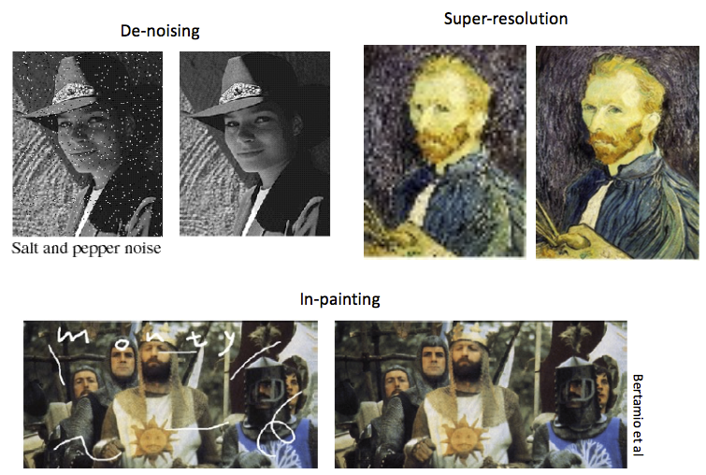
Image filtering
Slide from Fei Fei Li, Juan Carlos Niebles

Slide 5
Linear filtering: a key idea
Transformations on signals; e.g.:
  bass/treble controls on stereo
  blurring/sharpening operations in image editing
  smoothing/noise reduction in tracking
Key properties
  linearity: filter(f + g) = filter(f) + filter(g)
  shift invariance: behavior invariant to shifting the input
    delaying an audio signal
    sliding an image around
Can be modeled mathematically by convolution

Slide 6
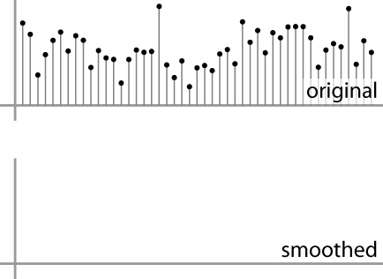
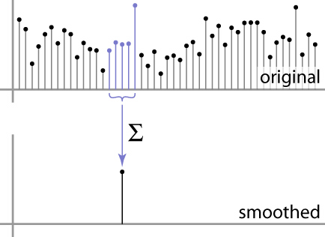
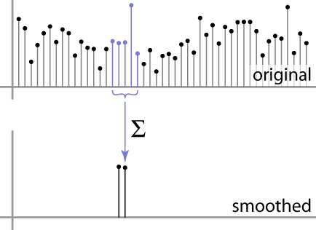
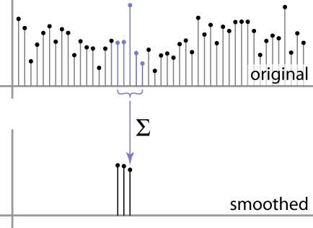
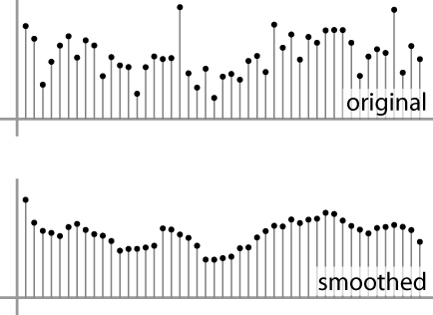
Moving Average
basic idea: define a new function by averaging over a sliding window
a simple example to start off: smoothing

Slide 7
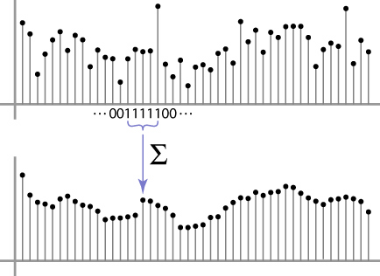
Weighted Moving Average
Can add weights to our moving average
Weights […, 0, 1, 1, 1, 1, 1, 0, …] / 5

Slide 8
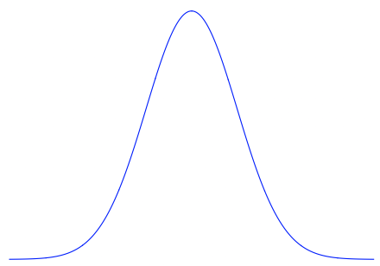

Weighted Moving Average
Bell curve (gaussian-like) weights […, 1, 4, 6, 4, 1, …]

Slide 9


Moving Average In 2D
What are the weights H?
For uniform filter? (takes the mean)
0 | 0 | 0 | 0 | 0 | 0 | 0 | 0 | 0 | 0
0 | 0 | 0 | 0 | 0 | 0 | 0 | 0 | 0 | 0
0 | 0 | 0 | 90 | 90 | 90 | 90 | 90 | 0 | 0
0 | 0 | 0 | 90 | 90 | 90 | 90 | 90 | 0 | 0
0 | 0 | 0 | 90 | 90 | 90 | 90 | 90 | 0 | 0
0 | 0 | 0 | 90 | 0 | 90 | 90 | 90 | 0 | 0
0 | 0 | 0 | 90 | 90 | 90 | 90 | 90 | 0 | 0
0 | 0 | 0 | 0 | 0 | 0 | 0 | 0 | 0 | 0
0 | 0 | 90 | 0 | 0 | 0 | 0 | 0 | 0 | 0
0 | 0 | 0 | 0 | 0 | 0 | 0 | 0 | 0 | 0
Input image
Slide by Steve Seitz
Notes:
ones, divide by 9

Slide 10
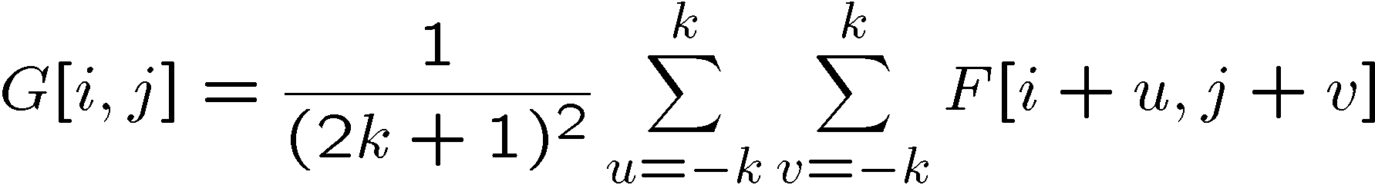
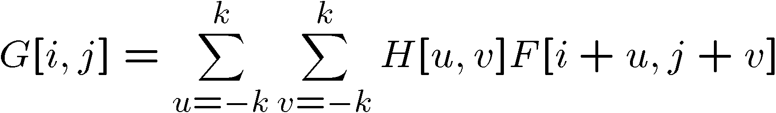

Cross-correlation filtering
Let’s write this down as an equation. Assume the averaging window is (2k+1)x(2k+1):
We can generalize this idea by allowing different weights for different neighboring pixels:
This is called a cross-correlation operation and
written:
H is called the “filter” or “kernel.”
Slide by Steve Seitz

Slide 11
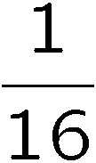
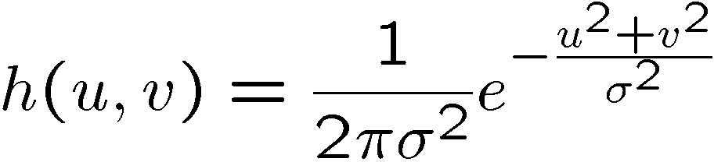
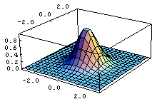
Gaussian filtering
A Gaussian kernel gives less weight to pixels further from the center of the window
0 | 0 | 0 | 0 | 0 | 0 | 0 | 0 | 0 | 0
0 | 0 | 0 | 0 | 0 | 0 | 0 | 0 | 0 | 0
0 | 0 | 0 | 90 | 90 | 90 | 90 | 90 | 0 | 0
0 | 0 | 0 | 90 | 90 | 90 | 90 | 90 | 0 | 0
0 | 0 | 0 | 90 | 90 | 90 | 90 | 90 | 0 | 0
0 | 0 | 0 | 90 | 0 | 90 | 90 | 90 | 0 | 0
0 | 0 | 0 | 90 | 90 | 90 | 90 | 90 | 0 | 0
0 | 0 | 0 | 0 | 0 | 0 | 0 | 0 | 0 | 0
0 | 0 | 90 | 0 | 0 | 0 | 0 | 0 | 0 | 0
0 | 0 | 0 | 0 | 0 | 0 | 0 | 0 | 0 | 0
1 | 2 | 1
2 | 4 | 2
1 | 2 | 1
Slide by Steve Seitz

Slide 12
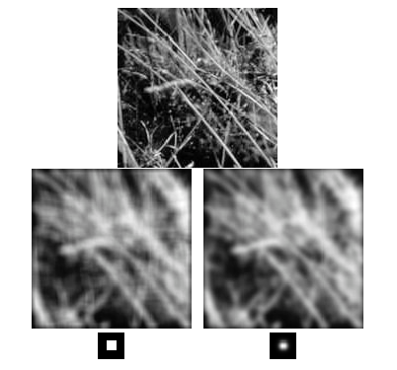
Box Filter vs. Gaussian Filter
Slide by Steve Seitz

Slide 13
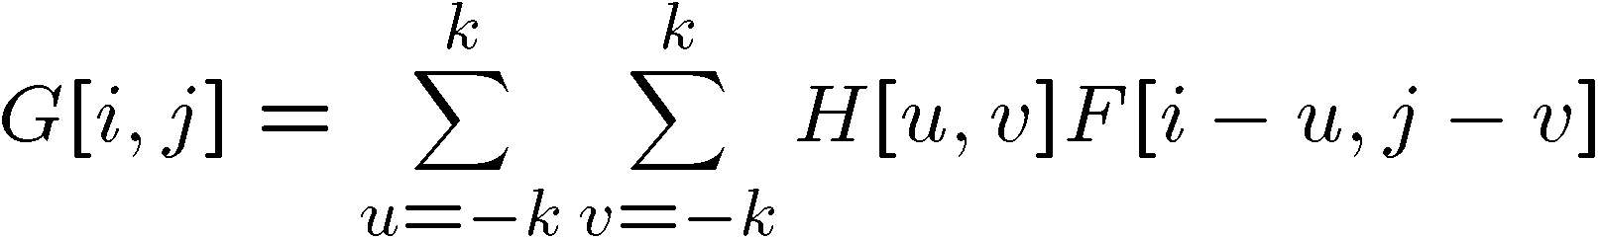

Convolution
Cross-correlation:
Convolution is similar to cross-correlation, but the filter is flipped horizontally and vertically before being applied:
It is written:
Suppose H is a Gaussian or uniform (mean) kernel. How does convolution differ from cross-correlation?
$$G=H∗F$$
Slide by Steve Seitz

Slide 14





Convolution is nice!
$$b=c∗a$$
Notation:
Convolution is a multiplication-like operation
  commutative
  associative
  distributes over addition
  scalars factor out
  identity: unit impulse e = […, 0, 0, 1, 0, 0, …]
Conceptually no distinction between filter and signal
Usefulness of associativity
  often apply several filters one after another: (((a * b₁) * b₂) * b₃)
  this is equivalent to applying one filter: a * (b₁ * b₂ * b₃)
$$a∗b=b∗a$$
$$a∗\left(b∗c\right)=\left(a∗b\right)∗c$$
$$a∗\left(b+c\right)=a∗b+a∗c$$
$$αa∗b=a∗\left(αb\right)=α(a∗b)$$
$$a∗e=a$$

Slide 15
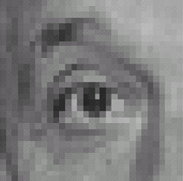
Practice with linear filters
Assume we are using cross-correlation filtering (filter is not flipped)
0
0
0
?
0
1
0
0
0
0
Original
Source: D. Lowe
Notes:
15

Slide 16
Practice with linear filters
0
0
0
0
1
0
0
0
0
Original
Filtered
(no change)
Source: D. Lowe
Notes:
16

Slide 17
Practice with linear filters
0
0
0
?
0
0
1
0
0
0
Original
Source: D. Lowe
Notes:
17

Slide 18
Practice with linear filters
0
0
0
0
0
1
0
0
0
Original
Shifted left
By 1 pixel
Source: D. Lowe
Notes:
18

Slide 19
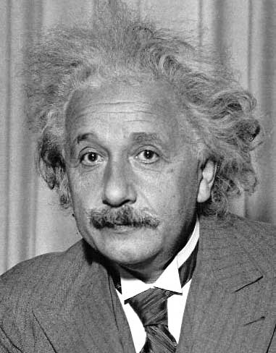
Practice with linear filters
?
1
0
-1
2
0
-2
1
0
-1
Sobel

Slide 20
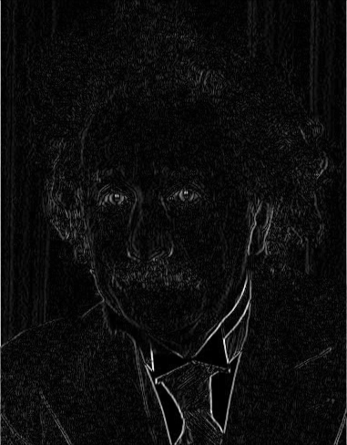
Practice with linear filters
1
0
-1
2
0
-2
1
0
-1
Sobel
Vertical Edge
(absolute value)

Slide 21
Practice with linear filters
?
1
2
1
0
0
0
-1
-2
-1
Sobel
Notes:
Questions at this point?
21

Slide 22
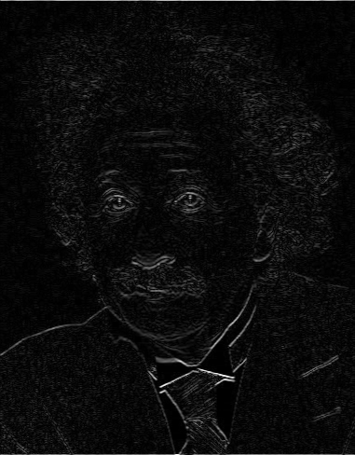
Practice with linear filters
1
2
1
0
0
0
-1
-2
-1
Sobel
Horizontal Edge
(absolute value)
Notes:
Questions at this point?
22

Slide 23
Outline
Filtering
  Linear filters: cross-correlation and convolution
  Gaussian filters

Slide 24
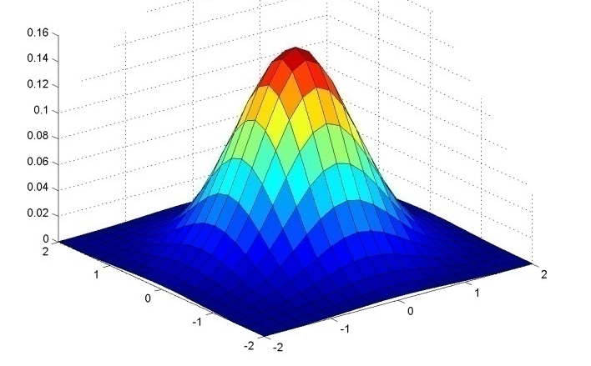
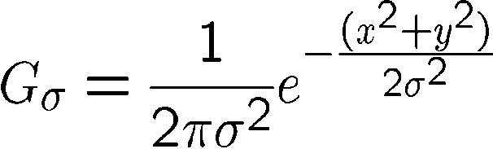
Important linear filter: Gaussian
Weight contributions of neighboring pixels by nearness
Same shape in spatial and frequency domain
(Fourier transform of Gaussian is Gaussian)
0.003 0.013 0.022 0.013 0.003
0.013 0.059 0.097 0.059 0.013
0.022 0.097 0.159 0.097 0.022
0.013 0.059 0.097 0.059 0.013
0.003 0.013 0.022 0.013 0.003
5 x 5, σ = 1
Slide credit: Christopher Rasmussen
Notes:
24

Slide 25

Gaussian filters
Input image (2048 x 1397)

Slide 26

Gaussian filters
Gaussian filtered (σ=5)

Slide 27

Gaussian filters
Gaussian filtered (σ=20)

Slide 28
Practical matters
How big should the filter be?
  Values at edges should be near zero
  Rule of thumb for Gaussian: set filter half-width to about 3 σ
  Normalize truncated
  kernel. Why?
Side by Derek Hoiem
Notes:
28

Slide 29
Separable Filters
Some kernels K can be written:
K = H ∗ V, H is horizontal, V is vertical
Example: 2D Gaussian
Filter first by H then V (or vice versa)
Why is this useful?

Slide 30
Filters in Python
scipy.ndimage.filters.convolve
Various pre-defined filters in skimage.filters
Deep Learning libraries (PyTorch, TensorFlow, Keras, …) have efficient GPU convolutions implemented

