Slide 1
CS 6501: 3D Reconstruction and
Understanding
Stereo Cameras
Connelly Barnes
Slides from Fei Fei Li, Juan Carlos Niebles, Jason Lawrence, Szymon Rusinkiewicz, David Dobkin, Adam Finkelstein, Tom Funkhouser

Slide 2
Outline
Stereo cameras
  Epipolar geometry
  Parallel stereo cameras and rectification
Structure from motion: Photo Tourism
Demos

Slide 3
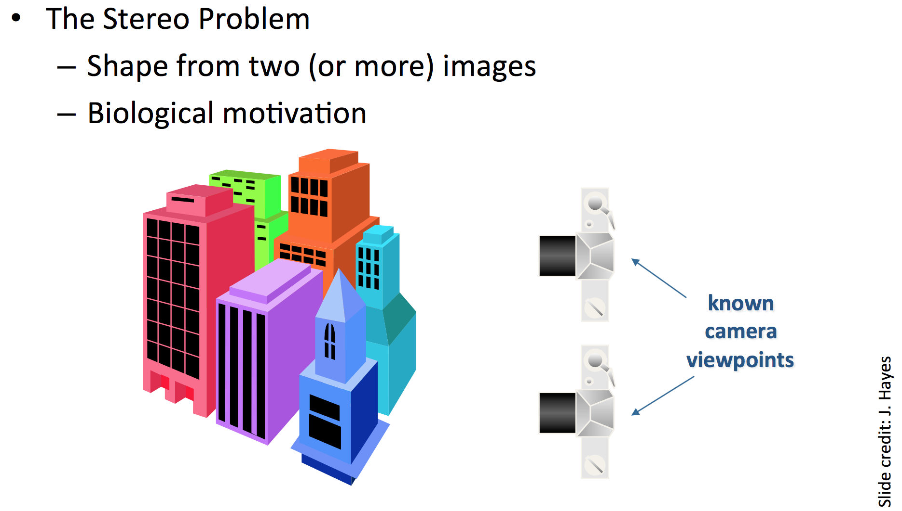
Stereo Matching

Slide 4
Normalized coordinates (3D ray):
P_{i} = [R_{i} t_{i}]
= K⁻¹ p_{i}
Slide from Jason Lawrence
Pixel coordinates
(projected onto camera): p_{i} = K [R_{i} t_{i}] P

Slide 5
Slide from Jason Lawrence
If we do not know the depth along ray P₁,
then there are many possible projections onto camera 2.

Slide 6
Slide from Jason Lawrence

Slide 7
Epipolar plane
Slide from Jason Lawrence

Slide 8
Slide from Jason Lawrence

Slide 9
Assumptions:
Work in normalized coordinates P₁, P₂
Without loss of generality, assume camera 1 is at origin,
with rotation matrix I.
Slide from Jason Lawrence

Slide 10
Slide from Jason Lawrence

Slide 11
Slide from Jason Lawrence

Slide 12
Slide from Jason Lawrence

Slide 13
Assumes normalized (image) coordinates:
  Measure coordinates in scene/world coordinate units (e.g. mm)
  Relative to the pinhole camera center.
Slide from Jason Lawrence

Slide 14
Slide from Jason Lawrence

Slide 15
Outline
Camera calibration
Overview of 3D vision (separate slide deck)
Camera demos
Stereo cameras
  Epipolar geometry
  Parallel stereo cameras and rectification
Structure from motion: Photo Tourism

Slide 16
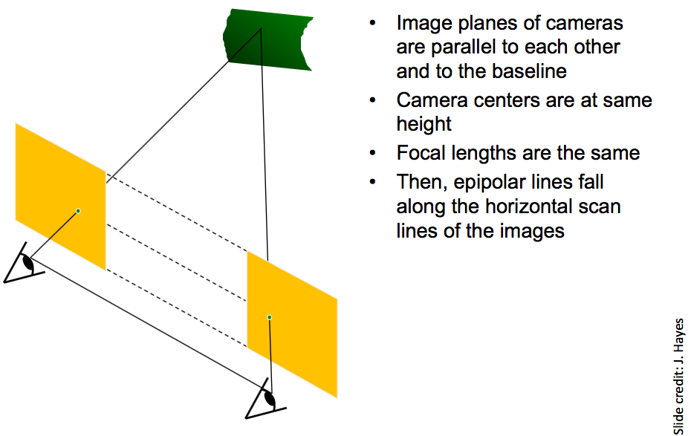
Parallel Stereo Cameras

Slide 17
Parallel Stereo Cameras

Slide 18
Parallel Stereo Cameras: Disparity
Disparity: displacement in pixels of the apparent motion of a 3D scene point as we switch between the left and right view of a stereo camera.
Examples from Middlebury stereo dataset
Discussion: how might this disparity information be useful?

Slide 19
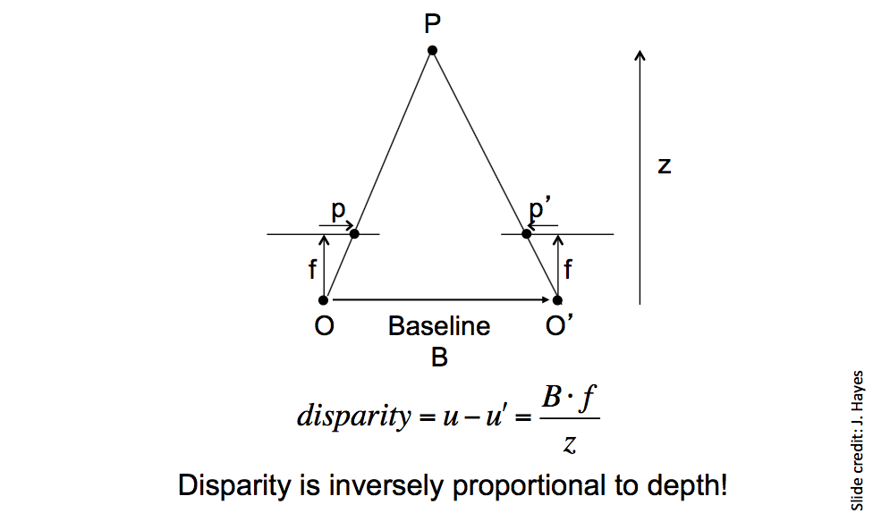
Parallel Stereo Cameras: Depth from Disparity
u
u'
Bf

Slide 20
Stereo Correspondence Problem
Usually assume rectified (parallel, upright) cameras.
For each pixel in the left camera image, find its disparity
(x pixels displacement of the corresponding point in the right image).
  Dense matching
Edges, corners: easier.
Challenge: flat regions.
  How might we determine where a flat region went from a left image to a right image?

Slide 21
Stereo Correspondence Problem
Typical algorithmic approach described in Szeliski 11.3:
  Compute matching cost
  Aggregate matching costs
  Compute/optimize disparities
  (Optional) refine disparities

Slide 22
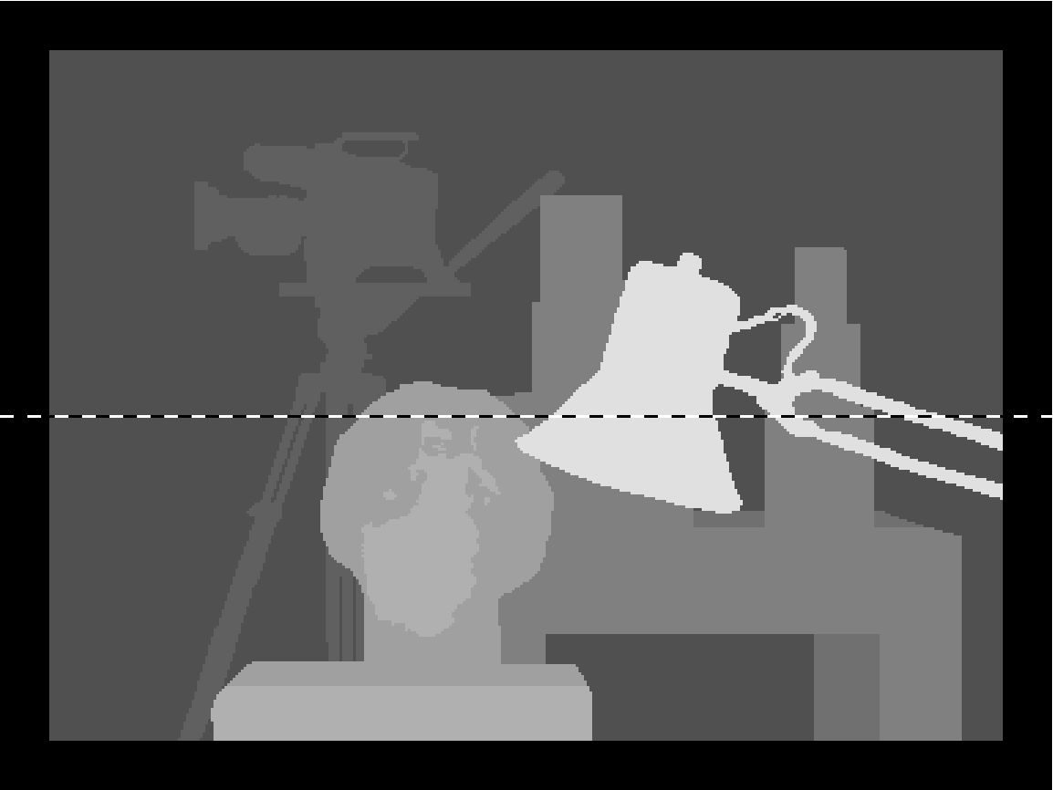
Stereo Correspondence Problem
From Scharstein and Szeliski 2002

Slide 23
Stereo Correspondence: Matching Cost
Disparity Space Image (DSI): A 3D array that measures at (x, y, d) the cost of assigning disparity d to pixel (x, y).
Typically a simple measure of dissimilarity such as sum of squared difference (SSD), or sum of absolute difference (SAD).

Slide 24
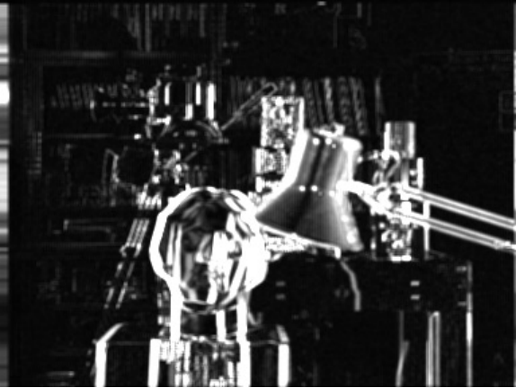
Stereo Correspondence: Matching Cost
Disparity Space Image (DSI): A 3D array that measures at (x, y, d) the cost of assigning disparity d to pixel (x, y).
From Scharstein and Szeliski 2002
(x, y) slice through the DSI for d = 10

Slide 25
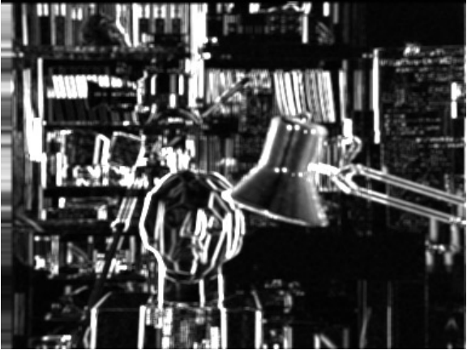
Stereo Correspondence: Matching Cost
Disparity Space Image (DSI): A 3D array that measures at (x, y, d) the cost of assigning disparity d to pixel (x, y).
From Scharstein and Szeliski 2002
(x, y) slice through the DSI for d = 16

Slide 26
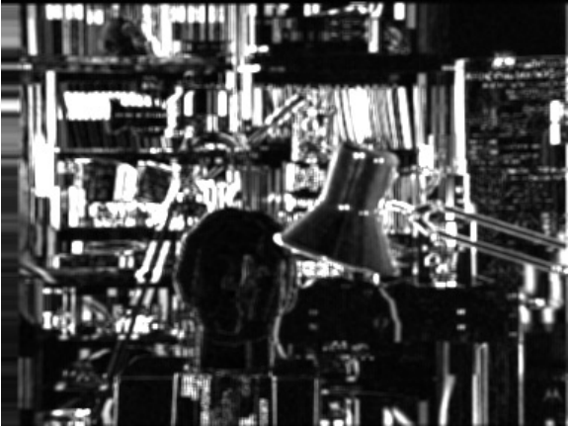
Stereo Correspondence: Matching Cost
Disparity Space Image (DSI): A 3D array that measures at (x, y, d) the cost of assigning disparity d to pixel (x, y).
From Scharstein and Szeliski 2002
(x, y) slice through the DSI for d = 21

Slide 27
Stereo Correspondence: Matching Cost
Disparity Space Image (DSI): A 3D array that measures at (x, y, d) the cost of assigning disparity d to pixel (x, y).
From Scharstein and Szeliski 2002
(x, d) slice through the DSI

Slide 28
Stereo Correspondence Problem
From Scharstein and Szeliski 2002

Slide 29
Stereo Correspondence: Aggregation
Disparity Space Image (DSI): A 3D array that measures at (x, y, d) the cost of assigning disparity d to pixel (x, y).
Convolve DSI with 2D or 3D filter to aggregate information.
Simple example: convolve with 2D Gaussian with given σ
  Larger window size: better handling of flat regions
  Smaller window size: better detail, depth discontinuities
Compute disparities:
  Choose at each pixel disparity d with min cost after aggregation
More advanced methods reviewed in Szeliski 11.3, 11.4

Slide 30
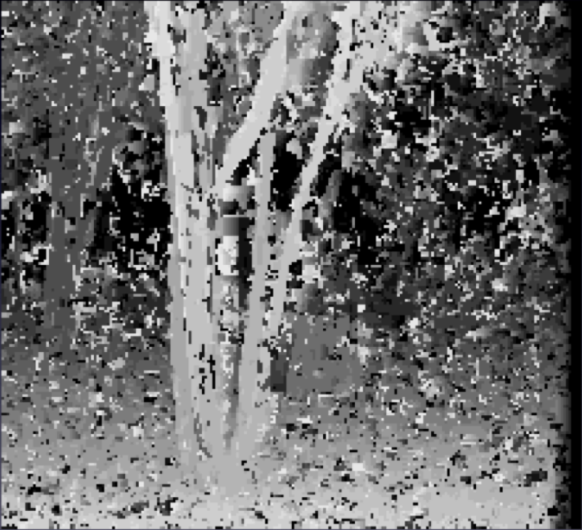
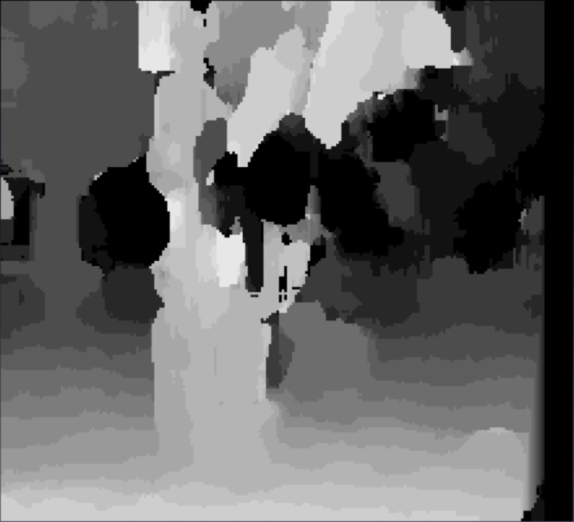
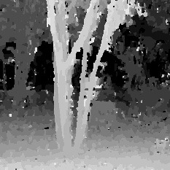
Stereo Correspondence: Window Size (or σ)
3 pixel window
20 pixel window
Nonlinear Diffusion
From Scharstein and Szeliski, 1996

Slide 31
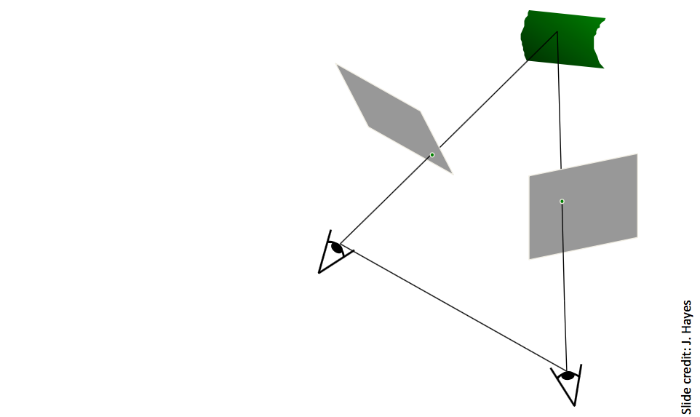
Stereo Rectification

Slide 32
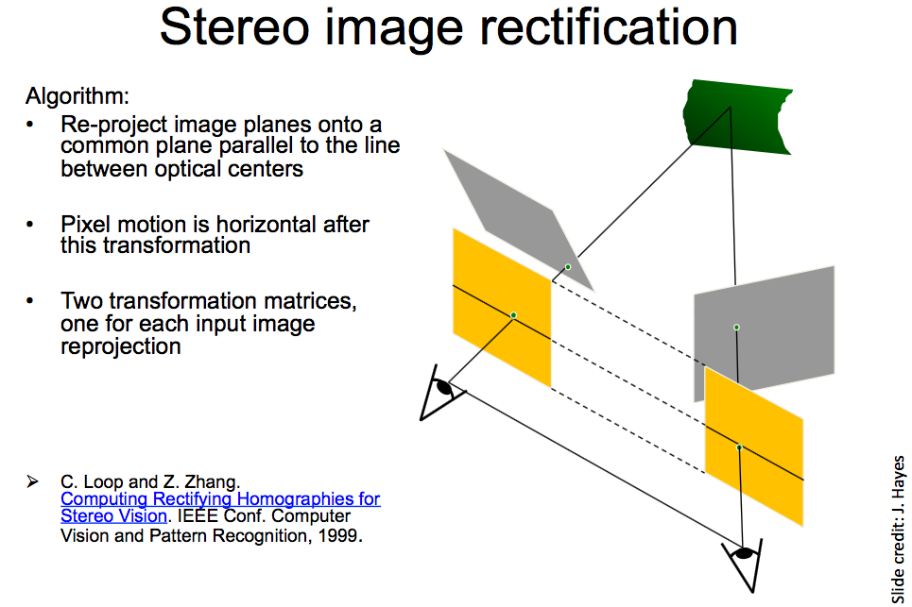
Stereo Rectification

Slide 33
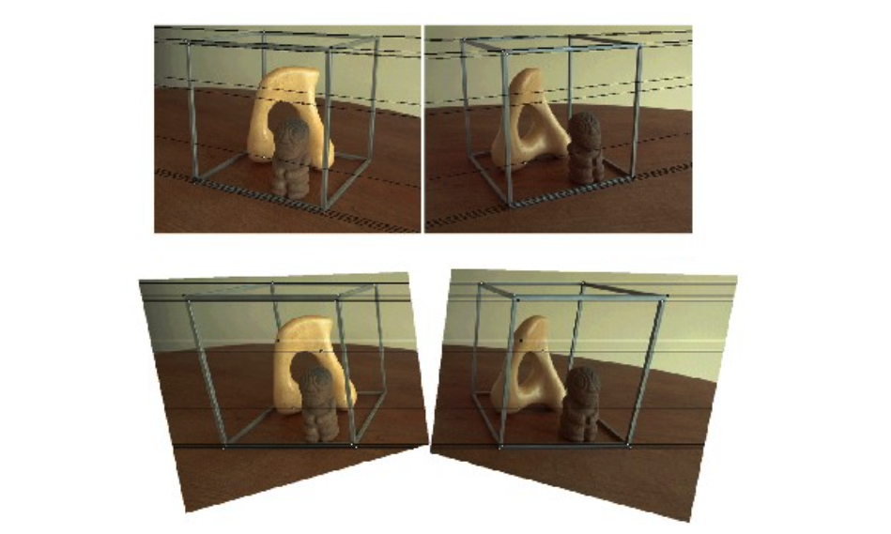
Stereo Rectification

Slide 34
Applications
Depth from Stereo (YouTube)
3D Reconstruction from Stereo (YouTube)

Slide 35
Implementation in OpenCV
OpenCV includes:
  Camera calibration
  Epipolar geometry
  Stereo rectification
  Finding stereo correspondences using block matching
  …

Slide 36
Outline
Stereo cameras
  Epipolar geometry
  Parallel stereo cameras and rectification
Structure from motion: Photo Tourism (separate slide deck)
Demos

Slide 37
Outline
Stereo cameras
  Epipolar geometry
  Parallel stereo cameras and rectification
Structure from motion: Photo Tourism
Demos

Slide 38
Demos
Structure from Motion:
  Video: 3D reconstruction with VisualSFM and MeshLab
  Blog post: comparing open source tools for 3D reconstruction
  Blog post: 3D reconstruction with VisualSFM and MeshLab

Slide 39
Camera Demos
Demo of stereo camera (StereoLabs ZED camera)
Demo of structured light depth sensor (Kinect)
  What it looks like in the infrared spectrum
Demonstrate depth discontinuities / occlusions

