Slide 1
CS 6501: 3D Reconstruction and Understanding Basics of Neural Networks, and Training Neural Nets I
Connelly Barnes

Slide 2
Overview
Simple neural networks
Perceptron
Feedforward neural networks
Multilayer perceptron and properties
Loss functions
How to train neural networks
Gradient descent
Stochastic gradient descent
Automatic differentiation
Backpropagation

Slide 3
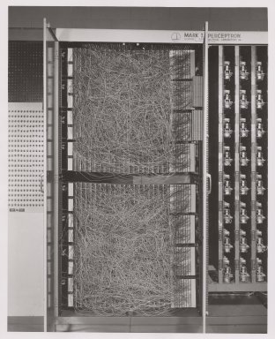
Perceptron (1957, Cornell)
400 pixel camera
Designed for image recognition
“Knowledge” encoded as weights in potentiometers (variable resistors)
Weights updated during learning performed by electric motors

Slide 4
History: Perceptron (1957, Cornell)
A single “neuron.”
Output (Class)
Inputs
+ Bias b: arbitrary, learned parameter,
followed by activation function f (step function)
Weights: arbitrary, learned parameters

Slide 5
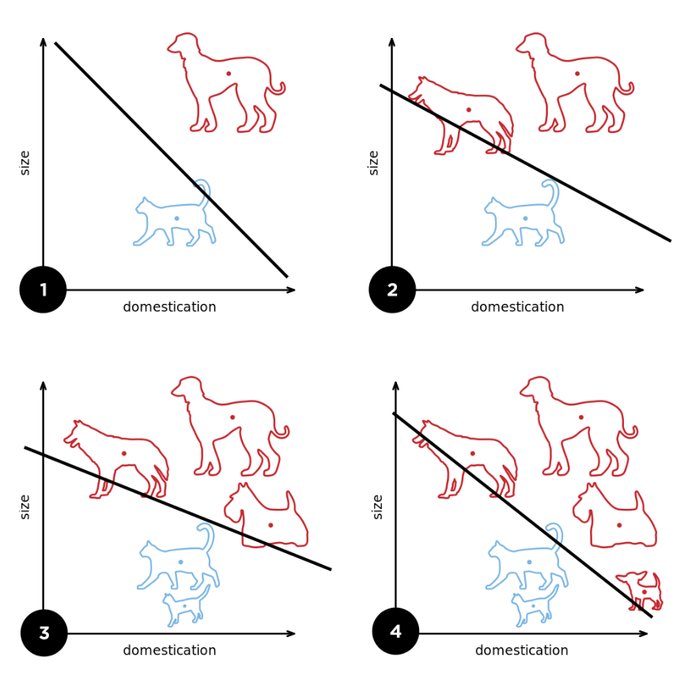
History: Perceptron (1957, Cornell)
Binary classifier, can learn linearly separable patterns.
Diagram from Wikipedia

Slide 6
Next Week (Where We Are Going): Convolutional Neural Networks (1990s)
Yann LeCun, Leon Bottou, Yoshua Bengio, Patrick Haffner
Many pixels / neurons
…
⋮
Diagram from Wikipedia

Slide 7
Feedforward neural networks
We could connect units (neurons) in any arbitrary graph
Input
Output

Slide 8
Feedforward neural networks
We could connect units (neurons) in any arbitrary graph
If no cycles in the graph we call it a feedforward neural network.
Input
Output

Slide 9
Recurrent neural networks (later)
If cycles in the graph we call it a recurrent neural network.
Input
Output

Slide 10
Overview
Simple neural networks
Perceptron
Feedforward neural networks
Multilayer perceptron and properties
Loss functions
How to train neural networks
Gradient descent
Stochastic gradient descent
Automatic differentiation
Backpropagation

Slide 11
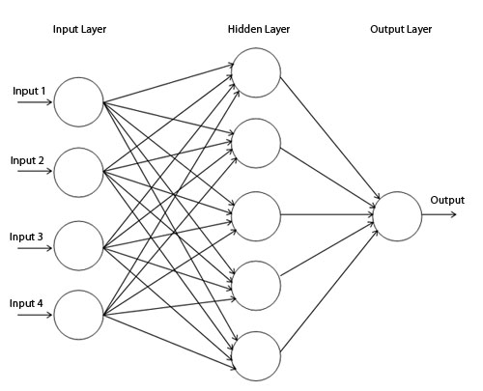
Multilayer Perceptron (1960s)
In matrix notation:
,$i≥1$
i
$$L_{1}:$$
Input layer (inputs) vector
$L_{2}$:
Hidden layer vector
$$L_{3}:$$
Output layer vector
$$W_{i}:$$
Weight matrix for connections from layer i-1 to layer i
$$b_{i}:$$
Biases for neurons in layer i
f_{i}:
Activation function for layer i

Slide 12
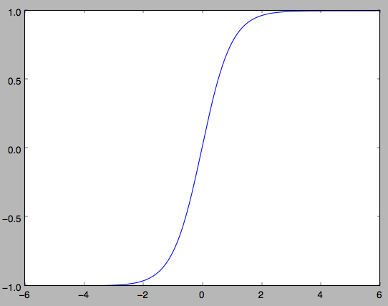
Activation Functions: Tanh
$$f\left(x\right)=\tanh\left(x\right)=\frac{2}{1+e^{−2x}}−1$$
$$\frac{df}{dx}=1−{f\left(x\right)}^{2}$$
Problems:
Gradients at tails are almost zero

Slide 13
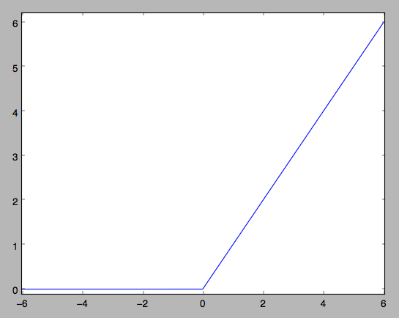
Activation Functions: ReLU (Rectified Linear Unit)
$$\frac{df}{dx}=\left\{\begin{matrix}1, & if x>0 \\ 0, & if x<0\end{matrix}\right.$$
$$f\left(x\right)=max⁡(x,0)$$
Pros:
Accelerates training stage by 6x over sigmoid/tanh [1]
Simple to compute
Sparser activation patterns
Cons:
Neurons can “die” by getting stuck in zero gradient region
Summary:
Often the preferred kind of neuron

Slide 14
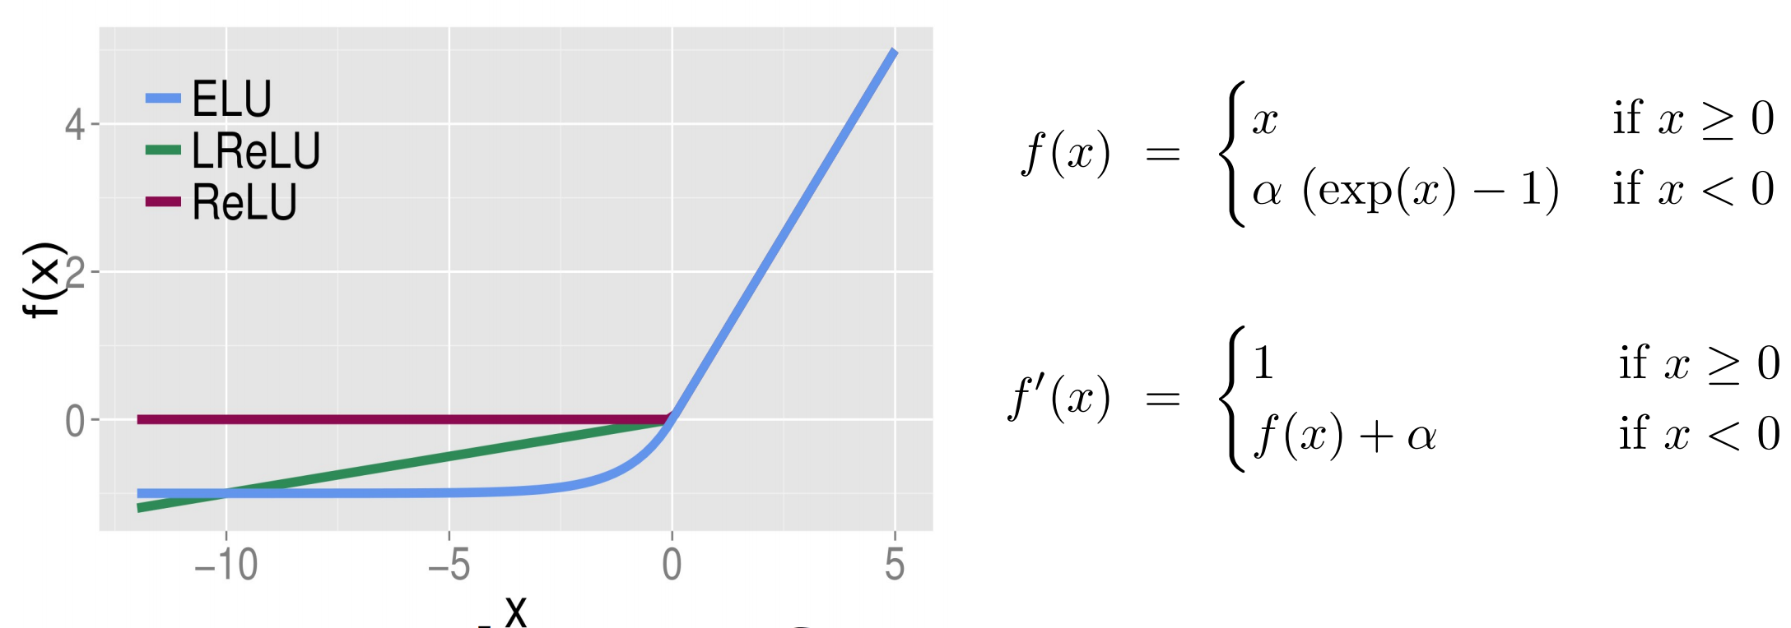
Activation Functions: ELU (Exponential Linear Unit)
Pros:
Accelerated convergence for some learning tasks (e.g. ImageNet)
Better generalization for some learning tasks (e.g. CIFAR-10)
Negative outputs can ensure more zero-centered activations
Cons:
Exponential could take longer to compute

Slide 15
Universal Approximation Theorem
Multilayer perceptron with a single hidden layer (“shallow network”) and linear output layer can approximate any continuous function on a compact subset of $ℝ^{n}$ to within any desired degree of accuracy.
Assumes activation function is bounded, non-constant, monotonically increasing.
Also applies for ReLU activation function.

Slide 16
Universal Approximation Theorem
In the worst case, exponential number of hidden units may be required (for the one hidden layer network).
Can informally show this for binary case:
If we have n bits input to a binary function, how many possible inputs are there?
How many possible binary functions are there?
So how many weights do we need to represent a given binary function?

Slide 17
Why Use Deep Networks?
Functions representable with a deep rectifier network can require an exponential number of hidden units with a shallow (one hidden layer) network (Goodfellow 6.4)
Piecewise linear networks (e.g. using ReLU) can represent functions that have a number of regions exponential in depth of network.
Can capture repeating / mirroring / symmetric patterns in data.
Empirically, greater depth often results in better generalization.

Slide 18
Neural Network Architecture
Architecture: refers to which parameters (e.g. weights) are used in the network and their topological connectivity.
Fully connected: A common connectivity pattern for multilayer perceptrons. All possible connections made between layers i-1 and i.
Is this network fully connected?

Slide 19
Neural Network Architecture
Architecture: refers to which parameters (e.g. weights) are used in the network and their topological connectivity.
Fully connected: A common connectivity pattern for multilayer perceptrons. All possible connections made between layers i-1 and i.
Input
Output
Is this network fully connected?

Slide 20
How to Choose Network Architecture?
Long discussion
Summary:
Rules of thumb do not work.
“Need 10x [or 30x] more training data than weights.”
Not true if very low noise
Might need even more training data if high noise
Try many networks with different numbers of units and layers
Check generalization using validation dataset or cross-validation.

Slide 21
Overview
Simple neural networks
Perceptron
Feedforward neural networks
Multilayer perceptron and properties
Loss functions
How to train neural networks
Gradient descent
Stochastic gradient descent
Automatic differentiation
Backpropagation

Slide 22
Loss Functions (Cost / Objective Function)
Measures the “cost” of fitting a given model to the data, with lower cost being better.
Can evaluate the loss on any of training, test, validation sets.
Reminder:
Training dataset: model is fit directly to this data
Testing dataset: model sees this data only once; used to measure the final performance of the classifier.
Validation dataset: model is repeatedly “tested” on this data during the training process to gain insight into overfitting

Slide 23
Loss Functions: L² Loss (Sum Squared Error)
Minimize squared difference between model prediction and known correct output given in supervised learning (“ground truth output”). $\sum_{i=1}^{n}{{(y_{i, correct}−y_{i, predict})}^{2}}$
Can be used for regression or classification.
Not as robust to outliers.
Stable.

Slide 24
Loss Functions: L¹ Loss (Sum of Absolute Error)
Minimize absolute difference between model prediction and known correct output given in supervised learning (“ground truth output”). $\sum_{i=1}^{n}{\left|y_{i, correct}−y_{i, predict}\right|}$
Can be used for regression or classification.
More robust to outliers.
Less stable.

Slide 25
Loss Functions: Cross Entropy
Suppose model has a single output that can be interpreted as a probability in a binary classification problem (classes 0 and 1).
Binary cross entropy: $\frac{1}{n}\sum_{i=1}^{n}{y_{i, correct}\log\left(y_{i, predict}\right)+(1−y_{i, correct})log⁡({1−y}_{i, predict})}$
Prediction should be in (0, 1) to avoid having log be undefined.
(e.g. sigmoid activation on last layer of network)
Often better for classification problems than L¹/L² loss.

Slide 26
Overview
Simple neural networks
Perceptron
Feedforward neural networks
Multilayer perceptron and properties
Loss functions
How to train neural networks
Gradient descent
Stochastic gradient descent
Automatic differentiation
Backpropagation

Slide 27
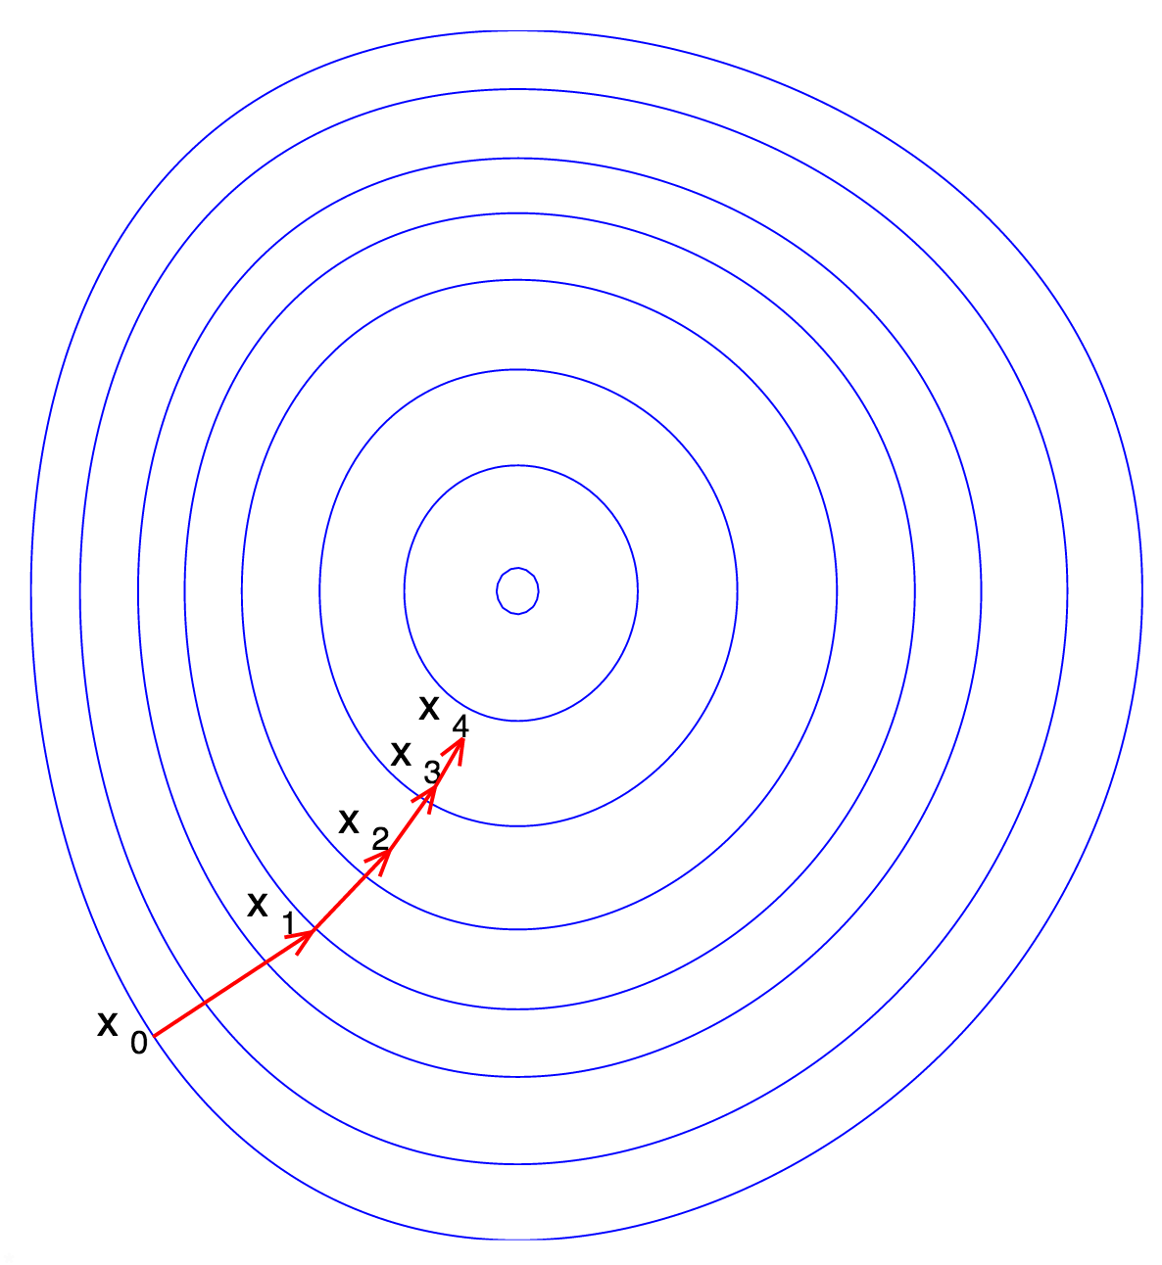
Standard (or “Batch”) Gradient Descent
Discuss amongst students near you:
What are some problems that could be easily optimized with gradient descent?
Problems where this is difficult?
Should the learning rate be constant or change?
Step size
or
Learning rate

Slide 28
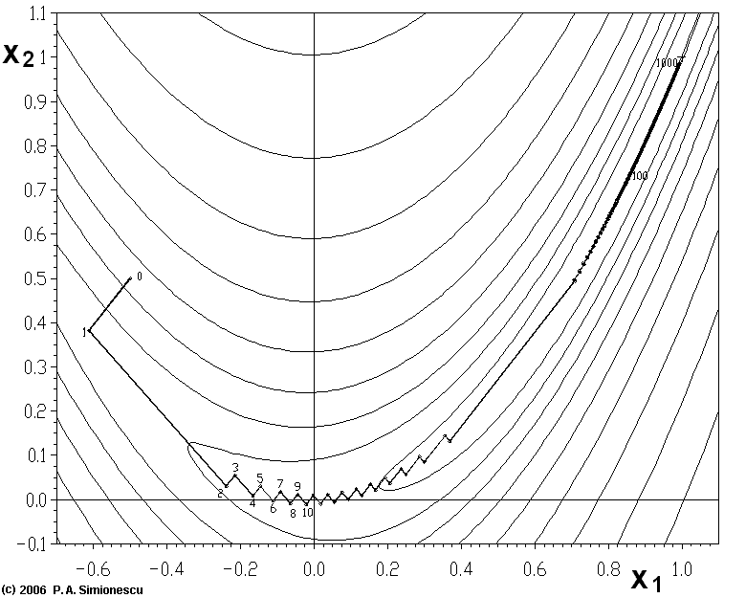
Gradient Descent with Energy Functions that have Narrow Valleys
“Zig-zagging problem”
Source: "Banana-SteepDesc" by P.A. Simionescu – Wikipedia English

Slide 29
Gradient Descent with Momentum
$${x_{n+1}=x_{n}−∆}_{n}$$
Momentum
Could use small value e.g. m=0.5 at first Could use larger value e.g. m=0.9 near end
of training when there are more oscillations.

Slide 30
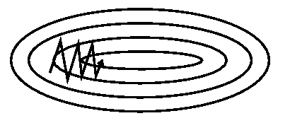
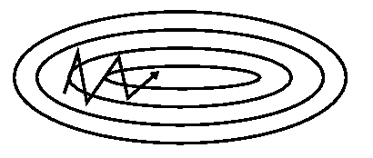
Gradient Descent with Momentum
Without Momentum
With Momentum
Figure from Genevieve B. Orr, Willamette.edu

Slide 31
Stochastic gradient descent
Stochastic gradient descent (Wikipedia)
Gradient of sum of n terms where n is large
Sample rather than computing the full sum
Sample size s is “mini-batch size”
Could be 1 (very noisy gradient estimate)
Could be 100 (e.g. collect photos 100 at a time to find each noisy “next” estimate for the gradient)
Use same step as in gradient descent to the estimated gradient

Slide 32
Stochastic gradient descent
Pseudocode:
From Wikipedia

Slide 33
Problem Statement: Automatic Differentiation
Suppose we write down an arbitrary model (that gives predictions) and compute a loss based on this model.
We would like to take the gradient of the loss with respect to the parameters in the model (e.g. weights).
If we can do this, we can use (stochastic) gradient descent to minimize the loss!

Slide 34
Review: Chain Rule in One Dimension
Suppose $f:ℝ→ℝ$ and $g:ℝ→ℝ$
Define
Then what is $h^{′}\left(x\right)=dh/dx$?
If we omit function arguments we just have a product:
$$h\left(x\right)=f(g\left(x\right))$$
$$h′\left(x\right)=f^{′}\left(g\left(x\right)\right)g′(x)$$
$$h′=f^{′}g′$$

Slide 35
Chain Rule in Multiple Dimensions
Suppose $f:ℝ^{m}→ℝ^{}$ and $g:ℝ^{n}→ℝ^{m}$, and ${x∈ℝ}^{n}$
Define
Chain rule is:
$$h\left(x\right)=f(g_{1}\left(x\right),…,g_{m}\left(x\right))$$
$$\frac{∂h}{∂x_{i}}=\sum_{j=1}^{m}{\frac{∂f}{∂g_{j}}\frac{∂g_{j}}{∂x_{i}}}$$
(Scalar notation)

Slide 36
Chain Rule in Multiple Dimensions
Suppose $f:ℝ^{m}→ℝ^{}$ and $g:ℝ^{n}→ℝ^{m}$, and ${x∈ℝ}^{n}$
Define
If we define the Jacobian matrix:
Chain rule can also be written:
$$h\left(x\right)=f(g_{1}\left(x\right),…,g_{m}\left(x\right))$$
$$\frac{∂g}{∂x}=\left[\begin{matrix}\frac{∂g_{1}}{∂x_{1}} & ⋯ & \frac{∂g_{1}}{∂x_{n}} \\ ⋮ & ⋱ & ⋮ \\ \frac{∂g_{m}}{∂x_{1}} & ⋯ & \frac{∂g_{m}}{∂x_{n}}\end{matrix}\right]$$
$$\frac{∂f}{∂x}=\frac{∂f}{∂g}\frac{∂g}{∂x}$$
(Vector notation)

Slide 37
One Solution: Symbolic Derivatives
We want to take the gradient of a loss L with respect to the model parameters w.
Write down L(w) as a symbolic math expression and apply chain rule many times to it until we get the result.

Slide 38
Backpropagation Algorithm (1960s-1980s)
Forward pass
Input
Computational graph (here a neural network)
Hidden
Output
Forward pass: calculate loss L by running the computation ordinarily (sequentially in a forward direction).

Slide 39
Backpropagation Algorithm (1960s-1980s)
Reverse pass
Input
Computational graph (here a neural network)
Hidden
Output
Backpropagate: from output (loss L) recursively compute derivative of L with respect to each intermediate value in the computation.
Gives us the derivative of loss L with respect to weights, biases, etc.

Slide 40
Automatic Differentiation (1960s, 1970s)
Actually there is nothing special about the neural network here.
We can differentiate any arbitrary differentiable program using the same process.
Only a constant factor slower than the original program.
In general, known as “reverse mode automatic differentiation.”
Backpropagation usually refers to neural networks.

Slide 41
Automatic Differentiation / Backpropagation
Write an arbitrary program as consisting of basic operations f₁, ..., f_{k} (e.g. +, -, *, cos, sin, …) that we know how to differentiate.
Label the inputs and intermediate values of the program as $x_{1},…,x_{N−1}$and the output ${L=x}_{N}.$
For machine learning, inputs could be unknown model parameters, output is loss.
Put the values $x_{i}$ in the order that they are computed.

Slide 42
Example
Inputs/Model Parameters
x₁
x₂
The program at right computes loss L.
As a formula of $x_{1},x_{2}$, how would we write this program?
Forward pass:
For i = 1, …, N:
Compute $x_{i}$from previous values.
Intermediate Values
$$x_{3}=$$
$f_{1}(x_{1}$) =
sin($x_{1}$)
$$x_{4}=$$
$f_{1}(x_{2}$) =
sin($x_{2}$)
Output/Loss
$${L=x}_{5}=$$
$f_{2}(x_{3}{,x}_{4}$) =
$x_{3}$+$x_{4}$

Slide 43
Reverse Pass (Backpropagation)
Goal: find $\frac{∂L}{∂x_{i}}$ for every $x_{i}$.
That is, find the derivative of the loss with respect to every input (weight, bias, etc) or intermediate value in the computation $x_{i}$.
Start at the output (the loss) of the program.
What is $\frac{∂L}{∂x_{N}}$?
$\frac{∂L}{∂x_{N}}=\frac{∂L}{∂L}=1$
Compute derivatives ($\frac{∂L}{∂x_{i}}$) in reverse order from output: i = N, N-1,…,1.

Slide 44
Reverse Pass: Case 1 (One Child)
How to get $\frac{∂L}{∂x_{i}}$ for a given compute node $i$, knowing $\frac{∂L}{∂x_{j}}$ for all j > i?
Case 1: $x_{i}$ has one child $c_{i}$.
Result (chain rule):
$$\frac{∂L}{∂x_{i}}$$
x_{i}
$$\frac{∂L}{∂x_{i}}=\frac{∂L}{∂c_{i}}\left(\frac{∂c_{i}}{∂x_{i}}\right)$$
$$\frac{∂c_{i}}{∂x_{i}}$$
Derivative of a basic
operation (e.g. if c_{i} computes sin(x_{i}), derivative is cos(x_{i})).
$$\frac{∂L}{∂c_{i}}$$
A derivative that has already been computed (for the child)
c_{i}

Slide 45
Reverse Pass: Case 2 (Multiple Children)
How to get $\frac{∂L}{∂x_{i}}$ for a given compute node $i$, knowing $\frac{∂L}{∂x_{j}}$ for all j > i?
Case 2: $x_{i}$ has multiple children $c_{i,1}, …,c_{i,k}$.
Derivative is linear, so reduce to the sum of multiple case 1s.
Result:
$$\frac{∂L}{∂x_{i}}$$
x_{i}
$$\frac{∂c_{i,k}}{∂x_{i}}$$
$$\frac{∂c_{i,1}}{∂x_{i}}$$
$\frac{∂L}{∂x_{i}}=\frac{∂L}{∂c_{i,1}}\left(\frac{∂c_{i,1}}{∂x_{i}}\right)$+…+$\frac{∂L}{∂c_{i,k}}\left(\frac{∂c_{i,k}}{∂x_{i}}\right)$
$$=\sum_{j=1}^{k}{\frac{∂L}{∂c_{i,j}}\left(\frac{∂c_{i,j}}{∂x_{i}}\right)}$$
c_{i,1}
…
c_{i,k}

Slide 46
Reverse Pass: Case 1 (Vectors)
If we have vector / matrix quantities in our computation (as unknowns or intermediate values), same result.
Case 1: $x_{i}$ has one child $c_{i}$.
Result (chain rule):
$$\frac{∂L}{∂x_{i}}$$
x_{i}
$$\frac{∂L}{∂x_{i}}=\frac{∂L}{∂c_{i}}\left(\frac{∂c_{i}}{∂x_{i}}\right)$$
$$\frac{∂c_{i}}{∂x_{i}}$$
Derivative of a basic
operation (e.g. if c_{i} computes sin(x_{i}), derivative is cos(x_{i})).
$$\frac{∂L}{∂c_{i}}$$
A derivative that has already been computed (for the child)
c_{i}

Slide 47
Example: Backpropagation
Input/Model Parameter
x₁
$$\frac{∂L}{∂x_{4}}=\frac{∂L}{∂L}=1$$
What is $\frac{∂L}{∂x_{4}}$?
What is $\frac{∂L}{∂x_{3}}$?
What is $\frac{∂L}{∂x_{2}}$?
What is $\frac{∂L}{∂x_{1}}$?
$$\frac{∂L}{∂x_{3}}=\frac{∂L}{∂x_{4}}\left(\frac{∂x_{4}}{∂x_{3}}\right)$$
$$=\frac{∂L}{∂x_{4}}\left(1\right)$$
Intermediate Values
$$x_{2}=$$
$f_{1}(x_{1}$) =
sin($x_{1}$)
$$x_{3}=$$
$f_{2}(x_{1}$) =
exp($x_{1}$)
$$\frac{∂L}{∂x_{2}}=\frac{∂L}{∂x_{4}}\left(\frac{∂x_{4}}{∂x_{2}}\right)$$
$$=\frac{∂L}{∂x_{4}}(1)$$
$$\frac{∂L}{∂x_{1}}=\frac{∂L}{∂x_{2}}\left(\frac{∂x_{2}}{∂x_{1}}\right)+\frac{∂L}{∂x_{3}}\left(\frac{∂x_{3}}{∂x_{1}}\right)$$
Output/Loss
$$=\frac{∂L}{∂x_{2}}\left(cos⁡{(x}_{1})\right)+\frac{∂L}{∂x_{3}}\left(exp(x_{1})⁡\right)$$
$${L=x}_{4}=$$
$f_{3}(x_{2}{,x}_{3}$) =
$x_{2}$+$x_{3}$
$$=cos⁡{(x}_{1})+exp(x_{1})$$

Slide 48
Summary Illustration of Backpropagation
$$\frac{∂L}{∂x_{1}}$$
$$\frac{∂L}{∂x_{2}}$$
Input
+$\frac{∂L}{∂x_{5}}\left(\frac{∂x_{5}}{∂x_{1}}\right)$
+$\frac{∂L}{∂x_{3}}\left(\frac{∂x_{3}}{∂x_{1}}\right)$
Initialize $\frac{∂L}{∂x_{i}}$ to zero.
Visit compute graph edges in reverse order: 2a. For each edge, multiply “child” node derivative against edge derivative, add to “parent” derivative.
Read off needed derivatives.
+$\frac{∂L}{∂x_{4}}\left(\frac{∂x_{4}}{∂x_{1}}\right)$
Forward pass
$$\frac{∂L}{∂x_{4}}$$
$$\frac{∂L}{∂x_{5}}$$
Reverse pass
$$\frac{∂L}{∂x_{3}}$$
Hidden
+$\frac{∂L}{∂x_{6}}\left(\frac{∂x_{6}}{∂x_{4}}\right)$
+$\frac{∂L}{∂x_{6}}\left(\frac{∂x_{6}}{∂x_{3}}\right)$
+$\frac{∂L}{∂x_{6}}\left(\frac{∂x_{6}}{∂x_{5}}\right)$
$$\frac{∂L}{∂x_{6}}$$
Output

Slide 49
Libraries That Use Backpropagation
Deep learning libraries TensorFlow/Keras/PyTorch let you build a compute graph out of variables and basic operations
Variables: scalars/vectors/matrices for parameters/training data
Basic operations: +, -, sin, exp, L² loss, etc.
Forward pass: evaluate compute graph in forward order
Reverse pass: compute for nodes in reverse order
Read off gradient with respect to model parameters.
Expose optimization routines (gradient descent, …)
$$\frac{∂L}{∂x_{i}}$$
Creative Commons Image

Slide 50
Libraries That Use Backpropagation
Each basic operation exposes:
How to compute the operation in forward pass from its inputs
How to compute the gradient with respect to the operation’s inputs given the gradient with respect to the operation’s outputs (chain rule for case 1).
Library tracks graph edges to resolve case 1 / case 2.
Usually basic operations already implemented.
Adding an Operation to TensorFlow

Slide 51
Gradient Descent with Backpropagation
Initialize weights at good starting point w₀
Repeatedly apply gradient descent step (1)
Continue training until validation error hits a minimum.
Step size
or
Learning rate
$$w_{n+1}=w_{n}−γ_{n}∇_{w}E(w_{n})$$
(1)

Slide 52
Stochastic Gradient Descent with Backpropagation
Initialize weights at good starting point w₀
Repeat until validation error hits a minimum:
Randomly shuffle dataset
Loop through mini-batches of data, batch index is i
Calculate stochastic gradient using backpropagation for each, and apply update rule (1)
Step size
or
Learning rate
$$w_{n+1}=w_{n}−γ_{n}∇_{w}E_{i} (w_{n})$$
(1)

