Slide 1
CS 6501:
3D Reconstruction and Understanding
Training Neural Networks II
Connelly Barnes

Slide 2
Overview
Preprocessing
Improving convergence
  Initialization
  Vanishing/exploding gradients problem
Improving generalization
  Batch normalization
  Dropout
Additional neuron type: softmax
Transfer learning / fine-tuning

Slide 3
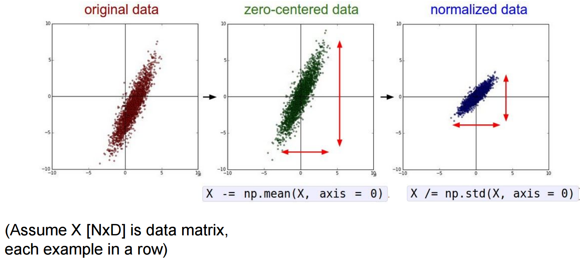
Preprocessing
Common: zero-center, can sometimes also normalize variance.
Slide from Stanford CS231n

Slide 4
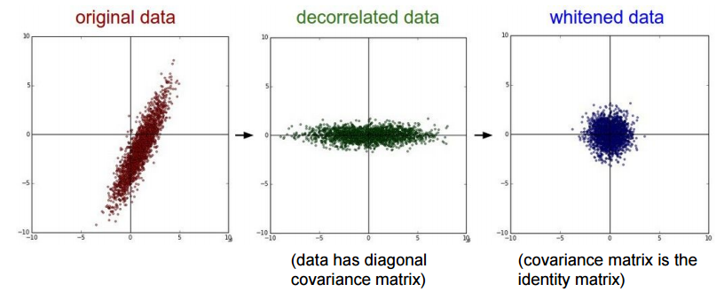
Preprocessing
Can also decorrelate the data by using PCA, or whiten data
Slide from Stanford CS231n

Slide 5
Preprocessing for Images
Center the data only:
  Compute a mean image of training set (examples of mean faces)
  Either grayscale or compute separate mean for channels (RGB)
  Subtract the mean from your dataset
Center the RGB channels only:
  Subtract mean training value of each channel

Slide 6
Overview
Preprocessing
Improving convergence
  Initialization
  Vanishing/exploding gradients problem
Improving generalization
  Batch normalization
  Dropout
Additional neuron type: softmax
Transfer learning / fine-tuning

Slide 7
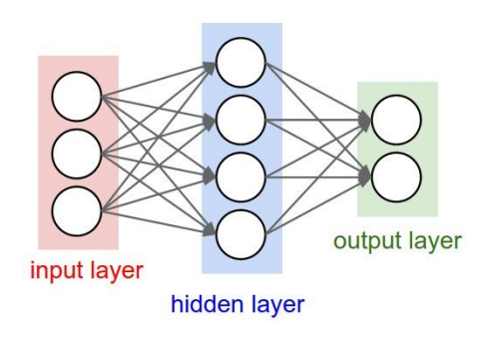
Initialization
Need to start gradient descent at an initial guess
What happens if we initialize all weights to zero?
Slide from Stanford CS231n

Slide 8
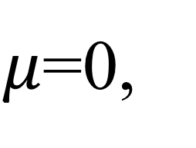
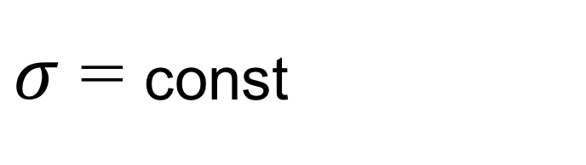
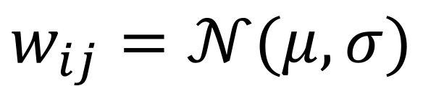
Initialization
Idea: random numbers (e.g. normal distribution)
OK for shallow networks, but what about deep networks?
$$w_{ij}=𝒩(μ,σ)$$
$μ$=0,
$σ$ = const

Slide 9
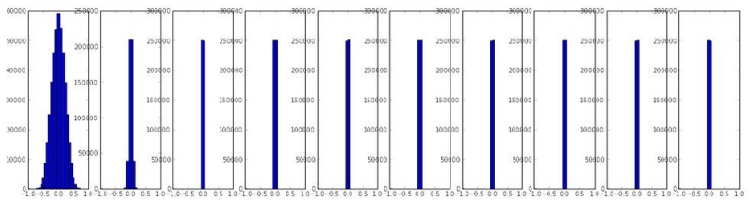

Initialization, $σ$= 0.01
Simulation: multilayer perceptron, 10 fully-connected hidden layers
Tanh() activation function
Hidden layer activation function statistics:
Are there any problems with this?
Hidden Layer 1
Hidden Layer 10
Slide from Stanford CS231n

Slide 10
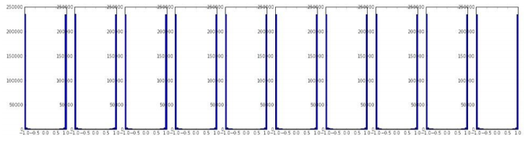

Initialization, $σ$= 1
Simulation: multilayer perceptron, 10 fully-connected hidden layers
Tanh() activation function
Hidden layer activation function statistics:
Are there any problems with this?
Hidden Layer 1
Hidden Layer 10
Slide from Stanford CS231n

Slide 11
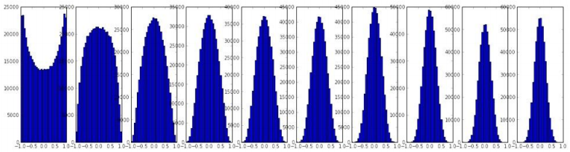
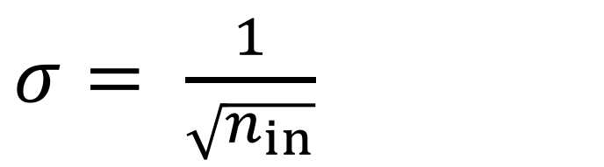
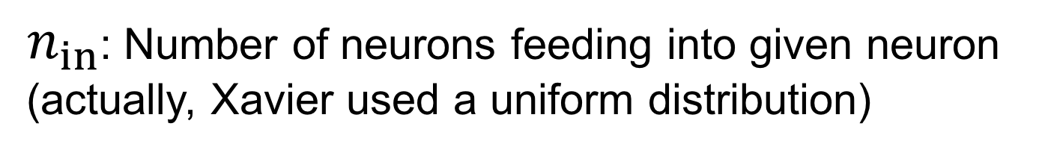
Xavier Initialization
$σ= \frac{1}{\sqrt{n_{in}}}$
$n_{in}$: Number of neurons feeding into given neuron
(actually, Xavier used a uniform distribution)
Hidden layer activation function statistics:
Reasonable initialization for tanh() activation function.
But what happens with ReLU?
Hidden Layer 1
Hidden Layer 10
Slide from Stanford CS231n

Slide 12
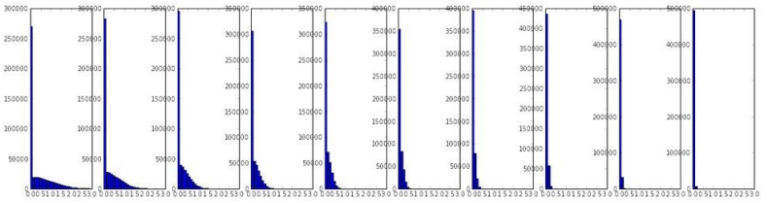
Xavier Initialization, ReLU
$σ= \frac{1}{\sqrt{n_{in}}}$
$n_{in}$: Number of neurons feeding into given neuron
Hidden layer activation function statistics:
Hidden Layer 1
Hidden Layer 10
Slide from Stanford CS231n

Slide 13
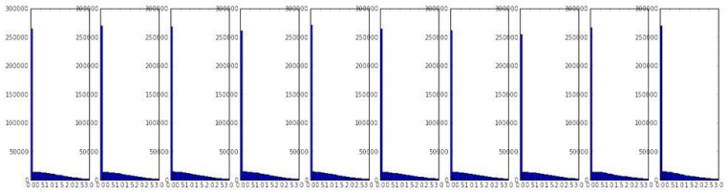
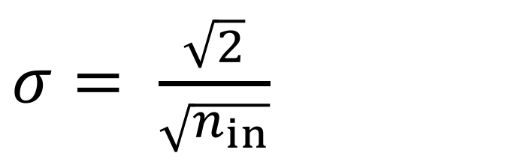
He et al. 2015 Initialization, ReLU
$σ= \frac{\sqrt{2}}{\sqrt{n_{in}}}$
$n_{in}$: Number of neurons feeding into given neuron
Hidden layer activation function statistics:
Hidden Layer 1
Hidden Layer 10
Slide from Stanford CS231n

Slide 14
Overview
Preprocessing
Improving convergence
  Initialization
  Vanishing/exploding gradients problem
Improving generalization
  Batch normalization
  Dropout
Additional neuron type: softmax
Transfer learning / fine-tuning

Slide 15
Vanishing/exploding gradient problem
Recall that backpropagation algorithm uses chain rule.
  Products of many derivatives…could get very big/small
  Could this be problematic for learning?

Slide 16
Vanishing/exploding gradient problem
Vanishing gradients problem: neurons in earlier layers learn more slowly than in latter layers.
Image from Nielson 2015

Slide 17
Vanishing/exploding gradient problem
Vanishing gradients problem: neurons in earlier layers learn more slowly than in latter layers.
Exploding gradients problem: gradients are significantly larger in earlier layers than latter layers.
How to avoid?
  Use a good initialization
  Do not use sigmoid for deep networks
  Use momentum with carefully tuned schedules, e.g.:
Image from Nielson 2015

Slide 18
Overview
Preprocessing
Improving convergence
  Initialization
  Vanishing/exploding gradients problem
Improving generalization
  Batch normalization
  Dropout
Additional neuron type: softmax
Transfer learning / fine-tuning

Slide 19

Batch normalization
It would be great if we could just whiten the inputs to all neurons in a layer: i.e. zero mean, variance of 1.
  Avoid vanishing gradients problem, improve learning rates!
  For each input k to the next layer:
Slight problem: this reduces representation ability of network
  Why?

Slide 20
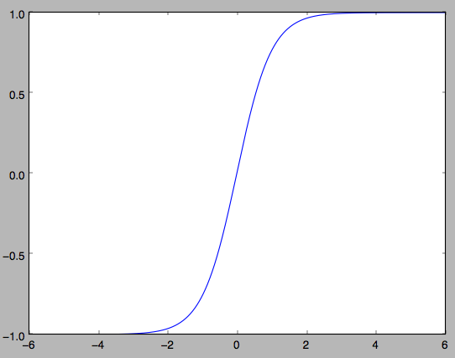
Batch normalization
It would be great if we could just whiten the inputs to all neurons in a layer: i.e. zero mean, variance of 1.
  Avoid vanishing gradients problem, improve learning rates!
  For each input k to the next layer:
Slight problem: this reduces representation ability of network
  Why?
Get stuck in this part of the activation function

Slide 21

Batch normalization
First whiten each input k independently, using statistics from the mini-batch:
Then introduce parameters to scale and shift each input:
These parameters are learned by the optimization.

Slide 22
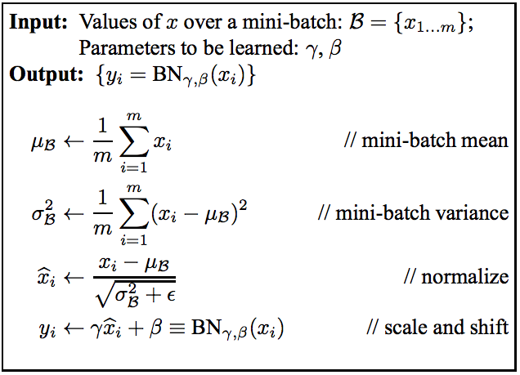
Batch normalization

Slide 23
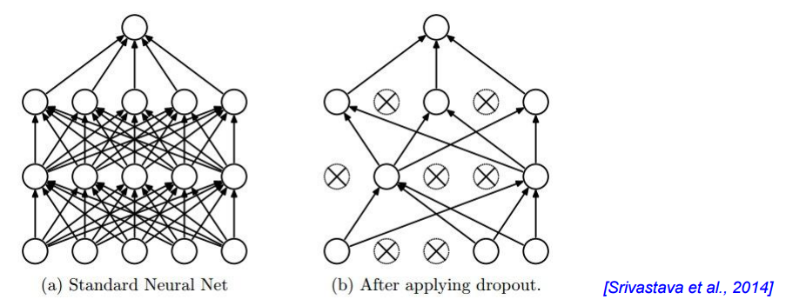
Dropout: regularization
Randomly zero outputs of p fraction of the neurons during training
Can we learn representations that are robust to loss of neurons?
Intuition: learn and remember useful information
even if there are some errors in the computation
(biological connection?)
Slide from Stanford CS231n

Slide 24
Dropout
Another interpretation: we are learning a large ensemble of models that share weights.
Slide from Stanford CS231n

Slide 25
Dropout
Another interpretation: we are learning a large ensemble of models that share weights.
What can we do during testing to correct for the dropout process?
  Multiply all neurons outputs by p.
  Or equivalently (inverse dropout) simply divide all neurons outputs by p during training.
Slide from Stanford CS231n

Slide 26
Overview
Preprocessing
Improving convergence
  Initialization
  Vanishing/exploding gradients problem
Improving generalization
  Batch normalization
  Dropout
Additional neuron type: softmax
Transfer learning / fine-tuning

Slide 27
Softmax
Often used in final output layer to convert neuron outputs into a class probability scores that sum to 1.
For example, might want to convert the final network output to:
  P(dog) = 0.2 (Probabilities in range [0, 1])
  P(cat) = 0.8
  (Sum of all probabilities is 1).

Slide 28
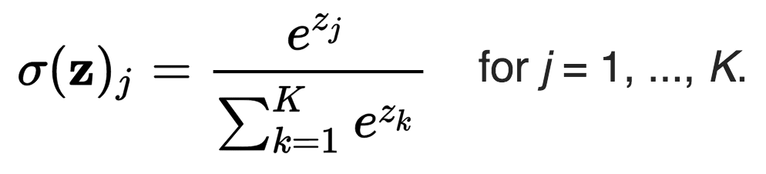
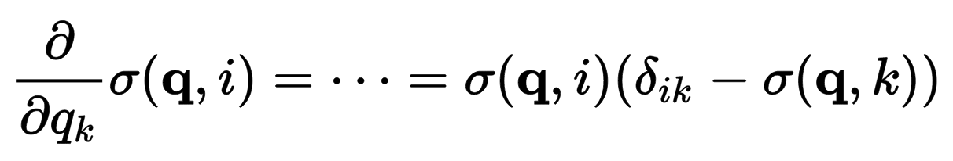
Softmax
Softmax takes a vector z and outputs a vector of the same length.

Slide 29
Softmax
Example from Wikipedia:
Input: [1, 2, 3, 4, 1, 2, 3 ]
Output: [0.024, 0.064, 0.175, 0.475, 0.024, 0.064, 0.175]
Most energy is concentrated where maximum element is.

Slide 30
Overview
Preprocessing
Improving convergence
  Initialization
  Vanishing/exploding gradients problem
Improving generalization
  Batch normalization
  Dropout
Additional neuron type: softmax
Transfer learning / fine-tuning

Slide 31

Transfer Learning / Fine-tuning
Neural networks are data hungry…
  Need tons of data to avoid overfitting
  e.g. ImageNet has millions of images
What if we have a problem with few images?
  Collect more data? (use Amazon Mechanical Turk?)
  What if collecting more data is too expensive / difficult?
  Use transfer learning (fine-tuning)
0, 1, 0, 0, 1, 0, 1, 1
Image by Sam Howzit, Creative Commons

Slide 32
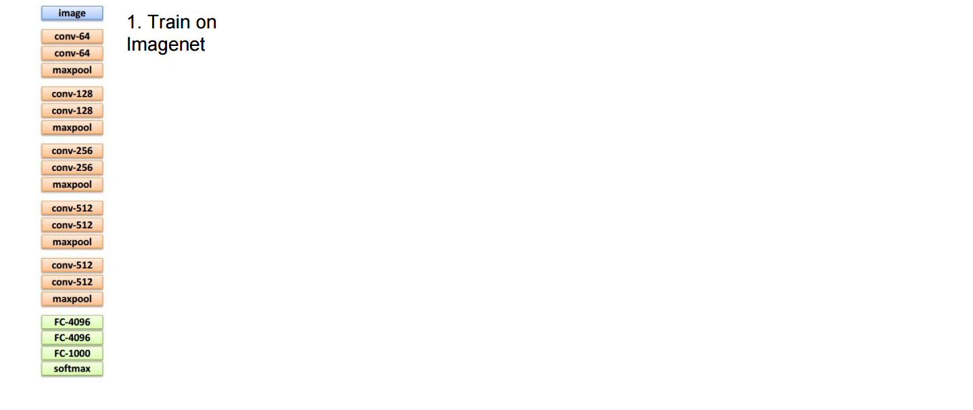
Transfer Learning / Fine-tuning
Slides from Fei-Fei Li, Justin Johnson, Andrej Karpathy

Slide 33
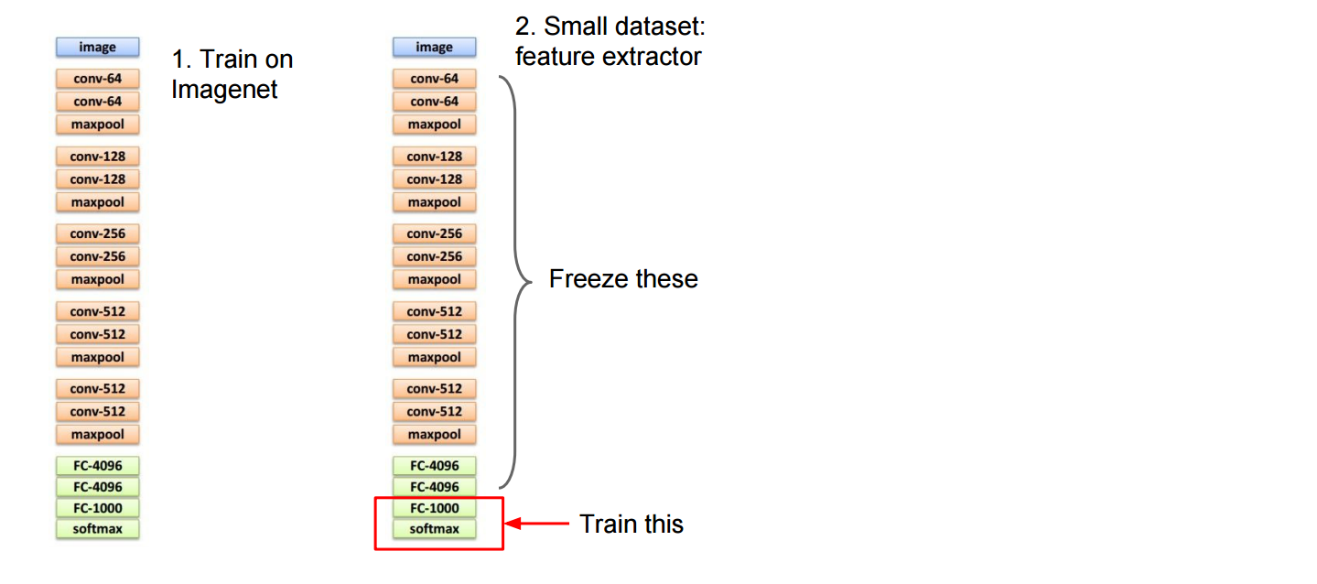
Transfer Learning / Fine-tuning
Slides from Fei-Fei Li, Justin Johnson, Andrej Karpathy

Slide 34
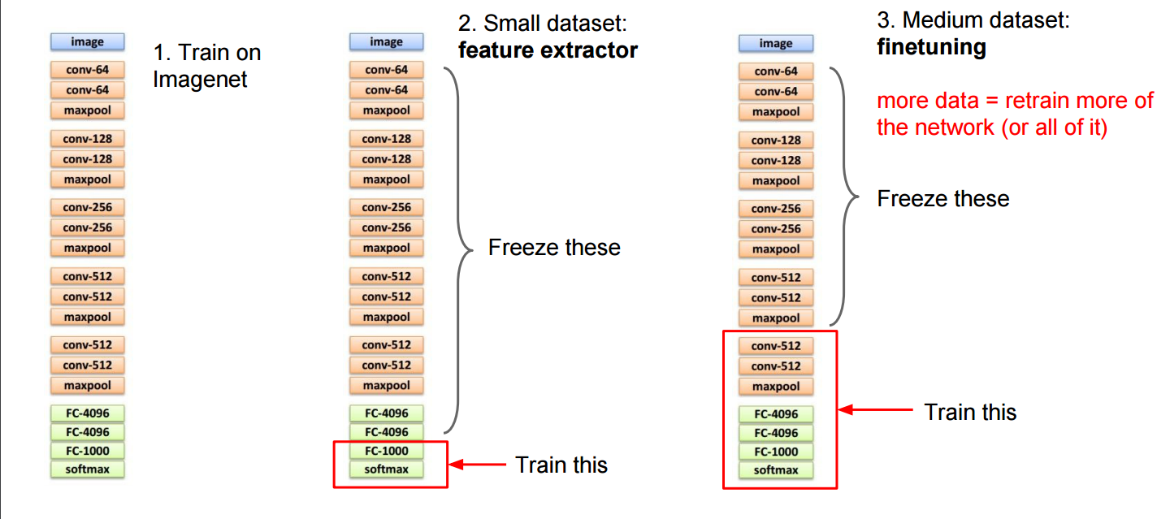
Transfer Learning / Fine-tuning
Use lower
learning rate (1/10)
Slides from Fei-Fei Li, Justin Johnson, Andrej Karpathy

