Slide 1
CS 4501: Introduction to Computer Vision Introduction / Overview
Connelly Barnes
Some slides from Jason Lawrence, Vicente Ordonez, Fei-Fei Li, Juan Carlos Niebles

Slide 2
Outline
Course info:
Website
Textbooks
Goals / topics
Related courses
Grading
How to define computer vision and machine learning?
History of computer vision, neural networks, example topics

Slide 3
About the Instructor
Background: computer graphics and computer vision
Ph.D. Princeton 2011
Adobe postdoctoral research scientist 2011-2013
University of Virginia 2013-present

Slide 4
Course Website
http://www.cs.virginia.edu/~connelly/class/2017/intro_vision/
Other ways to find the website:
Linked to from UVa Collab
Linked to from Lou’s list
Linked to from my websites: connellybarnes.com www.cs.virginia.edu/~connelly (mirrors the previous link)

Slide 5
Textbooks
Not required but may help you understand topics in greater detail Expensive ones (a few copies on reserve at Brown Engr library):
Computer Vision: A Modern Approach by Forsyth and Ponce
Multiple View Geometry by Hartley and Zisserman
Online, free ones:
Computer Vision: Algorithms and Applications by Szeliski
Deep Learning by Goodfellow, Bengio and Courville.

Slide 6
Course Goals
Know basic machine learning terminology
Understand how low-level visual features can be detected and tracked by computers (e.g. edges, corners, blobs)
Understand how high-level visual features can be understood by computers (e.g. faces, cars, streets, humans)
Understand how images, depth, and geometry can be acquired by computers
Learn about applications such as autonomous driving

Slide 7
Related courses
CS 4810: Intro to Computer Graphics
CS 6501: Graduate special topics courses, by
Vicente Ordonez (computer vision)
Connelly Barnes (computer graphics and vision)
Yanjun Qi, Kai-Wei Chang, Hongning Wang (machine learning)
Undergraduate students with appropriate background can join
Occasional undergraduate courses by the above researchers

Slide 8
Grading
In-class participation (10%)
e.g. being in class, participating in in-class discussions
Final course project (25%)
Three programming assignments (40%)
Four quizzes (indicated on course calendar): (25%)
10 midterm exams
Just kidding, no exams

Slide 9
Outline
Course info:
Website
Textbooks
Goals / topics
Related courses
Grading
How to define computer vision and machine learning?
History of computer vision, neural networks, example topics

Slide 10
What is Computer Vision?
“An interdisciplinary field that deals with how computers can be made to gain understanding from digital images or video. From the perspective of engineering, it seeks to automate tasks that the human visual system can do.” – Definition, slightly modified from Wikipedia

Slide 11
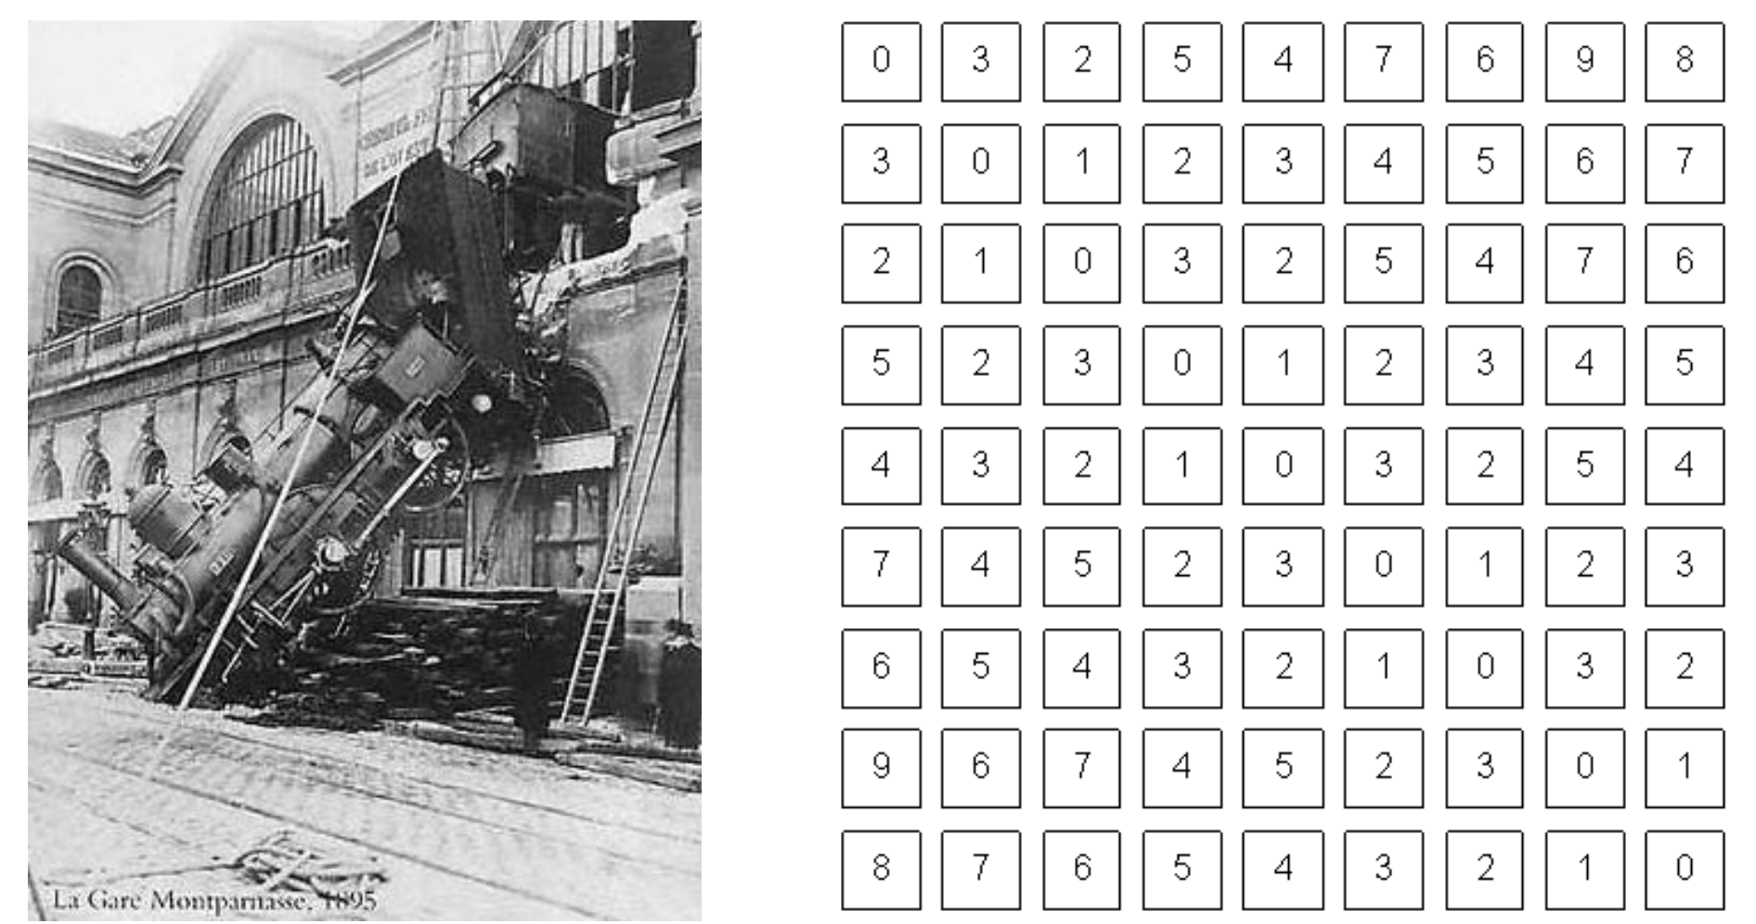
What is Computer Vision?
A way to bridge the gap between pixels and understanding
What we see
What a computer sees
Slide from Fei-Fei Li, Juan Carlos Niebles, S. Narasimhan

Slide 12
Examples of Computer Vision
Slide from Jason Lawrence

Slide 13
Examples of Computer Vision
Slide from Vicente Ordonez

Slide 14
What is Computer Vision?
Human Vision / Perceptual Psychology
Machine Learning
Computer Vision
Deep Learning

Slide 15
What is Machine Learning?
“The field of study that gives computers the ability to learn without being explicitly programmed.” – Arthur Samuel

Slide 16
What is Machine Learning?
Two main kinds used in computer vision:
Supervised learning: computer presented with example inputs and desired outputs by a “teacher”, goal is to learn general rule that maps inputs to outputs.
Most computer vision systems use supervised learning
Unsupervised learning: No output labels are given to the algorithm, leaving it on its own to find structure in the inputs.
= dog
= cat
Which is the input and the output, and why?

Slide 17
Outline
Course info:
Website
Textbooks
Goals / topics
Related courses
Grading
How to define computer vision and machine learning?
History of computer vision, neural networks, example topics

Slide 18
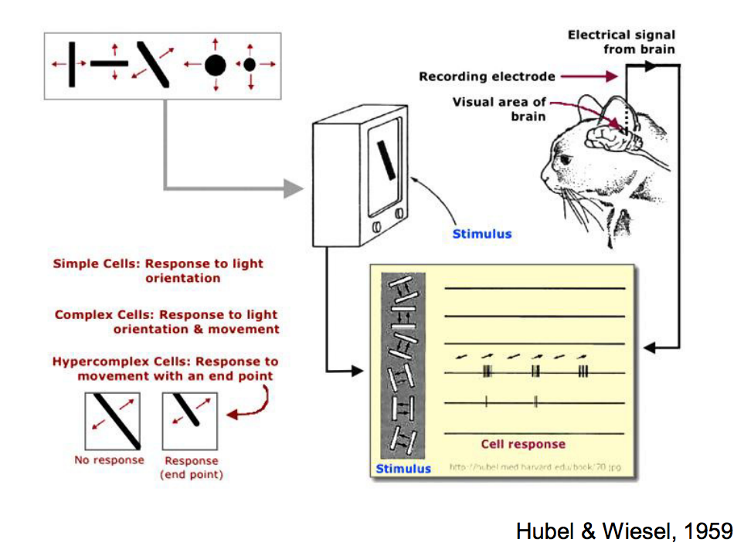
History of Computer Vision: Hubel & Wiesel (1959)
Slides from Stanford CS 231n

Slide 19
History of Computer Vision: Block World (1963)
Goal: recover 3D geometry
Slides from Stanford CS 231n

Slide 20
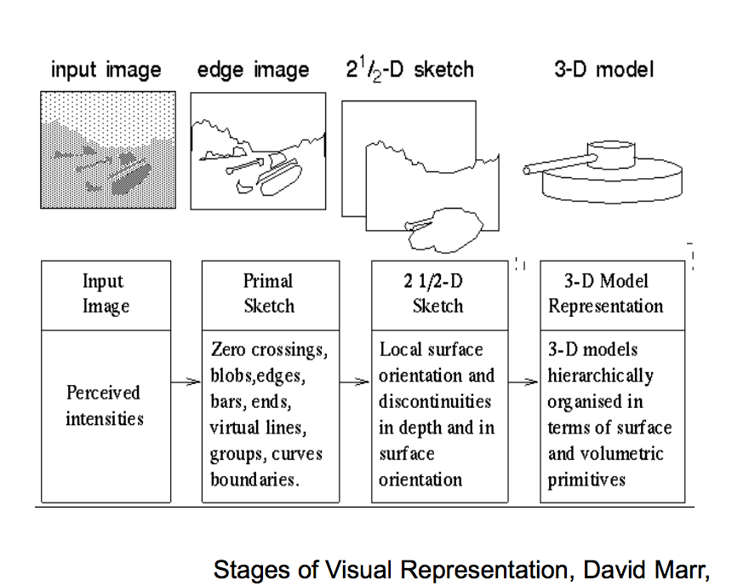
History of Computer Vision: David Marr (1970s)
Article summarizing Marr’s research by T. Poggio
Slides from Stanford CS 231n

Slide 21
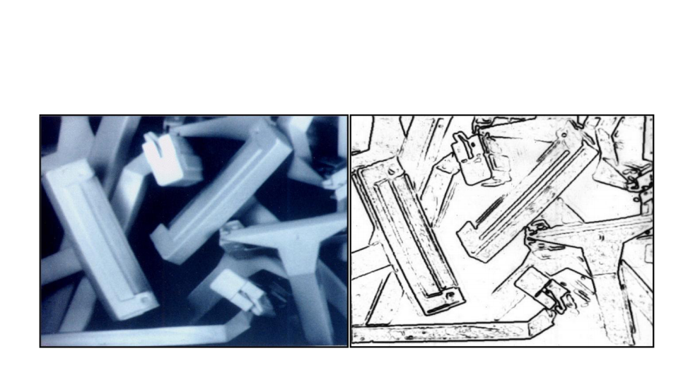
History of Computer Vision: 1980s
David Lowe 1987: 3D Object Recognition from Single 2D Images
Slides from Stanford CS 231n

Slide 22
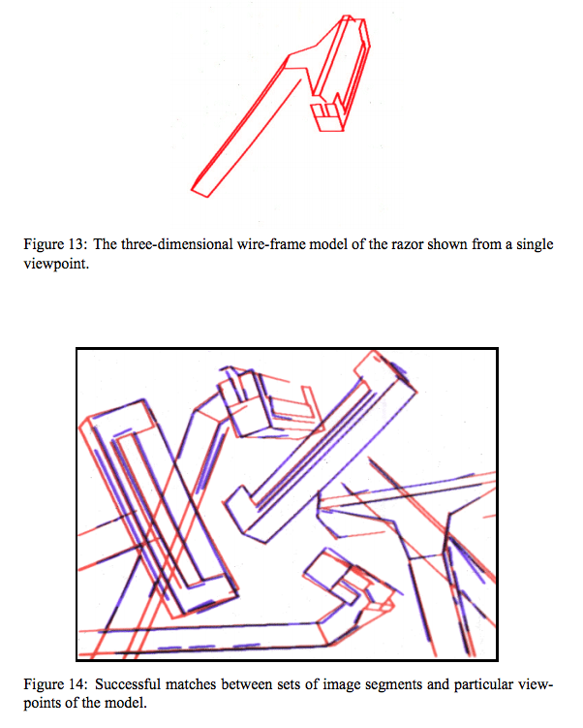
History of Computer Vision: 1980s
David Lowe 1987: 3D Object Recognition from Single 2D Images
Slides from Stanford CS 231n

Slide 23
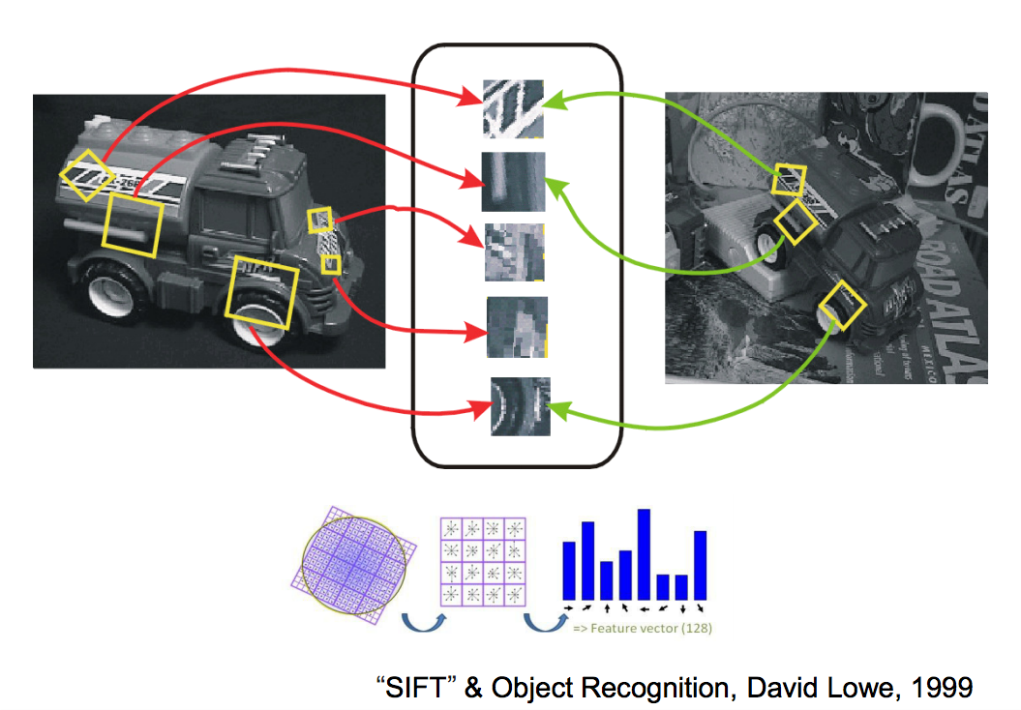
Scale-Invariant Feature Transform (SIFT, 1999)
Slides from Stanford CS 231n

Slide 24
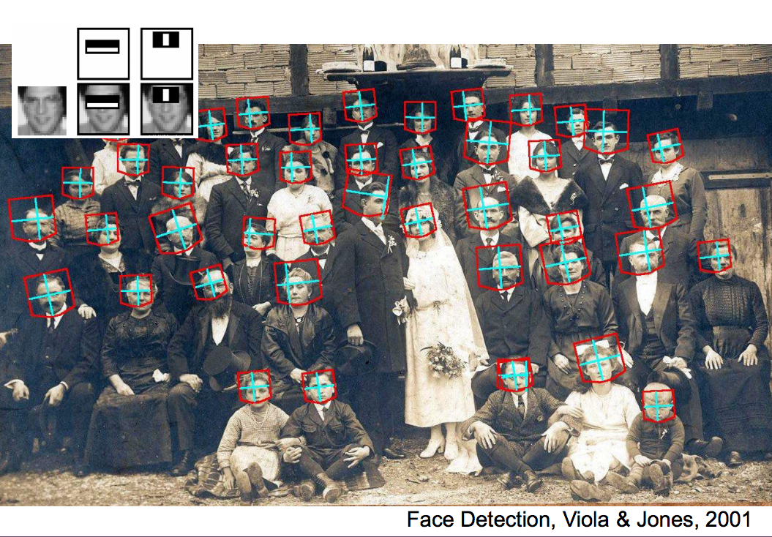
Face Detection (2001)
Slides from Stanford CS 231n

Slide 25
HoG and Deformable Part Models (mid 2000s)
Slides from Stanford CS 231n

Slide 26
Outline
Course info:
Website
Textbooks
Goals / topics
Related courses
Grading
How to define computer vision and machine learning?
History of computer vision, neural networks, example topics

Slide 27
Parallel Development: Artificial Neural Networks
“An artificial neural network is a network inspired by biological neural networks, which are used to estimate or approximate functions that can depend on a large number of inputs that are generally unknown.” - Wikipedia
In this class, we can call these “neural networks” for short.

Slide 28
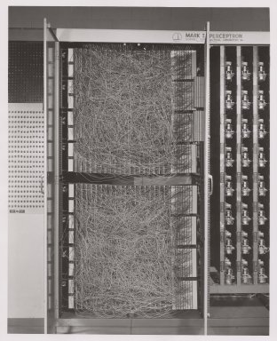
Perceptron (1957, Cornell)
400 pixel camera
Designed for image recognition
“Knowledge” encoded as weights in potentiometers (variable resistors)
Weights updated during learning performed by electric motors

Slide 29
Neural Networks: Perceptron (1957, Cornell)
Output (Class)
Inputs
Bias b: arbitrary, learned parameter
Weights: arbitrary, learned parameters

Slide 30
Convolutional Neural Networks (1990s)
Yann LeCun, Leon Bottou, Yoshua Bengio, Patrick Haffner
Diagram from Wikipedia

Slide 31
ImageNet (2009)
Jia Deng, Wei Dong, Richard Socher, Lia-Jia Li, Kai Li, Li Fei-Fei
Currently over 10 million images in tens of thousands of categories
http://image-net.org/explore
ImageNet Large Scale Visual Recognition Competition (ILSVRC)

Slide 32
Computer Vision: Deep Learning (2012-)
Deep learning: artificial neural networks with many layers.
In 2012, the AlexNet classifier gained a significant performance improvement on the ILSVRC by using deep neural networks.
Deep learning on ImageNet surpassed human performance for object recognition in 2015
Recently, computer vision predominantly uses deep learning.

Slide 33
Fast GPUs + Big Data => Deep Learning (2012-)
More data means we can train deeper networks
Fast GPUs mean we can run the training process more efficiently
Dramatic improvement in performance in computer vision and natural language processing.
Everyone uses Nvidia GPUs. What do you think happened to Nvidia stock?
GoogLeNet

Slide 34
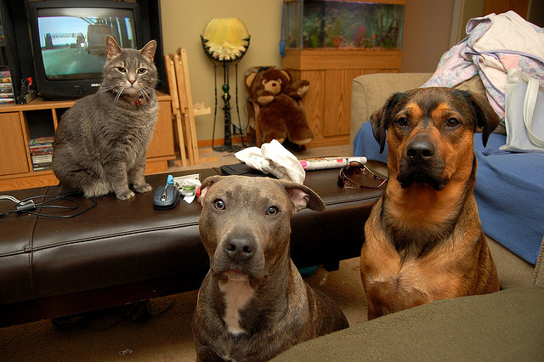
Image Tagging / Image Classification
feline
tv set
teddy bear
pitbull
bullmastiff
cat
tv stand
group of dogs
fish tank
room
indoor
man-made
footstool
furniture

Slide 35
Object Detection
tv set
fish tank
feline
cat, feline
tv set
teddy bear
sofa
bullmastiff, animal
teddy bear
tv stand
pitbull
bullmastiff
footstool
pitbull
cat
tv stand
group of dogs
fish tank
room
indoor
man-made
footstool
furniture

Slide 36
Image Parsing / Segmentation
feline
tv set
teddy bear
pitbull
dog
cat
tv stand
group of dogs
fish tank
room
indoor
man-made
footstool
furniture

Slide 37
Computer Vision + Natural Language Processing
Object Importance
Attribute
Importance
Action
Importance
World knowledge
A cat and two big dogs staring at the camera

Slide 38
Computer Vision + Natural Language Processing
How many dogs are in the picture?
Is the cat sitting on a bed?
What is the color of the dog on the right?
Visual question answering

Slide 39
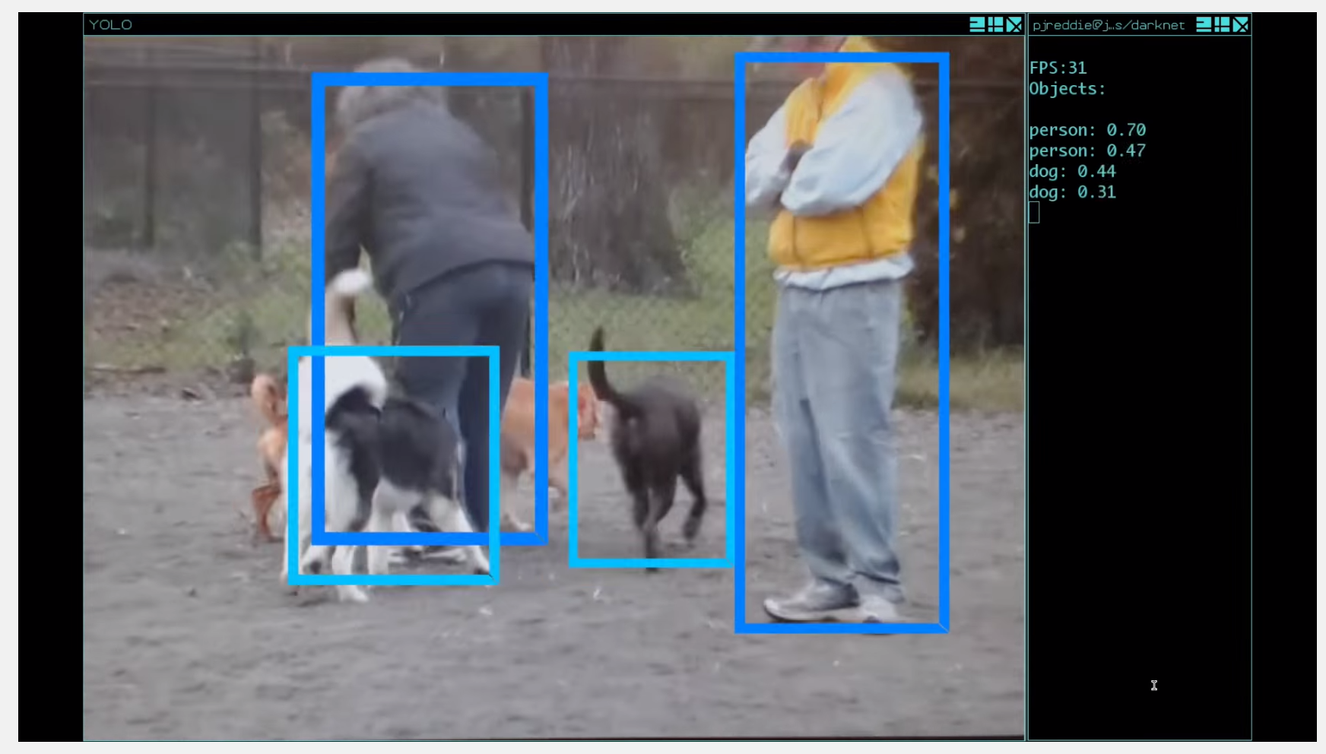
YOLO: Object Detection Demo
https://www.youtube.com/watch?v=r6ZzopHEO1U

Slide 40
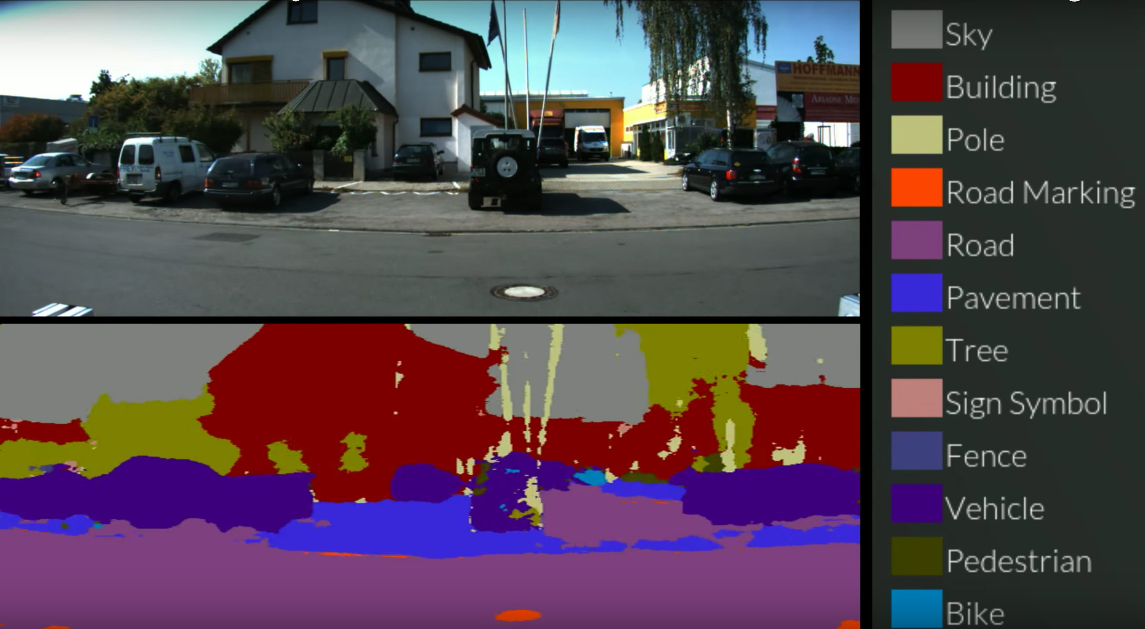
Semantic Image Segmentation Demo #1
https://www.youtube.com/watch?v=CrnLINlbfFA

Slide 41
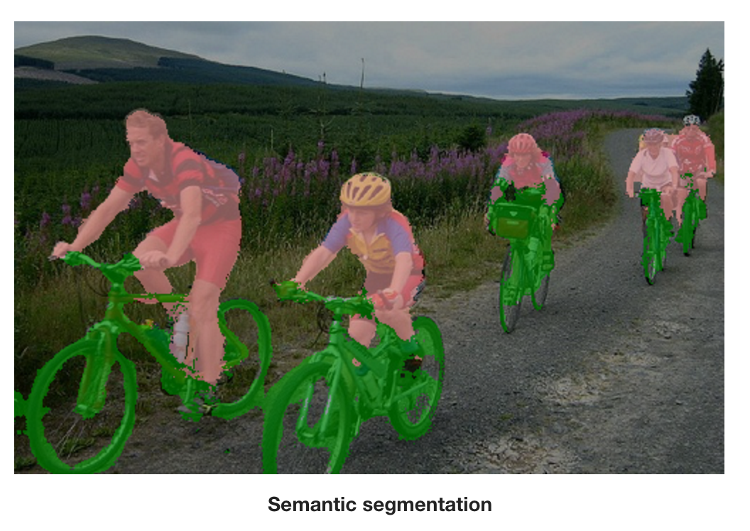
Segmentic Image Segmentation Demo #2
http://www.robots.ox.ac.uk/~szheng/crfasrnndemo

Slide 42
Programming Assignments
Recommend Python (another option: MATLAB?)
Set up Python (recommend Anaconda Python)
Install some packages. Recommend:
scikit-image (image processing)
tensorflow (neural networks), ideally configured with GPU support
keras (neural networks)
opencv might not hurt, either
Can sign up to use department machines also, will send document for that.

