Slide 1
CS 4501: Introduction to
Computer Vision
Image Formation
Connelly Barnes
Some slides from Jason Lawrence, Alexei Efros, Steve Seitz, Stephen Palmer, Fredo Durand, Edward Adleson

Slide 2
Outline
Human eyes
  How do they sense light?
  Visible light and human color perception
Electronic eyes
  How do they sense light?
  Image representation
  Color spaces
  Lens models and camera parameters

Slide 3
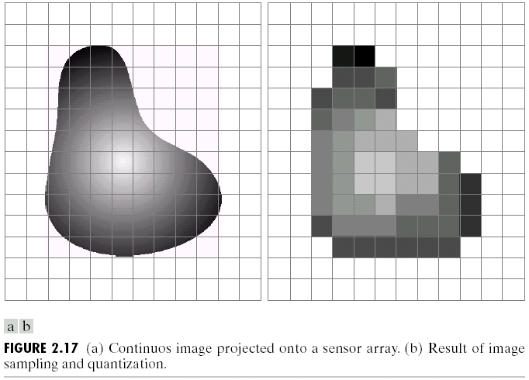
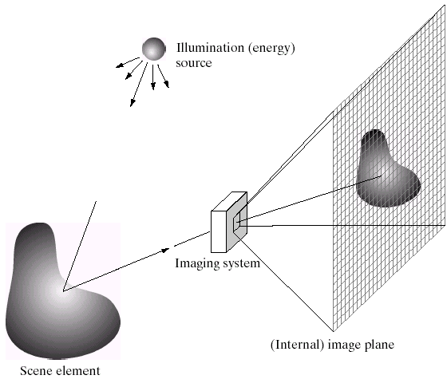
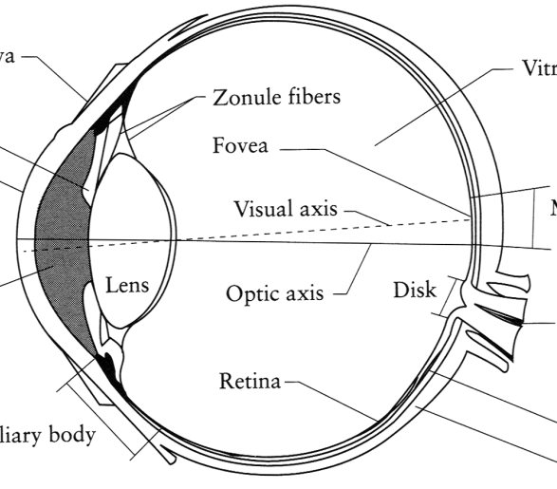
Image Formation
Digital Camera
Film
The Eye
Slide by Efros

Slide 4
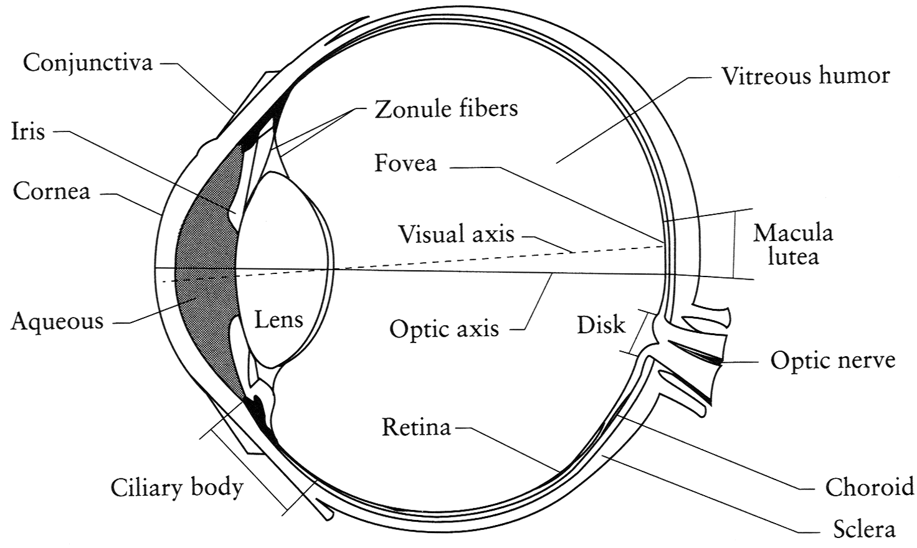
The Eye
The human eye is a camera!
  Iris - colored annulus (ring) with radial muscles
  Pupil - the hole (aperture) whose size is controlled by the iris
  What’s the “film”?
    photoreceptor cells (rods and cones) in the retina
Slide by Steve Seitz

Slide 5
The Retina
Notes:
Light passes through several transparent nerve layers to reach rods and cones, and is absorbed by the pigmented epithelium after that. When light falls on a receptor it sends a response to the bipolar cells which signal the retinal ganglion cells. A lot of compression and encoding…

Slide 6
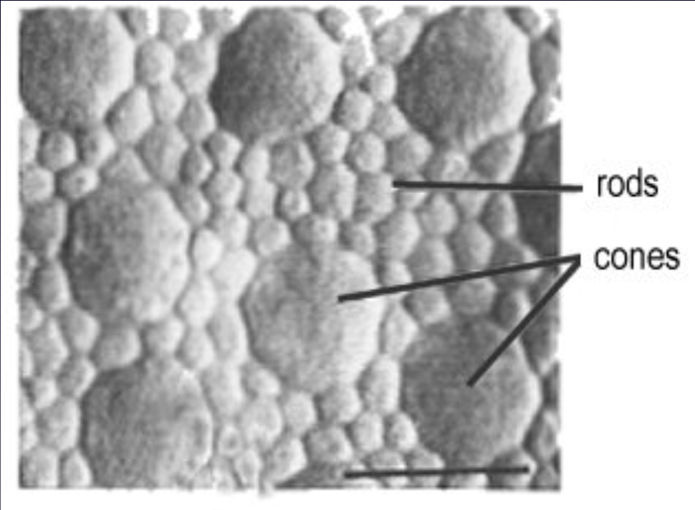
Two types of light-sensitive receptors
Cones
cone-shaped
less sensitive
operate in high light
color vision
Rods
rod-shaped
highly sensitive
operate at night
gray-scale vision
© Stephen E. Palmer, 2002
Image from Jason Lawrence and Szymon Rusinkiewicz

Slide 7
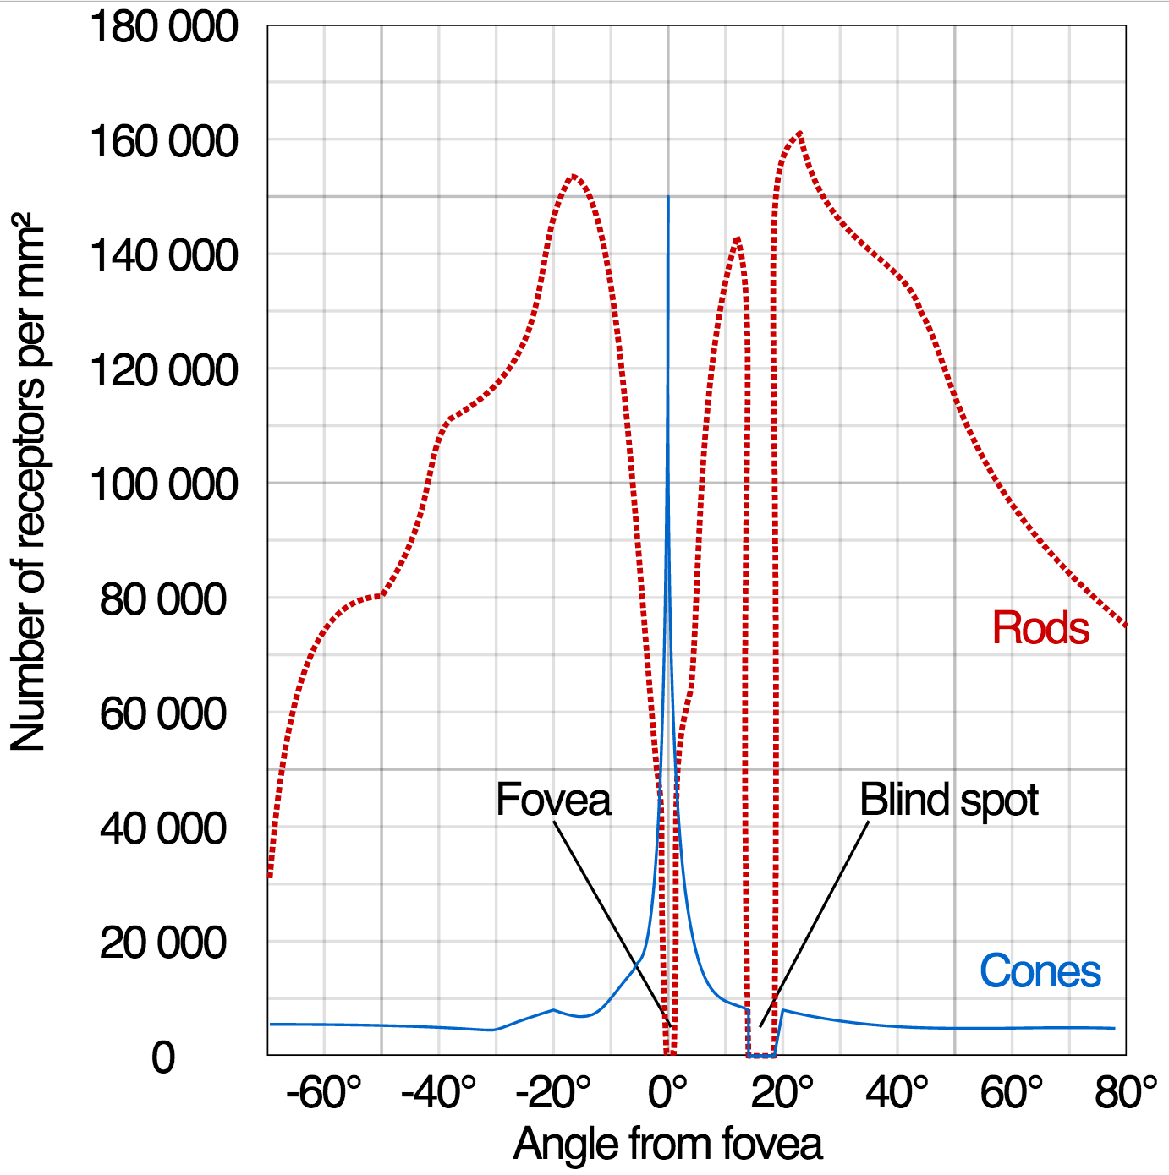
Distribution of Rods and Cones
From Wikipedia

Slide 8
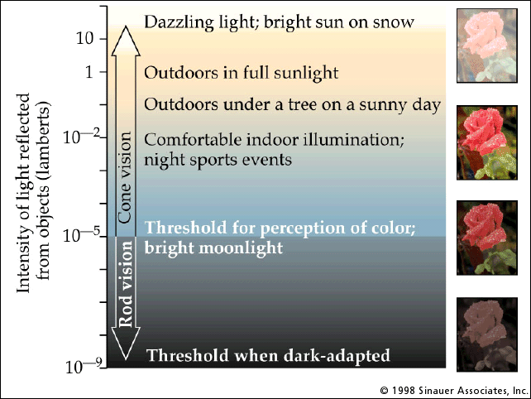
Rod / Cone Sensitivity

Slide 9
Some “Goals” of Human Eye
Recognize food
Recognize friends, mates
Detect predators
Navigation -- identify 3D structure
Limited memory, computation budget
Highest resolution in fovea
- (2 degrees, 50% of visual cortex)
                Absolute luminance discarded
  Edges, corners retained
  Store only a tiny fraction of what is observed

Slide 10
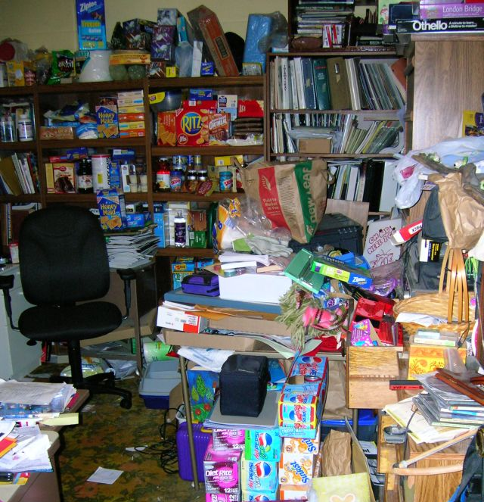
Visual Clutter - Bandwidth Overload

Slide 11
Eye Movements: Saccades
“se-KAHDs”
Motion Magnification -- Eye Movements

Slide 12
Outline
Human eyes
  How do they sense light?
  Visible light and human color perception
Electronic eyes
  How do they sense light?
  Image representation
  Color spaces
  Lens models and camera parameters

Slide 13
What is Visible Light?
Electromagnetic radiation with frequencies (wavelengths) between:
  Red: 4.3 x 10¹⁴ Hz (700 nm)
  Violet: 7.5 x 10¹⁴ Hz (400 nm)

Slide 14
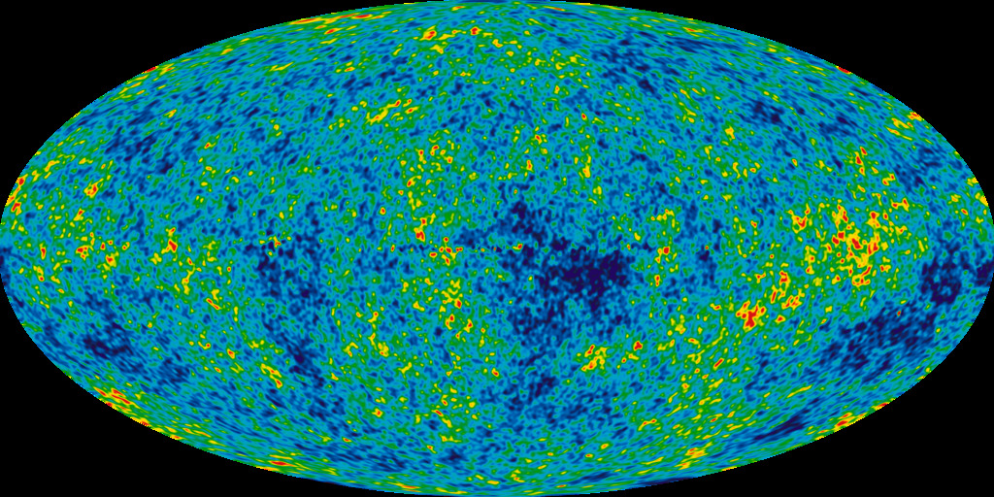
Beginnings of Visible Light…
“Immediately after the Big Bang, the universe was a hot, dense plasma of photons, electrons, and protons. The plasma was effectively opaque to electromagnetic radiation…
“Eventually, the universe cooled [and hydrogen formed]…”
“Once photons decoupled from matter, they traveled freely through the universe without interacting with matter and constitute what is observed today as cosmic microwave background radiation.” – Wikipedia Recombination

Slide 15
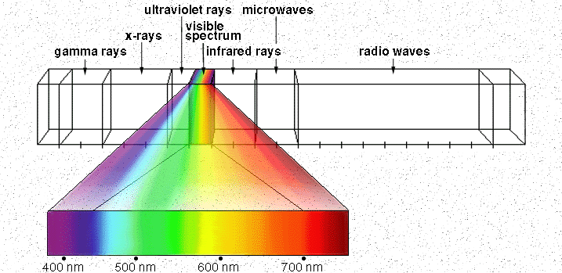
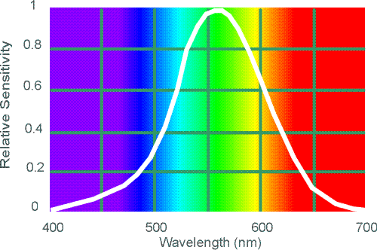
Electromagnetic Spectrum
Human Luminance Sensitivity Function
http://www.yorku.ca/eye/photopik.htm
Notes:
At least 3 spectral bands required (e.g. R,G,B)

Slide 16
Visible Light
Why do we see light of these wavelengths?
…because that’s where the
Sun radiates EM energy
© Stephen E. Palmer, 2002

Slide 17
The Physics of Light
Any patch of light can be completely described
physically by its spectrum: the number of photons
(per time unit) at each wavelength 400 - 700 nm.
© Stephen E. Palmer, 2002

Slide 18
The Physics of Light
Some examples of the spectra of light sources
© Stephen E. Palmer, 2002

Slide 19
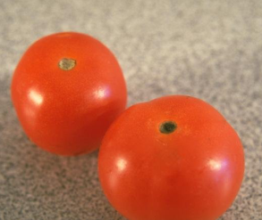
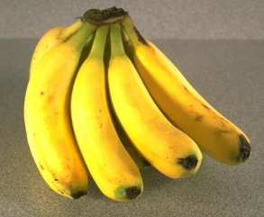
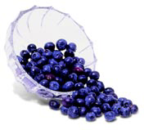
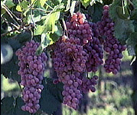
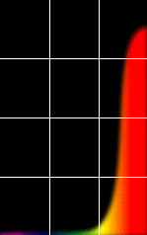
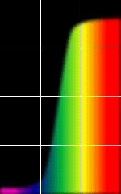
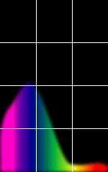
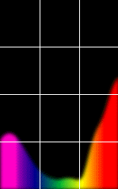
The Physics of Light
Some examples of the reflectance spectra of surfaces
Red
Yellow
Blue
Purple
% Photons Reflected
400 700
400 700
400 700
400 700
Wavelength (nm)
© Stephen E. Palmer, 2002

Slide 20
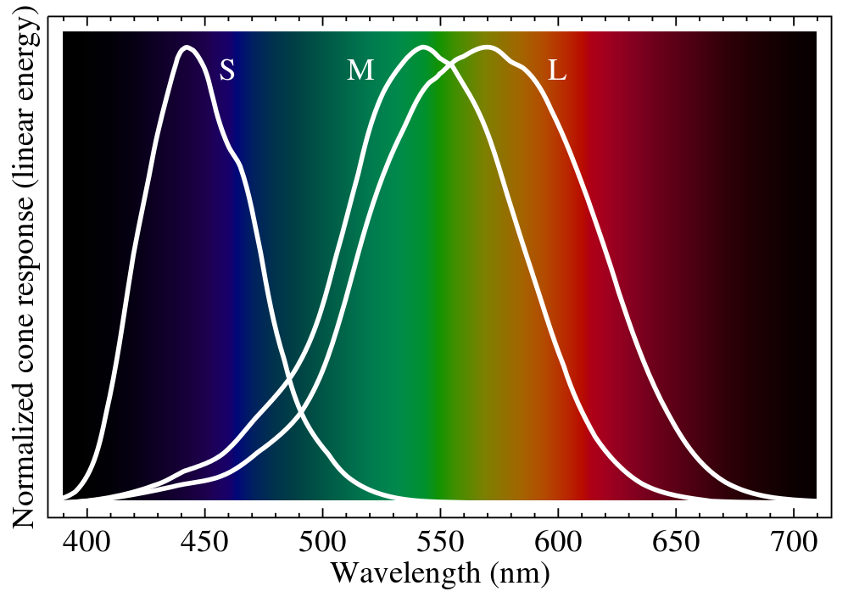
Ordinary Human Vision (Trichromatism)

Slide 21
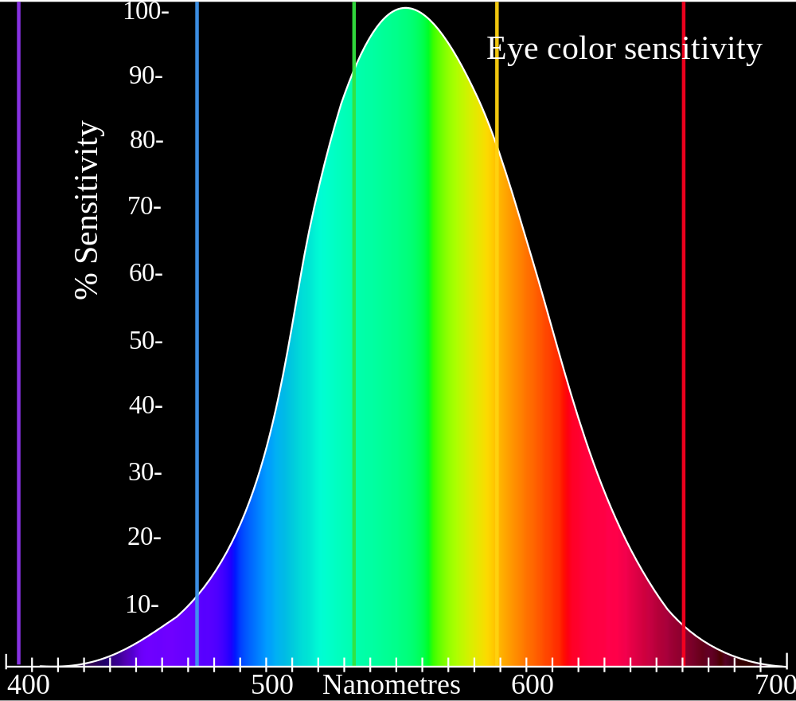
Perceptual Sensitivity
ITU Recommendation for HDTV:
Y = 0.21 R + 0.72 G + 0.07 B
Evolved to detect vegetation, berries?

Slide 22
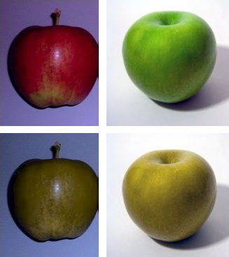
Color blindness
Missing cones (e.g. red or green)
Or mutated pigments in cones
Most common type is red-green
color-blindness
Image from Wikipedia

Slide 23
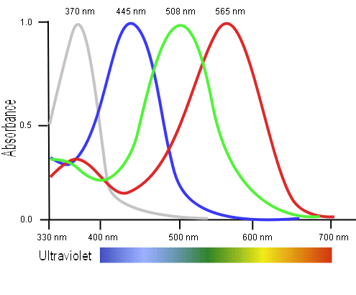
Tetrachromatism
Bird cone responses
Most birds, and many other animals, have cones for ultraviolet light.
  Used for courtship, foraging for food (e.g. berries), flowers
Some humans, mostly female, have slight tetrachromatism.

Slide 24
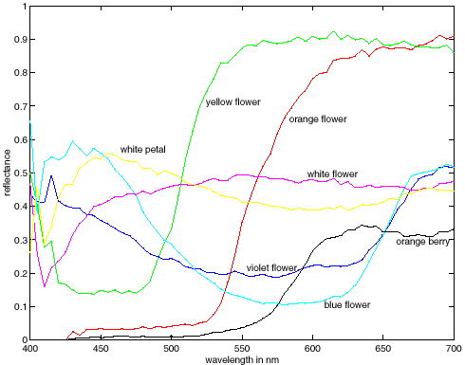
Metamers
metamers
Notes:
Metamerism can be illuminant based or observer based. Color blindness produced well known instances of metamerism.

Slide 25
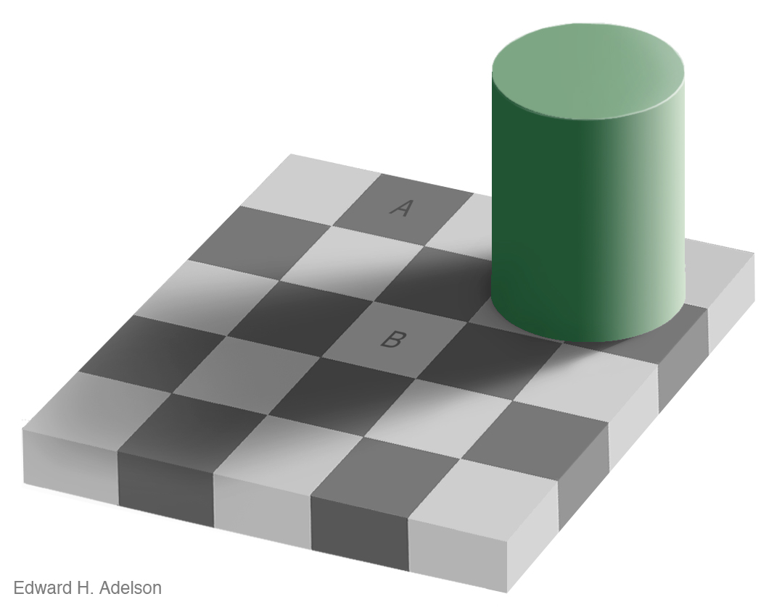
Human Eye is Not a Photo-Meter

Slide 26
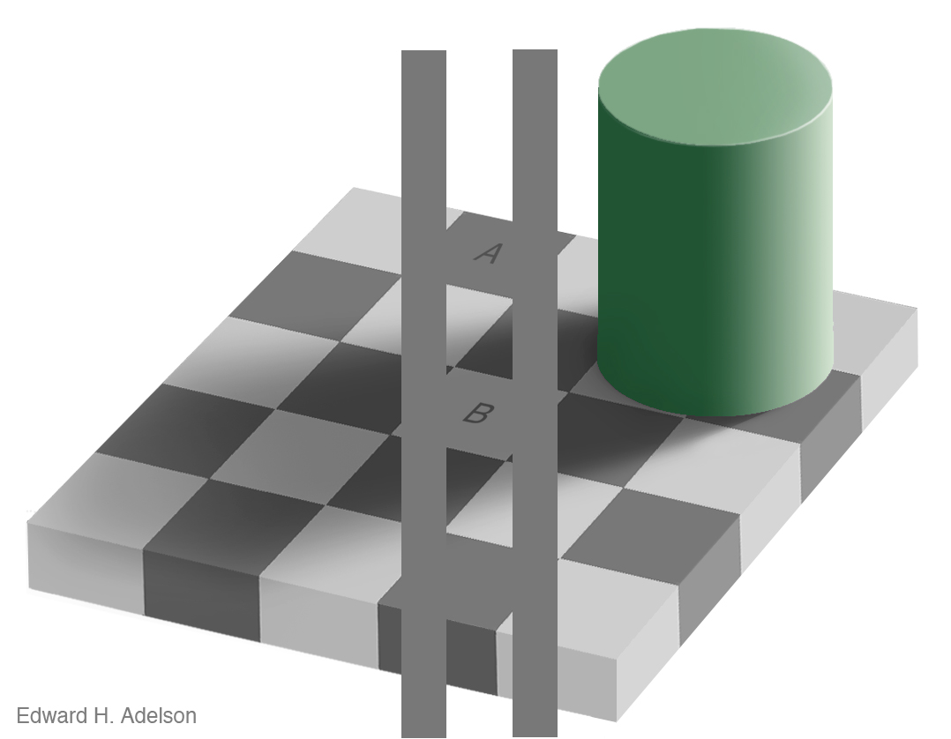
Human Eye is Not a Photo-Meter

Slide 27
Outline
Human eyes
  How do they sense light?
  Visible light and human color perception
Electronic eyes
  How do they sense light?
  Image representation
  Color spaces
  Lens models and camera parameters

Slide 28
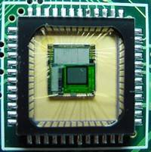
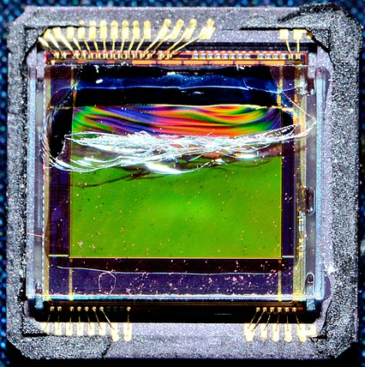
Electronic Eyes: Sensor Arrays
CMOS sensor
CCD sensor
Slide by Efros

Slide 29
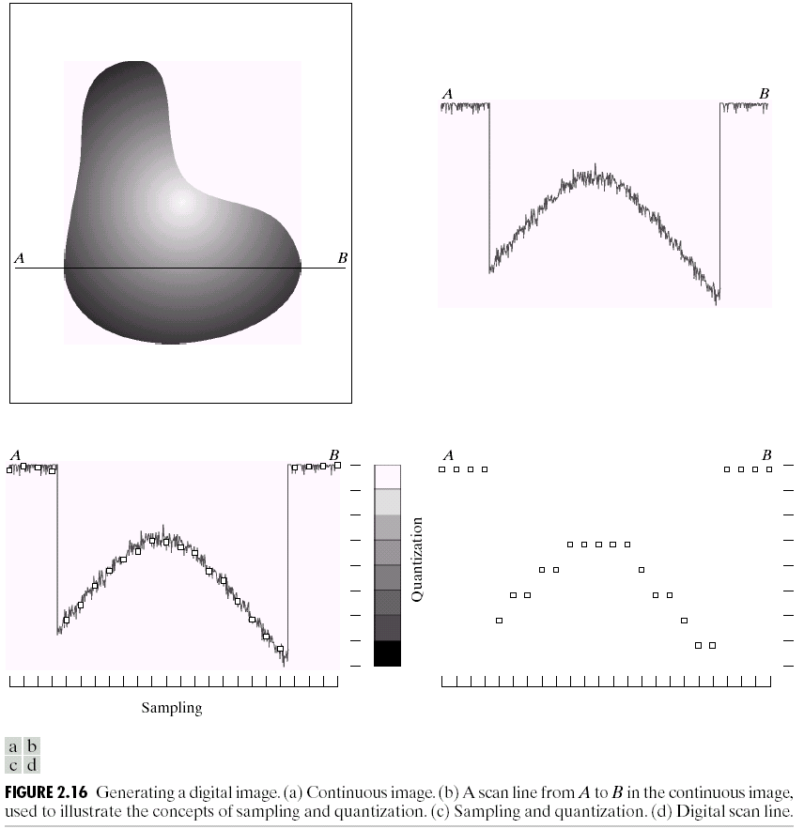
Sampling and Quantization

Slide 30
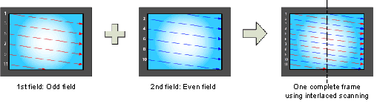
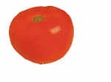
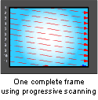
Interlace vs. progressive scan
http://www.axis.com/products/video/camera/progressive_scan.htm
Slide by Steve Seitz

Slide 31
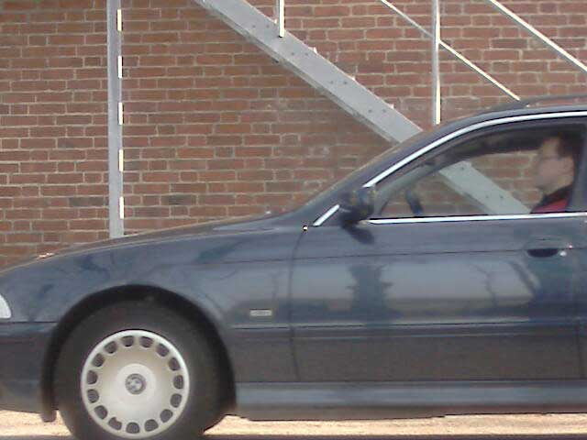
Progressive scan
http://www.axis.com/products/video/camera/progressive_scan.htm
Slide by Steve Seitz

Slide 32
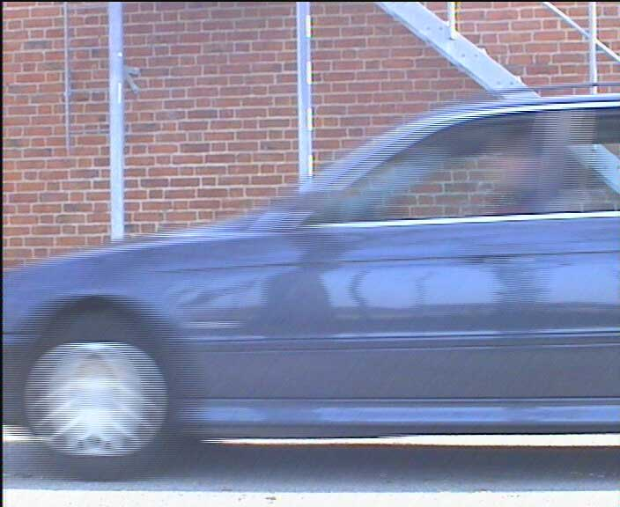
Interlace
http://www.axis.com/products/video/camera/progressive_scan.htm
Slide by Steve Seitz

Slide 33
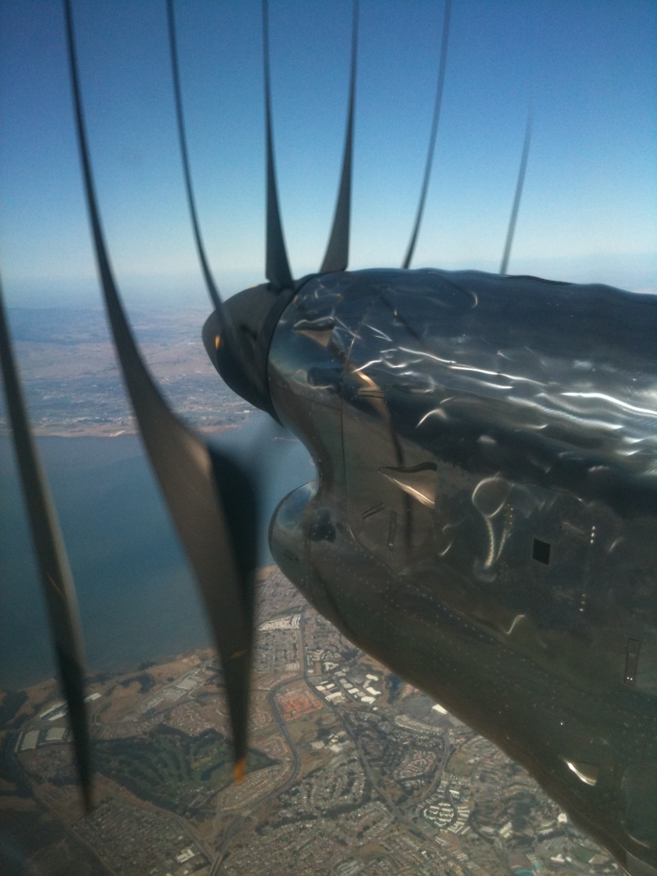
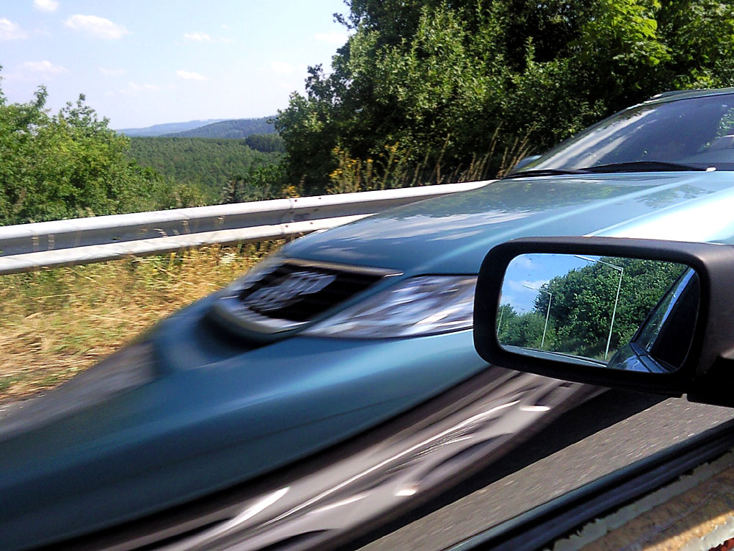
Rolling Shutter
YouTube video
SLR cameras at high shutter speed, most CMOS cameras
Notes:
http://en.wikipedia.org/wiki/Rolling_shutter
Even DSLRs have this problem.

Slide 34
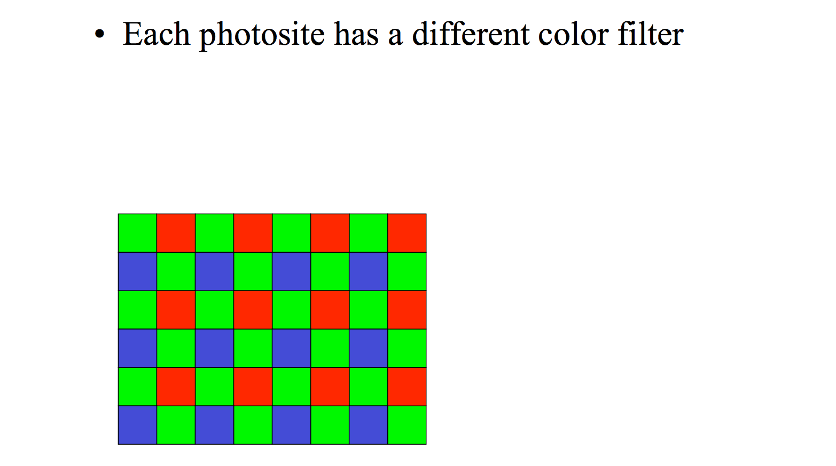
Bayer RGB mosaic
Slide by Fredo Durand

Slide 35
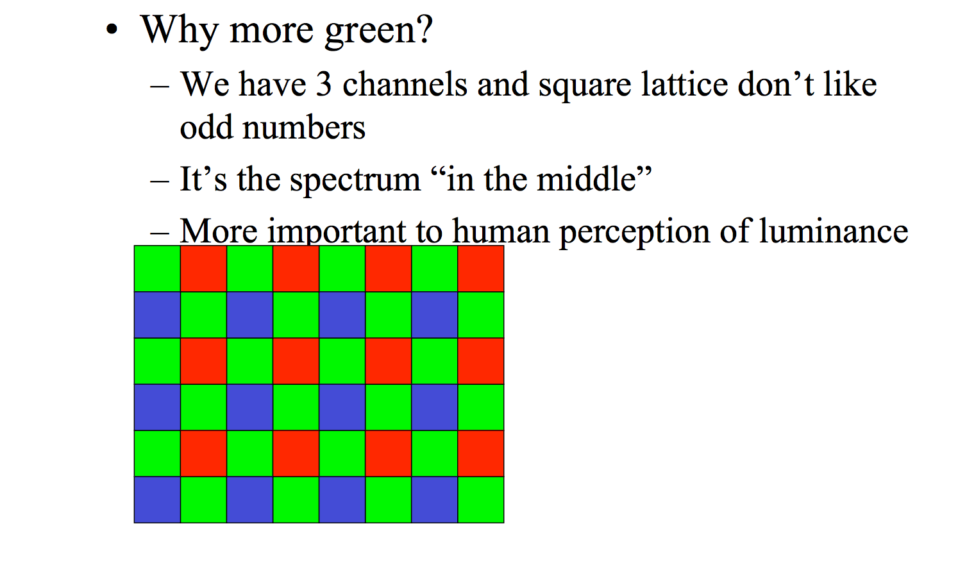
Bayer RGB mosaic
Slide by Fredo Durand

Slide 36
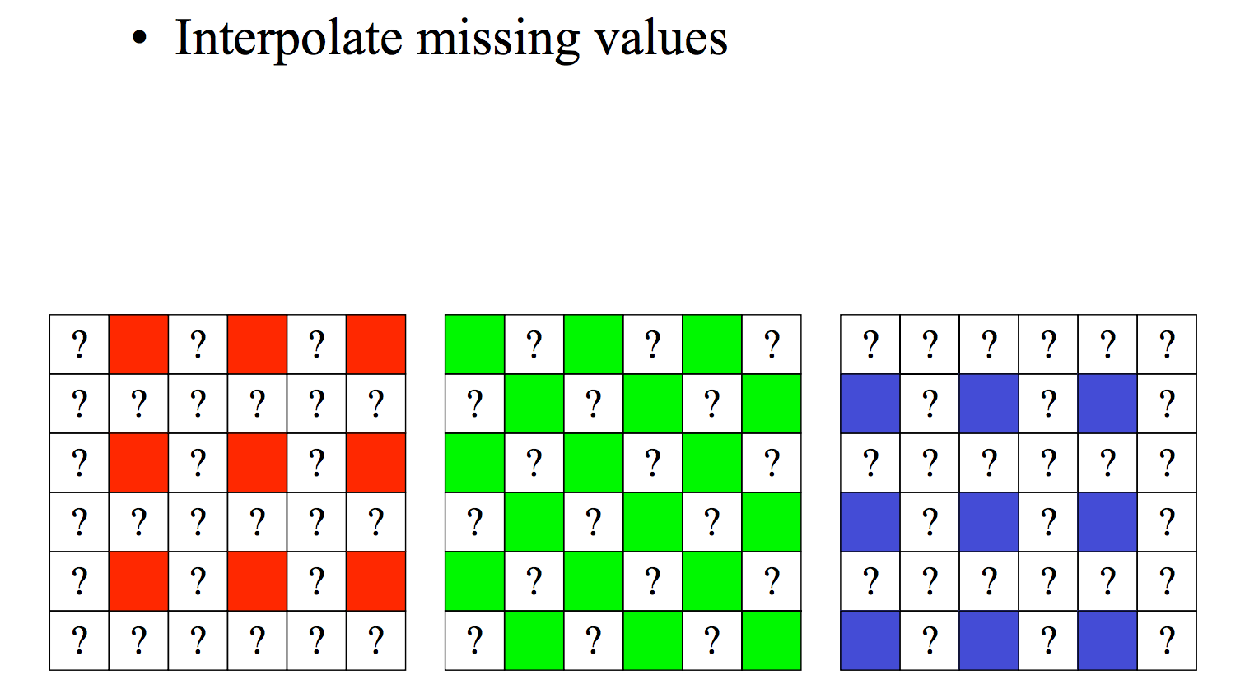
Demosaicing
Slide by Fredo Durand

Slide 37
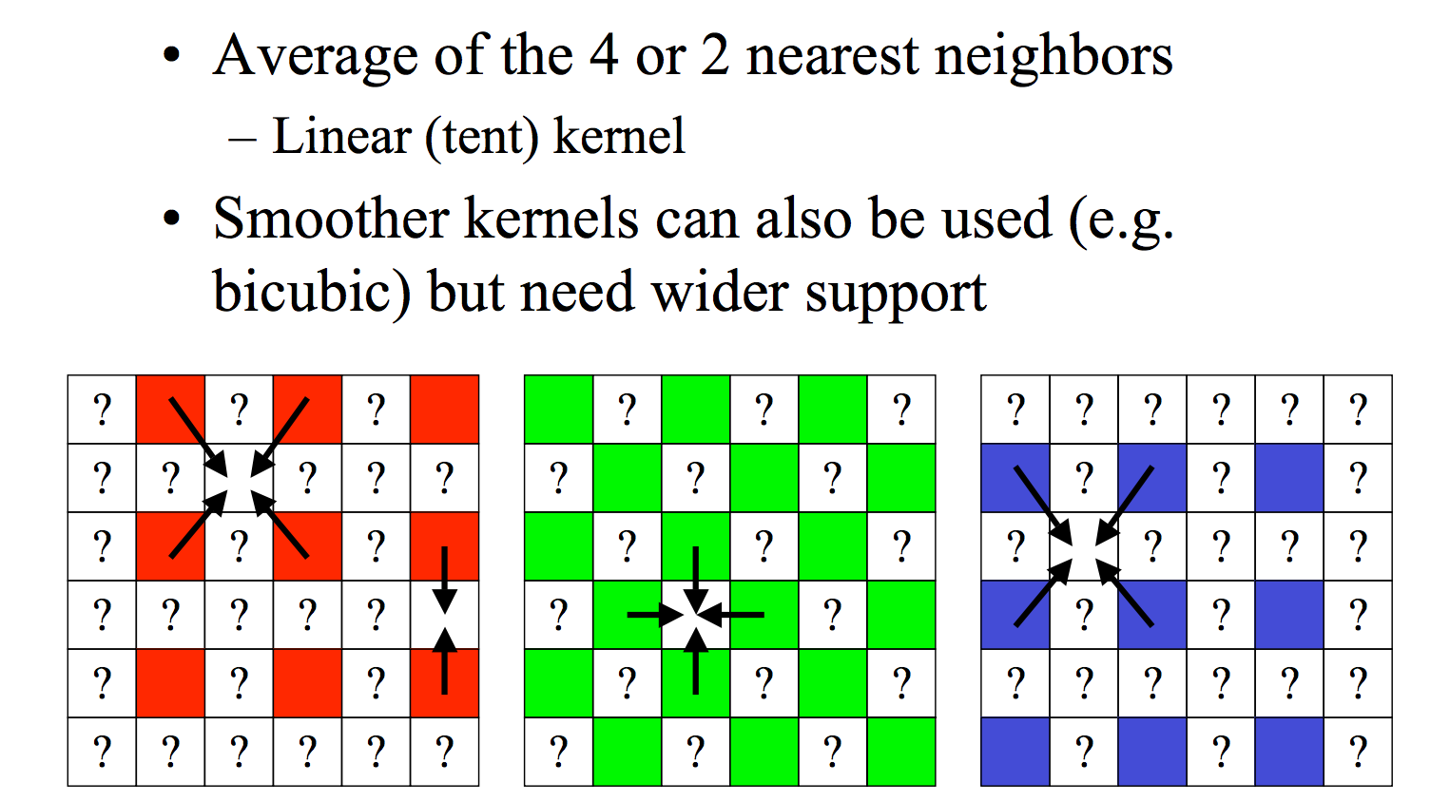
Linear Interpolation
Slide by Fredo Durand

Slide 38
Outline
Human eyes
  How do they sense light?
  Visible light and human color perception
Electronic eyes
  How do they sense light?
  Image representation
  Color spaces
  Lens models and camera parameters

Slide 39
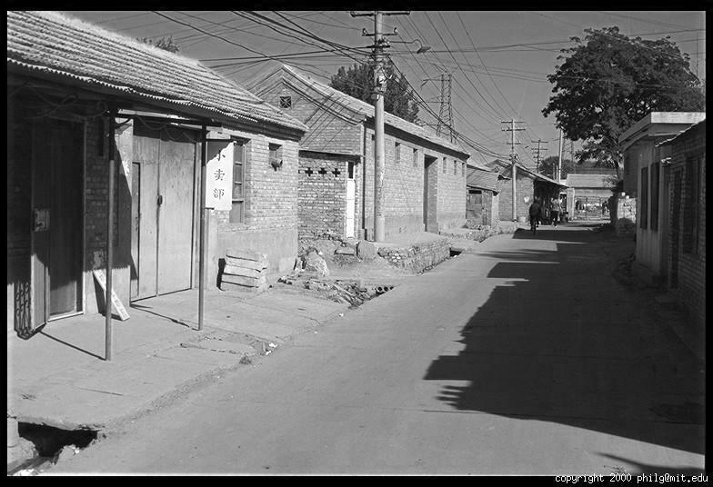
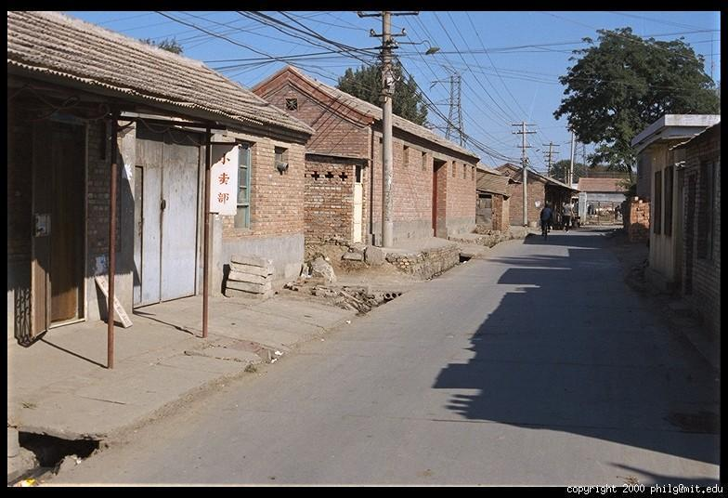
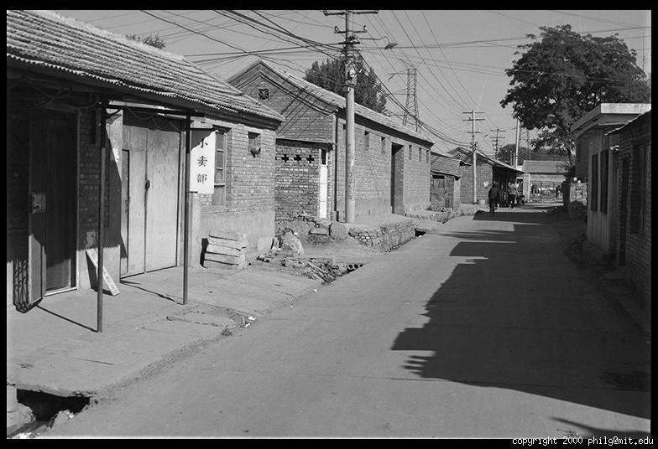
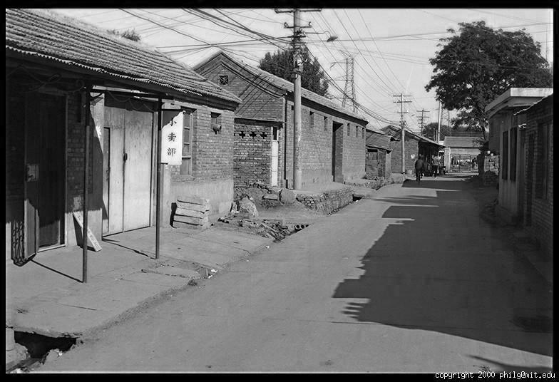
Color Image
R
Color
channels
G
B

Slide 40
Images in Python/MATLAB
Image as array: h x w x channels
  I(y,x,channel)
Red channel, upper left corner:
  MATLAB: I(1,1,1), Python: I[0,0,0]
Common ranges of pixel values:
Float (typical range: [0, 1])
Unsigned 8-bit integer (range: [0, 255])
Which is easier to work with?
column
R
row
0.92 | 0.93 | 0.94 | 0.97 | 0.62 | 0.37 | 0.85 | 0.97 | 0.93 | 0.92 | 0.99
0.95 | 0.89 | 0.82 | 0.89 | 0.56 | 0.31 | 0.75 | 0.92 | 0.81 | 0.95 | 0.91
0.89 | 0.72 | 0.51 | 0.55 | 0.51 | 0.42 | 0.57 | 0.41 | 0.49 | 0.91 | 0.92
0.96 | 0.95 | 0.88 | 0.94 | 0.56 | 0.46 | 0.91 | 0.87 | 0.90 | 0.97 | 0.95
0.71 | 0.81 | 0.81 | 0.87 | 0.57 | 0.37 | 0.80 | 0.88 | 0.89 | 0.79 | 0.85
0.49 | 0.62 | 0.60 | 0.58 | 0.50 | 0.60 | 0.58 | 0.50 | 0.61 | 0.45 | 0.33
0.86 | 0.84 | 0.74 | 0.58 | 0.51 | 0.39 | 0.73 | 0.92 | 0.91 | 0.49 | 0.74
0.96 | 0.67 | 0.54 | 0.85 | 0.48 | 0.37 | 0.88 | 0.90 | 0.94 | 0.82 | 0.93
0.69 | 0.49 | 0.56 | 0.66 | 0.43 | 0.42 | 0.77 | 0.73 | 0.71 | 0.90 | 0.99
0.79 | 0.73 | 0.90 | 0.67 | 0.33 | 0.61 | 0.69 | 0.79 | 0.73 | 0.93 | 0.97
0.91 | 0.94 | 0.89 | 0.49 | 0.41 | 0.78 | 0.78 | 0.77 | 0.89 | 0.99 | 0.93
G
0.92 | 0.93 | 0.94 | 0.97 | 0.62 | 0.37 | 0.85 | 0.97 | 0.93 | 0.92 | 0.99
0.95 | 0.89 | 0.82 | 0.89 | 0.56 | 0.31 | 0.75 | 0.92 | 0.81 | 0.95 | 0.91
0.89 | 0.72 | 0.51 | 0.55 | 0.51 | 0.42 | 0.57 | 0.41 | 0.49 | 0.91 | 0.92
0.96 | 0.95 | 0.88 | 0.94 | 0.56 | 0.46 | 0.91 | 0.87 | 0.90 | 0.97 | 0.95
0.71 | 0.81 | 0.81 | 0.87 | 0.57 | 0.37 | 0.80 | 0.88 | 0.89 | 0.79 | 0.85
0.49 | 0.62 | 0.60 | 0.58 | 0.50 | 0.60 | 0.58 | 0.50 | 0.61 | 0.45 | 0.33
0.86 | 0.84 | 0.74 | 0.58 | 0.51 | 0.39 | 0.73 | 0.92 | 0.91 | 0.49 | 0.74
0.96 | 0.67 | 0.54 | 0.85 | 0.48 | 0.37 | 0.88 | 0.90 | 0.94 | 0.82 | 0.93
0.69 | 0.49 | 0.56 | 0.66 | 0.43 | 0.42 | 0.77 | 0.73 | 0.71 | 0.90 | 0.99
0.79 | 0.73 | 0.90 | 0.67 | 0.33 | 0.61 | 0.69 | 0.79 | 0.73 | 0.93 | 0.97
0.91 | 0.94 | 0.89 | 0.49 | 0.41 | 0.78 | 0.78 | 0.77 | 0.89 | 0.99 | 0.93
B
0.92 | 0.93 | 0.94 | 0.97 | 0.62 | 0.37 | 0.85 | 0.97 | 0.93 | 0.92 | 0.99
0.95 | 0.89 | 0.82 | 0.89 | 0.56 | 0.31 | 0.75 | 0.92 | 0.81 | 0.95 | 0.91
0.89 | 0.72 | 0.51 | 0.55 | 0.51 | 0.42 | 0.57 | 0.41 | 0.49 | 0.91 | 0.92
0.96 | 0.95 | 0.88 | 0.94 | 0.56 | 0.46 | 0.91 | 0.87 | 0.90 | 0.97 | 0.95
0.71 | 0.81 | 0.81 | 0.87 | 0.57 | 0.37 | 0.80 | 0.88 | 0.89 | 0.79 | 0.85
0.49 | 0.62 | 0.60 | 0.58 | 0.50 | 0.60 | 0.58 | 0.50 | 0.61 | 0.45 | 0.33
0.86 | 0.84 | 0.74 | 0.58 | 0.51 | 0.39 | 0.73 | 0.92 | 0.91 | 0.49 | 0.74
0.96 | 0.67 | 0.54 | 0.85 | 0.48 | 0.37 | 0.88 | 0.90 | 0.94 | 0.82 | 0.93
0.69 | 0.49 | 0.56 | 0.66 | 0.43 | 0.42 | 0.77 | 0.73 | 0.71 | 0.90 | 0.99
0.79 | 0.73 | 0.90 | 0.67 | 0.33 | 0.61 | 0.69 | 0.79 | 0.73 | 0.93 | 0.97
0.91 | 0.94 | 0.89 | 0.49 | 0.41 | 0.78 | 0.78 | 0.77 | 0.89 | 0.99 | 0.93

Slide 41
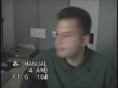

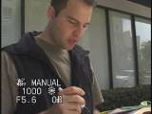
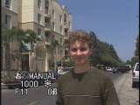
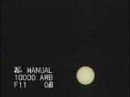
Problem: Dynamic Range
The real world is
high dynamic range
1
1500
25,000
400,000
2,000,000,000
Slide by Alexei Efros

Slide 42
Dynamic Range
Human eye (overall): 1,000,000 : 1
Human eye (instantaneous): 1,000: 1
Cell phone camera: 256: 1
Nikon D610 (DSLR): 22,000: 1
Conventional LCD: 500: 1

Slide 43
Is Camera a photometer?
Image
pixel (312, 284) = 42
42 photons?
Slide by Alexei Efros
Notes:
2

Slide 44
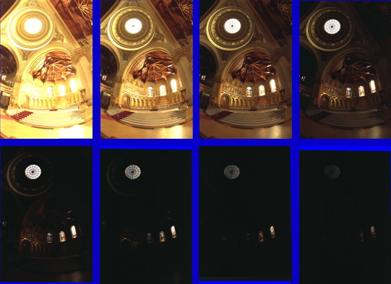
Varying Exposure

Slide 45
Long Exposure
10⁻⁶
High dynamic range
10⁶
Real world
Scene
10⁻⁶
10⁶
Picture
Photo
^{0 to 255}
Where do we lose information about the scene?
What happens to those areas?
Slide by Alexei Efros

Slide 46
Short Exposure
10⁻⁶
High dynamic range
10⁶
Real world
Scene
10⁻⁶
10⁶
Picture
Photo
^{0 to 255}
Where do we lose information about the scene?
What happens to those areas?
Slide by Alexei Efros

Slide 47
Image Acquisition Pipeline
Lens
Shutter
scene
radiance
(W/sr/m )
sensor
irradiance
∫
sensor
exposure
2
Δt
CCD
ADC
Remapping
analog
voltages
digital
values
pixel
values
Camera is NOT a photometer!
Notes:
3

Slide 48
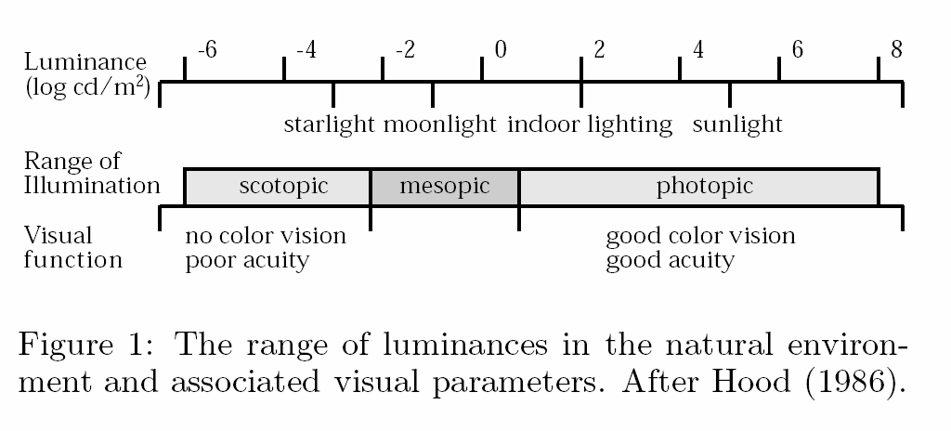
What does the eye see?
The eye has a huge dynamic range
Do we see a true radiance map?

Slide 49
Outline
Human eyes
  How do they sense light?
  Visible light and human color perception
Electronic eyes
  How do they sense light?
  Image representation
  Color spaces
  Lens models and camera parameters

Slide 50





Color spaces: RGB
Default color space
0,1,0
R
(G=0,B=0)
G
(R=0,B=0)
1,0,0
0,0,1
B
(R=0,G=0)
Some drawbacks
Strongly correlated channels
Non-perceptual
Image from: http://en.wikipedia.org/wiki/File:RGB_color_solid_cube.png

Slide 51




Color spaces: HSV
Intuitive color space
H
(S=1,V=1)
S
(H=1,V=1)
V
(H=1,S=0)

Slide 52




Color spaces: L*a*b*
“Perceptually uniform” color space
L
(a=0,b=0)
a
(L=65,b=0)
b
(L=65,a=0)

Slide 53


Color Problems: White Balance
Slide by Alexei Efros

Slide 54
Outline
Human eyes
  How do they sense light?
  Visible light and human color perception
Electronic eyes
  How do they sense light?
  Image representation
  Color spaces
  Lens models and camera parameters

Slide 55

Pinhole Camera
Center of Projection
Illustration by Steve Seitz
- Pinhole camera has small aperture size.
- All objects are in focus – depth of field infinite

Slide 56
Pinhole Camera
Screen
Object
h_{o}
d_{i}
d_{o}
h_{i}
Image
h_{i}
d_{i}
=
Similar triangles gives optics law:
h_{o}
d_{o}

Slide 57
Pinhole Camera
h_{o}
d_{i}
d_{o}
h_{i}
1
Fix object size and imaging plane distance:
h_{i}
∝
d_{o}

Slide 58

Perspective

Slide 59
Human Visual System
The human brain attempts to invert the
3D => 2D projective mapping.
Müller-Lyer Illusion

Slide 60
Limitations of Pinhole Camera
Pros:
  Infinite depth of field
Cons:
  Not much light => higher noise
  Diffraction for small aperture size

Slide 61

Limitations of Pinhole Camera

Slide 62
Lenses
Focal Length
f
Object
Focal Point
d_{o}
d_{i}
Image
Let in more light!

Slide 63
Lenses
Focal Length
f
Object
Focal Point
d_{o}
d_{i}
Image
1
1
1
=
+
Thin lens equation:
f
d_{o}
d_{i}

Slide 64
Lenses
Focal Length
f
Object
Focal Point
d_{o}
d_{i}
Image
- Focal length reported in mm, e.g. 50 mm lens.
- For zoom lenses, a range, e.g. 18-55 mm.

Slide 65
Angle of View (Field of View)
Focal Point
α
Sensor Dimension d
Focal length f
α = 2 tan⁻¹ [d/(2f)] ≈ d / f (radians)

Slide 66

Angle of View (Field of View)
[Slide content from Fredo Durand]

Slide 67

Shutter Speed
Expressed in fractions of a second, e.g. 1/100 sec
If shutter is open
longer, integrates
across a longer time
If shutter open too
short, can cause
noise

Slide 68

Shutter Speed
Was the shutter open a long time or a short time?
[Photo by Terence Tam]

Slide 69

Shutter Speed
[Photo by Terence Tam]

Slide 70

Shutter Speed
Was the shutter open a long time or a short time?
[Photo by Zach Heller]

Slide 71

Shutter Speed
[Photo by Evan ‘thevlue’]

Slide 72

Aperture
[Slide content from Fredo Durand]
- Trades off more/less light.
- Controls depth of field

Slide 73

Depth of Field
[mmphotography.it]

Slide 74

Depth of Field
[mmphotography.it]

Slide 75

Depth of Field
[Photo by Neil Halin]

Slide 76
Next class
Filtering and edge detection

Slide 77

Aperture
Aperture controls depth of field
Illustration by Steve Seitz
- Only one depth where objects are exactly in focus
- Other depths project to a circle on the film

Slide 78


How to Adjust Focus?
Aperture controls
depth of field
Denoted in f number
(“f-stop”)

