Slide 1
CS 4501: Introduction to
Computer Vision
Filtering and Edge Detection
Connelly Barnes
Slides from Jason Lawrence, Fei Fei Li, Juan Carlos Niebles, Misha Kazhdan, Allison Klein, Tom Funkhouser, Adam Finkelstein, David Dobkin

Slide 2
Outline
Simple image processing
  Greyscale
  Brightness
  Mirroring or “flipping”
Filtering
  Linear filters: cross-correlation and convolution
  Gaussian filters
Edge detection
  Simple edge detector
  Canny edge detector

Slide 3
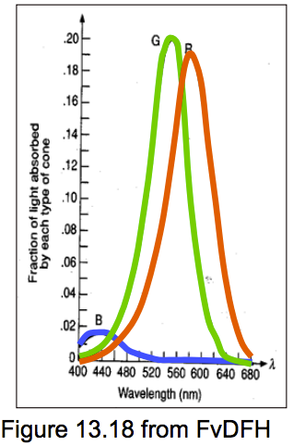
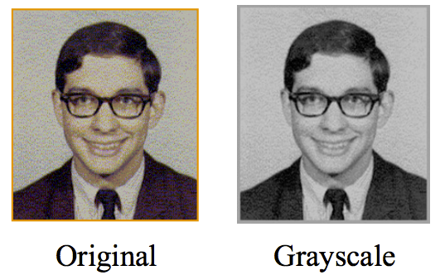
Image processing: greyscale
The human retina perceives red, green, blue.
To compute luminance of a pixel, we need to take an average of the RGBs:
  L = 0.21 R + 0.72 G + 0.07 B (ITU HDTV)
  L = 0.3 R + 0.59 G + 0.11 B (W3C)
If represented as arrays, what would the array sizes be for the input RGB image? The output greyscale image?

Slide 4
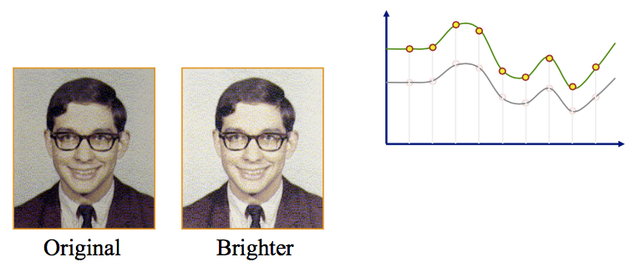
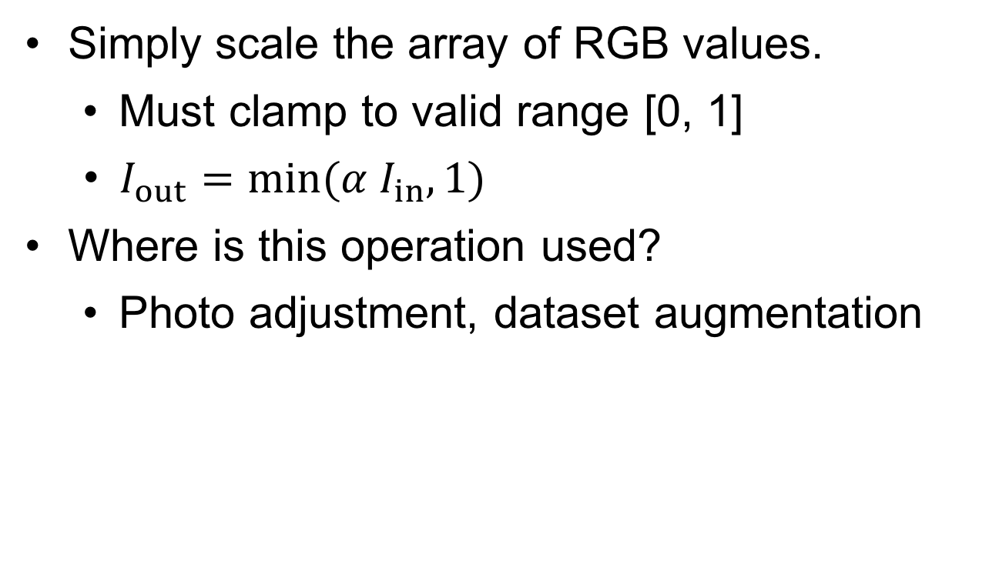
Image processing: brightness
Simply scale the array of RGB values.
  Must clamp to valid range [0, 1]
  $I_{out}=min⁡(α I_{in}, 1)$
Where is this operation used?
  Photo adjustment, dataset augmentation

Slide 5
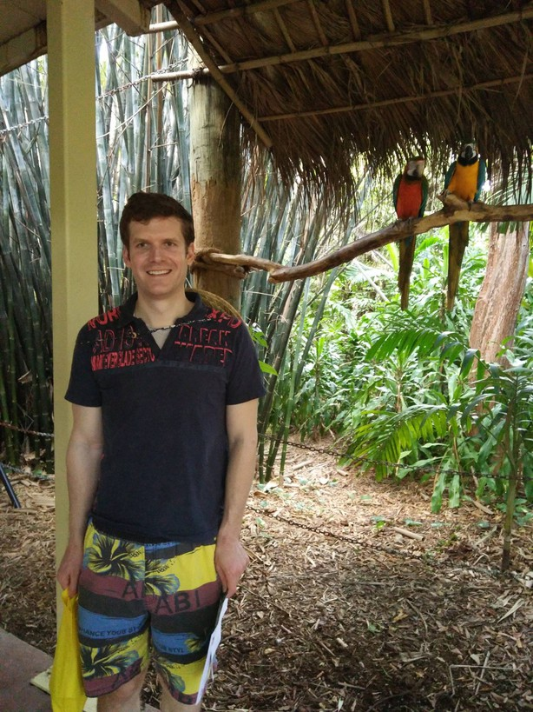
Image processing: mirroring or “flipping”
Mirrored or
Horizontally flipped
Why do we care?
Some linear filters involve “flipping” operations.
Another way to do dataset augmentation.
Vertically
and horizontally
flipped
Vertically
flipped
Notes:
Terrible joke: if an image runs into your car, what do you do to it? Flip it!

Slide 6
Outline
Simple image processing
  Greyscale
  Brightness
  Mirroring or “flipping”
Filtering
  Linear filters: cross-correlation and convolution
  Gaussian filters
Edge detection
  Simple edge detector
  Canny edge detector

Slide 7
Image filtering
Filtering:
  Form a new image whose pixels are a
  combination of original pixel values.
Goals:
  Extract useful information from image
    Features (corners, edges, blobs, …)
  Enhance image properties
    Remove noise, remove unwanted objects, …
Slide from Fei Fei Li, Juan Carlos Niebles

Slide 8
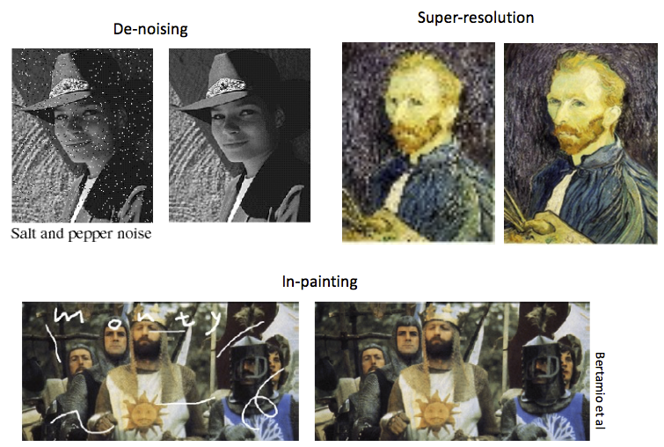
Image filtering
Slide from Fei Fei Li, Juan Carlos Niebles

Slide 9
Outline
Simple image processing
  Greyscale
  Brightness
  Mirroring or “flipping”
Filtering
  Linear filters: cross-correlation and convolution
  Gaussian filters
Edge detection
  Simple edge detector
  Canny edge detector

Slide 10
Linear filtering: a key idea
Transformations on signals; e.g.:
  bass/treble controls on stereo
  blurring/sharpening operations in image editing
  smoothing/noise reduction in tracking
Key properties
  linearity: filter(f + g) = filter(f) + filter(g)
  shift invariance: behavior invariant to shifting the input
    delaying an audio signal
    sliding an image around
Can be modeled mathematically by convolution

Slide 11
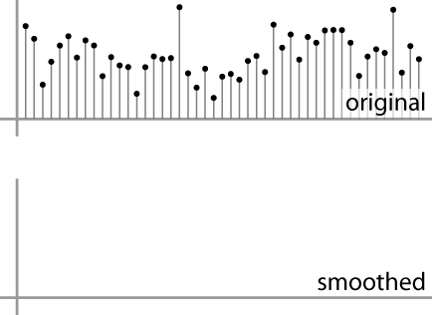
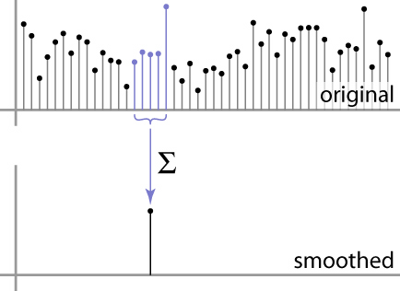
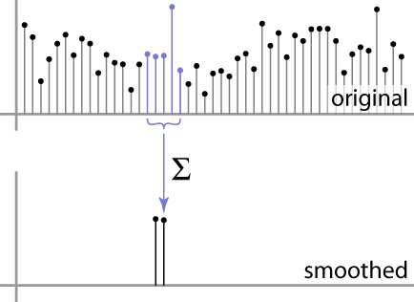
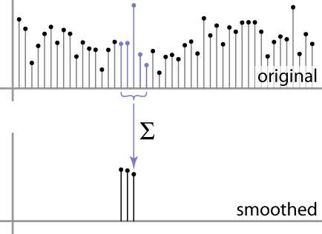
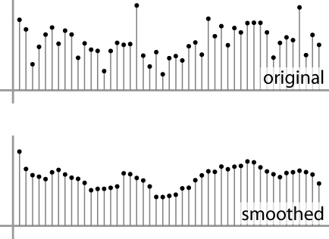
Moving Average
basic idea: define a new function by averaging over a sliding window
a simple example to start off: smoothing

Slide 12
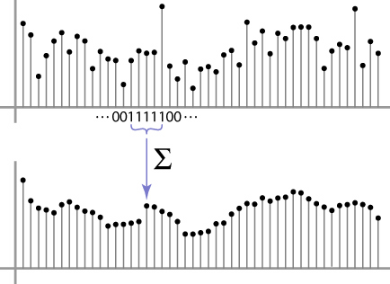
Weighted Moving Average
Can add weights to our moving average
Weights […, 0, 1, 1, 1, 1, 1, 0, …] / 5

Slide 13
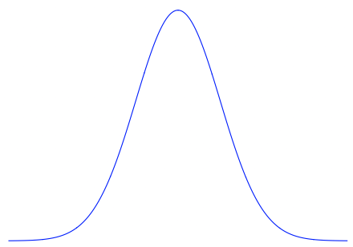

Weighted Moving Average
Bell curve (gaussian-like) weights […, 1, 4, 6, 4, 1, …]

Slide 14


Moving Average In 2D
What are the weights H?
For uniform filter? (takes the mean)
For bell curve shaped filter?
0 | 0 | 0 | 0 | 0 | 0 | 0 | 0 | 0 | 0
0 | 0 | 0 | 0 | 0 | 0 | 0 | 0 | 0 | 0
0 | 0 | 0 | 90 | 90 | 90 | 90 | 90 | 0 | 0
0 | 0 | 0 | 90 | 90 | 90 | 90 | 90 | 0 | 0
0 | 0 | 0 | 90 | 90 | 90 | 90 | 90 | 0 | 0
0 | 0 | 0 | 90 | 0 | 90 | 90 | 90 | 0 | 0
0 | 0 | 0 | 90 | 90 | 90 | 90 | 90 | 0 | 0
0 | 0 | 0 | 0 | 0 | 0 | 0 | 0 | 0 | 0
0 | 0 | 90 | 0 | 0 | 0 | 0 | 0 | 0 | 0
0 | 0 | 0 | 0 | 0 | 0 | 0 | 0 | 0 | 0
Input image
Slide by Steve Seitz
Notes:
ones, divide by 9

Slide 15
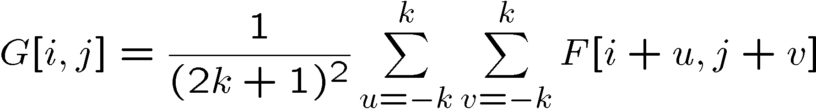
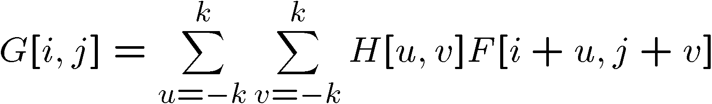

Cross-correlation filtering
Let’s write this down as an equation. Assume the averaging window is (2k+1)x(2k+1):
We can generalize this idea by allowing different weights for different neighboring pixels:
This is called a cross-correlation operation and
written:
H is called the “filter” or “kernel.”
Slide by Steve Seitz

Slide 16
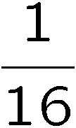
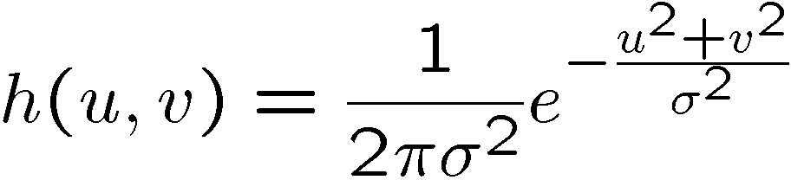
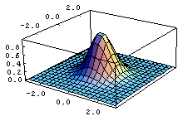
Gaussian filtering
A Gaussian kernel gives less weight to pixels further from the center of the window
0 | 0 | 0 | 0 | 0 | 0 | 0 | 0 | 0 | 0
0 | 0 | 0 | 0 | 0 | 0 | 0 | 0 | 0 | 0
0 | 0 | 0 | 90 | 90 | 90 | 90 | 90 | 0 | 0
0 | 0 | 0 | 90 | 90 | 90 | 90 | 90 | 0 | 0
0 | 0 | 0 | 90 | 90 | 90 | 90 | 90 | 0 | 0
0 | 0 | 0 | 90 | 0 | 90 | 90 | 90 | 0 | 0
0 | 0 | 0 | 90 | 90 | 90 | 90 | 90 | 0 | 0
0 | 0 | 0 | 0 | 0 | 0 | 0 | 0 | 0 | 0
0 | 0 | 90 | 0 | 0 | 0 | 0 | 0 | 0 | 0
0 | 0 | 0 | 0 | 0 | 0 | 0 | 0 | 0 | 0
1 | 2 | 1
2 | 4 | 2
1 | 2 | 1
Slide by Steve Seitz

Slide 17
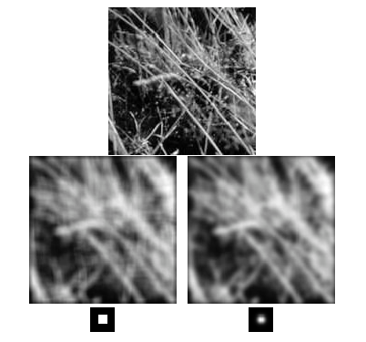
Box Filter vs. Gaussian Filter
Slide by Steve Seitz

Slide 18
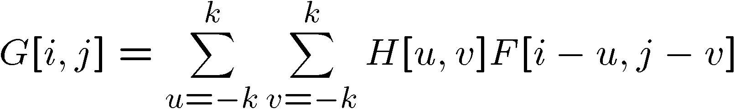

Convolution
Cross-correlation:
Convolution is similar to cross-correlation, but the filter is flipped horizontally and vertically before being applied:
It is written:
Suppose H is a Gaussian or uniform (mean) kernel. How does convolution differ from cross-correlation?
$$G=H∗F$$
Slide by Steve Seitz

Slide 19





Convolution is nice!
$$b=c∗a$$
Notation:
Convolution is a multiplication-like operation
  commutative
  associative
  distributes over addition
  scalars factor out
  identity: unit impulse e = […, 0, 0, 1, 0, 0, …]
Conceptually no distinction between filter and signal
Usefulness of associativity
  often apply several filters one after another: (((a * b₁) * b₂) * b₃)
  this is equivalent to applying one filter: a * (b₁ * b₂ * b₃)
$$a∗b=b∗a$$
$$a∗\left(b∗c\right)=\left(a∗b\right)∗c$$
$$a∗\left(b+c\right)=a∗b+a∗c$$
$$αa∗b=a∗\left(αb\right)=α(a∗b)$$
$$a∗e=a$$

Slide 20
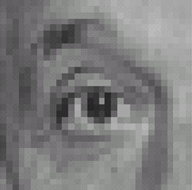
Practice with linear filters
Assume we are using cross-correlation filtering (filter is not flipped)
0
0
0
?
0
1
0
0
0
0
Original
Source: D. Lowe
Notes:
20

Slide 21
Practice with linear filters
0
0
0
0
1
0
0
0
0
Original
Filtered
(no change)
Source: D. Lowe
Notes:
21

Slide 22
Practice with linear filters
0
0
0
?
0
0
1
0
0
0
Original
Source: D. Lowe
Notes:
22

Slide 23
Practice with linear filters
0
0
0
0
0
1
0
0
0
Original
Shifted left
By 1 pixel
Source: D. Lowe
Notes:
23

Slide 24
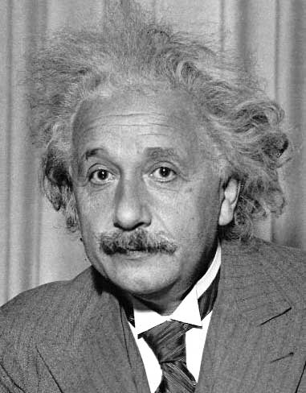
Practice with linear filters
?
1
0
-1
2
0
-2
1
0
-1
Sobel

Slide 25
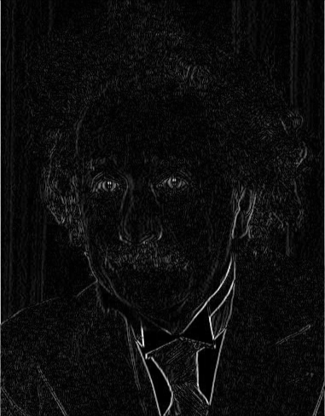
Practice with linear filters
1
0
-1
2
0
-2
1
0
-1
Sobel
Vertical Edge
(absolute value)

Slide 26
Practice with linear filters
?
1
2
1
0
0
0
-1
-2
-1
Sobel
Notes:
Questions at this point?
26

Slide 27
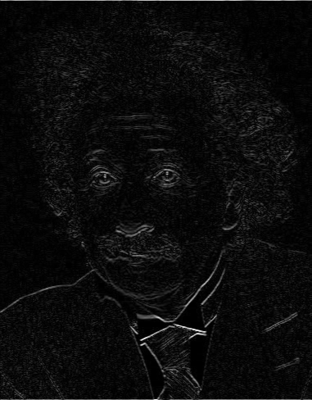
Practice with linear filters
1
2
1
0
0
0
-1
-2
-1
Sobel
Horizontal Edge
(absolute value)
Notes:
Questions at this point?
27

Slide 28
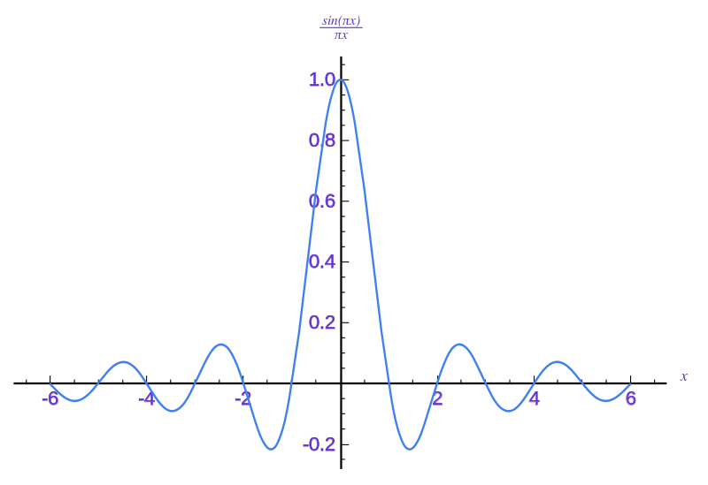
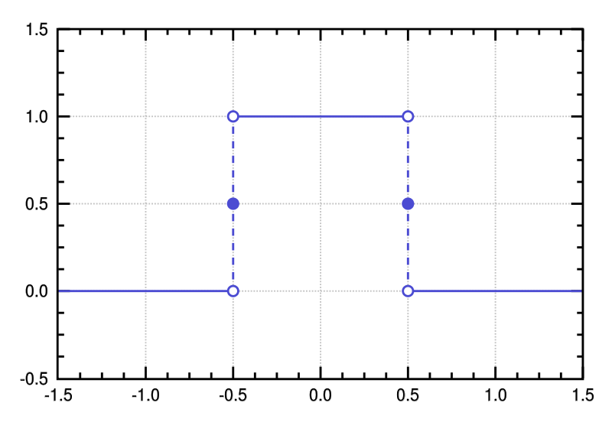
Sinc filter
Spatial Kernel
Frequency Response
Ideal for Nyquist-Shannon: removes high frequencies!
Often a bit higher quality than Gaussian
But can introduce ringing (oscillations) due to sine
Notes:
28
Linear vs. quadratic in mask size

Slide 29
Outline
Simple image processing
  Greyscale
  Brightness
  Mirroring or “flipping”
Filtering
  Linear filters: cross-correlation and convolution
  Gaussian filters
Edge detection
  Simple edge detector
  Canny edge detector

Slide 30
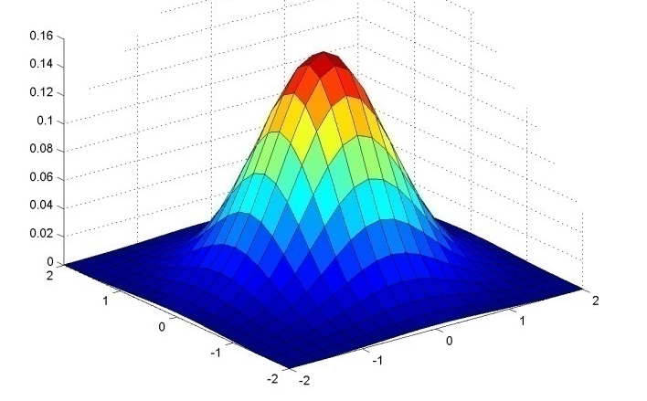
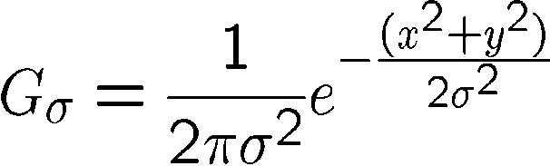
Important linear filter: Gaussian
Weight contributions of neighboring pixels by nearness
Same shape in spatial and frequency domain
(Fourier transform of Gaussian is Gaussian)
0.003 0.013 0.022 0.013 0.003
0.013 0.059 0.097 0.059 0.013
0.022 0.097 0.159 0.097 0.022
0.013 0.059 0.097 0.059 0.013
0.003 0.013 0.022 0.013 0.003
5 x 5, σ = 1
Slide credit: Christopher Rasmussen
Notes:
30

Slide 31
Gaussian filters
Remove “high-frequency” components from the image (low-pass filter)
  Images become more smooth
Convolution with self is another Gaussian
  So can smooth with small-width kernel, repeat, and get same result as larger-width kernel would have
  Convolving two times with Gaussian kernel of width σ is same as convolving once with kernel of width σ√2
Source: K. Grauman
Notes:
31
Linear vs. quadratic in mask size

Slide 32

Gaussian filters
Input image (2048 x 1397)

Slide 33

Gaussian filters
Gaussian filtered (σ=5)

Slide 34

Gaussian filters
Gaussian filtered (σ=20)

Slide 35
Practical matters
How big should the filter be?
  Values at edges should be near zero
  Rule of thumb for Gaussian: set filter half-width to about 3 σ
  Normalize truncated
  kernel. Why?
Side by Derek Hoiem
Notes:
35

Slide 36
Separable Filters
Some kernels K can be written:
K = H ∗ V, H is horizontal, V is vertical
Example: 2D Gaussian
Filter first by H then V (or vice versa)
Why is this useful?

Slide 37
Size of Output
MATLAB: conv2(g,f,shape)
Python: scipy.signal.convolve2d(g,f,shape)
  shape = ‘full’: output size is sum of sizes of f and g
  shape = ‘same’: output size is same as f
  shape = ‘valid’: output size is difference of sizes of f, g
Easier for color images: scipy.ndimage.filters.convolve(g,f)
g
full
g
same
valid
g
g
f
f
f
g
g
g
g
g
g
g
g
Source: S. Lazebnik
Notes:
37

Slide 38
Python convolution (with SciPy)
Python: scipy.signal.convolve2d(g,f,shape)
  Convolves 2D images (e.g. greyscale)
Python: scipy.ndimage.filters.convolve(g,f)
  Convolves n-D images (e.g. greyscale, color)
  But always uses ‘same’ size output
  Can specify how to handle out of bounds pixels
  (e.g. ‘constant’, ‘reflect’)
same
g
g
f
g
g
Source: S. Lazebnik
Notes:
38

Slide 39
Demo in Python
Python (Jupyter) Notebook

Slide 40
Python Environment for Programming Assignments
Recommend Python (another option: MATLAB?)
Set up Python (recommend Anaconda Python)
Already included packages: SciPy, matplotlib, scikit-image.
Recommend:
  tensorflow (neural networks), ideally configured with GPU support
  keras (neural networks)
Can sign up to use department machines also,
will send document for that.

Slide 41
Outline
Simple image processing
  Greyscale
  Brightness
  Mirroring or “flipping”
Filtering
  Linear filters: cross-correlation and convolution
  Gaussian filters
Edge detection
  Simple edge detector
  Canny edge detector

Slide 42
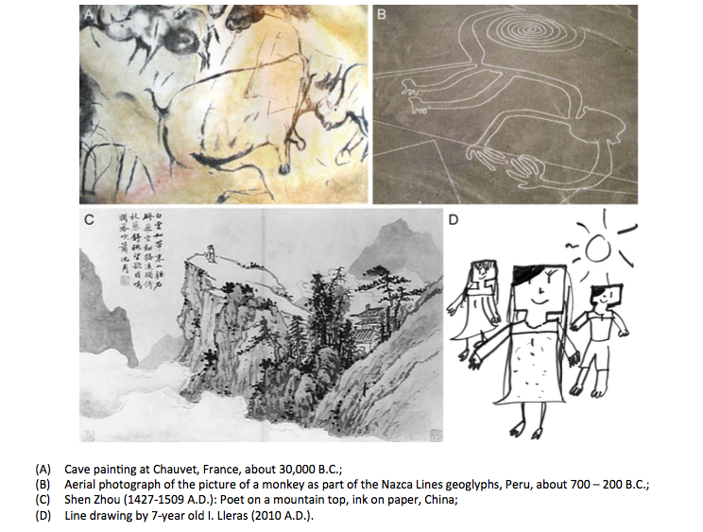
Edge Detection
Slide from Fei Fei Li, Juan Carlos Niebles

Slide 43
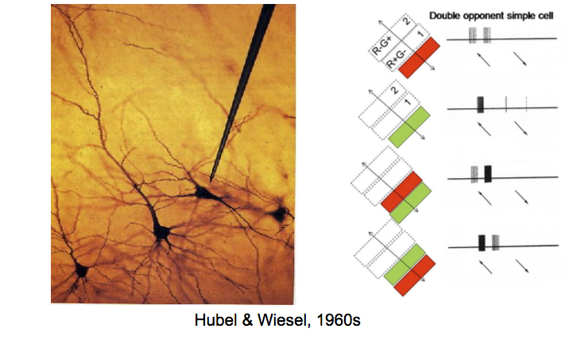
Edge Detection: Mammal Vision
Slide from Fei Fei Li, Juan Carlos Niebles

Slide 44
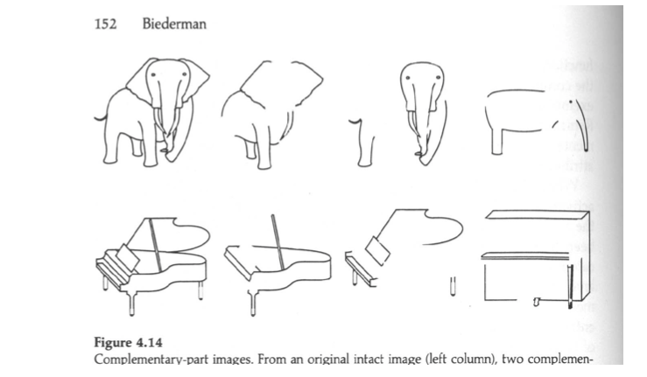
Edge Detection: Human Vision
Slide from Fei Fei Li, Juan Carlos Niebles

Slide 45

What is an Edge?
Slide from Jason Lawrence

Slide 46

What is an Edge?
Challenge: blur
Slide from Jason Lawrence

Slide 47
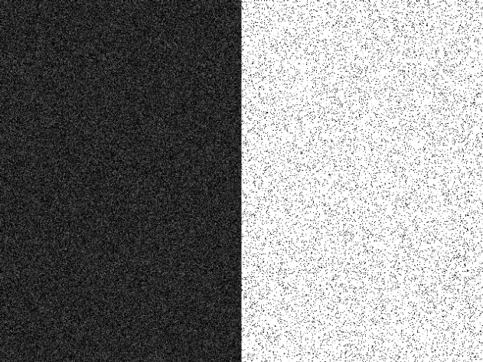
What is an Edge?
Challenge: noise
Slide from Jason Lawrence

Slide 48
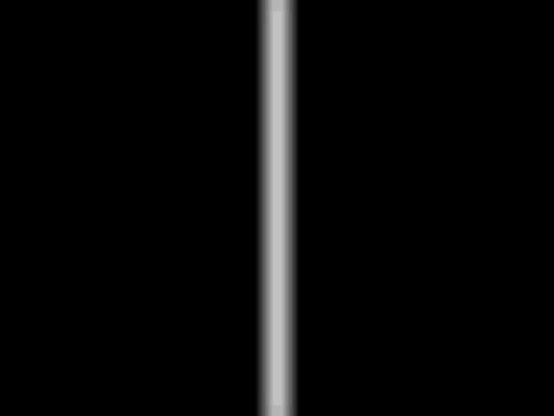
What is an Edge?
Is this one edge or two?
Slide from Jason Lawrence

Slide 49
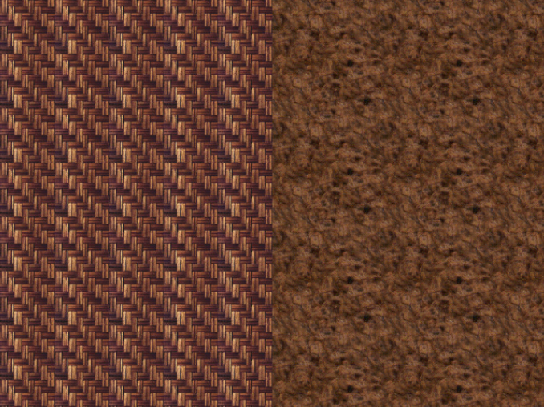
What is an Edge?
Where are the edges?
Slide from Jason Lawrence

Slide 50
Outline
Simple image processing
  Greyscale
  Brightness
  Mirroring or “flipping”
Filtering
  Linear filters: cross-correlation and convolution
  Gaussian filters
Edge detection
  Simple edge detector
  Canny edge detector

Slide 51
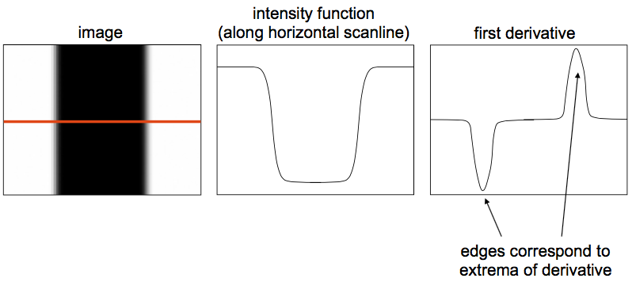
Characterizing Edges
An edge is a place of rapid change in the image intensity function.
Slide from Fei Fei Li, Juan Carlos Niebles

Slide 52
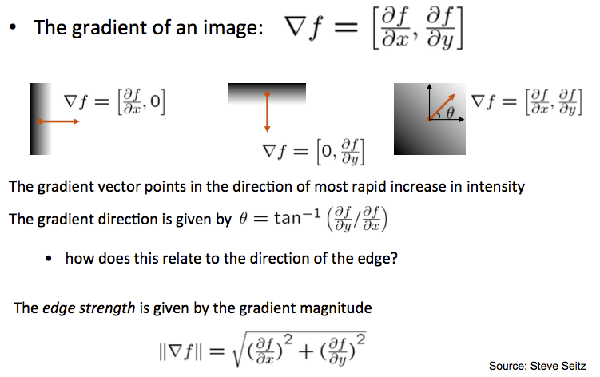
Image Gradient

Slide 53
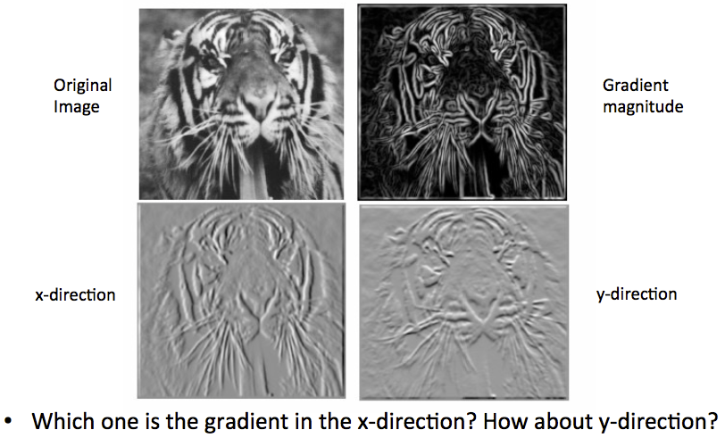
Image Gradient
Slide from Fei Fei Li, Juan Carlos Niebles

Slide 54
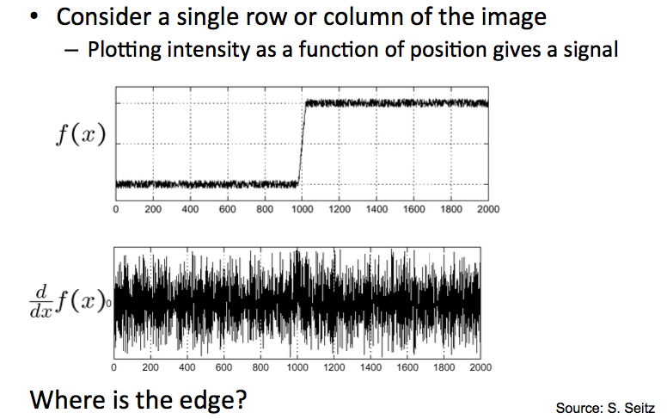
Effects of Noise

Slide 55
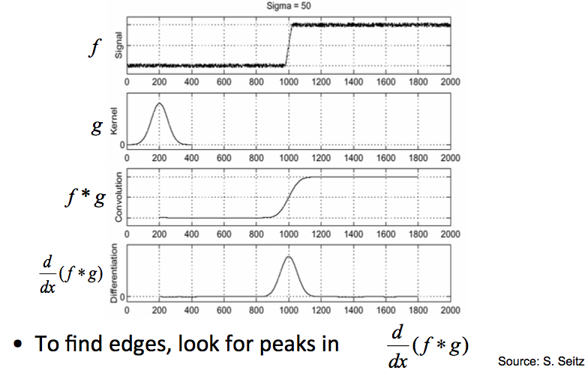
Simple Edge Detector
Input image:
Algorithm:
  Blur using Gaussian filter
  Find gradient magnitude
Gaussian kernel:
Blurred image:
Gradient:
Slide from Steve Seitz

Slide 56

Derivatives of Filters
Can optionally combine the blurring and differentiation steps using the theorem:
From Steve Seitz

Slide 57
Derivatives of Filters
Can optionally combine the blurring and differentiation steps using the theorem:
Algorithm 2 for simple edge detector:
  Convolve with x derivative of Gaussian, gives E_{x}
  Convolve with y derivative of Gaussian, gives E_{y}
  Find gradient magnitude: E = || E_{x}² + E_{y}² ||
From Steve Seitz

Slide 58
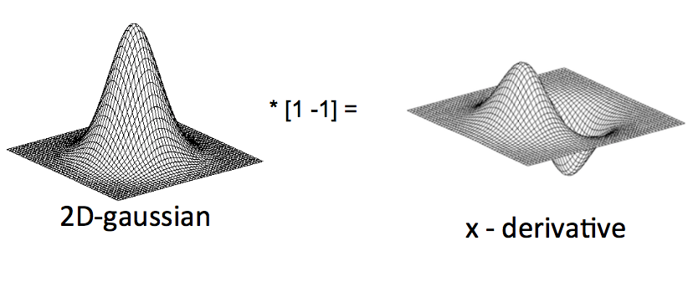
Derivatives of Gaussian Filter
From Steve Seitz

Slide 59
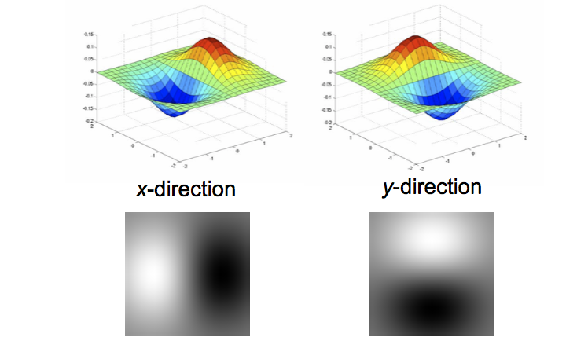
Derivatives of Gaussian Filter
These derivative of Gaussian filters are separable, just like the Gaussian.
How does that help?
From Steve Seitz

Slide 60
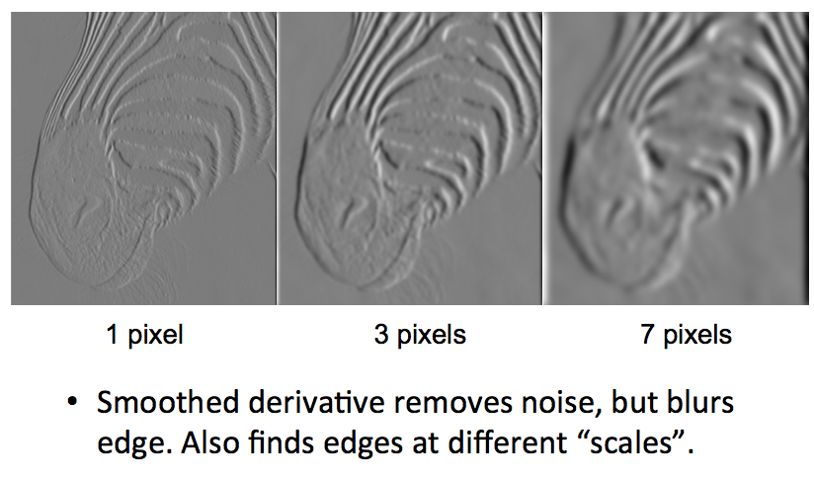
Effect of Gaussian Filter Width (σ)
From Steve Seitz

Slide 61
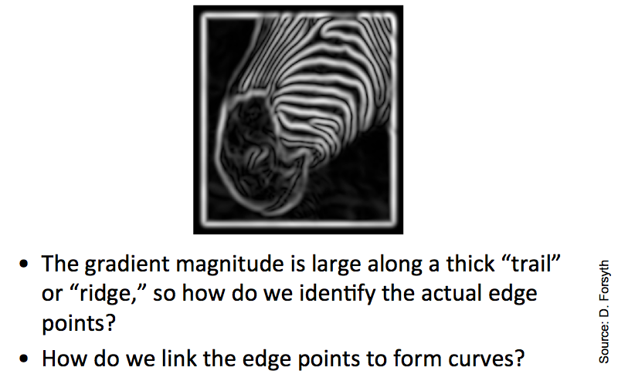
Remaining Issues

Slide 62
Outline
Simple image processing
  Greyscale
  Brightness
  Mirroring or “flipping”
Filtering
  Linear filters: cross-correlation and convolution
  Gaussian filters
Edge detection
  Simple edge detector
  Canny edge detector

Slide 63
Canny Edge Detector (in Project 1)
Smooth
Compute derivative
Non-maximum suppression
Thresholding

Slide 64

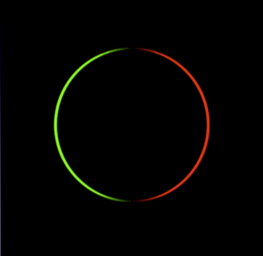

Canny Edge Detector
First, smooth with a Gaussian with filter width σ
Then compute x and y derivatives
As we mentioned before the above 2 steps can be combined (using two derivative of Gaussian filters)
Input image
Smoothed x derivative
Smoothed y derivative

Slide 65
Canny Edge Detector
Non-maximum suppression:
  Eliminate all but local maxima in magnitude of gradient
  At each pixel look along direction of gradient: if either neighbor is bigger, set to zero
  In practice, quantize gradient directions to vertical, horizontal, two diagonals
  Result: “thinned edge image.”

Slide 66
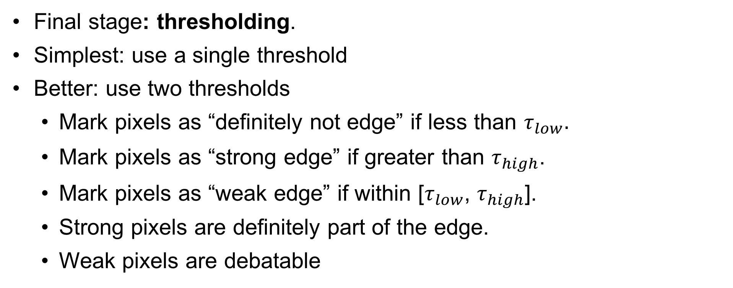
Canny Edge Detector
Final stage: thresholding.
Simplest: use a single threshold
Better: use two thresholds
  Mark pixels as “definitely not edge” if less than $τ_{low}.$
  Mark pixels as “strong edge” if greater than $τ_{high}$.
  Mark pixels as “weak edge” if within [$τ_{low}$, $τ_{high}$].
  Strong pixels are definitely part of the edge.
  Weak pixels are debatable

Slide 67
Canny Edge Detector
Only include weak pixels connected in a chain to some strong pixel.
How to do this?
  Visit pixels in chains starting from the strong pixels. For each strong pixel, recursively visit the weak pixels that are in the 8 connected neighborhood around the strong pixel, and label those also as strong (and as edge).
  Label as “not edge” any weak pixels that are not visited by this process.

Slide 68
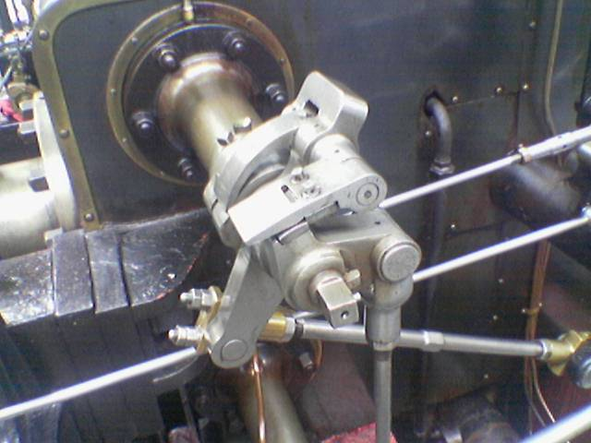
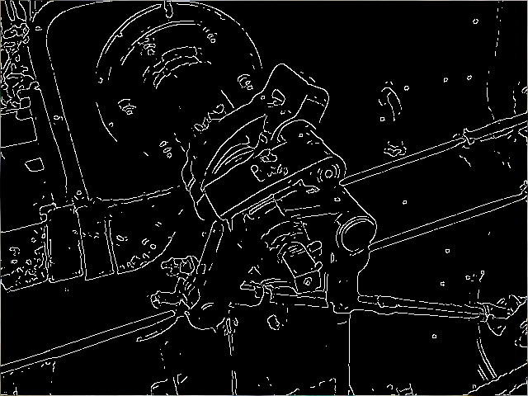
Canny Edge Detector
Input image
Canny Edge Detector
From Wikipedia

Slide 69
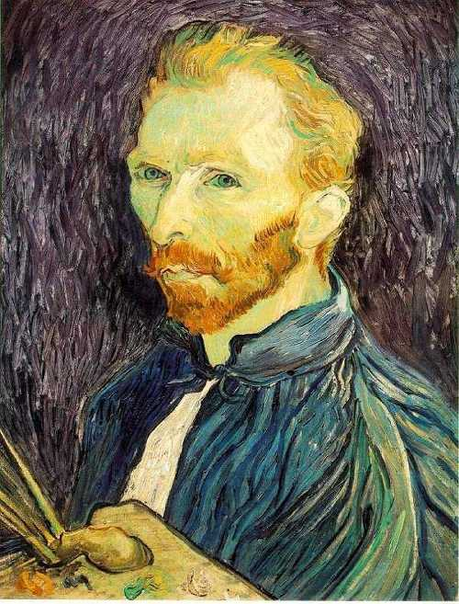
Image half-sizing
This image is too big to
fit on the screen. How
can we reduce it?
How to generate a half-
sized version?

Slide 70

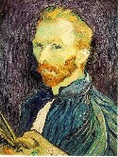

Image sub-sampling
1/8
1/4
Throw away every other row and column to create a 1/2 size image
  - called image sub-sampling
Slide by Steve Seitz

Slide 71
Image sub-sampling
1/2
1/4 (2x zoom)
1/8 (4x zoom)
Aliasing! What do we do?
Slide by Steve Seitz

Slide 72



Gaussian (lowpass) pre-filtering
G 1/8
G 1/4
Gaussian 1/2
Solution: filter the image, then subsample
  Filter size should double for each ½ size reduction. Why?
Slide by Steve Seitz

Slide 73
Subsampling with Gaussian pre-filtering
Gaussian 1/2
G 1/4
G 1/8
Slide by Steve Seitz

Slide 74
Compare with...
1/2
1/4 (2x zoom)
1/8 (4x zoom)
Slide by Steve Seitz

Slide 75
Gaussian (lowpass) pre-filtering
G 1/8
G 1/4
Gaussian 1/2
Solution: filter the image, then subsample
  Filter size should double for each ½ size reduction. Why?
  How can we speed this up?
Slide by Steve Seitz

Slide 76
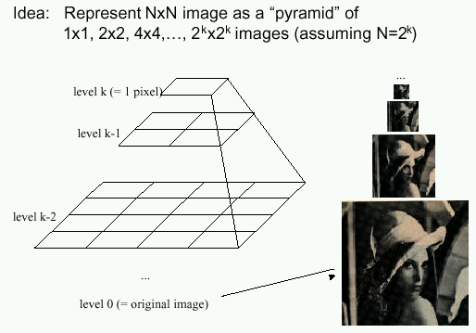
Image Pyramids
Known as a Gaussian Pyramid [Burt and Adelson, 1983]
  In computer graphics, a mip map [Williams, 1983]
  A precursor to wavelet transform
Slide by Steve Seitz

Slide 77

Figure from David Forsyth

Slide 78
What are they good for?
Improve Search
  Search over translations
    Classic coarse-to-fine strategy
  Search over scale
    Template matching
    E.g. find a face at different scales
Pre-computation
  Need to access image at different blur levels
  Useful for texture mapping at different resolutions (called mip-mapping)

Slide 79
Gaussian pyramid construction
filter mask
Repeat
  Filter
  Subsample
Until minimum resolution reached
  can specify desired number of levels (e.g., 3-level pyramid)
Whole pyramid is only 4/3 the size of the original image! (show)
Slide by Steve Seitz

