Slide 1
CS 4501: Introduction to
Computer Vision
Sparse Feature Detectors:
Harris Corner,
Difference of Gaussian
Connelly Barnes
Slides from Jason Lawrence, Fei Fei Li, Juan Carlos Niebles, Alexei Efros, Rick Szeliski, Fredo Durand, Kristin Grauman, James Hays

Slide 2
Outline
Motivation for sparse features
Harris corner detector
  Project 1
Difference of Gaussian (blob) feature detector
  Image pyramids
  Feature detector

Slide 3
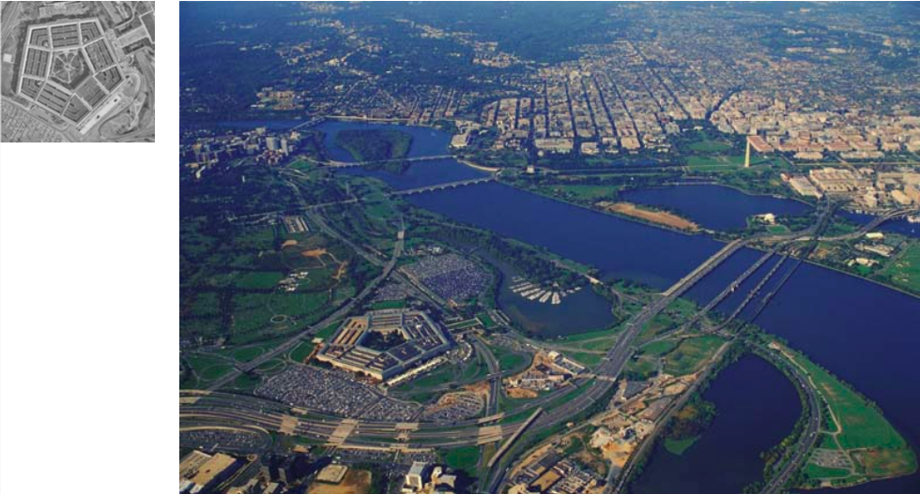
Motivation: Image Matching (Hard Problem)
Slide from Fei Fei Li, Juan Carlos Niebles

Slide 4
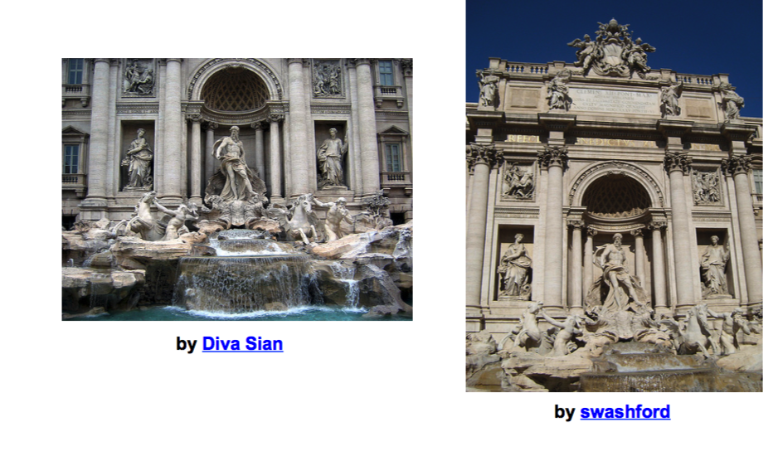
Motivation: Image Matching (Hard Problem)
Slide from Fei Fei Li, Juan Carlos Niebles, Steve Seitz

Slide 5
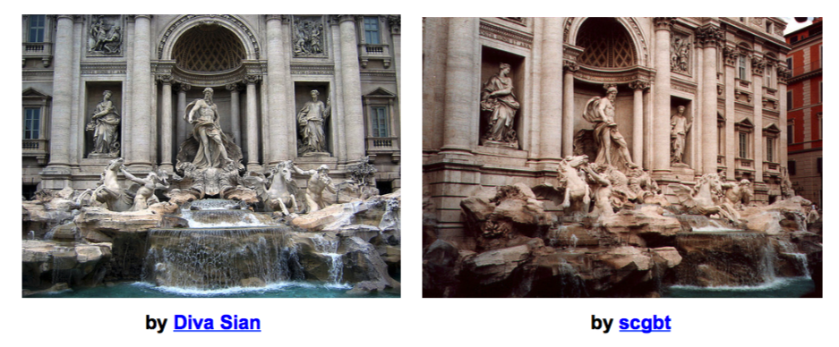
Motivation: Image Matching (Harder Case)
Slide from Fei Fei Li, Juan Carlos Niebles, Steve Seitz

Slide 6
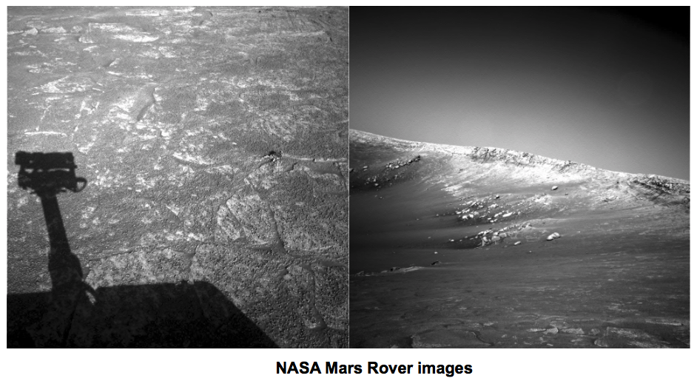
Motivation: Image Matching (Very Hard Case)
Slide from Fei Fei Li, Juan Carlos Niebles, Steve Seitz

Slide 7
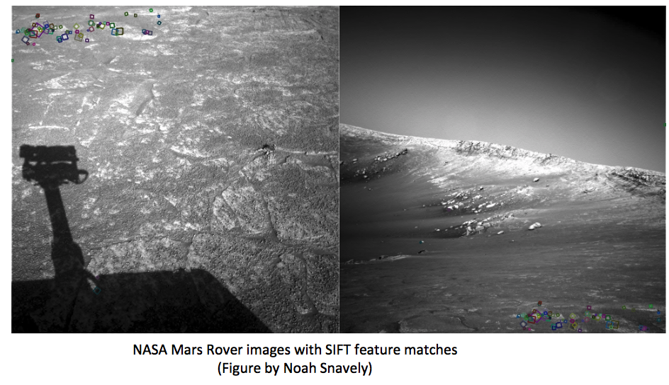
Motivation: Image Matching
(Answer: look for the tiny squares)
Slide from Fei Fei Li, Juan Carlos Niebles, Steve Seitz

Slide 8
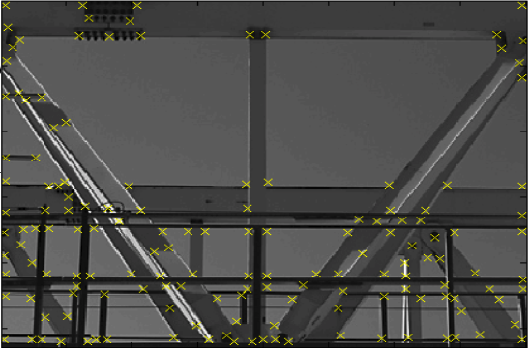
What is a Feature?
  In computer vision, a feature refers to a region of interest in an image: typically, low-level features, such as corner, edge, blob.
Corner features
Slide from Krystian Mikolajczyk

Slide 9
What is a Feature Descriptor?
  Feature vector or feature descriptor in computer vision is just a mathematical vector (in R^{n}) that describes an image or a local region of an image. Usually we want the property that similar images have similar feature vectors (and dissimilar images have dissimilar feature vectors).
We could describe an image using a single global descriptor:
  “Dog” = [1, 0, 0, 0, 0]
  “Person” = [0, 1, 0, 0, 0]
  etc
  We will explore this later for image recognition.

Slide 10
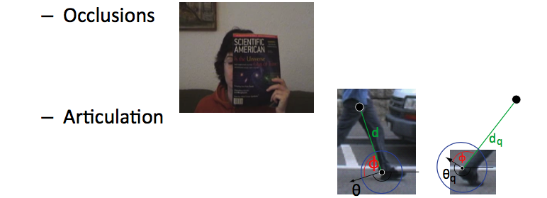
Motivation for sparse/local features
  Global features can only summarize the overall content of the image.
Local (or sparse) features can allow us to match local regions with more geometric accuracy.
Increased robustness to:
Slide from Fei Fei Li, Juan Carlos Niebles

Slide 11

Motivating Application: Panorama Stitching
Are you getting the whole picture?
  Compact Camera FOV = 50 x 35°
Slide from Brown & Lowe

Slide 12
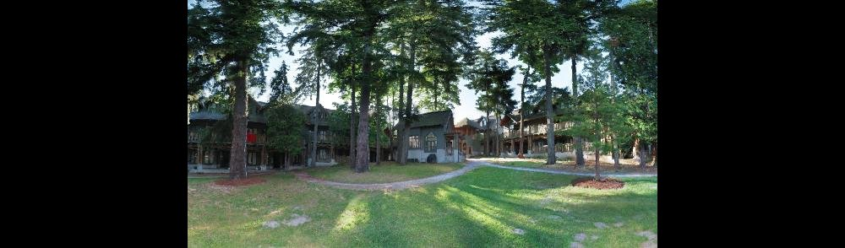
Motivating Application: Panorama Stitching
Are you getting the whole picture?
  Compact Camera FOV = 50 x 35°
  Human FOV = 200 x 135°
Slide from Brown & Lowe

Slide 13
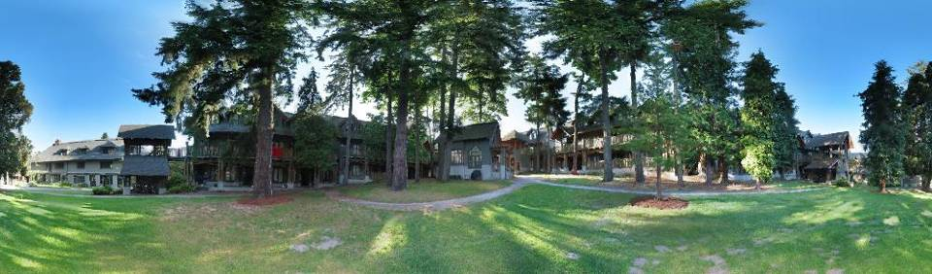
Motivating Application: Panorama Stitching
Are you getting the whole picture?
  Compact Camera FOV = 50 x 35°
  Human FOV = 200 x 135°
  Panoramic Mosaic = 360 x 180°
Slide from Brown & Lowe

Slide 14
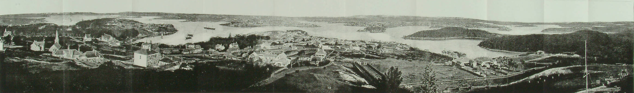
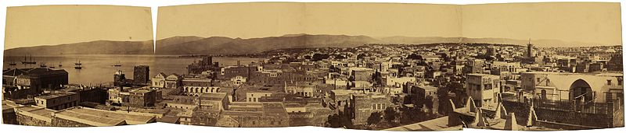
Panoramic Photos are old
Sydney,1875
Beirut, late 1800’s
Notes:
http://en.wikipedia.org/wiki/File:Historic_Sydney_Panorama.jpg

Slide 15
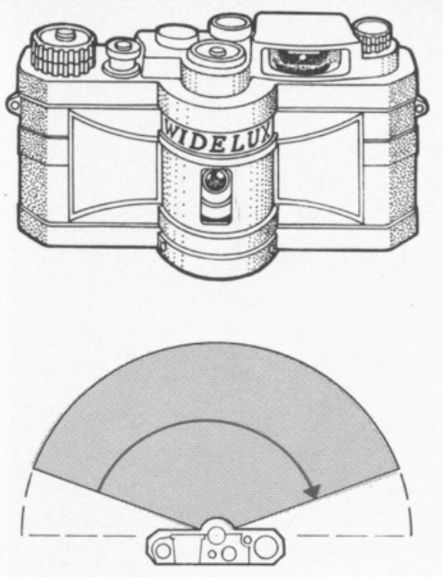
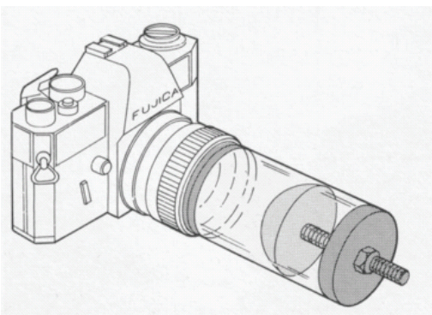
Panorama Capture

Slide 16
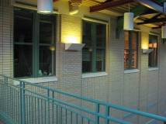
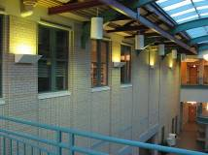
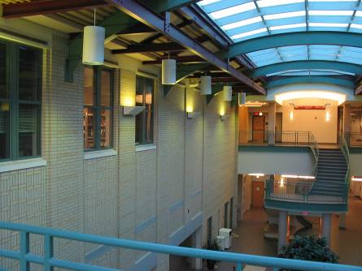
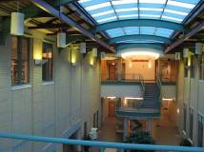
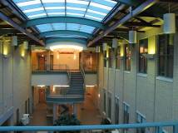
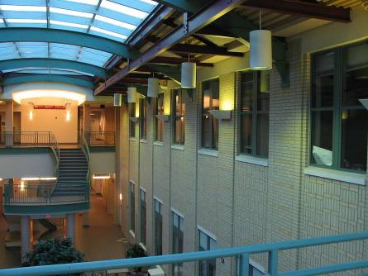
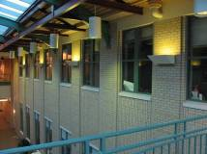
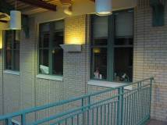
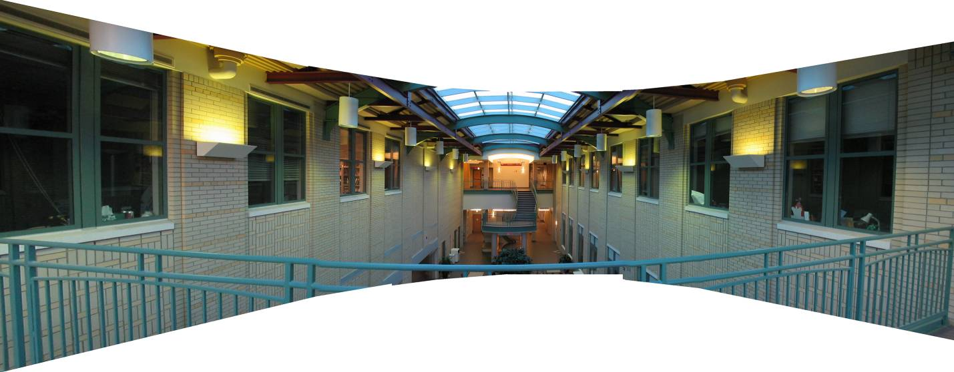
Mosaics: stitching images together
virtual wide-angle camera

Slide 17
Image Alignment
How do we align two images automatically?
Two broad approaches:
  Feature-based alignment
    Find a few matching features in both images
    Compute alignment
  Direct (pixel-based) alignment
    Search for alignment where most pixels agree
    High computation requirements if many unknown alignment parameters

Slide 18
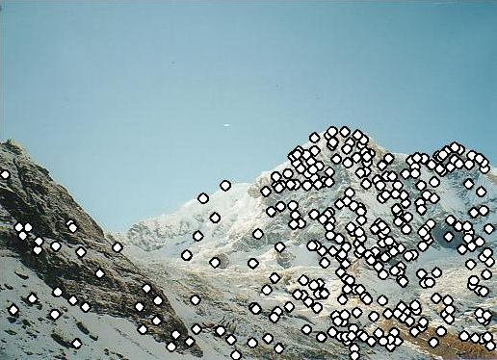
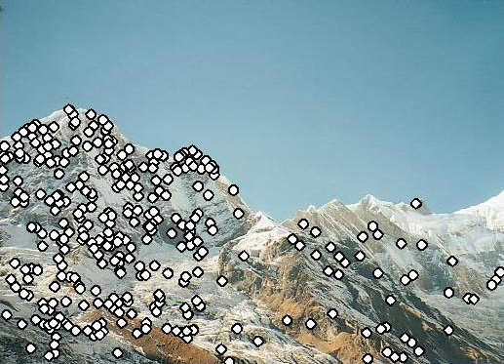
Feature-based Panorama Stitching
Find corresponding feature points
Fit a model placing the two images in correspondence
Blend / cut
?

Slide 19
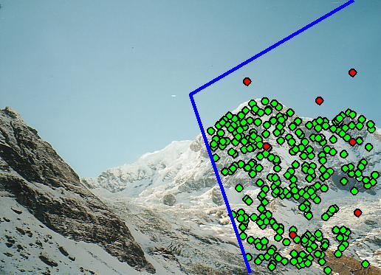
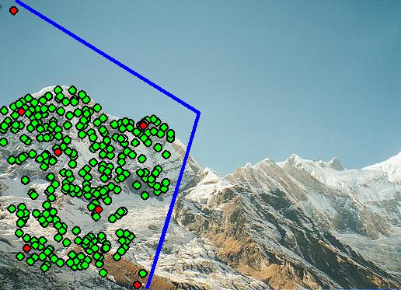
Feature-based Panorama Stitching
Find corresponding feature points
Fit a model placing the two images in correspondence
Blend / cut

Slide 20
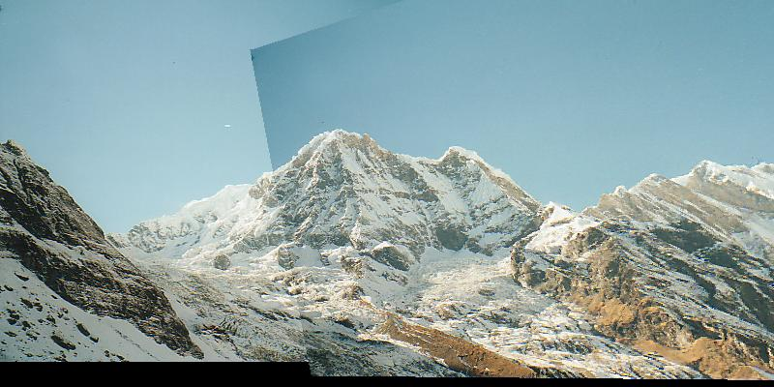
Feature-based Panorama Stitching
Detect feature points
Fit a model placing the two images in correspondence
Blend / cut

Slide 21
How to do it?
Basic Procedure
  Take a sequence of images from the same position
    Rotate the camera about its optical center
  Compute transformation between second image and first
  Transform the second image to overlap with the first
  Blend the two together to create a mosaic
  If there are more images, repeat
…but wait, why should this work at all?
  What about the 3D geometry of the scene?
  Why aren’t we using it?

Slide 22
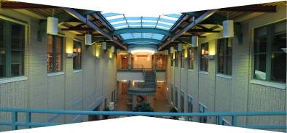
Aligning images
left on top
right on top
  Translations are not enough to align the images

Slide 23
Direct Alignment
The simplest approach is a brute force search
  Need to define image matching function
    SSD, Normalized Correlation, edge matching, etc.
  Search over all parameters within a reasonable range:
e.g. for translation:
for tx=x0:step:x1,
for ty=y0:step:y1,
compare image1(x,y) to image2(x+tx,y+ty)
end;
end;
Need to pick correct x0,x1 and step
  What happens if step is too large?

Slide 24
Direct Alignment (brute force)
What if we want to search for more complicated transformation, e.g. homography?
for a=a0:astep:a1,
for b=b0:bstep:b1,
for c=c0:cstep:c1,
for d=d0:dstep:d1,
for e=e0:estep:e1,
for f=f0:fstep:f1,
for g=g0:gstep:g1,
for h=h0:hstep:h1,
compare image1 to H(image2)
end; end; end; end; end; end; end; end;

Slide 25
Problems with brute force
Not realistic
  Search in O(N⁸) is problematic
  Not clear how to set starting/stopping value and step
What can we do?
  Use pyramid search to limit starting/stopping/step values
  For special cases (rotational panoramas), can reduce search slightly to O(N⁴):
    H = K₁R₁R₂⁻¹K₂⁻¹ (4 DOF: f and rotation)
Alternative: gradient descent on the error function
  i.e. how do I tweak my current estimate to make the SSD error go down?
  Can do sub-pixel accuracy
  BIG assumption?
    Images are already almost aligned (<2 pixels difference!)
    Can improve with pyramid
  Same tool as in motion estimation

Slide 26
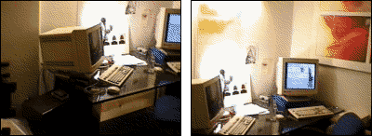
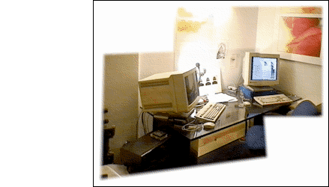
Image alignment

Slide 27
Feature-based alignment
Find a few important features (aka Interest Points)
Match them across two images
Compute image transformation
How do we choose good features?
  They must prominent in both images
  Easy to localize
  Think how you would do it by hand
  Corners!

Slide 28
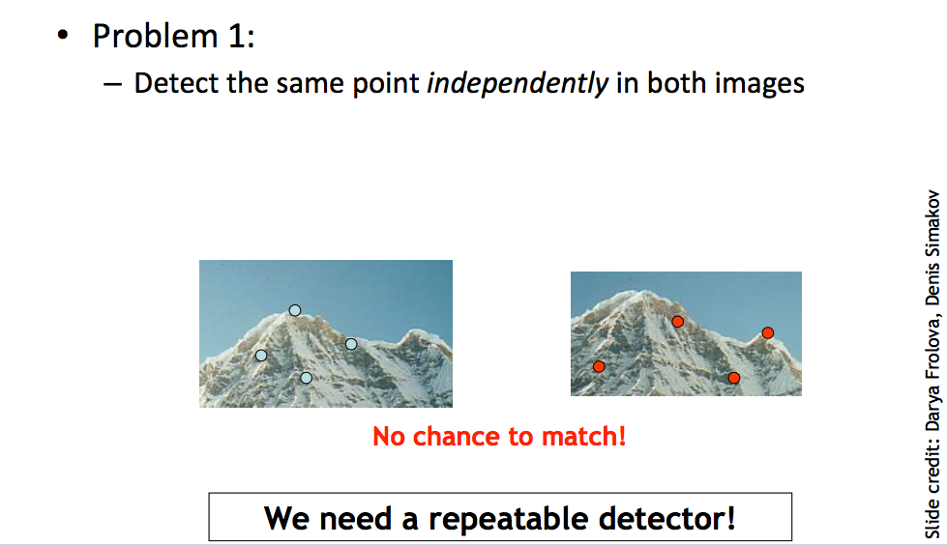
Requirements for the Features

Slide 29
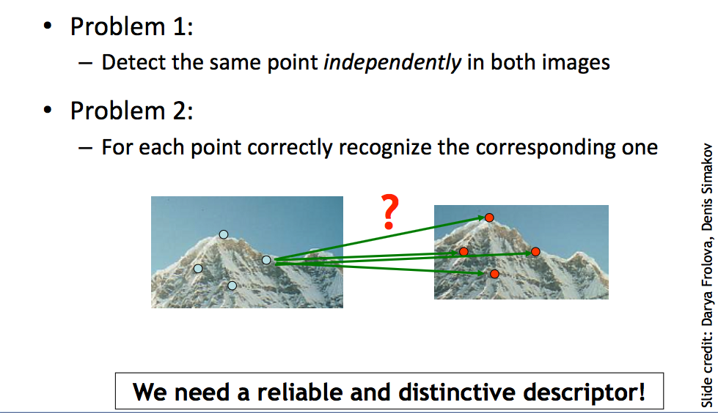
Requirements for the Features

Slide 30
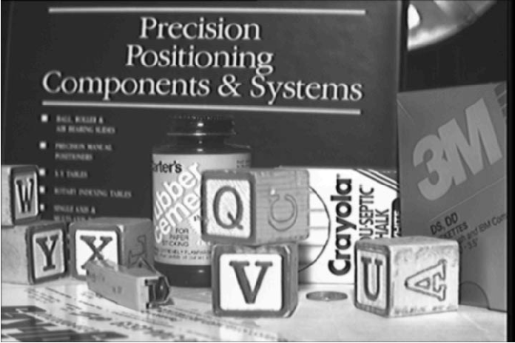
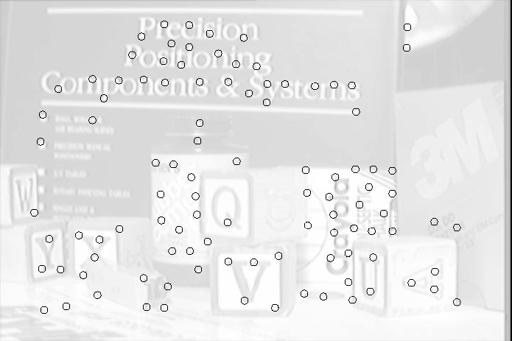
Feature Detection

Slide 31
Feature Matching
How do we match the features between the images?
  Need a way to describe a region around each feature
    e.g. image patch around each feature
  Use successful matches to estimate homography
    Need to do something to get rid of outliers
Issues:
  What if the image patches for several interest points look similar?
    Make patch size bigger
  What if the image patches for the same feature look different due to scale, rotation, exposure etc.
    Need an invariant descriptor

Slide 32
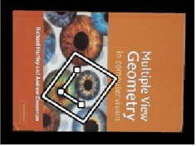

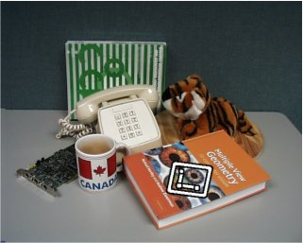

Invariant Feature Descriptors
Schmid & Mohr 1997, Lowe 1999, Baumberg 2000, Tuytelaars & Van Gool 2000, Mikolajczyk & Schmid 2001, Brown & Lowe 2002, Matas et. al. 2002, Schaffalitzky & Zisserman 2002

Slide 33
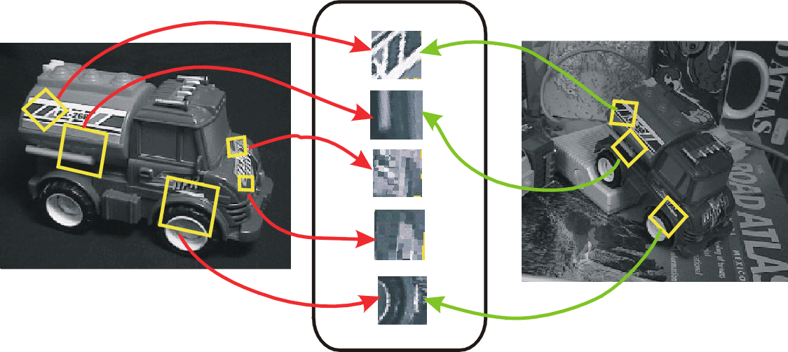
Invariant Local Features
Image content is transformed into local feature coordinates that are invariant to translation, rotation, scale, and other imaging parameters
Features Descriptors

Slide 34
Applications
Feature points are used for:
  Image alignment (homography, fundamental matrix)
  3D reconstruction
  Motion tracking
  Object recognition
  Scene categorization
  Indexing and database retrieval
  Robot navigation
  … other

Slide 35
Feature Detectors and Descriptors
1 Feature detector
  scale invariant Harris corners
1 Feature descriptor
  patches, oriented patches
Reading:
David Lowe 2004,
Distinctive Image Features from Scale-Invariant Keypoints

Slide 36
Outline
Motivation for sparse features
Harris corner detector
  Project 1
Difference of Gaussian (blob) feature detector
  Image pyramids
  Feature detector

Slide 37

Corner detection
What could we compute that
would help detect corners?

Slide 38



Edges

Slide 39
Corners

Slide 40


Corners
average ??

Slide 41

Corners

Slide 42


Case #1: Uniform Image Region

Slide 43

Case #2: Single Edge

Slide 44
Harris corner detector
Key property: in a region around a corner, image gradient has two or more dominant directions.
Corners are repeatable and distinctive.
C.Harris, M.Stephens. “A Combined Corner and Edge Detector”. 1988

Slide 45
Harris Corner Detector: Basic Idea
We should easily recognize the point by looking through a small window
Shifting a window in any direction should give a large change in intensity

Slide 46
Harris Corner Detector: Basic Idea
“flat” region:
no change in all directions
“edge”:
no change along the edge direction
“corner”:
significant change in all directions

Slide 47
Harris Detector: Mathematics
Change of intensity for the shift [u,v]:
Window function
Shifted intensity
Intensity
Window function w(x,y) =
or
1 in window, 0 outside
Gaussian

Slide 48
Harris Detector: Mathematics
For small shifts [u,v] we have a bilinear approximation:
where M is a 2×2 matrix computed from image derivatives:
Notes:
the structure tensor, also referred to as the second-moment matrix, is a matrix derived from the gradient of a function

Slide 49
Gradient covariance matrix
Summarizes second-order statistics of the gradient (F_{x}, F_{y})
in a window u = -m … m, v = -m … m around the center pixel (x, y).

Slide 50
Linear Algebra Review: Eigenvectors / Eigenvalues
Let A be a square N x N matrix
x is an eigenvector of A (x nonzero)
λ is its associated eigenvalue
A can have at most N unique eigenvectors
In the project, we just use a library to calculate eigenvalues.

Slide 51
Harris Detector: Mathematics
Classification of image points using eigenvalues of M:
λ₂
“Edge”
λ₂ >> λ₁
“Corner”
λ₁ and λ₂ are large,
λ₁ ~ λ₂;
E increases in all directions
λ₁ and λ₂ are small;
E is almost constant in all directions
“Flat” region
“Edge”
λ₁ >> λ₂
λ₁

Slide 52
Harris Detector
Algorithm:
  Find gradient (F_{x}, F_{y}) of our input image.
  For each pixel:
    Find 2x2 covariance matrix C
    Compute smaller eigenvalue, e, of C.
    If e > T, where T is a threshold parameter, consider it a corner candidate.
  Non-maximum suppression: remove corner candidates that are connected to other corner candidates with higher e.

Slide 53
Project 1
Canny edge detector
Harris corner detector
Project 1 posted to course website.

Slide 54
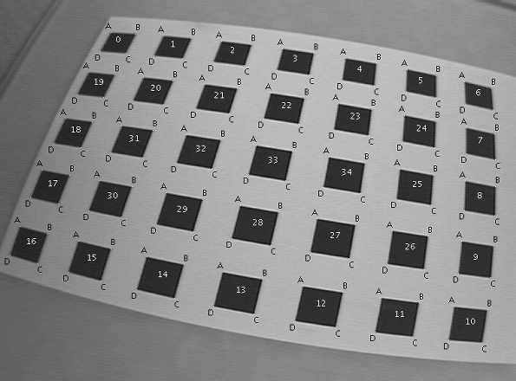
Applications of Corner Detectors

Slide 55
Applications of Corner Detectors
Augmented reality (video puppetry)
3D photography / light fields

Slide 56
Outline
Motivation for sparse features
Harris corner detector
  Project 1
Difference of Gaussian (blob) feature detector
  Image pyramids
  Feature detector

Slide 57
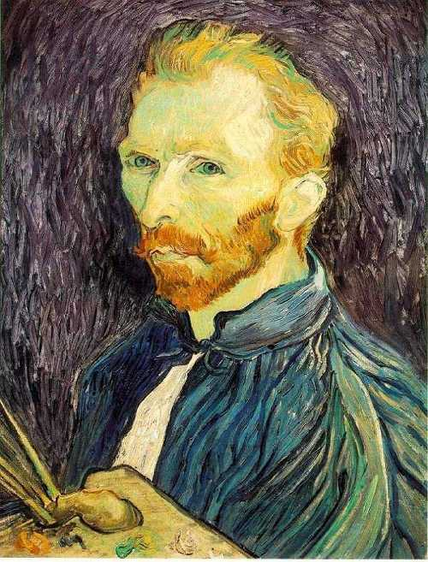
Image resizing
This image is too big to
fit on the screen. How
can we reduce it?
How to generate a different-
sized image?

Slide 58

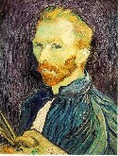

Image resizing: nearest neighbor resampling
1/8
1/4
Throw away every other row and column to create a 1/2 size image
  called image sub-sampling
Slide by Steve Seitz

Slide 59
Image resizing: nearest neighbor resampling
1/8
1/4
We can also increase the image size by duplicating
rows/columns.
Slide by Steve Seitz

Slide 60
Image resizing: nearest neighbor resampling
I(x, y)
I′(x, y)
I ′(x, y) =
I(round(x/s), round(y/s))
1/8
1/4
In the new image, we look up the nearest neighbor pixel in the original image after a scale operation.
Slide by Steve Seitz

Slide 61
Image resizing: nearest neighbor resampling
1/2
1/4 (2x zoom)
1/8 (4x zoom)
Low-quality filter: it arbitrarily retains some pixels, while discarding others.
Slide by Steve Seitz

Slide 62



Gaussian (lowpass) pre-filtering
G 1/8
G 1/4
Gaussian 1/2
Improvement: first smooth the image, then subsample with nearest neighbor filtering
  Filter size should double for each ½ size reduction. Why?
Slide by Steve Seitz

Slide 63
Image Subsampling with Gaussian Prefiltering
Gaussian 1/2
G 1/4
G 1/8
High-quality filter: averages together pixels when subsampling.
Slide by Steve Seitz

Slide 64
Compare with…
1/2
1/4 (2x zoom)
1/8 (4x zoom)
Slide by Steve Seitz

Slide 65
Image Subsampling with Gaussian Prefiltering
G 1/8
G 1/4
Gaussian 1/2
Solution: filter the image, then subsample
  Filter size should double for each ½ size reduction. Why?
  How can we speed this up?
Slide by Steve Seitz

Slide 66
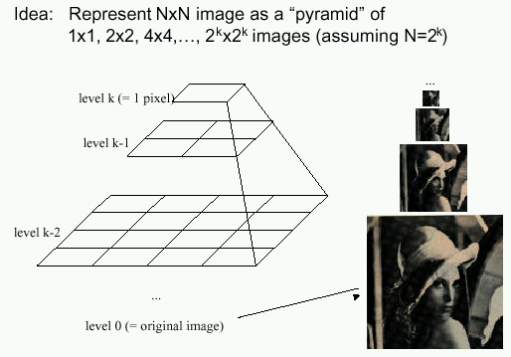
Gaussian Pyramids
Known as a Gaussian Pyramid [Burt and Adelson, 1983]
  In computer graphics, a mip map [Williams, 1983]
  A precursor to wavelet transform
Slide by Steve Seitz

Slide 67
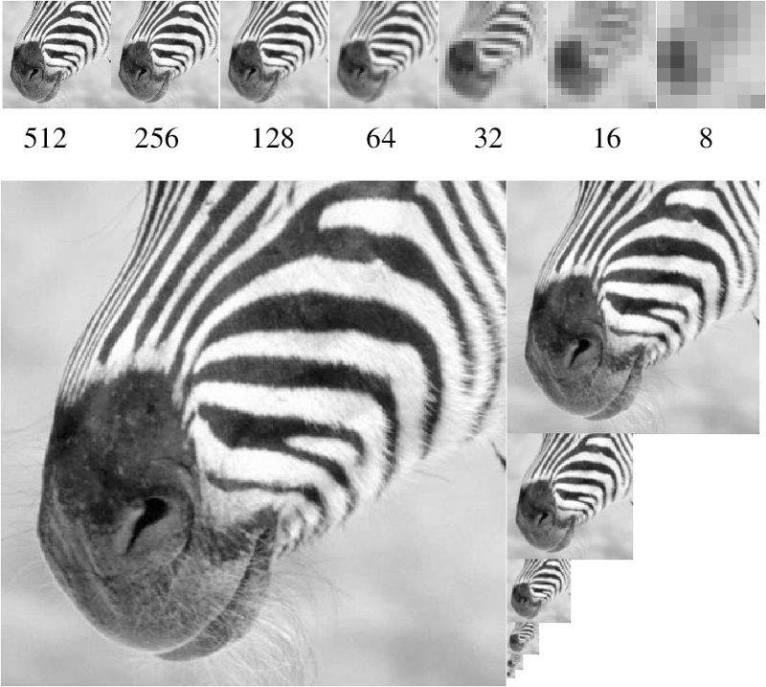
To generate the next level in the pyramid:
1. Filter with Gaussian filter
Typical filter:
2. Discard every other row and column
(nearest neighbor subsampling).
1/16 | 2/16 | 1/16
2/16 | 4/16 | 1/16
1/16 | 2/16 | 1/16
Figure from David Forsyth

Slide 68
What are they good for?
Improve Search
  Search over translations
    E.g. convolve with a filter of what we are looking for (circle filter?)
    Can use “coarse to fine” search: discard regions that are not of interest at coarse levels.
  Search over scale
    Template matching
    E.g. find a face at different scales
Pre-computation
  Need to access image at different blur levels
  Useful for texture mapping at different resolutions (called mip-mapping)

Slide 69
Gaussian pyramid construction
filter mask
Repeat
  Filter
  Subsample
Until minimum resolution reached
  can specify desired number of levels (e.g., 3-level pyramid)
Whole pyramid is only 4/3 the size of the original image! (show)
Slide by Steve Seitz

Slide 70
Difference of Gaussians Feature Detector
Idea: Find blob regions of various sizes
Approach:
  Run linear filter (Difference of Gaussians)
  At different resolutions of image pyramid
Often used for computing SIFT.
“SIFT” = DoG detector + SIFT descriptor

Slide 71
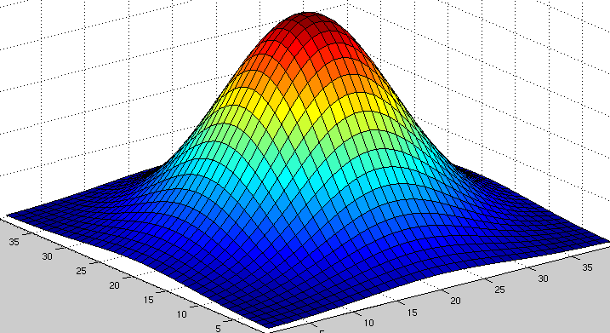
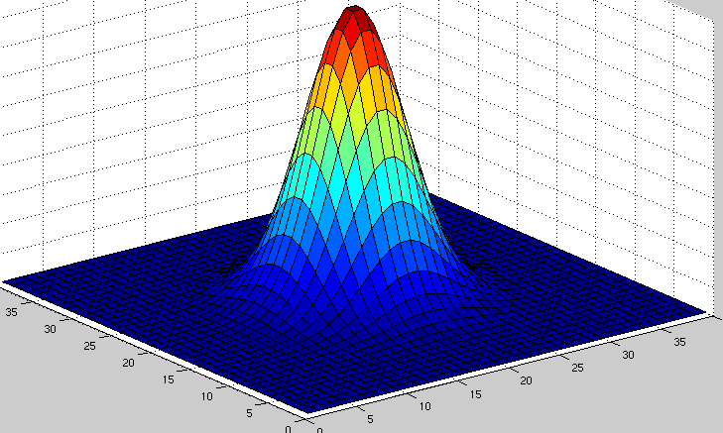
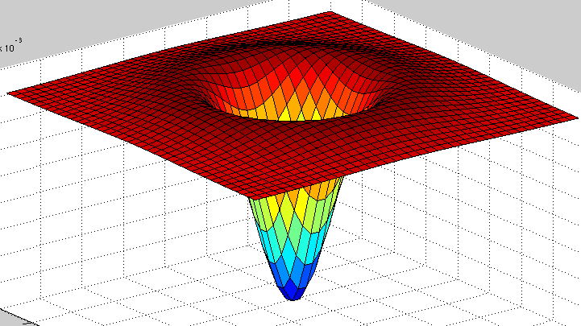
Difference of Gaussians
Minus
Gaussian with
parameter Kσ
Gaussian with
parameter σ
Equals
Typical K = 1.6

Slide 72
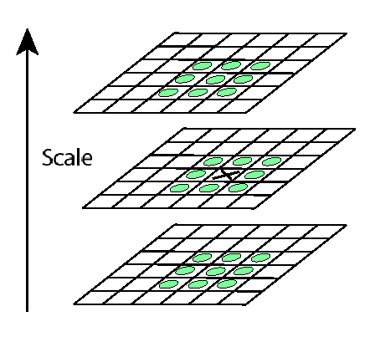
Non-maxima (non-minima) suppression
Detect maxima and minima of difference-of-Gaussian in scale space
For local maximum, how should the value of X be related to the value of the green circles?

Slide 73
Difference of Gaussian Detected Keypoints
Image from Ravimal
Bandara at CodeProject

