Slide 1
CS 4501: Introduction to
Computer Vision
Sparse Feature Descriptors: SIFT,
Model Fitting, Panorama Stitching.
Connelly Barnes
Slides from Jason Lawrence, Fei Fei Li, Juan Carlos Niebles, Alexei Efros, Rick Szeliski, Fredo Durand, Kristin Grauman, James Hays

Slide 2
Outline
Sparse feature descriptor: SIFT
Model fitting
  Least squares
  Hough transform
  RANSAC
Application: panorama stitching

Slide 3
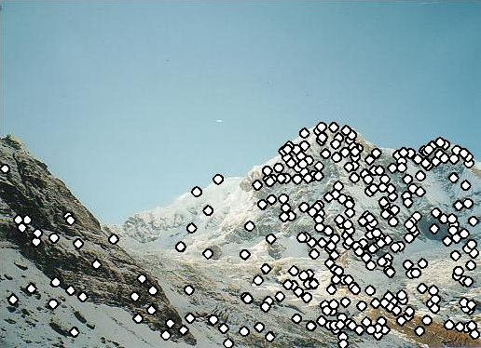
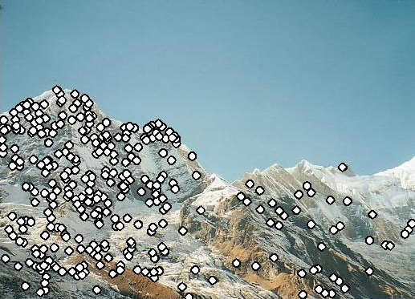
Feature Descriptors
We know how to detect points (corners, blobs)
Next question: How to match them?
?
Point descriptor should be:
  Invariant 2. Distinctive

Slide 4
Descriptors Invariant to Rotation
Find local orientation
  Make histogram of 36 different angles (10 degree increments).
  Vote into histogram based on magnitude of gradient.
  Detect peaks from histogram.
Dominant direction of gradient
Extract image patches relative to this orientation

Slide 5
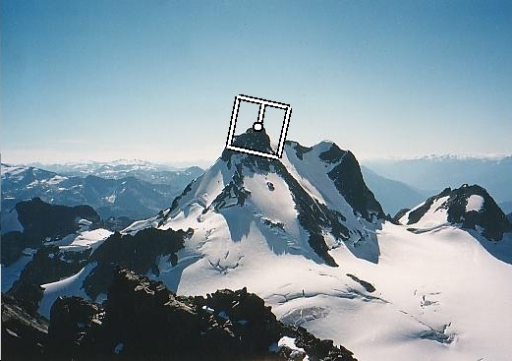
SIFT Keypoint: Orientation
Orientation = dominant gradient
Rotation Invariant Frame
  Scale-space position (x, y, s) + orientation (θ)

Slide 6
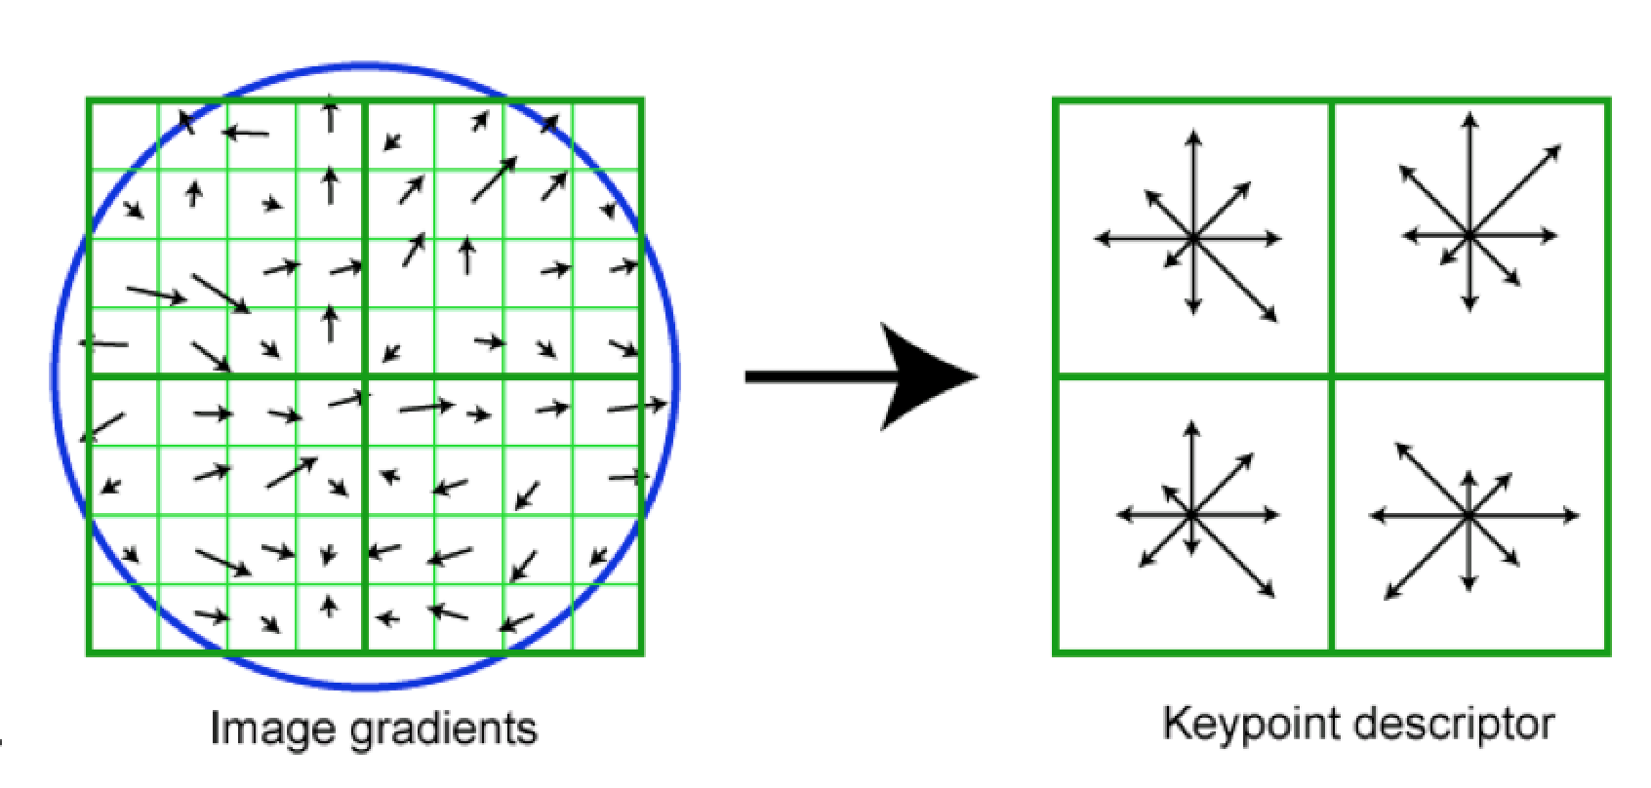
SIFT Descriptor (A Feature Vector)
Image gradients are sampled over 16x16 array of locations.
Find gradient angles relative to keypoint orientation (in blue)
Accumulate into array of orientation histograms
8 orientations x 4x4 histogram array = 128 dimensions
Keypoint

Slide 7
SIFT Descriptor (A Feature Vector)
Often “SIFT” =
  Difference of Gaussian keypoint detector, plus
  SIFT descriptor
  But you can also use SIFT descriptor computed at other locations
  (e.g. at Harris corners, at every pixel, etc)
More details: Lowe 2004 (especially Sections 3-6)

Slide 8
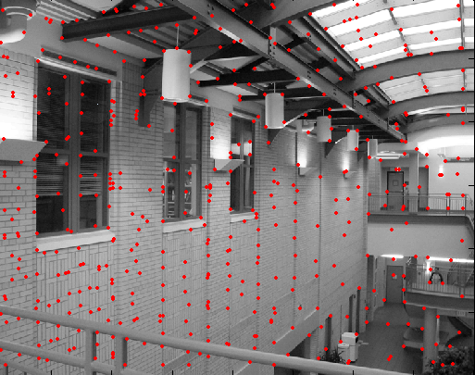
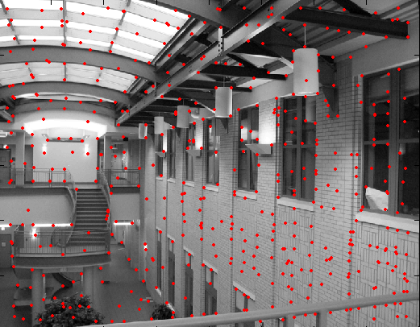
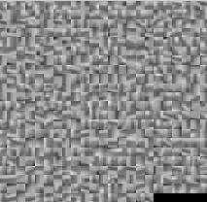
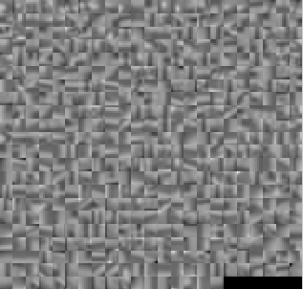
Feature Matching
?

Slide 9
Feature Matching
Exhaustive search
  for each feature in one image, look at all the other features in the other image(s)
Hashing (see locality sensitive hashing)
  Project into a lower k dimensional space, e.g. by random projections, use that as a “key” for a k-d hash table, e.g. k=5.
Nearest neighbor techniques
  kd-trees (available in libraries, e.g. SciPy, OpenCV, FLANN).

Slide 10
What about outliers?
?

Slide 11
Feature-space outlier rejection
Let’s not match all features, but only these that have “similar enough” matches?
How can we do it?
  SSD(patch1,patch2) < threshold
  How to set threshold?

Slide 12
Feature-space outlier rejection
From [Lowe, 1999]:
  1-NN: SSD of the closest match
  2-NN: SSD of the second-closest match
  Look at how much better 1-NN is than 2-NN, e.g. 1-NN/2-NN
  That is, is our best match so much better than the rest?
  Reject if 1-NN/2-NN > threshold.

Slide 13
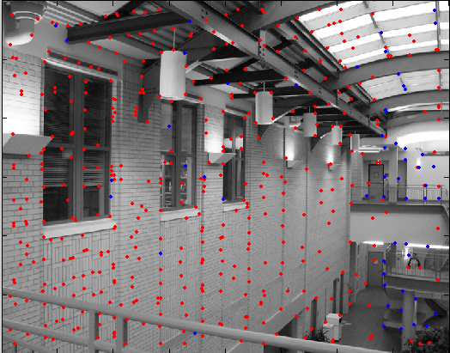
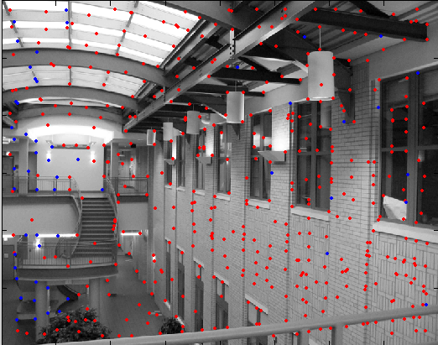
Feature-space outlier rejection
Can we now compute an alignment from the blue points? (the ones that survived the “feature space outlier rejection” test)
  No! Still too many outliers…
  What can we do?

Slide 14
Outline
Sparse feature descriptor: SIFT
Model fitting
  Least squares
  Hough transform
  RANSAC
Application: panorama stitching

Slide 15
Model fitting
Fitting: find the parameters of a model that best fit the data
Alignment: find the parameters of the transformation that best align matched points
Slide from James Hays

Slide 16
Example: Aligning Two Photographs

Slide 17
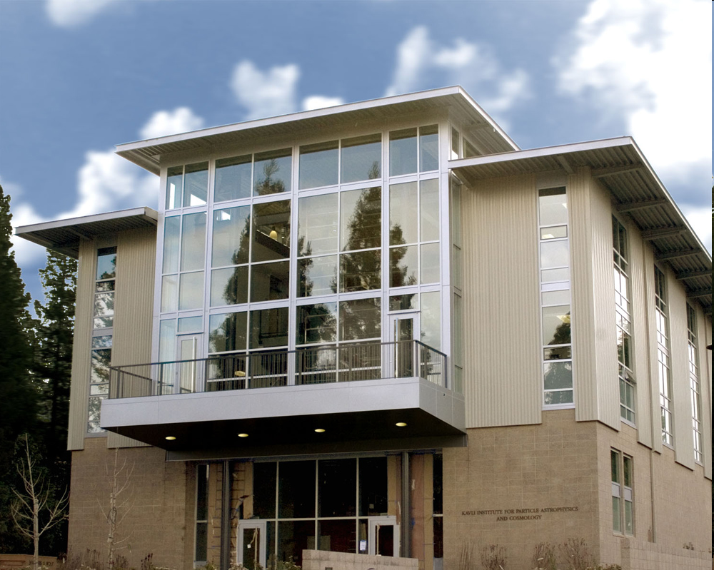
Example: Computing vanishing points
Slide from Silvio Savarese

Slide 18
Example: Estimating a transformation
H
Slide from Silvio Savarese

Slide 19
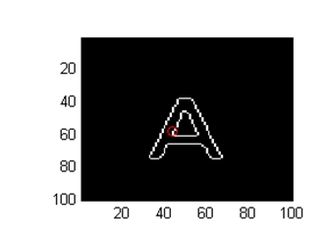
Example: fitting a 2D shape template
A
Slide from Silvio Savarese

Slide 20
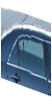
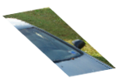
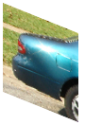
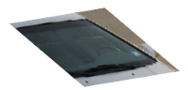
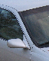
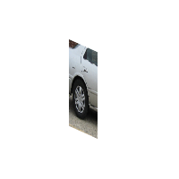

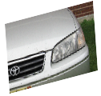
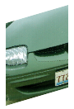
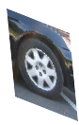

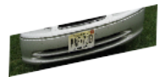

Example: fitting a 3D object model
Slide from Silvio Savarese
Notes:
As shown at the beginning, it interesting to visualize the geometrical relationship between canonical parts.
Notice that:
These 2 canonical parts share the same pose. All parts that share the same pose form a canonical pose.
These are other examples of canonical poses
Part belonging to different canonical poses are linked by a full homograhic transformation
Here we see examples of canonical poses mapped into object instances
%%
This plane collect canonical parts that share the same pose. All this canonical parts are related by a pure translation constraint.
- These canonical parts do not share the same pose and belong to different planes. This change of pose is described by the homographic transformation Aij.
- Canonical parts that are not visible at the same time are not linked.
Canonical parts that share the same pose forms a single-view submodel.
%Canonical parts that share the same pose form a single view sub-model of the object class. Canonical parts that do not belong to the same plane, correspond to different %poses of the 3d object. The linkage stucture quantifies this relative change of pose through the homographic transformations. Canonical parts that are not visible at the same %time are not linked.
Notice this representation is more flexible than a full 3d model yet, much richer than those where parts are linked by 'right to left', 'up to down‘ relationship, yet. . Also it is different from aspect graph: in that: aspect graphs are able to segment the object in stable regions across views

Slide 21
Critical issues: noisy data
Slide from Silvio Savarese

Slide 22
Critical issues: outliers
H
Slide from Silvio Savarese

Slide 23
Critical issues: missing data (occlusions)
Slide from Silvio Savarese
Notes:
As shown at the beginning, it interesting to visualize the geometrical relationship between canonical parts.
Notice that:
These 2 canonical parts share the same pose. All parts that share the same pose form a canonical pose.
These are other examples of canonical poses
Part belonging to different canonical poses are linked by a full homograhic transformation
Here we see examples of canonical poses mapped into object instances
%%
This plane collect canonical parts that share the same pose. All this canonical parts are related by a pure translation constraint.
- These canonical parts do not share the same pose and belong to different planes. This change of pose is described by the homographic transformation Aij.
- Canonical parts that are not visible at the same time are not linked.
Canonical parts that share the same pose forms a single-view submodel.
%Canonical parts that share the same pose form a single view sub-model of the object class. Canonical parts that do not belong to the same plane, correspond to different %poses of the 3d object. The linkage stucture quantifies this relative change of pose through the homographic transformations. Canonical parts that are not visible at the same %time are not linked.
Notice this representation is more flexible than a full 3d model yet, much richer than those where parts are linked by 'right to left', 'up to down‘ relationship, yet. . Also it is different from aspect graph: in that: aspect graphs are able to segment the object in stable regions across views

Slide 24
Outline
Sparse feature descriptor: SIFT
Model fitting
  Least squares
  Hough transform
  RANSAC
Application: panorama stitching

Slide 25
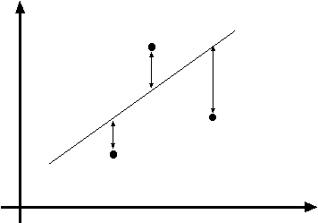
Least squares line fitting
Data: (x₁, y₁), …, (x_{n}, y_{n})
Line equation: y_{i} = m x_{i} + b
Find parameters (m, b) to minimize:
y=mx+b
(x_{i}, y_{i})
Least squares
problem
Matlab: p = A \ y;
Python: p = numpy.linalg.lstsq(A, y)
Least squares solution
Modified from S. Lazebnik

Slide 26
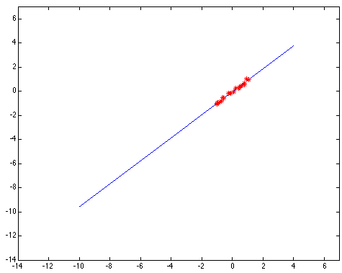
Least squares: Robustness to noise
Least squares fit to the red points:
Slides from Svetlana Lazebnik

Slide 27
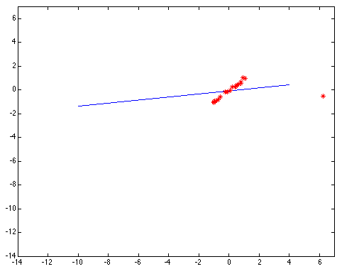
Least squares: Robustness to noise
Least squares fit with an outlier:
Problem: squared error heavily penalizes outliers

Slide 28
Least Squares Conclusions
Pros:
  Fast to compute
  Closed-form formula
Cons:
  Not robust to outliers

Slide 29
Outline
Sparse feature descriptor: SIFT
Model fitting
  Least squares
  Hough transform
  RANSAC
Application: panorama stitching

Slide 30
Hough transform
P.V.C. Hough, Machine Analysis of Bubble Chamber Pictures, Proc. Int. Conf. High Energy Accelerators and Instrumentation, 1959
Suppose we want to fit a line.
For each point, vote in “Hough space” for all lines that the point may belong to.
y
m
x
b
Hough space
y = m x + b
Slide from S. Savarese
Notes:
􀁑 Basic ideas
• A line is represented as . Every line in the image corresponds
to a point in the parameter space
• Every point in the image domain corresponds to a line in the parameter
space (why ? Fix (x,y), (m,n) can change on the line . In other
words, for all the lines passing through (x,y) in the image space, their
parameters form a line in the parameter space)
• Points along a line in the space correspond to lines passing through the
same point in the parameter space (why ?)

Slide 31
Hough transform
y
m
x
b
y
m
3
5
3
3
2
2
3
7
11
10
4
3
2
3
1
4
5
2
2
1
0
1
3
3
x
b
Slide from S. Savarese
Notes:
􀁑 Basic ideas
• A line is represented as . Every line in the image corresponds
to a point in the parameter space
• Every point in the image domain corresponds to a line in the parameter
space (why ? Fix (x,y), (m,n) can change on the line . In other
words, for all the lines passing through (x,y) in the image space, their
parameters form a line in the parameter space)
• Points along a line in the space correspond to lines passing through the
same point in the parameter space (why ?)

Slide 32
Hough transform
P.V.C. Hough, Machine Analysis of Bubble Chamber Pictures, Proc. Int. Conf. High Energy Accelerators and Instrumentation, 1959
Issue : parameter space [m,b] is unbounded…
Use a polar representation for the parameter space
y
x
Hough space
Slide from S. Savarese
Notes:
􀁑 Basic ideas
• A line is represented as . Every line in the image corresponds
to a point in the parameter space
• Every point in the image domain corresponds to a line in the parameter
space (why ? Fix (x,y), (m,n) can change on the line . In other
words, for all the lines passing through (x,y) in the image space, their
parameters form a line in the parameter space)
• Points along a line in the space correspond to lines passing through the
same point in the parameter space (why ?)

Slide 33
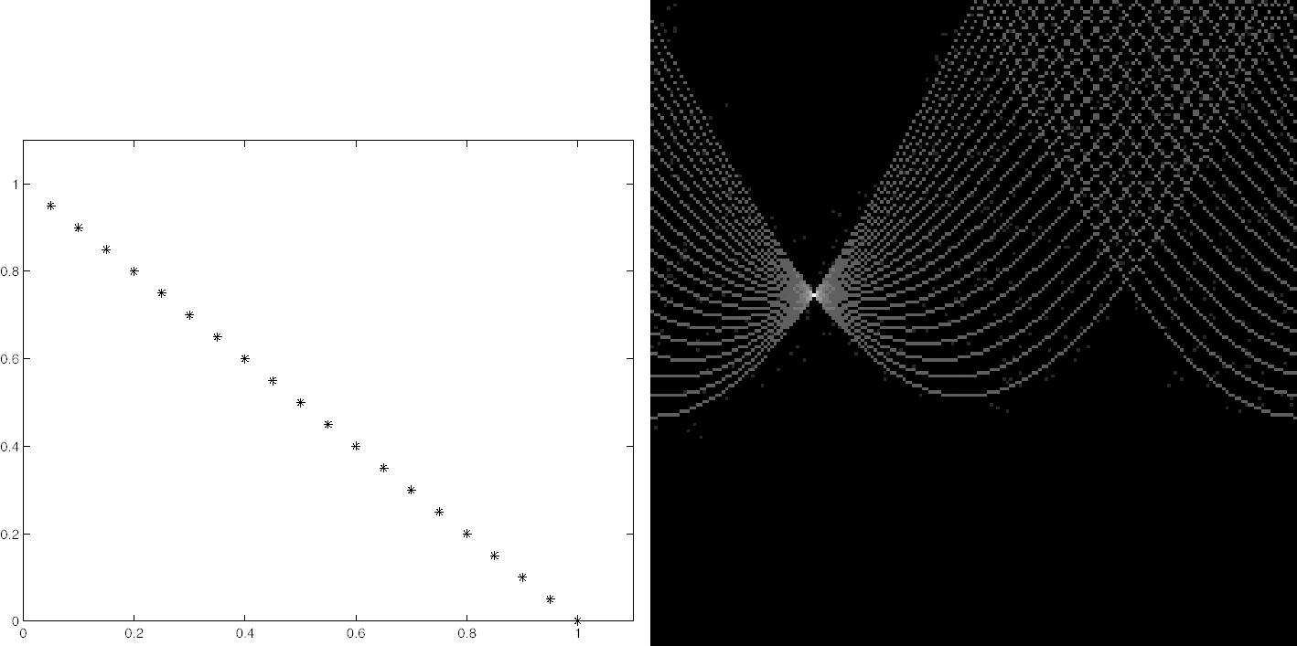
Hough Transform: Effect of Noise
[Forsyth & Ponce]

Slide 34
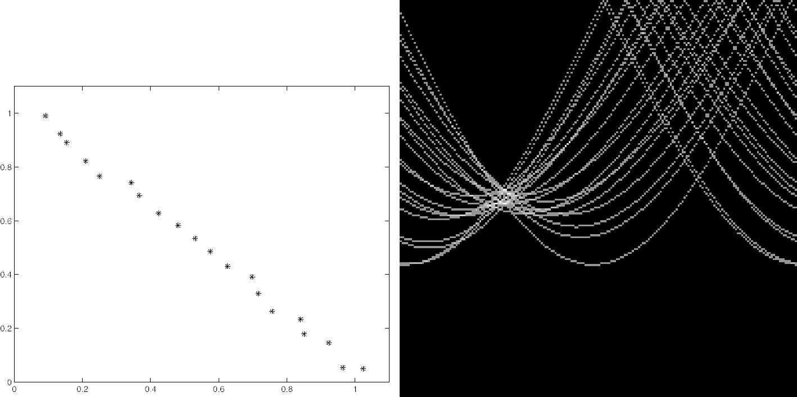
Hough Transform: Effect of Noise
Need to set grid / bin size based on amount of noise
[Forsyth & Ponce]

Slide 35
Discussion
Could we use Hough transform to fit:
Circles of a known size?
  What kinds of points would we first detect?
  What are the dimensions that we would “vote” in?
Circles of unknown size?
  What are the dimensions that we would “vote” in?
Squares?

Slide 36
Hough Transform Conclusions
Pros:
  Robust to outliers
Cons:
  Bin size has to be set carefully to trade of noise/precision/memory
  Grid size grows exponentially in number of parameters
Slide from James Hays

Slide 37
RANSAC
_{(RANdom SAmple Consensus) :}
Fischler & Bolles in ‘81.
Algorithm:
Sample (randomly) the number of points required to fit the model
Solve for model parameters using samples
Score by the fraction of inliers within a preset threshold of the model
Repeat 1-3 until the best model is found with high confidence
Notes:
Let me give you an intuition of what is going on. Suppose we have the standard line fitting problem in presence of outliers.
We can formulate this problem as follows: want to find the best partition of points in inlier set and outlier set such that…
The objective consists of adjusting the parameters of a model function so as to best fit a data set.
"best" is defined by a function f that needs to be minimized.
Such that the best parameter of fitting the line give rise to a residual error lower that delta
as when the sum, S, of squared residuals

Slide 38
RANSAC
Line fitting example
Algorithm:
Sample (randomly) the number of points required to fit the model (#=2)
Solve for model parameters using samples
Score by the fraction of inliers within a preset threshold of the model
Repeat 1-3 until the best model is found with high confidence
Illustration by Savarese
Notes:
Let me give you an intuition of what is going on. Suppose we have the standard line fitting problem in presence of outliers.
We can formulate this problem as follows: want to find the best partition of points in inlier set and outlier set such that…
The objective consists of adjusting the parameters of a model function so as to best fit a data set.
"best" is defined by a function f that needs to be minimized.
Such that the best parameter of fitting the line give rise to a residual error lower that delta
as when the sum, S, of squared residuals

Slide 39
RANSAC
Line fitting example
Algorithm:
Sample (randomly) the number of points required to fit the model (#=2)
Solve for model parameters using samples
Score by the fraction of inliers within a preset threshold of the model
Repeat 1-3 until the best model is found with high confidence
Notes:
Let me give you an intuition of what is going on. Suppose we have the standard line fitting problem in presence of outliers.
We can formulate this problem as follows: want to find the best partition of points in inlier set and outlier set such that…
The objective consists of adjusting the parameters of a model function so as to best fit a data set.
"best" is defined by a function f that needs to be minimized.
Such that the best parameter of fitting the line give rise to a residual error lower that delta
as when the sum, S, of squared residuals

Slide 40
RANSAC
Line fitting example
Algorithm:
Sample (randomly) the number of points required to fit the model (#=2)
Solve for model parameters using samples
Score by the fraction of inliers within a preset threshold of the model
Repeat 1-3 until the best model is found with high confidence
Notes:
Let me give you an intuition of what is going on. Suppose we have the standard line fitting problem in presence of outliers.
We can formulate this problem as follows: want to find the best partition of points in inlier set and outlier set such that…
The objective consists of adjusting the parameters of a model function so as to best fit a data set.
"best" is defined by a function f that needs to be minimized.
Such that the best parameter of fitting the line give rise to a residual error lower that delta
as when the sum, S, of squared residuals

Slide 41
RANSAC
Algorithm:
Sample (randomly) the number of points required to fit the model (#=2)
Solve for model parameters using samples
Score by the fraction of inliers within a preset threshold of the model
Repeat 1-3 until the best model is found with high confidence
Notes:
Let me give you an intuition of what is going on. Suppose we have the standard line fitting problem in presence of outliers.
We can formulate this problem as follows: want to find the best partition of points in inlier set and outlier set such that…
The objective consists of adjusting the parameters of a model function so as to best fit a data set.
"best" is defined by a function f that needs to be minimized.
Such that the best parameter of fitting the line give rise to a residual error lower that delta
as when the sum, S, of squared residuals

Slide 42
Choosing the parameters
Initial number of points s
  Minimum number needed to fit the model
Distance threshold t
  Choose t so probability for inlier is p (e.g. 0.95)
  Zero-mean Gaussian noise with std. dev. σ: t =1.96σ
Number of iterations N
  Choose N so that, with probability p, at least one random sample is free from outliers (e.g. p=0.99) (outlier ratio: e)
 | proportion of outliers e
s | 5% | 10% | 20% | 25% | 30% | 40% | 50%
2 | 2 | 3 | 5 | 6 | 7 | 11 | 17
3 | 3 | 4 | 7 | 9 | 11 | 19 | 35
4 | 3 | 5 | 9 | 13 | 17 | 34 | 72
5 | 4 | 6 | 12 | 17 | 26 | 57 | 146
6 | 4 | 7 | 16 | 24 | 37 | 97 | 293
7 | 4 | 8 | 20 | 33 | 54 | 163 | 588
8 | 5 | 9 | 26 | 44 | 78 | 272 | 1177
Source: M. Pollefeys

Slide 43
RANSAC Conclusions
Pros:
  Robust to outliers
  Can use models with more parameters than Hough transform
Cons:
  Computation time grows quickly with fraction of outliers and number of model parameters
Slide from James Hays

Slide 44
Outline
Sparse feature descriptor: SIFT
Model fitting
  Least squares
  Hough transform
  RANSAC
Application: panorama stitching

Slide 45
Feature-based Panorama Stitching
Find corresponding feature points (SIFT)
Fit a model placing the two images in correspondence
Blend / cut
?

Slide 46
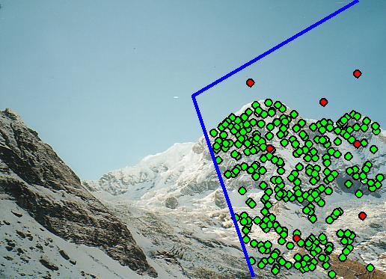
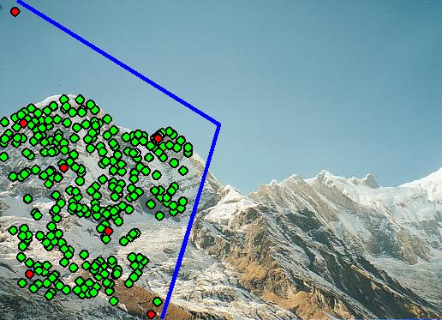
Feature-based Panorama Stitching
Find corresponding feature points
Fit a model placing the two images in correspondence
Blend / cut

Slide 47
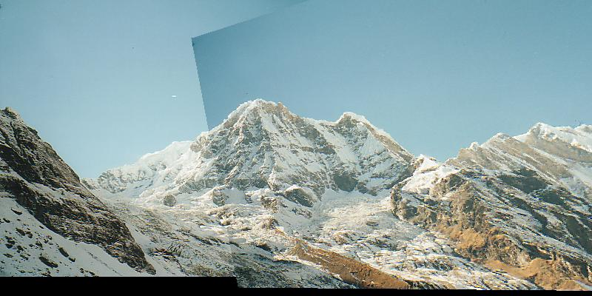
Feature-based Panorama Stitching
Find corresponding feature points
Fit a model placing the two images in correspondence
Blend / cut

Slide 48
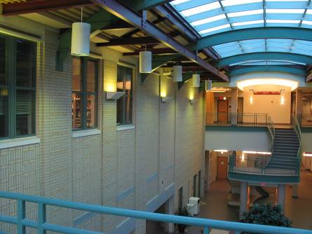
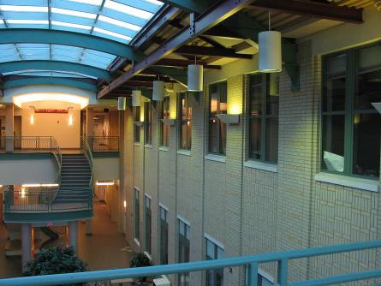
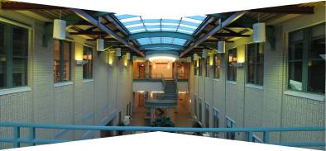
Aligning Images with Homographies
left on top
right on top
  Translations are not enough to align the images

Slide 49
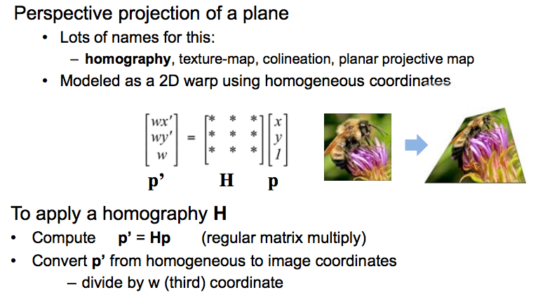
Homographies
/ maps pixels between cameras at the same position but different rotations.
Example: planar ground textures in classic games (e.g. Super Nintendo Mario Kart)
Any other examples?
(Write out matrix multiplication on board
for students without
linear algebra)

Slide 50
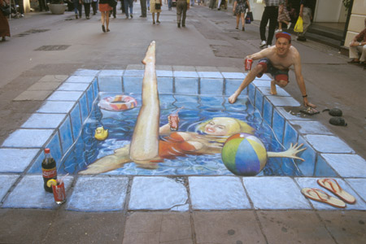
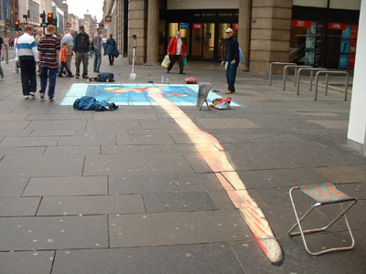
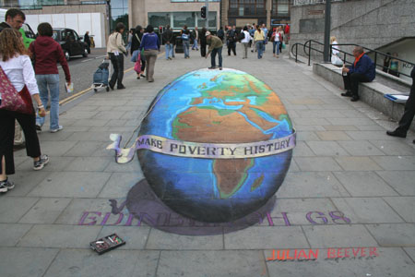
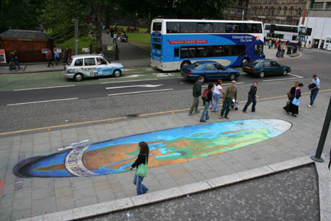
Julian Beever: Manual Homographies
http://users.skynet.be/J.Beever/pave.htm

Slide 51
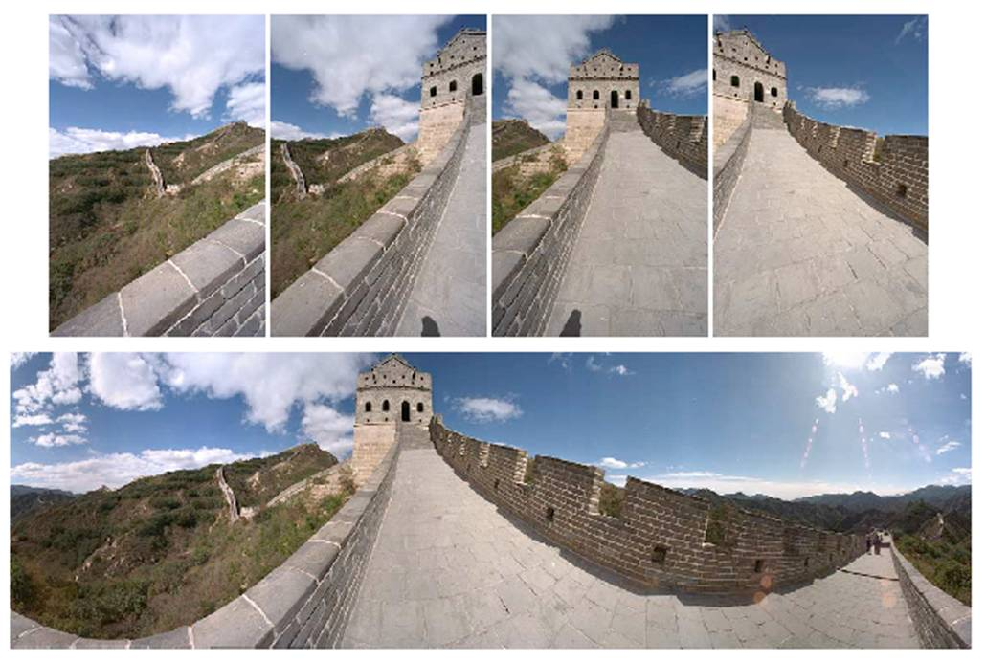
Homography
…
…
To compute the homography given pairs of corresponding points in the images, we need to set up an equation where the parameters of H are the unknowns…

Slide 52
Solving for homographies
p’ = Hp
Can set scale factor i=1. So, there are 8 unknowns.
Set up a system of linear equations:
Ah = b
Where vector of unknowns h = [a,b,c,d,e,f,g,h]^{T}
Multiply everything out so there are no divisions.
Need at least 8 eqs, but the more the better…
Solve for h using least-squares:
Matlab: p = A \ y;
Python: p = numpy.linalg.lstsq(A, y)

Slide 53
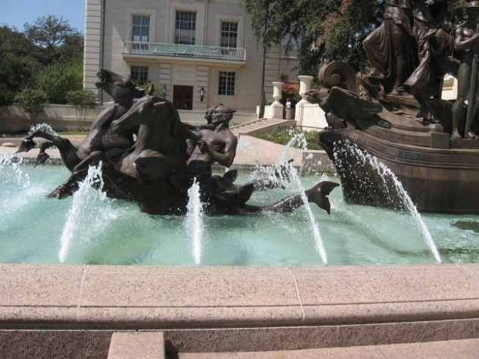
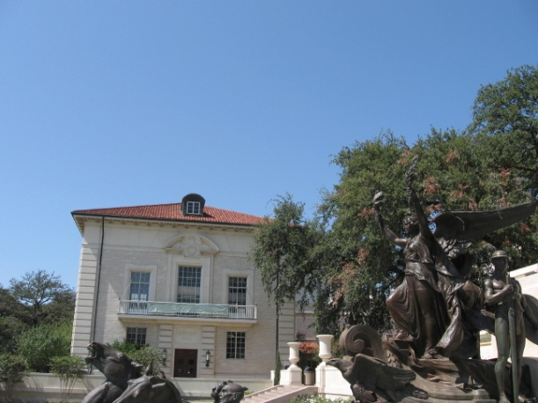
im2
im1

Slide 54
im2
im1

Slide 55
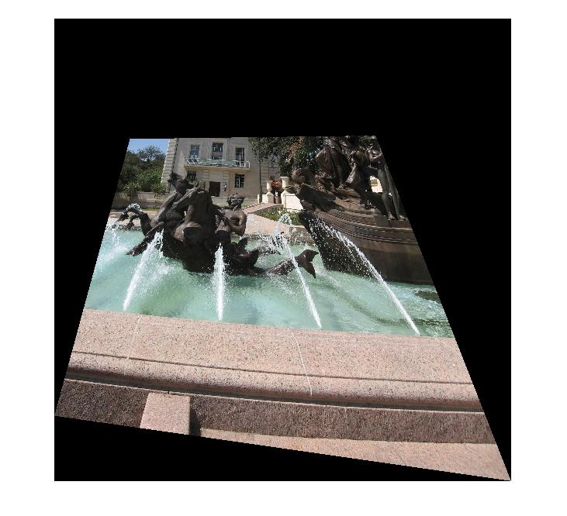
im1
im1 warped into reference frame of im2.
im2
Can use skimage.transform.ProjectiveTransform to ask for the colors (possibly interpolated) from im1 at all the positions needed in im2’s reference frame.

Slide 56
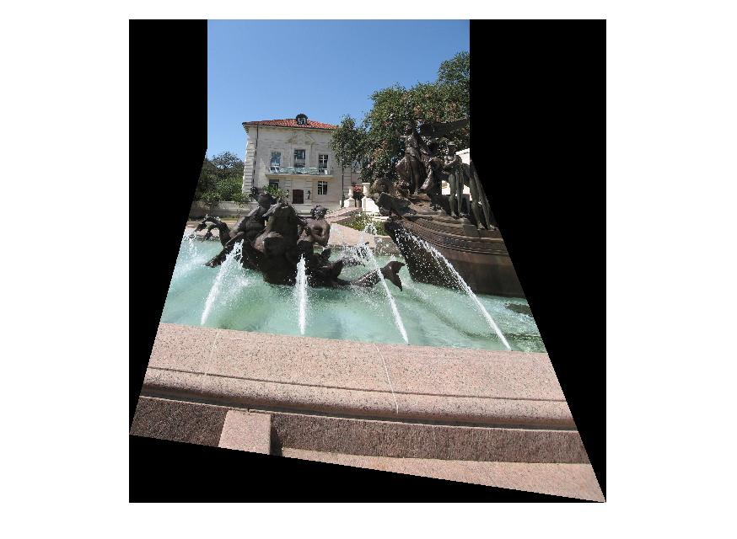

Slide 57
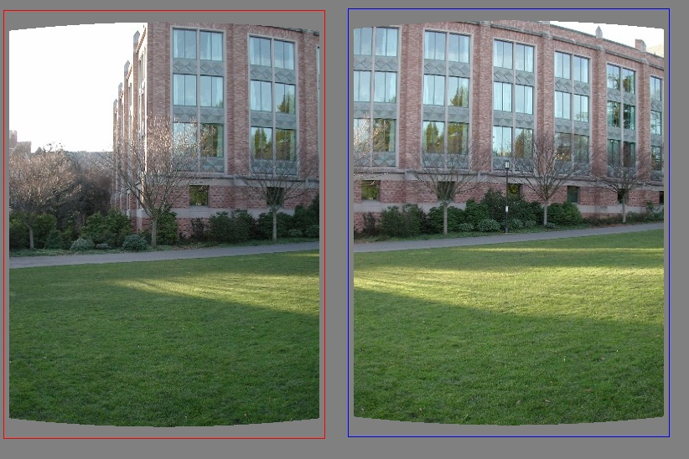
Matching features with RANSAC + homography
What do we do about the “bad” matches?

Slide 58
RANSAC for estimating homography
RANSAC loop:
Select four feature pairs (at random)
Compute homography H (exact)
Compute inliers where SSD(p_{i}’, H p_{i)} < ε
Keep largest set of inliers
Re-compute least-squares H estimate on all of the inliers

Slide 59
RANSAC
The key idea is not that there are more inliers than outliers, but that the outliers are wrong in different ways.
“All happy families are alike; each unhappy family is unhappy in its own way.”
– Tolstoy, Anne Karenina

Slide 60
Feature-based Panorama Stitching
Find corresponding feature points
Fit a model placing the two images in correspondence
Blend
Easy blending: for each pixel in the overlap region, use linear interpolation with weights based on distances.
Fancier blending: Poisson blending

Slide 61
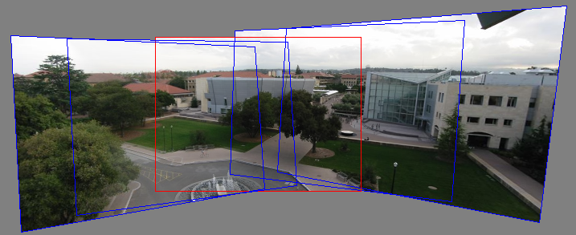
Panorama Blending
Pick one image (red)
Warp the other images towards it (usually, one by one)
Blend

