Slide 1
CS 4501: Introduction to Computer Vision Brief Tutorial of Linear Algebra and Transformations
Connelly Barnes
Slides from Fei Fei Li, Juan Carlos Niebles, Jason Lawrence, Szymon Rusinkiewicz, David Dobkin, Adam Finkelstein, Tom Funkhouser

Slide 2
Outline
Vectors and matrices
Operations
Solving linear systems
Representation in Python
Transformation matrices
2D
Homogeneous coordinates
3D
Camera transformations

Slide 3
Vectors
$$v∈ℝ^{n×1}$$
A column vector
A row vector
Default to column vectors.
$$v=\left[\begin{matrix}v_{1} \\ ⋮ \\ v_{n}\end{matrix}\right]$$
$$v′∈ℝ^{1×n}$$
$$v′=\left[\begin{matrix}v_{1} & … & v_{n}\end{matrix}\right]$$

Slide 4
Matrix
$$A∈ℝ^{m×n}$$
A matrix
Convention: indexed by (row, column).
Square matrix: m = n.
$$A=\left[\begin{matrix}a_{11} & … & a_{1,n} \\ ⋮ & & ⋮ \\ a_{m,1} & … & a_{m,n}\end{matrix}\right]$$

Slide 5
Matrix/Vector Operations
Addition
Scaling
Transpose
Dot product
Multiplication
Inverse
Algebraic properties

Slide 6
Matrix Addition
Matrices (and vectors) add elementwise:
$\left[\begin{matrix}a_{11} & a_{12} \\ a_{21} & a_{22}\end{matrix}\right]$+ $\left[\begin{matrix}b_{11} & b_{12} \\ b_{21} & b_{22}\end{matrix}\right]$ = $\left[\begin{matrix}a_{11}+b_{11} & a_{12}+b_{12} \\ a_{21}+b_{21} & a_{22}+b_{22}\end{matrix}\right]$

Slide 7
Matrix Scaling
Matrix (and vector) product with a scalar multiplies each element:
$c\left[\begin{matrix}a_{11} & a_{12} \\ a_{21} & a_{22}\end{matrix}\right]$ = $\left[\begin{matrix}c{ a}_{11} & {c a}_{12} \\ {c a}_{21} & c a_{22}\end{matrix}\right]$

Slide 8
Transpose
Transpose swaps the rows and columns of a vector or matrix:
${\left[\begin{matrix}v_{1} \\ ⋮ \\ v_{n}\end{matrix}\right]}^{T}=$ $\left[\begin{matrix}v_{1} & … & v_{n}\end{matrix}\right]$
${\left[\begin{matrix}a & b & c \\ d & e & f\end{matrix}\right]}^{T}$ = $\left[\begin{matrix}a & d \\ b & e \\ c & f\end{matrix}\right]$

Slide 9
Dot Product
Inner (dot) product of two vectors multiplies corresponding entries and sums the result:
Also written as:
$$x∙y=\sum_{i=1}^{n}{x_{i}y_{i}}$$
$$x∙y=|x||y|cosθ$$
Shortest angle between x and y
x
$x^{T}y=\left[\begin{matrix}x_{1} & … & x_{n}\end{matrix}\right]$ $\left[\begin{matrix}y_{1} \\ ⋮ \\ y_{n}\end{matrix}\right]$

Slide 10
Matrix Multiplication
Matrix-vector product Av: take dot product between each row of matrix and the column vector:
Matrix-matrix product AB: entry (i, j) is dot product between row i of A and column j of B.
$\left[\begin{matrix}a_{11} & a_{12} \\ a_{21} & a_{22}\end{matrix}\right]\left[\begin{matrix}v_{1} \\ v_{2}\end{matrix}\right]$ = $\left[\begin{matrix}a_{11}v_{1}+a_{12}v_{2} \\ a_{21}v_{1}+a_{22}v_{2}\end{matrix}\right]$
$\left[\begin{matrix}− r_{1}− \\ − r_{2}− \\ − r_{3}−\end{matrix}\right]\left[\begin{matrix}| & | & | \\ c_{1} & c_{2} & c_{3} \\ | & | & |\end{matrix}\right]$ = $\left[\begin{matrix}r_{1}∙c_{1} & r_{1}∙c_{2} & r_{1}∙c_{3} \\ r_{2}∙c_{1} & r_{2}∙c_{2} & r_{2}∙c_{3} \\ r_{3}∙c_{1} & r_{3}∙c_{2} & r_{3}∙c_{3}\end{matrix}\right]$

Slide 11
Matrix Multiplication
If A is shape $m×n$and B is shape $n×k$ then AB is shape $m×k$ .
Why? Because we take each row of A dot with each column of B.
(And the “inner” dimension $n$ must match to take the product).
$\left[\begin{matrix}− r_{1}− \\ − r_{2}− \\ − r_{3}−\end{matrix}\right]\left[\begin{matrix}| & | & | \\ c_{1} & c_{2} & c_{3} \\ | & | & |\end{matrix}\right]$ = $\left[\begin{matrix}r_{1}∙c_{1} & r_{1}∙c_{2} & r_{1}∙c_{3} \\ r_{2}∙c_{1} & r_{2}∙c_{2} & r_{2}∙c_{3} \\ r_{3}∙c_{1} & r_{3}∙c_{2} & r_{3}∙c_{3}\end{matrix}\right]$

Slide 12
Matrix Inverse
Identity matrix is a square matrix with all ones along main diagonal:
For square matrices, matrix inverse A⁻¹ is defined (when it exists) such that:
Beyond the scope of this course to actually compute the inverse: instead, just call a matrix inverse library routine.
$$I=\left[\begin{matrix}1 & 0 & 0 \\ 0 & 1 & 0 \\ 0 & 0 & 1\end{matrix}\right]$$
$\text{A}\text{−1}$A= AA⁻¹ = I

Slide 13
Algebraic Properties
For matrices A, B, C and scalar c:
Scalar multiplication: $c\left(AB\right)=\left(cA\right)B=A\left(cB\right)$
Associative: $\left(AB\right)C=A\left(BC\right)$
Distributive: $\left(A+B\right)C=AC+BC$
Identity:$AI=IA=A$
Transpose: ${\left(AB\right)}^{T}=B^{T}A^{T},{\left(A+B\right)}^{T}=A^{T}+B^{T}$
Inverse: ${\left(AB\right)}^{−1}=B^{−1}A^{−1}$
Not commutative: in general, $AB≠BA$

Slide 14
Outline
Vectors and matrices
Operations
Solving linear systems
Representation in Python
Transformation matrices
2D
Homogeneous coordinates
3D
Camera transformations

Slide 15
Solving Linear Systems
If we have a linear system Ax = b:
By using our multiplication rule, this is a system of linear equations:
If matrix A and invertible, then the solution is x = A⁻¹ b
What to do if A is non-square or non-invertible?
$\left[\begin{matrix}a_{11} & a_{12} \\ a_{21} & a_{22}\end{matrix}\right]\left[\begin{matrix}x_{1} \\ x_{2}\end{matrix}\right]$ = $\left[\begin{matrix}b_{1} \\ b_{1}\end{matrix}\right]$
$$a_{11}x_{1}+a_{12}x_{2}=b_{1}$$
$$a_{21}x_{1}+a_{22}x_{2}=b_{2}$$

Slide 16
Solving Linear Systems (Pseudoinverse)
If we have a linear system Ax = b and the matrix A is non-square or non-invertible, then often cannot solve the system exactly.
Usual solution: solve using psuedoinverse A⁺, defined as:
If neither inverse exists, A⁺ can still be computed.
Solution to the linear system: x = A⁺ b
If system over-determined, solution minimizes least-squares error.
If system under-determined, finds solution with smallest norm.
$\text{A}\text{+}$ = (A^{T}A)⁻¹A^{T}
$\text{(}\text{if}$(A^{T}A)⁻¹ $\text{exists}\text{)}$
$\text{A}\text{+}$ = A^{T} (AA^{T})⁻¹
$\text{(}\text{if}$(AA^{T})⁻¹ $\text{exists}\text{)}$

Slide 17
Outline
Vectors and matrices
Operations
Solving linear systems
Representation in Python
Transformation matrices
2D
Homogeneous coordinates
3D
Camera transformations

Slide 18
Representation in Python
Vector: v = numpy.array([1.0, 2.0])
Matrix: A = numpy.array([[1.0, 2.0], [3.0, 4.0]])
Number of elements in vector: len(v)
Number of rows: A.shape[0] (height of image)
Number of columns: A.shape[1] (width of image)
Access element in vector: v[i] (i starts at 0)
Access element in matrix: v[row, column] (starts at 0)

Slide 19
Representation in Python
Vector: v = numpy.array([1.0, 2.0])
Matrix: A = numpy.array([[1.0, 2.0], [3.0, 4.0]])
Elementwise sum: A + A
Scalar product: 2*A
Dot product: v.dot(v)
Matrix product: A.dot(v), A.dot(A)
Magnitude (Euclidean length): numpy.linalg.norm(v)
Matrix inverse: numpy.linalg.inv(A)
Pseudoinverse: numpy.linalg.pinv(A)
Solve linear systems: numpy.linalg.solve, numpy.linalg.lstsq

Slide 20
Outline
Vectors and matrices
Operations
Solving linear systems
Representation in Python
Transformation matrices
2D
Homogeneous coordinates
3D
Camera transformations

Slide 21
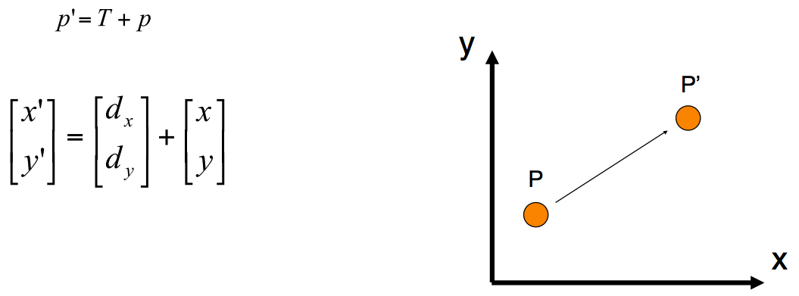
2D Transformations: Translation

Slide 22
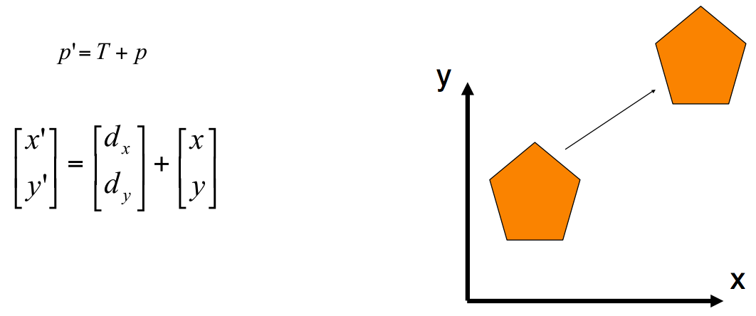
2D Transformations: Translation

Slide 23
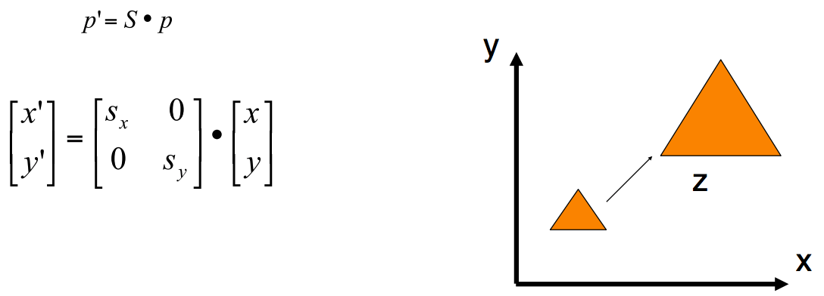
2D Transformations: Scaling

Slide 24
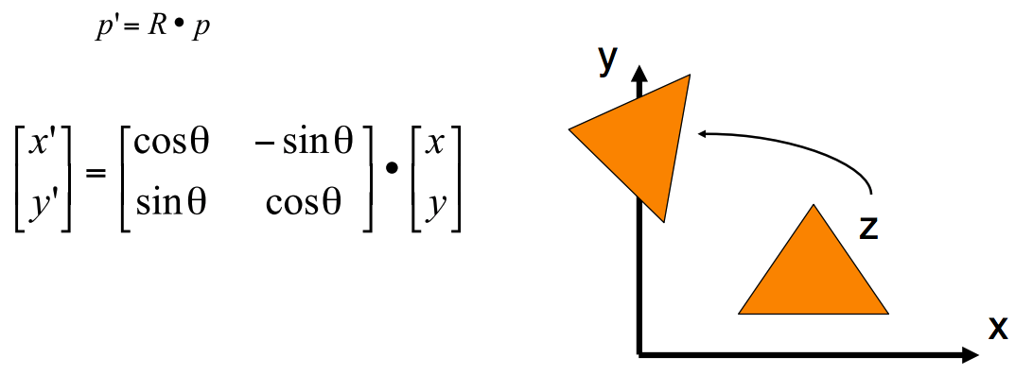
2D Transformations: Rotation
Inverse of any rotation matrix R is just R^{T}.

Slide 25
Transformation Matrices
Slide from Fei-Fei Li and Juan Carlos Niebles

Slide 26
Homogeneous Coordinates
Slide from Fei-Fei Li and Juan Carlos Niebles

Slide 27
Homogeneous Coordinates
Slide from Fei-Fei Li and Juan Carlos Niebles

Slide 28
2D Translation Using Homogeneous Coordinates
$$p^{′}=Tp$$
$\left[\begin{matrix}x′ \\ y′ \\ 1\end{matrix}\right]=\left[\begin{matrix}1 & 0 & t_{x} \\ 0 & 1 & t_{y} \\ 0 & 0 & 1\end{matrix}\right]$ $\left[\begin{matrix}x \\ y \\ 1\end{matrix}\right]$

Slide 29
2D Transformations: Scaling
$$p^{′}=Sp$$
$\left[\begin{matrix}x′ \\ y′ \\ 1\end{matrix}\right]=\left[\begin{matrix}s_{x} & 0 & 0 \\ 0 & s_{y} & 0 \\ 0 & 0 & 1\end{matrix}\right]$ $\left[\begin{matrix}x \\ y \\ 1\end{matrix}\right]$

Slide 30
2D Rotation Using Homogeneous Coordinates
$$p^{′}=Rp$$
$$\left[\begin{matrix}x′ \\ y′ \\ 1\end{matrix}\right]=\left[\begin{matrix}cosθ & −sinθ & 0 \\ sinθ & cosθ & 0 \\ 0 & 0 & 1\end{matrix}\right]\left[\begin{matrix}x \\ y \\ 1\end{matrix}\right]$$

Slide 31
3D Homogeneous Coordinates
Represent a 3D point as:
If last coordinate ends up non-one, convention is to divide by it:
$$\left[\begin{aligned}\begin{matrix}x \\ y\end{matrix} \\ z \\ 1\end{aligned}\right]$$
$$\left[\begin{aligned}\begin{matrix}x \\ y\end{matrix} \\ z \\ w\end{aligned}\right]=>\left[\begin{aligned}\begin{matrix}x/w \\ y/w\end{matrix} \\ z/w \\ 1\end{aligned}\right]$$

Slide 32
3D Homogeneous Coordinates
Translation by (t_{x}, t_{y}, t_{z}):
$$p^{′}=Tp$$
$\left[\begin{matrix}x^{′} \\ \begin{aligned}y^{′} \\ z^{′}\end{aligned} \\ 1\end{matrix}\right]=\left[\begin{matrix}1 & 0 & 0 & t_{x} \\ 0 & 1 & 0 & t_{y} \\ 0 & 0 & 1 & t_{z} \\ 0 & 0 & 0 & 1\end{matrix}\right]$ $\left[\begin{matrix}x \\ \begin{aligned}y \\ z\end{aligned} \\ 1\end{matrix}\right]$

Slide 33
3D Homogeneous Coordinates
Scaling by (s_{x}, s_{y}, s_{z}):
$$p^{′}=Sp$$
$\left[\begin{matrix}x^{′} \\ \begin{aligned}y^{′} \\ z^{′}\end{aligned} \\ 1\end{matrix}\right]=\left[\begin{matrix}s_{x} & 0 & 0 & 0 \\ 0 & s_{y} & 0 & 0 \\ 0 & 0 & s_{z} & 0 \\ 0 & 0 & 0 & 1\end{matrix}\right]$ $\left[\begin{matrix}x \\ \begin{aligned}y \\ z\end{aligned} \\ 1\end{matrix}\right]$

Slide 34
3D Homogeneous Coordinates
Rotation around z axis:
(Rotates counterclockwise in right-handed coordinate system when axis is pointed towards observer)
$$p^{′}=Rzp$$
$\left[\begin{matrix}x^{′} \\ \begin{aligned}y^{′} \\ z^{′}\end{aligned} \\ 1\end{matrix}\right]=\left[\begin{matrix}cosθ & −sinθ & 0 & 0 \\ sinθ & cosθ & 0 & 0 \\ 0 & 0 & 1 & 0 \\ 0 & 0 & 0 & 1\end{matrix}\right]$ $\left[\begin{matrix}x \\ \begin{aligned}y \\ z\end{aligned} \\ 1\end{matrix}\right]$

Slide 35
3D Homogeneous Coordinates
Rotation around x axis:
$$p^{′}=Rxp$$
$\left[\begin{matrix}x^{′} \\ \begin{aligned}y^{′} \\ z^{′}\end{aligned} \\ 1\end{matrix}\right]=\left[\begin{matrix}1 & 0 & 0 & 0 \\ 0 & cosθ & −sinθ & 0 \\ 0 & sinθ & cosθ & 0 \\ 0 & 0 & 0 & 1\end{matrix}\right]$ $\left[\begin{matrix}x \\ \begin{aligned}y \\ z\end{aligned} \\ 1\end{matrix}\right]$

Slide 36
3D Homogeneous Coordinates
Rotation around y axis:
$$p^{′}=Ryp$$
$\left[\begin{matrix}x^{′} \\ \begin{aligned}y^{′} \\ z^{′}\end{aligned} \\ 1\end{matrix}\right]=\left[\begin{matrix}cosθ & 0 & sinθ & 0 \\ 0 & 1 & 0 & 0 \\ −sinθ & 0 & cosθ & 0 \\ 0 & 0 & 0 & 1\end{matrix}\right]$ $\left[\begin{matrix}x \\ \begin{aligned}y \\ z\end{aligned} \\ 1\end{matrix}\right]$

Slide 37
Rotation Mathematics
Inverse of any rotation matrix R is just R^{T}.
Euler angles: any 3D rotation matrix R can be written as the composition of three rotation matrices about the three axes: R = R_{x}($θx$) R_{y}($θy$) R_{z}($θz$)
How many parameters for an arbitrary 3D rotation matrix?

Slide 38
Outline
Vectors and matrices
Operations
Solving linear systems
Representation in Python
Transformation matrices
2D
Homogeneous coordinates
3D
Camera transformations

Slide 39
Pinhole Camera
Center of Projection
Illustration by Steve Seitz

Slide 40
Perspective Transformation

Slide 41
Perspective Transformation

Slide 42
Perspective Transformation
Perspective projection is the result of projecting from a point in a 3D scene to a 2D pixel coordinate on a camera sensor.
In homogeneous coordinates:

Slide 43
Perspective Transformation
Perspective projection is the result of projecting from a point in a 3D scene to a 2D pixel coordinate on a camera sensor.
Often we do not care about the depth (“z”) associated with a given (x, y) pixel. So we can remove that row and write as a 3x4 matrix:

Slide 44
Combining Transformations
If we first translate (T), then scale (S), then rotate (R), then perspective project (P), we can model this as:
The transformations are applied in order from right to left.
Can use associativity to combine multiple transformations into a single transformation matrix M:
p' = P(R(S(Tp)))
p' = Mp= (PRST)p

Slide 45
Camera Matrices: Intrinsic and Extrinsic
Camera matrix: a 3x4 matrix that transforms from 3D scene points (x, y, z) to 2D screen points (x$′$/w$′$, y$′$/w$′$):
Intrinsic parameters model properties within the camera and lens: focal length, image sensor format, optical center.
Extrinsic parameters model the rotation and translation of a camera within a 3D scene.
$\left[\begin{matrix}x^{′} \\ y^{′} \\ w^{′}\end{matrix}\right]=\left[\begin{matrix}c_{11} & c_{12} & c_{13} & c_{14} \\ c_{21} & c_{22} & c_{23} & c_{24} \\ c_{31} & c_{32} & c_{33} & c_{34}\end{matrix}\right]$ $\left[\begin{matrix}x \\ \begin{aligned}y \\ z\end{aligned} \\ 1\end{matrix}\right]$

Slide 46
Camera Matrices: Intrinsic and Extrinsic
Can rewrite the camera matrix in terms of intrinsic and extrinsic parameters.
$α_{x}$, $α_{y}$ focal length in pixels, $γ$ skew between x and y axes (often zero), $u_{0}$, $v_{0}$ principal point (typically center of image).
$\left[\begin{matrix}x^{′} \\ y^{′} \\ w^{′}\end{matrix}\right]=K \left[\begin{matrix}R & t\end{matrix}\right]$ $\left[\begin{matrix}x \\ \begin{aligned}y \\ z\end{aligned} \\ 1\end{matrix}\right]$
K=$\left[\begin{matrix}α_{x} & γ & u_{0} \\ 0 & α_{x} & v_{0} \\ 0 & 0 & 1\end{matrix}\right]$
Intrinsic matrix

Slide 47
Camera Matrices: Intrinsic and Extrinsic
Can rewrite the camera matrix in terms of intrinsic and extrinsic parameters.
t: 3x1 vector representing origin of scene coordinate system represented in camera coordinates.
R: 3x3 rotation matrix that rotates from scene coordinates to camera coordinates.
$\left[\begin{matrix}x^{′} \\ y^{′} \\ w^{′}\end{matrix}\right]=K \left[\begin{matrix}R & t\end{matrix}\right]$ $\left[\begin{matrix}x \\ \begin{aligned}y \\ z\end{aligned} \\ 1\end{matrix}\right]$
Extrinsic parameters

Slide 48
Next classes…
Camera calibration
Stereo
Optical flow

