Slide 1
CS 4501: Introduction to
Computer Vision
Camera Calibration and Stereo Cameras
Connelly Barnes
Slides from Fei Fei Li, Juan Carlos Niebles, Jason Lawrence, Szymon Rusinkiewicz, David Dobkin, Adam Finkelstein, Tom Funkhouser

Slide 2
Outline
Camera calibration
Overview of 3D vision
Camera demos
Stereo cameras
  Epipolar geometry
  Parallel stereo cameras and rectification
Structure from motion: Photo Tourism

Slide 3
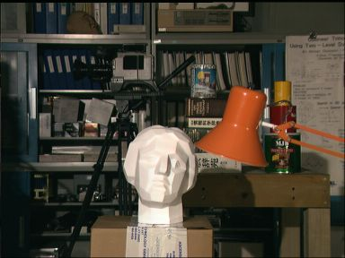
Camera Calibration
Determine mathematical relationship between points in 3D and their projection onto a 2D imaging plane
3D scene
imaging
device
2D image
[Tsukuba]

Slide 4
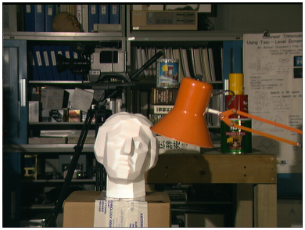
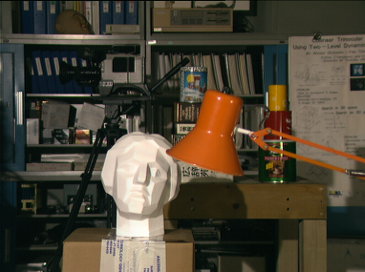
Stereo Vision

Slide 5
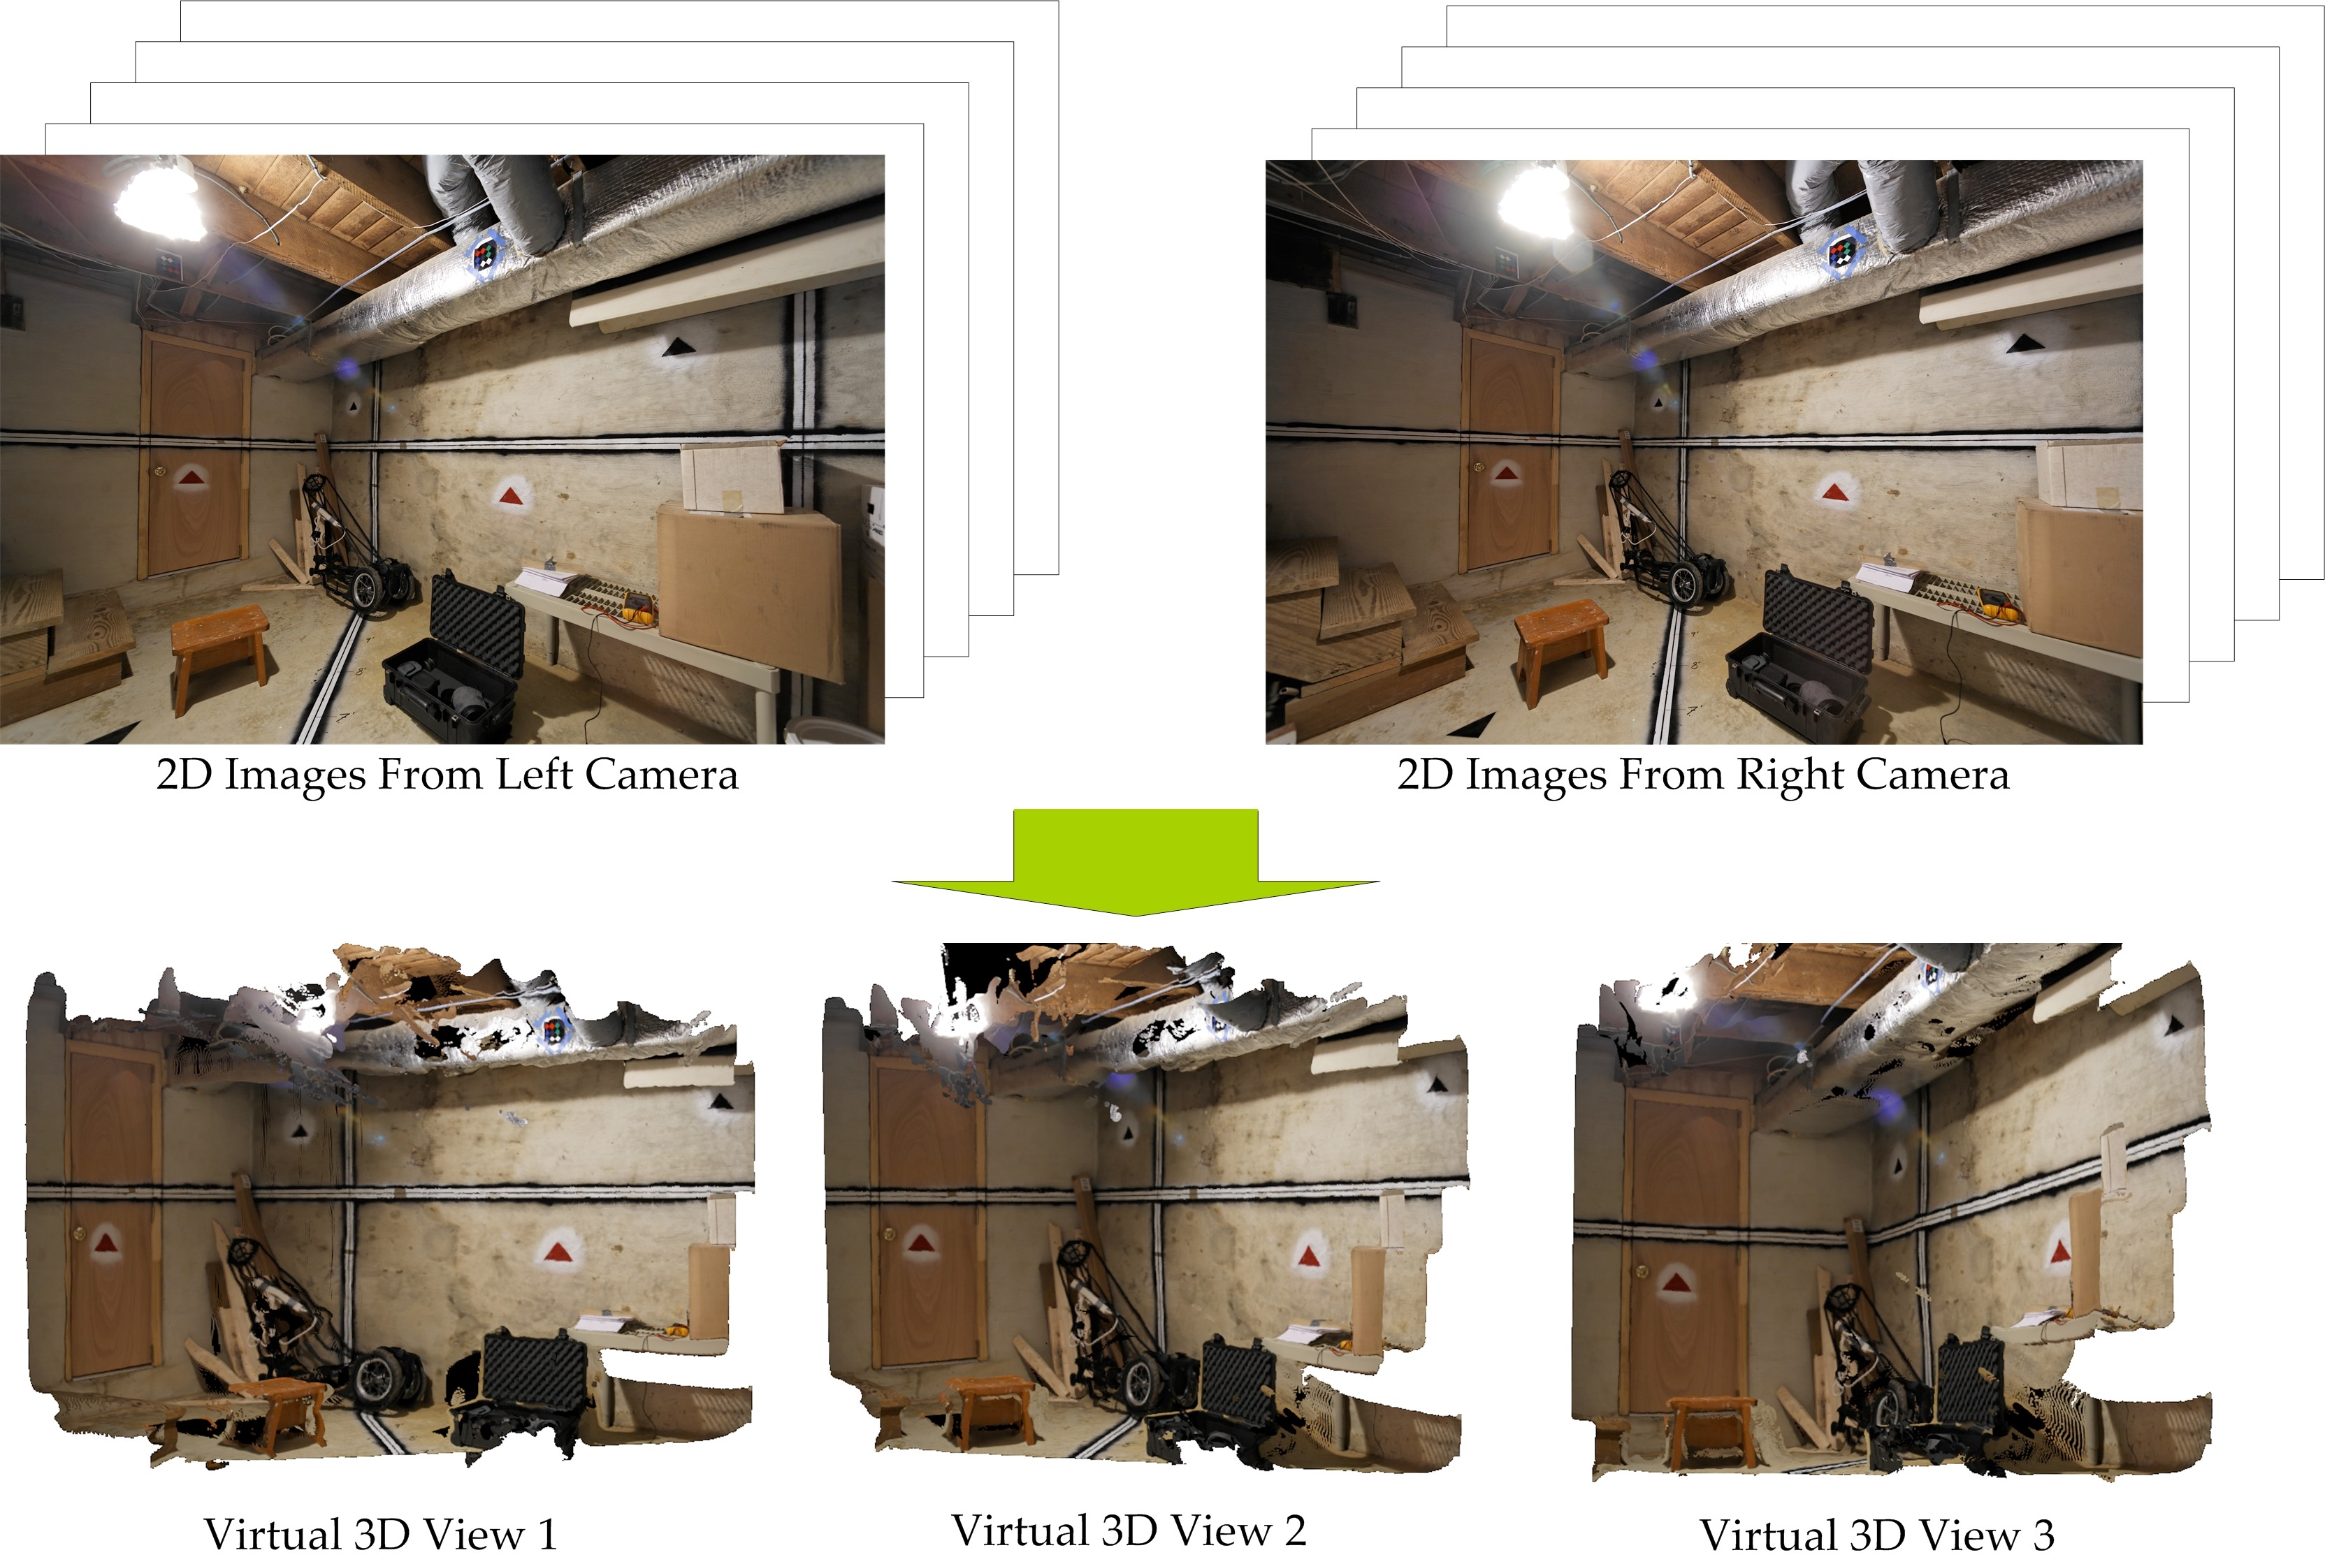
Principal Application: 3D Scene Reconstruction
[Zhu and Humphreys]

Slide 6
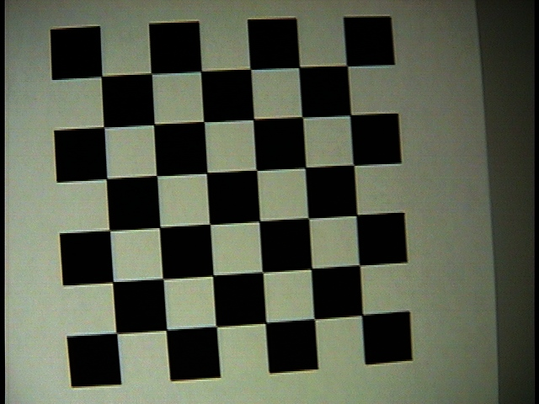
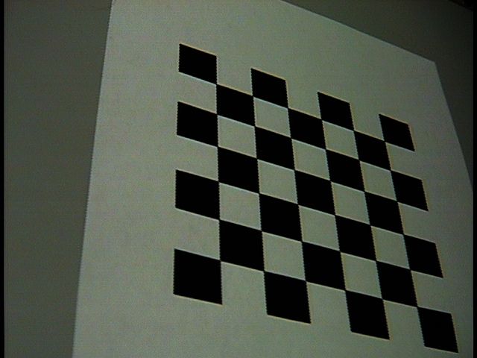
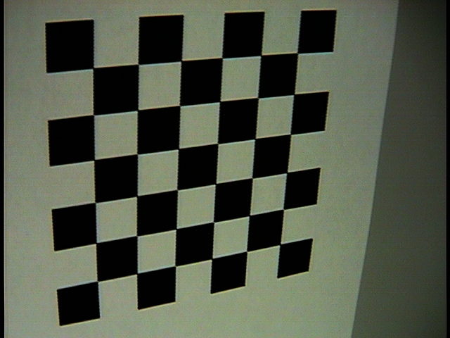
Camera Calibration
Take pictures of scene with known 3D structure and solve for free parameters in projection:
y
x
z

Slide 7
Camera Calibration
Need to address these issues:
  How do we model the way a camera projects 3D points onto a 2D image?
  How many parameters are involved in this projection and what is their relationship (linear/non-linear)?
  Which measurements/how many allow us to robustly estimate these parameters?

Slide 8

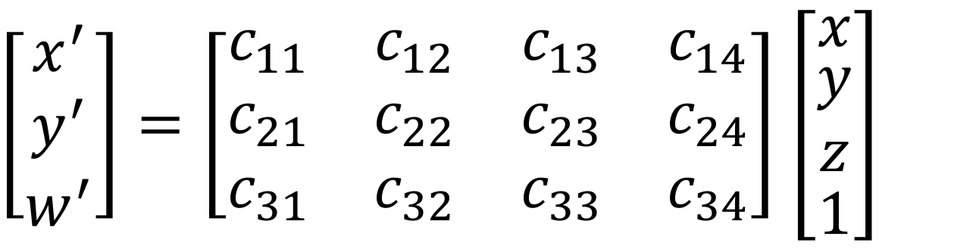
Pinhole Camera Model: Camera Matrix
Camera matrix: a 3x4 matrix that transforms from 3D scene points (x, y, z) to 2D screen points (x$′$/w$′$, y$′$/w$′$):
How many free parameters in the camera matrix?
$\left[\begin{matrix}x^{′} \\ y^{′} \\ w^{′}\end{matrix}\right]=\left[\begin{matrix}c_{11} & c_{12} & c_{13} & c_{14} \\ c_{21} & c_{22} & c_{23} & c_{24} \\ c_{31} & c_{32} & c_{33} & c_{34}\end{matrix}\right]$ $\left[\begin{matrix}x \\ \begin{aligned}y \\ z\end{aligned} \\ 1\end{matrix}\right]$

Slide 9
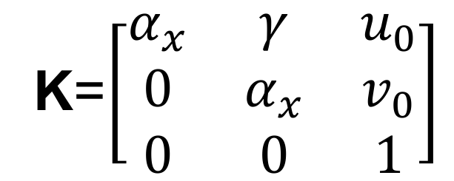
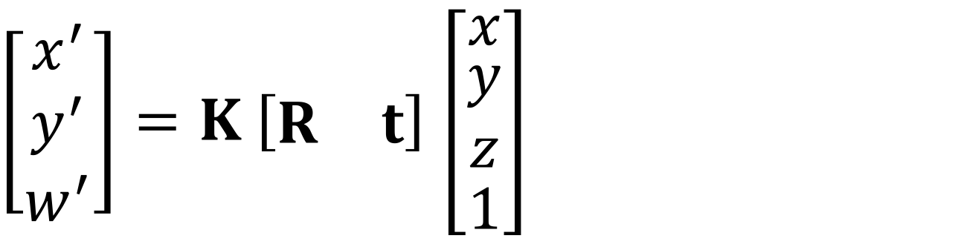
Pinhole Camera Model
Can rewrite the camera matrix in terms of intrinsic and extrinsic parameters.
How many intrinsic parameters?
How many extrinsic parameters?
How many parameters in total?
$\left[\begin{matrix}x^{′} \\ y^{′} \\ w^{′}\end{matrix}\right]=K \left[\begin{matrix}R & t\end{matrix}\right]$ $\left[\begin{matrix}x \\ \begin{aligned}y \\ z\end{aligned} \\ 1\end{matrix}\right]$
K=$\left[\begin{matrix}α_{x} & γ & u_{0} \\ 0 & α_{x} & v_{0} \\ 0 & 0 & 1\end{matrix}\right]$
Intrinsic matrix

Slide 10
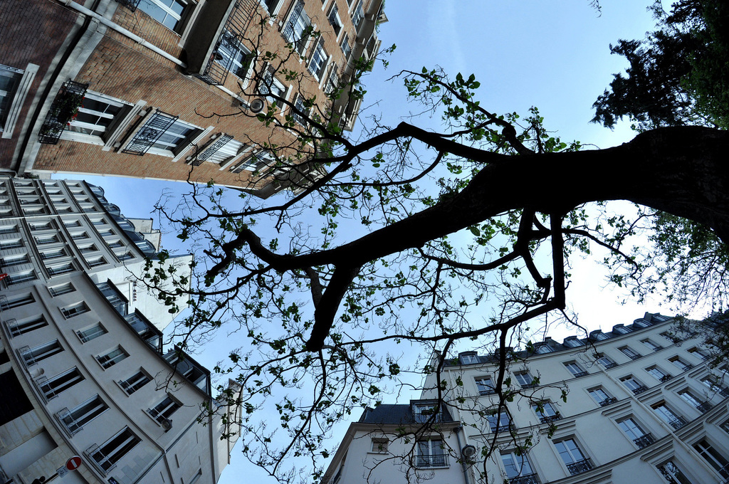
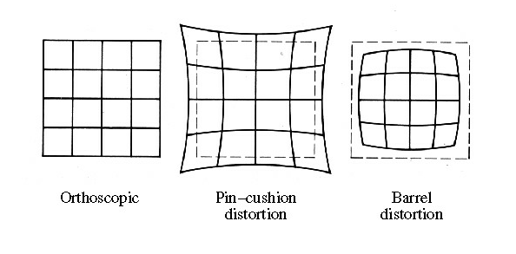
Real Camera Model: Radial Distortion
Photo by Renaud Leon, Creative Commons Licensed

Slide 11




Real Camera Model: Radial Distortion
These nonlinear effects cannot be represented by a matrix
Additional intrinsic
parameters (for more accuracy,
can also include r⁴, r⁶ terms)

Slide 12
Camera Calibration
Take pictures of scene with known 3D structure and solve for free parameters in projection:
y
x
z

Slide 13
Calibration Algorithms
Particular method used depends on:
  What data is available!
  Intrinsics only vs. extrinsics only vs. both
  Camera model being used (pinhole, weak-perspective, affine, etc.)

Slide 14

Camera Calibration: Example #1
Given:
  3D <=> 2D correspondences
  General pinhole camera model
  (11-parameter, no radial distortion)
Convert camera matrix into system of equations:
$\left[\begin{matrix}x^{′} \\ y^{′} \\ w^{′}\end{matrix}\right]=\left[\begin{matrix}c_{11} & c_{12} & c_{13} & c_{14} \\ c_{21} & c_{22} & c_{23} & c_{24} \\ c_{31} & c_{32} & c_{33} & c_{34}\end{matrix}\right]$ $\left[\begin{matrix}x \\ \begin{aligned}y \\ z\end{aligned} \\ 1\end{matrix}\right]$

Slide 15


Camera Calibration: Example #1
Known
3D
point 1
Convert camera matrix into system of equations:
$$u_{1}^{}=\frac{c_{11}x_{1}+c_{12}y_{1}+c_{13}z_{1}+c_{14}}{c_{31}x_{1}+c_{32}y_{1}+c_{33}z_{1}+c_{34}}$$
Known
screen
point 1
$$v_{1}^{}=\frac{c_{21}x_{1}+c_{22}y_{1}+c_{23}z_{1}+c_{24}}{c_{31}x_{1}+c_{32}y_{1}+c_{33}z_{1}+c_{34}}$$
.
.
.

Slide 16
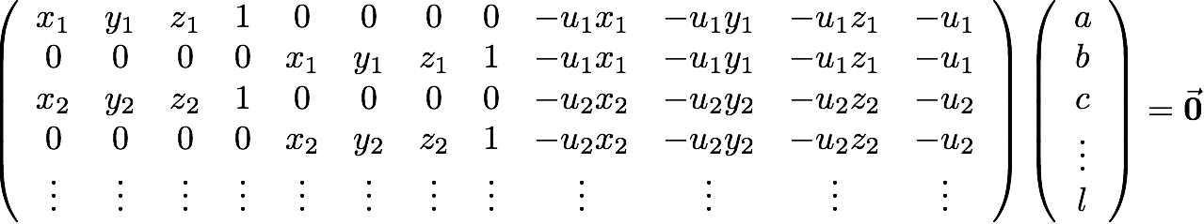
Camera Calibration: Example #1
Multiply by denominator to get linear system:
c₁₁
c₁₂
c₁₃
⋮
c₃₄

Slide 17
Camera Calibration: Example #1
Standard linear least squares methods for Ax=0 will give the solution x=0
Instead, look for solution with ||x||=1 (recall our solution is valid up to global scale)
That is, minimize ||Ax||² subject to ||x||² =1

Slide 18



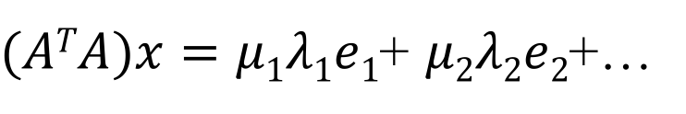
Camera Calibration: Example #1
$$ATAei=λiei$$
Eigenvector e_{i}, eigenvalue $λi$
$(ATA)x=μ1λ1e1$+ $μ2λ2e2$+…

Slide 19





Camera Calibration: Example #1
to minimize
subject to
set and all others to
Summary: least squares solution is eigenvector of corresponding to minimum eigenvalue

Slide 20
Camera Calibration: Example #1.5
Incorporating additional constraints into camera model
  No shear, no scale (rigid-body motion)
  Square pixels
These lead to nonlinear constraints on camera parameters

Slide 21
Camera Calibration: Example #1.5
Option 1: solve for general perspective model as before, then find closest solution that satisfies constraints
Option 2: nonlinear least squares
  Usually “gradient descent” techniques
  Common implementations available
  (e.g., MATLAB’s optimization toolbox, scipy.optimize.minimize)

Slide 22
Camera Calibration: Example #2
Incorporating radial distortion
Option 1:
  Find distortion first (use straight lines in calibration target)
  Warp image to eliminate distortion
  Run (simpler) perspective calibration
Option 2: nonlinear least squares

Slide 23
Camera Calibration in Practice
Camera Calibration with OpenCV
YouTube Video

Slide 24
camera calibration: example #4
what if 3D points are not known?
Structure from Motion!
unknowns: 3N + 6C (extrinsics only)
knowns: 2NC
overconstrained when: 2NC > 3N + 6C

Slide 25
multi-camera geometry
epipolar geometry - relationship between observed positions of points in multiple cameras
assumptions:
  2 cameras
  known intrinsics and extrinsics
  (i.e., fully calibrated rig)

Slide 26
Outline
Camera calibration
Overview of 3D vision (separate slide deck)
Camera demos
Stereo cameras
  Epipolar geometry
  Parallel stereo cameras and rectification
Structure from motion: Photo Tourism

Slide 27
Camera Demos
Demo of stereo camera (StereoLabs ZED camera)
Demo of structured light depth sensor (Kinect)
  What it looks like in the infrared spectrum
Demonstrate depth discontinuities / occlusions

Slide 28
Outline
Camera calibration
Overview of 3D vision (separate slide deck)
Camera demos
Stereo cameras
  Epipolar geometry
  Parallel stereo cameras and rectification
Structure from motion: Photo Tourism

Slide 29
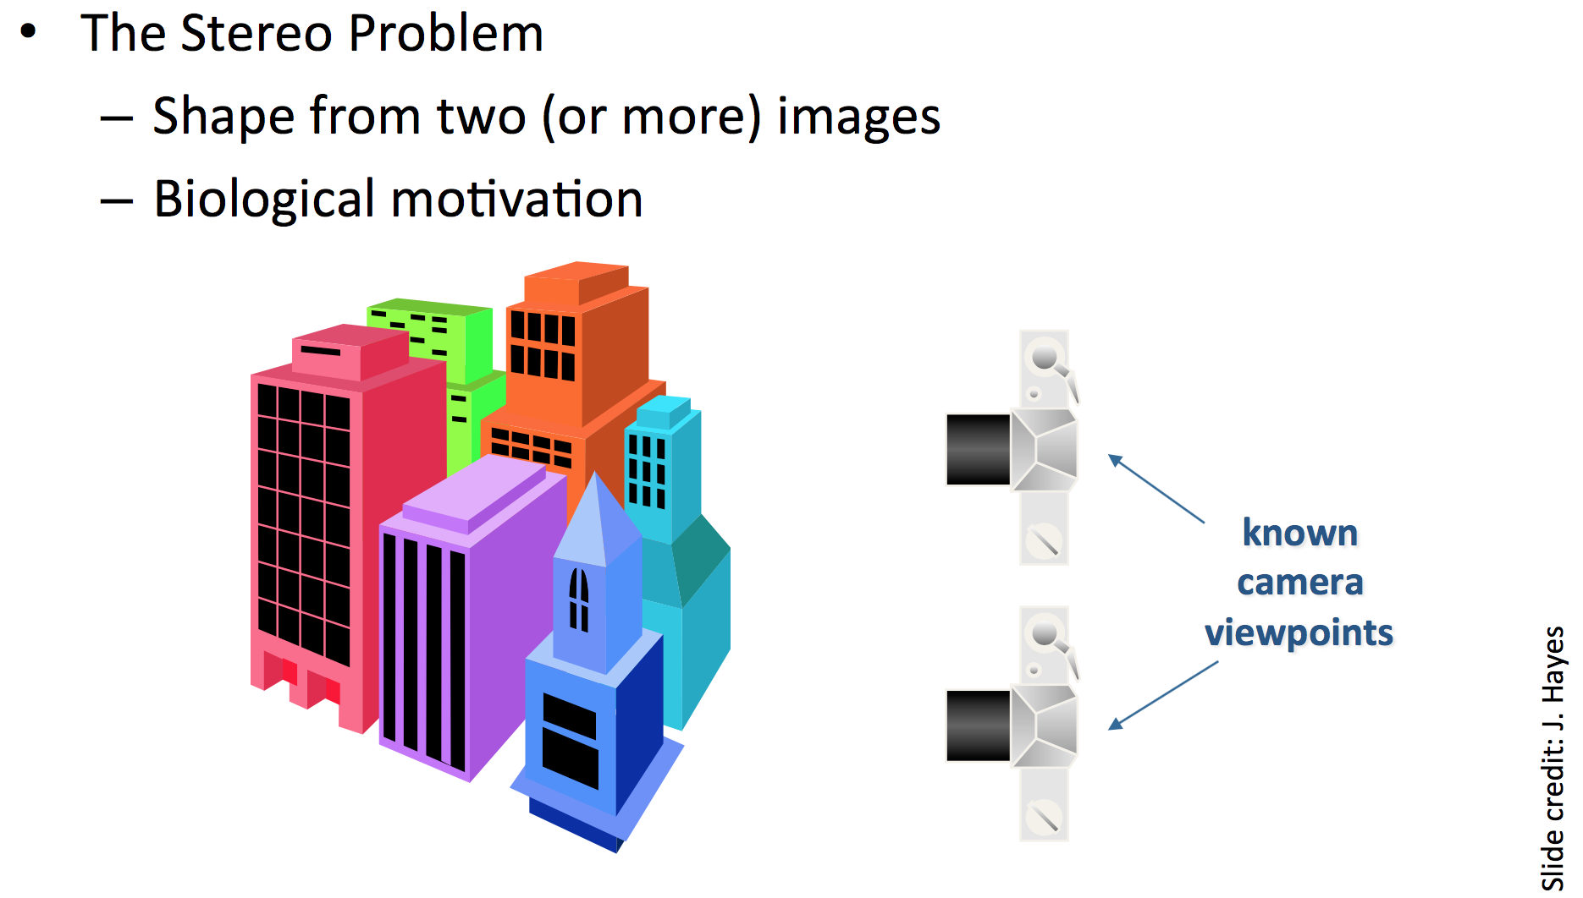
Stereo Matching

Slide 30
Slide from Jason Lawrence

Slide 31
Slide from Jason Lawrence

Slide 32
Slide from Jason Lawrence

Slide 33
Slide from Jason Lawrence

Slide 34
Slide from Jason Lawrence

Slide 35
Slide from Jason Lawrence

Slide 36
Slide from Jason Lawrence

Slide 37
Slide from Jason Lawrence

Slide 38
Slide from Jason Lawrence

Slide 39
Assumes normalized image coordinates:
  Measure coordinates in scene/world coordinate units (e.g. mm)
  Relative to the pinhole camera center.
Slide from Jason Lawrence

Slide 40
Slide from Jason Lawrence

Slide 41
Outline
Camera calibration
Overview of 3D vision (separate slide deck)
Camera demos
Stereo cameras
  Epipolar geometry
  Parallel stereo cameras and rectification
Structure from motion: Photo Tourism

Slide 42
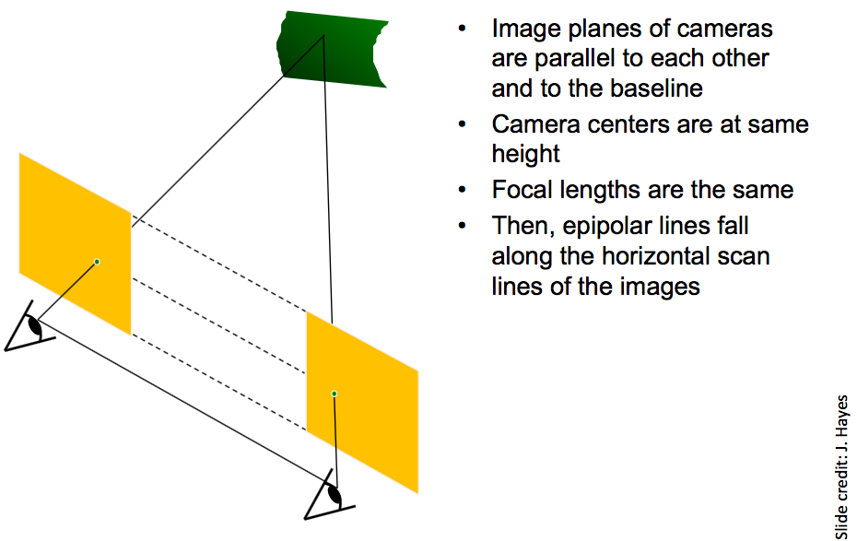
Parallel Stereo Cameras

Slide 43
Parallel Stereo Cameras

Slide 44
Parallel Stereo Cameras: Disparity
Disparity: displacement in pixels of the apparent motion of a 3D scene point as we switch between the left and right view of a stereo camera.
Examples from Middlebury stereo dataset
Discussion: how might this disparity information be useful?

Slide 45
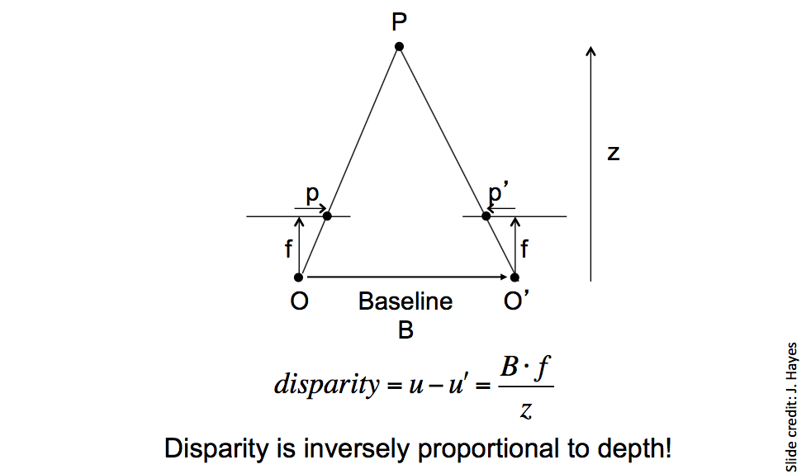
Parallel Stereo Cameras: Depth from Disparity

Slide 46
Stereo Correspondence Problem
Usually assume rectified (parallel, upright) cameras.
For each pixel in the left camera image, find its disparity
(x pixels displacement of the corresponding point in the right image).
  Dense matching
Edges, corners: easier.
Challenge: flat regions.
  How might we determine where a flat region went from a left image to a right image?

Slide 47
Stereo Correspondence Problem
Typical algorithmic approach described in Szeliski 11.3:
  Compute matching cost
  Aggregate matching costs
  Compute/optimize disparities
  (Optional) refine disparities

Slide 48
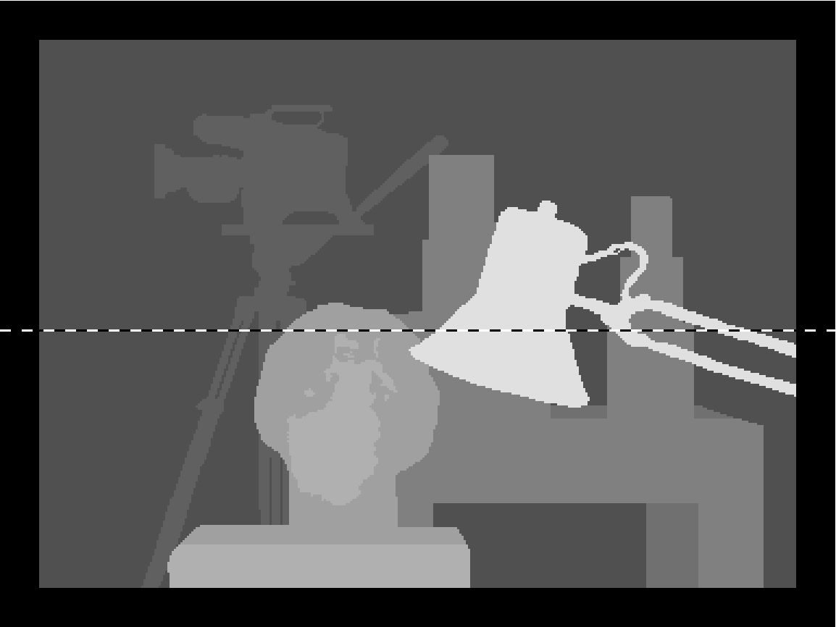
Stereo Correspondence Problem
From Scharstein and Szeliski 2002

Slide 49
Stereo Correspondence: Matching Cost
Disparity Space Image (DSI): A 3D array that measures at (x, y, d) the cost of assigning disparity d to pixel (x, y).
Typically a simple measure of dissimilarity such as sum of squared difference (SSD), or sum of absolute difference (SAD).

Slide 50
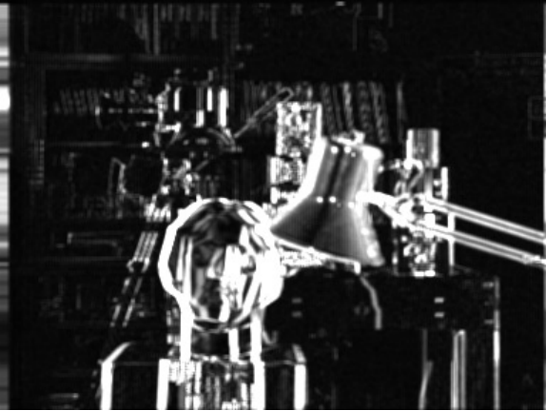
Stereo Correspondence: Matching Cost
Disparity Space Image (DSI): A 3D array that measures at (x, y, d) the cost of assigning disparity d to pixel (x, y).
From Scharstein and Szeliski 2002
(x, y) slice through the DSI for d = 10

Slide 51
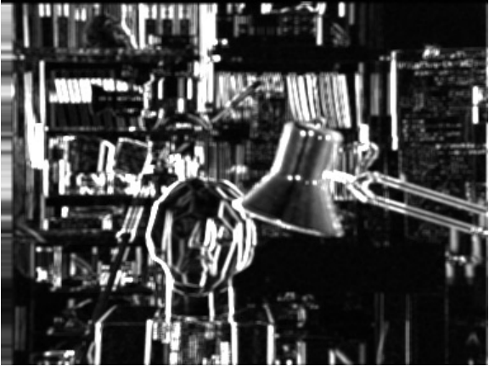
Stereo Correspondence: Matching Cost
Disparity Space Image (DSI): A 3D array that measures at (x, y, d) the cost of assigning disparity d to pixel (x, y).
From Scharstein and Szeliski 2002
(x, y) slice through the DSI for d = 16

Slide 52
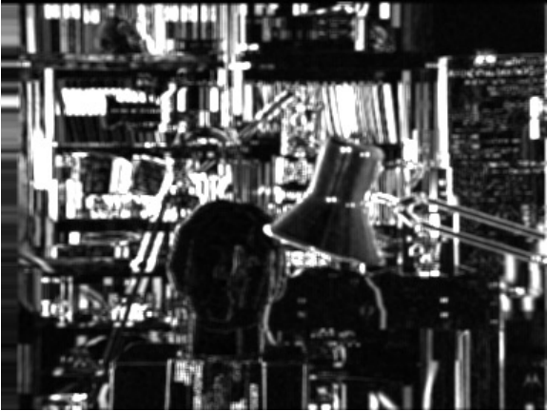
Stereo Correspondence: Matching Cost
Disparity Space Image (DSI): A 3D array that measures at (x, y, d) the cost of assigning disparity d to pixel (x, y).
From Scharstein and Szeliski 2002
(x, y) slice through the DSI for d = 21

Slide 53
Stereo Correspondence: Matching Cost
Disparity Space Image (DSI): A 3D array that measures at (x, y, d) the cost of assigning disparity d to pixel (x, y).
From Scharstein and Szeliski 2002
(x, d) slice through the DSI

Slide 54
Stereo Correspondence Problem
From Scharstein and Szeliski 2002

Slide 55
Stereo Correspondence: Aggregation
Disparity Space Image (DSI): A 3D array that measures at (x, y, d) the cost of assigning disparity d to pixel (x, y).
Convolve DSI with 2D or 3D filter to aggregate information.
Simple example: convolve with 2D Gaussian with given σ
  Larger window size: better handling of flat regions
  Smaller window size: better detail, depth discontinuities
Compute disparities:
  Choose at each pixel disparity d with min cost after aggregation
More advanced methods reviewed in Szeliski 11.3, 11.4

Slide 56
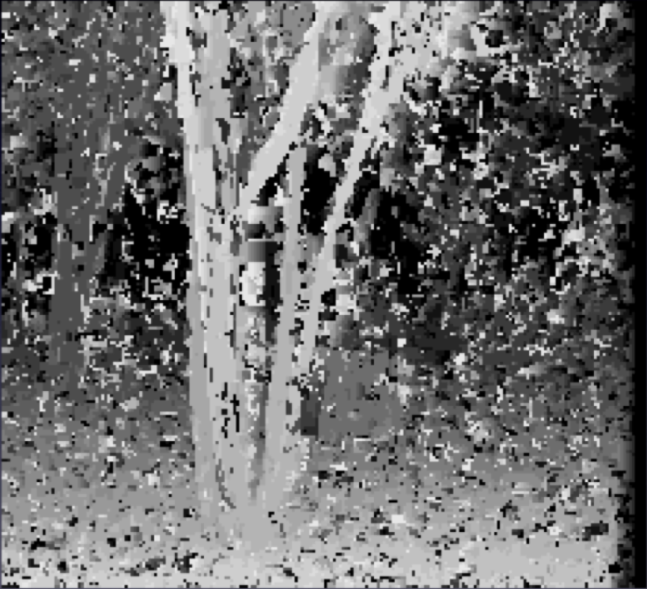
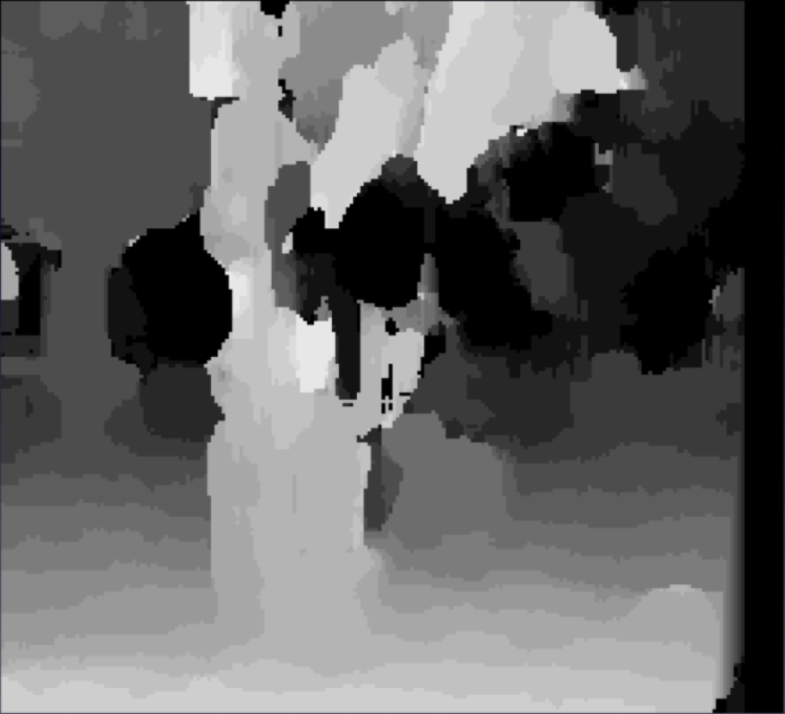
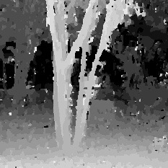
Stereo Correspondence: Window Size (or σ)
3 pixel window
20 pixel window
Nonlinear Diffusion
From Scharstein and Szeliski, 1996

Slide 57
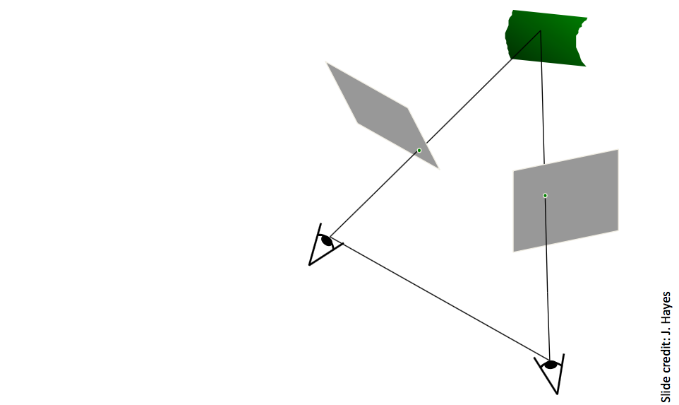
Stereo Rectification

Slide 58
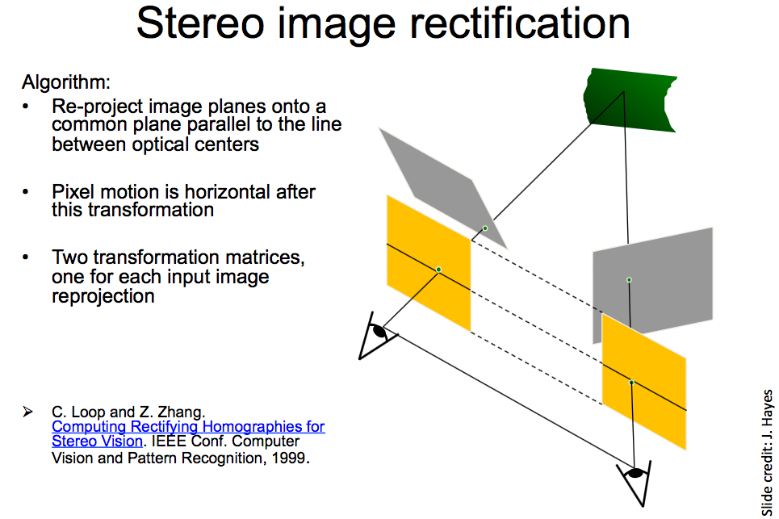
Stereo Rectification

Slide 59
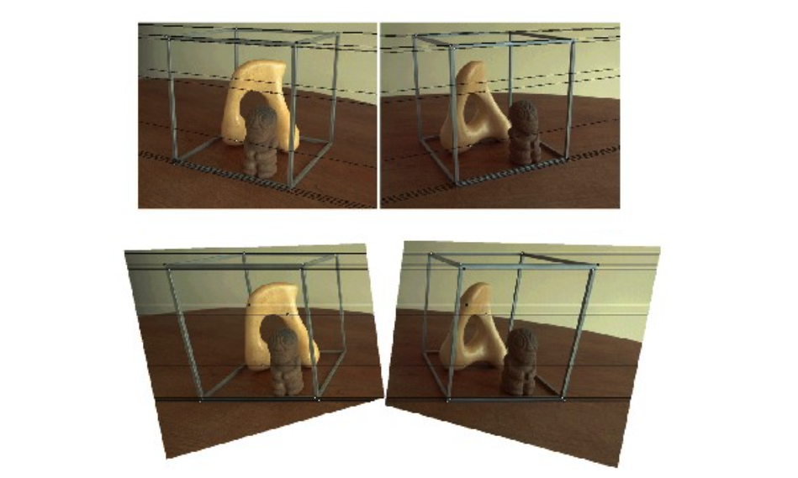
Stereo Rectification

Slide 60
Applications
Depth from Stereo (YouTube)
3D Reconstruction from Stereo (YouTube)

Slide 61
Implementation in OpenCV
OpenCV includes:
  Camera calibration
  Epipolar geometry
  Stereo rectification
  Finding stereo correspondences using block matching
  …

Slide 62
Outline
Camera calibration
Overview of 3D vision (separate slide deck)
Camera demos
Stereo cameras
  Epipolar geometry
  Parallel stereo cameras and rectification
Structure from motion: Photo Tourism

