Slide 1
Overview of 3D Computer Vision
Slides by Connelly Barnes, Jason Lawrence, Szymon Rusinkiewicz
CS 4501

Slide 2
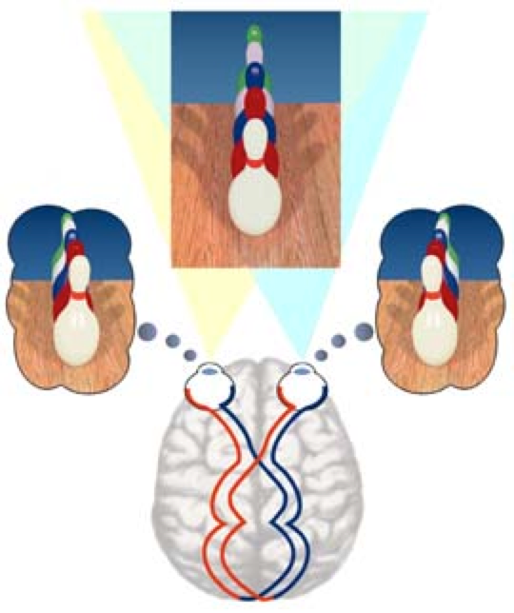
3D perception: stereo

Slide 3
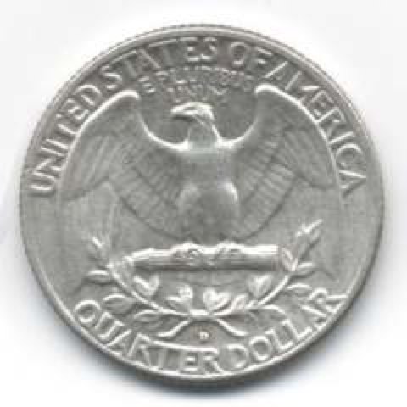
3D perception: stereo
experiments show that absolute depth estimation not very accurate
low “relief” judged to be deeper than it is
relative depth estimation very accurate
can judge which object is closer for stereo disparities of a few seconds of arc

Slide 4
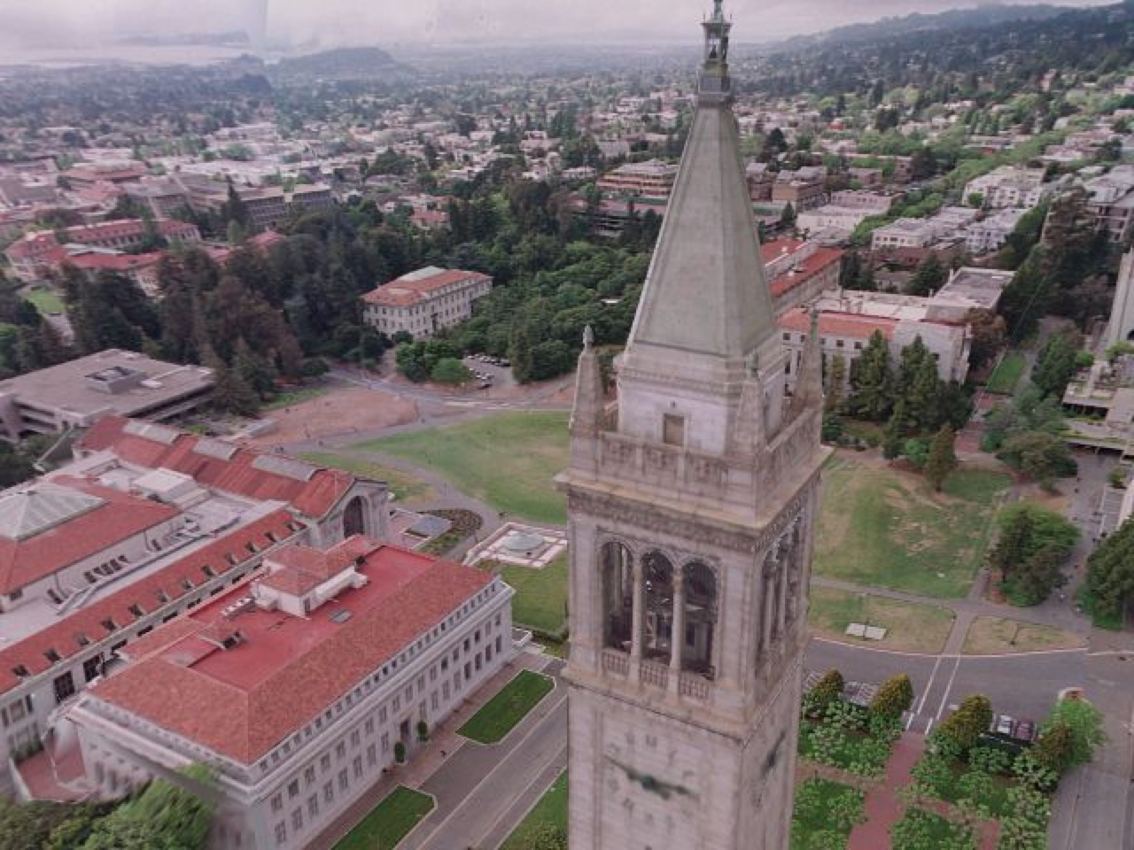
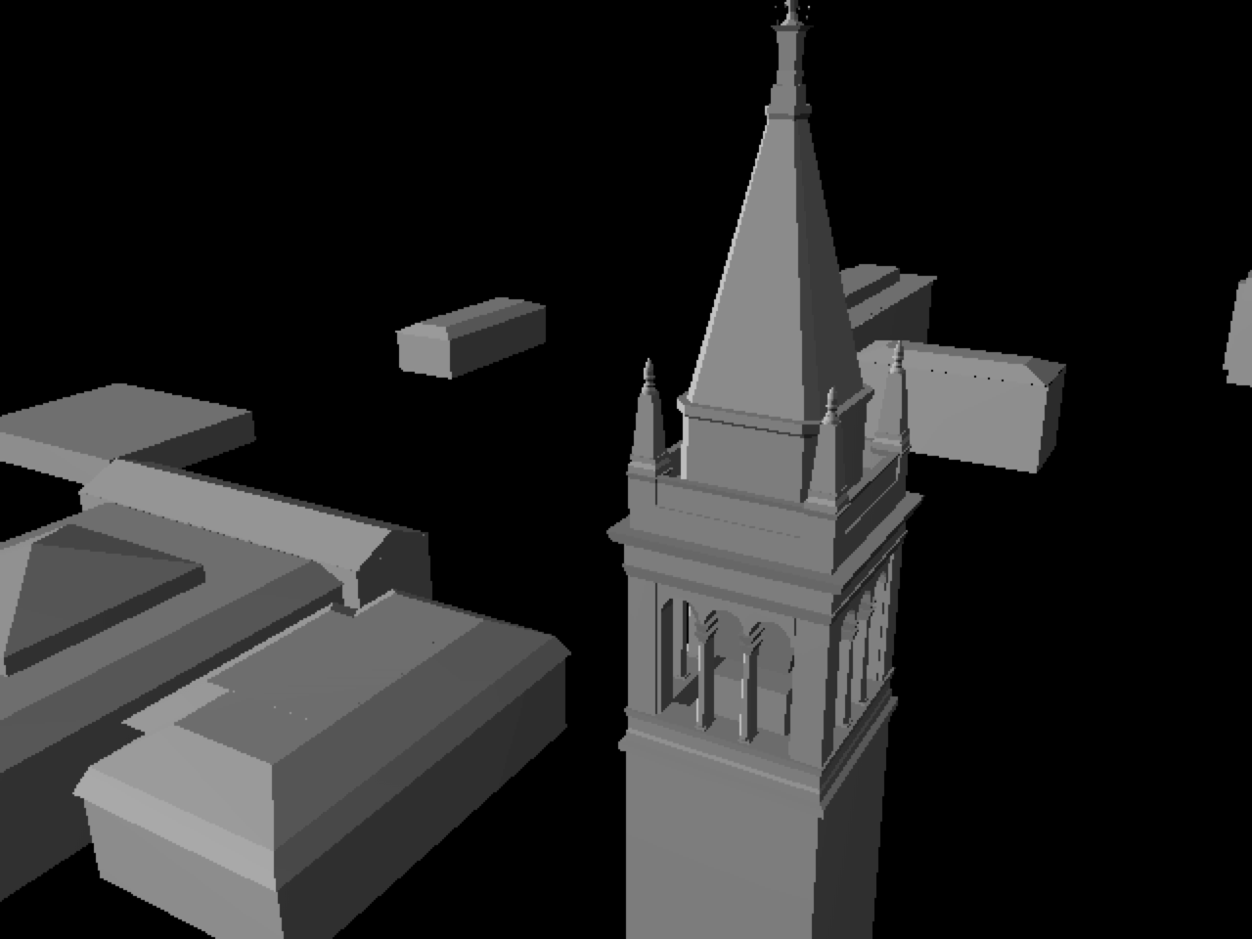
3D computer vision
recover representation of 3D shapes from (primarily) images:
[Debevec et al.]

Slide 5
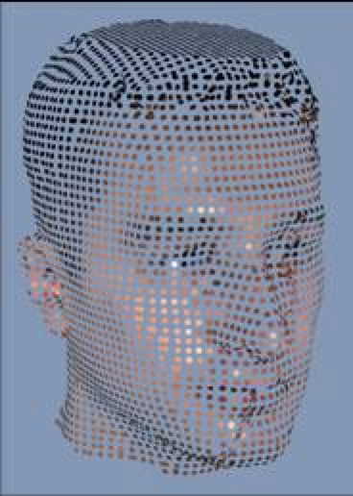
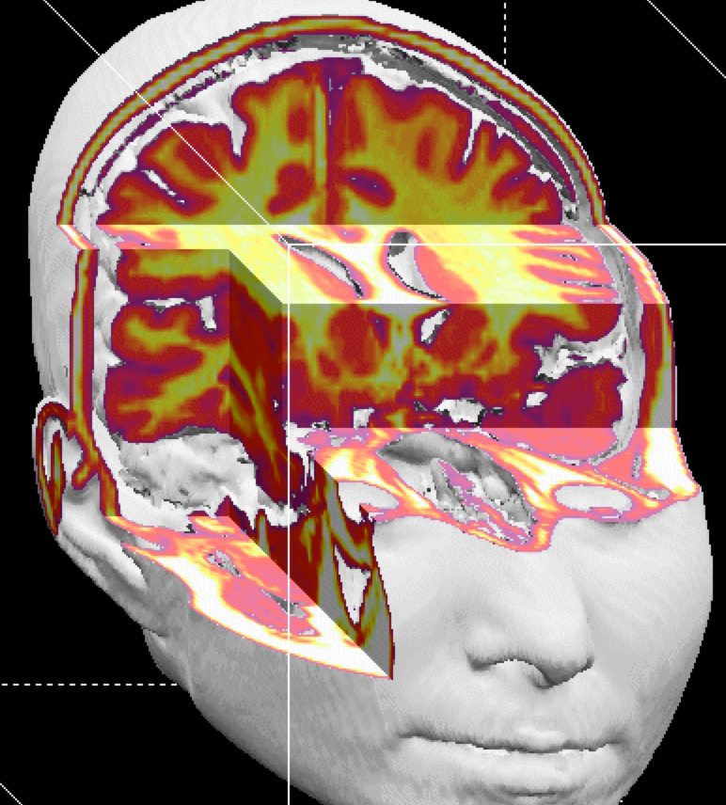
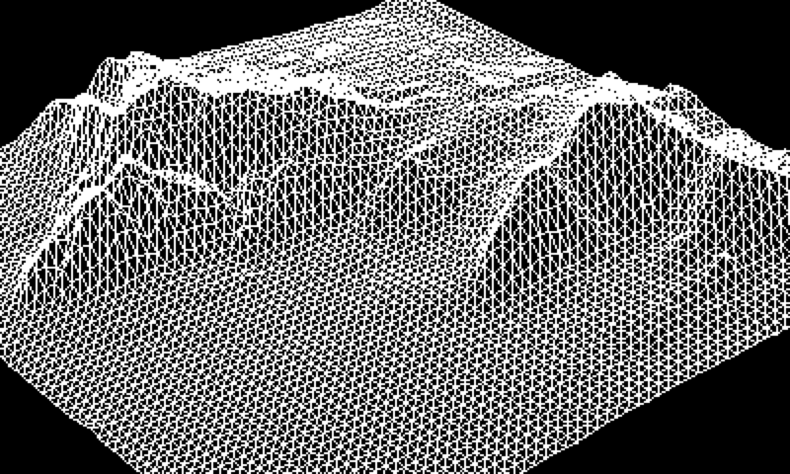
3D data types
point data
volumetric data
surface data

Slide 6
3D data types: point data
“point clouds”
advantage: simplest data type
disadvantage: no information on adjacency/connectivity

Slide 7
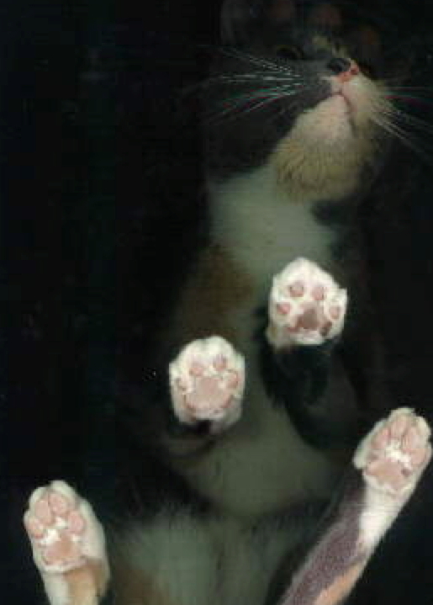
3D data types: volumetric data
regularly-spaced grid in (x,y,z): “voxels”
for each grid cell, store
occupancy (binary: occupied/empty)
density
other properties
popular in medical imaging
CAT scans
MRI

Slide 8
3D data types: volumetric data
advantages:
can “see inside” objects
uniform sampling: simpler algorithms
disadvantages:
lots of data
wasteful if only storing surface
most “vision” sensors / algorithms return point or surface data

Slide 9
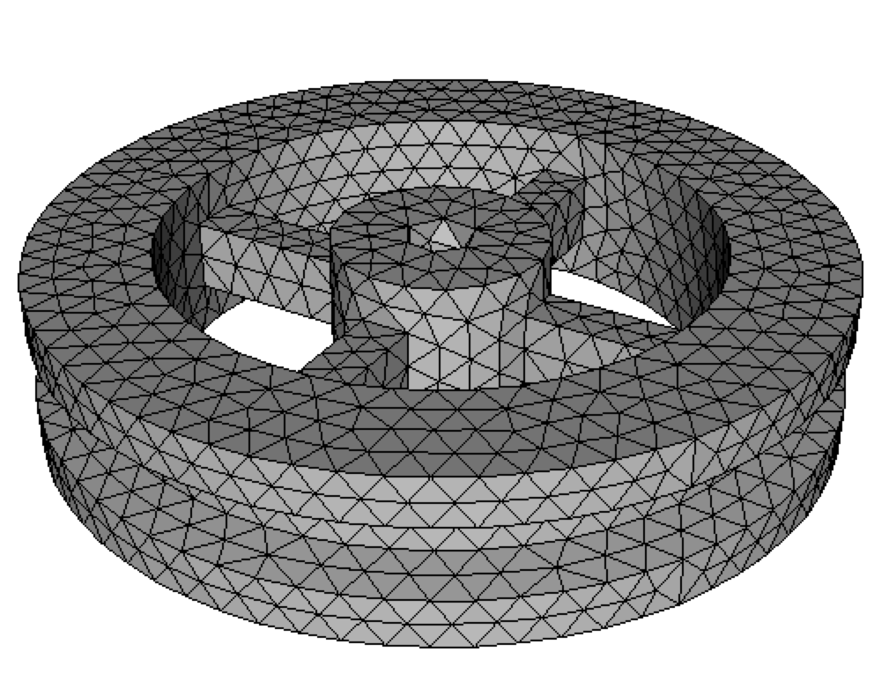
3D data types: surface data
polyhedral
piecewise planar
polygons connected together
most popular: “triangle meshes”
smooth
higher-order (quadratic, cubic, etc.) curves
Bezier patches, splines, NURBS, subdivision surfaces, etc.

Slide 10
3D data types: surface data
advantages:
preserves adjacency information
usually returned by vision sensors / algorithms
disadvantages:
difficult to define for translucent objects
non-uniform parameterization
non-topology-preserving algorithms difficult

Slide 11
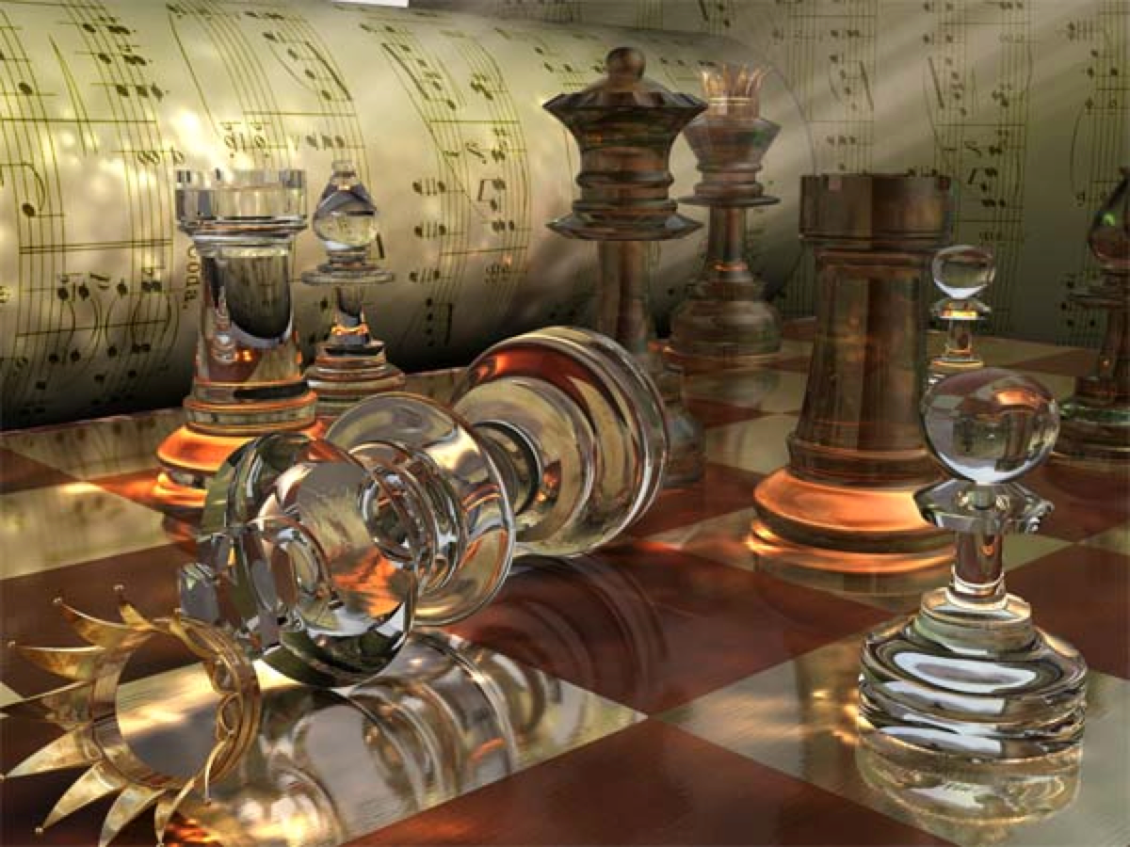
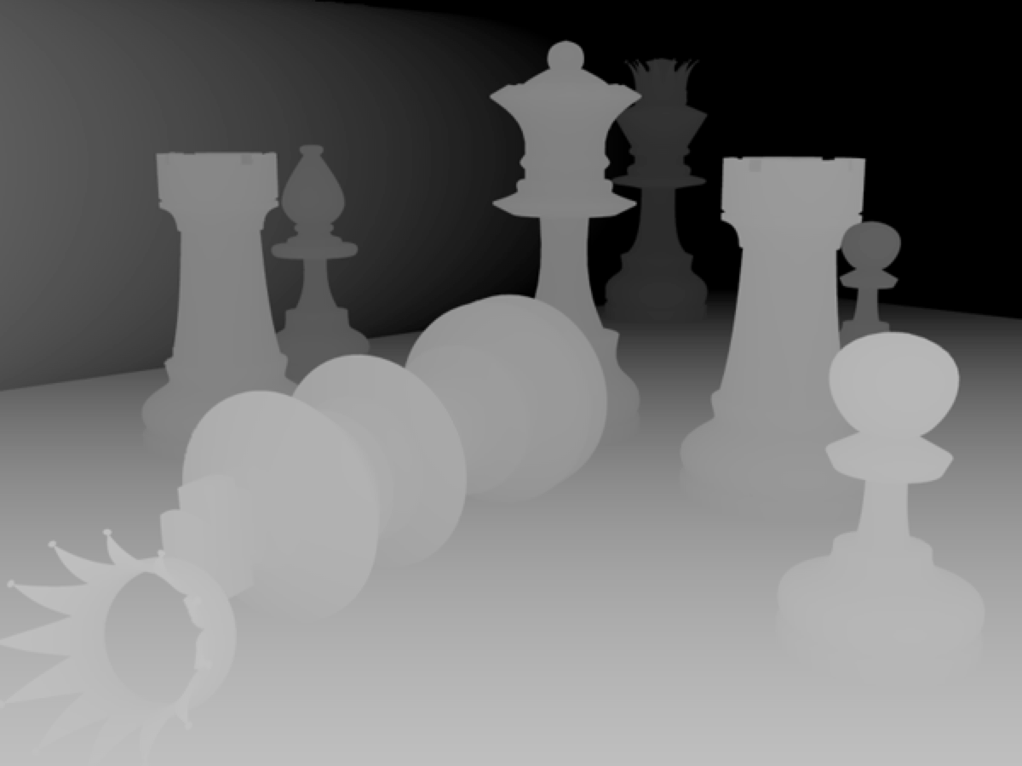
2.5-D data
color along each ray
depth along each ray
http://www.ixbt.com

Slide 12
2.5-D data
image: stores an intensity / color along each set of regularly-spaced rays in space
range images: stores a depth along each of a set of regularly-spaced rays in space
not a complete 3D description: does not store objects occluded (from some view)
view-dependent scene description

Slide 13
2.5-D data
this is what most sensors / algorithms actually return
advantages:
uniform parameterization
adjacency / connectivity information
disadvantages:
does not represent entire object
view dependent

Slide 14
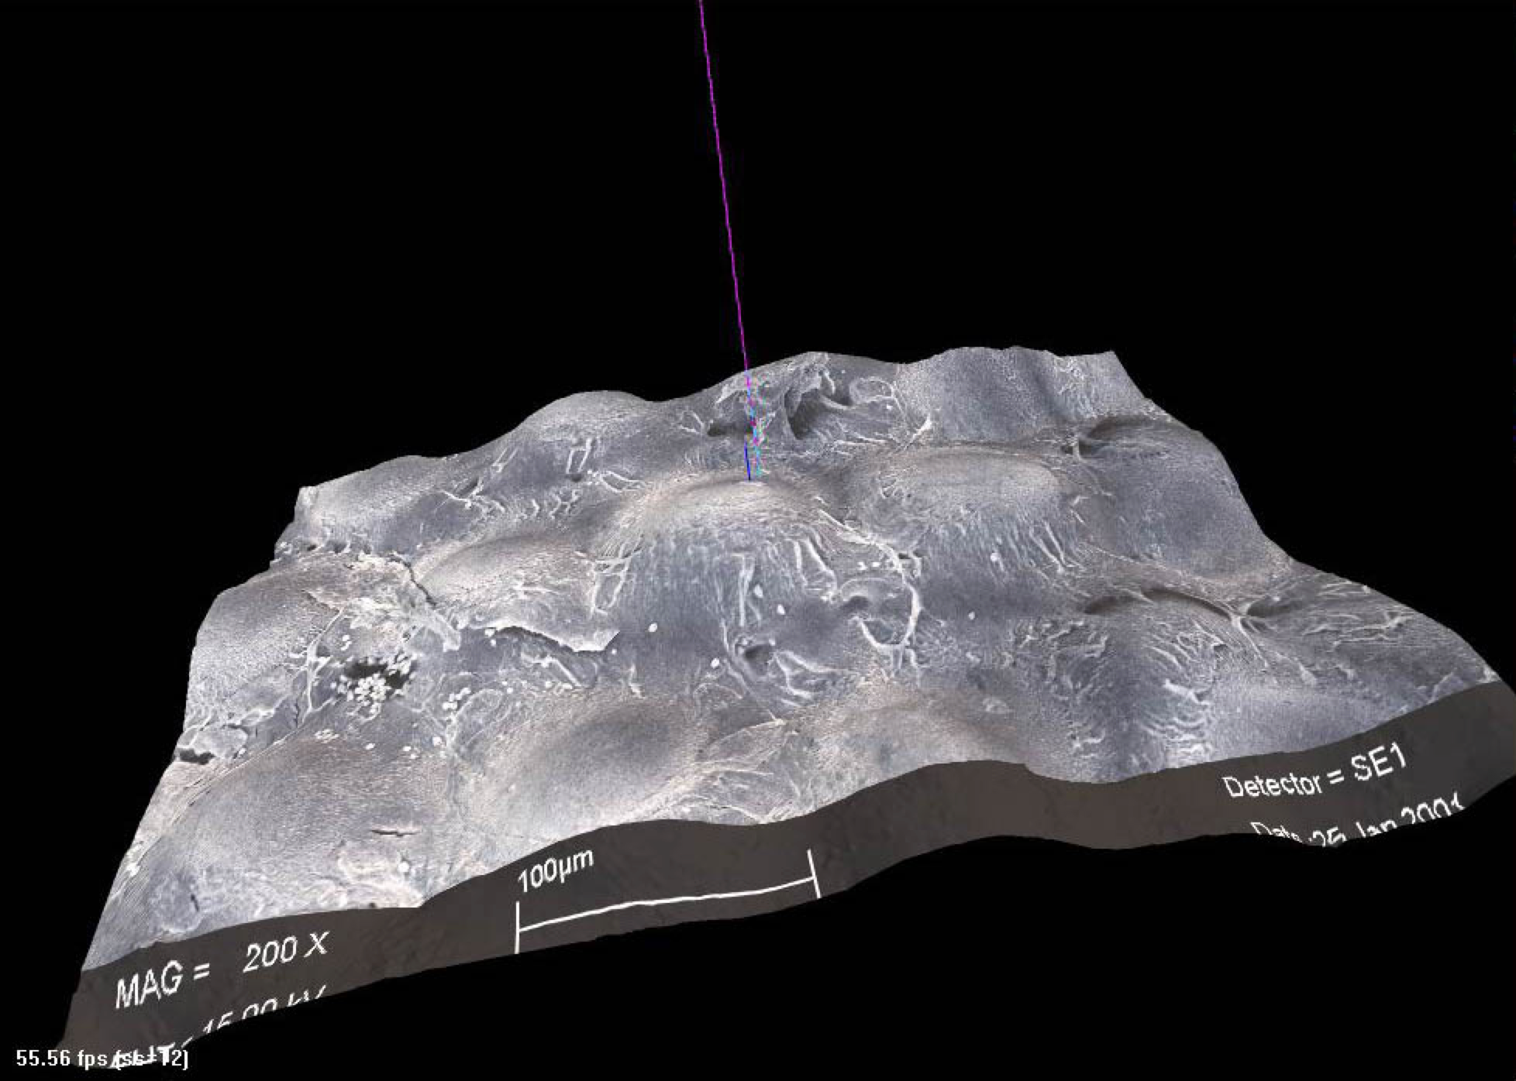
2.5-D data
range images
range surfaces
depth images
depth maps
height fields
2.5-D images
surface profiles
xyz maps
...

Slide 15
range acquisition taxonomy
Mechanical (CMM, jointed arm)
Inertial (gyroscope, accelerometer)
Contact
Ultrasonic trackers
Magnetic trackers
Industrial CT
Range acquisition
Transmissive
Ultrasound
MRI
Radar
Non-optical
Reflective
Sonar
Optical

Slide 16
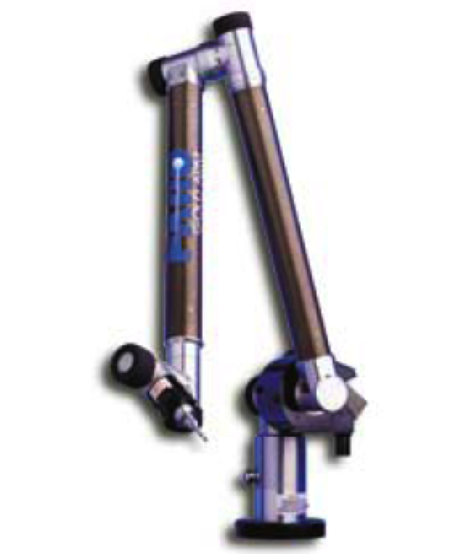
touch probes
jointed arms with angular encoders
return position, orientation of tip
Faro Arm - Faro Technologies, Inc.

Slide 17
range acquisition taxonomy
Shape from X:
stereo
motion
shading
texture
focus
defocus
Passive
Optical methods
Active variants of passive methods
Stereo w. projected texture
Active depth from defocus
Photometric stereo
Active
Time of flight
Triangulation

Slide 18
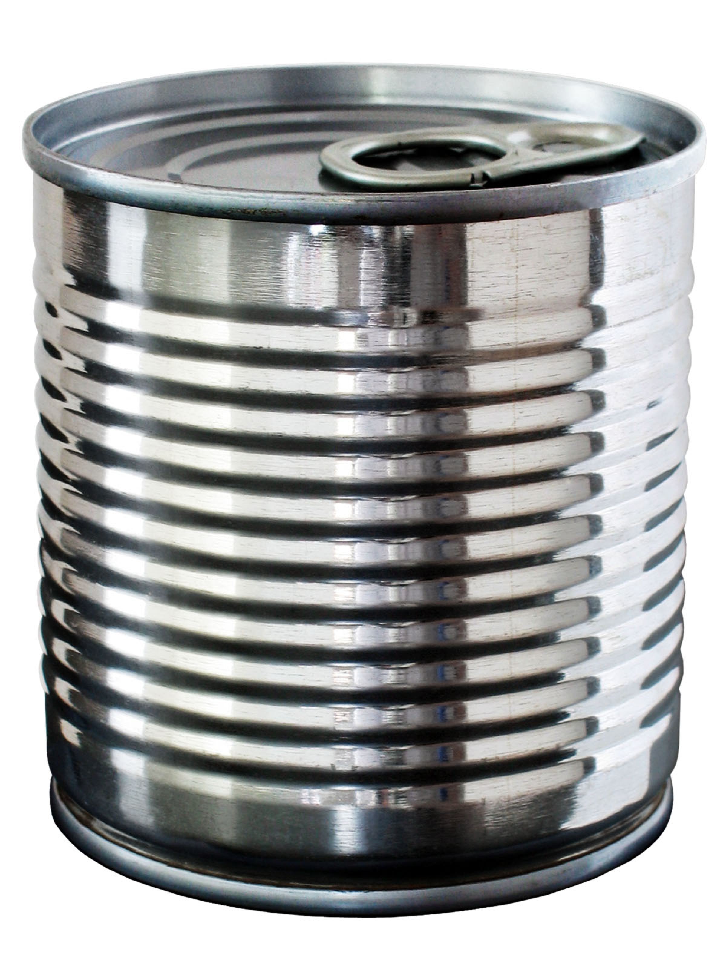
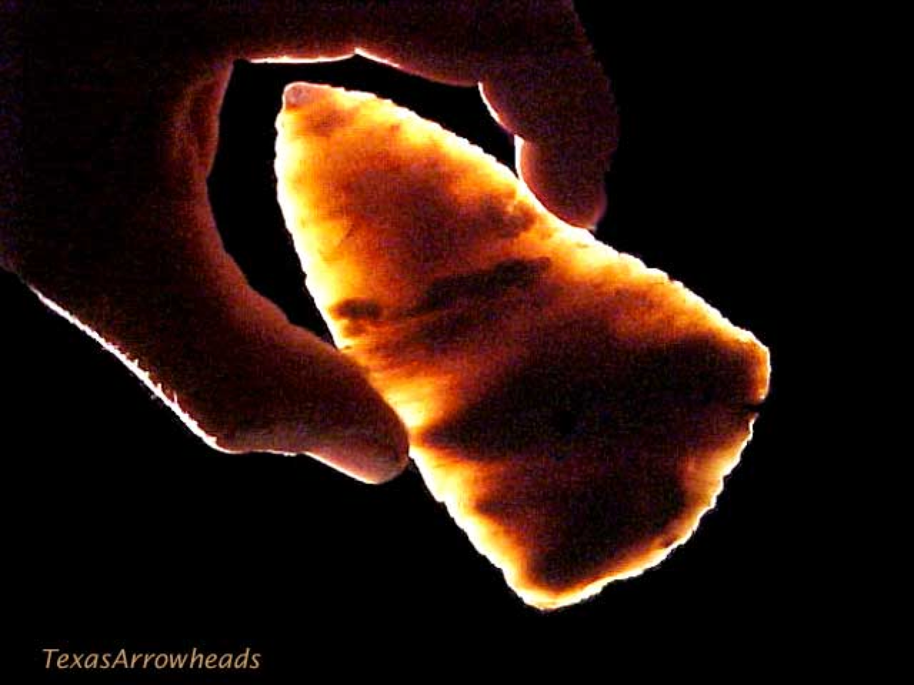
optical range acquisition methods
advantages:
non-contact
safe
usually inexpensive
usually fast
disadvantages:
sensitive to transparency
confused by specularity and interreflection
texture (helps some methods, hurts others)

Slide 19
stereo
find feature in one image, search for corresponding feature in other image:

Slide 20
stereo
advantages:
passive
cheap hardware (2 cameras)
intuitive analogue to human vision
disadvantages:
only acquire good data at “features”
sparse, relatively noisy data (correspondence is hard)
bad around silhouettes
confused by non-diffuse surfaces
variant: incorporate multiple cameras into multibaseline stereo to reduce ambiguity

Slide 21
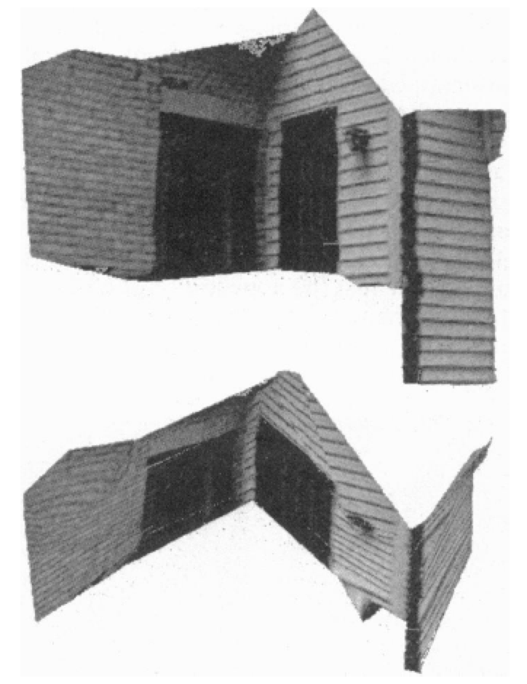
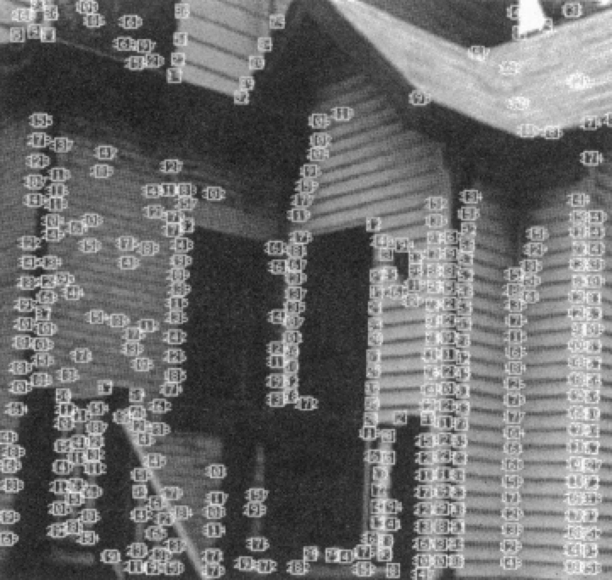
shape (structure) from motion
“limiting case” of multibaseline stereo
track a feature in a sequence of images
for N frames and F features have 2NF knowns and 6N+3F unknowns
[Tomasi and Kanade]

Slide 22
shape (structure) from motion
advantages:
feature tracking easier than correspondence in far-away views
mathematically more stable (large baseline)
disadvantages:
does not accommodate object motion
still problems in areas of low texture, non-diffuse regions, and around silhouettes

Slide 23
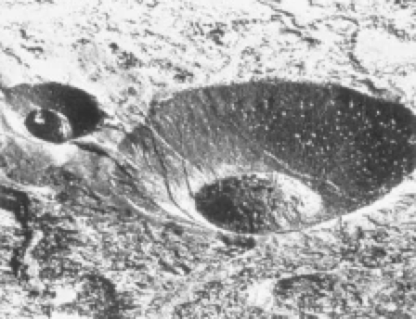
shape from shading
problem: ambiguity
[Pentland]

Slide 24
shape from shading
advantages:
single image
no correspondences
analogue in human vision
disadvantages:
mathematically unstable
can’t have texture
“photometric stereo” (active method) more practical than passive version

Slide 25
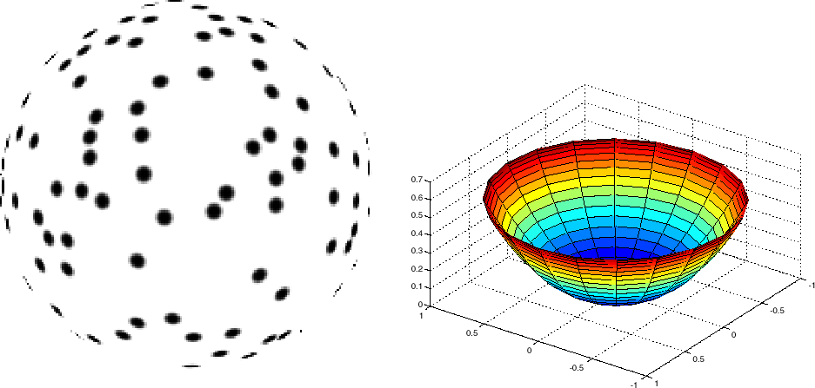
shape from texture
mathematically similar to shape from shading, but uses distortion of texture

Slide 26
shape from texture
analogue to human vision
same disadvantage as shape from shading

Slide 27
shape from focus
shape from focus: at which focus setting is a given image region sharpest?
shape from defocus: how out-of-focus is each image region?
passive versions rarely used
active depth from defocus can be made practical

Slide 28
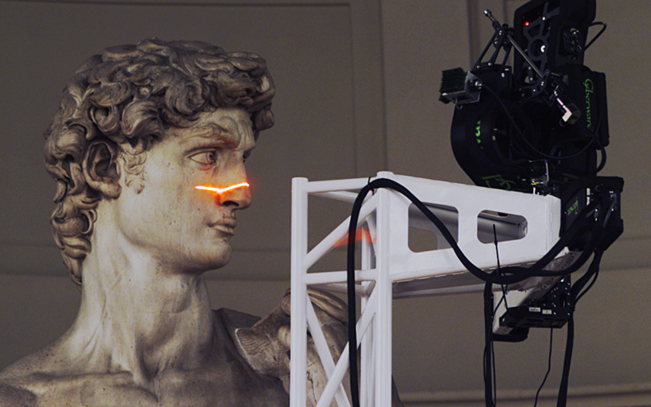
active optical methods
advantages:
can usually obtain dense data
usually much more robust and accurate than passive techniques
disadvantages:
introduces light into the scene
not motivated by human vision
[Digital Michaelangelo Project]

Slide 30
terminology
range acquisition, shape acquisition, rangefinding, range scanning, 3D scanning
alignment, registration
surface reconstruction, 3D scan merging, scan integration, surface extraction
3D model acquisition

