Slide 1
CS 4501: Introduction to Computer Vision Basics of Machine Learning
Connelly Barnes

Slide 2
Overview
Supervised and unsupervised learning
Simple learning models
Clustering
Linear regression
Linear Support Vector Machines (SVM)
k-Nearest Neighbors
Overfitting and generalization
Training, testing, validation
Balanced datasets
Measuring performance of a classifier

Slide 3
Supervised, Unsupervised
Supervised learning: computer presented with example inputs and desired outputs by a “teacher”, goal is to learn general rule that maps inputs to outputs.
Unsupervised learning: No output labels are given to the algorithm, leaving it on its own to find structure in the inputs.

Slide 4
Classification and Regression
Classifier: identify to which discrete set of categories an observation belongs. e.g. classify an email as “spam” or “non-spam.”
Regressors: predict a continuous quantity such as height (meters).

Slide 5
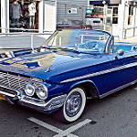
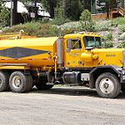
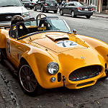
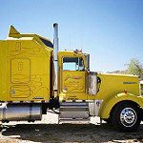
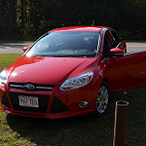
What Kind of Learning is This?
Learn given input image, whether it is truck or car? Training data:
Label(
) = Truck
Label(
) = Car
Label(
) = Truck
Label(
) = Car
Label(
) = Truck
Label(
) = Car
Images are Creative Commons, sources: [1], [2], [3], [4], [5], [6]

Slide 6
What Kind of Learning is This?
We have a dataset of customers, each with 2 associated attributes (x₁ and x₂). We want to discover groups of similar customers.
What features could we use as inputs for a machine learning algorithm?
x₁
x₂

Slide 7
Overview
Supervised and unsupervised learning
Simple learning models
Clustering
Linear regression
Linear Support Vector Machines (SVM)
k-Nearest Neighbors
Overfitting and generalization
Training, testing, validation
Balanced datasets
Measuring performance of a classifier

Slide 8
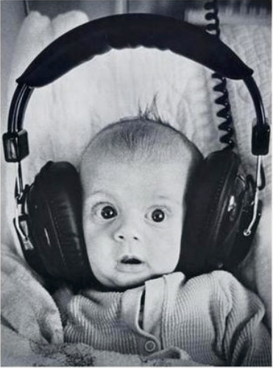
Clustering
Unsupervised learning
Requires input data, but no labels
Detects patterns, e.g.
Groups of similar emails, similar web-pages in search results
Similar customer shopping patterns
Regions of images
Slides adapted from David Sontag, Luke Zettlemoyer, Vibhav, Gogate, Carlos Guestrin, Andrew Moore, Dan Klein

Slide 9
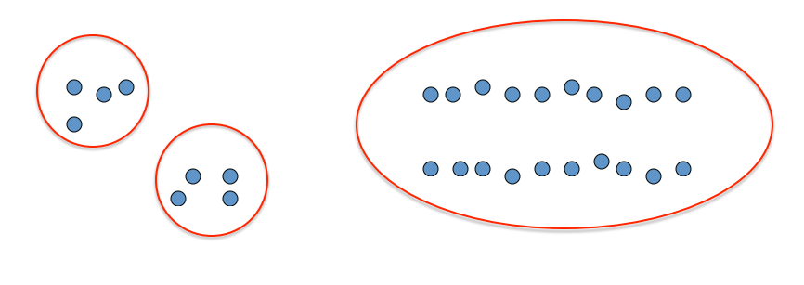
Clustering
Idea: group together similar instances
Example: 2D point patterns
Slides adapted from David Sontag, Luke Zettlemoyer, Vibhav, Gogate, Carlos Guestrin, Andrew Moore, Dan Klein

Slide 10
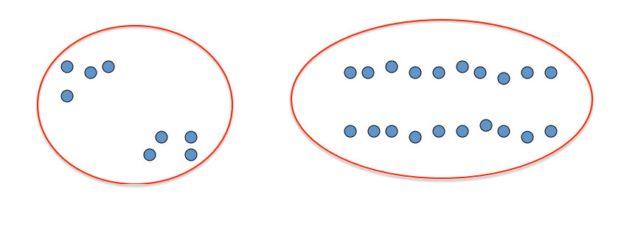
Clustering
Idea: group together similar instances
Example: 2D point patterns
Slides adapted from David Sontag, Luke Zettlemoyer, Vibhav, Gogate, Carlos Guestrin, Andrew Moore, Dan Klein

Slide 11
Clustering
Idea: group together similar instances
Example: 2D point patterns
Slides adapted from David Sontag, Luke Zettlemoyer, Vibhav, Gogate, Carlos Guestrin, Andrew Moore, Dan Klein

Slide 12
Clustering
Idea: group together similar instances
Problem: How to define “similar”?
Problem: How many clusters?
Slides adapted from David Sontag, Luke Zettlemoyer, Vibhav, Gogate, Carlos Guestrin, Andrew Moore, Dan Klein

Slide 13
Clustering
Similarity: in Euclidean space R^{n}, could be a distance function.
For example: $D\left(x,y\right)={\left\|x−y\right\|}_{2}^{2}$
Clustering results will depend on measure of similarity / dissimilarity
Slides adapted from David Sontag, Luke Zettlemoyer, Vibhav, Gogate, Carlos Guestrin, Andrew Moore, Dan Klein

Slide 14
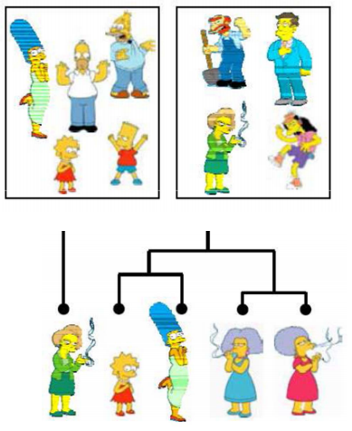
Clustering Algorithms
Partitioning algorithms (flat)
K-means
Hierarchical algorithms
Bottom-up: agglomerative
Top-down: divisive
Slides adapted from David Sontag, Luke Zettlemoyer, Vibhav, Gogate, Carlos Guestrin, Andrew Moore, Dan Klein

Slide 15
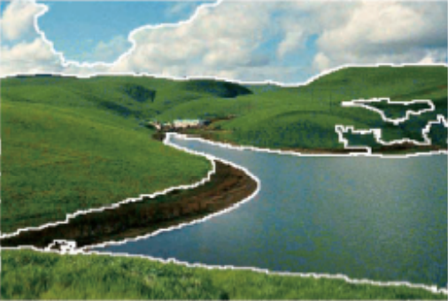
Clustering Examples: Image Segmentation
Divide an image into regions that are perceptually similar to humans.
Slides adapted from James Hays, David Sontag, Luke Zettlemoyer, Vibhav, Gogate, Carlos Guestrin, Andrew Moore, Dan Klein

Slide 16
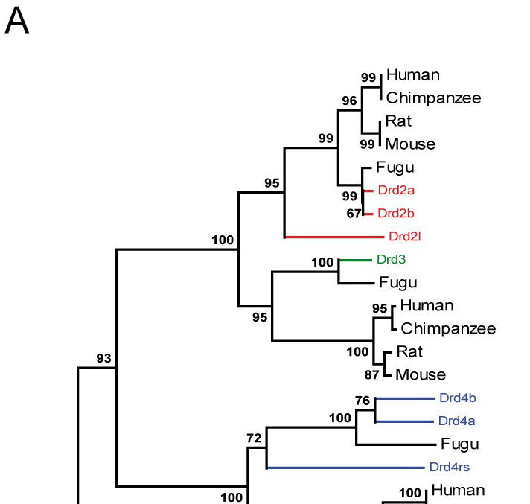
Clustering Examples: Biology
Cluster species based on e.g. genetic or phenotype similarity.
Slides adapted from David Sontag, Luke Zettlemoyer, Vibhav, Gogate, Carlos Guestrin, Andrew Moore, Dan Klein. Image: [1]

Slide 17
Clustering: k-Means
Iterative clustering algorithm based on partitioning (flat).
Initialize: Pick k random points as cluster centers.
Iterate until convergence:
Assign each point based on the closest cluster center.
Update each cluster center based on the mean of the points assigned to it.

Slide 18
Clustering: k-Means
Cluster centers
Iterative clustering algorithm based on partitioning (flat).
Initialize: Pick k random points as cluster centers.
Iterate until convergence:
Assign each point based on the closest cluster center.
Update each cluster center based on the mean of the points assigned to it.

Slide 19
Clustering: k-Means
What color should this point be?
Iterative clustering algorithm based on partitioning (flat).
Initialize: Pick k random points as cluster centers.
Iterate until convergence:
Assign each point based on the closest cluster center.
Update each cluster center based on the mean of the points assigned to it.

Slide 20
Clustering: k-Means
What color should this point be?
Iterative clustering algorithm based on partitioning (flat).
Initialize: Pick k random points as cluster centers.
Iterate until convergence:
Assign each point based on the closest cluster center.
Update each cluster center based on the mean of the points assigned to it.

Slide 21
Clustering: k-Means
What color should this point be?
Iterative clustering algorithm based on partitioning (flat).
Initialize: Pick k random points as cluster centers.
Iterate until convergence:
Assign each point based on the closest cluster center.
Update each cluster center based on the mean of the points assigned to it.

Slide 22
Clustering: k-Means
What color should this point be?
Iterative clustering algorithm based on partitioning (flat).
Initialize: Pick k random points as cluster centers.
Iterate until convergence:
Assign each point based on the closest cluster center.
Update each cluster center based on the mean of the points assigned to it.

Slide 23
Clustering: k-Means
Iterative clustering algorithm based on partitioning (flat).
Initialize: Pick k random points as cluster centers.
Iterate until convergence:
Assign each point based on the closest cluster center.
Update each cluster center based on the mean of the points assigned to it.

Slide 24
Clustering: k-Means
Iterative clustering algorithm based on partitioning (flat).
Initialize: Pick k random points as cluster centers.
Iterate until convergence:
Assign each point based on the closest cluster center.
Update each cluster center based on the mean of the points assigned to it.

Slide 25
Clustering: k-Means
Cluster centers
Iterative clustering algorithm based on partitioning (flat).
Initialize: Pick k random points as cluster centers.
Iterate until convergence:
Assign each point based on the closest cluster center.
Update each cluster center based on the mean of the points assigned to it.
Any changes?

Slide 26
Clustering: k-Means
Iterative clustering algorithm based on partitioning (flat).
Initialize: Pick k random points as cluster centers.
Iterate until convergence:
Assign each point based on the closest cluster center.
Update each cluster center based on the mean of the points assigned to it.

Slide 27
Clustering: k-Means
Result of k-Means:
Iterative clustering algorithm based on partitioning (flat).
Initialize: Pick k random points as cluster centers.
Iterate until convergence:
Assign each point based on the closest cluster center.
Update each cluster center based on the mean of the points assigned to it.

Slide 28
Clustering: k-Means
Result of k-Means:
Minimizes within-cluster sum of squares distance:
Here $μ_{i}$ is the mean of the points belonging to cluster $S_{i}$.
No guarantee algorithm will converge to global minimum.
Can run several times and take best result according to (1).
(1)

Slide 29
Overview
Supervised, unsupervised, and reinforcement learning
Simple learning models
Clustering
Linear regression
Linear Support Vector Machines (SVM)
k-Nearest Neighbors
Overfitting and generalization
Training, testing, validation
Balanced datasets

Slide 30
Linear Regression
Uses a linear model to model relationship between dependent variable $y∈ℝ$, and input (independent) variables x₁, …, x_{n} $∈ℝ^{n}$
Is this supervised or unsupervised learning?
y
x₁

Slide 31
Linear Regression
Uses a linear model to model relationship between dependent variable $y∈ℝ$, and input (independent) variables x₁, …, x_{n} $∈ℝ^{n}$
y
For each observation (data point) i = 1, …, m:
$$yi=w∙xi+b$$
$$=w1x_{i,1}+…+wnx_{i,n}+…+b$$
Here $x_{i,j}$ is observation i of input variable j.
Parameters of model: w, b.
x₁

Slide 32
Linear Regression
Can simply the model by adding additional input that is always one: x_{i,n+1} = 1 i = 1, …, m
The corresponding parameter in w is called the intercept.
y
For each observation (data point) i = 1, …, m:
$$yi=w∙xi$$
$$=w1x_{i,1}+…+w_{n+1}x_{i,n+1}$$
Parameters of model: w. Gives a system of linear equations that we can solve for unknowns w using linear least squares (see previous lectures).
x₁

Slide 33
Linear Least Squares Regression
Goal (want to achieve this in least square sense):
Linear least squares solution:
$$y=Xw$$
X is the matrix with x_{ij} being observation i of input variable j.
y is the vector of dependent variable (output) observations.
w are unknown parameters of linear model.
$$w={\left(X^{T}X\right)}^{−1}X^{T}y$$

Slide 34
Overview
Supervised, unsupervised, and reinforcement learning
Simple learning models
Clustering
Linear regression
Linear Support Vector Machines (SVM)
k-Nearest Neighbors
Overfitting and generalization
Training, testing, validation
Balanced datasets
Measuring performance of a classifier

Slide 35
Linear Support Vector Machines (SVM)
In linear regression, we had input variables x₁, …, x_{n} and we regressed them against a dependent variable $y∈ℝ$
But what if we want to make a classifier?
For example, a binary classifier could predict either y = -1, y = 1
One simple option: use linear regression to find a linear model that best fits the data
But this will not necessarily generalize well to new inputs.

Slide 36
Linear Support Vector Machines (SVM)
Idea: if data are separable by a linear hyperplane, then maximize separation distance (margin) between points.
From Wikipedia

Slide 37
Linear Support Vector Machines (SVM)
If data are not linearly separable, can use a soft margin classifier, which has an objective function that sums for all data points i, a penalty of zero if the data point is correctly classified, otherwise, the distance to the margin.
Penalty
Penalty

Slide 38
Overview
Supervised, unsupervised, and reinforcement learning
Simple learning models
Clustering
Linear regression
Linear Support Vector Machines (SVM)
k-Nearest Neighbors
Overfitting and generalization
Training, testing, validation
Balanced datasets
Measuring performance of a classifier

Slide 39
k-Nearest Neighbors
Suppose we can measure distance between input features.
For example, Euclidean distance: $D\left(x,y\right)={\left\|x−y\right\|}_{2}^{2}$
k-Nearest Neighbors simply uses the distance to the nearest k points to determine the classification or regression.
Classifier: take most common class within the k nearest points
Regression: take mean of k nearest points
No parameters, so no need to “train” the algorithm

Slide 40
k-Nearest Neighbors Example, k=3
?

Slide 41
k-Nearest Neighbors Example, k=5
?

Slide 42
Overview
Supervised, unsupervised, and reinforcement learning
Simple learning models
Clustering
Linear regression
Linear Support Vector Machines (SVM)
k-Nearest Neighbors
Overfitting and generalization
Training, testing, validation
Balanced datasets
Measuring performance of a classifier

Slide 43
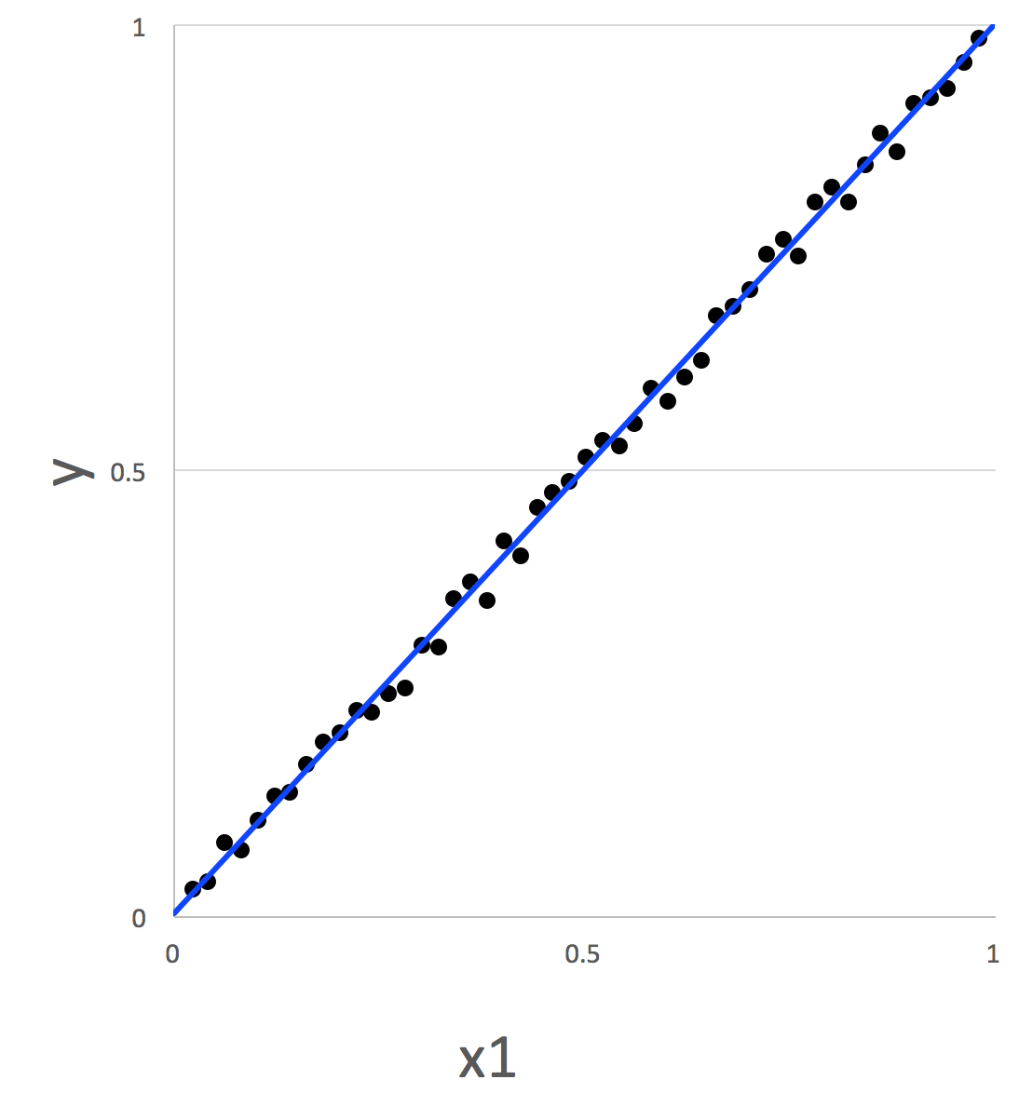
Overfitting and generalization
Will this model have decent prediction for new inputs? (i.e. inputs similar to the training exemplars in blue)

Slide 44
Overfitting and generalization
How about the model here, shown as the blue curve?
y
x1
From Wikipedia

Slide 45
Overfitting and generalization
Overfitting: the model describes random noise or errors instead of the underlying relationship.
y
x1
From Wikipedia

Slide 46
Overfitting and generalization
Overfitting: the model describes random noise or errors instead of the underlying relationship.
Frequently occurs when model is overly complex (e.g. has too many parameters) relative to the number of observations.
Has poor predictive performance.
y
x1
From Wikipedia

Slide 47
Overfitting and generalization
Overfitting: the model describes random noise or errors instead of the underlying relationship.
Frequently occurs when model is overly complex (e.g. has too many parameters) relative to the number of observations.
Has poor predictive performance.
y
x1
From Wikipedia

Slide 48
Overfitting and generalization
A rule of thumb for linear regression: one in ten rule
One predictive variable can be studied for every ten events.
In general, want number of data points >> number of parameters.
But models with more parameters often perform better!
One solution: gradually increase number of parameters in model until it starts to overfit, and then stop.
From Wikipedia

Slide 49
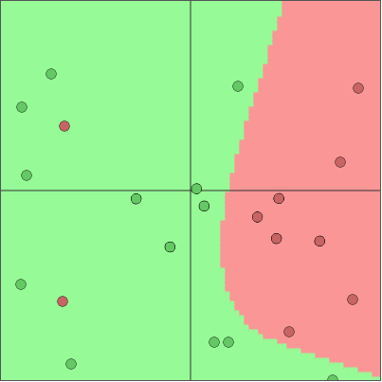
Overfitting Example with 2D Classifier
From ConvnetJS Demo: 2D Classification with Neural Networks
23 data points, 17 parameters (5 neurons)

Slide 50
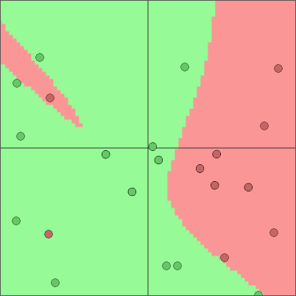
Overfitting Example with 2D Classifier
From ConvnetJS Demo: 2D Classification with Neural Networks
23 data points, 32 parameters (10 neurons)

Slide 51
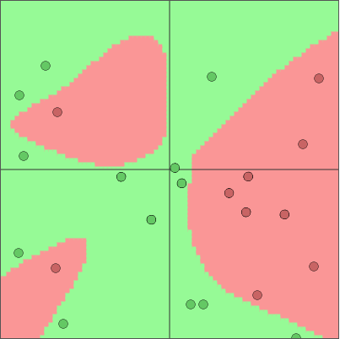
Overfitting Example with 2D Classifier
From ConvnetJS Demo: 2D Classification with Neural Networks
23 data points, 102 parameters (22 neurons total)

Slide 52
Generalization
Generalization error is a measure of how accurately an algorithm is able to predict outcome values for previously unseen data.
A model that is overfit will have poor generalization.

Slide 53
Overview
Supervised, unsupervised, and reinforcement learning
Simple learning models
Clustering
Linear regression
Linear Support Vector Machines (SVM)
k-Nearest Neighbors
Overfitting and generalization
Training, testing, validation
Balanced datasets
Measuring performance of a classifier

Slide 54
Training, testing, validation
Break dataset into three parts by random sampling:
Training dataset: model is fit directly to this data
Testing dataset: model sees this data only once; used to measure the final performance of the classifier.
Validation dataset: model is repeatedly “tested” on this data during the training process to gain insight into overfitting
Common percentages:
Training (80%), testing (15%), validation (5%).

Slide 55
Cross-validation
Repeatedly partition data into subsets: training and test.
Take mean performance of classifier over all such partitions.
Leave one out: train on n-1 samples, test on 1 sample.
Requires training n times.
k-fold cross-validation: randomly partition data into k subsets (folds), at each iteration, train on k-1 folds, test on the other fold.
Requires training k times.
Common: 10-fold cross-validation

Slide 56
Overview
Supervised, unsupervised, and reinforcement learning
Simple learning models
Clustering
Linear regression
Linear Support Vector Machines (SVM)
k-Nearest Neighbors
Overfitting and generalization
Training, testing, validation
Balanced datasets
Measuring performance of a classifier

Slide 57
Balanced datasets
Unbalanced dataset:
Suppose we have a binary classification problem (labels: 0, 1)
Suppose 99% of our observations are class 0.
We might learn the model “everything is zero.”
This model would be 99% accurate, but not model class 1 at all.
Balanced dataset:
Equal numbers of observations of each class

Slide 58
Overview
Supervised, unsupervised, and reinforcement learning
Simple learning models
Clustering
Linear regression
Linear Support Vector Machines (SVM)
k-Nearest Neighbors
Overfitting and generalization
Training, testing, validation
Balanced datasets
Measuring performance of a classifier

Slide 59
Confusion Matrix
If n classes, n x n matrix comparing actual versus predicted classes.
 |  | Class Predicted by Model
 |  | Cat | Dog
Actual Class | Cat | 9 | 1
 | Dog | 4 | 6

Slide 60
Example: Handwritten Digit Recognition
Prediction
Actual
Slide from Nelson Morgan at ICSI / Berkeley

Slide 61
Example: Handwritten Digit Recognition
Visualization from MathWorks

Slide 62
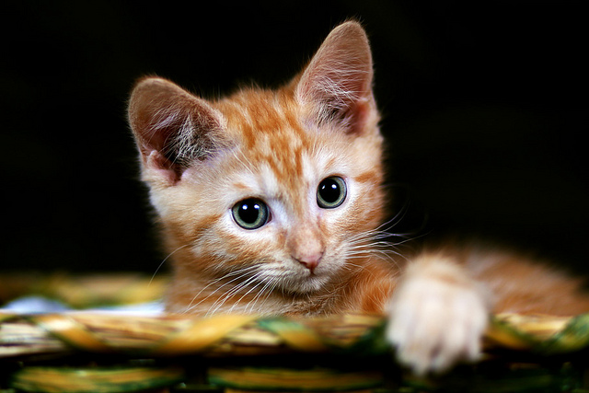
Confusion Matrix
For binary classifier, can call one class positive, the other negative.
Should we call cats positive or negative?
 |  | Class Predicted by Model
 |  | Cat | Dog
Actual Class | Cat | 9 | 1
 | Dog | 4 | 6
Photo from [1]

Slide 63
Confusion Matrix
For binary classifier, can call one class positive, the other negative.
Cats are cuter, so cats = positive.
 |  | Class Predicted by Model
 |  | Positive | Negative
Actual Class | Positive | 9 | 1
 | Negative | 4 | 6

Slide 64
Confusion Matrix
For binary classifier, can call one class positive, the other negative.
 |  | Class Predicted by Model
 |  | Positive | Negative
Actual Class | Positive | True positive | 1
 | Negative | 4 | True negative

Slide 65
Confusion Matrix
For binary classifier, can call one class positive, the other negative.
 |  | Class Predicted by Model
 |  | Positive | Negative
Actual Class | Positive | True positive | ?
 | Negative | ? | True negative

Slide 66
Confusion Matrix
For binary classifier, can call one class positive, the other negative.
 |  | Class Predicted by Model
 |  | Positive | Negative
Actual Class | Positive | True positive | False negative
 | Negative | False positive | True negative

Slide 67
Classifier Performance
Accuracy: (TP + TN) / (Population Size)
Precision: TP / (Predicted Positives) = TP / (TP + FP)
Recall: TP / (Actual Positives) = TP / (TP + FN) (also known as sensitivity, true positive rate)
Specificity: TN / (Actual Negatives) = TN / (TN + FP) (also known as true negative rate)
 |  | Class Predicted by Model
 |  | Positive | Negative
Actual Class | Positive | True positive | False negative
 | Negative | False positive | True negative

Slide 68
Classifier Performance: Unbalanced Dataset
Accuracy: (TP + TN) / (Population Size)
Precision: TP / (Predicted Positives) = TP / (TP + FP)
Recall: TP / (Actual Positives) = TP / (TP + FN) (also known as sensitivity, true positive rate)
Specificity: TN / (Actual Negatives) = TN / (TN + FP) (also known as true negative rate)
 |  | Class Predicted by Model
 |  | Positive | Negative
Actual Class | Positive | TP: 99 | FN: 0
 | Negative | FP: 1 | TN: 0

Slide 69
Classifier Performance: Unbalanced Dataset
Accuracy: (TP + TN) / (Population Size) = ?
Precision: TP / (Predicted Positives) = TP / (TP + FP)
Recall: TP / (Actual Positives) = TP / (TP + FN) (also known as sensitivity, true positive rate)
Specificity: TN / (Actual Negatives) = TN / (TN + FP) (also known as true negative rate)
 |  | Class Predicted by Model
 |  | Positive | Negative
Actual Class | Positive | TP: 99 | FN: 0
 | Negative | FP: 1 | TN: 0

Slide 70
Classifier Performance: Unbalanced Dataset
Accuracy: (TP + TN) / (Population Size) = 99%
Precision: TP / (Predicted Positives) = TP / (TP + FP) = ?
Recall: TP / (Actual Positives) = TP / (TP + FN) (also known as sensitivity, true positive rate)
Specificity: TN / (Actual Negatives) = TN / (TN + FP) (also known as true negative rate)
 |  | Class Predicted by Model
 |  | Positive | Negative
Actual Class | Positive | TP: 99 | FN: 0
 | Negative | FP: 1 | TN: 0

Slide 71
Classifier Performance: Unbalanced Dataset
Accuracy: (TP + TN) / (Population Size) = 99%
Precision: TP / (Predicted Positives) = TP / (TP + FP) = 99%
Recall: TP / (Actual Positives) = TP / (TP + FN) (also known as sensitivity, true positive rate)
Specificity: TN / (Actual Negatives) = TN / (TN + FP) (also known as true negative rate)
 |  | Class Predicted by Model
 |  | Positive | Negative
Actual Class | Positive | TP: 99 | FN: 0
 | Negative | FP: 1 | TN: 0

Slide 72
Classifier Performance: Unbalanced Dataset
Accuracy: (TP + TN) / (Population Size) = 99%
Precision: TP / (Predicted Positives) = TP / (TP + FP) = 99%
Recall: TP / (Actual Positives) = TP / (TP + FN) = ? (also known as sensitivity, true positive rate)
Specificity: TN / (Actual Negatives) = TN / (TN + FP) (also known as true negative rate)
 |  | Class Predicted by Model
 |  | Positive | Negative
Actual Class | Positive | TP: 99 | FN: 0
 | Negative | FP: 1 | TN: 0

Slide 73
Classifier Performance: Unbalanced Dataset
Accuracy: (TP + TN) / (Population Size) = 99%
Precision: TP / (Predicted Positives) = TP / (TP + FP) = 99%
Recall: TP / (Actual Positives) = TP / (TP + FN) = 100% (also known as sensitivity, true positive rate)
Specificity: TN / (Actual Negatives) = TN / (TN + FP) (also known as true negative rate)
 |  | Class Predicted by Model
 |  | Positive | Negative
Actual Class | Positive | TP: 99 | FN: 0
 | Negative | FP: 1 | TN: 0

Slide 74
Classifier Performance: Unbalanced Dataset
Accuracy: (TP + TN) / (Population Size) = 99%
Precision: TP / (Predicted Positives) = TP / (TP + FP) = 99%
Recall: TP / (Actual Positives) = TP / (TP + FN) = 100% (also known as sensitivity, true positive rate)
Specificity: TN / (Actual Negatives) = 0% (also known as true negative rate)
 |  | Class Predicted by Model
 |  | Positive | Negative
Actual Class | Positive | TP: 99 | FN: 0
 | Negative | FP: 1 | TN: 0

Slide 75
Summary
Supervised, unsupervised, and reinforcement learning
Simple learning models
Clustering
Linear regression
Linear Support Vector Machines (SVM)
k-Nearest Neighbors
Overfitting and generalization
Training, testing, validation
Balanced datasets
Measuring performance of a classifier

