Slide 1
Face Recognition, SVD, and PCA
Connelly Barnes
CS 4501: Introduction to Computer Vision
Slides modified from those by Jason Lawrence

Slide 2
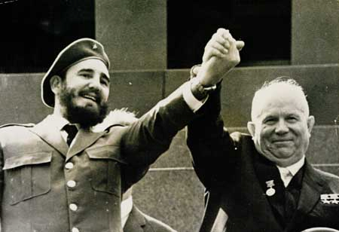
Recognition
Discussion: How might we detect faces in this image?

Slide 3
Recognition
One possibility: look for regions that resemble a face (oval with two dark circles and dark band near bottom)
Another possibility: look for pieces of faces (eyes, mouth, etc.) in a specific arrangement

Slide 4
Templates
“Generic” or “average” face
computed from examples
Image courtesy: Bavor and Levinson

Slide 5
Consider Multiple Scales (Pyramid)
“Generic” or “average” face
computed from examples
Image courtesy: Bavor and Levinson

Slide 6
Consider Multiple Orientations
[Schneiderman and Kanade]

Slide 7
Measure of Distance
Intensity (e.g., SSD)
Outputs of feature detector (e.g. histograms of gradients)
Color histograms
…
Image courtesy: Bavor and Levinson

Slide 8
Sliding Window Detector
Image
Template
Slide template over image (in a pyramid)
For each translation, compute how well template matches the image
Matching response: (darker = better)
[Bavor and Levinson]

Slide 9
Simple Detection Algorithm
Image
Template
Simple matching cost: compute SSD of intensity at each pixel
But what if template is darker (brighter) than the image we are searching?
[Bavor and Levinson]

Slide 10
Simple Detection Algorithm
Image
Template
Normalized cross-correlation: invariant to scale/bias of intensity:
f = image, t = template
[Bavor and Levinson]

Slide 11
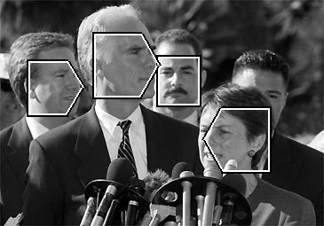
Alternative Detection System
Compute templates at different facial orientations; compare frequency content between image regions
Wavelet transform: localized frequency/orientation information
wavelet histogram template
[Schneiderman and Kanade]

Slide 12
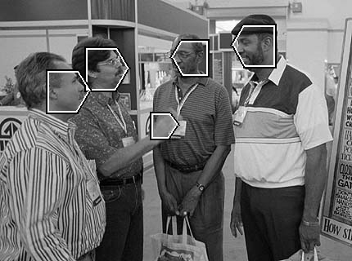
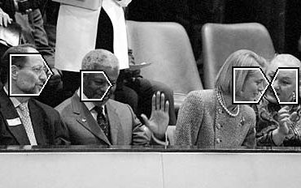
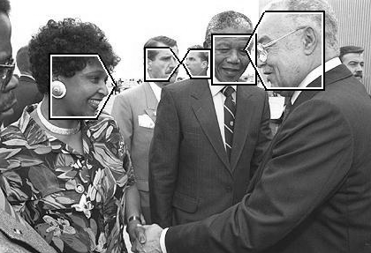
More Detection Results
[Schneiderman and Kanade]

Slide 13
Recognition
Suppose you want to recognize a particular face (criminal detector)?
Key question: how does this face differ from the average face?

Slide 14
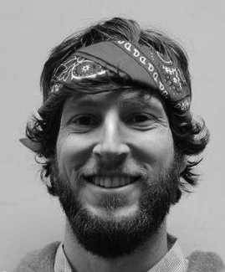
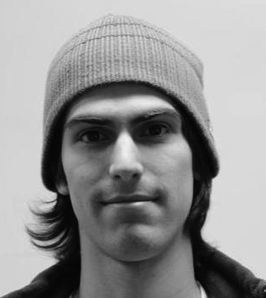
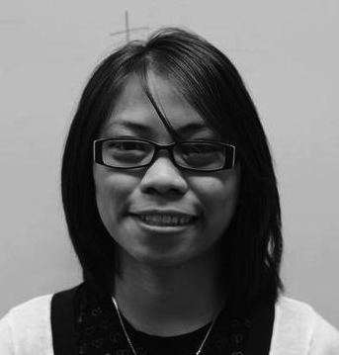
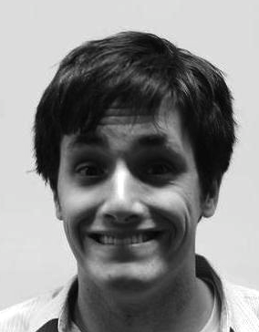
Recognition
Understand variation from average face
Treat image regions as high-dimensional vectors:
image of face = point in X-dim space

Slide 15
Principal Component Analysis (PCA)
Approximating high-dimensional data with projection onto lower-dimensional subspace
Principal components are “axes” of ellipse / multidimensional Gaussian fit to the data
Equal-probability curve for Gaussian
*
*
Second principal component
*
*
First principal component
*
*
*
*
*
*
*
*
*
*
*
*
*
Original axes
*
*
*
*
*
*
*
Data points

Slide 16
Digression: Singular Value Decomposition (SVD)
Useful mathematical technique that has applications to many problems
Given an MxN matrix A, SVD computes matrices U, Σ and V such that:
A = UΣV^{T}
U is MxN and orthonormal (UU^{T} = I)
Σ is NxN and diagonal
V is NxN and orthonormal (VV^{T} = I)

Slide 17
SVD
N
$$σ_{1}$$
$$σ_{2}$$
M
=
. . . .
$$V^{T}$$
$$σ_{n}$$
This class focuses on applications of SVD (course on linear algebra for further study)
Treat as black box (e.g., numpy.linalg.svd in Python)

Slide 18
SVD
are called singular values of A
If A is singular (i.e., rows/cols are linear combinations of others) then some will be 0
listed in descending order
In general, rank(A) = dimension of vector space spanned by the columns of A = number nonzero
SVD is mostly unique (up to permutation of singular values if some are equal)
$$σ_{i}$$
$$σ_{i}$$
$$σ_{i}$$
$$σ_{i}$$

Slide 19
SVD and inverses
SVD is incredibly useful
Application #1: matrix inversion:

Slide 20
SVD and inverses
SVD is incredibly useful
Application #1: matrix inversion:
What happens when some are zero?
Pseudoinverse A⁺: if = 0 set 1/ to 0 (!!)
“Closest” matrix to inverse
Defined for all (even non-square) matrices
$A^{−1}={(V^{T})}^{−1}Σ^{−1}U^{−1}$= ?
$$σ_{i}$$
$$σ_{i}$$
$$σ_{i}$$

Slide 21
SVD and least squares problems
Solving Ax=b by least squares:
Compute pseudoinverse ( ) using SVD
Detect singular dataset
Ratio of max to min singular value (condition number) tells you how stable the solution will be

Slide 22
SVD and eigenvectors
on board...

Slide 23
SVD and PCA
Approximating high-dimensional data with projection onto lower-dimensional subspace
*
*
Second principal component
*
*
First principal component
*
*
*
*
*
*
*
*
*
*
*
*
*
Original axes
*
*
*
*
*
*
*
Data points

Slide 24
SVD and PCA
Put data points as rows of matrix X
Also center the data (subtract mean of each dimension)
Compute SVD of X = UΣV*
Principal axes are columns of V
Standard deviation along each principal axis is
Projection into principal component space is: ${Y=\tilde{U}}^{T}X$
Reduce to k dimensions: $\tilde{U}$ is first k columns of U.
$$σ_{i}$$

Slide 25
Eigenfaces: PCA for Faces

Slide 26
Centering
Subtract mean from input
For faces: subtract off average face
*
*
*
*
*
*
*
*
*
*
*
*
*
*
*
*
*
*
*
*
*
*
*
*

Slide 27
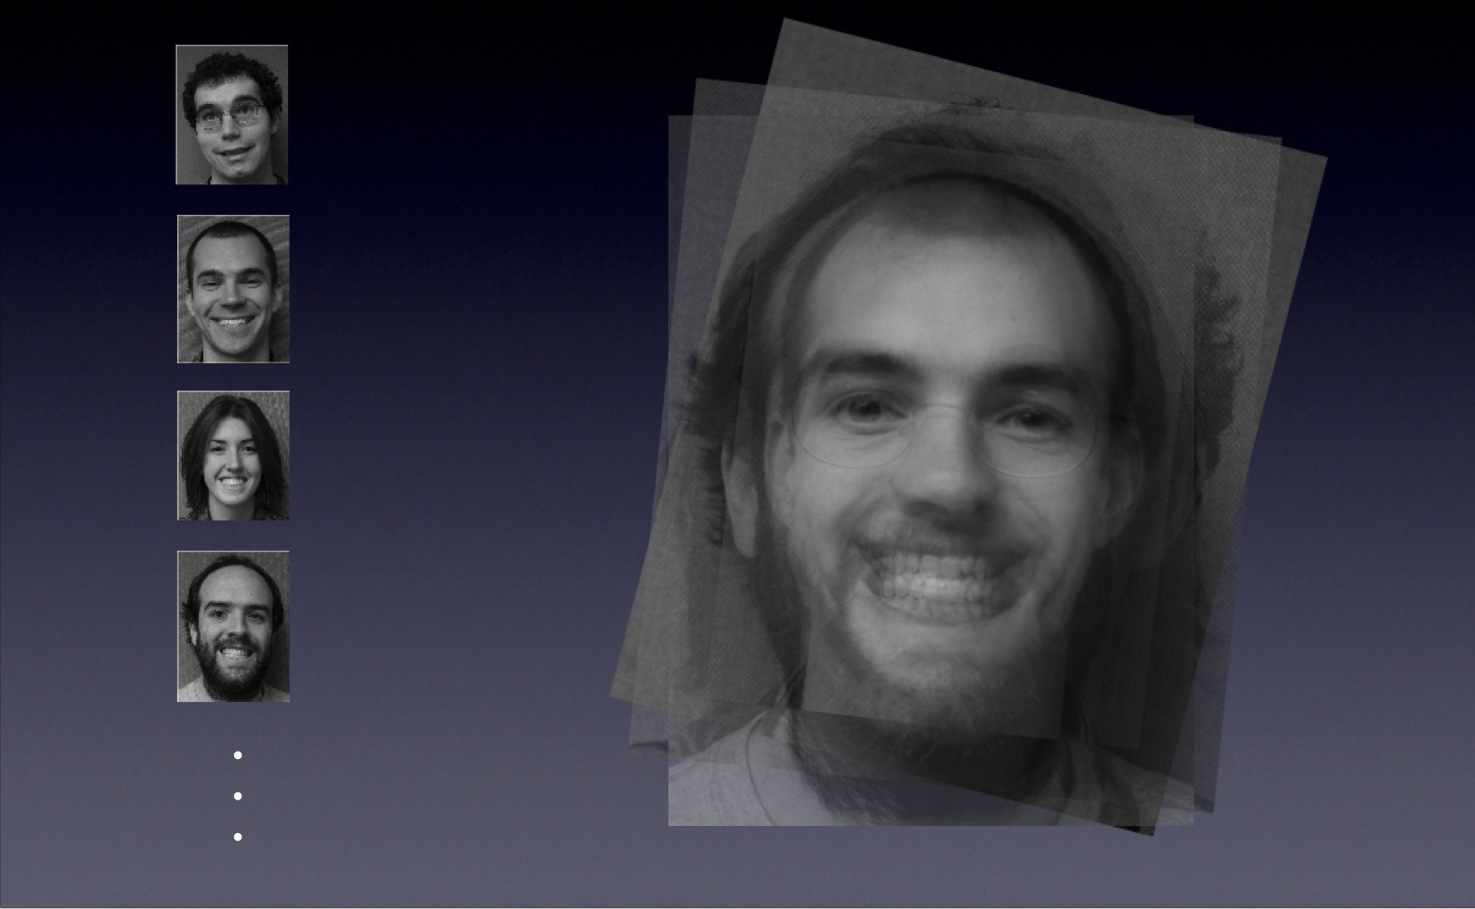
Average Face

Slide 28
Eigenfaces: PCA for Faces
mn
$$σ_{1}$$
N
A
=
U
Average Face

Slide 29
Compact Representation

Slide 30
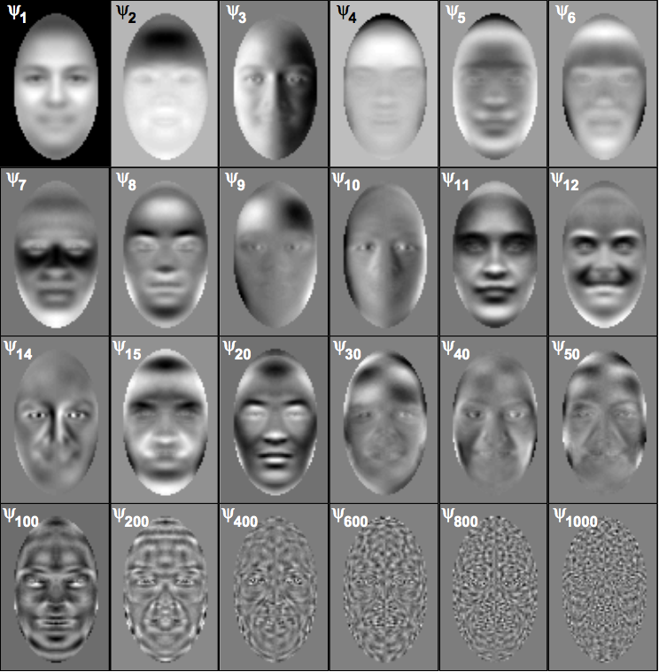
Eigenfaces: PCA Basis
Average Face
From “On the Dimensionality of Face Space,” Meytlis and Sirovich, IEEE PAMI 2007

Slide 31
Using PCA for Detection/recognition
Compute projection of target image onto eigenface basis and compute distances in that space
*
*
*
*
*
*
*
*
*
*
*
*
*
*
*
*
*
*
*
*
*
*
*
*
*
Target image region
Data points

Slide 32
Eigenface Details
Compute min distance d (in PCA space) to each face in the database:
If d < T₁ then recognized an existing face
If T₁ < d < T₂, then unknown new face
If d > T₂, not a face image
Typically drop first three eigenfaces because they encode mostly lighting information.

Slide 33
Face Recognition: State of the Art
Deep neural network methods (can discuss later in course)
Taigman et al 2014, DeepFace: Closing the Gap to Human-Level Performance in Face Verification

