Slide 1
CS 4501: Introduction to Computer Vision Convolutional Neural Networks
Connelly Barnes

Slide 2
Outline
Convolutional Neural Networks (“CNNs”, “ConvNets”)
Useful for images
Deep learning libraries

Slide 3
Outline
Convolutional Neural Networks
History
Convolutional layers
Downsampling: stride and pooling layers
Fully connected layers
Residual networks
Data augmentation
Deep learning libraries
Keras

Slide 4
History
Slide from Stanford CS231N

Slide 5
History
Slide from Stanford CS231N

Slide 6
History
Slide from Stanford CS231N

Slide 7
History
Slide from Stanford CS231N

Slide 8
History
Slide from Stanford CS231N

Slide 9
History
Slide from Stanford CS231N

Slide 10
Today: CNNs Widely Used
Self-driving cars

Slide 11
Today: CNNs Widely Used
Image Classification

Slide 12
Convolutional Neural Networks
Similar to multilayer neural network, but weight matrices now have a special structure (Toeplitz or block Toeplitz) due to convolutions.
The convolutions typically sum over all color channels.

Slide 13
Convolutional Neural Network Neuron Layout
Input layer: RGB image
Centered, i.e. subtract mean over training set
Usually crop to fixed size (square) input image
R
G
B
Image from Wikipedia

Slide 14
Convolutional Neural Network Neuron Layout
Hidden layer
Feature
map 1
Feature
map n
Image from Wikipedia

Slide 15
Receptive Field
Weights (Shared)
Hidden Layer Neuron
Receptive Field: Input Region
Image from Wikipedia

Slide 16
Mathematically…
Weights for Feature Map 1
Weights for Feature Map n
Activation Function
Biases
$L_{i}=φ(L_{i−1}∗[W_{1},W_{2},$…$W_{n}]+[b_{1},$…, $b_{n}])$
h x w x d
k₁ x k₂ x d
Current Layer Feature Maps
Previous Layer Feature Maps
Convolution (Shares Weights Spatially)

Slide 18
Outline
Convolutional Neural Networks
History
Convolutional layers
Downsampling: stride and pooling layers
Fully connected layers
Residual networks
Data augmentation
Deep learning libraries
Keras

Slide 19
Stride
Stride m indicates that instead of computing every pixel in the convolution, compute only every mth pixel.

Slide 20
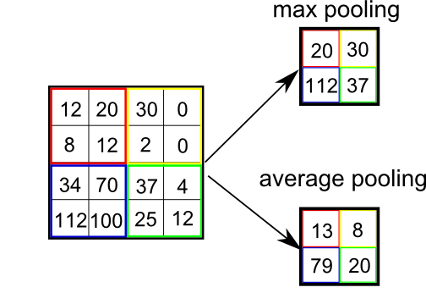
Max/average pooling
“Downsampling” using max() operator
Downsampling factor f could differ from neighborhood size N that is pooled over.

Slide 21
Max/average pooling
For max pooling, backpropagation just propagates error back to to whichever neuron had the maximum value.
For average pooling, backpropagation splits error equally among all the input neurons.

Slide 22
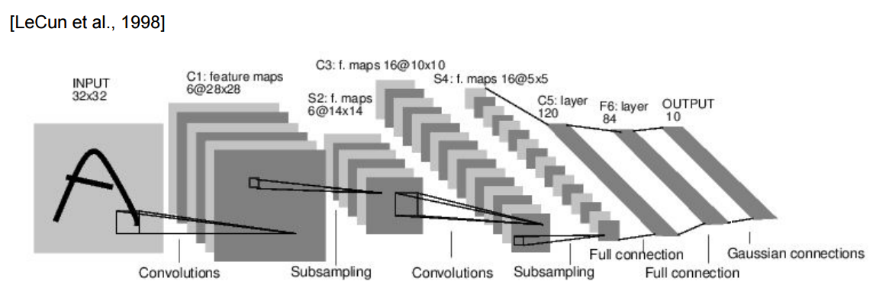
Fully connected layers
Connect every neuron to every other neuron, as with multilayer perceptron.
Common at end of ConvNets.

Slide 23
Outline
Convolutional Neural Networks
History
Convolutional layers
Downsampling: stride and pooling layers
Fully connected layers
Residual networks
Data augmentation
Deep learning libraries
Keras

Slide 24
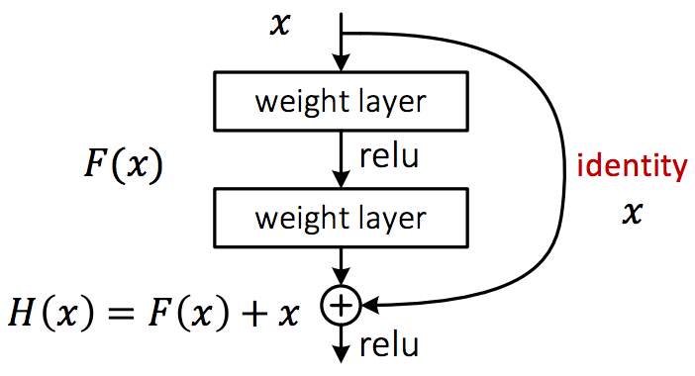
Residual networks
Make it easy to learn the identity function:
Network with all zero weights gives identity function.
Helps with vanishing/exploding gradients.

Slide 25
Outline
Convolutional Neural Networks
History
Convolutional layers
Downsampling: stride and pooling layers
Fully connected layers
Residual networks
Data augmentation
Deep learning libraries
Keras

Slide 26
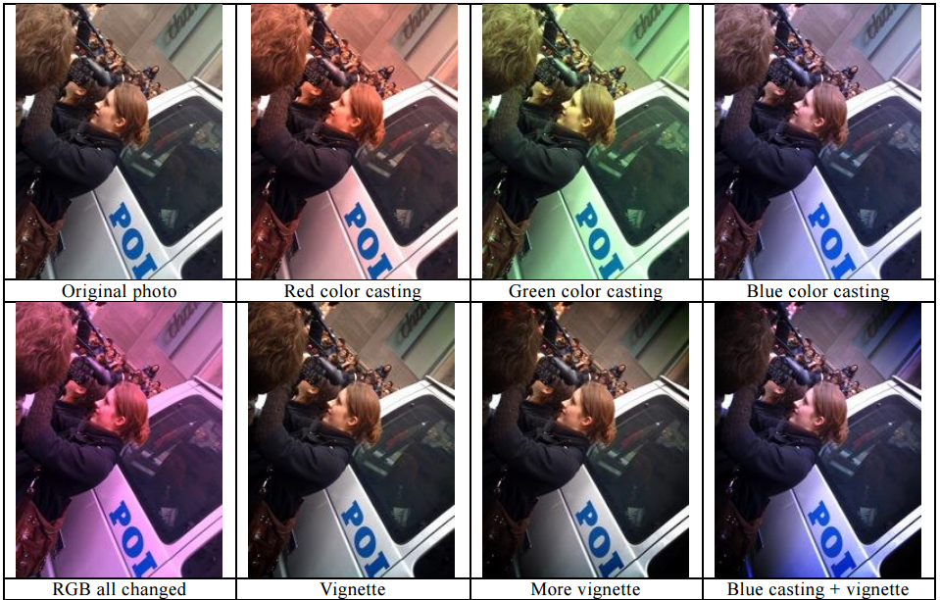
Data Augmentation
Many weights to train
Often would be helpful to have more training data
Fake having more training data
Random rotations
Random flips
Random shifts
Random “zooms”
Recolorings
etc
Figure from BaiduVision

Slide 27
Libraries
Deep learning:
Caffe (C++ with Python bindings),
Torch (Lua)
TensorFlow (C++ with Python bindings)
Python: Keras, built on Theano
MATLAB neural network toolbox
…

Slide 28
Keras
Has two backends: TensorFlow or Theano.
TensorFlow backend is better developed by Google
I found Theano backend slightly easier to install
Can take advantage of powerful GPUs needed for deep learning but for this class you can use CPU-only mode (easier to install)
Simple API
Many nice examples (demo mnist_cnn.py in class)
Good documentation

