Slide 1
CS 4501: Introduction to Computer Vision Recurrent Neural Networks
Connelly Barnes

Slide 2
Outline
Recurrent Neural Networks
Simple RNNs
LSTM, GRU
Applications

Slide 3
Recurrent Neural Networks
Feedforward neural networks have no memory: cannot remember the state of the world between one instant of time and the next
Cannot remember important events and recall them in the future
Cannot perform loops
Cannot implement arbitrary algorithms
Recurrent networks help by adding memory to the computation

Slide 4
Recurrent Neural Networks
Outputs
Hidden State (Memory)
Inputs
Slide from Stanford CS231N

Slide 5
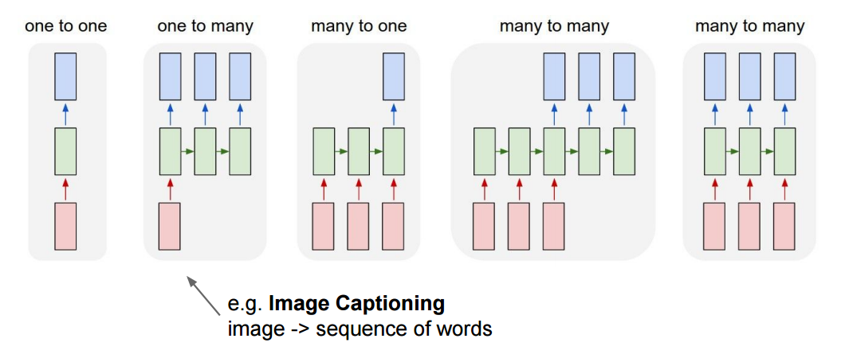
Recurrent Neural Networks
Slide from Stanford CS231N

Slide 6
Recurrent Neural Networks
Slide from Stanford CS231N

Slide 7
Recurrent Neural Networks
Slide from Stanford CS231N

Slide 8
Recurrent Neural Networks
Slide from Stanford CS231N

Slide 9
Simple Recurrent Neural Network
Slide from Stanford CS231N

Slide 10
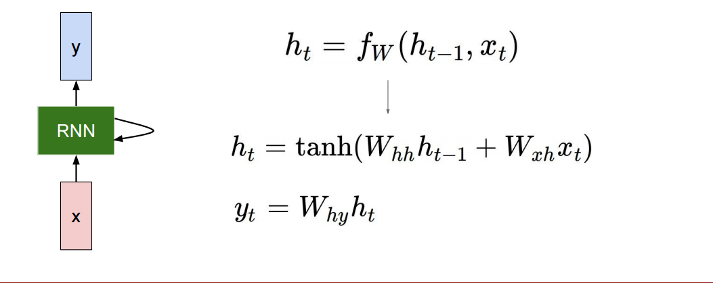
Simple Recurrent Neural Network
Hidden state:
Output:
Slide from Stanford CS231N

Slide 11
How to Train?
Backpropagation through time
Image from Wikipedia

Slide 12
How to Train?
More efficient: Truncated backpropagation through time
(1) Only run backpropagation every k₁ time steps
(2) Limit number of times (k₂) unfolded
Image from Wikipedia

Slide 13
Application of Recurrent Neural Network
Text synthesis

Slide 14
Applications of Recurrent Neural Network
Video frame prediction
Video activity prediction

Slide 15
Vanishing Gradients Revisited
Suppose we want to “remember” an event at time 0 and use this in our model of the world at some later time t.
Error gradients vanish exponentially quickly in the size of the time lag between these events.
Fancier RNN models help with this problem:
Long Short Term Memory (LSTM)
Gated Recurrent Units (GRU)

Slide 16
Long Short Term Memory
How to better remember hidden state for a long time?
Idea: use gates to create cells that can remember for a long time.
Rough analogy: ternary logic gates used in transistors, AND, OR, …
But use sigmoid activations so we have continuous values in [0, 1]
Transistor diagram (from Wikipedia)

Slide 17
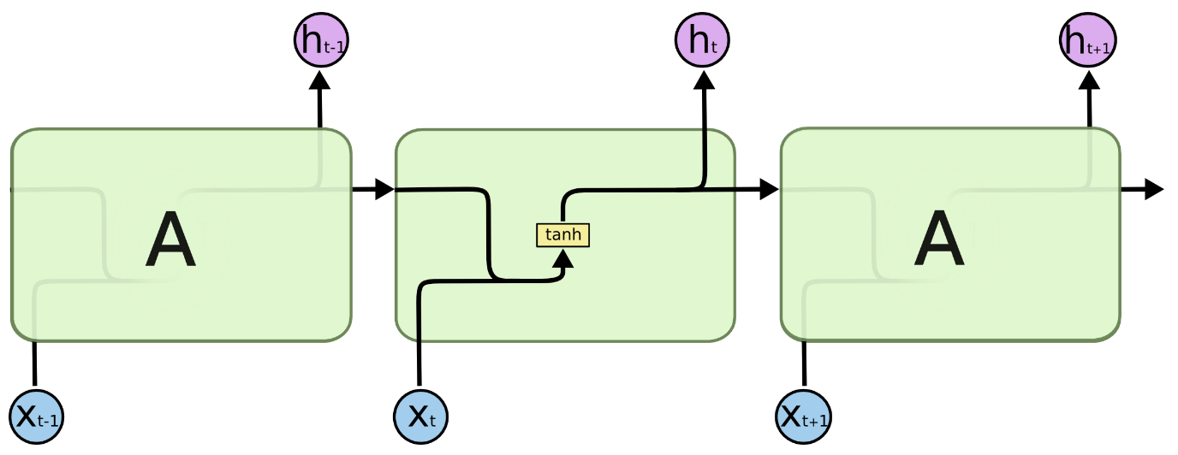
Simple Recurrent Neural Network
Outputs
No gates!
Hidden State (Memory)
Inputs
Diagrams from Christopher Olah

Slide 18
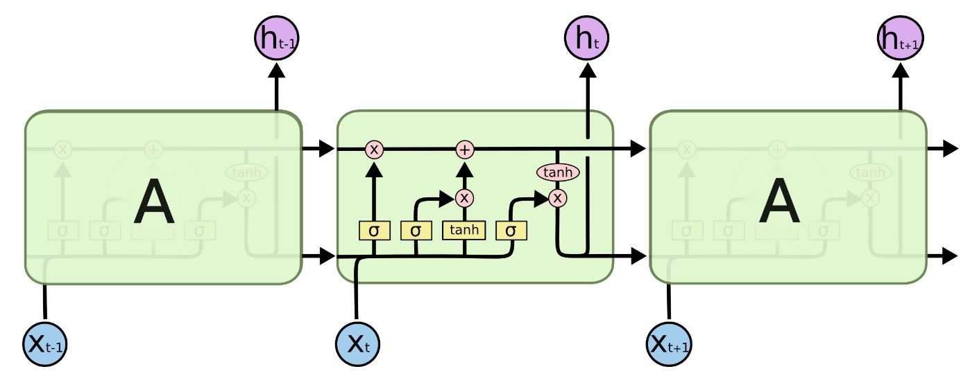
Long Short Term Memory
Gates: forget, input, output
Diagrams from Christopher Olah

Slide 19
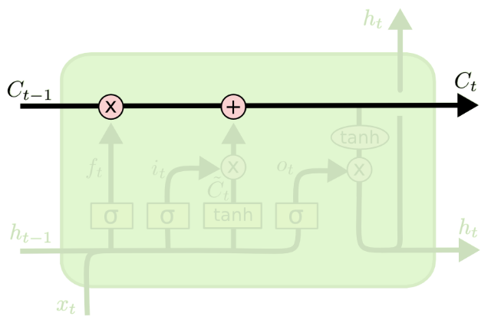
Long Short Term Memory
Easy to have hidden state C_{t} just flow through time, unchanged.
Diagrams from Christopher Olah

Slide 20
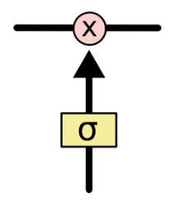
Long Short Term Memory
Gate: pointwise multiplication.
Multiply by zero: let nothing through.
Multiply by one: let everything through.
Diagrams from Christopher Olah

Slide 21
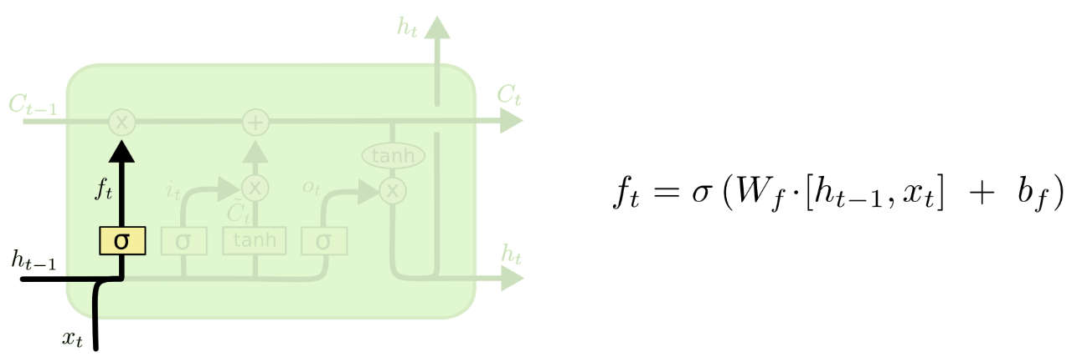
Long Short Term Memory
Forget gate: conditionally discard previously remembered information.
Diagrams from Christopher Olah

Slide 22
Long Short Term Memory
Input gate: conditionally remember new information.
Diagrams from Christopher Olah

Slide 23
Long Short Term Memory
Output gate: conditionally output a relevant part of our memory.
Diagrams from Christopher Olah

Slide 24
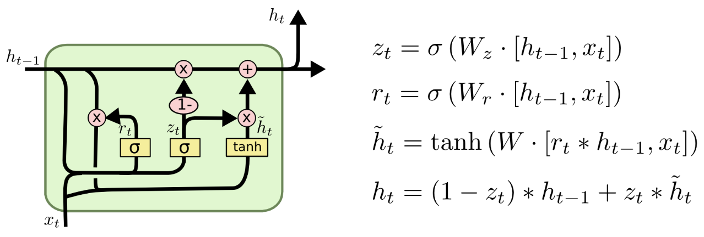
Gated Recurrent Units (GRUs)
Merge input / forget units into a single “update unit” z.
Replace output gate with “reset” gate r.
Merge hidden states.
Diagrams from Christopher Olah

Slide 25
Discussion: How Could We Improve the Memory?
LSTM / GRU have limited memory that intuitively seems different than say human memory
e.g. we have some idea of addressing information, and putting information in context by connecting it to other related ideas.
How might we improve this memory model? What architectural changes might we want to make?

