Slide 1
CS 4501: Introduction to Computer Vision (Deep) Reinforcement Learning
Connelly Barnes
Slides based on those by David Silver

Slide 2
Outline
Introduction to Reinforcement Learning
Value-based deep reinforcement learning
Q-learning

Slide 3
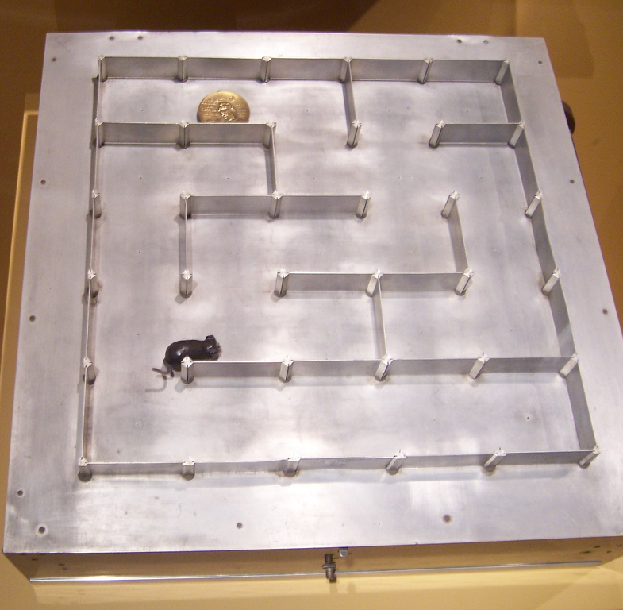
Introduction to Reinforcement Learning
“How software agents ought to take actions in an environment so as to maximize some notion of cumulative reward.” – Wikipedia
Studied in various disciplines:
Game theory
Control theory
Operations research
Swarm intelligence
Statistics
Economics
…
Photo from Flickr

Slide 4
Introduction to Reinforcement Learning
Goal: determine the best action for every state.
Optimize an objective function, such as average reward per time unit, or discounted reward.
Few states: dynamic programming.
Many states: reinforcement learning, deep reinforcement learning.

Slide 5
Examples Related to Computer Vision
Deep Q Networks: Atari Breakout
Visual Doom Winner (IntelAct)
MarI/O

Slide 6
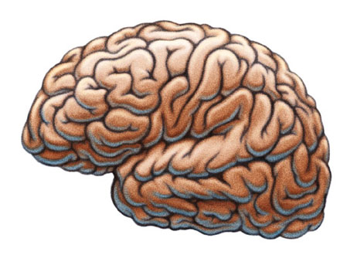
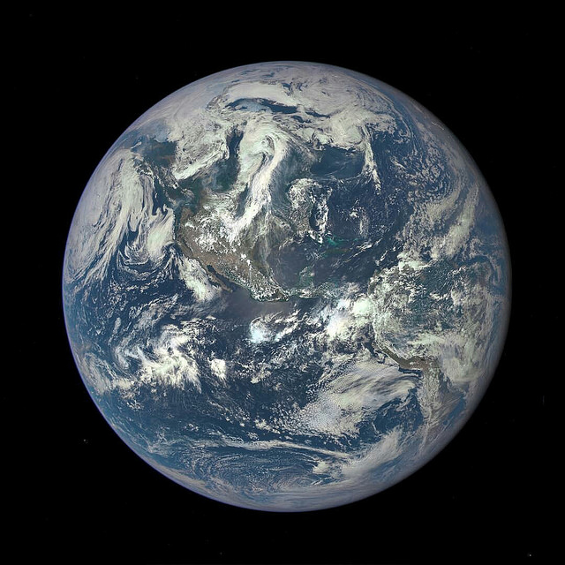
Terminology
Agent
At each time step t the agent:
Receives observation o_{t}
Receives scalar reward r_{t}
Executes action a_{t}
The environment:
Receives action a_{t}
Determines observation o_{t+1}
Determines scalar reward r_{t+1}
Observation o_{t}
Reward r_{t}
Action a_{t}
Environment
Slides based on those by David Silver, images [1], [2]

Slide 7
Modeling Agent Behavior
Agent
Agent can include these components:
Policy: agent’s behavior function
Value function: how good is each state/action?
Model: agent’s understanding of the environment
Observation o_{t}
Reward r_{t}
Action a_{t}
Environment
Slides based on those by David Silver, images [1], [2]

Slide 8
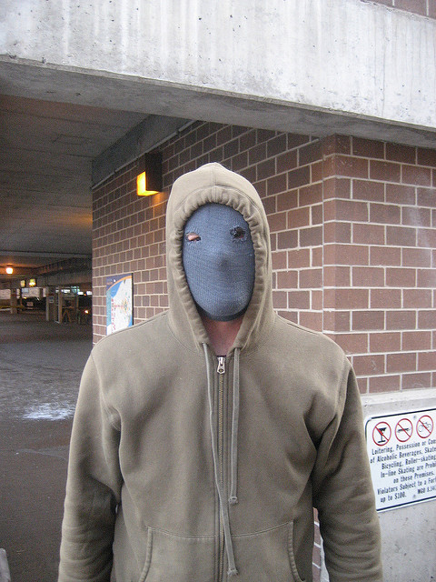
Policy
Mugger: run or fight?
Determines agent’s behavior directly
Maps from state to action
Deterministic policy: $a=π\left(s\right)$
Stochastic policy: $π\left(a | s\right)=P[a|s]$
Slides based on those by David Silver
Image is Creative Commons, by Flickr user cometstarmoon

Slide 9
Value Function
Value function is discounted prediction of future reward
Q-value function gives expected total reward
From state s and action a
Under policy $π$
With discount factor $γ$
$Q^{π}\left(s,a\right)=E[r_{t+1}+γr_{t+2}+γ^{2}r_{t+3}+…|s,a]$
Slides based on those by David Silver

Slide 10
Bellman’s Principle of Optimality
“An optimal policy has the property that whatever the initial state and initial decision are, the remaining decisions must constitute an optimal policy with regard to the state resulting from the first decision.” – Bellman 1957
i.e. dynamic programming
Q-value function: $Q^{π}\left(s,a\right)=E[r_{t+1}+γr_{t+2}+γ^{2}r_{t+3}+…|s,a]$
Bellman equation:
$$Q^{π}\left(s,a\right)=E_{s^{′},a^{′}} [r_{t+1}+γQ^{π}\left(s′,a′\right)|s,a]$$
Slides based on those by David Silver

Slide 11
Optimal Value Function
The maximum achievable value:
$Q^{∗}\left(s,a\right)=\max_{π}(Q^{π}\left(s,a\right)$)
Once we have Q* we can act optimally:
$π^{∗}\left(s\right)={argmax}_{a}(Q^{∗}\left(s,a\right)$)
Slides based on those by David Silver

Slide 12
Reinforcement Learning Approaches
Value-based
Estimate optimal value function $Q^{∗}\left(s,a\right)$
Policy-based
Estimate the optimal policy $π^{∗}$ directly
Model-based
Build model of environment, plan future actions using model
Slides based on those by David Silver

Slide 13
Outline
Introduction to Reinforcement Learning
Value-based deep reinforcement learning
Q-learning

Slide 14
Q-Learning
Optimal Q values should follow Bellman equation:
$$Q^{π}\left(s,a\right)=E_{s^{′},a′} [r_{t+1}+γQ^{π}\left(s′,a′\right)|s,a]$$
Given an initial Q, iteratively estimate a better one:
$$Q\left(s_{t},a_{t}\right)←\left(1−α\right)Q\left(s_{t},a_{t}\right)+α [r_{t+1}+γ\max_{a}Q\left(s_{t+1},a \right)−Q\left(s_{t},a_{t}\right)]$$
Estimate of future optimal value
Reward
Old value
Learning rate
Discount factor
Slides based on those by David Silver

Slide 15
Q-learning Details
Initial conditions
Often high values to encourage exploration
No matter what action is selected, update rule will cause it to have lower value than alternatives, so alternatives will be explored also.
Learning rate
Often a constant such as 0.1

Slide 16
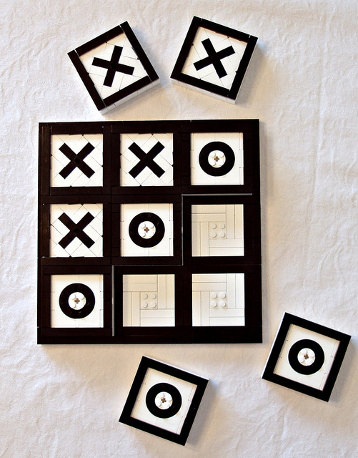
Example: Q-Learning for Tic Tac Toe
Class discussion: what could states, actions, and rewards be?
Image is Creative Commons, by Katie Walker

Slide 17
Q-Learning and Neural Networks
If there is a large number of (state, action) pairs, cannot store $Q\left(s,a\right)$ directly.
Instead, approximate $Q\left(s,a\right)$ using a neural network:
Q-function.

Slide 18
Q-Learning and Neural Networks
Supervised learning: can take the value from the right-hand side of the Q-learning rule as the target for a neural network with weights w.
Minimize:
Diverges using neural networks due to:
Correlations between samples
Non-stationary learning target
$$E=\left[r_{t+1}+γ\max_{a′}Q\left(s^{′},a^{′},w\right)−Q\left(s,a,w\right)\right]2$$
Slides based on those by David Silver

Slide 19
Deep Q-Networks (DQN): Experience Replay
To remove correlations, build a history data-set from the agent’s own experiences: $\left(s_{i},a_{i},r_{i+1},s_{i+1}\right)$
Sample experiences from this data-set and apply the stochastic gradient descent update for the squared loss:
To prevent problems with non-stationary learning targets, fix the weights $w^{−}$ while performing SGD.
Discussion question: concretely, how might we use DQN to play Tic Tac Toe? (e.g. 6x6 board). What are the states, actions, rewards? What network architecture?
$$E=\left[r_{t+1}+γ\max_{a′}Q\left(s^{′},a^{′},w^{−}\right)−Q\left(s,a,w\right)\right]2$$
Slides based on those by David Silver

Slide 20
ε-greedy Strategy
Select random action with probability ε
Select action that maximizes Q score with probability 1 - ε
DQN paper uses ε = 0.05

Slide 21
Deep Q Networks with CNNs
Fully Connected
Fully Connected,
Output
Deep Q Networks paper (example video)
Convolutional
Convolutional
32 4x4 filters (stride 2)
8 to
18
16 8x8 filters (stride 4)
256
Input:
84x84 (RGB)

Slide 22
Deep Q-Networks (DQN)
For more details, see the tutorial by David Silver

Slide 23
Software Packages
https://gym.openai.com/
https://github.com/VinF/deer
https://github.com/rlpy/rlpy

