Slide 1
CS 4501: Introduction to Computer Vision Object Localization, Detection, Semantic Segmentation
Connelly Barnes
Some slides from Fei-Fei Li / Andrej Karpathy / Justin Johnson

Slide 2
Outline
Object localization
Object detection
YOLO: You Only Look Once
Semantic segmentation
Fully convolutional networks
SegNet

Slide 3
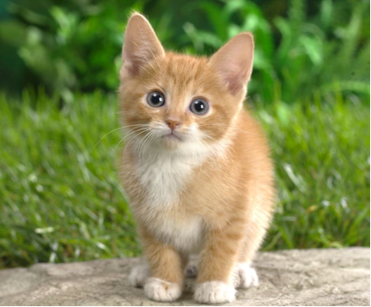
Object Localization
We already have seen that we can run CNN-based classifiers on an input image to classify it:
Suppose an image contains a single object. How might we predict the object’s bounding box? i.e. localize it (discussion question).
Cat
Image from Fei-Fei Li / Karpathy / Johnson

Slide 4
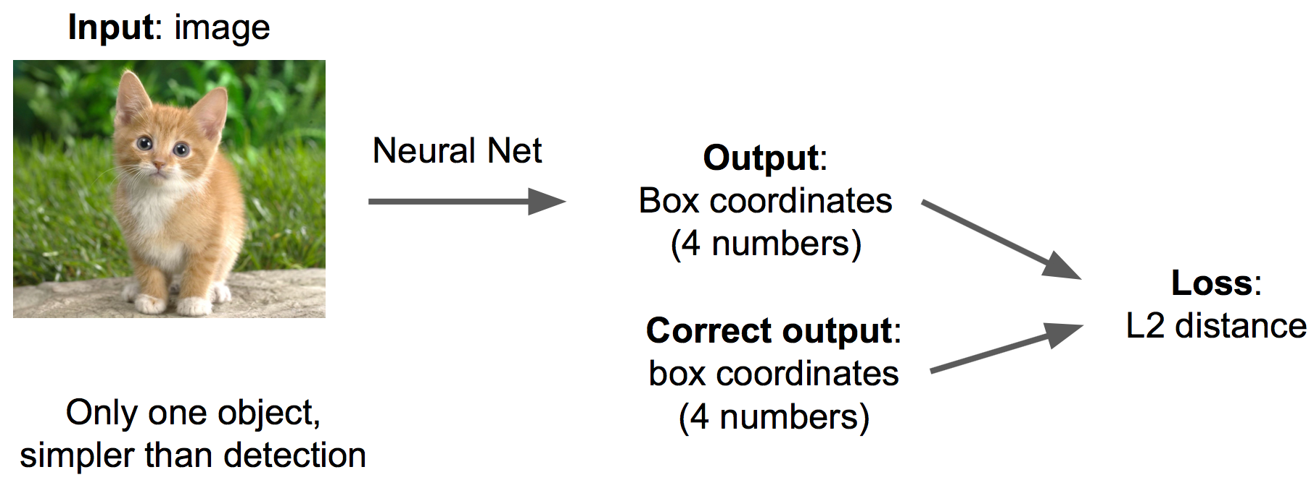
Object Localization
One possible setup: regression
Slide from Fei-Fei Li / Andrej Karpathy / Justin Johnson

Slide 5
Object Localization
(fine-tune)
e.g. ImageNet- pretrained CNN (freeze parameters)
Slide from Fei-Fei Li / Andrej Karpathy / Justin Johnson

Slide 6
Discussion Question
Localization is pretty straightforward…
Discuss with nearby classmates about whether it would be appropriate for your final project.
Can also discuss whether object detection would be more appropriate.
(Detection means determining locations/boxes for multiple objects)
Report back any projects that could use localization or detection, and how this might be done.

Slide 7
Outline
Object localization
Object detection
YOLO: You Only Look Once
Semantic segmentation
Fully convolutional networks
SegNet

Slide 8
YOLO: “You Only Live Once”
Slang phrase for doing something exciting / dangerous / stupid?
e.g. YOLO Adventures

Slide 9
YOLO: You Only Look Once
Real-time object detection using a simple architecture
10s to 100s of frames/sec

Slide 10
YOLO: You Only Look Once
Candidate Object Bounding Boxes
For each grid cell, predict B boxes: 4 coordinates + confidence (B = 2)
Divide Image into Grid (H x W)
Final Detected Objects
Solve using regression: input is image, output is
tensor: H x W x (5B + C)
Object Class Probabilities
Predict C class probabilities (C = 20 for PASCAL VOC)

Slide 11
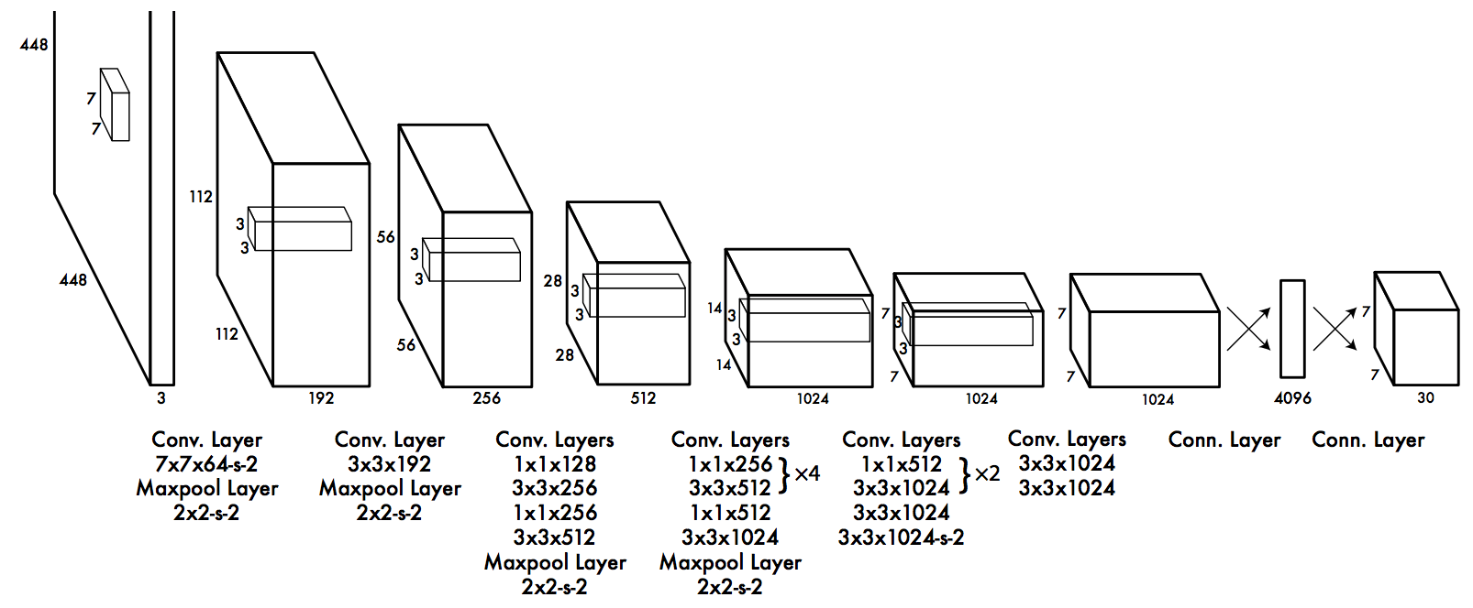
YOLO: You Only Look Once
CNN architecture (inspired by GoogLeNet)

Slide 12
Useful Metrics: Intersection over Union (IoU)
Area of Intersection
IoU = =
Area of Union

Slide 13
YOLO Details: Boxes and Probabilities
Boxes:
(x, y): center of box relative to grid cell
(w, h): size relative to whole image
Confidence:
If no object in cell, 0
If object in cell, IoU between ground truth and predicted box
Class probabilities:
P(Class_{i} | There is an Object)
Multiplied by confidence scores at test time

Slide 14
YOLO Details
YOLO outputs multiple bounding boxes per grid cell.
What to do about this?
At training time, for each object, assign one predictor to be responsible for predicting object based on current highest IOU.
Benefits due to specialization
When performing inference, can add non-maximal suppression and/or threshold confidence to reduce number of boxes

Slide 15
Improvements: YOLOv2 / YOLO9000

Slide 16
Improvements: YOLOv2 / YOLO9000
Improvements:
9000 object categories: train with ImageNet and MS COCO
Batch normalization
Increase input resolution
Anchor boxes (coordinates relative to some predefined boxes)
Pass-through layers to bring fine-grained feature information
Multi-resolution training (320x320 to 608x608; switch each 10 batches)

Slide 17
YOLO Evaluation
Mean Average Precision (mAP).
Defined by PASCAL VOC paper.
20 classes for PASCAL VOC:

Slide 18
YOLO Evaluation
PASCAL VOC 2007:
YOLO: mAP: 63.4
Fast R-CNN: mAP: 71.8
YOLO v2 (544x544): mAP: 78.6
PASCAL VOC 2012:
YOLO: mAP: 57.9
Fast R-CNN: mAP: 70.4
YOLO v2 (544x544): mAP: 73.4

Slide 19
YOLO Watches YouTube
Video

Slide 20
Outline
Object localization
Object detection
YOLO: You Only Look Once
Semantic segmentation
Fully convolutional networks
SegNet

Slide 21
Fully Convolutional Networks

Slide 22
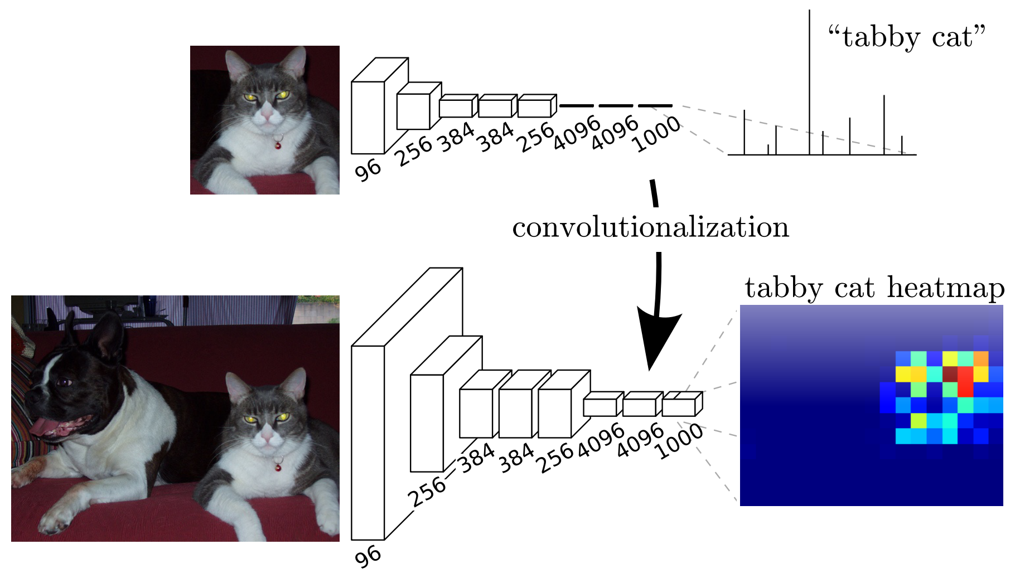
Fully Convolutional Networks
Can convert fully-connected layers to convolutional.

Slide 23
Fractionally Strided Convolution / Deconvolution
For a convolution, can compute every f samples of the output.
This is called the stride.
e.g. if f = 2, subsamples by a factor of 2.
f = 2

Slide 24
Fractionally Strided Convolution / Deconvolution
If f is a fraction (e.g. ½), increases sampling rate.
Called upsampled convolution / fractionally strided convolution / deconvolution.
f = 1/2

Slide 25
Fully Convolutional Networks
Deconvolution

Slide 26
Fully Convolutional Networks
Convolutions
Convolutions

Slide 27
Fully Convolutional Networks

Slide 28
Fully Convolutional Networks
Evaluated on PASCAL VOC 2011 and 2012 (and others: see paper)
20 classes:

Slide 29
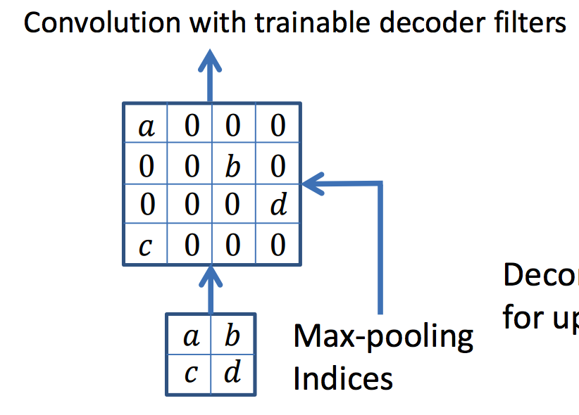
SegNet
Similar to Fully Convolutional Networks
Upsample based upon max pool index used => sparse feature map
Convolve sparse map => dense map

Slide 30
SegNet: Architecture

Slide 31
SegNet Evaluation
CamVid road scenes dataset
11 classes: building, tree, sky, car, sign, road, pedestrian, fence, pole, sidewalk, bicyclist

Slide 32
SegNet Video
https://www.youtube.com/watch?v=e9bHTlYFwhg

Slide 33
Discussion Question
Brainstorm applications of semantic segmentation:
With the outdoor labels?
Outdoor: building, tree, sky, car, sign, road, pedestrian, fence, pole, sidewalk, bicyclist
Fine-tuning with new labels

