Slide 1
CS 4501: Introduction to Computer Vision Visualizing CNNs, Style Transfer, Image Inpainting
Connelly Barnes
Some content inspired by Fei-Fei Li / Andrej Karpathy / Justin Johnson

Slide 2
Outline
Visualizing CNNs
Visualizing the whole classifier
Visualizing certain layers
Style transfer
Image inpainting

Slide 3
Neural Networks Criticism?
Criticism: Neural networks are not human-interpretable
We learn a highly nonlinear function, with many fully connected and convolutional layers: this could be pretty opaque to a human.

Slide 4
Visualizing CNNs [Simonyan et al. 2014]
Assume we have a classifier.
For each class, generate an image that is representative of that class.
Solve for image I that maximizes above loss. How could we do that?

Slide 5
Visualizing CNNs [Simonyan et al. 2014]

Slide 6
Google DeepDream
Website
Video

Slide 7
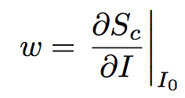
Visualizing CNNs [Simonyan et al. 2014]
Which pixels are important for recognizing a given image?
For a given class c and image I, can take gradient of score S_{c} with respect to I:
Visualize w after taking the maximum across the 3 color channels.

Slide 8
Visualizing CNNs [Simonyan et al. 2014]

Slide 9
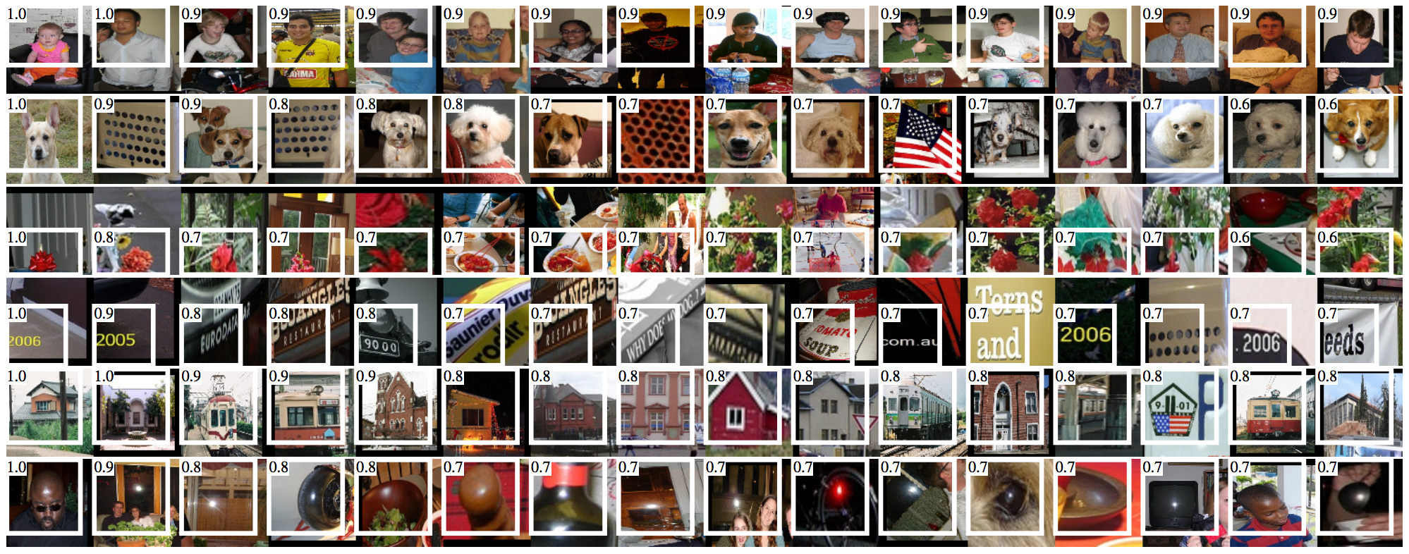
Visualizing CNNs [Girshick et al. 2014]
Retrieve images (in ranked order) that best activate a given neuron.
Images maximizing activations of 5th pooling layer of AlexNet.

Slide 10
Outline
Visualizing CNNs
Visualizing the whole classifier
Visualizing certain layers
Style transfer
Image inpainting

Slide 11
Visualizing Certain Layers [Zeiler and Fergus 2013]
Want to be able to invert a given convolution layer.
Use “deconvnets,” approximately inverts a layer.

Slide 12
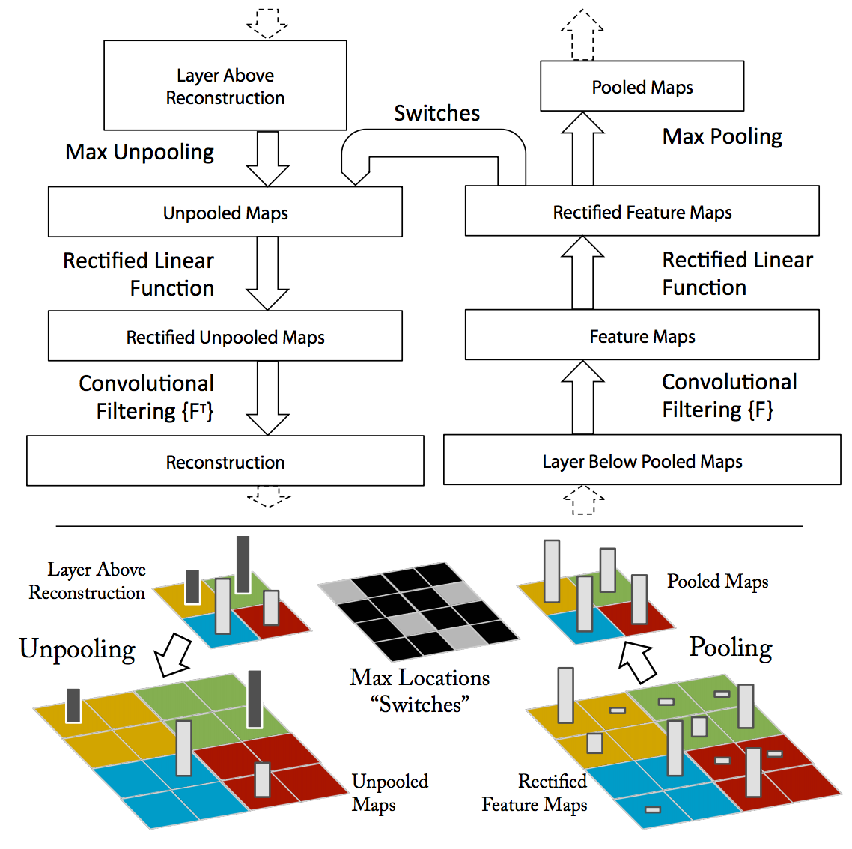
Visualizing Certain Layers [Zeiler and Fergus 2013]

Slide 13
Visualizing Certain Layers [Zeiler and Fergus 2013]
Feed a given input image through the ConvNet.
To visualize a given activation, set all other activations to zero, repeatedly deconv until we reach image pixel space.

Slide 14
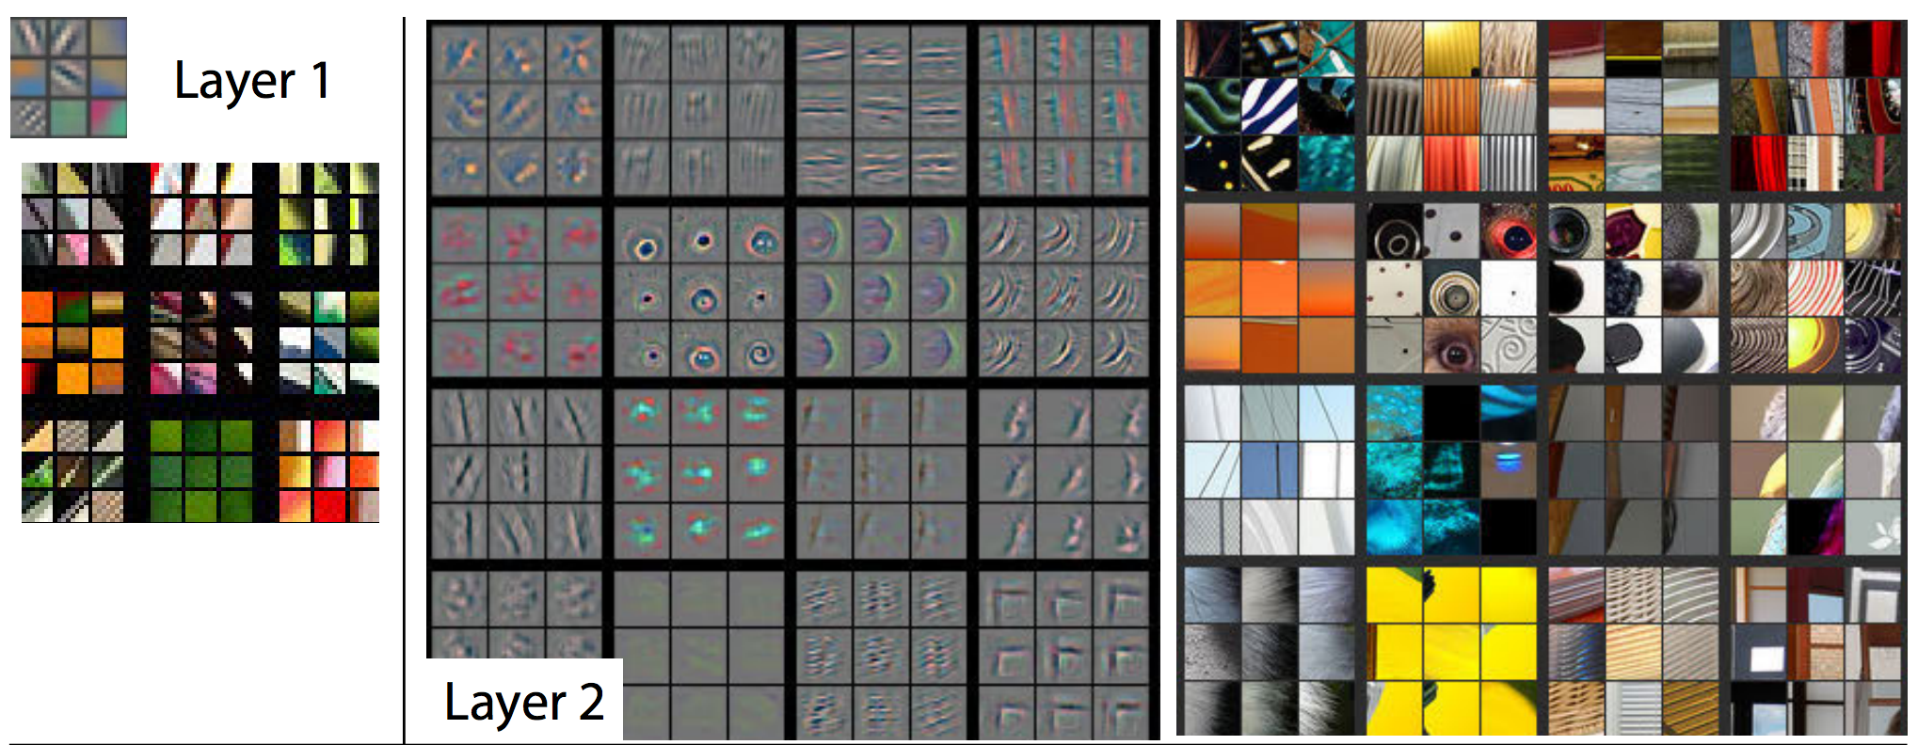
Visualizing Certain Layers [Zeiler and Fergus 2013]
Feed a given input image through the ConvNet.
To visualize a given activation, set all other activations to zero, repeatedly deconv until we reach image pixel space.

Slide 15
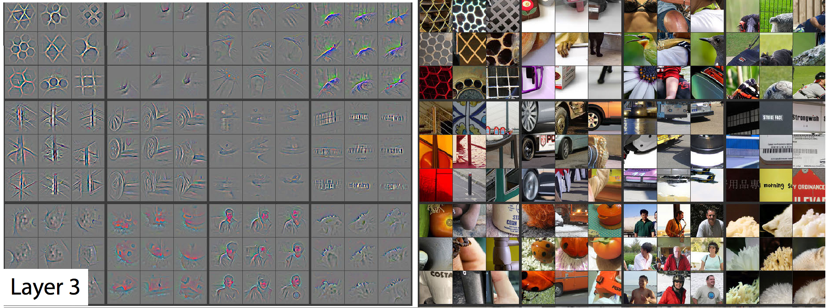
Visualizing Certain Layers [Zeiler and Fergus 2013]

Slide 16
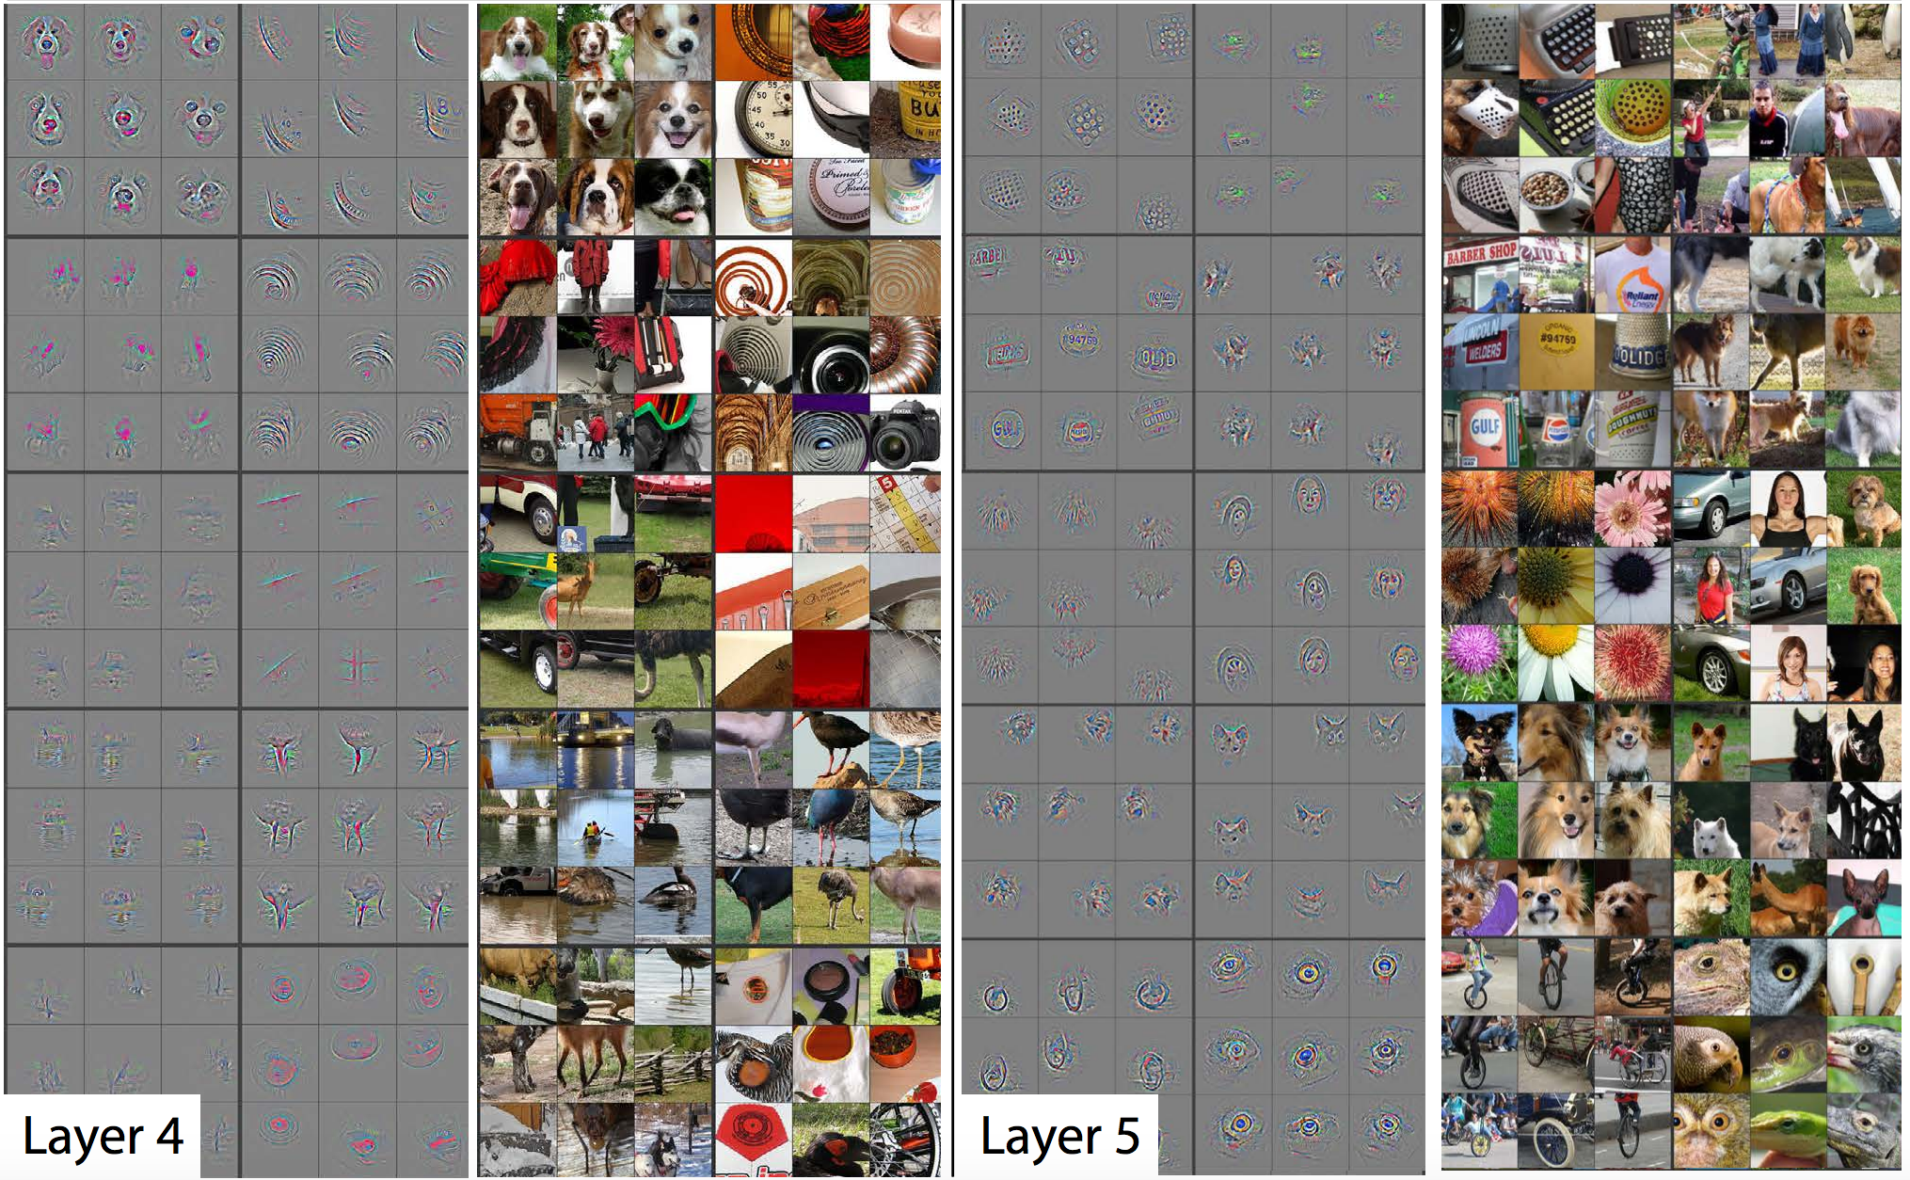
Visualizing Certain Layers [Zeiler and Fergus 2013]

Slide 17
Outline
Visualizing CNNs
Visualizing the whole classifier
Visualizing certain layers
Style transfer
Image inpainting

Slide 18
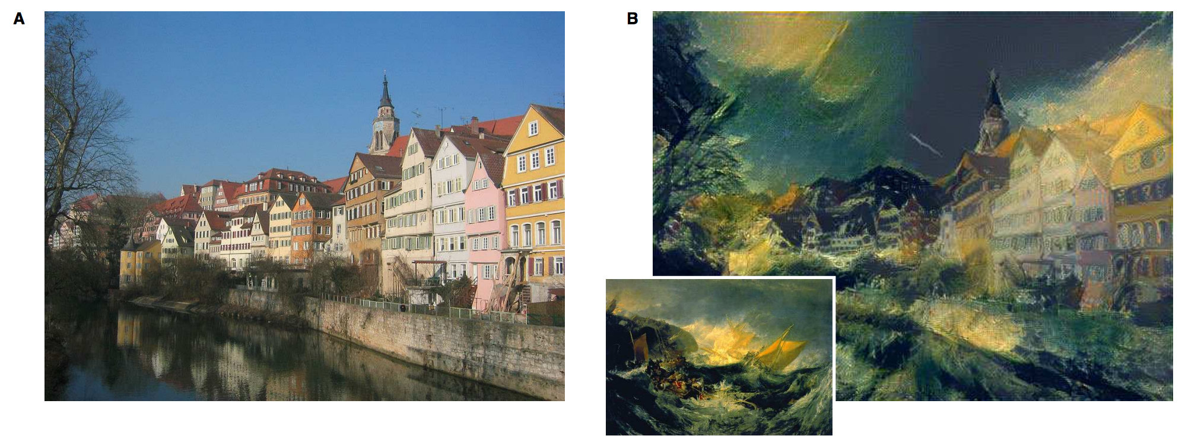
Style Transfer [Gatys et al 2016]
Content Exemplar
Result Image
Style Exemplar

Slide 19
Style Transfer [Gatys et al 2016]
Represent “style” as Gram matrix measuring co-occurrence statistics of two features i and j of a given layer l:
Here F^{l}_{ik} is the activation map of feature i, pixel j.
Similar to covariance matrix between features i, j, but Gram matrix does not subtract means, whereas covariance matrix does.

Slide 20
Style Transfer [Gatys et al 2016]
Represent “content” as activation maps of given layer.

Slide 21
Style Transfer [Gatys et al 2016]
Features from result image
Content loss for a given layer l:
Style loss for a given layer l (uses Gram matrices) :
Optimize result image via backpropagation.
Features from content exemplar
Gram matrices
Features from style exemplar

Slide 22
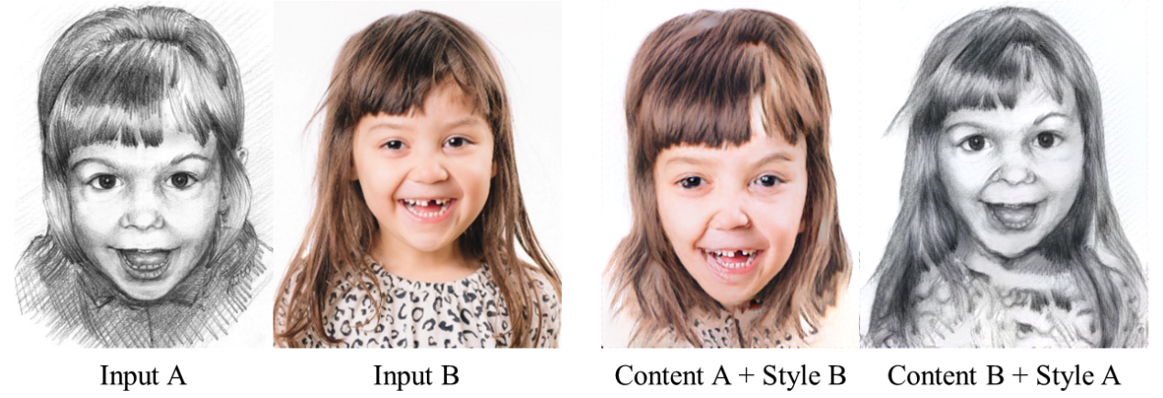
Additional References
[Li and Wand 2016]: Combining Markov Random Fields and Convolutional Neural Networks for Image Synthesis
Feedforward methods (faster, but generally lower quality):
[Ulyanov et al. 2016]
[Huang and Belongie 2017]

Slide 23
Outline
Visualizing CNNs
Visualizing the whole classifier
Visualizing certain layers
Style transfer
Image inpainting

Slide 24
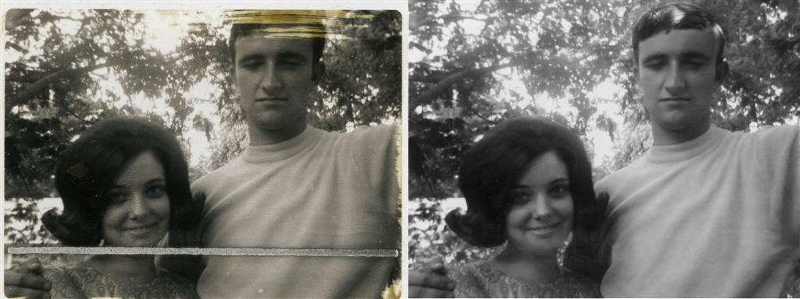
Image Inpainting
Replace an area of an image with a plausible replacement.
Once performed manually [image from Wikipedia]

Slide 25
Image Inpainting
Two main approaches:
Patch-based
Convolutional neural network

Slide 26
Patch-based Inpainting [Barnes et al. 2009]
PatchMatch
Video

Slide 27
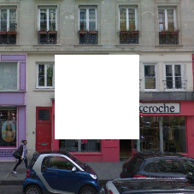
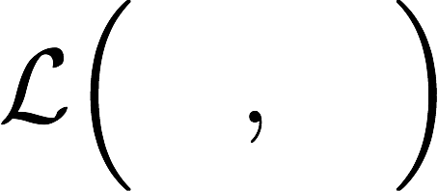
Context Encoders [Pathak et al 2016]
Encoder
Decoder
Encoder can be any network architecture like AlexNet etc.
Decoder is a set of UpConv/deconv/frac-strided-conv layers

Slide 28
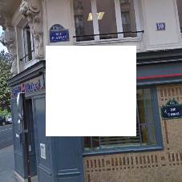
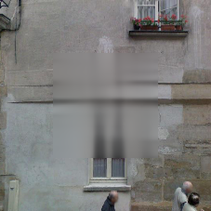
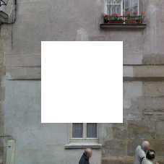
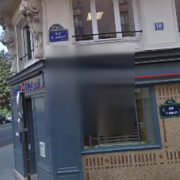
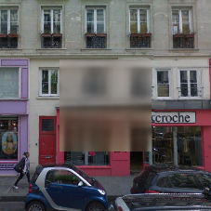
Context Encoders [Pathak et al 2016]
L² loss creates blurry results.

Slide 29
Generative Adversarial Networks [GANs]
Generator is given noise z and tries to mimic a real distribution by playing an adversarial 2 player game against a discriminator.
Discriminator: is the input real or fake?

Slide 30
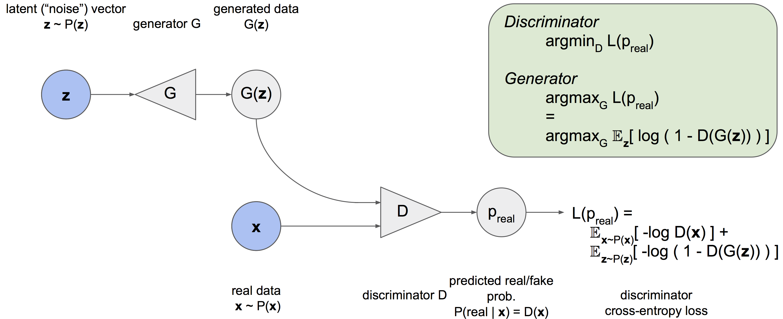
Generative Adversarial Networks [GANs]
[Slide adapted from Jeff Donahue and Pathak et al. 2016]

Slide 31
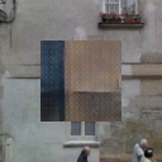
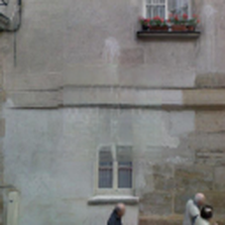
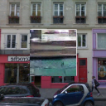
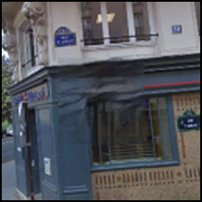
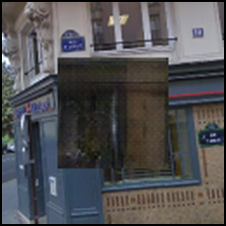
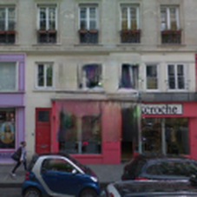
Context Encoders [Pathak et al 2016]
Adversarial loss + L2 loss does best.
Input Image
L2 Loss
Adversarial Loss
Joint Loss

Slide 32
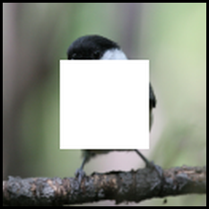
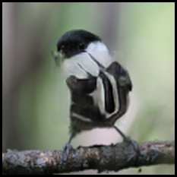
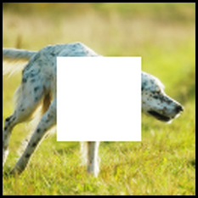
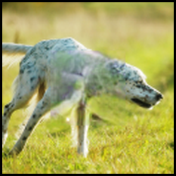
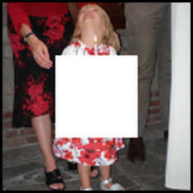
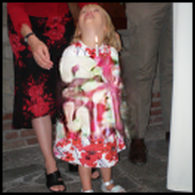
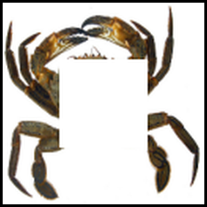
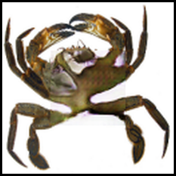
Context Encoders [Pathak et al 2016]

Slide 33
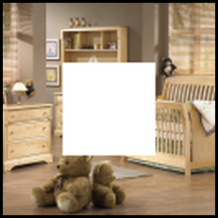
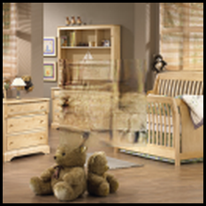
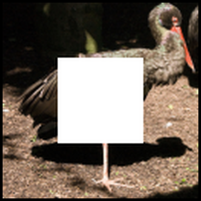
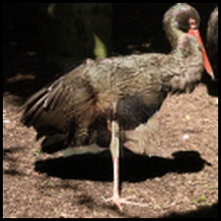
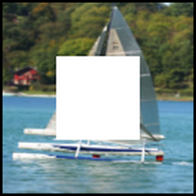
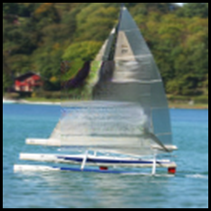
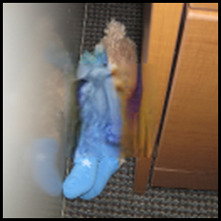
Context Encoders [Pathak et al 2016]

Slide 34
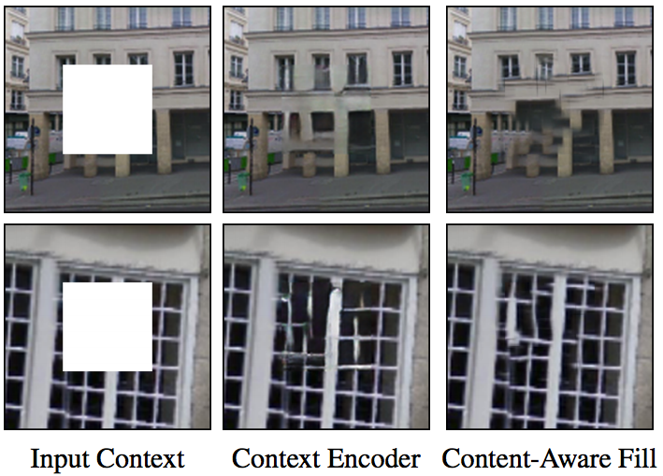
Context Encoders vs Patch-based
Semantics needed
Texture
From [Pathak et al 2016]

Slide 35
Discussion Question
Could we inpaint video using neural networks? How?
How about inpainting ads on the Web?

