Slide 1
CS 4501: Introduction to Computer Vision Computer Vision + Natural Language
Connelly Barnes
Some slides from Fei-Fei Li / Andrej Karpathy / Justin Johnson

Slide 2
Faculty Who Work on Natural Language
Kai-Wei Chang
Vicente Ordonez
Yanjun Qi
Hongning Wang

Slide 3
Outline
Image captioning
Visual question answering

Slide 4
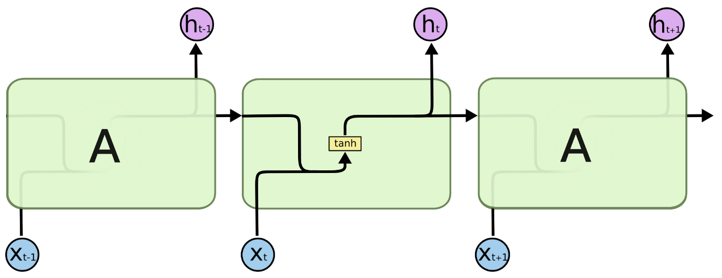
Previous Classes: Simple Recurrent Neural Network
Outputs
Hidden State (Memory)
Inputs
Diagrams from Christopher Olah

Slide 5
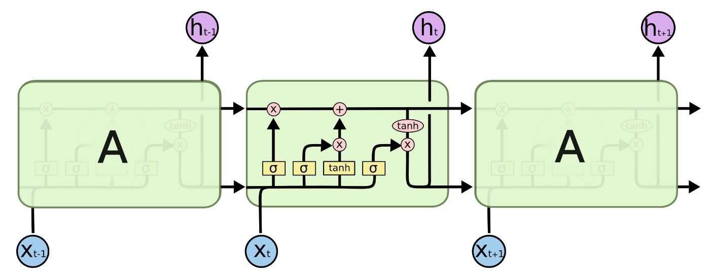
Previous Classes: Recurrent Neural Networks (LSTM)
Gates: forget, input, output
Diagrams from Christopher Olah

Slide 6
Previous Class: Recurrent Neural Networks
Text synthesis

Slide 7
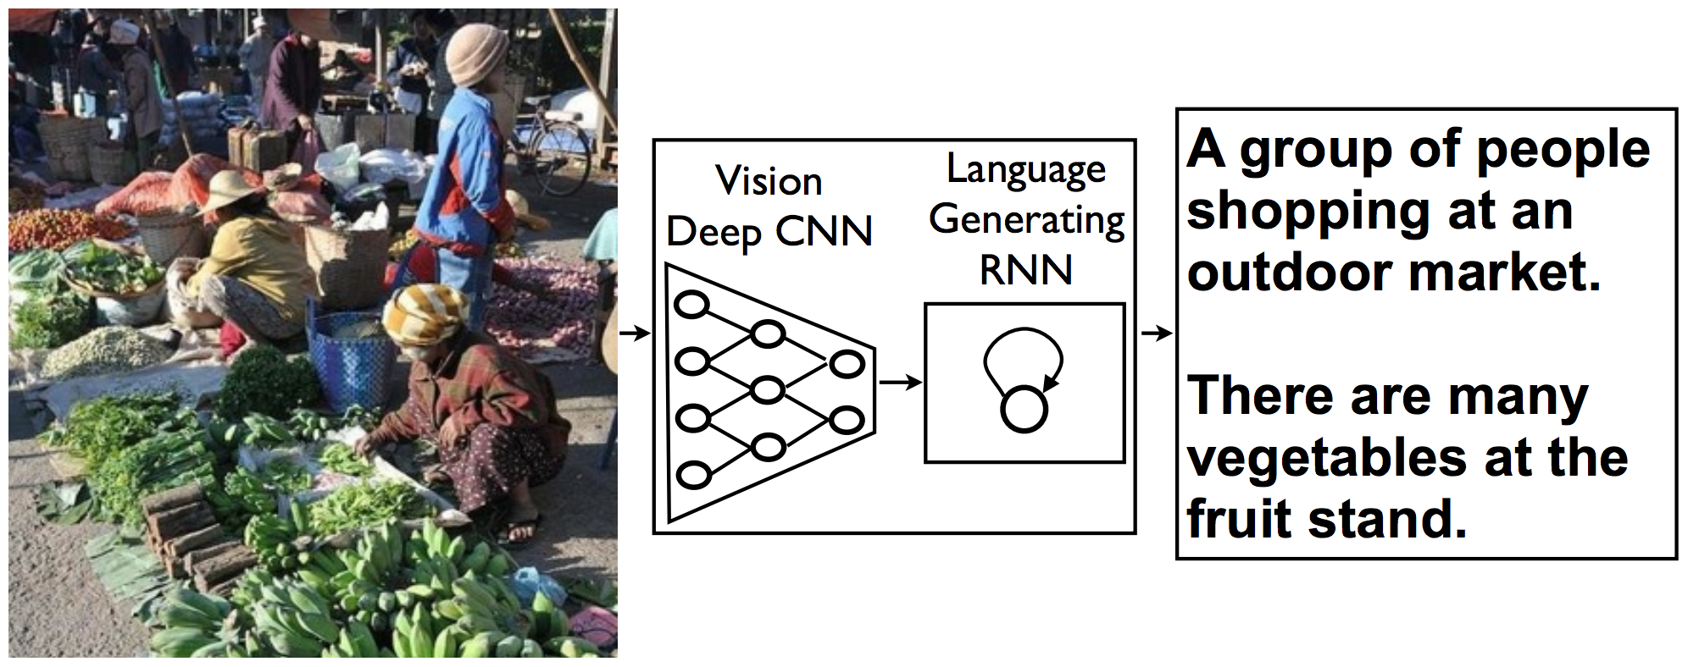
Image Captioning [Vinyals et al. 2014]
“Show and Tell: A Neural Image Caption Generator:”, Vinyals et al. 2014
Applications? (Class discussion)

Slide 8
Image Captioning [Vinyals et al. 2014]
Inspired by neural machine translation.
English => Encoder RNN => hidden state => decoder RNN => French
Image captioning: replace encoder with CNN.
Image => Encoder CNN => decoder RNN => text caption.
Trained end-to-end (optimize parameters of CNN, RNN).

Slide 9
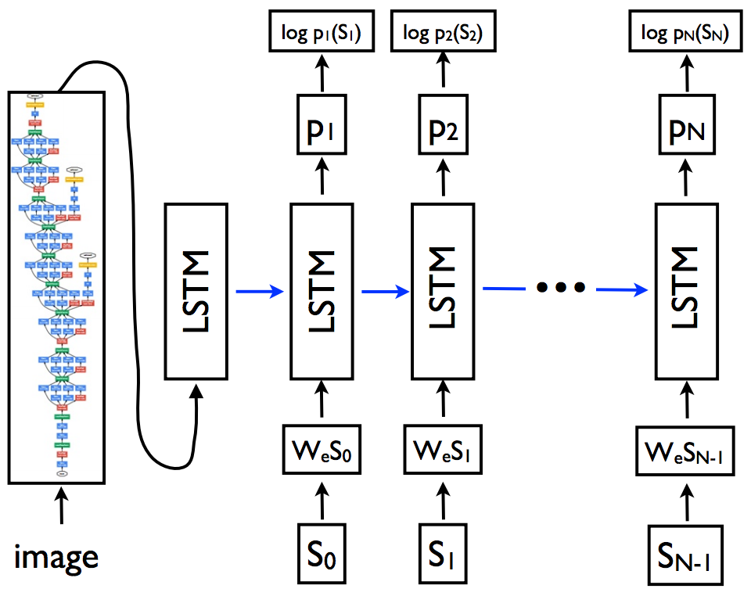
Image Captioning [Vinyals et al. 2014]
Predict current word (S_{t}) given previous words and image:
End of sentence: Special “stop” word
512 dimensions
Word embeddings (linear)
Special “start” word

Slide 10
One-hot Encoding
Uses one-hot encoding of words
Construct a dictionary (e.g. n most common words)
Associate a length n indicator vector to each word:
Word | Encoding
“the” | 1000
“dog” | 0100
“fruit” | 0010
“penguin” | 0001

Slide 11
Training [Vinyals et al. 2014]
Unroll across time (backpropagation through time)
Use ImageNet-pretrained neural network
Fine-tune last CNN layer, all LSTM weights, word embeddings.

Slide 12
Inference [Vinyals et al. 2014]
Sampling: LSTM outputs probabilities (via softmax), so just sample the next word according to those probabilities.
Beam search: Maintain a set P_{t} of top k predicted sentences at time t, consider all possible one-word extensions of P_{t}, sort these by probability of the sentence, take the top k to obtain P_{t+1}.
Greedy search: k = 1
Probability of the sentence:
Authors found best results for beam search with k = 20.

Slide 13
Results [Vinyals et al. 2014]

Slide 14
Evaluation [Vinyals et al. 2014]
BLEU metric: BiLinear Evaluation Understudy.
BLEU has high correlation with human judgements of quality.

Slide 15
Outline
Image captioning
Visual question answering

Slide 16
Visual Question Answering Demo
http://visualqa.csail.mit.edu/

Slide 17
Visual Question Answering: Applications
Assist visually impaired
Search surveillance video
Move towards “AI-complete” understanding of images
Any others? (Class discussion)

Slide 18
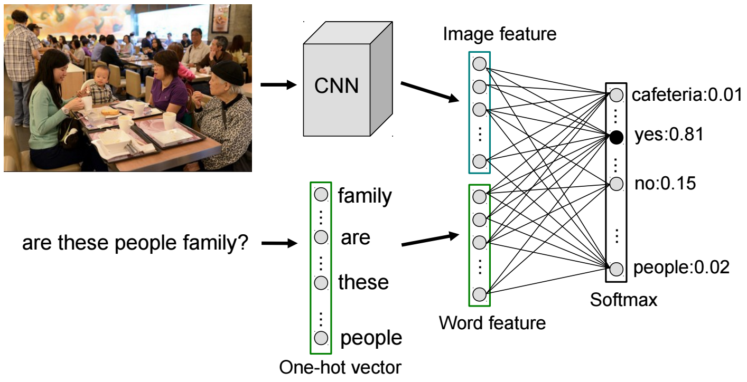
Visual Question Answering: iBOWIMG Baseline
Architecture

Slide 19
Visual Question Answering: iBOWIMG Baseline
Examples

Slide 20
Visual Question Answering: iBOWIMG Baseline
Importance of words and image regions

Slide 21
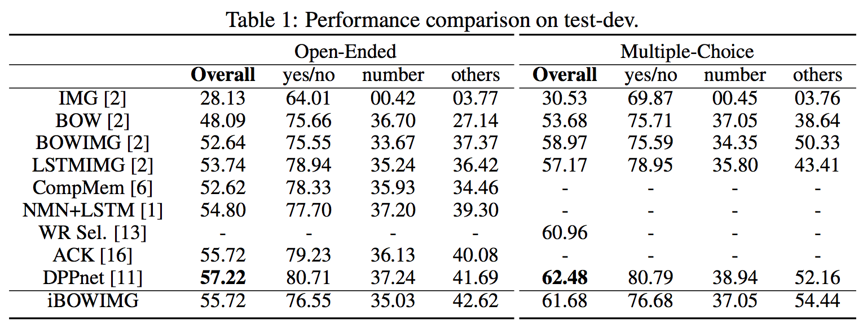
Visual Question Answering: iBOWIMG Baseline
Performance on COCO VQA

Slide 22
Visual Question Answering Challenges+Datasets
VQA 2016 Challenge Competition Results
VQA v2.0
Browse Dataset

