Slide 1
CS 4501: Introduction to Computer Vision Augmented and Virtual Reality
Connelly Barnes
Some slides from Fei-Fei Li / Andrej Karpathy / Justin Johnson

Slide 2
Outline
Augmented reality
Virtual reality

Slide 3
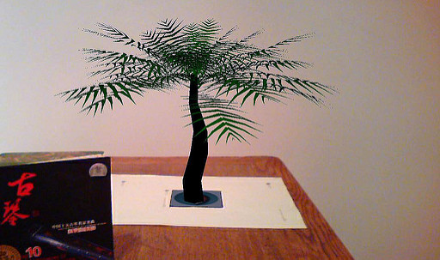
Augmented and Virtual Reality
Augmented reality: Live view of a physical, real-world environment augmented with virtual objects.
Virtual reality: a headset is used to generate synthetic images (sounds) that replace the real environment.
Image from Wangxiang Tuxing
Image from Wikipedia / HTC

Slide 4
Augmented Reality Videos
Microsoft Hololens
5 color cameras, 1 depth camera
1 Inertial Measurement Unit
Measures linear/angular motion: gyroscopes and accelerometers
"The Future of Augmented Reality"

Slide 5
SLAM (Simultaneous Localization And Mapping)
SLAM: Constructing or updating a map of an unknown environment while also tracking an agent’s location in the environment.

Slide 6
LSD-SLAM
https://www.youtube.com/watch?v=GnuQzP3gty4

Slide 7
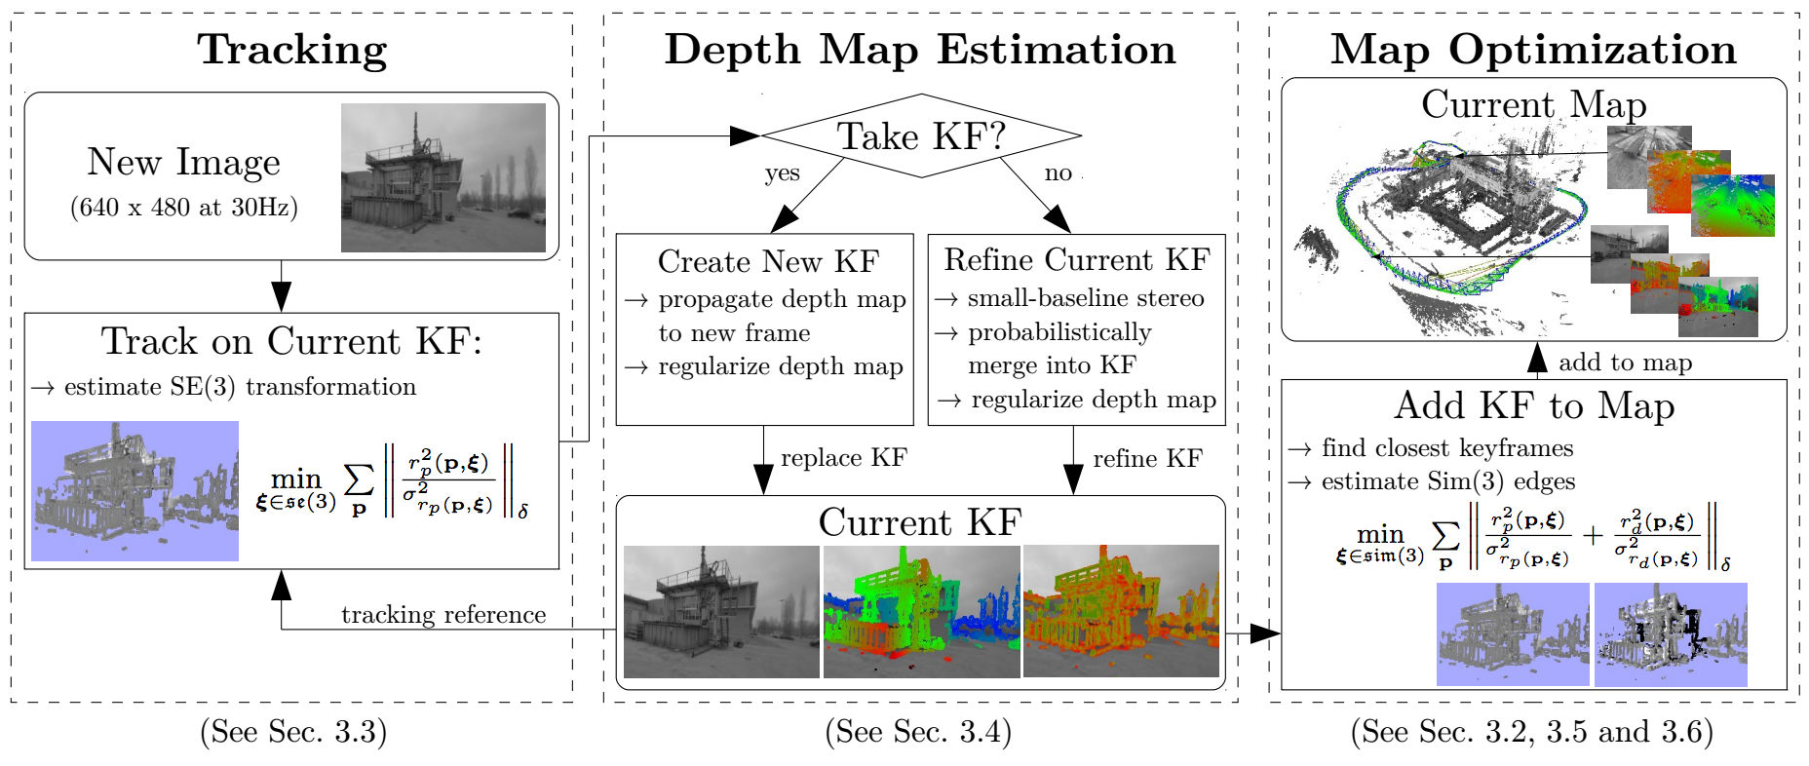
LSD-SLAM Overview

Slide 8
How to Represent Rotations?
SO(3): group of all rotations about the origin in 3D Euclidean space
“Special orthogonal group”
3x3 orthogonal matrices (A^{T} = A⁻¹) with determinant 1
Could represent rotation directly as a 3x3 matrix R, but
This requires 9 entries to represent rotations (only 3 DOF)
Accumulated errors can cause matrices to drift from orthogonal

Slide 9
How to Represent Rotations?
Common solutions:
Re-orthogonalize matrices (e.g. via SVD)
Unit quaternions
Lie algebra so(3): set of 3x3 skew-symmetric matrices.
Used by LSD-SLAM paper
“Differential rotations”
Can map so(3) to SO(3) via matrix exponential
Matrix exponential:

Slide 10
How to Represent Rigid Motions?
SE(3): group of 3D rigid motions: translation plus rotation
“Special Euclidean group”
Related (via matrix exponential) to
se(3): the Lie algebra of differential translations and rotations.
For more details, see tutorial on Lie groups for 2D/3D transforms

Slide 11
Software: ARToolKit
Widely used open source tracking library first released in 1999
Tracking
Barcodes
FREAK --- Fast REtinA Keypoints, a SIFT-inspired feature
Camera calibration
Stereo cameras
See-through displays

Slide 12
Augmented Reality Application (ARToolKit)
Simple example:
Use square template markers
ARSimple / simpleLite video
ARSimple code
Intrinsic camera matrix:
ARToolKit knows for popular iOS cameras
Otherwise, may need to do camera calibration for best results

Slide 13
Software: ARToolKit
Demo

Slide 14
Augmented Reality + Faces
Face landmark detection example
Snapchat lenses

Slide 15
Outline
Augmented reality
Virtual reality

Slide 16
History
The Sword of Damocles: VR/AR head mounted display
Ivan Sutherland and Bob Sproull, 1965 to 1968
“The ultimate display would, of course, be a room within which the computer can control the existence of matter. A chair displayed in such a room would be good enough to sit in. Handcuffs displayed in such a room would be confining, and a bullet displayed in such a room would be fatal.” – Ivan Sutherland

Slide 17
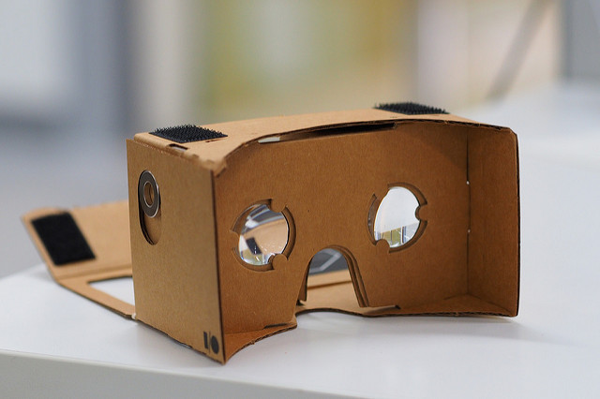
Google Cardboard
Android Phone + $15 kit

Slide 18
Example: Oculus Rift
Example Interactions
Sensors:
Gyroscope / accelerometer / magnetometer
Infrared LEDs
Tracking cameras

Slide 19
VR Applications
Tilt Brush

Slide 20
Rendering
Game engines (e.g. Unity)
OpenGL / WebGL / Direct3D

Slide 21
University of Virginia Resources
Clemons Library / Robertson Media Center
HTC Vive
Oculus Rift

