Slide 1
CS 4501: Introduction to Computer Vision Autonomous Driving and Medical Applications of Deep Learning
Connelly Barnes
Some slides from Fei-Fei Li / Andrej Karpathy / Justin Johnson

Slide 2
Course Evaluations
Give valuable feedback about course
See email
Due May 3

Slide 3
Outline
Autonomous driving
Medical

Slide 4
The Inefficiency of Humans Driving
“Americans were stuck in traffic for 8 billion hours in 2015” – CNN
Bureau of Labor Statistics: average wage ~$25 per hour
If that time were spent working => $200 billion wasted per year (U.S.)
Trillion dollar business opportunity?
Additional pain points: driver tests, licensing, parking permits, tickets, insurance, DMV lines, auto repair, parking, carpool/bus coordination.
Second order effects: desire for short commutes => high housing prices in urban centers.

Slide 5
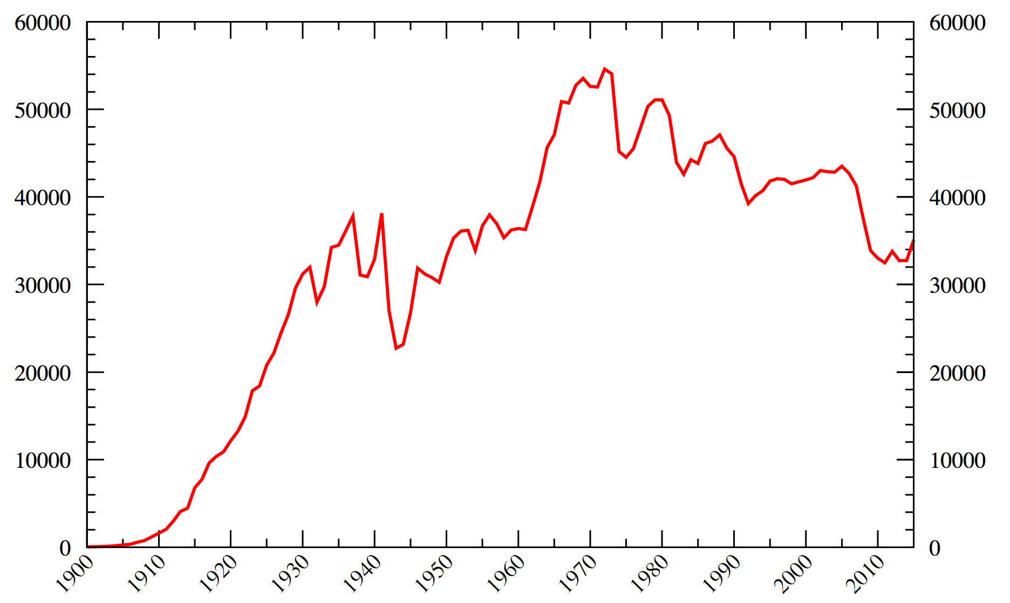
The Danger of Humans Driving
Motor vehicle deaths in the U.S. per year [from Wikipedia]:
Worldwide: 1.25 million deaths in 2010 [Wikipedia/WHO]

Slide 6
Google Alphabet Waymo Self-Driving Car
Overview Video
More Technical Video
Sensors:
LIDAR: Light Detection And Ranging
Pacifica minivan, 3 LIDAR sensors:
Short-range: see near vehicle
Long-range: can zoom in on distant objects
97% of California autonomous miles driven (635k miles) in 2016
As of June 2016, a total of 1.7 million miles driven
14 collisions, human drivers at fault 13 times

Slide 7
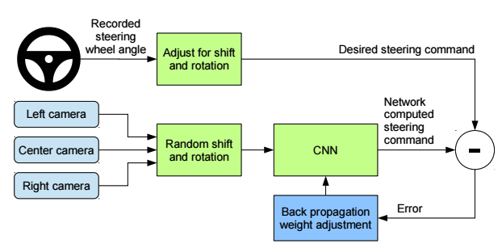
End-to-end self-driving [Nvidia, Bojarski et al. 2016]

Slide 8
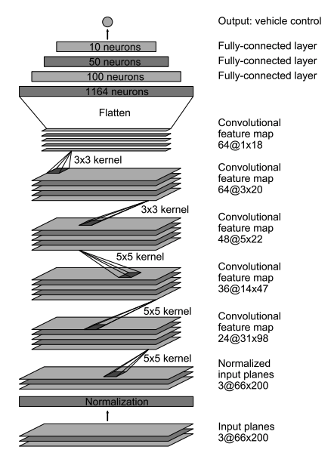
End-to-end self-driving [Nvidia, Bojarski et al. 2016]
Authors’ driving test: ~98% autonomy

Slide 9
Political Environment
Study: autonomous vehicles have 2x the crash rate as humans.
But, hardly ever the autonomous vehicle’s fault.
Politics vs facts? Status quo bias? Cognitive biases?
Waymo:
California
Phoenix, Arizona
Austin, Texas
Image from Wikipedia

Slide 10
International Legal Status (2015)
Tests under way:
Germany
Netherlands
Spain
France
U.K.
China (Baidu and BMW, driving in Beijing and Shanghai)
Tests planned:
Belgium
Italy

Slide 11
Challenges / Limitations
Discussed in various media articles:
Still gathering data for snow conditions
May misinterpret temporary traffic lights
Revert to slow “extra cautious” mode in complex unmapped intersections.
Cannot follow officers directing traffic.
Swerve unnecessarily for minor debris

Slide 12
Self-driving Technology
Tesla Autopilot
Crash demo
Deadly crash in Florida (Joshua Brown) ruling by NHTSA: Tesla exculpated, outside the car’s capabilities.
Apple
Baidu
Uber
Volkswagon, Daimler, GM, Toyota, Honda, Hyundai
Ford (aims to roll out a fleet in 2021)
…
Startup: AutoX

Slide 13
Robo-Taxis
Discussion:
What would be the effects on the economy, daily life, road utilization, parking, jobs in the transportation industry, …?
Robustness in cases of the Internet being disrupted for extended periods of time due to natural disasters, warfare, malicious hackers (kidnappers), …?
How many self-driving car companies will there be? Which will be #1?

Slide 14
Predictions
Columbia University Earth Institute predicts reduction in U.S. fleet of vehicles by 10x.
PricewaterhouseCoopers forecasts reduction in traffic accidents by 10x, reduction in fleet by 100x.
Morgan Stanley estimates autonomous cars could save the U.S. $1.3 trillion annually ($169B in fuel consumption, $488B crash costs, $645B in boosted productivity)
IEEE committee predicts 75% of vehicles will be autonomous by 2040.

Slide 15
National Highway Traffic Safety Administration Classification System
Level 0: Driver controls vehicle at all times.
Level 1: Individual vehicle controls automated, such as electronic stability control or automatic braking.
Level 2: Two controls can be automated in unison, such as adaptive cruise control with automated braking.
Level 3: Driver can cede all control, but car may require driver to re-take control.
Level 4: Driver does not control car at any time.

Slide 16
Outline
Autonomous driving
Medical

Slide 17
Dermatology
Deep learning algorithm does as well as dermatologists in identifying skin cancer
Matched performance of 21 board-certified dermatologists
Melanoma
5 year survival rate in earliest stage: ~97%
Latest stages: ~14%
Smartphone health-care?

Slide 18
Companies
Enlitic
Zebra Medical
Hundreds of other startups

Slide 19
Course Conclusion
Thanks!

